Slide 1
Applied Research in Public Policy Making
Fall 2024
In pursuit of happiness
and job satisfaction
Week 1
Martin GUZI
martin.guzi@econ.muni.cz

Slide 2







Slide 3
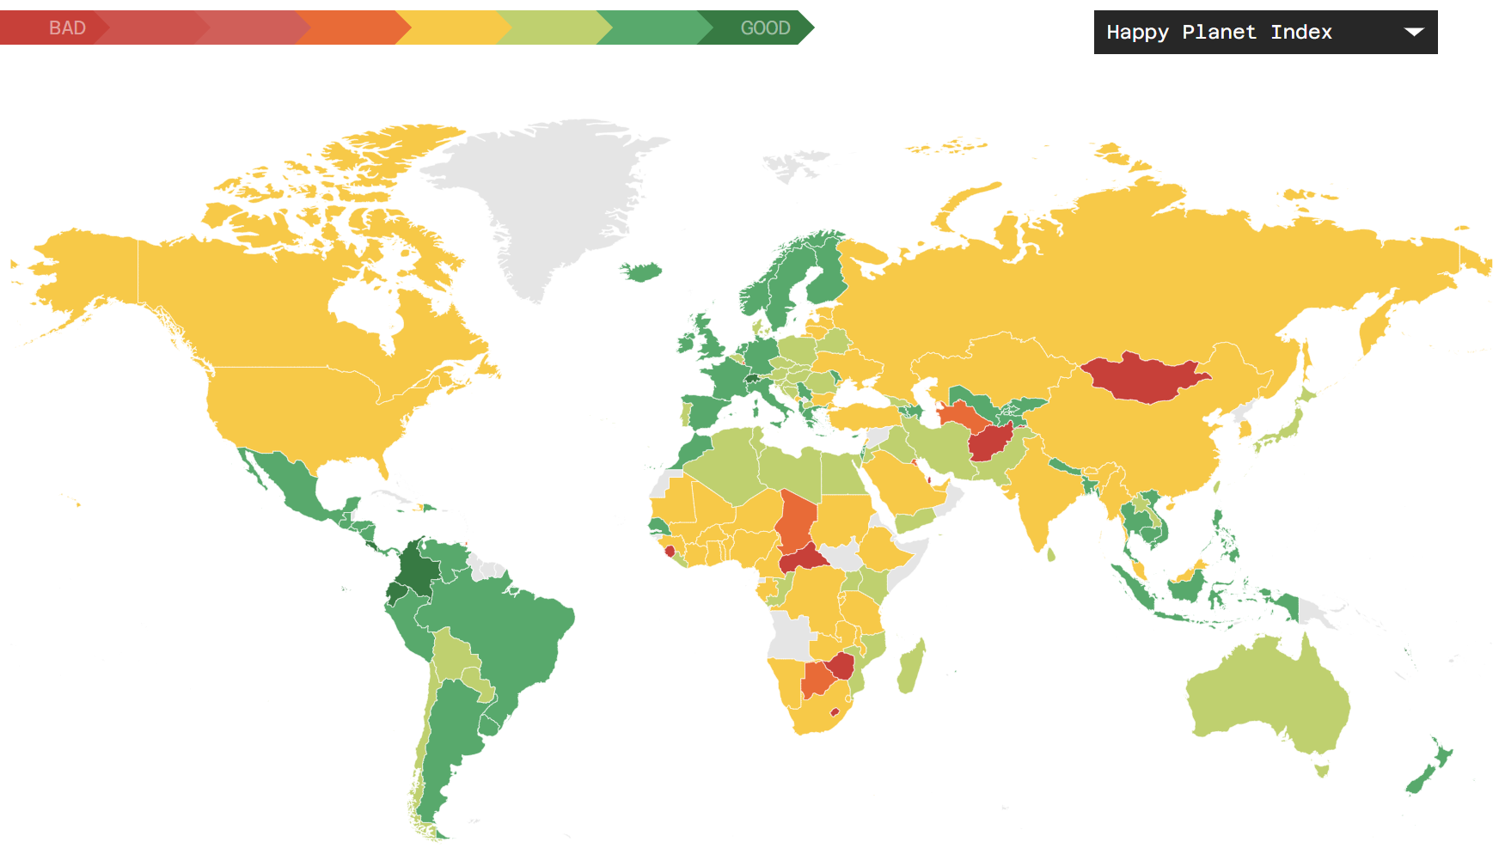
The Happy Planet Index is a measure of sustainable wellbeing. HPI reflects how efficiently residents of different countries are using environmental resources to lead long, happy lives.
Wellbeing (Gallup World Poll)
Life expectancy
Inequality of 1) and 2)
Ecological Footprint
http://happyplanetindex.org/
https://www.ted.com/talks/nic_marks_the_happy_planet_index

Slide 5
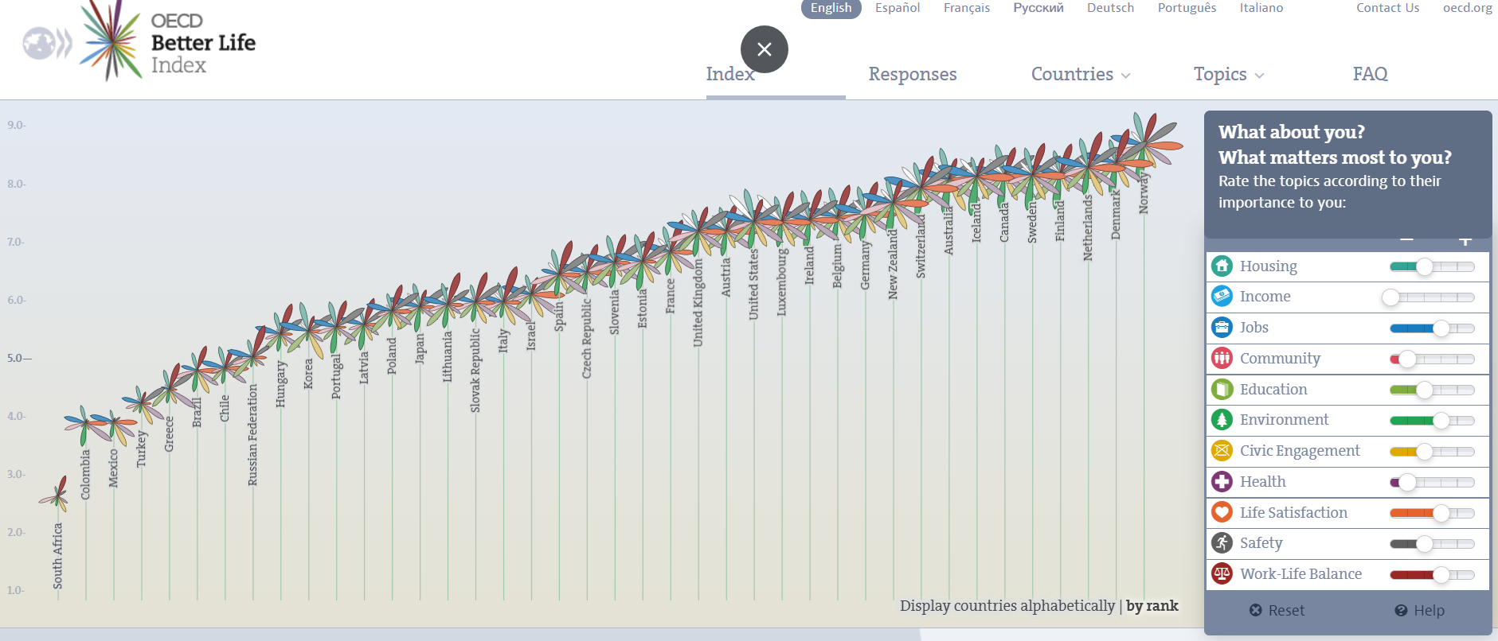
http://www.oecdbetterlifeindex.org/

Slide 6


Slide 7

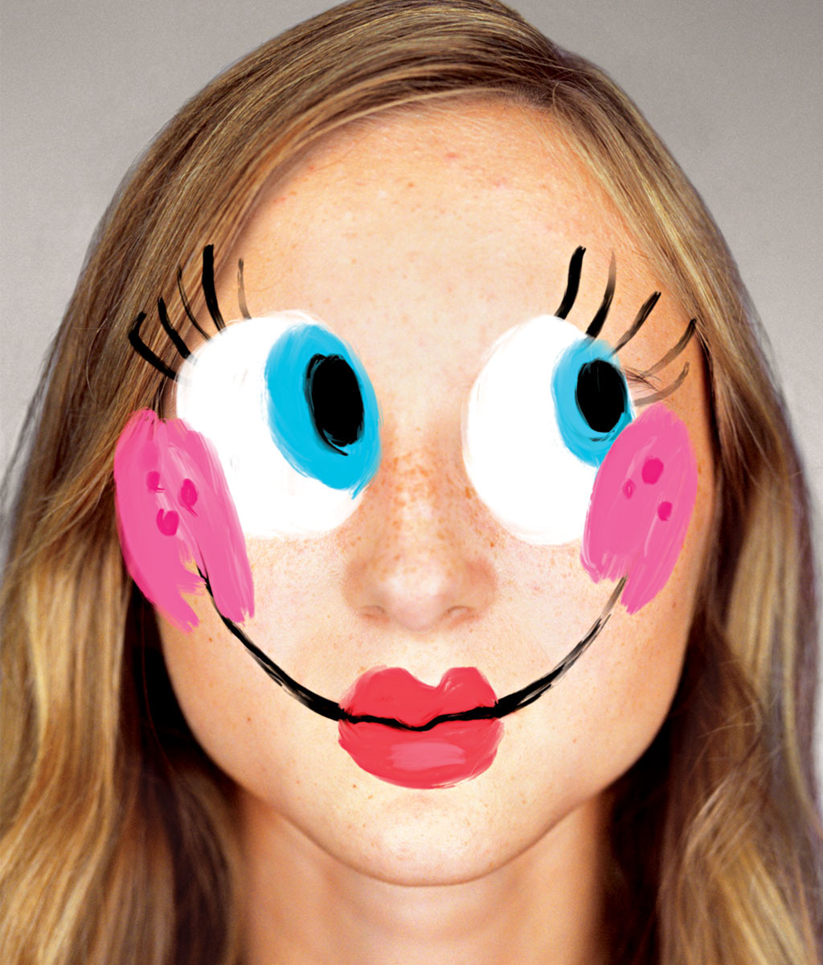
Correlates of
High Life Satisfaction and Happiness
Smiling frequency
Smiling with the eyes (“unfakeable smile”)
Ratings of one’s happiness made by friends
Frequent verbal expressions of positive emotions
Sociability and extraversion
Sleep quality
Happiness of close relatives
Self-reported health
High income, and high income rank in a reference group
Active involvement in religion
Recent positive changes of circumstances
(increased income, marriage)
Sources: Diener and Suh (1999), Layard (2005) and
Frey and Stutzer (2002).

Slide 8
The Brain Responses to Two Pictures (MRI Scan)
Source: Richard Davidson, University of Wisconsin

Slide 9
The measure of well-being
“How satisfied are you with your life?”
“All things considered, how satisfied are you with your life as a whole these days? Using this card on which 1 means you are “completely dissatisfied” and 10 means you are “completely satisfied” where would you put your satisfaction with life as a whole?”
“Taking all things together, how satisfied are you with your life as a whole these days? Are you very satisfied, satisfied, not very satisfied, not at all satisfied?”
Data reveals: Surveys asking people about life satisfaction and happiness do measure subjective well-being with reasonable accuracy.

Slide 10
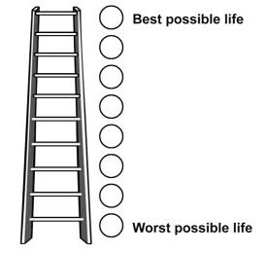
Cantril’s Ladder
Please imagine a ladder with steps numbered from 0 at the bottom to 10 at the top. Suppose we say that the top of the ladder represents the best possible life for you and the bottom of the ladder represents the worst possible life for you. If the top step is 10 and the bottom step is 0, on which step of the ladder do you feel you personally stand at the present time?
Named after Albert Hadley Cantril (1906-1969), who developed and used it in surveys.
Notes:
simplicity is a virtue: no other measure of subjective wellbeing has been so widely used in a more or less stable form over such a long period of time.
Cantril’s Ladder provides single, numerical data points. And it has a ring of authenticity, of old wisdom. Just as Cantril intended, its assumptions are concealed beneath a deferral to the individual of whom it is asked.

Slide 11
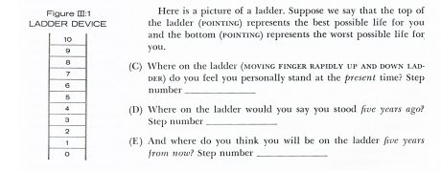
Cantril’s Ladder
Named after Albert Hadley Cantril (1906-1969), who developed and used it in surveys.
Notes:
simplicity is a virtue: no other measure of subjective wellbeing has been so widely used in a more or less stable form over such a long period of time.
Cantril’s Ladder provides single, numerical data points. And it has a ring of authenticity, of old wisdom. Just as Cantril intended, its assumptions are concealed beneath a deferral to the individual of whom it is asked.

Slide 12
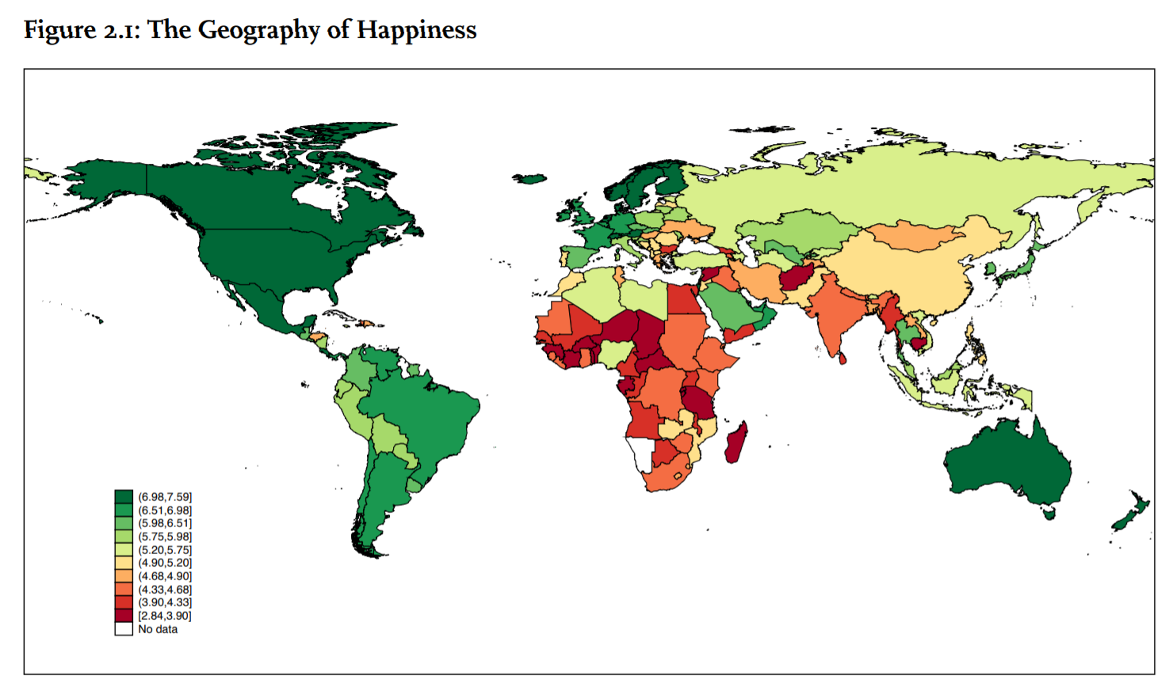
Figure 1: Average Cantril’s Ladder scores over the period 2012–2014
(from World Happiness Report 2015). Data: Gallup World Poll

Slide 13
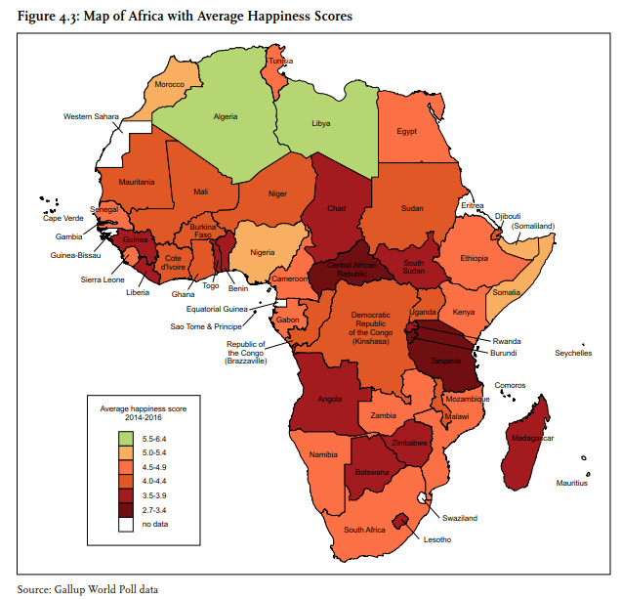
Africa’s History of Depressed Happiness
There is a strong negative association between happiness and lived poverty.
Poor infrastructure
High religiosity
Optimist future life evaluations

Slide 14
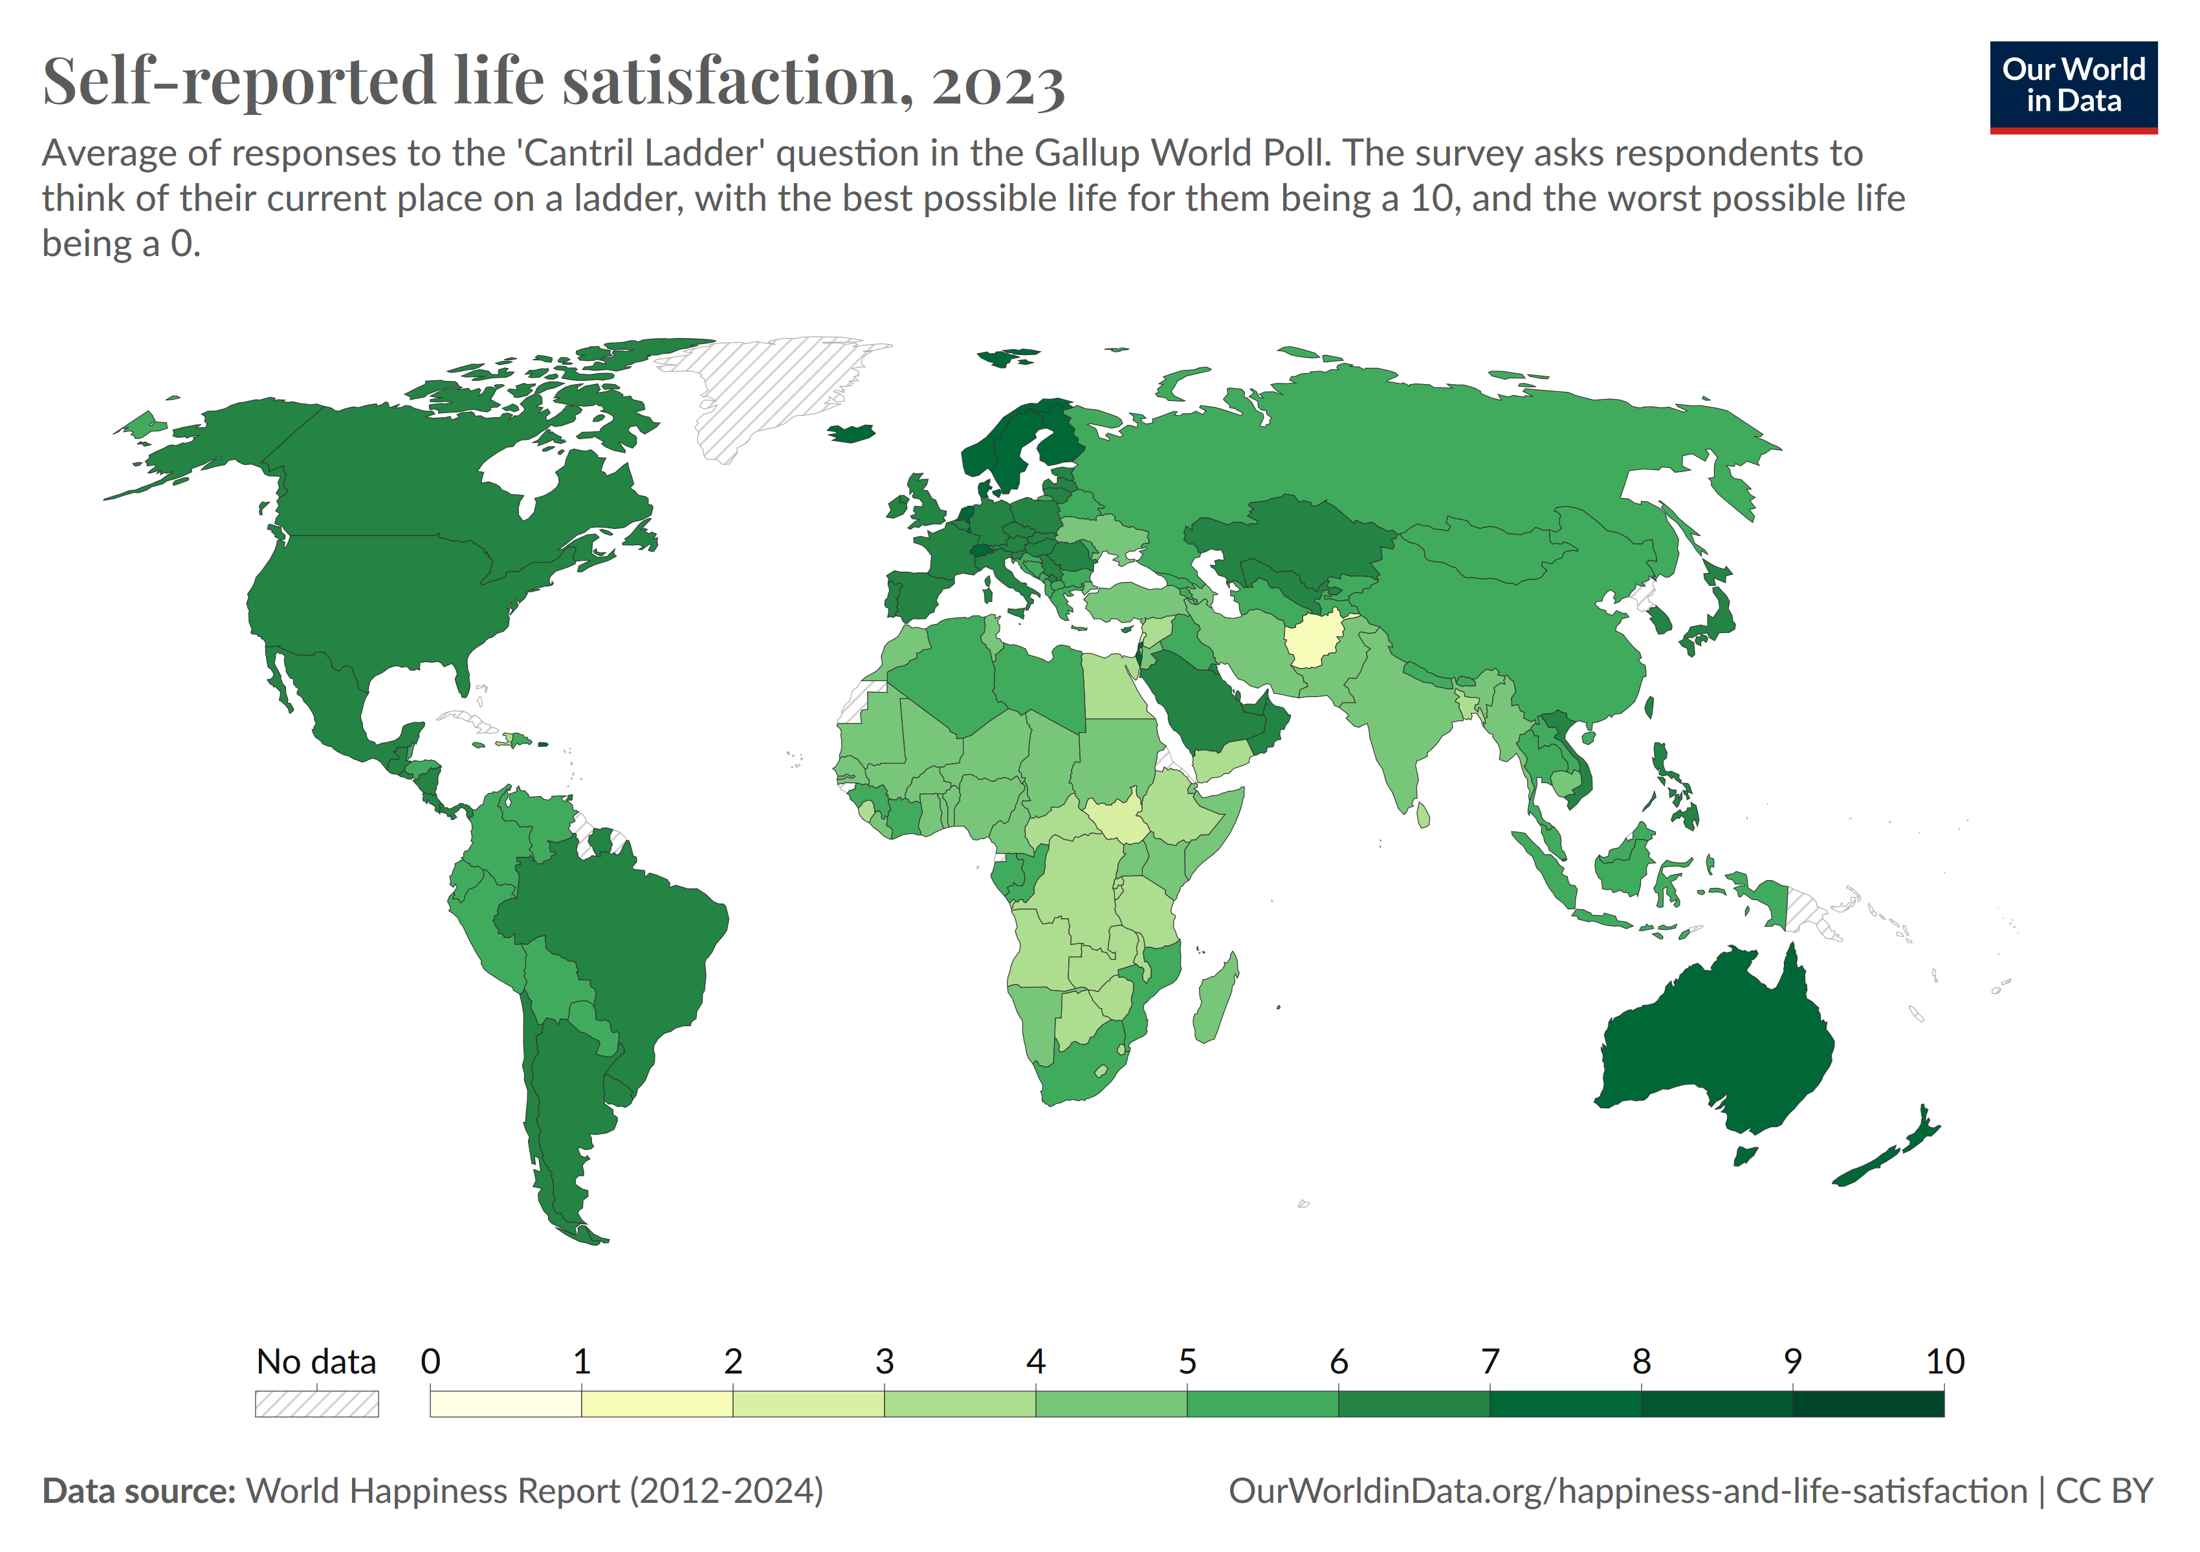

Slide 15
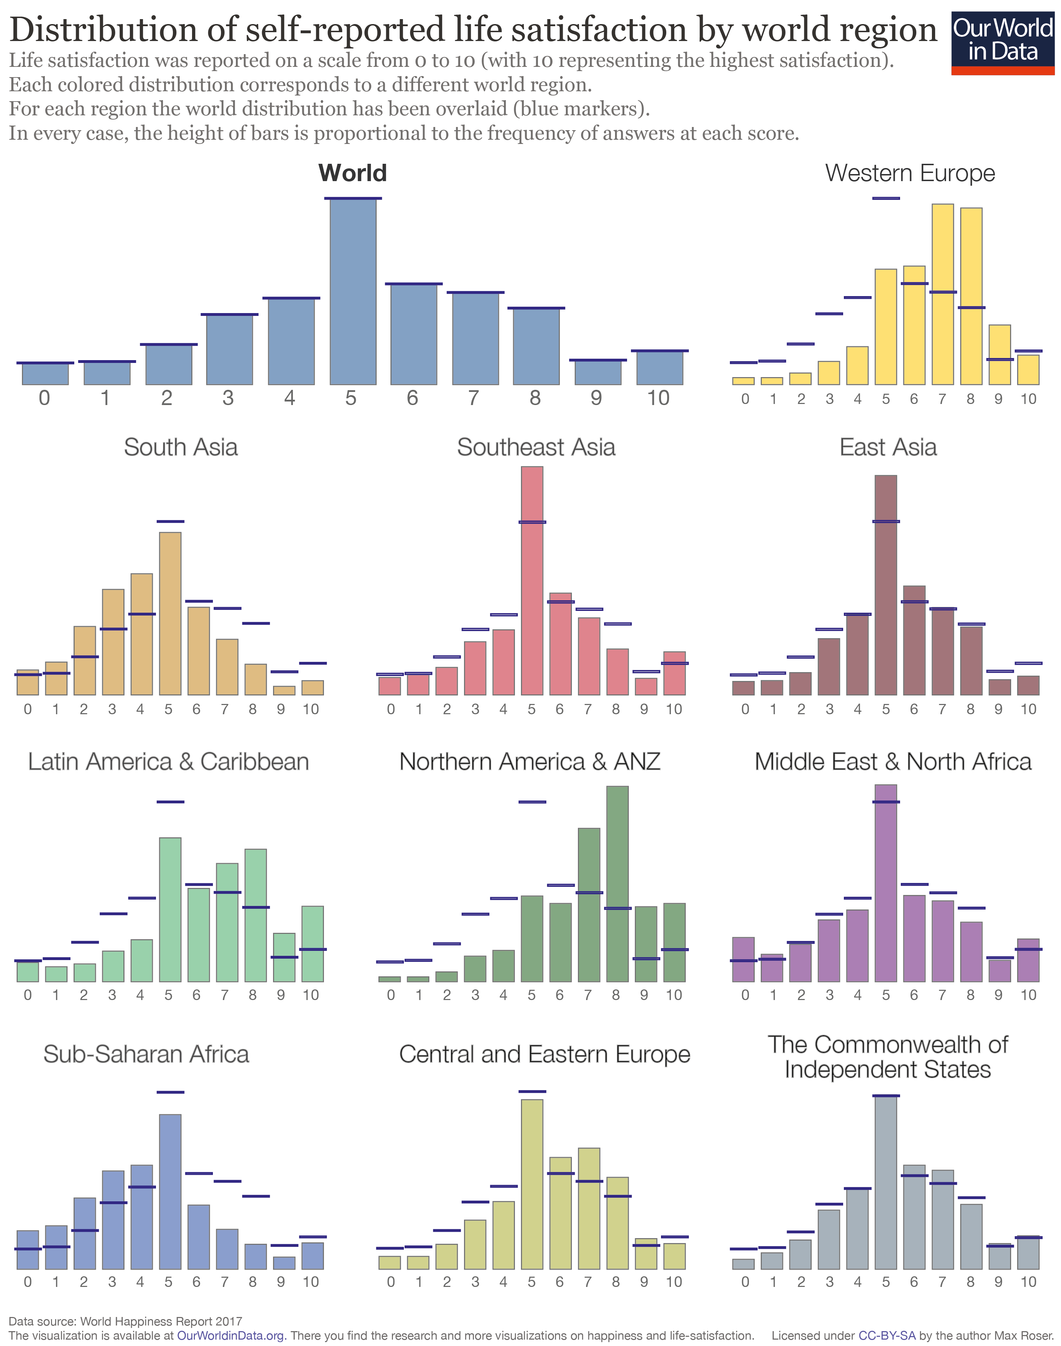

Slide 16
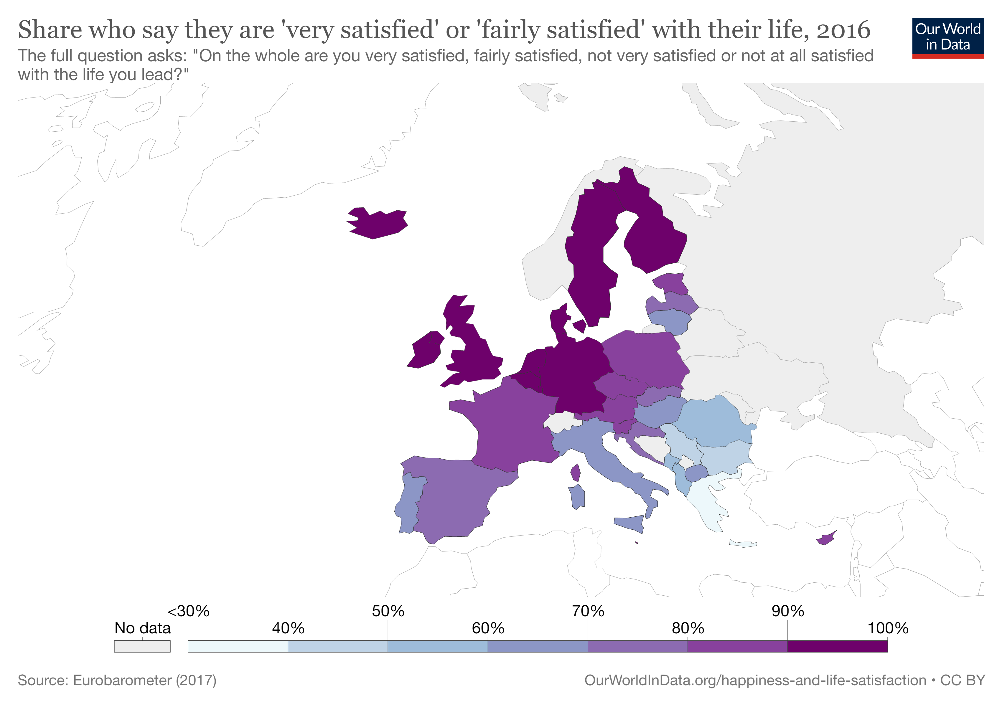

Slide 17
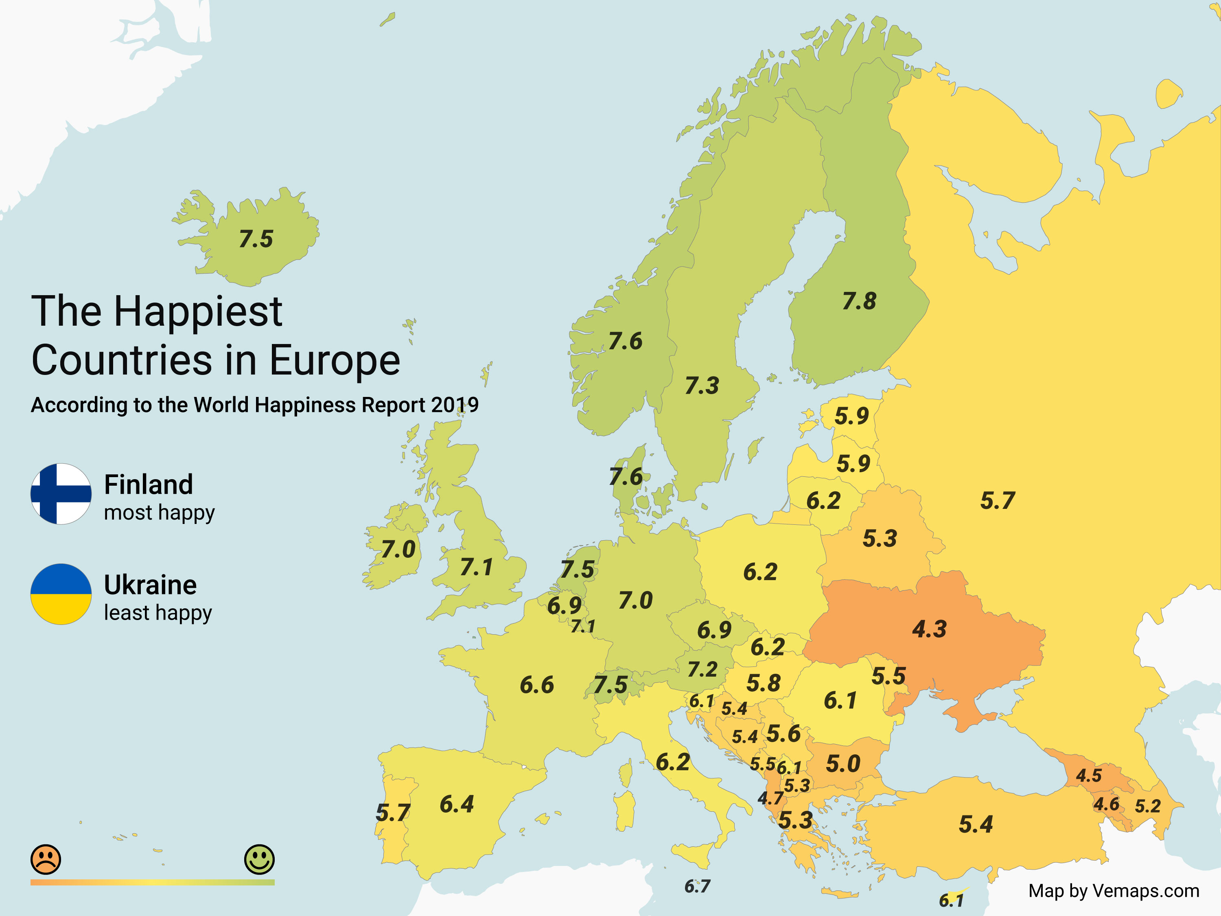
https://vemaps.com/europe-facts/eu-facts-02

Slide 18
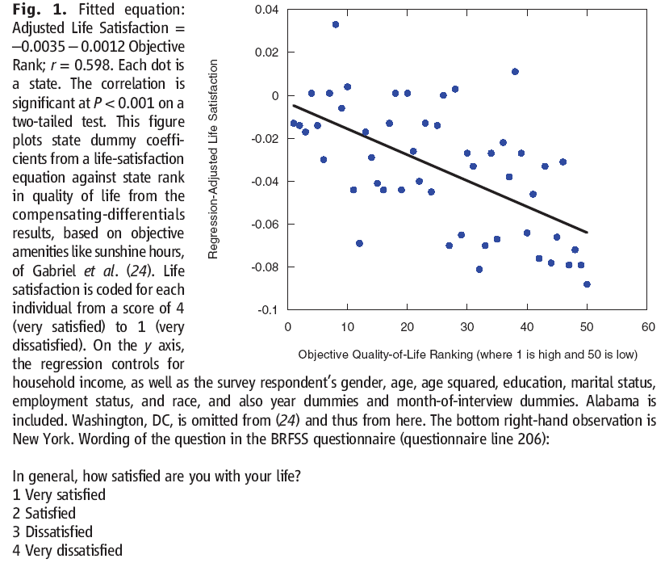

Are objective and subjective data on quality-of-life correlated?
1.3 million randomly sampled Americans
2005 to 2008
Quality of life is based on data on Precipitation, Humidity, Heating Degree Days, Cooling Degree Days, Wind Speed, Sunshine, Coast, Inland Water, Federal Land, Visitors to National Parks, Visitors to State Parks, Number of hazardous waste sites Environmental Regulation Leniency, Commuting Time, Violent Crime Rate, Air Quality-Ozone, Air Quality-Carbon Monoxide, Student-teacher ratio, State and local taxes on property, income and sales and other, State and local expenditures on higher education, public welfare, highways, and corrections, Cost-of-living
18
Notes:
18
Also the self-reported measures correlate with certain physiological states (brain activty)
But empirical results differ depending on what outcome measure is used
e.g see the Borooah paper on the reading list
self-assessed happiness question
v. usage of tranquilisers and antidepressants
v. thoughts of self-harm (inc suicide)

Slide 19
Across US states:
There is a match between life-satisfaction scores (subjective data) and the quality of life calculated using (only) non-subjective data.

Slide 20
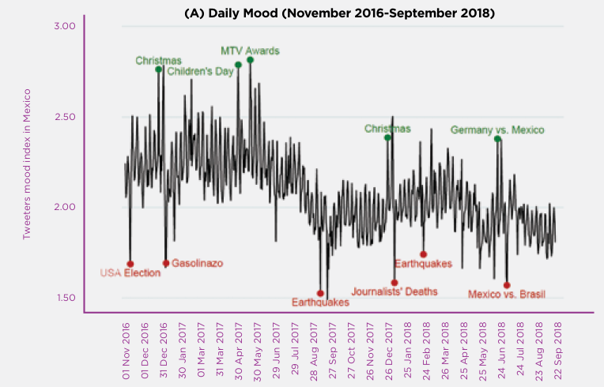
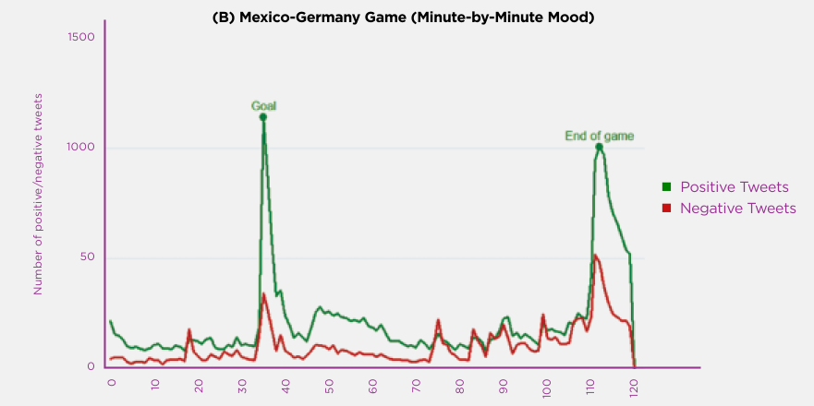
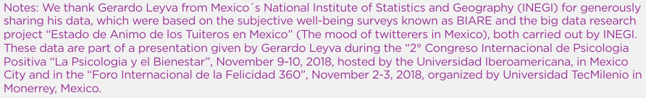
Big data as a complement to survey-based well-being measures

Slide 21
Notes:
Panel A of Figure 2.3 shows the dynamics for the four well-being measures collected by the ONS, reported separately for male and female respondents. For both genders, there is a ranking of effects, with life worthwhile being least affected, followed by life satisfaction, happiness, and anxiety. For both emotions- happiness yesterday and anxiety yesterday - the effects were largest during the lockdown Q2, and largely returned to baseline in Q3, when cases and fatalities seemed to be in check and restrictions were being lifted. The drops in life satisfaction and happiness, and the increases in anxiety, in Q2 were significantly greater for women than men, with the gender gap disappearing in Q3.

Slide 22
The macroeconomics of happiness
Countries are happier if they have low unemployment and inflation, and generous welfare benefits.
The Easterlin Paradox (1974):
Growth in income is not correlated with growth in happiness over time
“Once a country has over $15,000 per head, its level of happiness appears to be independent of its income per head” (Layard, 2005).

Slide 23
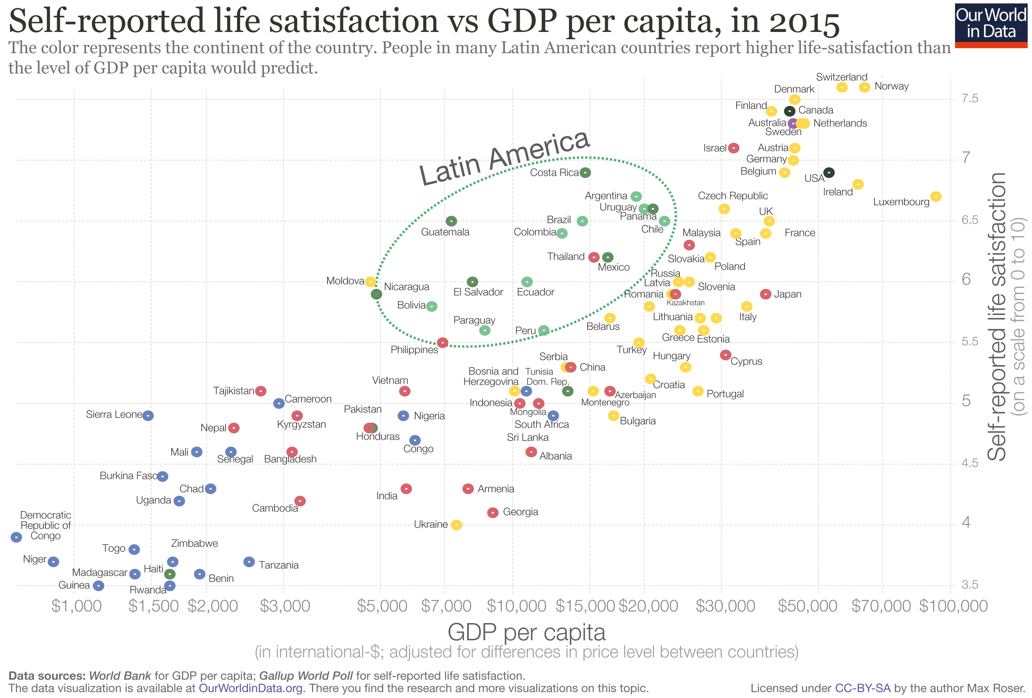

Slide 24
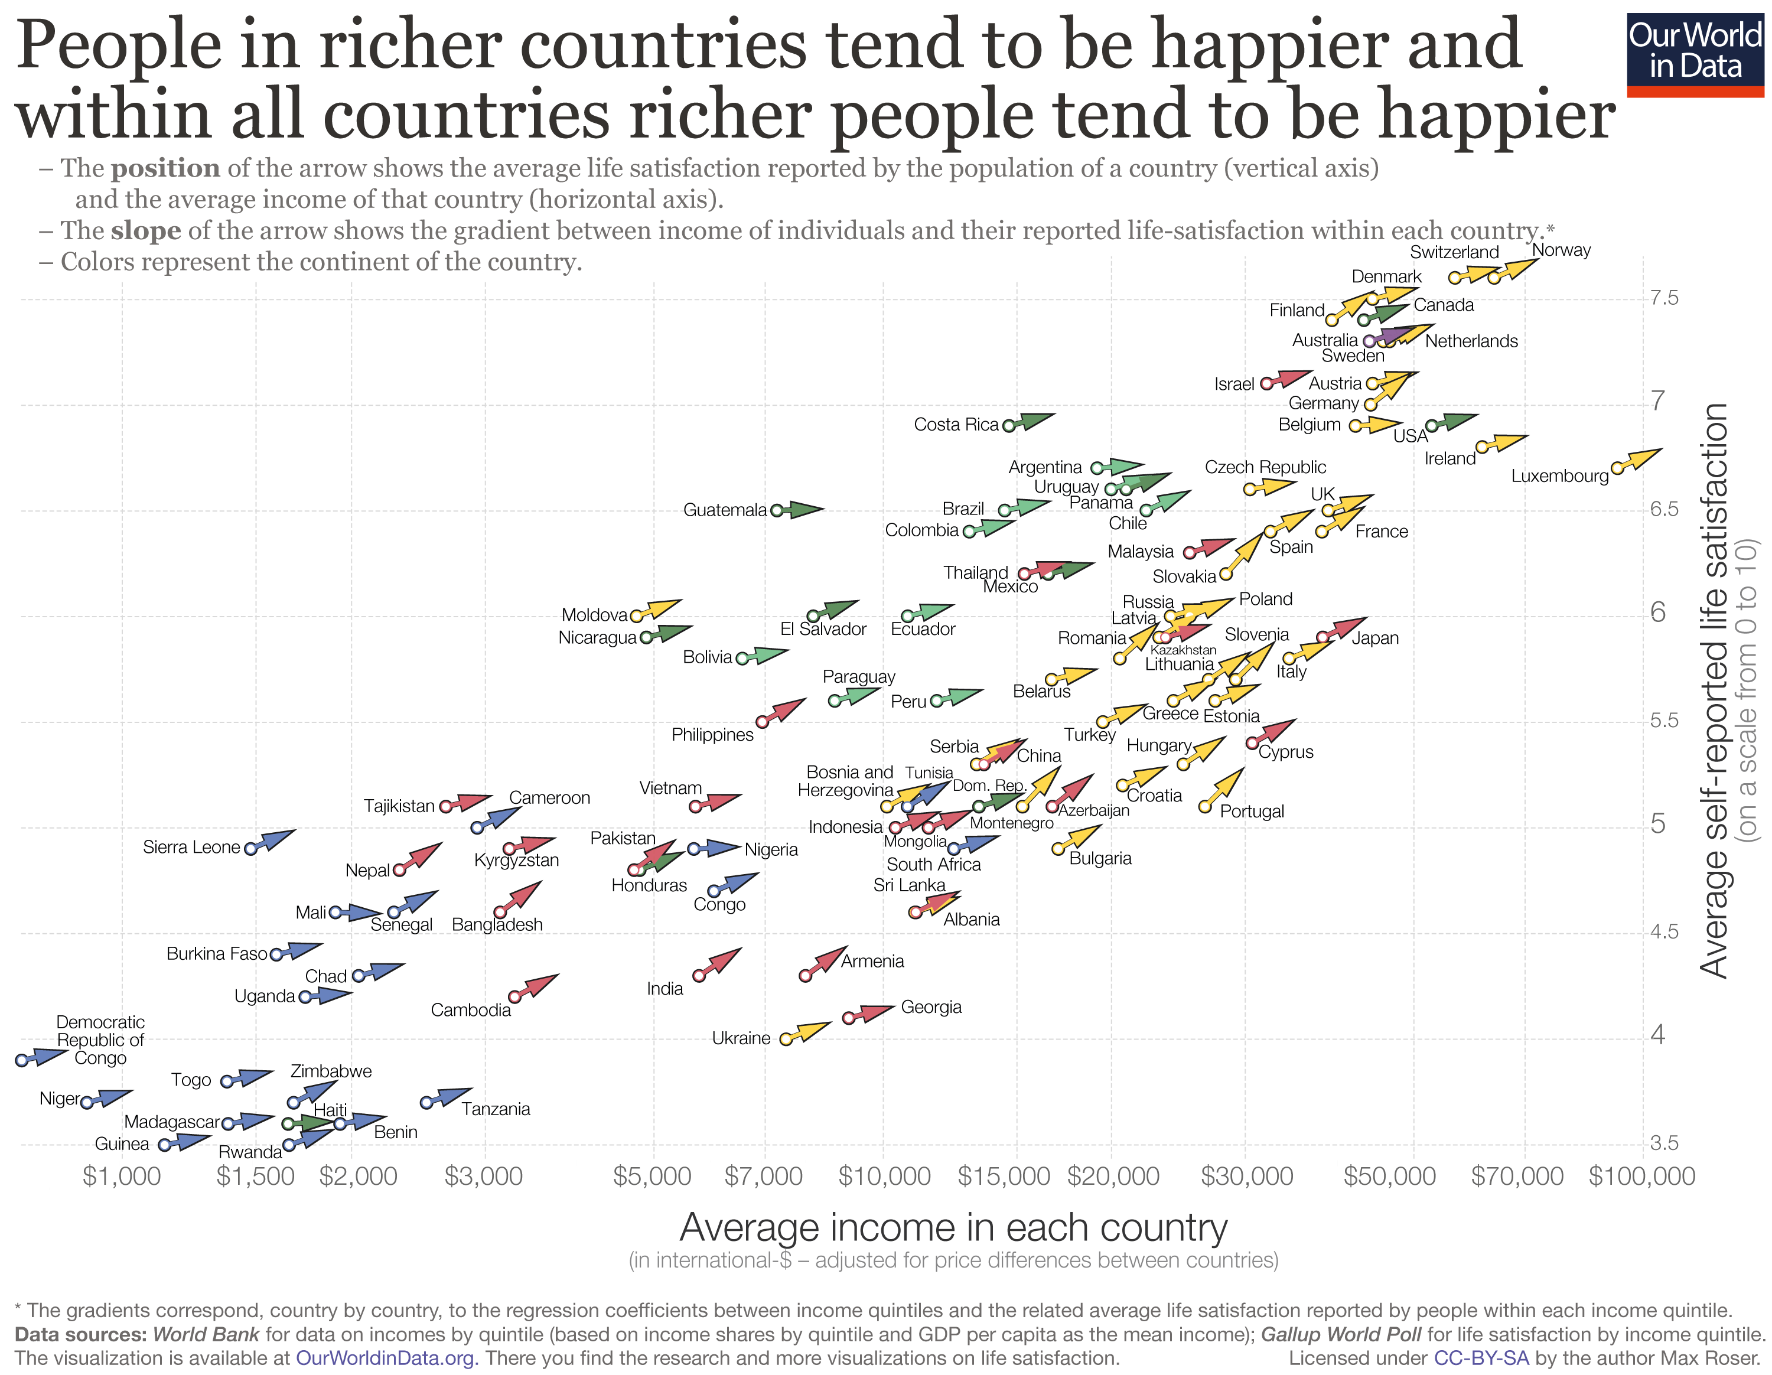

The data show that richer people are happier and healthier.

Slide 25
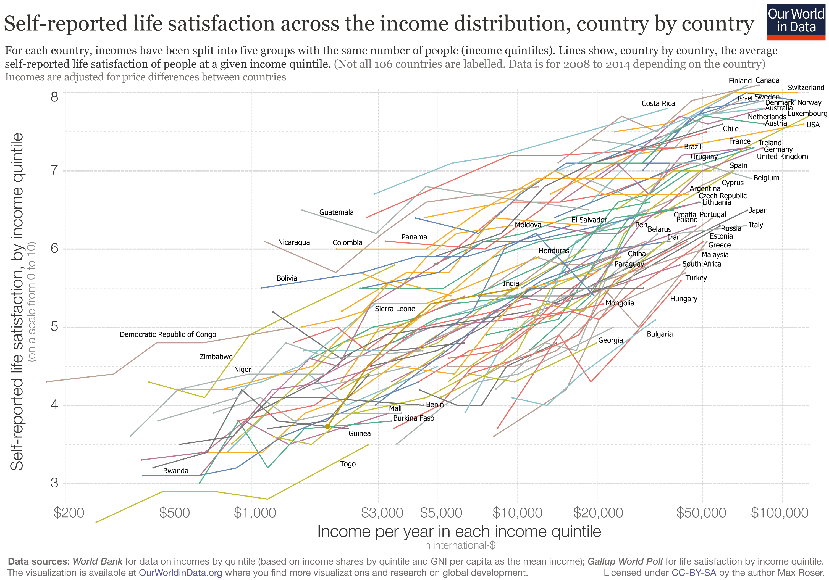
What about money and happiness?
The data show that richer people are happier and healthier.

Slide 26
In summary
Cross-country analysis: positive relation between
Life Satisfaction and GDP per capita.
Cross-section and panel analysis based on individual data: strong relation between individual income and well-being.
Aggregate time-series: no correlation between Life Satisfaction and GDP per capita.
The Easterlin Paradox is related to the time-dimension.

Slide 27
Microeconomics of human well-being

Slide 28
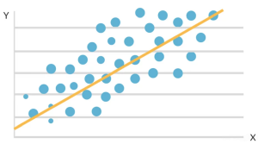
Regression equations
Subjective well-being = f(Age, gender, education level, income, marital status, friendship network, region, year, ….)

Slide 29
Big effects
Unemployment
Divorce
Marriage
Bereavement (the death or loss of a loved one)
Friendship networks
Health
Children

Slide 30
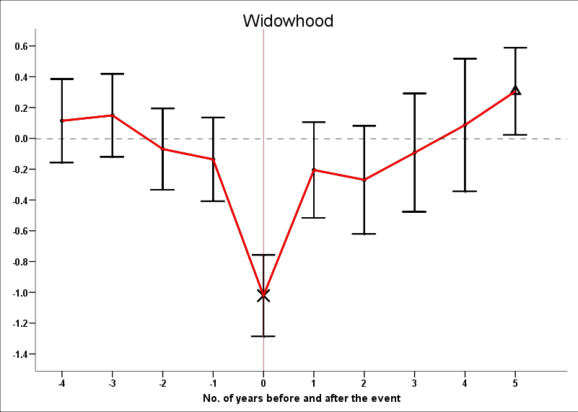
Important life events such as marriage or divorce do affect our happiness, but have surprisingly little long-term impact. The evidence suggests that people tend to adapt to changes.
Note: Research follows the same people over time.

Slide 31
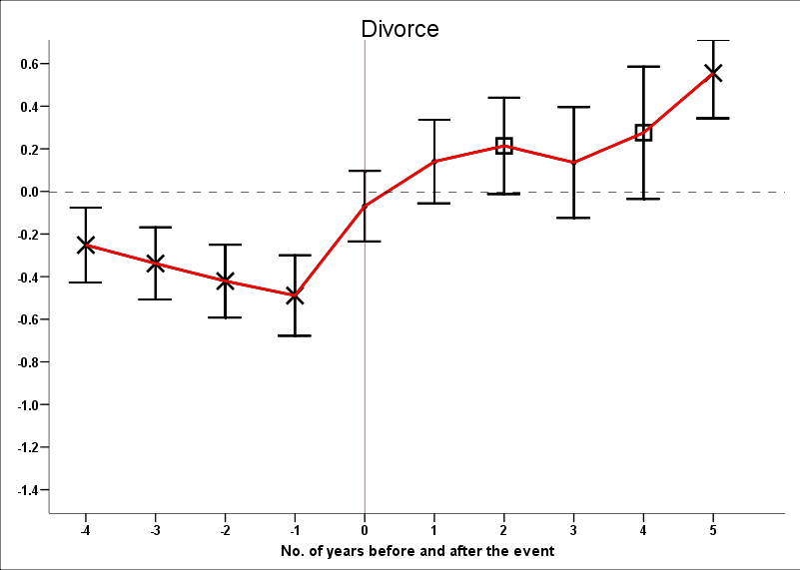
Divorce (eventually) makes people happier

Slide 32
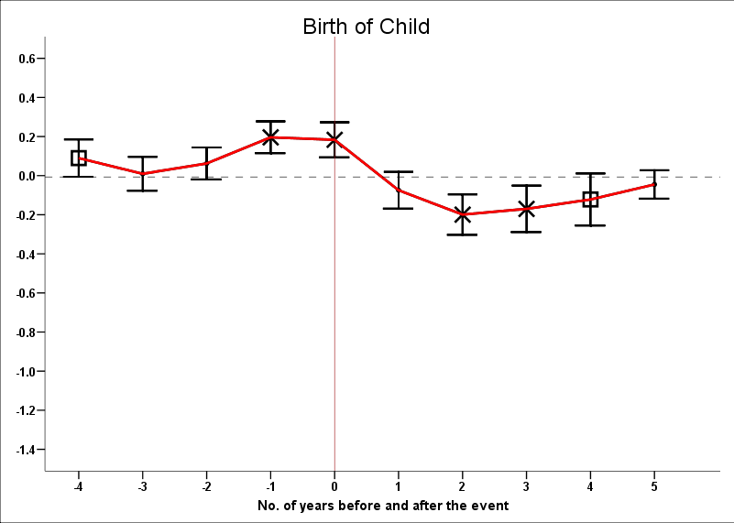
Happiness and children

Slide 33
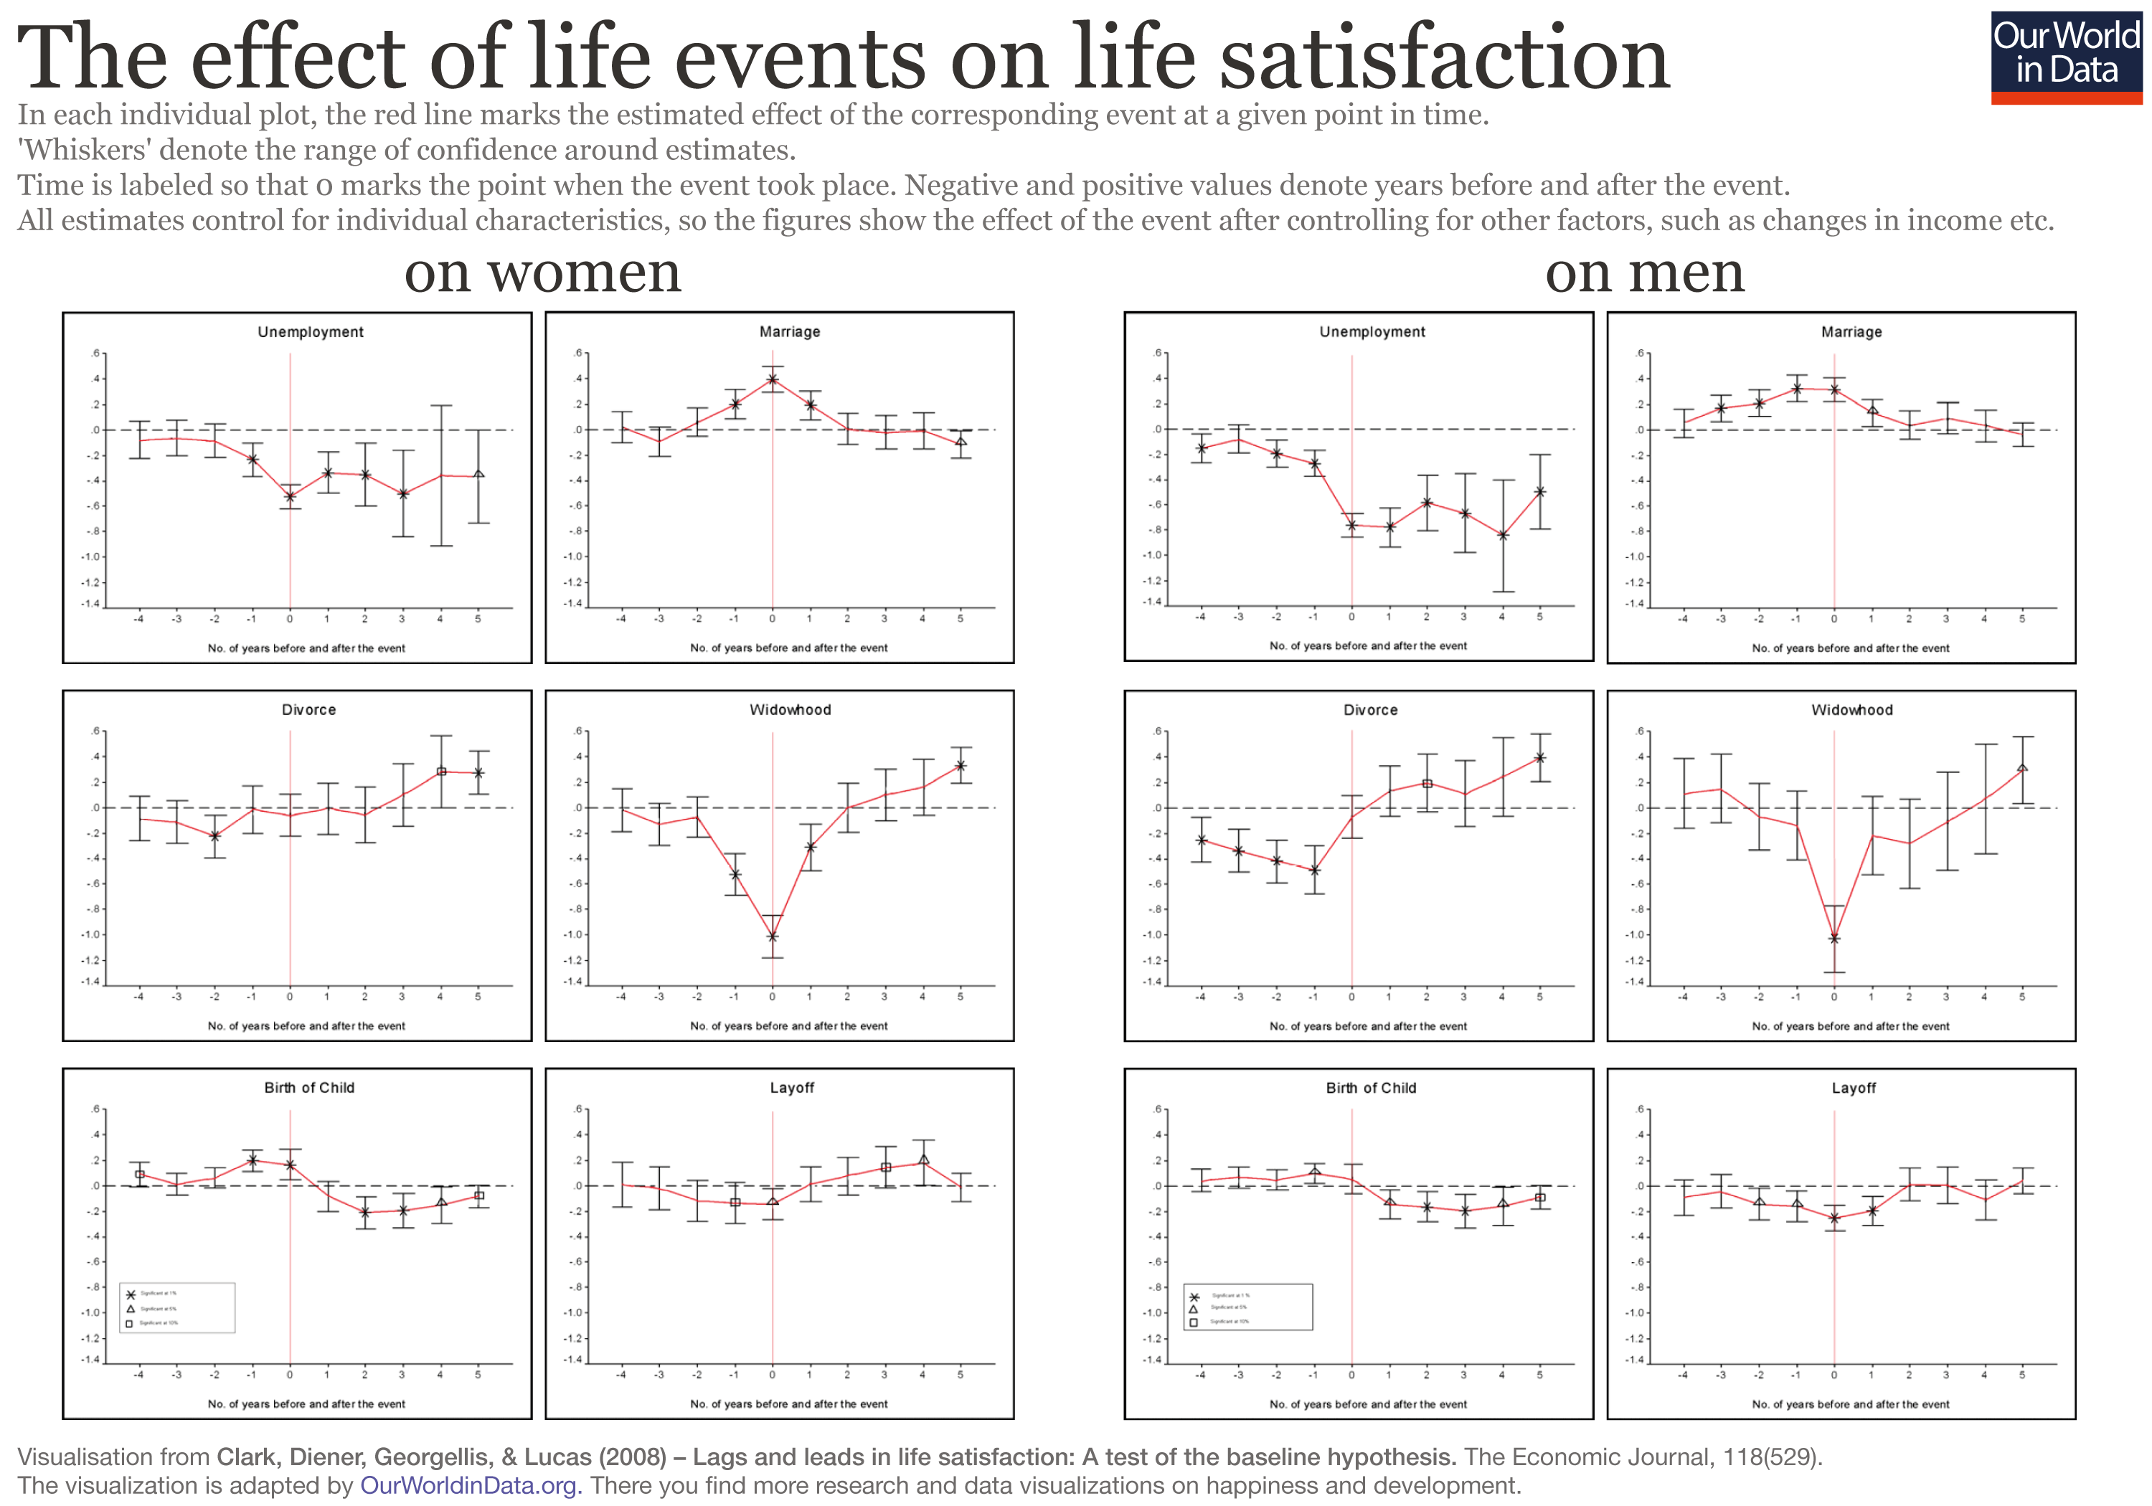

Slide 34
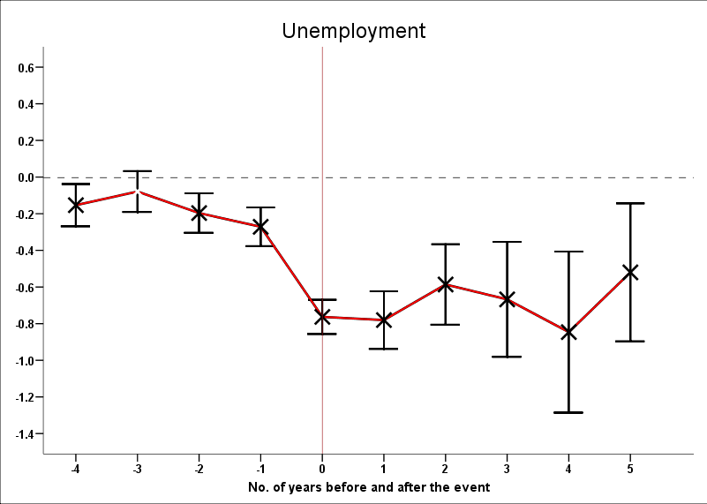
But people do not seem to adapt to joblessness

Slide 35
The evidence suggests that when a person is made unemployed:
20% of the fall in mental well-being is due to the decline in income
80% is due to non-pecuniary things (loss of self-esteem, status..).

Slide 36
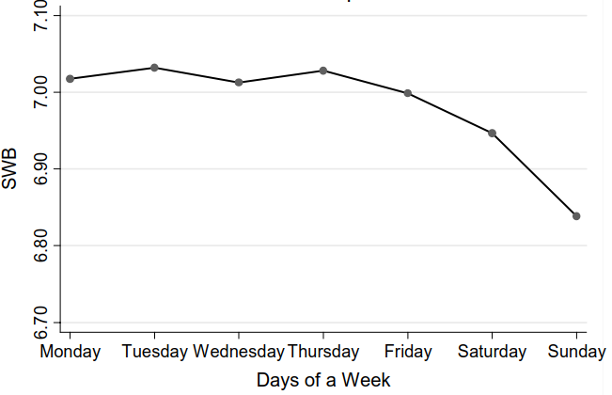
The effects of the day of the week on subjective well-being among people
Sundays are found to be the bluest day
Alpaslan Akay and Peter Martinsson, 2009 “Sundays Are Blue: Aren’t They? The Day-of-the-Week Effect on Subjective Well-Being and Socio-Economic Status”

Slide 37
Intriguing life cycle pattern of well-being
https://www.youtube.com/watch?v=VKTXSBS4Ok8

Slide 38
Life Satisfaction in Eurobarometer data (36 nations; 32,000 observations). Year 2016. Blanchflower-Oswald estimates

Slide 40
The latest UK government data
(Sample: 100,000 Britons) Blanchflower-Oswald estimates

Slide 41
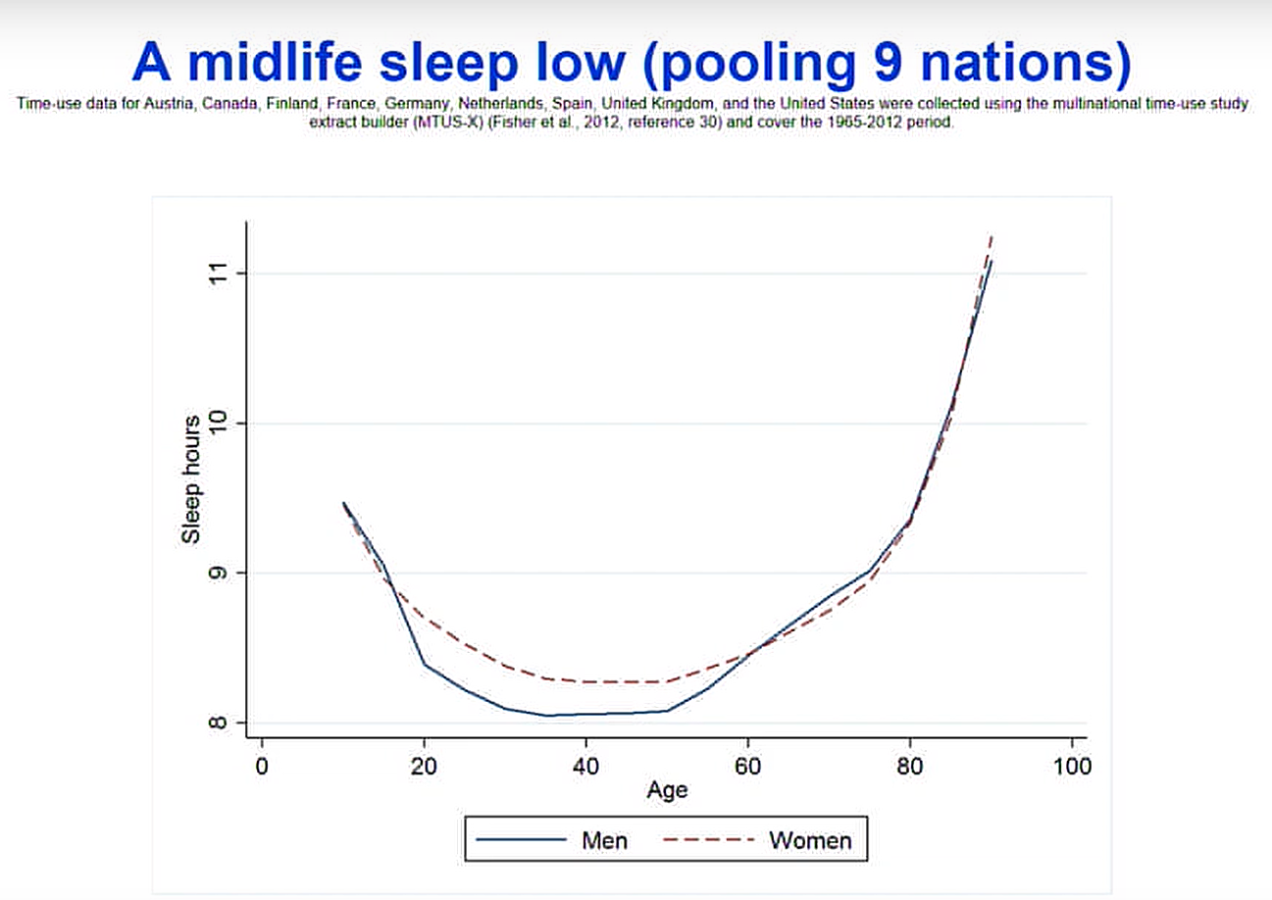
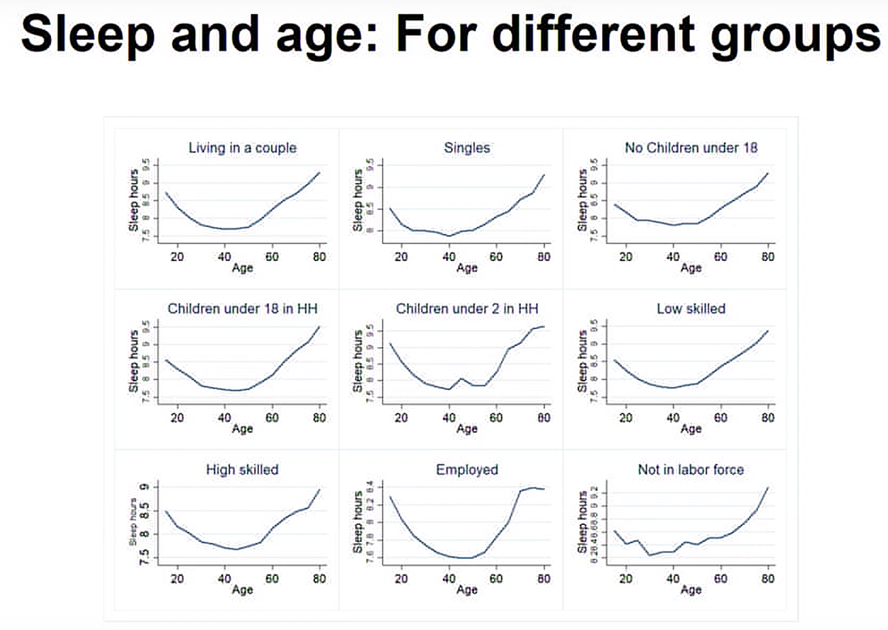
Sleeping problems
Sleeping problems are a marker of internal mental distress

Slide 42
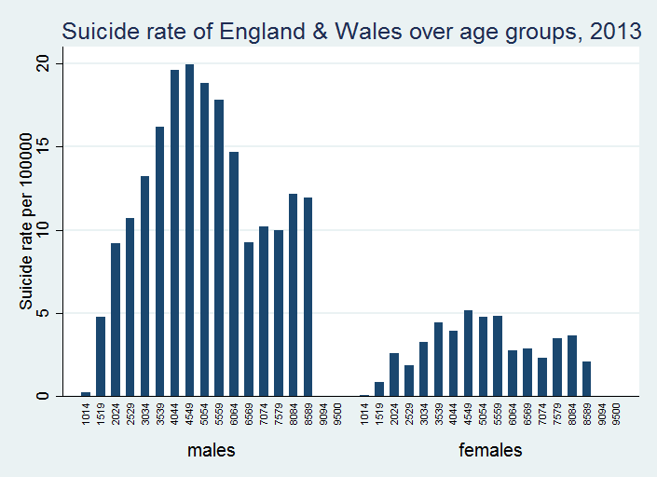
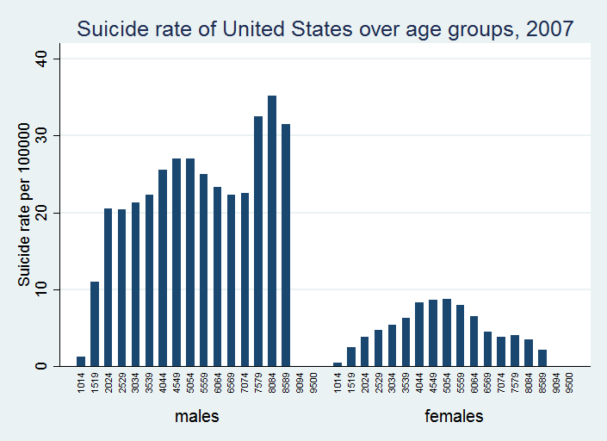
The hill-shaped pattern of suicide
Middle age population has at least two times higher risk relative to teenagers

Slide 43
The Relationship Between the Probability of Antidepressant Use and Age (European nations)
David G.Blanchflower and Andrew J.Oswald (2016) Antidepressants and age: A new form of evidence for U-shaped well-being through life

Slide 44
The scientific evidence for a midlife crisis
There really is a midlife low
It seems to happen equally in men and women
It is scientifically unexplained
There is a possibility that it is somehow biological (research with apes).

Slide 45
A fundamental paradox
People reach peak earnings around the age of 50, with almost not illness, and this is the richest (healthiest & safest) era in history.

Slide 46
Job satisfation

Slide 47
Day Reconstruction Method (DRM)
Alternative approach
A study by Daniel Kahneman and his colleagues on 1,000 working women in Texas (see Kahneman et al., 2004)
These women were asked to divide the previous day into 15 episodes. They were then asked what they were doing in each episode, and who were they doing it with, and how they felt during each episodes.
Data on people’s emotional expriences at various times of the day
Kahneman, Krueger, Schkade, Schwarz and Stone (2004)
Notes:
The Day Reconstruction Method combines elements of experience sampling and time diaries, and is designed specifically to facilitate accurate emotional recall. Respondents are first asked to fill out a diary summarizing episodes that occurred in the preceding day. Next they describe each episode by indicating: when the episode began and ended; what they were doing (by selecting activities from a provided list); where they were; and with whom they were interacting. To ascertain how they felt during each episode in regards to selected affective dimensions, respondents were asked to report the intensity of their feelings along nine categories on a scale from 0 (“Not at all”) to 6 (“Very Much”). The affective categories were specified by descriptors, mostly adjectives, such as happy, worried and angry. The anchor, “Not at all,” is a natural zero point that is likely to have a common meaning across respondents for these descriptors.

Slide 48
Happiness in Different Activities
Activity | Time spent | Happiness Index
 | (hours)
Intimate relations | 0.23 | 4.83
Socializing after work | 1.14 | 4.15
Relaxing | 2.17 | 3.96
Dinner | 0.81 | 3.94
Lunch | 0.57 | 3.91
Exercising | 0.22 | 3.85
Praying/worship | 0.45 | 3.78
Socializing at work | 1.12 | 3.78
Watching TV | 2.19 | 3.65
Phone at home | 0.93 | 3.52
Napping | 0.89 | 3.35
Cooking | 1.15 | 3.27
Shopping | 0.41 | 3.23
Computer (non-work) | 0.51 | 3.22
Housework | 1.12 | 2.99
Childcare | 1.1 | 2.99
Evening commute | 0.61 | 2.77
Working | 6.89 | 2.68
Morning commute | 0.47 | 2.09
Happiness index is the average of three positive adjectives (happy, warm/friendly, enjoying myself) less the average of six negative adjectives (frustrated/annoyed, depressed/blue, hassled/pushed around, angry/hostile, worried/anxious, criticized/put down). All of the adjectives are reported on a 0 to 6 scale, ranging from 0 “not at all” to 6 “very much.” Sample consists of one day in the life of 909 employed women in Texas.

Slide 49
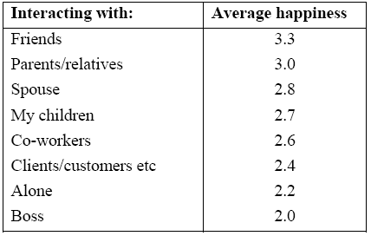
Happiness while Spending Time with
Different People
The average reported feelings across 1,000 people correspond well with activities predicted to be good for us, as well as activities predicted to be bad for us

Slide 50
Literature identifies that long working hours, irregular working schedules and long work commutes have strong detrimental effects on overall worker life quality.
Workers largely underestimate the negative effects of commuting on the quality of their life when making decisions about commuting
Job characteristics such as occupation prestige and a proper skill match have a positive effect on life satisfaction and job satisfaction.
Past unemployment experience often has a persistent negative effect on life satisfaction.

Slide 51
Overview of well-being research findings:
(1) Well-being involves more than happy feelings
(2) Well-being can be validly measured
(3) Income influences well-being, up to a point
(4) High quality relationships are essential for well-being
(5) Genes and personality influence well-being
(6) People adapt to many circumstances, but it takes time
(7) Culture and society influence well-being
(8) There are important benefits of experiencing well-being beyond feeling good (e.g. health, longevity, career success)

Slide 52
The broader message for today
Policy may need to concentrate on non-materialistic goals
We should measure what people care about.
Design policies that will raise people
happiness and mental health.

Slide 53
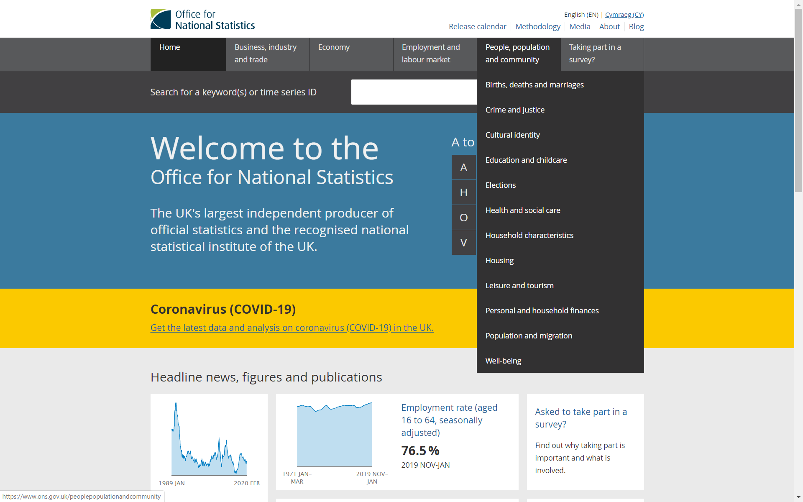
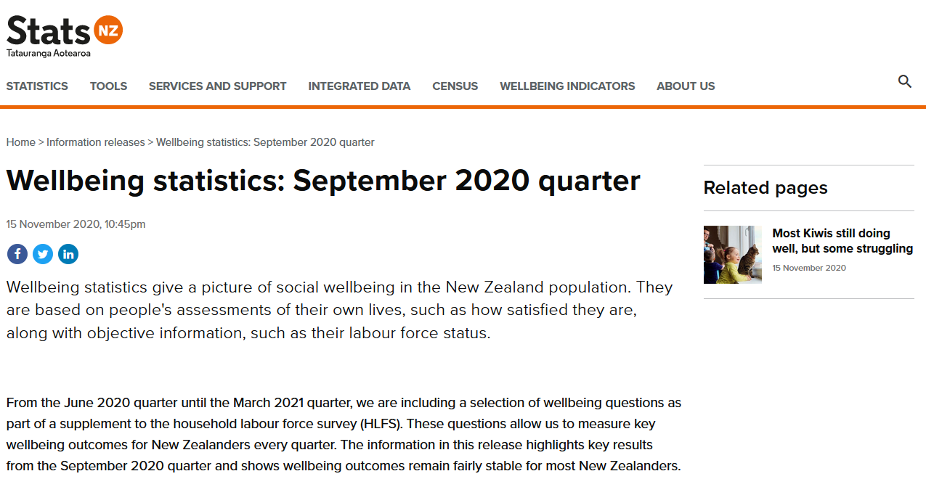
https://www.stats.govt.nz/information-releases/wellbeing-statistics-september-2020-quarter
https://www.ons.gov.uk/peoplepopulationandcommunity/wellbeing

