Slide 1
Applied Research in Public Policy Making
Fall 2024
Benefits and costs of migration
Week 2
Martin GUZI
martin.guzi@econ.muni.cz

Slide 2
Outline
Theory of migration
Push and pull factors of migration
Benefits and costs of migration
Remittances

Slide 3
Theory of MIgration

Slide 4
Adam Smith (1776) was the first economist to write on migration:
... the wages of labour vary more from place to place than the price of provisions. The prices of bread and butcher's meat are generally the same or very nearly the same through the greater part of the United Kingdom. These and most other things which are sold by retail, the way in which the labouring poor buy all things, are generally fully as cheap or cheaper in great towns than in the remoter parts of the country ... But the wages of labour in a great town and its neighbourhood are frequently a fourth or a fifth part higher than at a few miles distance. Eighteen pence a day may be reckoned the common price of labour in London and its neighbourhood. At a few miles distance it falls to eight pence, the usual price of common labour through the greater part of the low country of Scotland, where it varies a good deal less than in England. Such a difference of prices, which it seems is not always sufficient to transport a man from one parish to another, would necessarily occasion so great a transportation of the most bulky commodities, not only from one parish to another, but from one end of the kingdom to the other. After all that has been said of the levity and inconstancy of human nature, it appears evidently from experience that a man is of all sorts of luggage the most difficult to be transported.
An Inquiry into the Nature and Causes of the Wealth of Nations, 1776

Slide 5
Adam Smith (1776) was the first economist to write on migration:
... the wages of labour vary more from place to place than the price of provisions. The prices of bread and butcher's meat are generally the same or very nearly the same through the greater part of the United Kingdom. These and most other things which are sold by retail, the way in which the labouring poor buy all things, are generally fully as cheap or cheaper in great towns than in the remoter parts of the country ... But the wages of labour in a great town and its neighbourhood are frequently a fourth or a fifth part higher than at a few miles distance. Eighteen pence a day may be reckoned the common price of labour in London and its neighbourhood. At a few miles distance it falls to eight pence, the usual price of common labour through the greater part of the low country of Scotland, where it varies a good deal less than in England. Such a difference of prices, which it seems is not always sufficient to transport a man from one parish to another, would necessarily occasion so great a transportation of the most bulky commodities, not only from one parish to another, but from one end of the kingdom to the other. After all that has been said of the levity and inconstancy of human nature, it appears evidently from experience that a man is of all sorts of luggage the most difficult to be transported.
An Inquiry into the Nature and Causes of the Wealth of Nations, 1776

Slide 6
Smith found trade to be more intense than migration. The reason is that migration is hampered by certain barriers that trade is not.
Regional differences in commodity or factor prices provide opportunities for arbitrage.
Intercity movements of goods (trade) arbitrages away commodity price differentials, whereas intercity movements of people (migration) arbitrages away wage differentials.
Smith suggested that migration is a response to spatial differences in the returns to labor supply.
Notes:
Thus the movement of goods and finance between countries is easier, and greater in magnitude, than the movement of people. Sending your money or your goods to some distant economy is much easier than sending yourself.

Slide 7
Theory of migration: migration as human capital investment
Becker (1964) argues that migration is an investment because it involves the incurring of direct and indirect costs up-front in order to realize an (uncertain) payoff in the future.
The migrant’s goal is to maximize utility by choosing the location that offers the highest
net return to human capital.
People can migrate for reasons other than income maximization (e.g. family reunification, political asylum).
Notes:
Non-monetary gains enjoyed from moving (e.g., amenities such as better climate and
recreational opportunities, a desirable social, political or religious environment, or more
desirable quantities of public goods available at the destination) are not counted among
migration returns in the migration model.This does not mean that the influences of
amenities and consumption goods are irrelevant. Spatial differences
in such influences on migration will already be accounted for by geographic differences in
living costs (his model includes spatial differences in real pecuniary returns to migration).
For example, a more pleasant climate in California versus Minnesota should already be
reflected in higher prices for California real estate.

Slide 8
Empirical observations by Becker (1964)
Imperfect transferability of human capital, especially in high-skill areas, across borders
limits migration
Younger persons are more likely to migrate than older persons
Temporary migrants have less incentives
to invest in skills than permanent residents
More able people tend to migrate more
Migration is relatively low despite huge real international earnings differences
Becker (1964), Human Capital: A Theoretical and Empirical Analysis with Special Reference to Education

Slide 9
Determinants of migration

Slide 10
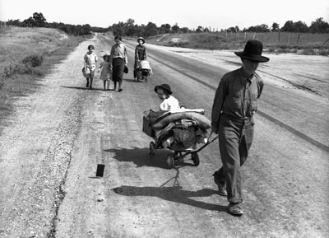
Why people do migrate (relocate)?
For work
For study
Marriage
Retirement
Housing amenities
(e.g. air quality, culture, university)
Notes:
n 2013, 232 million people – 3.2 per cent of the world's population – lived outside their country of origin. - See more at: http://www.unfpa.org/migration#sthash.cQdrQRj1.dpuf

Slide 11
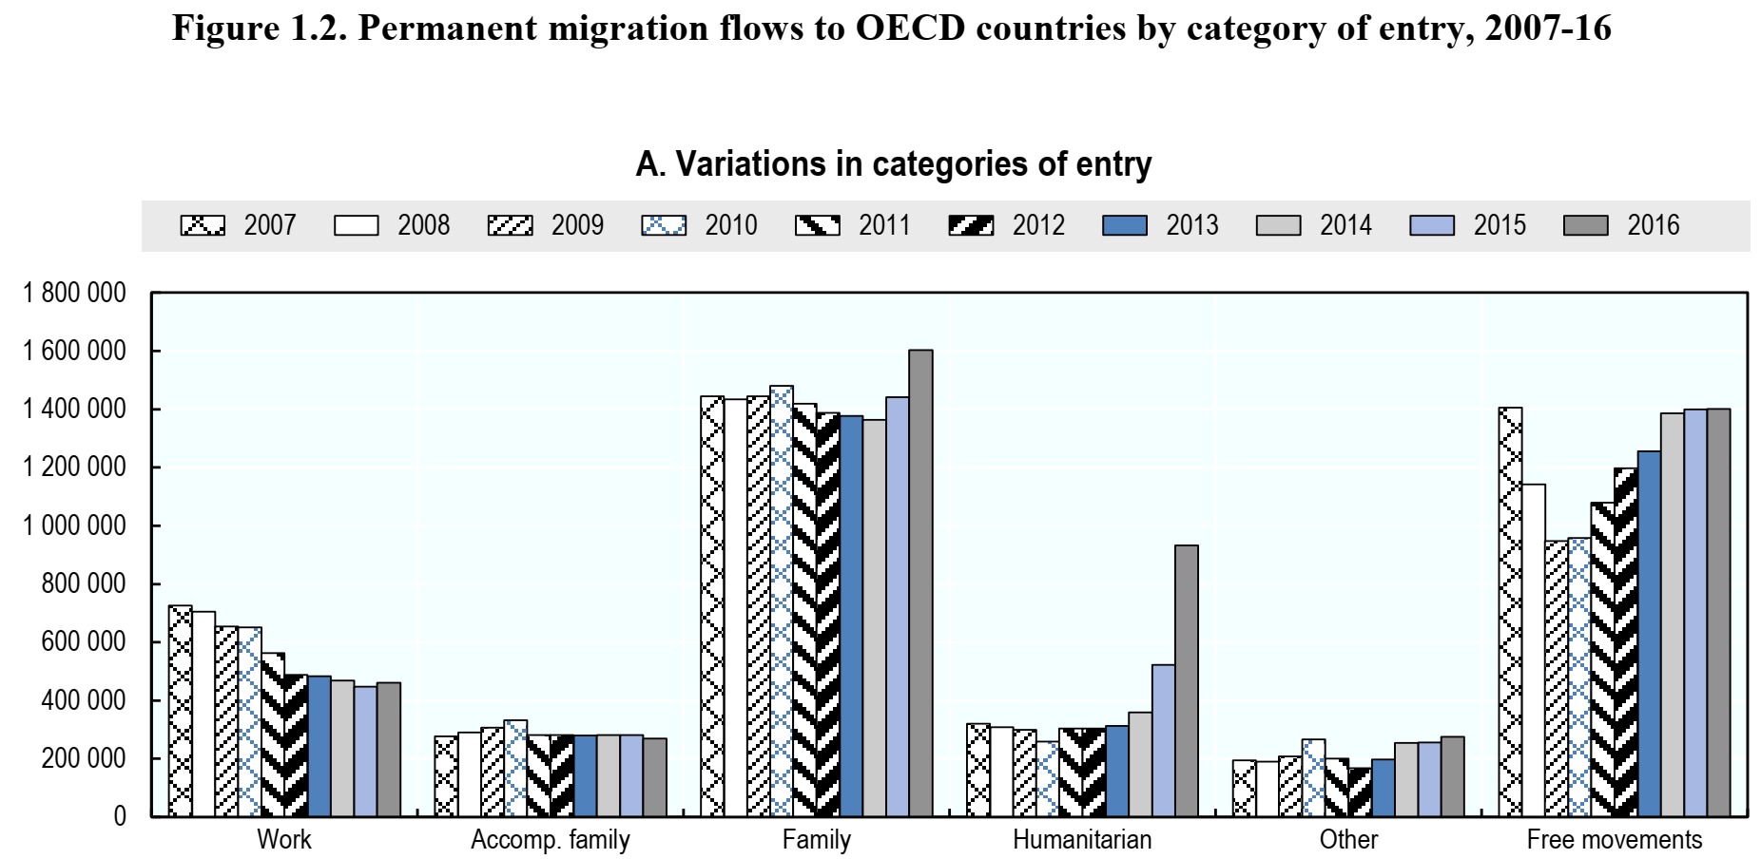
One out of five permanent migrants in 2016 was a humanitarian migrant (900,000 people).
United States (17%) and Germany (50%) were main destinations.
Source: INTERNATIONAL MIGRATION OUTLOOK 2017

Slide 12
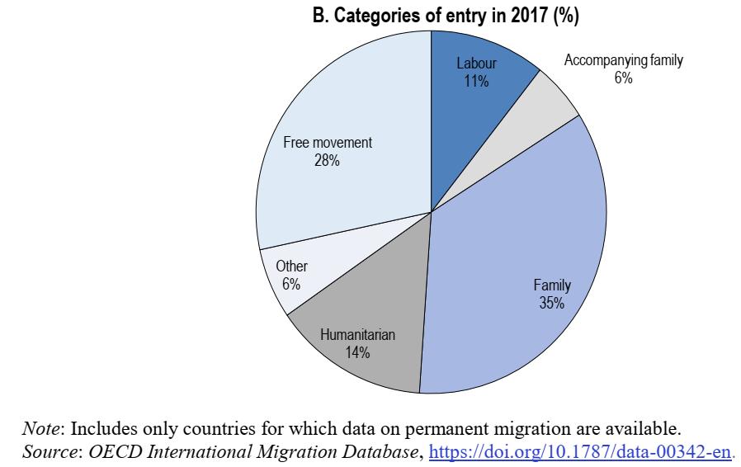
Permanent migration flows to OECD countries by category of entry
The family migration accounts for more than a half of all migration excluding free movement.
Source: INTERNATIONAL MIGRATION OUTLOOK 2019

Slide 13
Push and pull factors

Slide 14
Immigration push and pull factors
Push factors | Pull factors
Economic | Economic
High unemployment | Demand for labor
Poverty | High wages
High taxes | Strong economic growth
Poor health care | Opportunity for advancement
Overpopulation | Schooling
 | Technology
Political and social | Generous welfare benefits
Discrimination | Low cost of living
War or oppression
Corruption | Political and social
Crime | Family and friends
Compulsory military service | Rights and freedoms
 | Law and order
Other | Safety
Natural disaster
Famine | Other
Climate change | Amenities

Slide 15
Immigration push and pull factors
Push factors | Pull factors
Economic | Economic
High unemployment | Demand for labor
Poverty | High wages
High taxes | Strong economic growth
Poor health care | Opportunity for advancement
Overpopulation | Schooling
 | Technology
Political and social | Generous welfare benefits
Discrimination | Low cost of living
War or oppression
Corruption | Political and social
Crime | Family and friends
Compulsory military service | Rights and freedoms
 | Law and order
Other | Safety
Natural disaster
Famine | Other
Climate change | Amenities

Slide 16
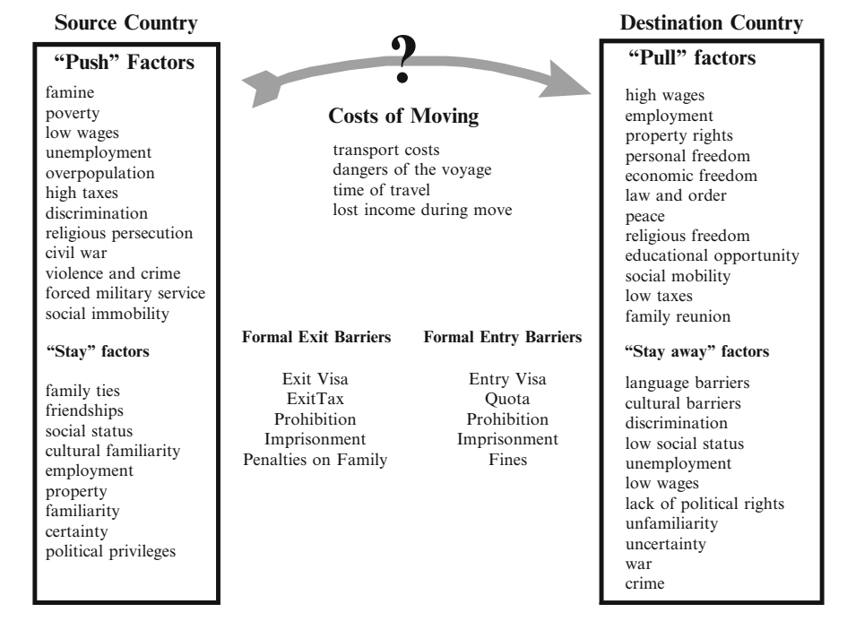

Slide 17
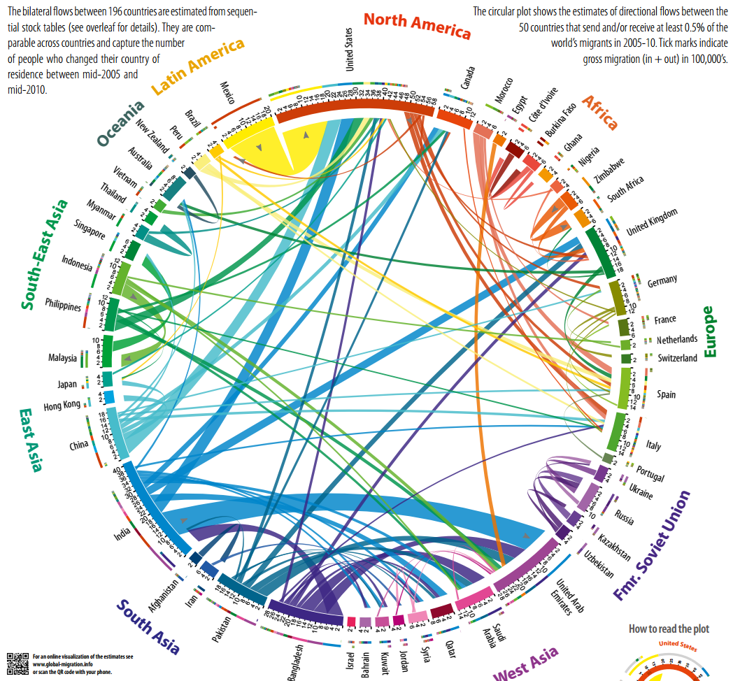
Source: http://download.gsb.bund.de/BIB/global_flow/

Slide 18
Roy-Borjas Model – Selection of immigrants
Roy (OEP 1951); Borjas (AER 1987)
Consider two countries, A and B
  Identical mean earnings
  Different income distributions: returns to human capital higher in A
Individual returns to migration depend on one’s skills
In which country can skilled workers earn more?
  Migration patterns:
  Skilled migration to A and unskilled migration to B
Notes:
Skilled workers fare better in A

Slide 19
The Self-Selection of the immigrant
Frequency
Negatively selected
Immigrant Flow
Positively selected
Immigrant Flow
Skills
Skills
If immigrants have above-average skills, the immigrant flow is positively selected. If immigrants have below-average skills, the immigrant flow is negatively selected.

Slide 20
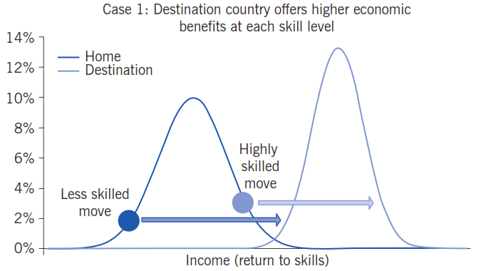
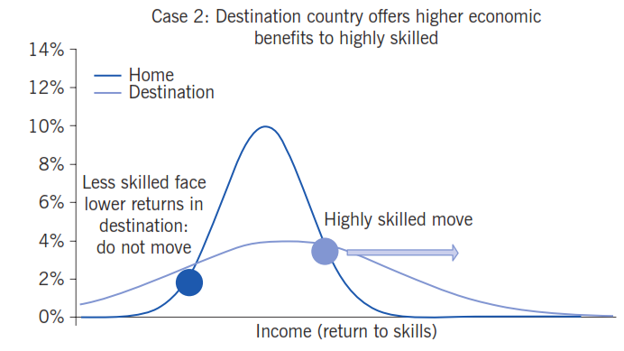
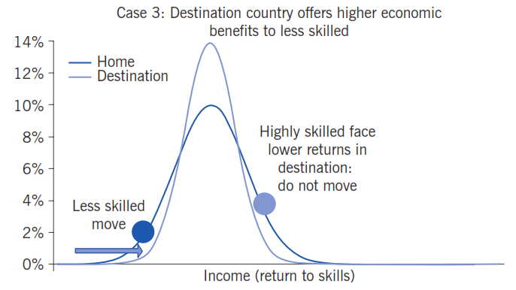

Slide 22
The Roy model of migration illustrates the self-selection of migrants on skill. How can you describe the migration motives of the low-skilled workers?
Low-skilled workers prefer to migrate to a country with higher income inequality.
Low-skilled workers prefer to migrate to a country with the more compressed income distribution (and lower income inequality).
Low-skilled workers prefer to migrate to a neighbouring country to minimize travelling costs.
There are no economic incentives to migration for low-skilled workers.

Slide 23
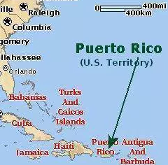
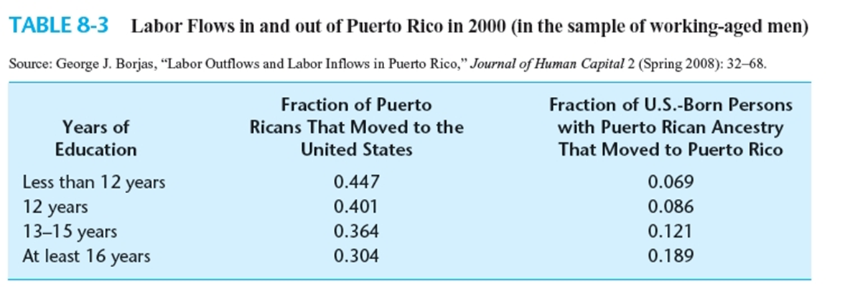
Migration between Puerto Rico and the US
Puerto Ricans can move freely to the US without the legal restrictions. About 10% of the population born outside PR during 1970-2000.
Return to skills is much higher in PR than in the US.
The patterns of migration can be understood with Roy model – relative payoffs for skills across countries determine the skill composition of the immigrant flow.

Slide 24
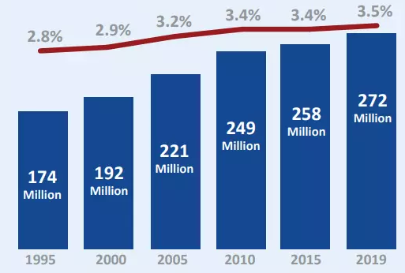
The international migrant population globally has increased in size but remained relatively stable as a proportion of the world’s population
Migration flows
The number of people living in a country other than where they were born
Migrants in 2019:
1 in every 30 people
48 % are females
14 % are children
74% are of working age 20-64
60 % are migrant workers
2 % are students
10 % are refugees
15% are displaced (BD, MM)
In last 5 years, more than 30,900 have died before trying to reach other country.
Source: World Migration Report 2020

Slide 25
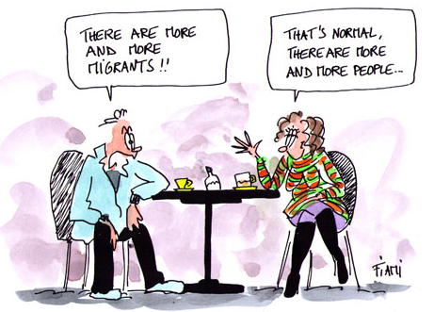

Slide 26
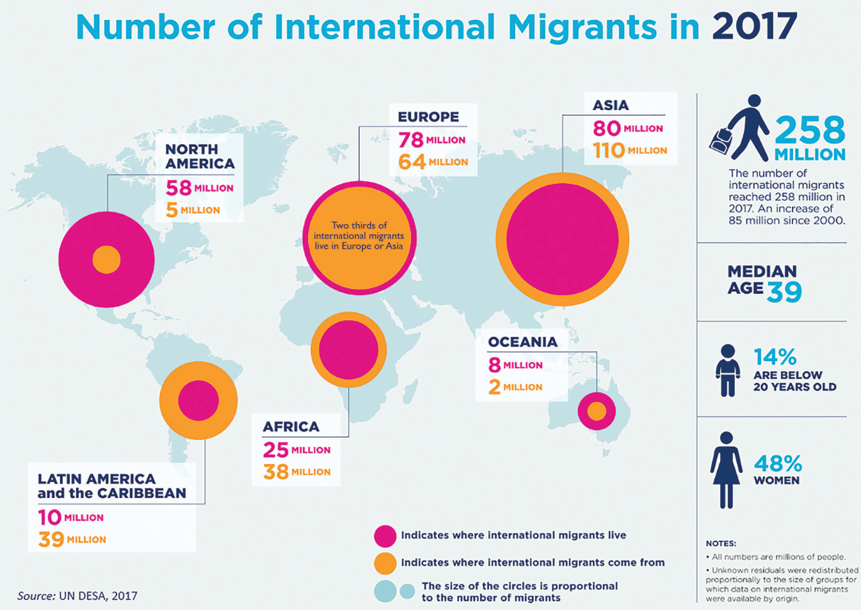

Slide 27
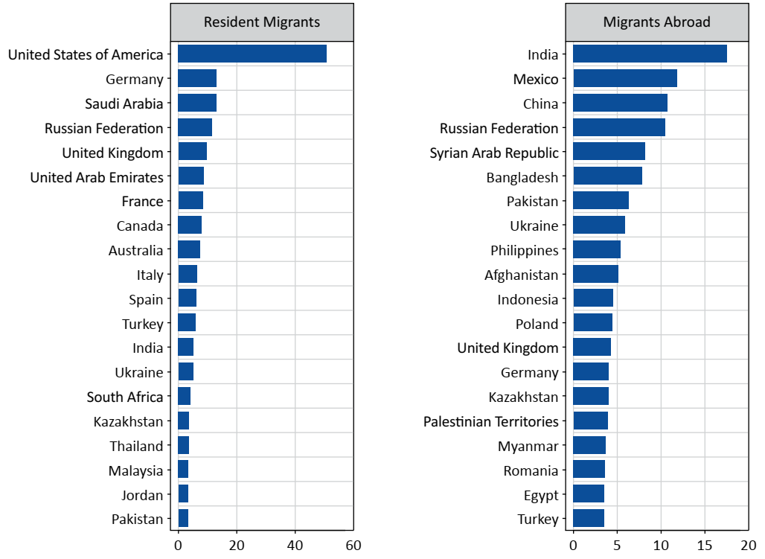
Top 20 world destinations (left) and origins (right) of international migrants in 2019 (millions)
Source: World Migration Report 2020

Slide 28
Legal barriers to mobility
In medieval Europe (feudalism) serfs were prohibited to move without lord's consent
Barriers to internal migration in Czarist Russia and the USSR
China’s internal passport system (“Hukou”)
State specific occupational licensing laws act as barriers to internal migration in the US
Visa

Slide 29

Occupation licensing is a legal requirement in order to practice a profession
In the US in 1970s, about 10 percent of workers had to have licenses, but by 2008, almost 30 percent of the work force needed them.
Louisiana, requires licenses for florists, math teachers need to be relicensed every time they move from one state to another.
Workers with licenses must pay upfront costs and face limited geographic mobility.
https://www.nytimes.com/2014/05/29/opinion/why-license-a-florist.html
Notes:
https://www.nytimes.com/2014/05/29/opinion/why-license-a-florist.html
MINNEAPOLIS — IN Minnesota, more classroom time is required to become a cosmetologist than to become a lawyer. Becoming a manicurist takes double the number of hours of instruction as a paramedic. In Louisiana, the only state in the country that requires licenses for florists, monks were until recently forbidden to sell coffins because they were not licensed funeral directors.
These regulations are not just unusual cases of state laws run amok but deliberate policies from one of the fastest growing labor market institutions in the United States: government licensing of jobs. This form of regulation — largely established by state governments and implemented through their licensing boards — is often referred to as “the right to practice.” Under these laws, working in a licensed occupation is illegal without first meeting government standards.
In the 1970s, about 10 percent of individuals who worked had to have licenses, but by 2008, almost 30 percent of the work force needed them.
With this explosion of licensing laws has come a national patchwork of stealth regulation that has, among other things, restricted labor markets, innovation and worker mobility. There is a role for government in protecting the public from incompetent or unscrupulous service providers, but there is little reason for math teachers to be relicensed every time they move from one state to another. These requirements put additional burdens on teachers that reduce the ability of good teachers to find work and schools to find good teachers.
Having more flexible reciprocity between states for occupations like teachers would allow these professionals to move to jobs more easily. But even better would be to stop requiring licenses for jobs whose potential harm to the public is minimal, like tour guides, and instead allow for certification. This lesser form of regulation provides a distinction in the eyes of a consumer but does not forbid others from offering the service.
There is good reason for workers in licensed fields to push for the laws. Jobs in a service-oriented economy are more likely to be licensed, which raises wages by about 15 percent, as I found in research with the Princeton economist Alan B. Krueger, the former head of President Obama’s Council of Economic Advisers. This is largely because of the ability of regulated professions working through state legislators and regulatory boards to limit the supply of practitioners and to drive up costs to consumers.
Yet the growth of occupational regulation has prompted rare bipartisan opposition. On the left, there are concerns about inflated prices for essential services like plumbers and the availability of those services for people in or near poverty. Many of the jobs that require licenses are relatively low-skilled, like barbers and nurse’s aides, and licensing creates a barrier that might keep low-income people out of those positions.
Occupational licensing, moreover, does nothing to close the inequality gap in the United States. For consumers, there is likely to be a redistribution effect in the “wrong” direction, as higher income consumers have more choice among higher quality purveyors of a service and lower income individuals are left with fewer affordable service options.
On the right, the issue is one of economic liberty. From that perspective, government-issued licenses largely protect occupations from competition. Conservatives often see members of the regulated occupation supporting licensing laws under claims of “public health and safety.” However, these laws do much more to stop competition and less to enhance the quality of the service.
Also, all consumers do not demand the same level of quality. If licensure “improves quality” by restricting entry into the profession, then some consumers will be forced to pay for more “quality” than they want or need. Not everyone wants a board-licensed hairdresser.
If both the left and right oppose more occupational regulation, why is it growing? From the time of medieval guilds, service providers have had strong incentives to create barriers to entry for their professions in order to raise wages. The Dartmouth economist Charles Wheelan’s research showed in the late 1990s that respiratory therapists who organized themselves and raised their profession’s dues in order to lobby for licensing laws tended to be more successful in getting these statutes passed. In contrast, consumers who will be affected by the higher fees of, say, a licensed manicurist are unorganized and arguably underrepresented in the political process.
Given these arguments from both the left and the right, can the growth of occupational regulation be reversed or slowed down? Last week, Representative Eric Cantor, Republican of Virginia, said he would ask governors around the country to take a closer look at licensing practices. And during the 2012-13 legislative sessions, Gov. Terry E. Branstad of Iowa, a Republican, vetoed the licensing of addictive disorder counselors and related occupations. In Indiana, Gov. Mike Pence, a Republican, vetoed the licensing of diabetes counselors and anesthesiologist assistants and dietitians. Both Mr. Branstad and Mr. Pence mentioned that this type of regulation would result in economic losses to consumers, higher prices and less employment.
Occupational licensure has a large and growing impact on labor markets and consumers, but has yet to draw significant public attention or scrutiny. The left and right seem to be in agreement that policy makers need to revisit the process for creating licensure regulations and consider amending or rolling back existing laws in favor of lesser forms of regulations such as certification. Ultimately, we all would benefit from wiser, not more, occupational licensing.

Slide 30
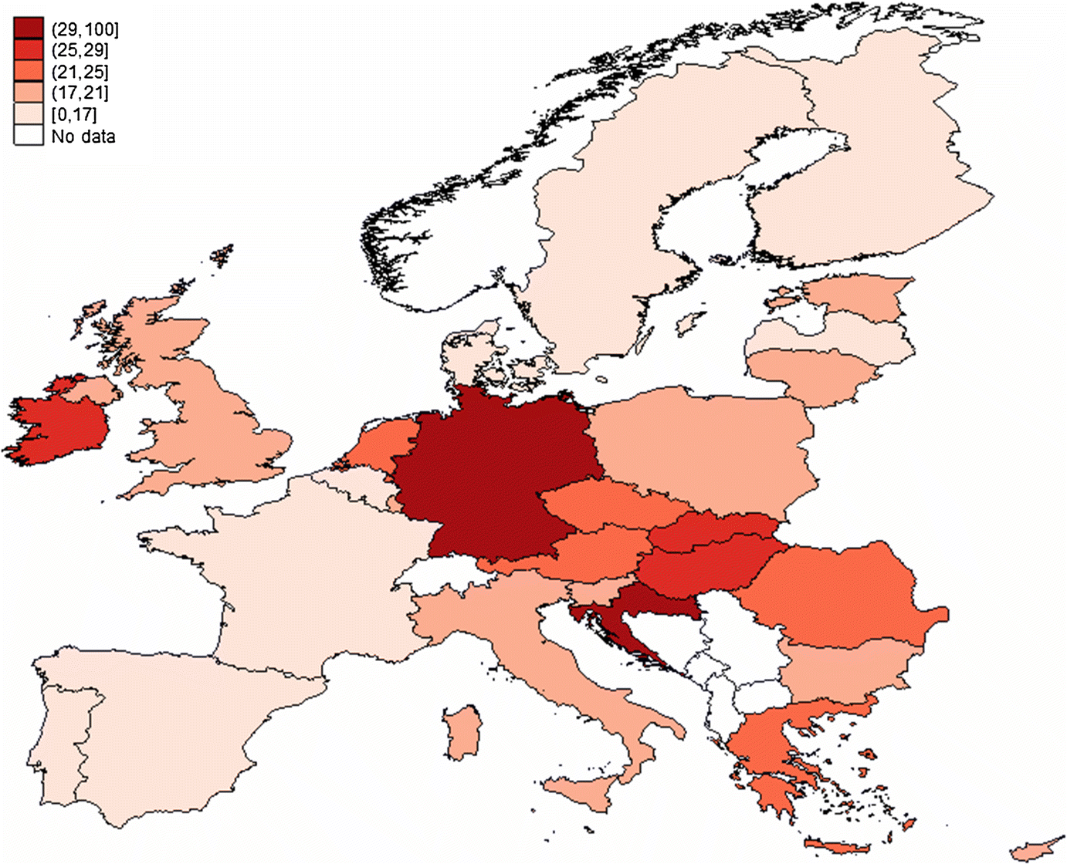
In the craft and related occupations, the proportion of licensed workers is 38% in Germany and 7% in Spain, while the average proportion of licensed workers at the state level is 33 and 17%
The prevalence of licensing varies significantly across member states: ranging between 14% in Denmark and 33% in Germany
Occupational licensing is least common in managerial occupations (e.g., managers, executives) and elementary occupations (e.g., food preparation, cleaners) and most common among plant and machine operators, technicians (e.g., electricians), and professionals (e.g., lawyers).
Pagliero, 2019 (https://link.springer.com/article/10.1007/s11151-019-09711-8)

Slide 31
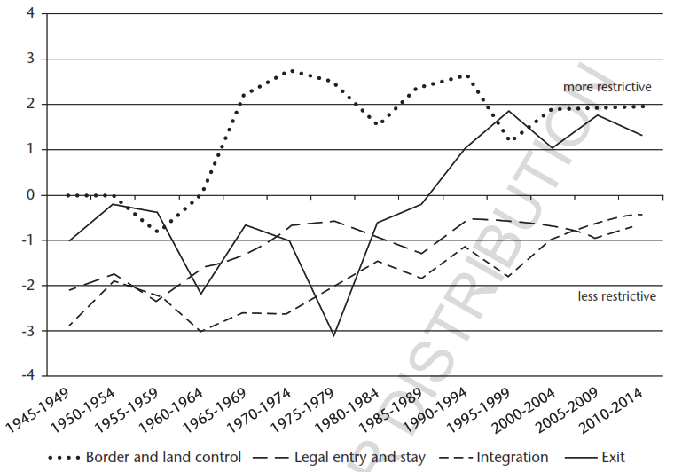
Changes in immigration regimes in 22 Western liberal states
Source: Hass et al. 2016
Over the past 70 years, immigration regimes (in Western countries) have been heavily concentrated on border control and more recently on exit and return measures (e.g. deportation). Policies have become more targeted on speciﬁc migrant groups providing multiple entry channels for low and high-skilled workers, permanent and temporary migrants, family members, students, entrepreneurs, and asylum seekers. Governments have liberalised entry for ‘wanted’ migrants, while policies have become more restrictive to prevent the entry and (irregular) stay of ‘unwanted’ migrants.
Notes:
Figure 27.2 reveals that over the past 70 years, policy changes in major (mostly Western) destination countries have been heavily concentrated on border control and more recently on exit and return measures, while admission regulations and post-entry integration policies have become overall less restrictive over the past few decades. However, policies have become more ﬁne-grained and targeted on speciﬁc migrant groups which are reﬂected in the creation of multiple entry channels for low and high-skilled workers, permanent and temporary migrants, family members, students, entrepreneurs, and asylum seekers. Obviously, for each of these migrant categories, entry and post-entry regula- tions have not changed uniformly for the diﬀerent legal categories but have become stricter for some migrant groups while turning more liberal for other groups. These trends and patterns reﬂect the extent to which governments have liberalised regular entry channels and stay perspectives for ‘wanted’ migrants, while border control and enforcement policies, as well as return and deportation measures, have become more restrictive in an apparent attempt to prevent the entry and (irregular) stay of ‘unwanted’ migrants.

Slide 32

https://www.passportindex.org/

Slide 33
Passport fees around the world
(Passport fee for 10 years in USD)
https://www.passport-collector.com/passport-fees-around-world-2018-2/

Slide 34
Costs and benefits of migration

Slide 35
Receiving economies (mostly developed countries)
Short-run | Long-run
+ lower wages, advantage for employers | + lower labour costs
+ growing demand for social capital from the migrants (flats - accommodation, education, health and social insurance, energies, waste collection etc.) | + increased demand for social capital from the migrants
+ inflow of highly-qualified labour force | + inflow of highly-qualified labor force
– decrease in the real wages | + increased state budget revenues
– increase in the unemployment rate of the domestic population (mostly with low qualification) | + increase in the economical effectiveness
 | + increase of the competitiveness of the domestic companies
– problems of migrants to adapt in the new environment | – growth of criminality
+ lower labour costs
+ lower wages, advantage for employers
+ increased state budget revenues
+ increase in the economical effectiveness
+ growing demand for social capital from the migrants (flats - accommodation, education, health and social insurance, energies, waste collection etc.)
+ inflow of highly-qualified labour force
+ increased demand for social capital from the migrants
– decrease in the real wages
+ inflow of highly-qualified labor force
+ increase of the competitiveness of the domestic companies
– growth of criminality
– increase in the unemployment rate of the domestic population (mostly with low qualification)

Slide 36
Receiving economies (mostly developed countries)
Short-run | Long-run
+ lower wages, advantage for employers | + lower labour costs
+ growing demand for social capital from the migrants (flats - accommodation, education, health and social insurance, energies, waste collection etc.) | + increased demand for social capital from the migrants
+ inflow of highly-qualified labour force | + inflow of highly-qualified labor force
– decrease in the real wages | + increased state budget revenues
– increase in the unemployment rate of the domestic population (mostly with low qualification) | + increase in the economical effectiveness
 | + increase of the competitiveness of the domestic companies
– problems of migrants to adapt in the new environment | – growth of criminality

Slide 37
Sending economies (mostly developing countries)
Short-run | Long-run
+ decrease in the unemployment rate | + decrease in the unemployment rate
 | + increase in the level of remittances (thanks to the growing revenues of the migrant workers)
– losses in the form of cost for migration (travelling, accommodation in the receiving economy etc..) | + potential re-emigration – return of the migrants with new experiences and knowledge, as well as accumulated capital
– brain drain | – lost investment due to brain drain to those workers (economical loss)
 | – decrease of the level of the labor productivity influenced by the loss of qualified labor force
 | – decrease in the pensions and incomes
+ decrease in the unemployment rate
– losses in the form of cost for migration (travelling, accommodation in the receiving economy etc..)
+ increase in the level of remittances (thanks to the growing revenues of the migrant workers)
+ potential re-emigration – return of the migrants with new experiences and knowledge, as well as accumulated capital
– brain drain
– lost investment due to brain drain to those workers (economical loss)
+ decrease in the unemployment rate
– decrease of the level of the labor productivity influenced by the loss of qualified labor force
– decrease in the pensions and incomes

Slide 38
Sending economies (mostly developing countries)
Short-run | Long-run
+ decrease in the unemployment rate | + decrease in the unemployment rate
 | + increase in the level of remittances (thanks to the growing revenues of the migrant workers)
– losses in the form of cost for migration (travelling, accommodation in the receiving economy etc..) | + potential re-emigration – return of the migrants with new experiences and knowledge, as well as accumulated capital
– brain drain | – lost investment due to brain drain to those workers (economical loss)
 | – decrease of the level of the labor productivity influenced by the loss of qualified labor force
 | – decrease in the pensions and incomes

Slide 39
remittances

Slide 40
REMITTANCES
Financial or in-kind transfers made by migrants directly to families or communities in their countries of origin.
Official estimates (by World Bank) on the scale of remittances are likely underestimated.
Globally, remittances are now more than three times the amount of official development assistance.
The biggest beneficents are middle income countries.

Slide 41
706 billions USD
Estimated volume of remittances sent by migrants in 2019
(up from 126 billion in 2000).

Slide 42
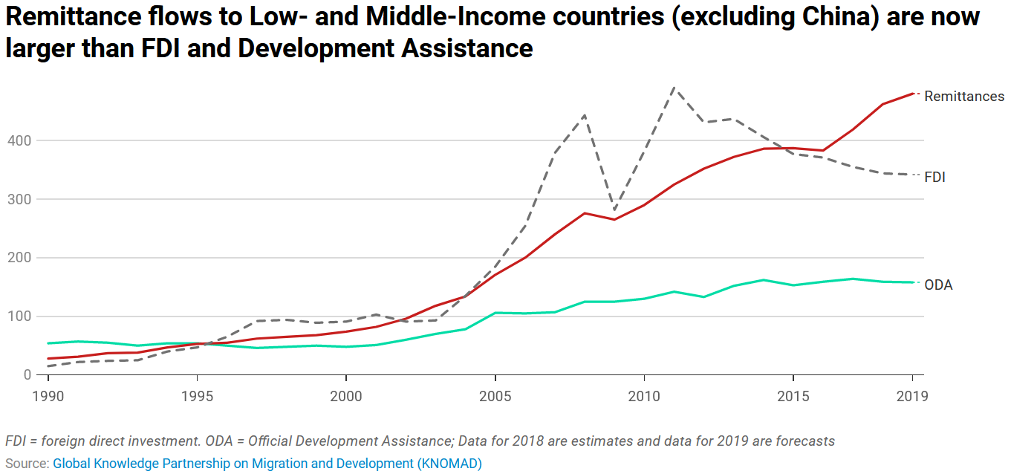
Officially recorded remittances to developing countries amounted to a record $550 billion in 2019.

Slide 43
Remittance Flows dropped during the pandemic
Remittances to Low- and Middle-Income Countries (LMIC) are expected to grow by 1.4 percent to reach $656 billion in 2023, following a very strong 8 percent growth in 2022 and 10.6 percent in 2021.

Slide 44
Remittances
Moneys sent back home by immigrants (why?)
Large inflows, esp. for developing countries
Macroeconomic effects of remittances:
  economic growth
  employment
  prices
  exchange rate
High remittances may create dependency, increase local prices, appreciate exchange rate

Slide 45
Microeconomic effects of remittances
Remittances go directly to households in emigrants’ home countries
Reduce poverty and increase consumption
Allow higher spending on education and health care, hence better life for children and people
Help starting a small business (investment)
Facilitate the return of migrants

Slide 46
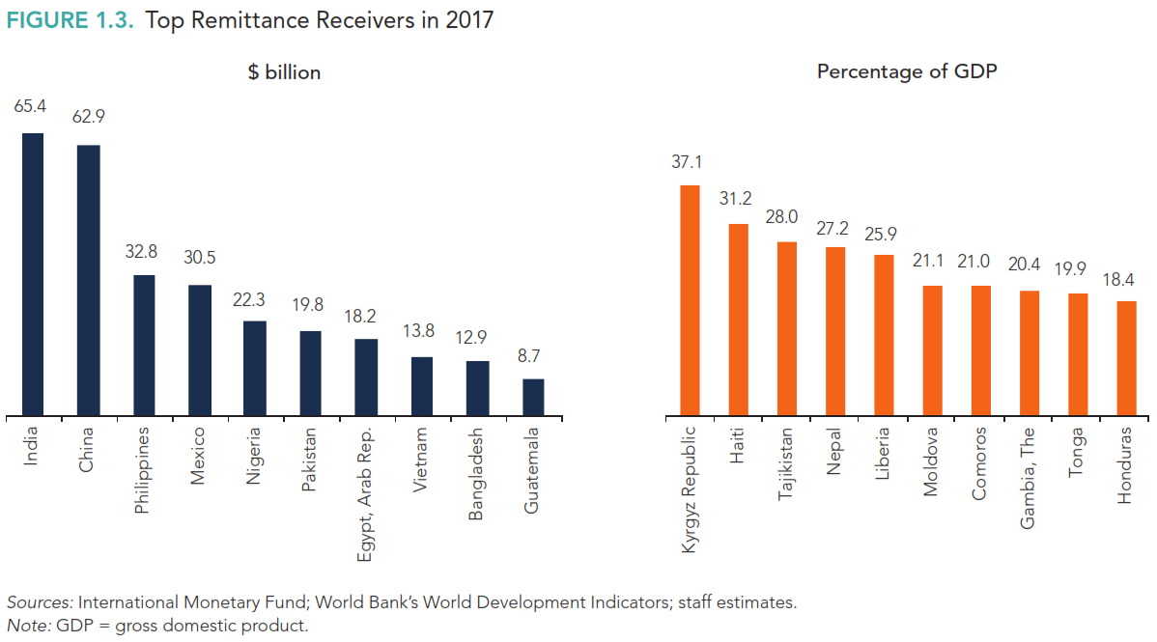

Slide 47
World bank monitors the cost of international remittance services since 2008 when the cost to send money was 10%. G20 set a target to reduce costs to 5%. Sustainable Development Goal (SDG) 10.c.1 aims to reduce this cost to 3% on average by 2030. Faster adoption of digital financial services, which make remittances cheaper and more convenient, should be a priority.
https://remittanceprices.worldbank.org/

Slide 48
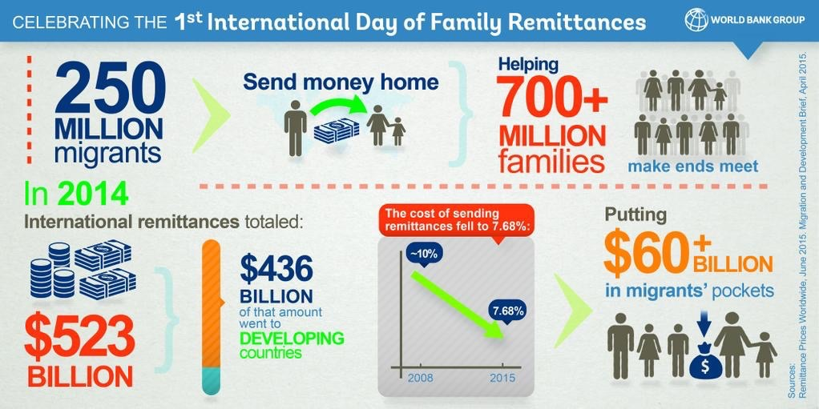
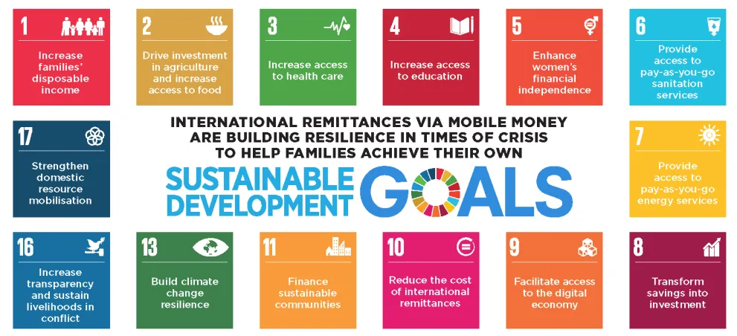


Slide 49
Social remittances
In addition to money, migration leads to the circulation of ideas, practices, skills, identities, and social capital.
Research shows how emigrants influence social protests, elections, and calls for greater transparency or reform.
Migration may affect traditional gender norms

Slide 50
Which one is the push-factor of migration?
Average income
Ethnic conflict
Democracy
Unemployment benefits

Slide 51
Why do people migrate most?
For work, family reasons and better living
For political reasons
For education
All of above

Slide 52
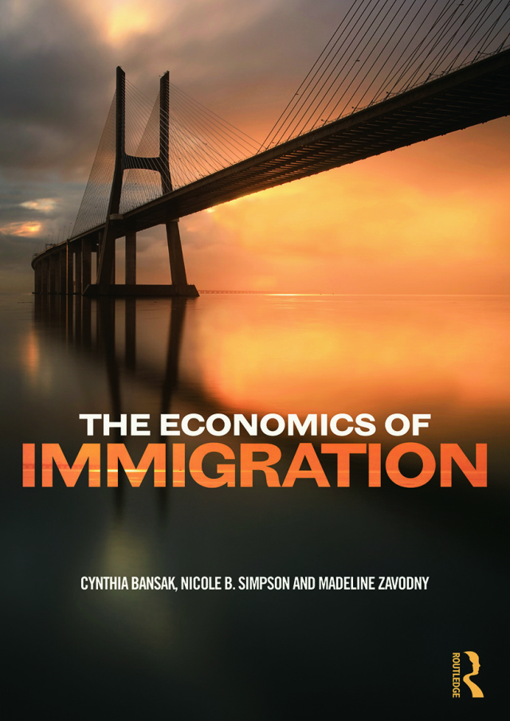
Reading
Chapter 2 - Why People Become Immigrants
Chapter 3 - Where Immigrants go

