Slide 1
Applied Research in Public Policy Making
Fall 2024
Integration of immigrants
in the labour market
Week 3
Martin GUZI
martin.guzi@econ.muni.cz

Slide 2
Outline
Labour market integration (=assimilation)
Migrants = mobile labour force
Access to citizenship and its impact on migrants’ integration
The role of language in migrants' integration

Slide 3
Labour market assimilation of immigrants
Migration changes people’s lives (language, culture, skills, marriage, aspirations)
Immigrants become similar to natives over time (both migrants and natives may change).
By comparing immigrants to natives in the labour market we measure integration.
Children of immigrants (second generation)

Slide 4
Assimilation is faster when immigrants
have more human capital at entry.
enter under good economic conditions.
learn language.
enter country with lower inequalities.
enter on the basis of family ties (have better networks, and have incentives to stay long).
are legally in the country.

Slide 5
Name choice and the assimilation of immigrants, 1910-1930
The vast majority of immigrants to the United States adopted American sounding first names.
Choice of an American first name was associated with a more successful assimilation (better job, higher wage, marriage to a US native and take-up of US citizenship).
When comparing the labor market trajectories of two migrants both named Guido at birth, one who Americanizes his name to John and one who keeps his name, John’s occupational-based earning growth is 22% higher than Guido’s.
Poor local labor market conditions for immigrants led to more frequent name changes among immigrants
Biavaschi, C., Giulietti, C. and Siddique, Z., 2017. The economic payoff of name Americanization.
Journal of Labor Economics, 35(4), pp.1089-1116.
Notes:
For example, around 40% of Czech male immigrants, about 30% of Portuguese male immigrants and around 20% of Italian male immigrants held a name from the respective top three American names. In contrast, only 15% of US natives held any of the three top names

Slide 6
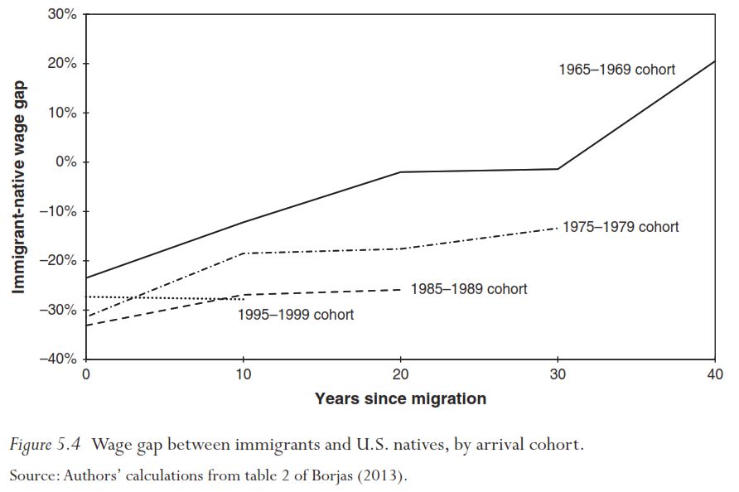
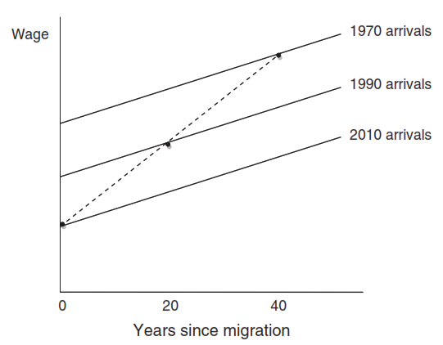
Labour market assimilation of different migrant cohorts
Earlier cohorts of immigrants to U.S. experienced faster assimilation than recent cohorts.
If cohort quality has changed over time, cross-sectional data may give misleading picture of immigrant assimilation.

Slide 7
Migrants = mobile labour force
Immigrants are in general not less, and in many cases more responsive to economic conditions (changing wages) in the labor market.
US labor market (Borjas 2001)
  newly arrived immigrants are much more likely to be clustered to those states which offer higher wages
Dustmann, Frattini and Preston (2010)
  immigration reduces regional disparities between wages in the United Kingdom
Immigrants are more vulnerable to business cycle
Fresh immigrants are more responsive to the changing economic environment than those who arrived longer ago.

Slide 8
Evidence from academic literature
Dustmann, Glitz and Vogel (2010) show that in Germany the risk of unemployment for migrants is more sensitive to the economic cycle than that of the natives.
Røed and Schøne (2012) show that the mobility of immigrants between regions in Norway is more responsive to the differences in average wage levels and unemployment rates.
Amuedo-Dorantes and De la Rica (2010) find that the mobility of immigrants in Spain is more responsive to regional employment opportunities than the mobility of similarly skilled natives.

Slide 9
The composition of foreign-born population by origin in EU-15
Source: Based on EU-LFS 2004-2014 data
Note: Shares add up to unity. Immigrants are recognized by the country of birth or nationality (Germany).

Slide 10
The composition of foreign-born population by origin in EU-15
Source: Based on EU-LFS 2004-2014 data
Note: Shares add up to unity. Immigrants are recognized by the country of birth or nationality (Germany).

Slide 11
Immigrant to native ratio of employment rates in the EU-15 for various immigrant groups (ratio 1 means immigrants are similar to natives)
Source: Based on EU-LFS 2004-2014 data

Slide 12
Immigrant to native ratio of unemployment rates in the EU-15 for various immigrant groups
Source: Based on EU-LFS 2004-2014 data

Slide 13
Immigrant to native ratio of the proportion of workers who look for another job
Source: Based on EU-LFS 2004-2014 data

Slide 14
Immigrant to native ratio of workforce without a job for more than 11 months

Slide 15
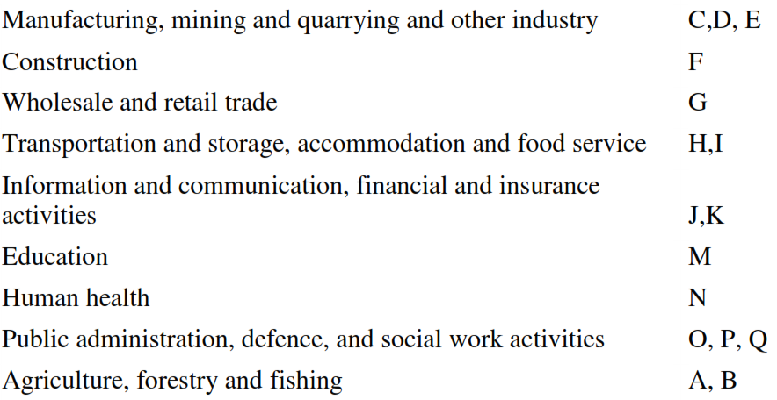
Immigrant to native ratio of proportion of workers who changed industry during the previous year

Slide 16
Benefits of mobile workforce in the EU
Benefits of brain circulation in an enlarged EU.
Improves allocative efficiency and labour-market flexibility.
(e.g. economic growth lowers unemployment)
Equalizes labor-market conditions across regions
(e.g. when workers move from depressed regions to prosperous ones)
Mobility strengthens the social fabric and improves cohesion in the EU (natives may also change over time in response to migration).
Triple-Win Migration

Slide 17
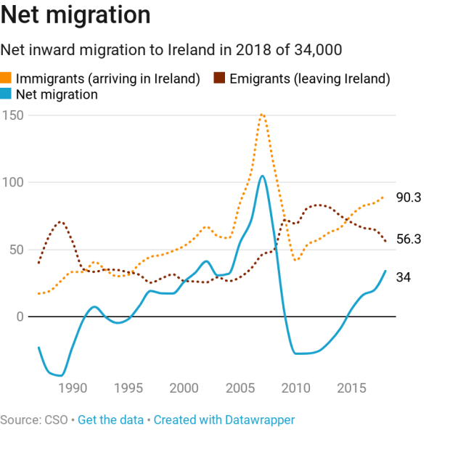
Migrants go where jobs are – the case of Ireland
Rapidly growing Irish economy (termed the ‘Celtic Tiger’) in late 90s and early 00s, resulted in prosperity and net immigration.
In June 2009 due to the country’s recession Ireland tighten its work permit system.
Fewer Irish emigrating
Nine years after crash and the pain of forced emigration, more Irish citizens are coming home (from AU, CA, UK, US), than moving abroad.
12.7% population are foreign nationals in 2019.

Slide 18
Access to citizenship and its impact on immigrant integration
Naturalization can lead to better economic integration.
Some professions in public sectors are not accessible to foreigners (20 % in France, Fougere and Safi, 2009)
Nationality in CV helps applicants with foreign-sounding names (removes discrimination)
Rules of naturalization process vary across destinations
MIPEX Index: Access to nationality, 2010
https://mipex.eu/access-nationality
Notes:
unrestricted access to the local labor market

Slide 19
“Earlier naturalization was a gateway to integration. Today, the logic is completely reversed. Naturalization has become a certificate of good conduct," wrote immigration specialist Catherine de Wenden in the
left-leaning French daily, Libération, in May 2012.
Debate about naturalization and foreigners’ labour market integration:
  Tool for integration
  At an earlier stage of integration – Easier access to citizenship
  Reward for integration
  At the end of integration process – Difficult path to citizenship
Notes:
Note: What she is saying is that she opposes any attempt to make naturalization something you earn. Instead, it should just be given to you, so you can integrate, and make your demands on European society more freely.

Slide 20
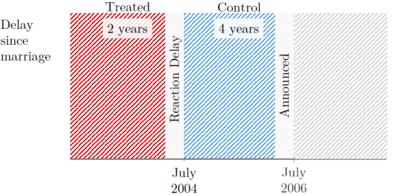
Marriage reform in France
Around 40% of immigrants are naturalized.
Naturalization through marriage for well-integrated immigrants (Requires: a certain number of years of marital life, a valid marriage, and a knowledge of French).
Due to the rising fear towards migrants, countries tend to become stricter in terms of their naturalization rules.
Reform in 2006 increased
the time in marriage
from 2 years to 4 years
(retroactively).
Source: Yajna Govind, 2020: Is naturalization a passport for better labor market integration?
Evidence from a quasi-experimental setting
Notes:
The identiffcation strategy relies on the fact that the reform was unanticipated at the time of marriage: any couple married before the announcement of the reform in March 2006 expected to wait only two years after marriage to be eligible to apply for naturalization. Hence, there is no reason to expect mixed married couples before and after 2004 to be any di
erent except for their differential probability of obtaining the nationality, due to this exogenous shock.

Slide 21
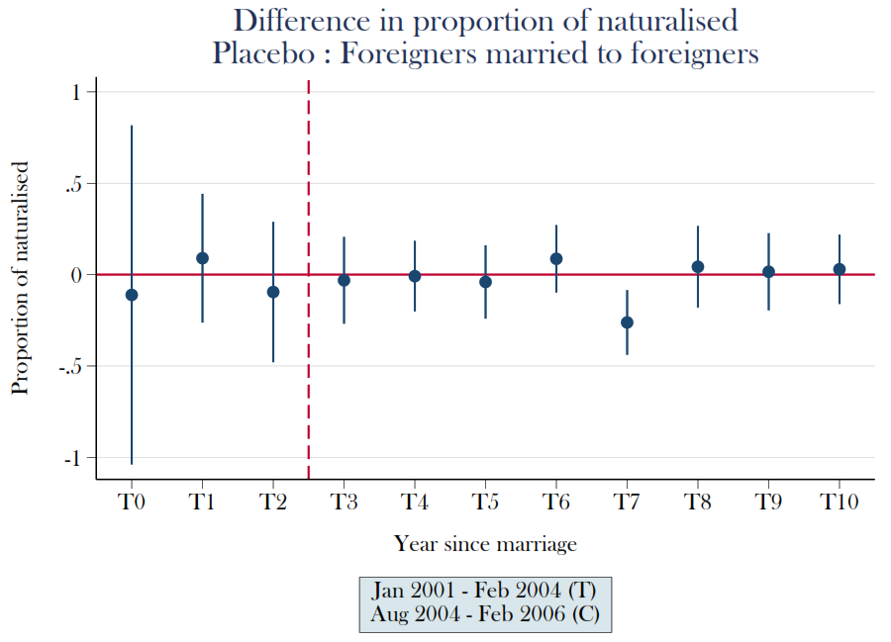
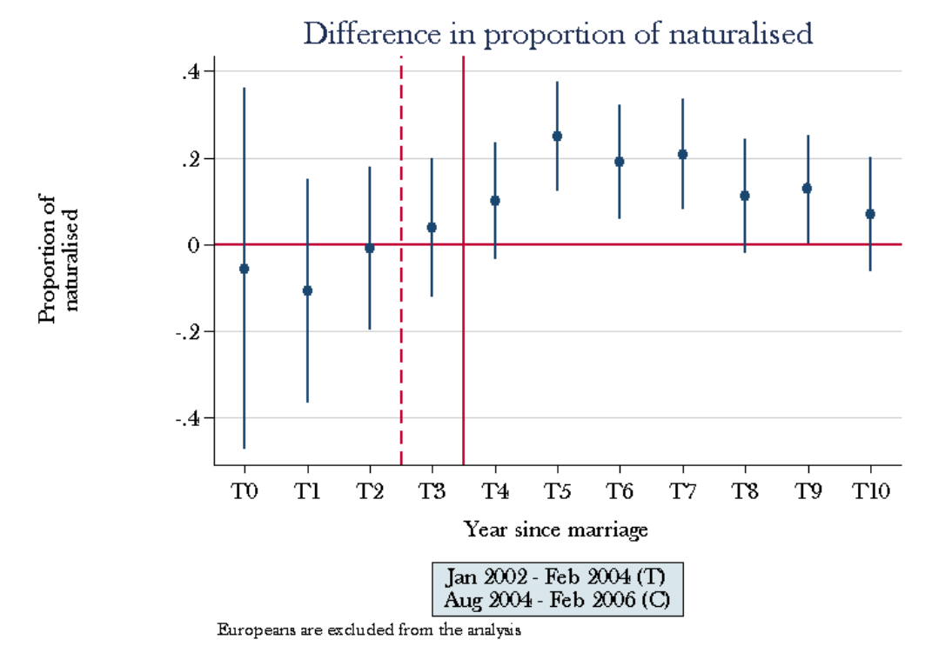
Based on administrative panel data naturalization rate is same between control and treatment groups in pre-treatment period
The difference gradually opens from the fourth year of marriage, likely due to the one-year administrative delay to process application for naturalization.
The gap seems to close as from 6 years of marriage, consistent with expectations.
(Placebo) Foreigners married to foreigners are not eligible to apply to the nationality through the marriage channel (no changes over time)

Slide 22
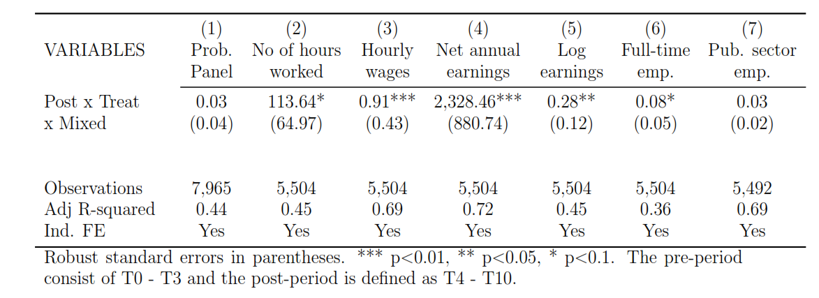
Causal effects of naturalization based on triple difference analysis:
Citizenship leads to an increase in annual earnings by 28% (2,328 EUR).
Higher earnings are driven by an increase in the number of hours worked, and hourly wages.
Both men and women experience an increase in earnings.
Obtaining the nationality helps more foreigners from non-francophone countries by signalling better language proficiency
Access to jobs in public sector does not change (too late in a career)

Slide 23
The circularity of migration suggests the potential of a win-win-win situation for
Migrants
Sending countries
Receiving countries
All of the above

Slide 24
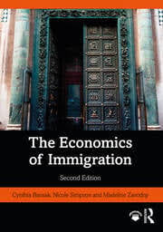
https://ebookcentral.proquest.com/lib/masaryk-ebooks/detail.action?docID=6378535

