Slide 1
Applied Research in Public Policy Making
Fall 2024
Hiring discrimination
Week 4
Martin GUZI
martin.guzi@econ.muni.cz

Slide 2
Outline
1. Group identity
2. Statistical discrimination
3. Hiring discrimination
4. Correspondence testing
5. Self-perceived objectivity

Slide 3
Introduction
People belong to groups. Groups vary enormously. Some are religious, others are ethnic. People benefit from group membership.
The more obvious reasons to discriminate would be:
  Material incentives associated with cultural/language differences, to conflict between groups or to specific policies - like those favouring hiring a native employee over a foreign one
  Prejudices or cultural stereotypes and beliefs that affect probabilities in expected value calculations

Slide 4
Minimal group assignment can affect behavior
Experiments in social psychology show that subjects are more likely to give rewards to those with the same label than to those with other labels (ex: Blue or Red), even when choices are anonymous and have no impact on own payoffs.
https://en.wikibooks.org/wiki/Bestiary_of_Behavioral_Economics/Trust_Game

Slide 5
Does group identification influence the capacity of people to trust each other?
- Trust game experiment with subjects randomly assigned to two groups just defined by color labels (Blue/Red).
Summary of results:
1 The creation of groups did not aﬀect mean giving rates to in-groups.
2 The creation of groups reduced mean giving rates to out-groups.
3 The creation of groups reduced mean return rates to out-groups.
4 People place a monetary value on their own group membership which exceeds the advantages of belonging to that group (the experiment allows subjects to trade their membership).
To sum up, the minimal creation of groups is sufficient to produce in-group bias, i.e. the tendency to favour the in-groups over the out-groups, in the form of a negative discrimination. However, being a member of a group yields a distinct additional psychological benefit.
‘The value of groups’ (Shaun Hargreaves Heap and Daniel J. Zizzo), American Economic Review, 99, March 2009, 295-323. or https://www.youtube.com/watch?v=6_d-d1UJzq8

Slide 6
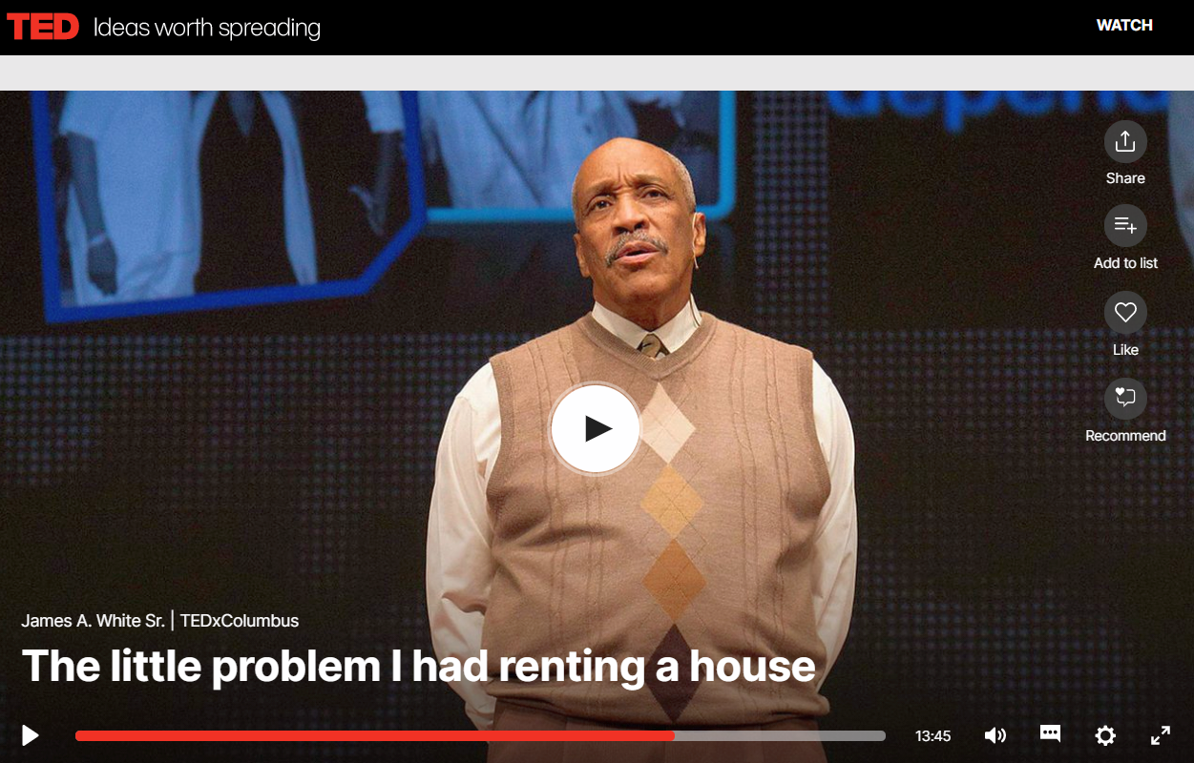
http://www.ted.com/talks/james_a_white_sr_the_little_problem_i_had_renting_a_house

Slide 7
Ethnic minorities in Europe
Europe is an ethnically diverse continent
‘United in Diversity’ – official EU Motto (since 2000)
There is no agreed definition of what constitutes an ethnic group.
Defined by a collective name, shared myths, and cultural characteristics, such as language, religion, traditions and customs that distinguish a given group from others.
Group membership is a matter of individual choice and not determined by the state.
Notes:
"United in diversity", the motto of the European Union, first came into use in 2000.
It signifies how Europeans have come together, in the form of the EU, to work for peace and prosperity, while at the same time being enriched by the continent's many different cultures, traditions and languages.

Slide 8
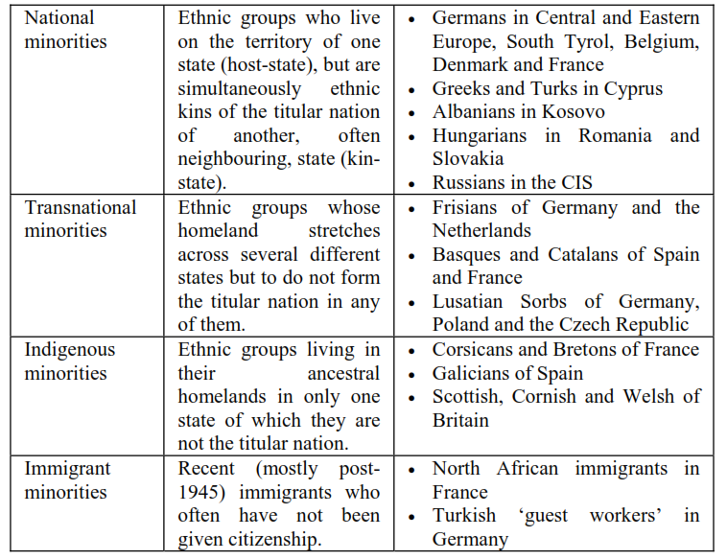
Where do Europe’s ethnic minorities come from?
Notes:
Stefan Wolff, 2008 Ethnic Minorities in Europe: The Basic Facts

Slide 9
Identification of minorities
In Eastern European countries the term nationality has the meaning of ethnicity.
In Western Europe nationality is a
synonym of citizenship.
Self-identification
In the empirical field the definition of ethnic minority is by the country of origin (birth).
Language spoken at home.

Slide 10
Limited evidence on ethnic minority
The main limitation is the scarcity of quantitative and qualitative data.
Standard data surveys fail to correctly capture those who belong to an ethnic minority.
The empirical research and comparisons of economic conditions of ethnic minorities is uninformative and biased.
(the most disadvantaged minority in EU are Roma)

Slide 11
Statistics on Roma population [2005]
Country | Census statistics |  | Unofficial estimates
 | Total population | Roma population | Min | Max
Albania | 3,142,065 | 31,768 | 80,000 | 150,000
Bosnia and Herzegovina | 3,781,284 | 9,864 | 40,000 | 60,000
Bulgaria | 7,718,750 | 370,908 | 638,162 | 815,313
Croatia | 4,442,000 | 9,463 | 30,000 | 40,000
Czech Republic | 10,251,079 | 12,444 | 179,778 | 179,778
Hungary | 10,090,330 | 205,720 | 520,000 | 650,000
Macedonia | 1,607,997 | 53,879 | 135,490 | 135,490
Montenegro | 620,145 | 2,601 | 20,000 | 20,000
Romania | 21,623,849 | 535,140 | 1,500,000 | 1,500,000
Serbia | 7,440,769 | 108,193 | 250,000 | 380,000
Slovakia | 5,389,180 | 98,170 | 320,000 | 380,000
Spain | 43,038,035 | n/a | 650,000 | 700,000
Notes:
Source: OSI. No Data—No Progress. Country Findings. Data Collection in Countries Participating in the
Decade of Roma Inclusion 2005-2015. New York: Open Society Institute, 2010

Slide 12
Theories of discrimination
Gary Becker (1957) – The economics of discrimination
Definition of labor market discrimination is based on the unequal treatment of equally qualified workers.
Taste discrimination: individuals prefer certain individuals to others.
Statistical discrimination: agents make decisions about individuals based on their attributes and those of their group.

Slide 13
Discrimination at the group level.
(also called) Statistical discrimination
In the absence of direct information about a certain fact of ability, a decision maker would substitute group averages.
Employer decides based on the workers' visible features as long as these features are associated with some desirable but more difficult to measure trait.
Statistical discrimination is often used and tolerated.
Notes:
http://en.wikipedia.org/wiki/Statistical_discrimination_%28economics%29

Slide 14
The cost of discrimination
Discriminating against an individual based on the perceived characteristics of his or her group is illegal in many cases.
There are also economic consequences of discrimination (e.g. company that fail to hire qualified female lag behind the companies that enforce egalitarian social norms)
It should be in the employers’ own interest to hire the most productive workers.

Slide 15
Policy responses
Discrimination raises problems of inequity and inefficiency.
Many countries have responded to these perceived inequities by enacting equality promoting legislation.
European Union (EU) laws clearly prohibit discrimination in employment based on race or ethnicity, gender, age, disability, and religion or beliefs.
Color-blind treatment
Quotas (reversed discrimination)

Slide 16
We all have subconscious biases.
Studies have shown that personal information, such as a name, can trigger these subconscious biases about ethnic origin, immigrant status and gender, for example, and prevent employers from objectively seeing the rest of what’s in the application.”

Slide 17
How do we measure discrimination?
Identifying discriminatory practices is not an easy task.
Correspondence testing can be used to test for hiring discrimination based on race or ethnicity, gender, age, sexual orientation.
The method involves sending matched pairs of identical job applications to employers posting jobs—the only difference being a characteristic that signals membership to a group.

Slide 18
The hiring process and discrimination.
Discrimination is more frequent at the hiring level than the compensation/promotion plan
Discrimination appears to be strongest when employers decide about invitations to interviews
Anonymous jobs applications simply hide characteristics of minority groups and may improve callbacks rates.

Slide 19
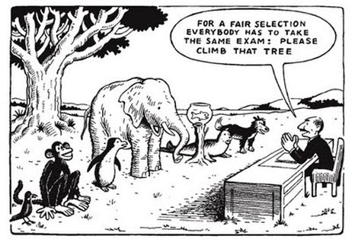
Is this a discriminatory employer?

Slide 20
Study 1: Discrimination against Female Migrants Wearing Headscarves
Source: Discrimination against Female Migrants Wearing Headscarves
by Doris Weichselbaumer, 2016

Slide 21
Motivation
Main issues:
Reasons for conducting the experiment:
→ Substantial growth of anti-Muslim views and Islamophobia in Western countries
9/11 terrorist attack which led to the spread of negative stereotypes that depict Muslims as “religious fanatics, terrorists, hostile, evil, barbaric, disorganized people who mistreat and oppress women” (Ghumman and Jackson 2010)
A high influx of Muslim migrants to Europe
Examine the employment chances of females with backgrounds of migration from Muslim countries, especially of those wearing headscarves
To depict that the Muslim headscarves or hijabs are particularly controversial, and attitudes of non-Muslims are significantly more negative towards the headscarf than towards Muslims in general
The proportion of Muslims in the German population ranges from 1.9% to 5%.

Slide 22
Reasons for discrimination:
→ The headscarf is often considered as a symbol not of Islam in general but of Muslim fundamentalism - associated with intolerance and terrorism.
→ Headscarf is interpreted as a sign of unwillingness on the part of Muslim migrants to integrate - used by the media to claim that national integration policies have failed.
→ The headscarf is considered as an expression of women’s oppression and the rejection of gender equality - liberal state should not accommodate the cultural traditions of minority groups if these infringe upon women’s rights, freedom and autonomy.

Slide 23
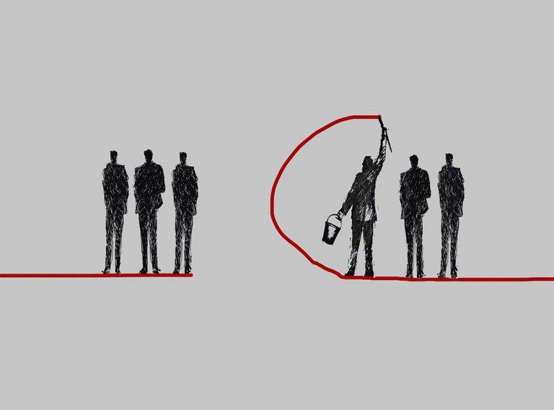
Theoretical Background
Social Identity Theory
People gain self-esteem by attributing a higher value to their own social group (“ingroup”) than to others (“outgroup”)
Individuals who identify more strongly with an outgroup are perceived as more “distant” by members of the ingroup - they suffer from increased levels of discrimination.
→ Crucial to our understanding of who should do what job in the economy
Women wearing the headscarf should be particularly negatively affected, as they signal a strong identification with the Muslim outgroup and may be perceived as particularly distant

Slide 24


Research Design
Research question
Are migrants, especially those wearing headscarves, discriminated against on the German labour market?
Audit study / Correspondence testing
Field experiment
Test persons with different demographic backgrounds apply for a vacant position
Valid method to test for discrimination
Unbiased responses by employers
Experimental method
Sample
Country: Germany
Amount of information in CV
Attached photographs in CV
Occupations: Office workers
Secretaries Accountants Chief accountants
Occupations with different social status allows testing for Social Identity Theory

Slide 25
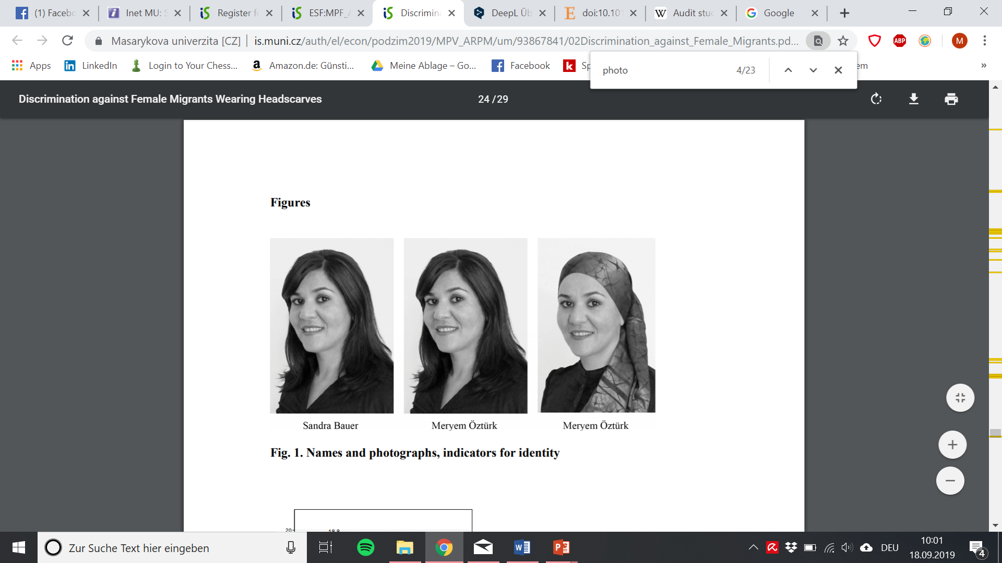

Research Design
German applicant: Sandra Bauer Turkish applicant: Meryem Öztürk Turkish applicant headscarf: Meryem Öztürk
→ Indicated by name →Indicated by name and photograph
Procedure
Three personas were created: identical qualification (education, work experience, language)
For one year relevant jobs in various cities were selected from online job portals
Only one profile was sent to each firm: applications can be identical except for the variable of interest
Sample size
1,474 applications were sent to German companies in response to job advertisements
Measurement of success
Callback rates for each applicant were determined

Slide 26
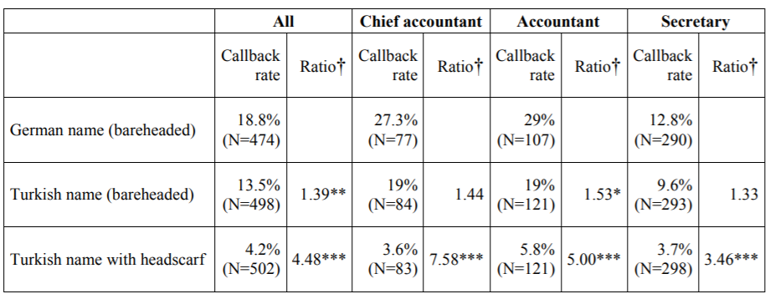
Main findings
*** = p<0.01;
** = p<0.05;
* = p<0.1
Definition Ratio: $\frac{Callback rate German applicant}{Callback rate Turkish applicant (with headscarf)}$

Slide 27
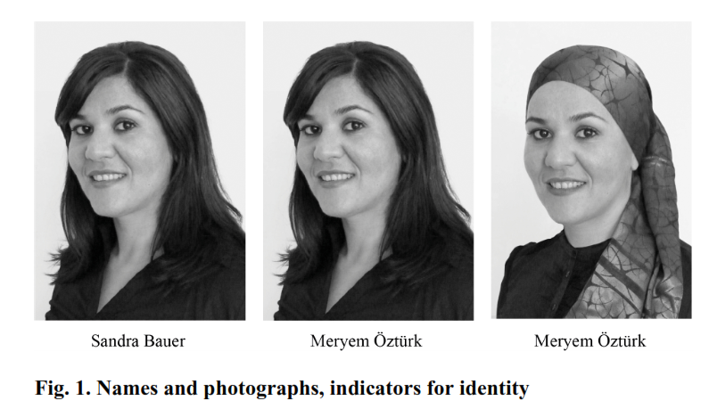
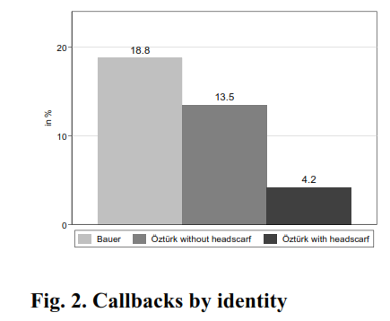
Everything else equal, a female with a Turkish name who wears a headscarf has to send 4.5 times as many applications (and even 7.6 times as many for higher-ranking jobs) as an applicant with a German name and no headscarf to receive the same number of callbacks for an interview
Notes:
http://newsroom.iza.org/en/2016/09/20/discrimination-against-female-migrants-wearing-a-headscarf/

Slide 28
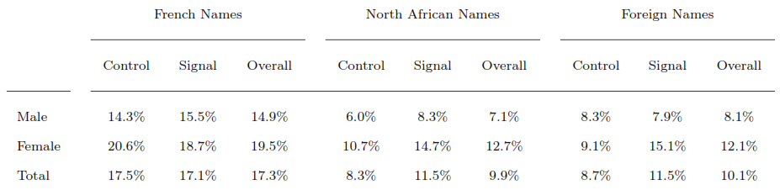
Study 2: Language skills and hiring discrimination
Experiment conducted between Sep 2011 and Feb 2012 in Paris
Sent 3204 resumes to 504 job postings (accounting jobs, assistant)
Applicants aged 23, single, from South Paris, work experience <2y
Signal is the language ability
Callback rates:
(e.g. teacher, writer, reading club)

Slide 29
Applications with French names always elicit far more callbacks (17%) than non-French ones (10%).
North African (9.9%) and Foreign applicants (10.1%) are equally treated
Females are considerably more successful than males
The effect of the signal improves rates for non-French applicants but no effect on French (stronger effect for females)
Employer discrimination towards men may be primarily taste based (job), while women may suffer from statistical discrimination
Language ability potentially signals assimilation.
Discrimination is greater in the city of Paris than in the suburbs.
Discrimination disappears for recruiters with non-European name which points to Homophilous discrimination (preference for similar individuals)
Edo, Anthony, Nicolas Jacquemet, and Constantine Yannelis. "Language Skills and Homophilous Hiring Discrimination: Evidence from Gender-and Racially-Differentiated Applications." (2013).

Slide 30


Study 3: Testing Discrimination against Workers with Visible Tattoos: Experimental Evidence from Germany
Daviti Jibuti (2017)
15 % of the population (14-44) in Germany have tattoo.
Fictitious resumes are sent to online job postings. Candidates have identical characteristics, but some applicants have a visible tattoo on the presented picture
Visible tattooed candidates have, on average, 12 % less chance of getting callback.

Slide 31
Anonymous job applications in Europe
In 2010 Germany’s Anti-Discrimination Agency, an advisory body, sponsored a voluntary scheme to get businesses to try it.
In France a law passed in 2006 made the anonymising of applicants’ CVs compulsory for firms of over 50 employees.
In the UK, big employers in the public and private sectors—including the civil service, HSBC and Deloitte—have agreed to start recruiting on a “name-blind” basis in Britain.
“IF YOU’VE got the grades, the skills and the determination, this government will ensure you can succeed”
David Cameron, October 26, 2015

Slide 32
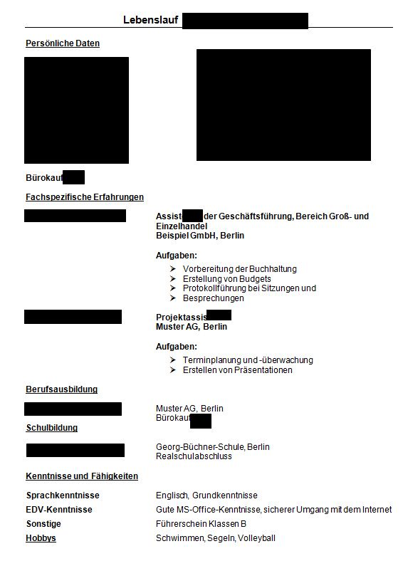
Anonymous application from German experiment
Notes:
German anonymous application

Slide 33
Debate
Equal opportunities employer provide opportunities to talented people regardless of their race, sex, age or other characteristic.
Can anonymous CVs help beat recruitment discrimination?

Slide 34
Anonymous job applications
Achieve better outcome with less information
In most cases, anonymous job applications lead to the desired effect of increasing the interview invitation probabilities of disadvantaged groups.
Anonymous hiring can reduce discrimination if discrimination is present beforehand.
Notes:
It should be in the employers’ own interest to hire the most productive workers.

Slide 35
Practical implementation
Employers that have online applications or that use a particular type of software could hide certain information—such as name, age or gender—during the initial screening stage.
Employers that use traditional paper or e-mail applications could simply instruct the applicants to submit two versions of their resume—one anonymous, one conventional—or to put their personal information on the last page.

Slide 36
Not all information can be removed
Recruiters may have used other indicators, such as knowledge of Arabic, to identify race. In places fraught with religious tension, such as Northern Ireland, the name of a school can reveal a candidate’s faith, while a few years missing on a CV may suggest maternity leave, and thus that the candidate is female.
When documents are not effectively anonymous then the result is worst than a normal application

Slide 37
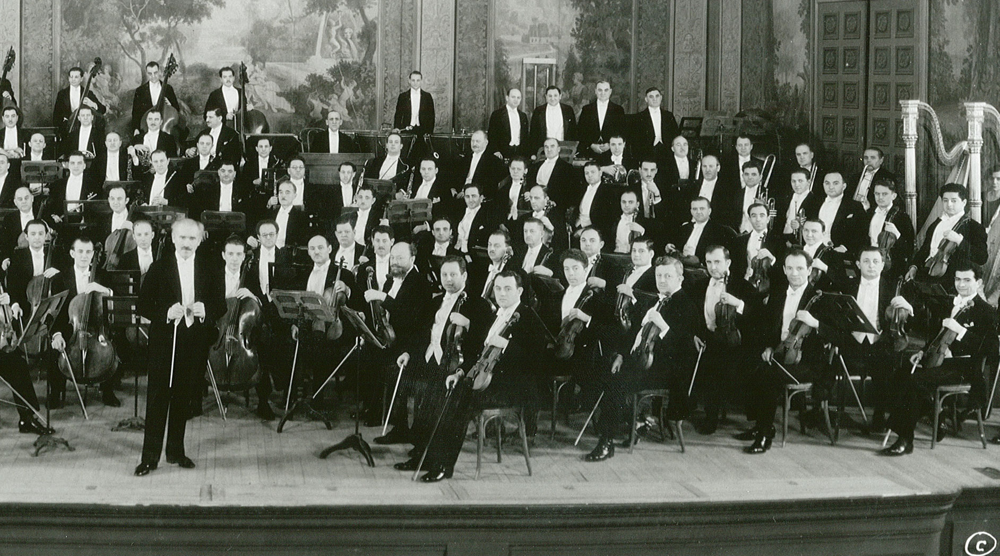

the New York
Philharmonic

Slide 38
Study 4: Gender bias in the symphony orchestra
Symphony orchestra has 95-105 musicians
Types of jobs are identical and turnover is low
(only few female-dominant instruments: harp)
Before 1970s the US finest orchestras had less than 10% of women.
Most renewed conductors claimed: female musicians are not the equal of male musicians.
The audition procedures began to change in 70s.
Notes:
Goldin, Claudia, and Cecilia Rouse. Orchestrating impartiality: The impact of" blind" auditions on female musicians. No. w5903. National bureau of economic research, 1997.
Zubin Mehta, conductor of the Los Angeles Symphony from 1964 to 1978 and of the
New York Philharmonic from 1978 to 1990, is credited with saying, "I just don't think women
should be in an orchestra."' Many European orchestras had, and some continue to have, stated
poUcies not to hire women.

Slide 39
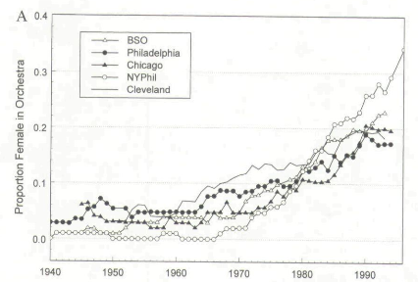
Proportion of female musicians in the top five symphony orchestras in the United States
Goldin, Claudia, and Cecilia Rouse. Orchestrating impartiality: The impact of" blind" auditions on female musicians. No. w5903. National bureau of economic research, 1997.
Notes:
Goldin, Claudia, and Cecilia Rouse. Orchestrating impartiality: The impact of" blind" auditions on female musicians. No. w5903. National bureau of economic research, 1997.

Slide 40
Self-perceived objectivity
A sense of personal objectivity gives rise to an
‘I think it, therefore it’s true’ mindset, which increases people’s confidence in the validity of stereotypic beliefs, thoughts, and intuitions they have, and therefore increases their likelihood of acting on them.
When people feel objective, their hiring judgments should be relatively more influenced by stereotypic beliefs and thoughts.

Slide 41
Conclusion
Feeling objective appears to makes people more likely to act on their stereotypic biases.
Decision-makers who endorsed stereotypic beliefs.
Anonymous job applications appear as an attractive policy instrument to combat hiring discrimination (particularly in public sector).

Slide 42
The anonymous job application can be used to remove discrimination in the hiring process. What determines the success of the program for minority applicants?
The higher call-back rate.
The higher job offer rate.
The higher wage.
All of above

Slide 43
In what situation anonymous job application cannot be used?

