Slide 1
Labor Market Imperfections: Unemployment, Discrimination and Mobility
Applied Research in Public Policy Making Fall 2024
Dinara Alpysbayeva
Dinara.Alpysbayeva@econ.muni.cz

Slide 2
Adapted from World Bank Open Data (https://data.worldbank.org/). Source: International Labour Organization

Slide 3
Source: https://www.voronoiapp.com/economy/Which-Global-Region-Has-The-Highest-Youth-Unemployment-Rate--2353#dataset

Slide 4
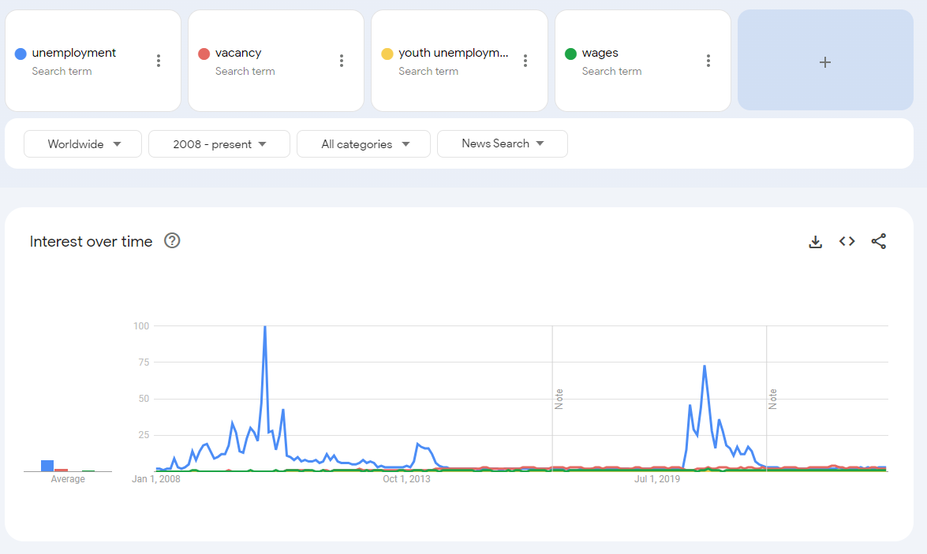
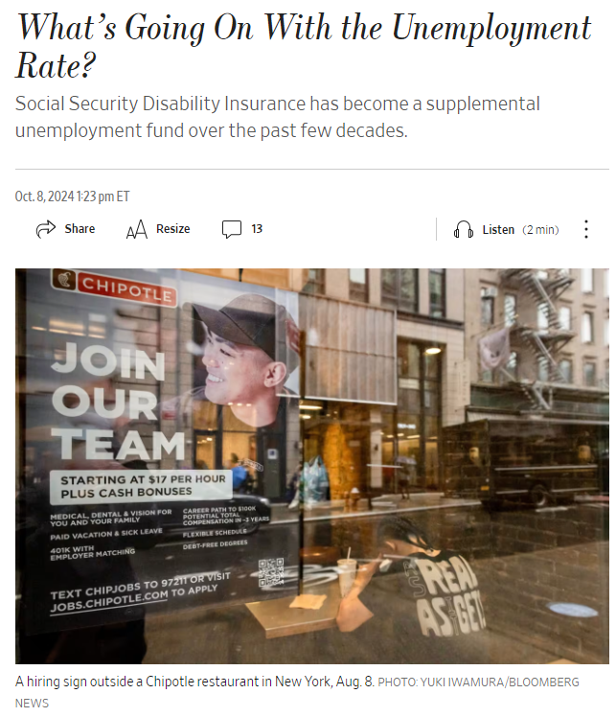
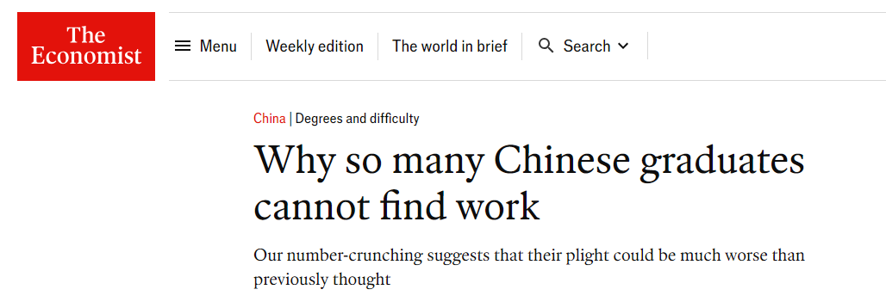

Slide 5
Learning Objectives
Understand the concept of labor market imperfections and their impact on unemployment.
Explore the role of discrimination and mobility in labor market outcomes.
Analyze policy interventions aimed at addressing these imperfections.
Evaluate the implications for economic welfare and social equity.

Slide 6
Outline
Definition of Labor Market Imperfections and link to Unemployment
Definition of Unemployment and its types
Discrimination and Labor Markets
Mobility and Labor Markets
Policies and Implications

Slide 7
Labor Market Imperfections
These are deviations from the ideal conditions of a perfectly competitive labor market. In a perfect market, workers and jobs would match perfectly based on supply and demand, wages would adjust freely, and there would be full employment. However, in reality, various imperfections, such as wage rigidity, information asymmetry, discrimination, and barriers to mobility, prevent this ideal situation.

Slide 8
Examples of Sources of Imperfections
Wage Rigidity
Minimum wage laws, union-negotiated wages can prevent wages from adjusting downward during periods of low demand.
Imperfect Information
Job seekers may not know all available job opportunities, and employers may not have complete information about all potential candidates.
Discrimination
Mobility Barriers
Geographic, social, or economic factors that limit workers’ ability to move to regions or industries where jobs are available.
Biases in hiring and wage-setting processes that disadvantage certain groups based on race, gender, age, or other characteristics.

Slide 9
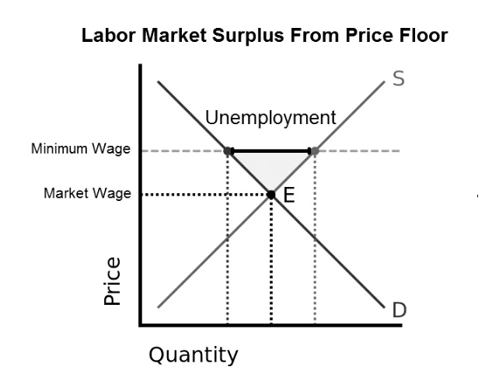
Link to Unemployment
Labor market imperfections contribute to various types of unemployment by preventing the market from clearing efficiently. For example, wage rigidity can lead to higher unemployment during economic downturns because wages cannot fall to levels that would clear the labor market. Discrimination and mobility barriers can prevent certain groups from accessing jobs, increasing their risk of unemployment.

Slide 10
Does the theory hold in practice?
Source: https://aneconomicsense.org/2013/03/06/the-impact-of-increasing-the-minimum-wage-on-unemployment-no-evidence-of-it/

Slide 11
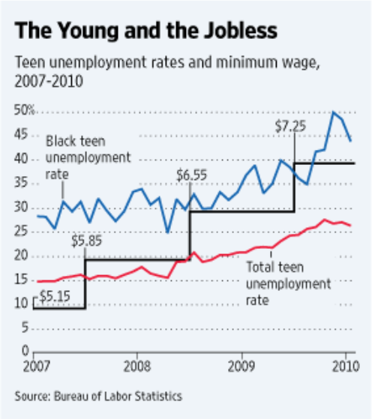
Does the theory hold in practice?
Source: https://aneconomicsense.org/2013/03/06/the-impact-of-increasing-the-minimum-wage-on-unemployment-no-evidence-of-it/
Not necessarily
Depends on ‘presentation’
Be critical
More on wages and rigidity in coming lectures
Source: https://www.coordinationproblem.org/2010/03/the-minimum-wage-and-unemployment.html

Slide 12
What Is Unemployment?
a situation where a person actively searches for employment but is unable to find work;
key measure of the health of the economy;
A low unemployment rate represents a strong economy while a high unemployment rate represents a weak economy.
The most frequently used measure of unemployment is the unemployment rate;
calculated by dividing the number of unemployed people by the number of people in the labor force
The labour force or workforce or economically active population, includes both employed (employees and self-employed) and unemployed people, but not the economically inactive, such as pre-school children, school children, students and pensioners.

Slide 13
Types of Unemployment
Frictional
It is a natural form of unemployment
Cyclical
the variation in the number of unemployed workers over the course of economic upturns and downturns
rises during recessionary periods and declines during periods of economic growth
Structural
occurs when there is a mismatch between the skills of the labor force and the skills demanded by employers.
can be due to technological changes, shifts in consumer demand, or other long-term changes in the economy
Institutional?
reflecting the time it takes for people to find new employment that matches their skills and preferences.
Short-lived
Occurs when people voluntarily change jobs
Least problematic from an economic standpoint
results from long-term or permanent institutional factors and incentives in the economy.
Government policies, such as high minimum wage floors, generous social benefits programs, and restrictive occupational licensing laws
Labor market phenomena, e.g., discriminatory hiring

Slide 14
Cyclical (un)employment
drop in employment during recessions
Structural (un)employment
declining employment trend in industries, increasing trend in trade/services
Source: Catherine A. Wood, "The rise in women’s share of nonfarm employment during the 2007–2009 recession: a historical perspective," Monthly Labor Review, U.S. Bureau of Labor Statistics, April 2014, https://doi.org/10.21916/mlr.2014.12
Accessed from: https://www.bls.gov/opub/mlr/2014/article/the-rise-in-women-share-of-nonfarm-employment.htm

Slide 15
Structural change
Increase in demand in IT
Source: Feist, Lisa. Imbalances between supply and demand: Recent causes of labour shortages in advanced economies. No. 115. ILO Working Paper, 2024.

Slide 16
Source: https://www.dol.gov/agencies/wb/data/latest-annual-data/employment-rates

Slide 17
Source: https://www.dol.gov/agencies/wb/data/latest-annual-data/employment-rates

Slide 18
Discrimination
Gender
Racial
Age/Tenure

Slide 19
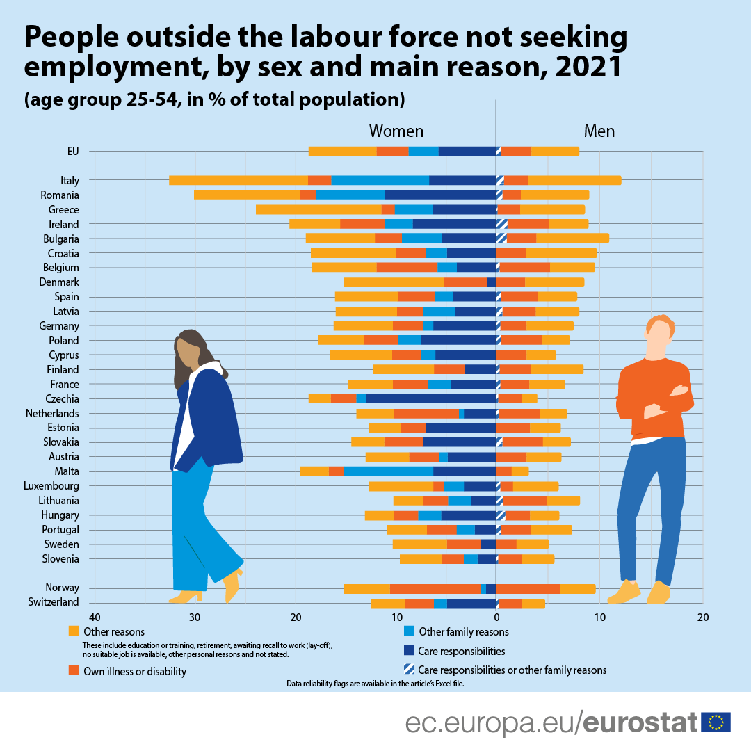
Gender Discrimination
Source: https://ec.europa.eu/eurostat/web/products-eurostat-news/-/ddn-20220622-1

Slide 21
Gender Discrimination
When women and men have equal rights, opportunities and responsibilities in all spheres of life, such as in education, decision-making, political and economic participation and health, gender equality is achieved. To date, no country has fully achieved gender equality (Cavalcanti und Tavares 2016).
women are overrepresented in low-paid, low-skilled jobs and in precarious employment arrangements (Kidder und Raworth 2004).
Despite women’s rising level of education, labour market participation and access to decent work for women and men are unequally distributed. Women’s limited access to decent work is linked to gender stereotypes, social norms and division of labour.

Slide 23
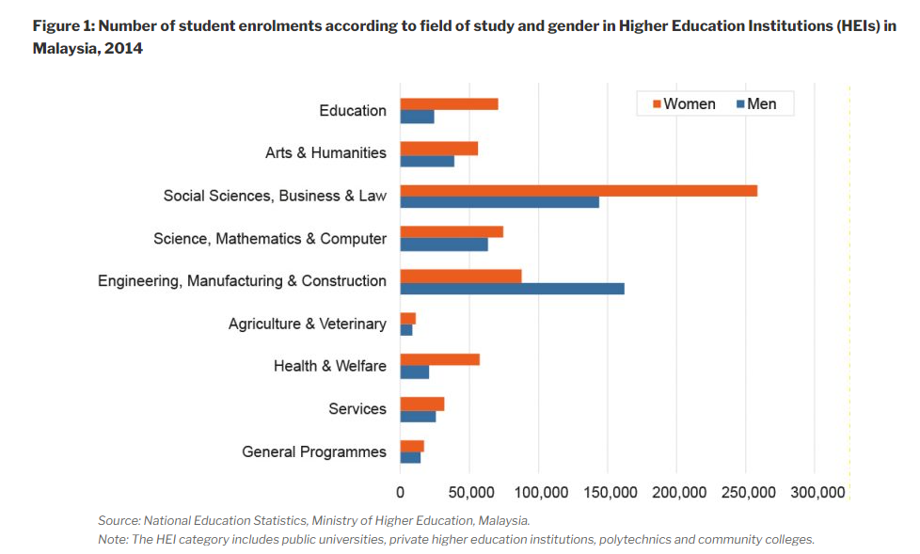
Example: Malaysia
Source: What widens the gender pay gap? By Negin Vaghefi. https://penanginstitute.org/wp-content/uploads/2018/04/april_27_2018_updated1_download.pdf

Slide 24
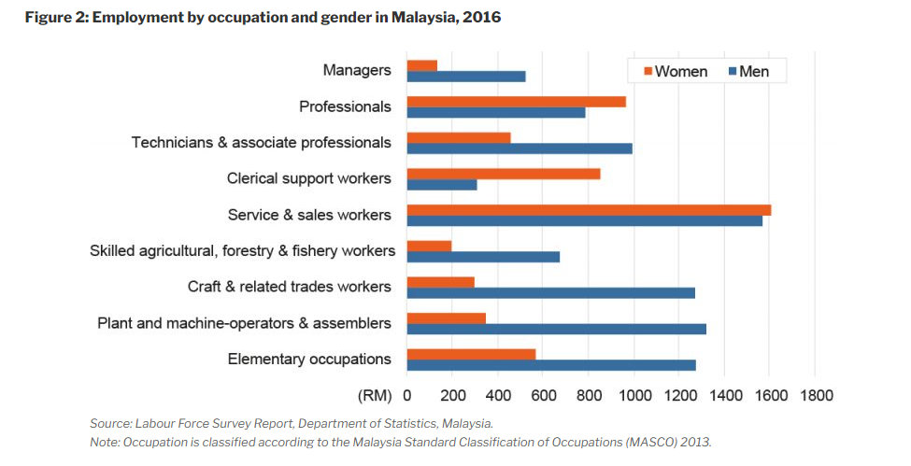
Source: What widens the gender pay gap? By Negin Vaghefi. https://penanginstitute.org/wp-content/uploads/2018/04/april_27_2018_updated1_download.pdf

Slide 25
Source: What widens the gender pay gap? By Negin Vaghefi. https://penanginstitute.org/wp-content/uploads/2018/04/april_27_2018_updated1_download.pdf

Slide 26
Underrepresentation of women in managerial positions
the glass ceiling phenomenon, socio-cultural barriers, and workplace dynamics. Despite equal qualifications, women face invisible barriers that hinder their career advancement, often linked to family obligations and childcare responsibilities (Tešanović et al., 2024).
Sociocultural factors, gender roles, and perceived discrimination contribute to the challenges women encounter in attaining leadership roles (Barbara & Chircop, 2024).
The lack of flexibility in work arrangements further exacerbates these issues, making it difficult for women to balance professional and personal responsibilities (Barbara & Chircop, 2024).
Systemic issues such as myths and stereotypes about women's capabilities persist, necessitating a cultural shift to improve gender equity in management (Cordova-Buiza, 2023).

Slide 27
How to solve it?

Slide 28
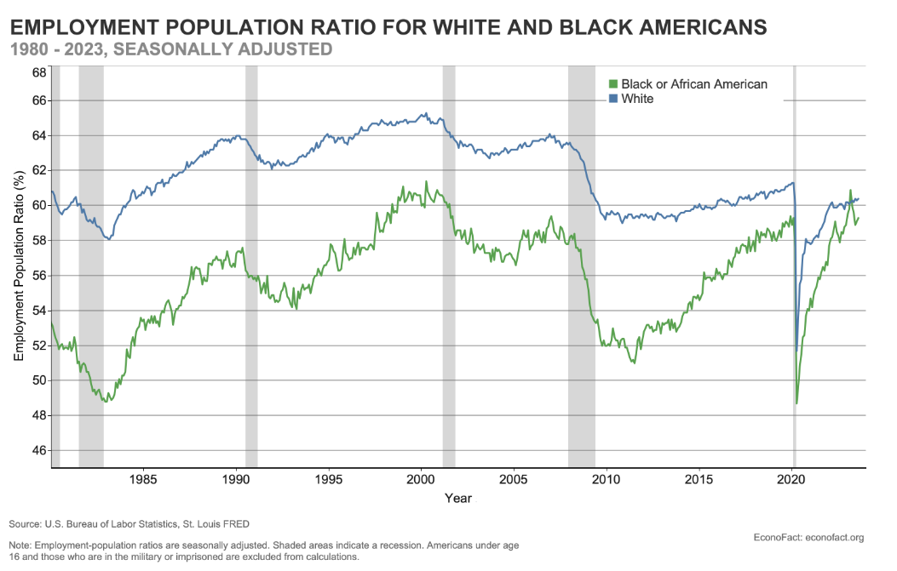
Racial Discrimination (recap)
Source: https://econofact.org/is-black-employment-catching-up-with-white-employment

Slide 29
Racial discrimination
Systemic discrimination, educational disparities, and labor market dynamics.
Research indicates that Black individuals face significantly higher unemployment rates compared to Whites, largely due to a higher risk of job loss and lower labor force participation, which remains largely unexplained by observable characteristics (Cajner et al., 2017).
Racialized groups in Canada encounter barriers such as name-based discrimination, leading to lower callback rates for job interviews (Ng, 2020).

Slide 30
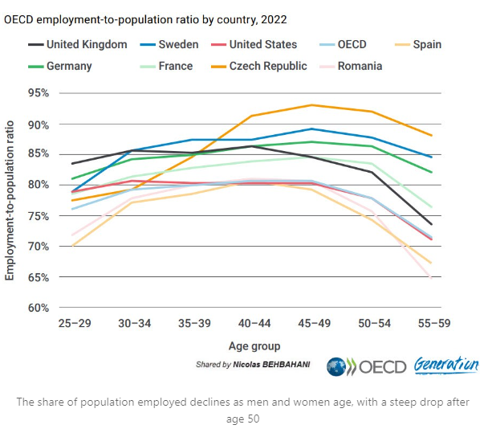
Age Discrimination
Source: https://www.linkedin.com/pulse/age-performance-paradox-employees-aged-45-over-less-likely-behbahani-ii7ce/

Slide 31
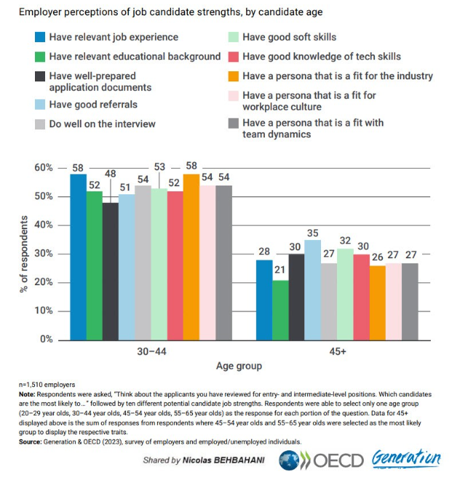
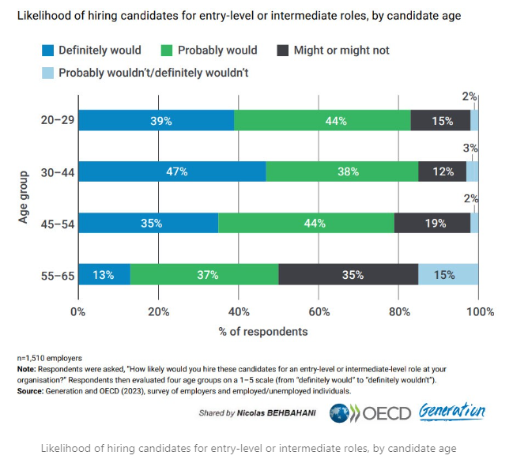
Age discrimination

Slide 32
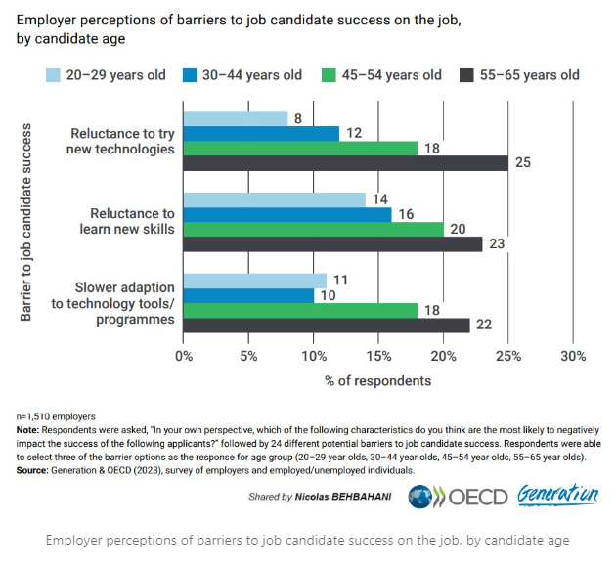
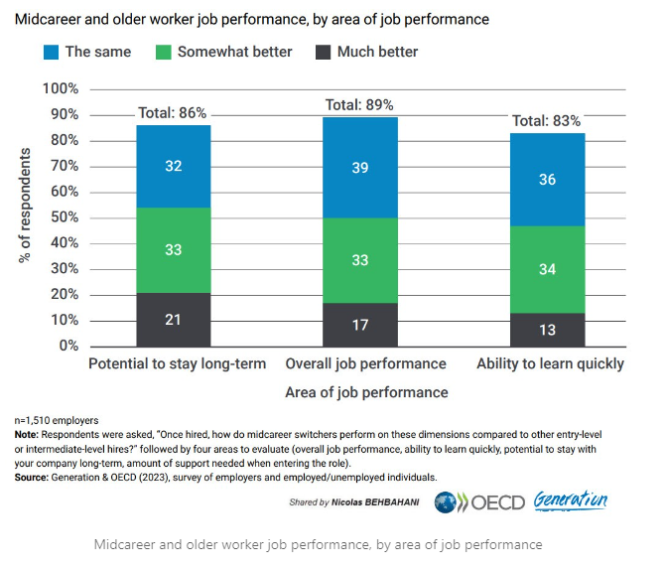
The Paradox

Slide 33
Stereotypes and systemic biases
Employers often harbor outdated views about older workers, perceiving them as less adaptable or overqualified, which leads to exclusion from job opportunities (Ventrell-Monsees, 2020; Linneman, 2022).
Younger workers face discrimination due to assumptions about their job commitment and longevity (Leslie, 2022).
Recruitment practices often favor younger candidates, reinforcing age biases (Davey, 2014).
While age discrimination is prevalent, some employers recognize the reliability and productivity of older workers, indicating a potential shift in attitudes (Linneman, 2022).

Slide 34
Mobility
Geographic
Workers’ ability to physically relocate to regions where jobs are available.
Results in persistent regional unemployment disparities
Social
Social and cultural factors that limit workers’ ability to move
Can result in employment segregation
Economic
Factors: immigration restrictions; housing prices; infrastructure
Factors: family responsibilities; discrimination, cultural expectations
Financial factors that limit workers’ ability to move
Can result in employment segregation
Factors: relocation costs; wage disparities; job insecurity

Slide 35
What about occupational mobility and skill mismatch?
Skill mismatch occurs when workers’ qualifications, skills, or experience do not align with the requirements of the jobs available.
Economic Mobility: When workers’ skills become obsolete (e.g., due to technological advancements) or industries shift, they may lack the resources (time, money, or access to retraining) to acquire new skills and shift into new sectors. Economic barriers, such as the cost of education or retraining programs, can limit workers' ability to adapt to new job requirements.
Occupational Mobility refers to workers' ability to move up or down within the job ladder—from lower-level positions to more senior or skilled roles, or vice versa.
This type of mobility is tied to career progression and can be hindered by both social and economic barriers, such as access to education, workplace discrimination, or limited career development opportunities.

Slide 36
Mobility
The concept of mobility barriers is closely linked to reallocation and/or misallocation of labor.
Labor reallocation refers to the movement of workers from less productive jobs, sectors, or regions to more productive ones.
Labor misallocation occurs when workers are not employed in their most productive use or when there are inefficiencies in the labor market that prevent the optimal allocation of talent and resources.

Slide 37
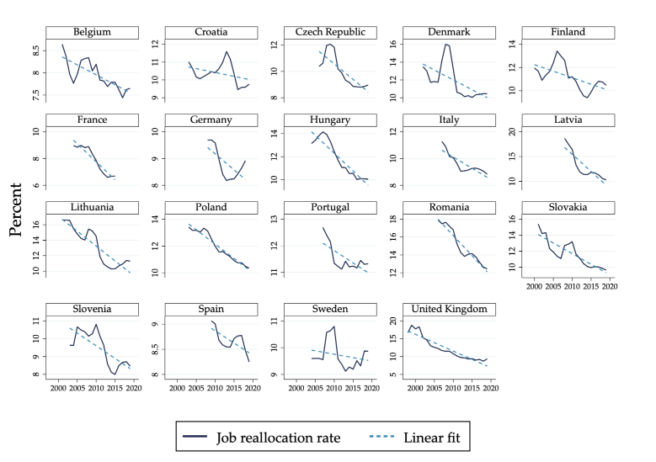
Why care?
In countries or regions where labor mobility is restricted the allocation of labor is suboptimal, leading to slower economic growth.
Conversely, countries with more flexible labor markets and fewer mobility barriers tend to experience higher productivity growth, as labor can be reallocated more efficiently.
Applies not only to mobility restrictions, but in general – any sources of imperfections
Source: https://cepr.org/voxeu/columns/declining-business-dynamism-europe-role-shocks-market-power-and-responsiveness
→ Declining business dynamism

Slide 38
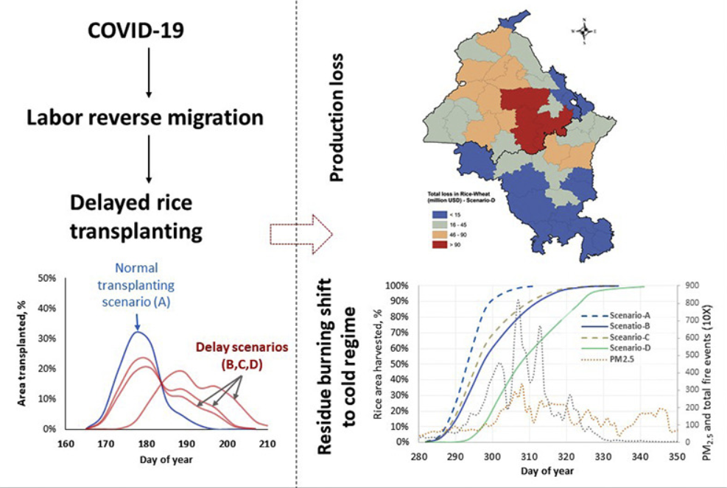
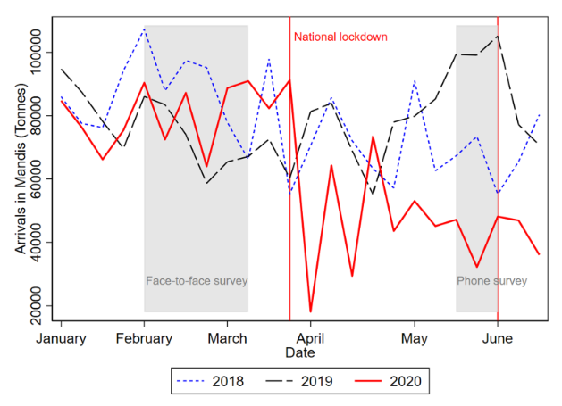
Example: COVID
Preusse, V., Silva, M. S., Steinhübel, L., & Wollni, M. (2024). Covid‐19 and agricultural labor supply: Evidence from the rural–urban interface of an Indian mega‐city. Agribusiness, 40(2), 391-415.
Shirsath, Paresh B., M. L. Jat, A. J. McDonald, Amit K. Srivastava, Peter Craufurd, D. S. Rana, A. K. Singh et al. "Agricultural labor, COVID-19, and potential implications for food security and air quality in the breadbasket of India." Agricultural Systems 185 (2020): 102954.

Slide 39
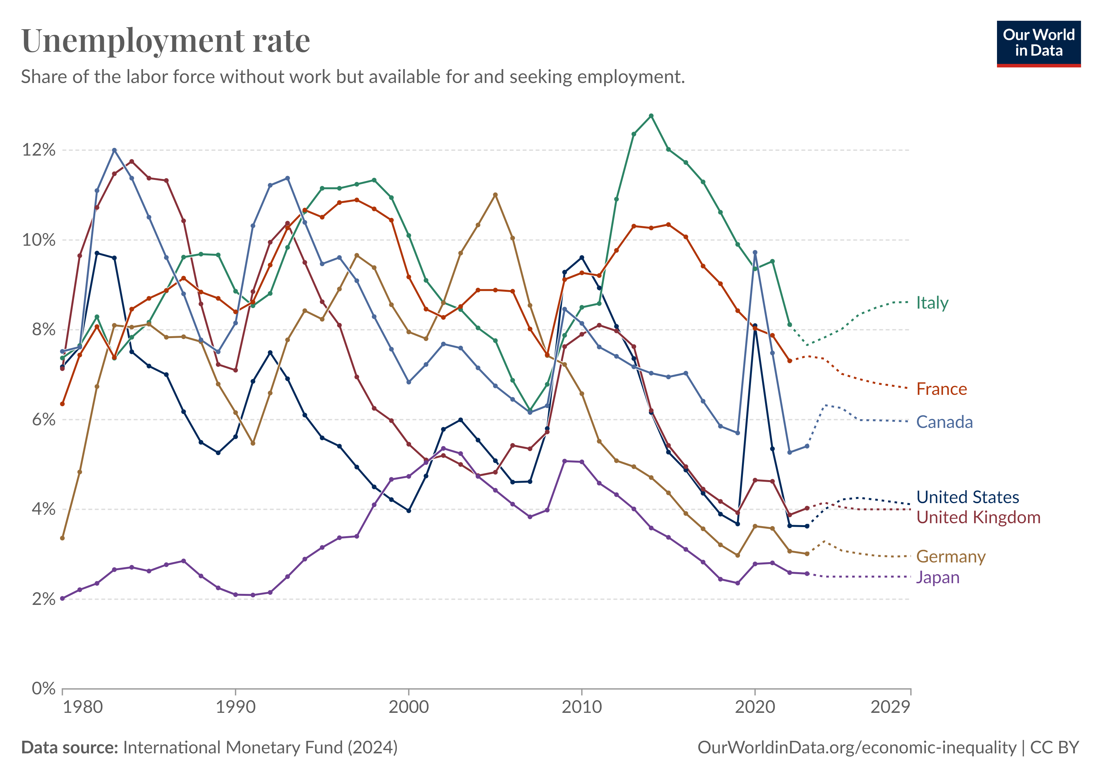
Policies and Implications

Slide 40
Policies
Training
Harmonization of labor contracts
Unemployment benefits

Slide 41
Training
Unemployed adults participating in labor market training experience increased employment rates, particularly with short (5-10 weeks) and long courses (over 30 weeks) outperforming semi-long courses (Torp, 2016).
Training fosters employee efficiency, reducing costs and material wastage, which ultimately benefits organizations (Kumar, 2021).
For older workers, training is crucial in preventing skills obsolescence, thereby aiding their retention in the workforce (Belloni et al., 2015).

Slide 42
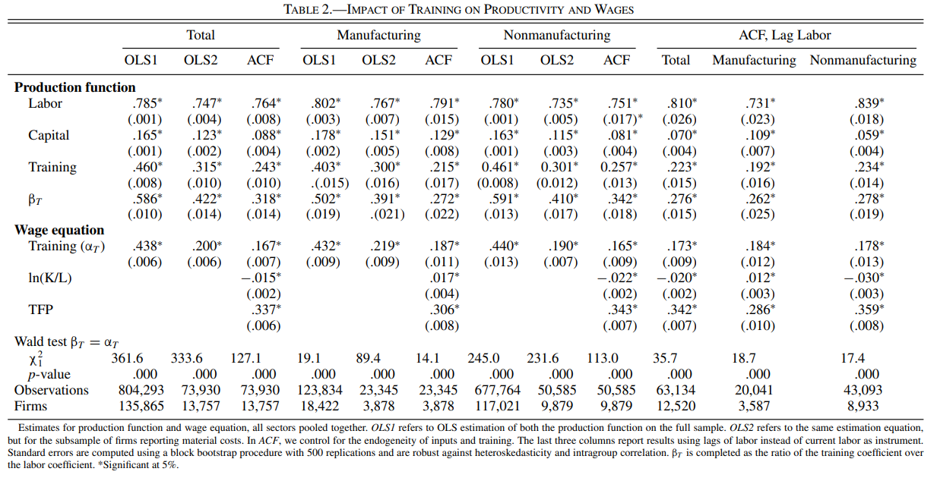
Training
costly. Is it worth it?

Slide 43
Training
value added increases by 2.4% in response to an increase of 10 percentage points of the share of trained workers;
the marginal product of a trained worker is around 32% (β_{T} = .243/.764) higher than the marginal product of an untrained worker – productivity premium
the wage premium for a trained worker in the Belgian private sector is equal to 17%

Slide 44
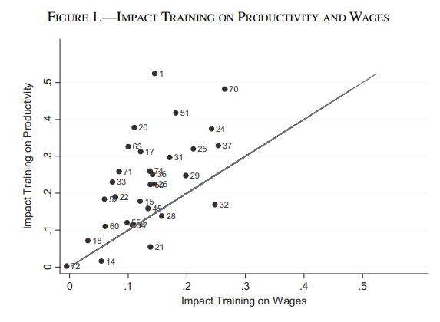
Training
Industry heterogeneity
NACE Rev.2 two digit classification
45-degree line: return of training on productivity and wages is the same
(in theory) indifferent between training and not training

Slide 45
Harmonization of labor contracts
White vs. Blue-collar workers
Belgium is characterized as a country with strong employment protection mechanisms; provided through the means of the advance notice periods upon dismissal and severance payments.
However, the labor law in Belgium treated white- and blue-collar workers differently until 2014.
This distinction is observed not only in their working conditions and salaries but also in the notice periods and benefits, which were shorter and lower for blue-collar workers.
in 2011, the Belgian Constitutional Court recognized the distinction as discriminatory urging the Government to eliminate it by July 8, 2013. One of the paragraphs of the Law on Employment Agreement, attempting to harmonize employment status, fixed the advance notice periods upon dismissal for both types of employees; abolished the trial period.
Alpysbayeva, D., & Vanormelingen, S. (2022). Labor market rigidities and misallocation: Evidence from a natural experiment. Labour Economics, 78, 102229.

Slide 46
Harmonization of labor contracts
Changes to the notice periods have a direct impact on labor adjustment costs through compensation in lieu of notice. In a situation of dismissal without an appropriate notice period, severance payment is equivalent to the amount of salary that would have been received during the notice period.
It has been argued that since the compensation would be tax-exempt, employers will not bear additional costs resulting from this harmonization of the contracts. However, many employers believe it to substantially increase the labor cost, which will affect their hiring and firing behavior, i.e. the reallocation of labor.

Slide 47
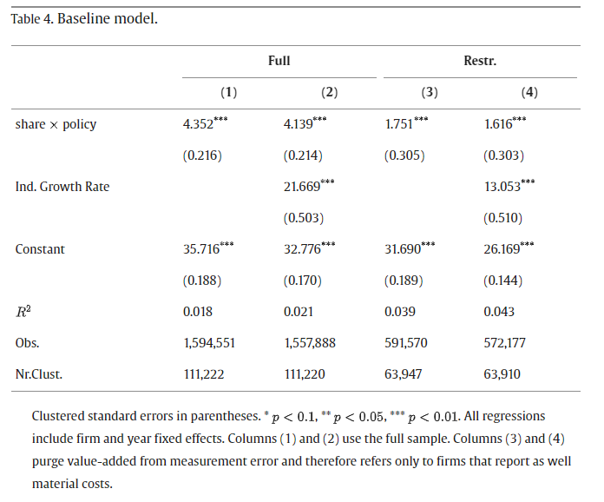
Harmonization of labor contracts
RG is real absolute gap for labor input
equivalent to aggregate productivity loss (Petrin and Sivadasan, 2013)
After the policy, a firm with 90% blue-collar workers witnessed an increase in the gap (productivity loss) of 3311 euro relative to a firm with only 10% share of blue-collar workers.

Slide 48
Unemployment benefits
Unemployment benefits play a crucial role in shaping employment dynamics and job quality.
They provide essential financial support to unemployed individuals, allowing them to meet basic needs.
However, the design and generosity of these benefits can significantly influence labor market outcomes.
the welfare gains are determined by individual’s willingness to postpone consumption during employment for receiving payments to keep consumption during unemployment and weighted against the effects on job search incentives

Slide 49
Unemployment benefits

Slide 50
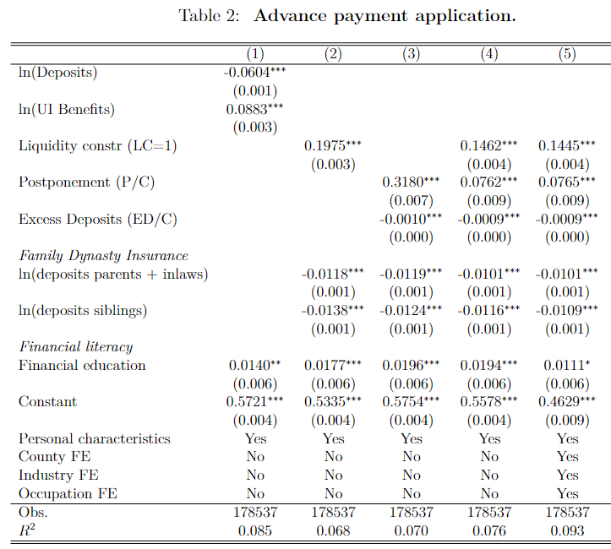
Unemployment benefits
COVID-19 emergency support to cushion the hit of the crisis;
Expand unemployment insurance system;
Administrative delays;
“Unemployment benefit in advance” - Norway
to secure income for laid-off and unemployed household during waiting period (delayed handling of UI applications).
Who applied?
Did it help in alleviating consumption drop?
The impact of training on productivity and wages: firm-level evidence. D.Alpysbayeva and O.Raaum. Skatteforsk – Centre for Tax Research Working Paper Series WP15. 2024. .

Slide 51
Unemployment benefits
Program aim: alleviate a temporary drop in consumption;
Welfare loss from postponed consumption depends on the magnitude, preferences, and other sources of income;
Consumption of non-constrained households stays the same;
Average (median) postponement of consumption among constrained applicants is 36% (31%).

Slide 52
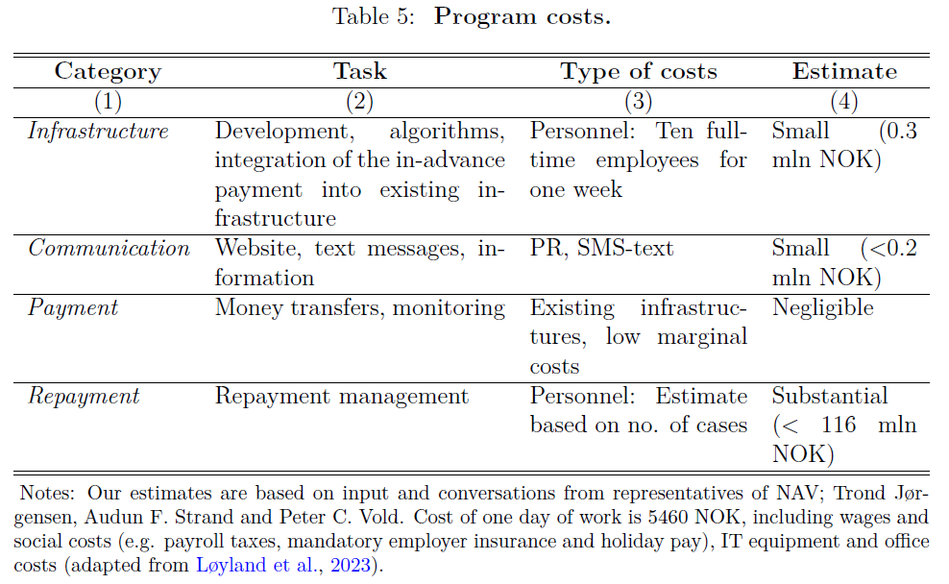
Unemployment benefits

Slide 53
Summary
Labor markets are not perfect
Policies are aimed to address the imperfections, normally designed to reach a specific goal or target specific group
Never forget about the implications on other economic factors

