Slide 1
Applied Research in Public Policy Making
Fall 2024
The many dimensions of poverty
Week 8
  Martin Guzi
  martin.guzi@econ.muni.cz
Notes:
https://ourworldindata.org/extreme-poverty

Slide 2
Outline
Measures of poverty based on income
Multidimensional measures of poverty
Self-employment and poverty
Poverty indicators used in the EU
Limitations of poverty indicators

Slide 3
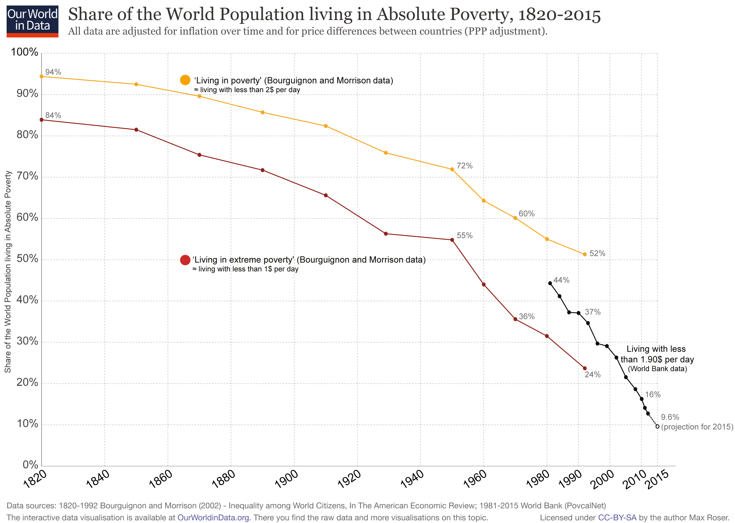

Slide 4
From $1.90 to $2.15 a day
In September 2022, World bank shifted the poverty line from $1.90 to $2.15.
This reflects a change in the units in which the World Bank expresses its poverty – from international dollars given in 2011 prices to international dollars given in 2017 prices.
In 2019 an estimated of 650 million people live below $2.15 a day (2017 prices).
https://data.oecd.org/conversion/purchasing-power-parities-ppp.htm

Slide 5
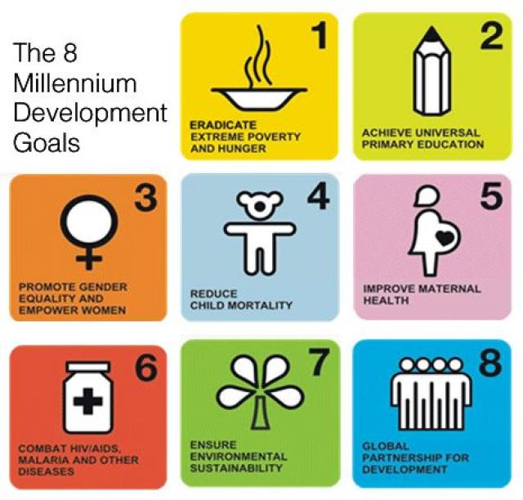
8 Millennium Development Goals
From 2000 to 2015:
extreme poverty declined from 2b to 900m
Significant improvements in malnourishment, attendance in primary education, infant mortality.

Slide 6
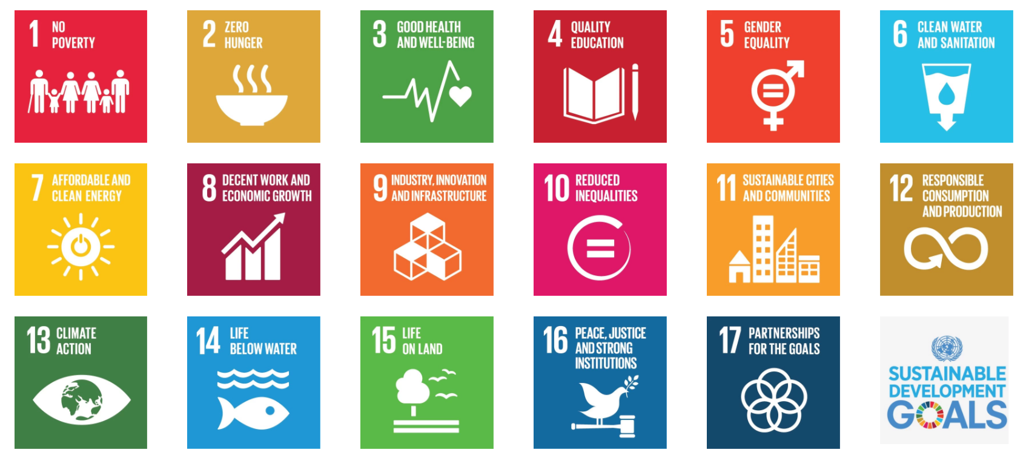
17 Sustainable Development Goals
SDGs demonstrates the strong interdependence of our world community.
http://www.un.org/sustainabledevelopment/takeaction/

Slide 7
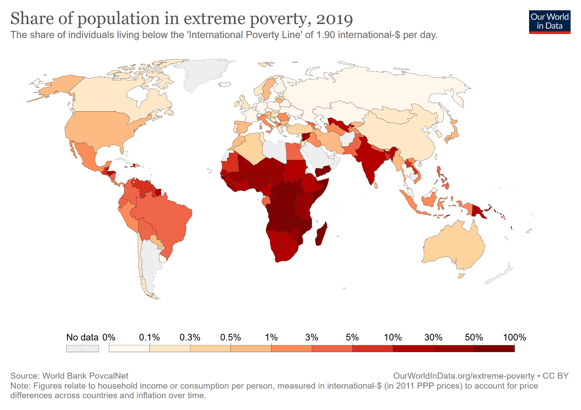
https://ourworldindata.org/extreme-poverty

Slide 8
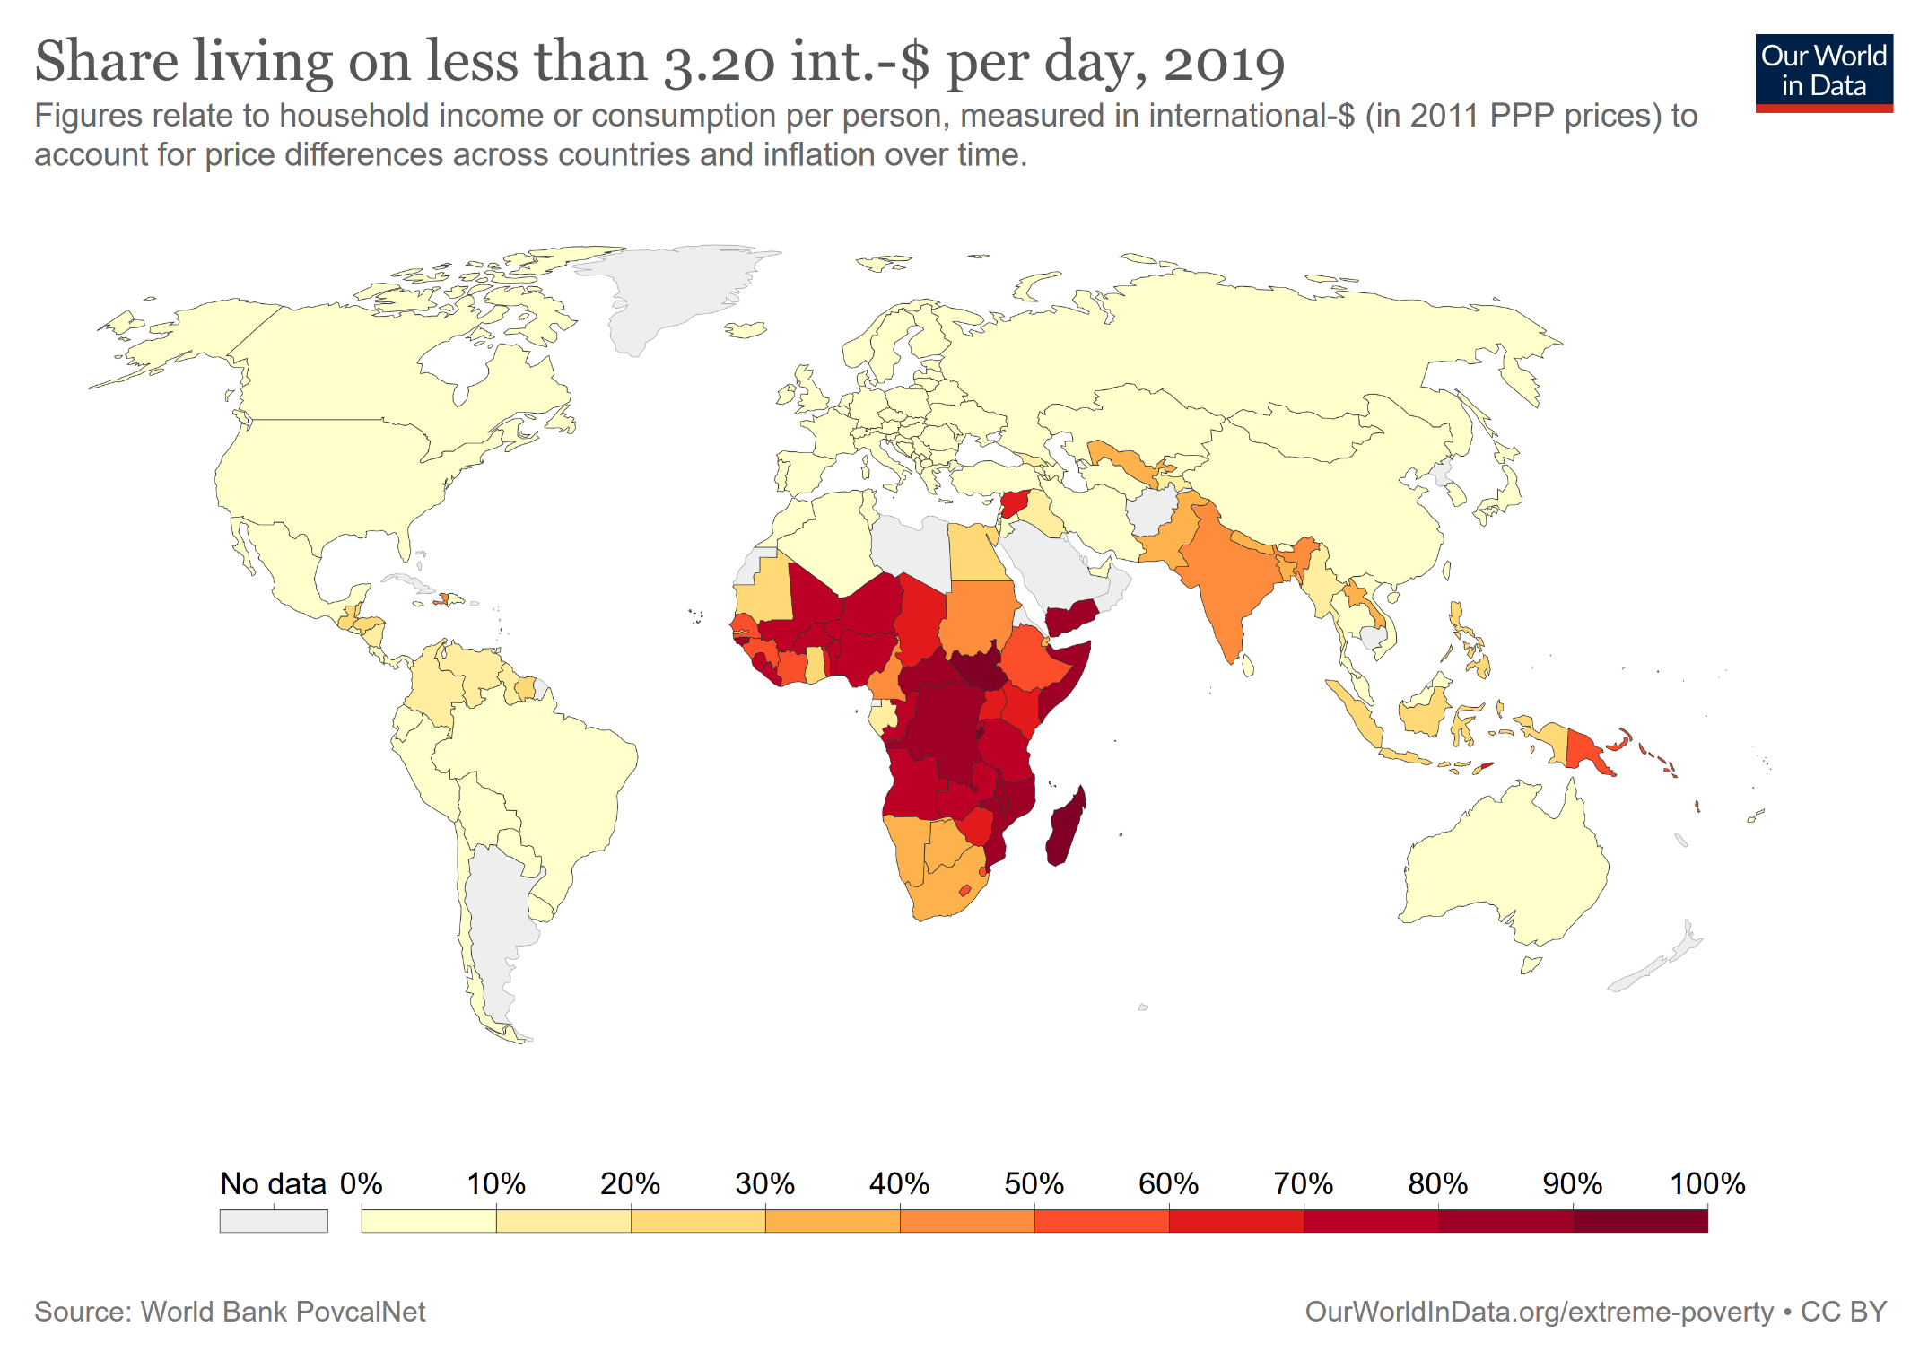
Notes:
Extreme poverty, as defined by the World Bank, is indeed extreme – living on $1.90 per day is very difficult. Hence, it is both interesting and important to measure poverty with higher poverty lines. The World Bank also reports poverty headcount ratios using a higher line at 3.10 int.-$, and the map shows these estimates.

Slide 9
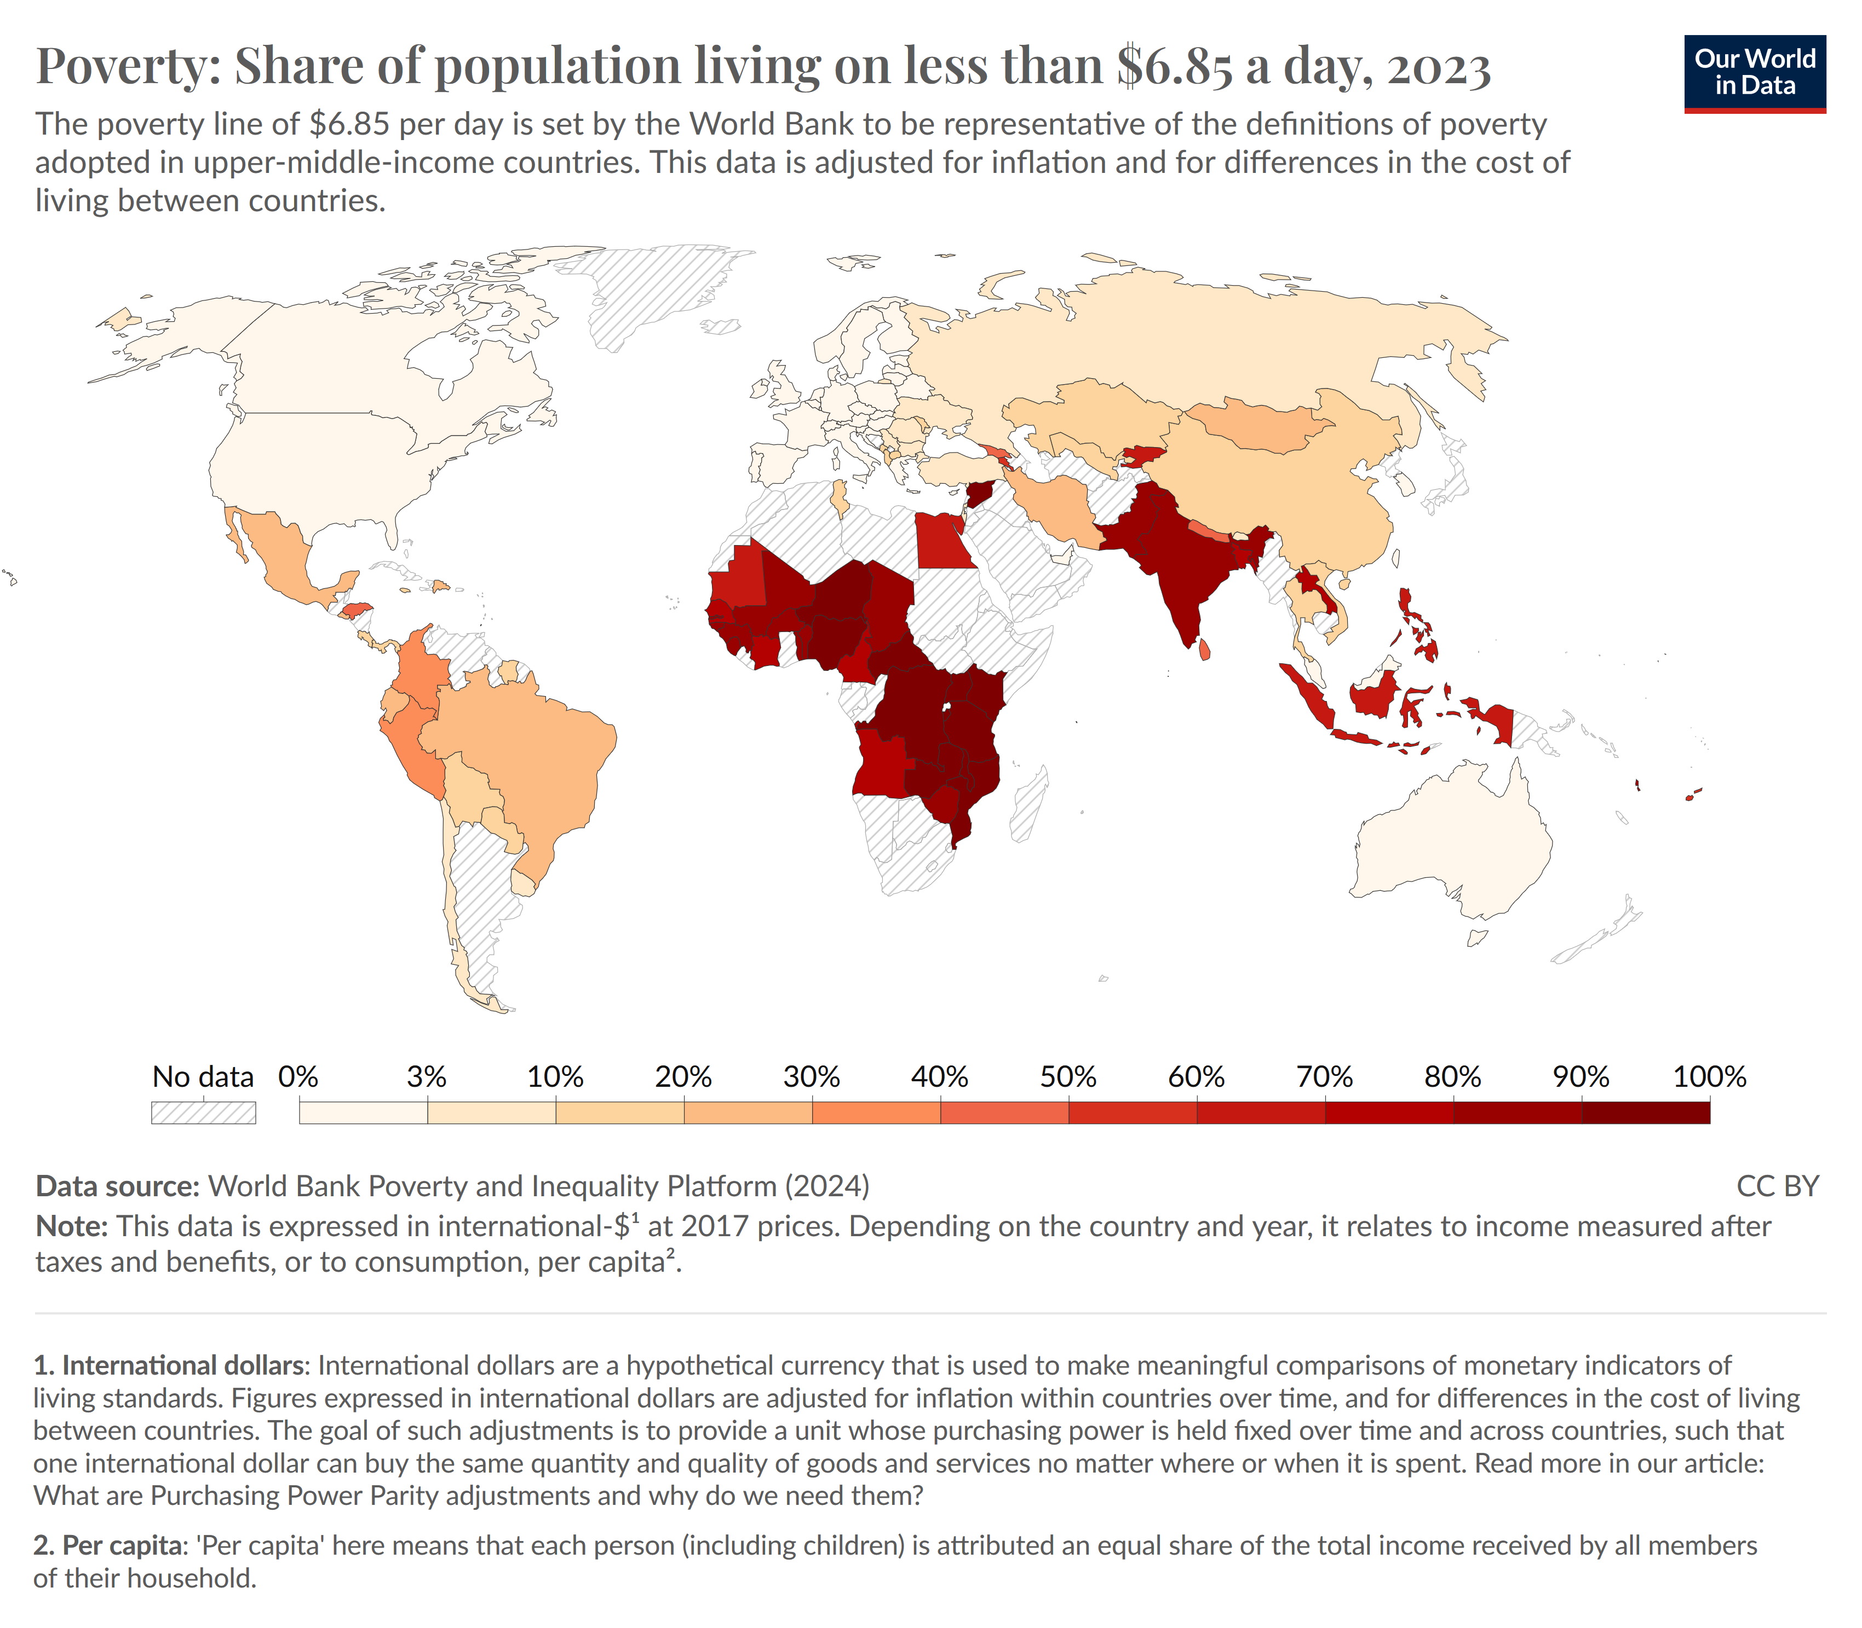

Slide 10
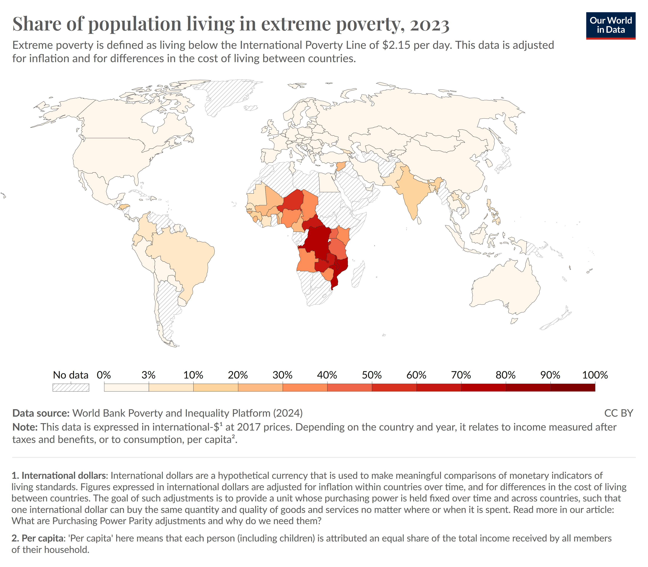

Slide 11
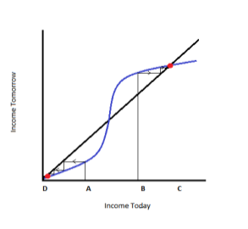
Poverty trap
The amount of money you have today determines what you eat, how much you spent on health, education, etc., which in turn influences your income in the future.
The poverty trap is seen as an “S-shaped” curve: the poor are stuck on the left side of the graph below the diagonal line, wherein future income is lower than present income, and it continues to decrease over time.
Poor Economics by Abhijit Banerjee and Esther Duflo

Slide 12
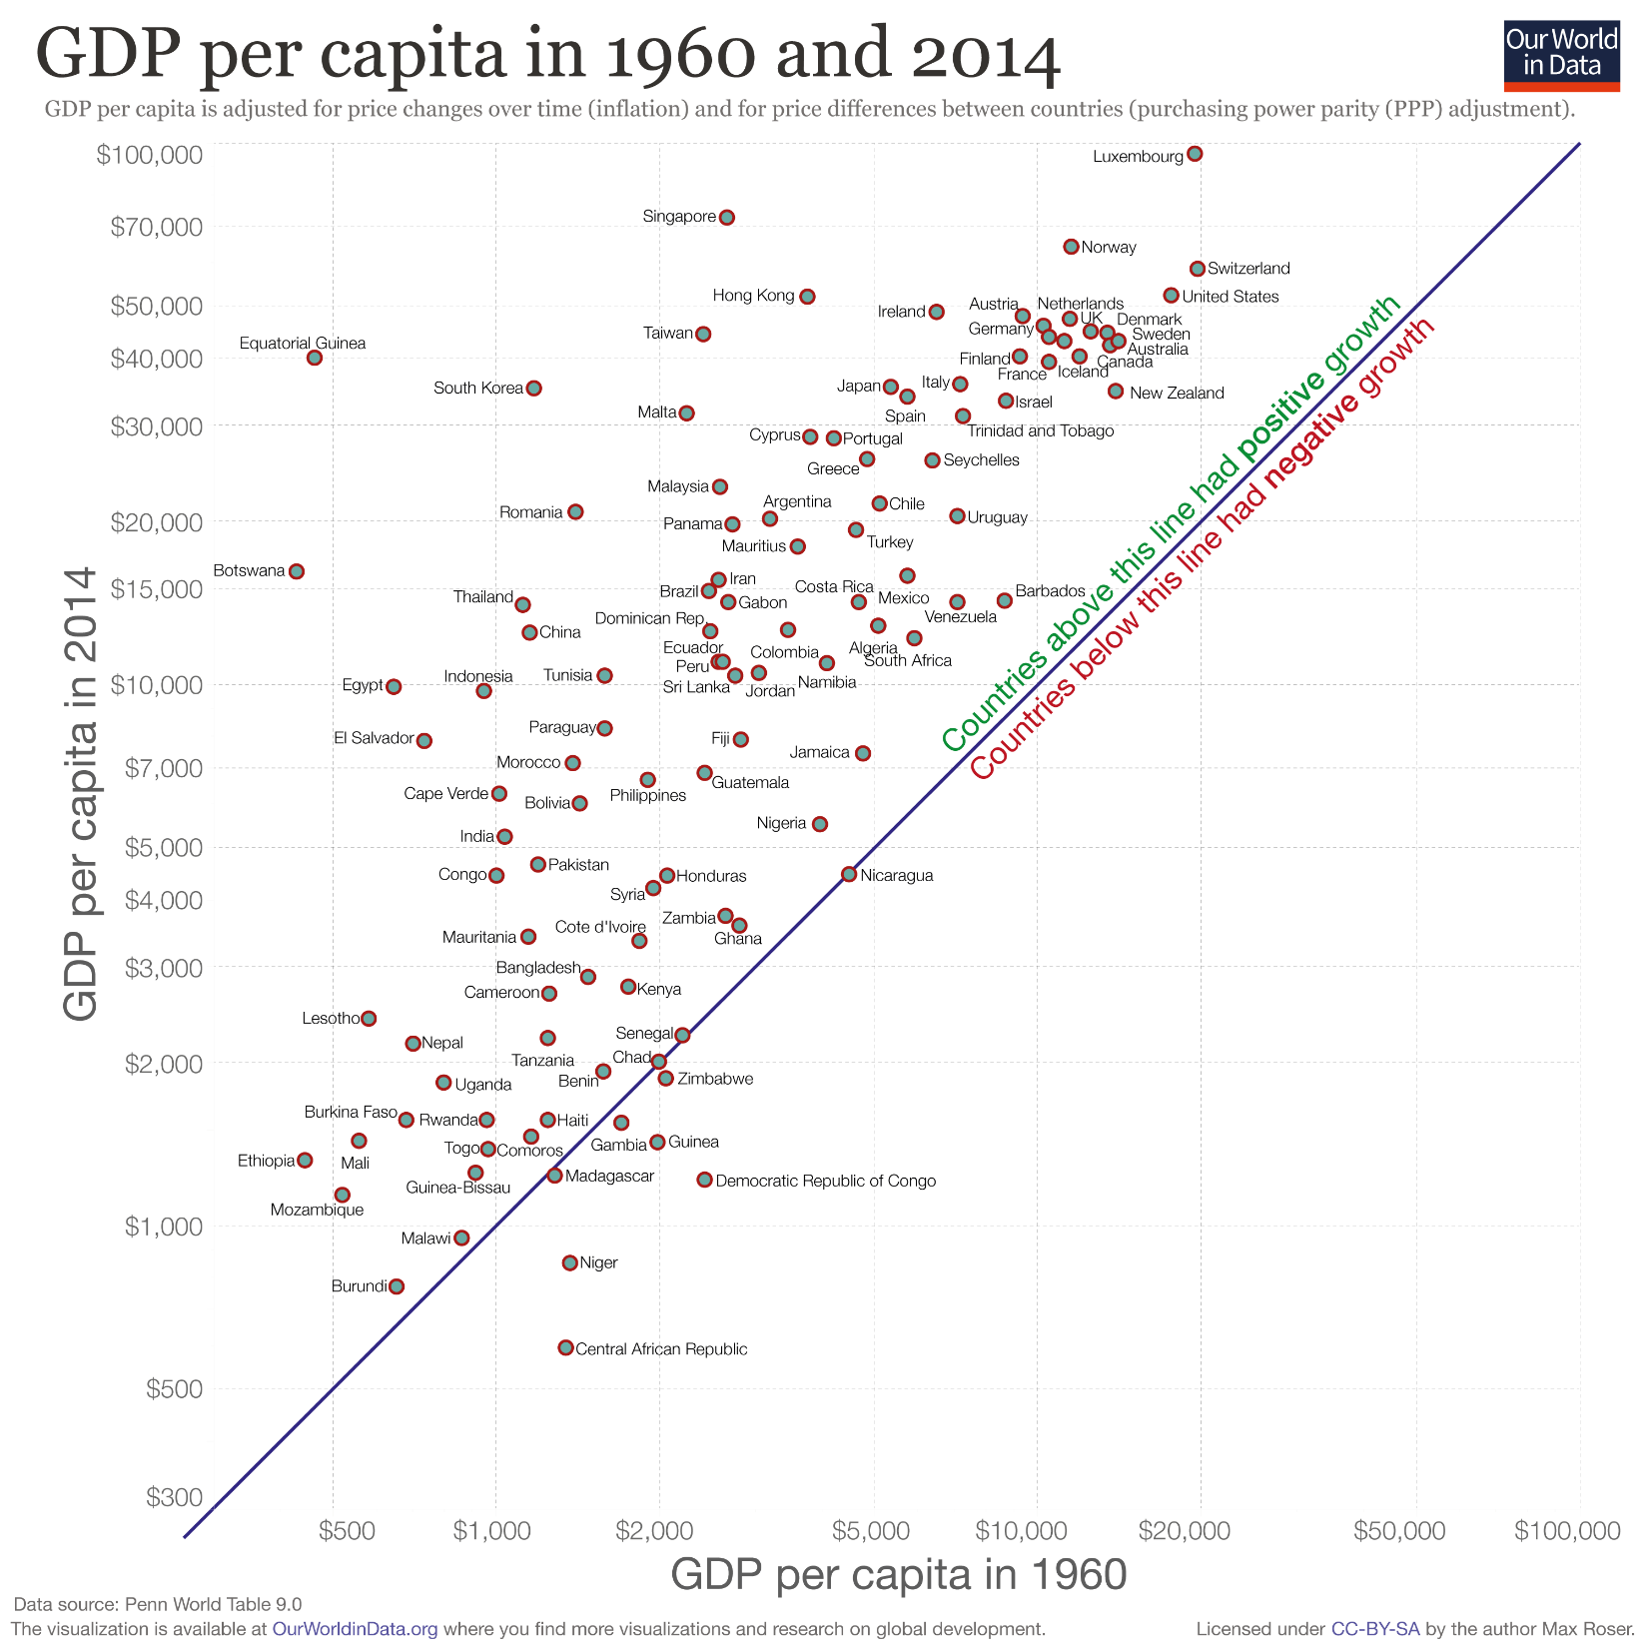
Notes:
Stagnation for the poorest
Many of the world’s poorest today live in countries that had very low economic growth in the past.⁹ Consider the case of Madagascar: In the last 20 years GDP per capita has not grown; and the number in extreme poverty increased almost one-for-one with total population.
Development economists have emphasized this for some time: The very poorest people in the world did not see their material living conditions improve.¹⁰ This fact is surely one of the biggest development failures of our time. Yet the stagnation of the world’s poorest countries is not as widely known as it should be – one reason is that we are not paying attention to poverty lines low enough to focus on what happens to the very poorest. This is an important reminder that one poverty line is not enough and we need to rely on several poverty lines – higher and lower than the international poverty line – to understand what is happening.
A rising global middle class and stagnation of the world’s poorest will also mean that a new divide at the lowest end of the global income distribution is opening up. We miss this if we only follow what is happening to the rapidly emerging global middle class or if we rely on global poverty lines that are not capturing what is happening to the poorest.
The projections suggest that over the coming decade the stagnation at the bottom will become very clear. The majority of the world’s poorest today live in economies that are not growing and half a billion face the prospect to remain stuck in extreme poverty.
This is terrible news.

Slide 13
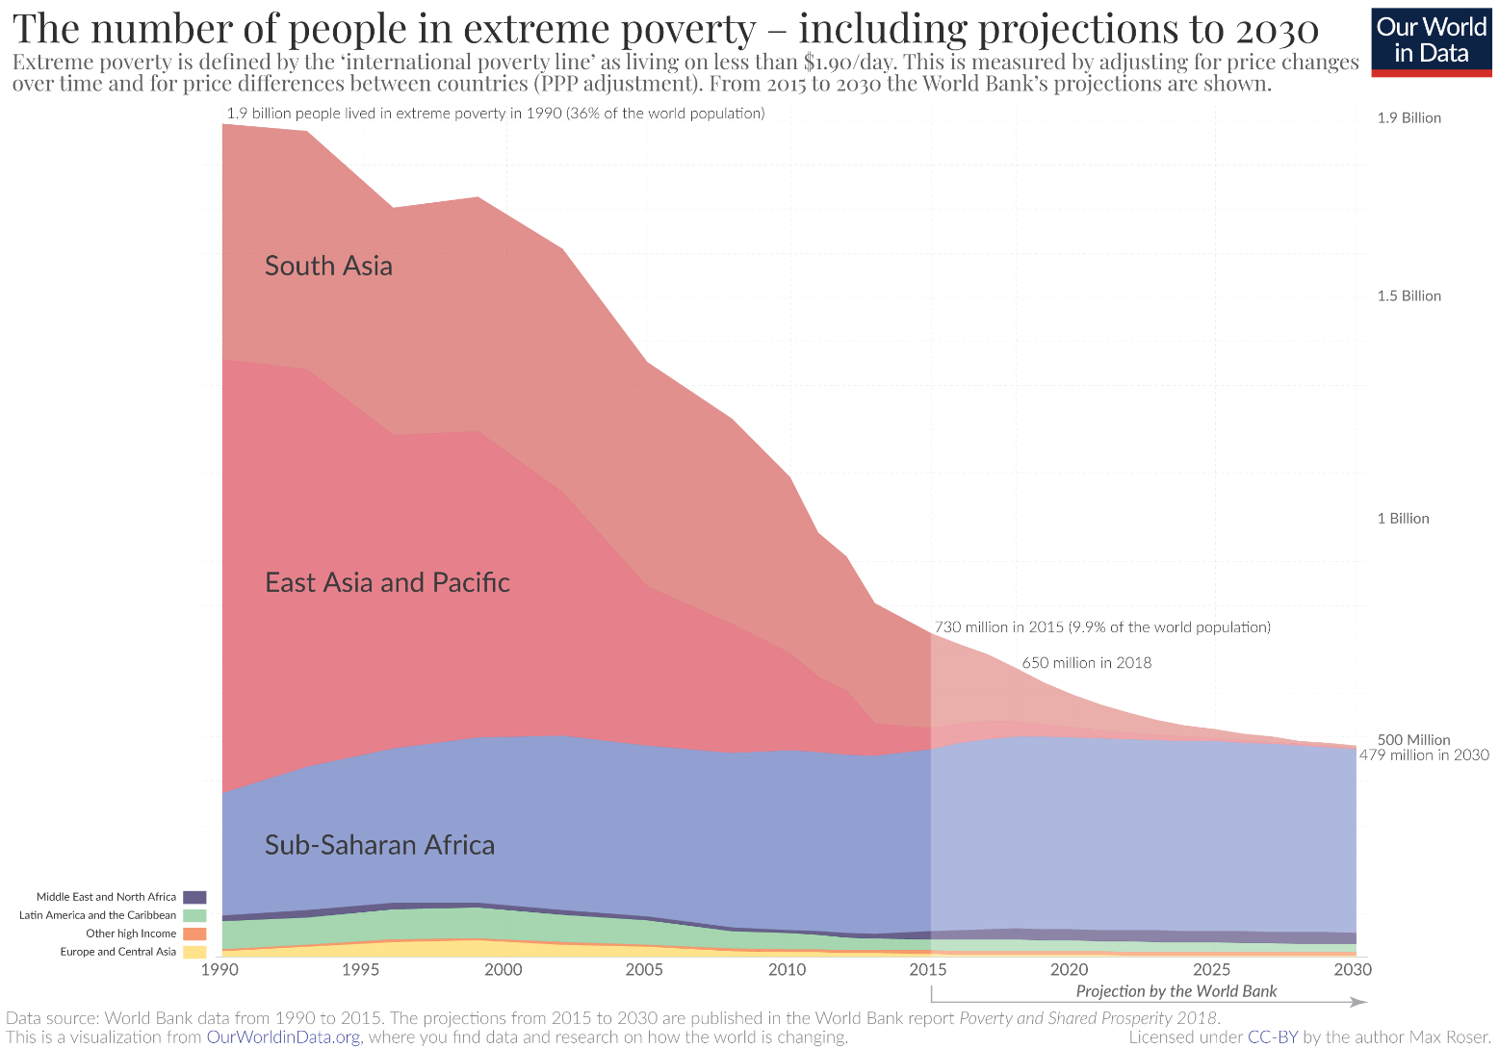

Slide 14
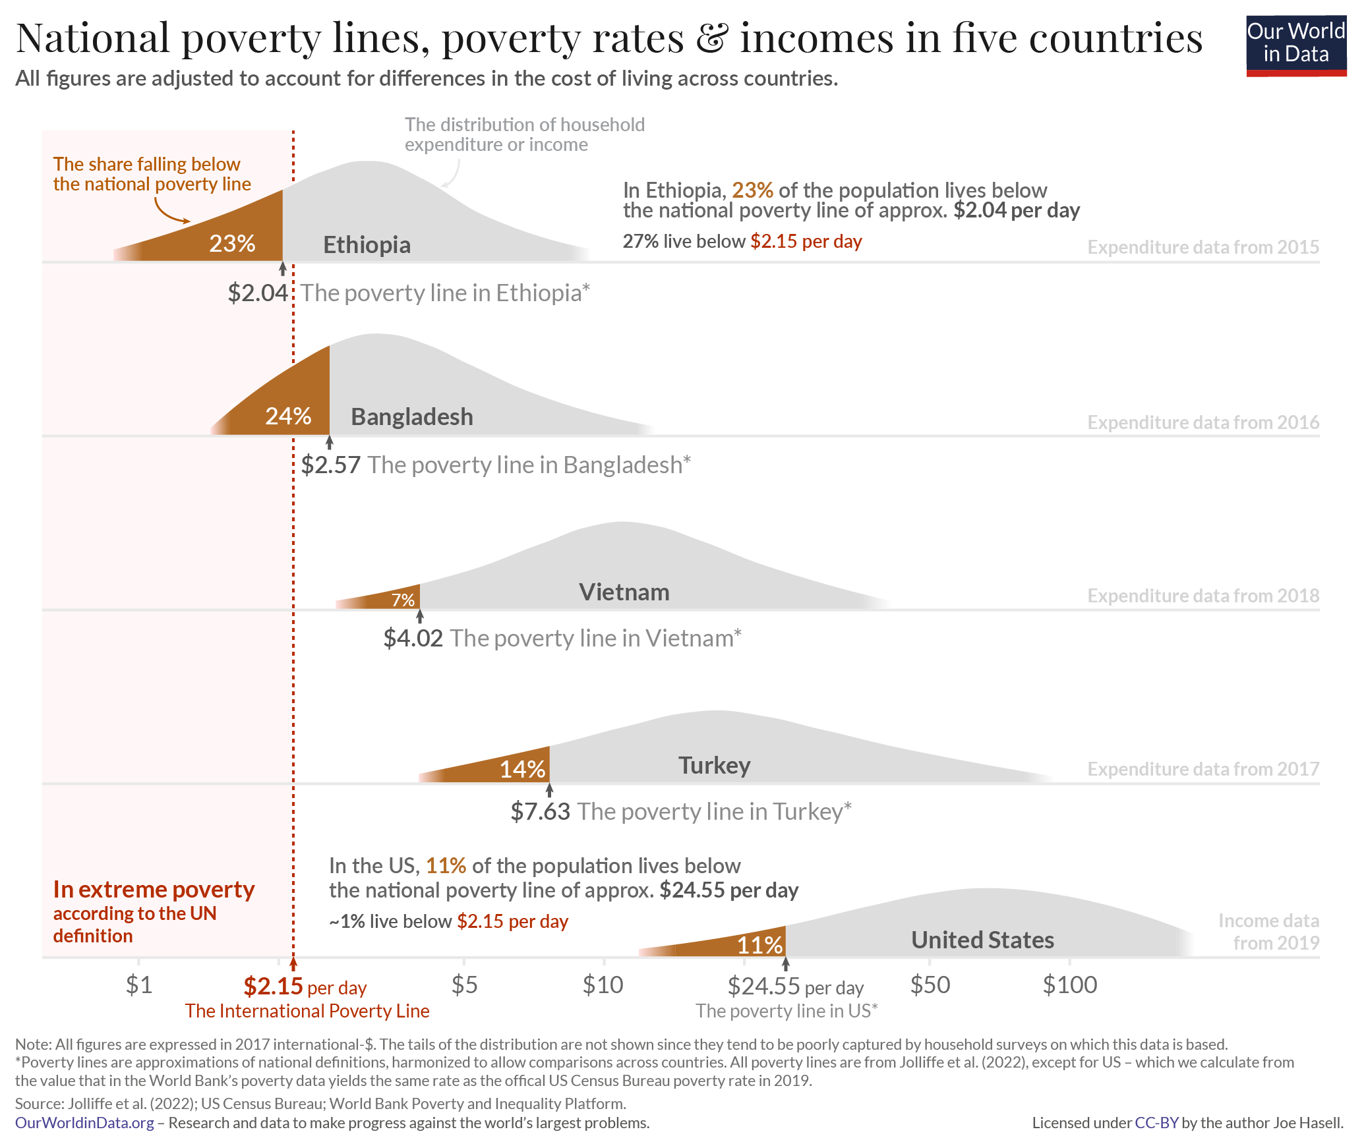
Richer and poorer countries set very different poverty lines in order to measure poverty

Slide 15
What Does It Mean To Be Poor?
Poverty is measured on the basis of income, but that is often too one-dimensional for such a complex phenomenon.

Slide 16
What people in poverty experience?
Lack of basic necessities
Isolation from family and friends
Lack information about the supports and services available to them due to bureaucracy
Lack of decent work
Fear for one's children
Being unable to afford to buy medicines
Unable to participate in normal social

Slide 17
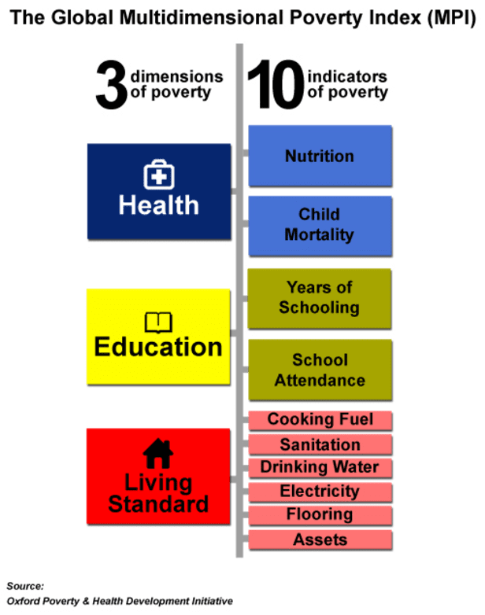
Global Multidimensional Poverty Index
An international measure of acute poverty covering over 100 developing countries
If someone is deprived in a third or more of ten (weighted) indicators (see left), the global index identifies them as ‘MPI poor’.
In 2017 1.45 billion people are MPI poor, some 26.5% of the people living in 103 countries (5.4billion). 40 percent of them live in India.
In 2021, 1.3 billion are MPI poor.
Sanitation is the biggest problem.
Half of all MPI poor people are destitute and experience extreme deprivations such as severe malnutrition.
Two-thirds MPI poor households have girls or women with less than 6y of education.
https://ophi.org.uk/research/multidimensional-poverty/
Notes:
http://www.ophi.org.uk/research/multidimensional-poverty/

Slide 18
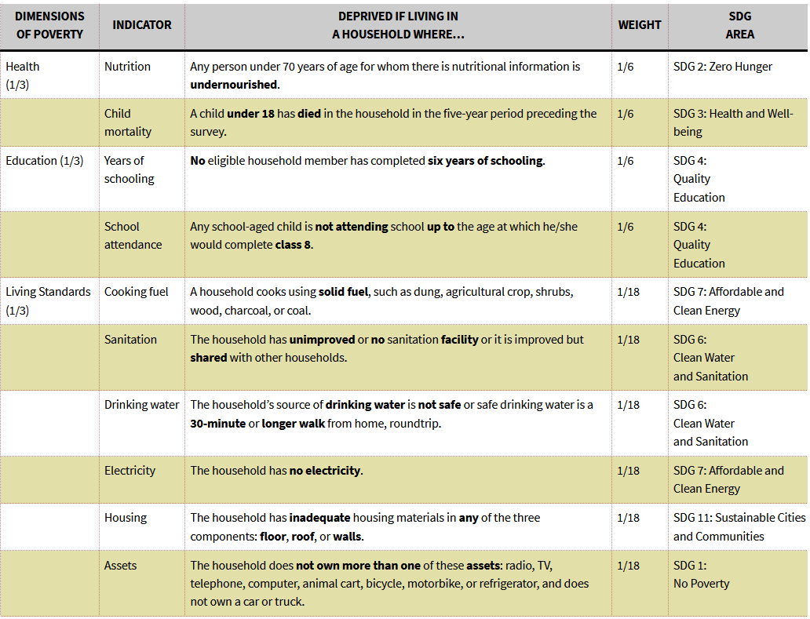
Source: ophi.org.uk/publications/mpi-methodological-notes/

Slide 20
Comparing MPI poor, destitute and extreme poverty

Slide 21
In 43 of the 60 countries with both multidimensional and monetary poverty estimates, the incidence of multidimensional poverty was higher than the incidence of monetary poverty
MPI in 2021

Slide 22
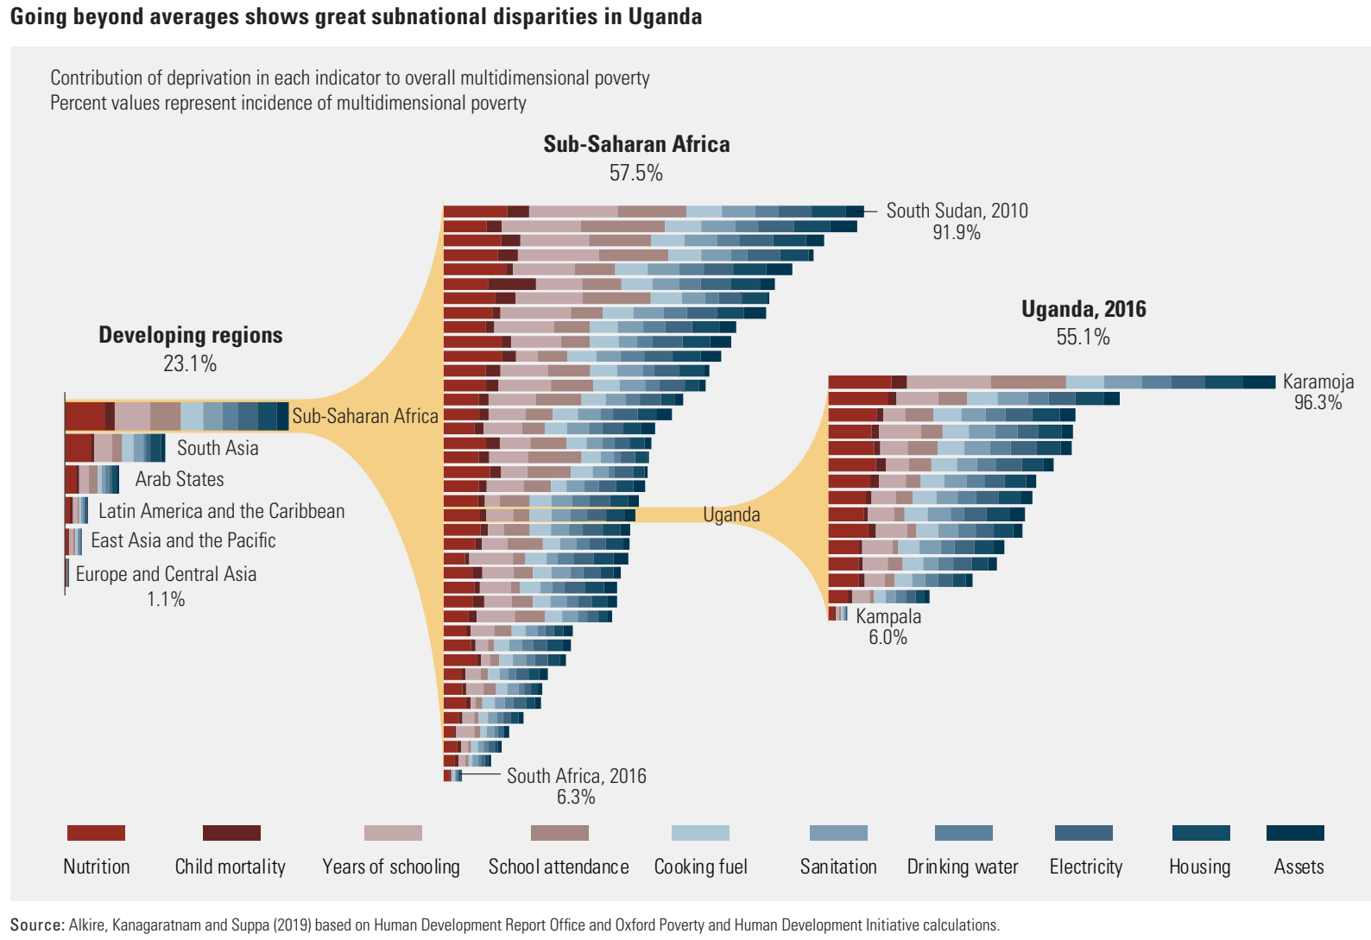

Slide 23
Self-employment and poverty in developing countries

Slide 24
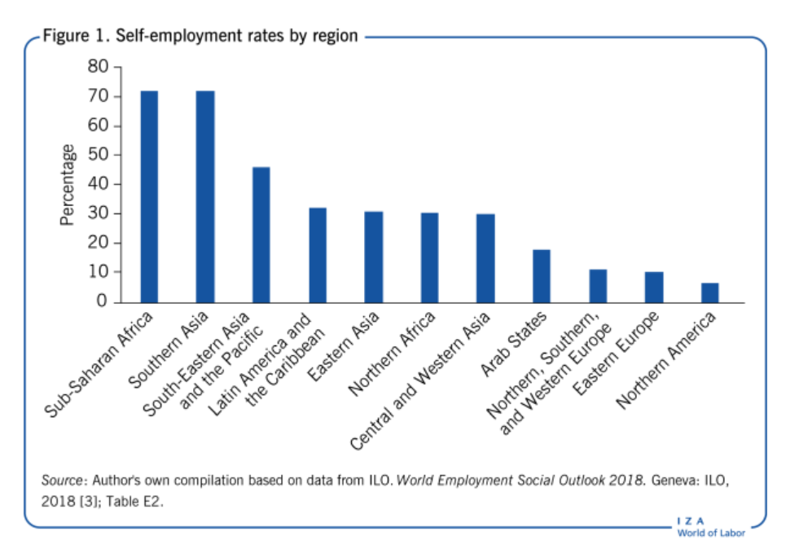
Majority of workers in developing countries are self-employed
Approximately 40% of workers are self-employed globally.
Self-employment as a choice — or lack of choice?

Slide 25
Effective policy interventions
  Support the self-employed in their current activities
    raise the productivity of the self-employed
    Training to improve their skills and business know-how
    making affordable credit
  Help self-employed with transition into better-paying jobs
    Training people for wage employment
    Creating more wage employment (off-farm jobs)

Slide 26
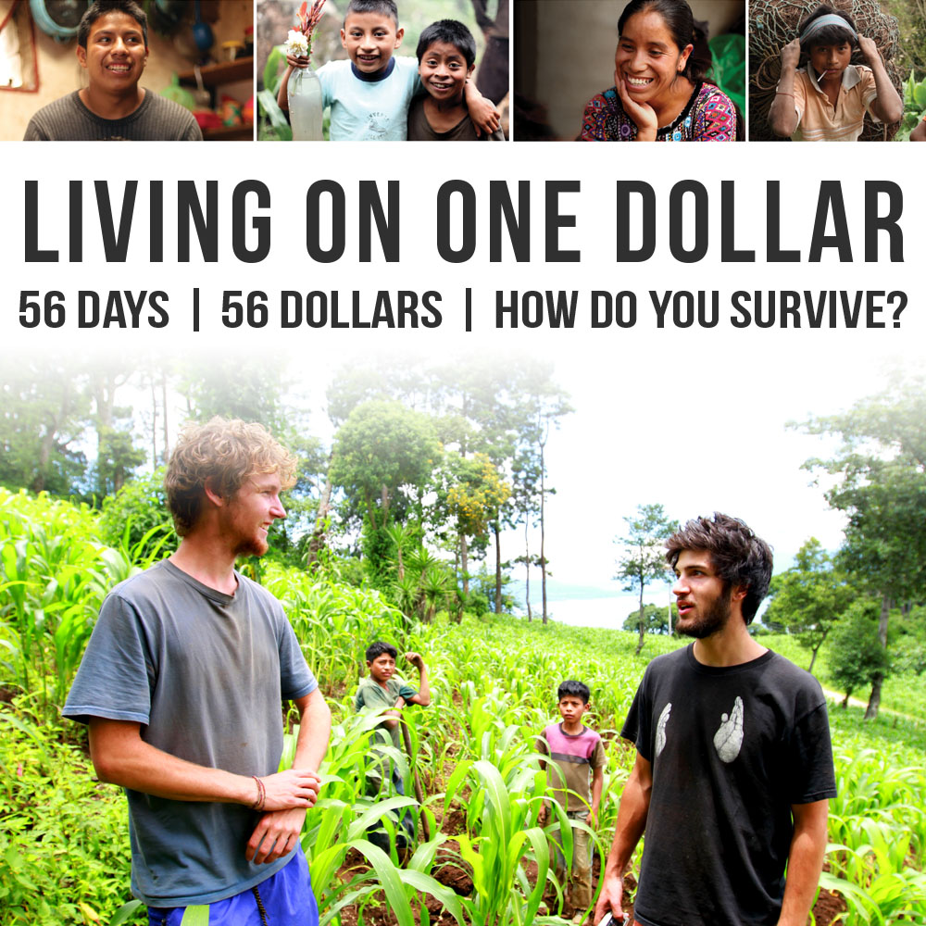
http://livingononedollar.org/

Slide 27
https://www.gapminder.org/dollar-street/
Visit "Dollar street" website and explore how living standards vary with family income across the globe. Compare the living conditions in selected countries. To visit a family click on the "Visit this family" button on the right side.
1/ What % of their budget do families spend on food and on housing?
2/ What do they wish to buy next (is it a necessity or a luxury thing)?
3/ What shortages or unnecessary luxury do you observe in the living of families?

Slide 28
Poverty indicators in the EU

Slide 29
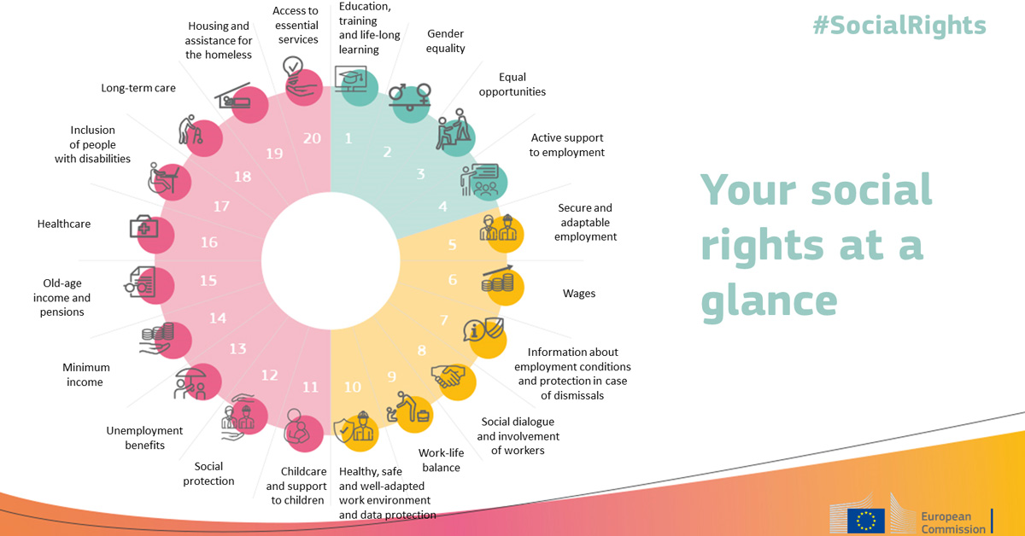
https://op.europa.eu/webpub/empl/european-pillar-of-social-rights/en/

Slide 30
At-risk-of income poverty
People at-risk-of income poverty have an equalized disposable income below the risk-of-poverty threshold, set at 60 % of the national median equalized disposable income (after social transfers).

Slide 31
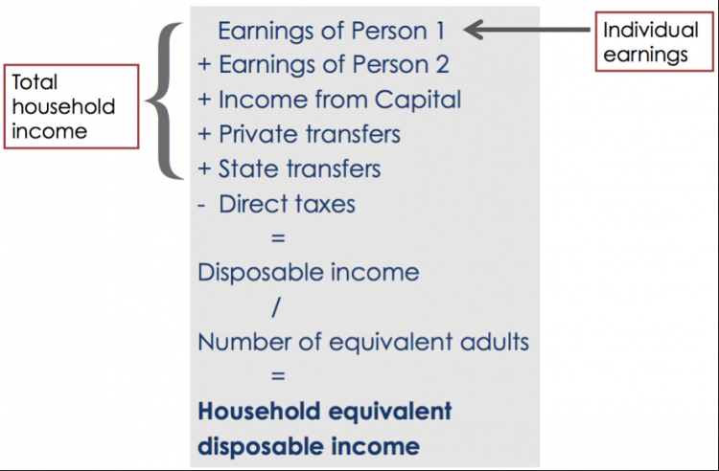
Equalized disposable household income
Disposable income is the amount of money that individuals and families have available for spending or saving after they have paid their direct taxes and received any state welfare benefits.
Number of equivalent adults is calculated as according to equivalence scale:
1.0 to the first adult;
0.5 to each subsequent person 14+;
0.3 to each child aged under 14;
e.g. family 2+2 is scaled by factor 2.1

Slide 32
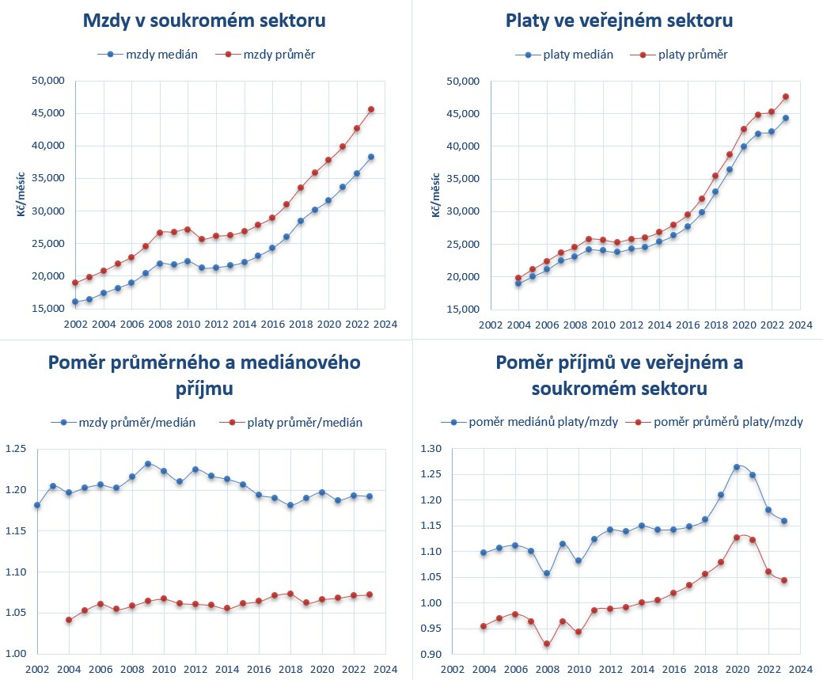
Czech Republic wage levels
Poverty Threshold in 2023 is 16 774 CZK

Slide 33
At-risk-of-poverty thresholds
(equalized disposable monthly income in EUR per person, 2015)
https://ec.europa.eu/eurostat/databrowser/view/tessi014/default/bar?lang=en

Slide 34
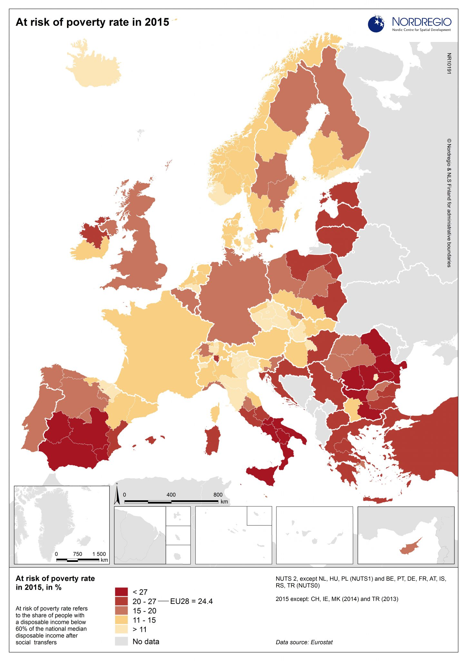
The highest at-risk-of-poverty rates can be found in Southern and Eastern Europe, and there are also large regional differences within countries such as Spain and Italy, with substantially higher at-risk-of-poverty rates found in the southern regions.
All the regions in the Nordic countries have at-risk-of-poverty rates below the EU average.
Notes:
The highest at-risk-of-poverty rates can be found in Southern and Eastern Europe. There are also large regional differences within countries such as Spain and Italy, with substantially higher at-risk-of-poverty rates found in the southern regions. All the regions in the Nordic countries have at-risk-of-poverty rates below the EU average.

Slide 35
Poverty indicators in the EU
(Severe) Material deprivation (9% of EU in 2014)
  Living conditions are severely constrained by a lack of resources. People cannot afford at least 3 (4) out of the 9 following items: i. to pay rent or utility bills, ii. keep home adequately warm, iii. Face unexpected expenses, iv. eat meat, fish or a protein equivalent every second day, v. a week holiday away from home, vi. a car, vii. a washing machine, viii. a colour TV, or ix. a telephone.
At-risk-of-income poverty (17% of EU)
  Peple who have an equivalised disposable income below the risk-of-poverty threshold, set at 60 % of the national median equivalised disposable income (after social transfers).
Social exclusion - low work intensity (11% of EU)
  People 0-59 who live in households where on average the adults (aged 18-59) worked less than 20% of their total work potential during the past year
At-risk-of-poverty or social exclusion (24% of EU)

Slide 36
Poverty indicators in the EU
(Severe) Material deprivation (9% of EU in 2014)
  Living conditions are severely constrained by a lack of resources. People cannot afford at least 3 (4) out of the 9 following items: i. to pay rent or utility bills, ii. keep home adequately warm, iii. Face unexpected expenses, iv. eat meat, fish or a protein equivalent every second day, v. a week holiday away from home, vi. a car, vii. a washing machine, viii. a color TV, or ix. a telephone.
At-risk-of-income poverty (17% of EU)
  People who have an equalized disposable income below the risk-of-poverty threshold, set at 60 % of the national median equalized disposable income (after social transfers).
Social exclusion – low work intensity (11% of EU)
  People 0-59 who live in households where on average the adults (aged 18-59) worked less than 20% of their total work potential during the past year
->> At-risk-of-poverty or social exclusion (24%=122mil) << -
  Any member of a household that falls below the defined threshold in at least one of these indicators is identified as at risk of poverty or social exclusion.
Notes:
http://ec.europa.eu/eurostat/documents/2995521/7034688/3-16102015-CP-EN.pdf

Slide 37
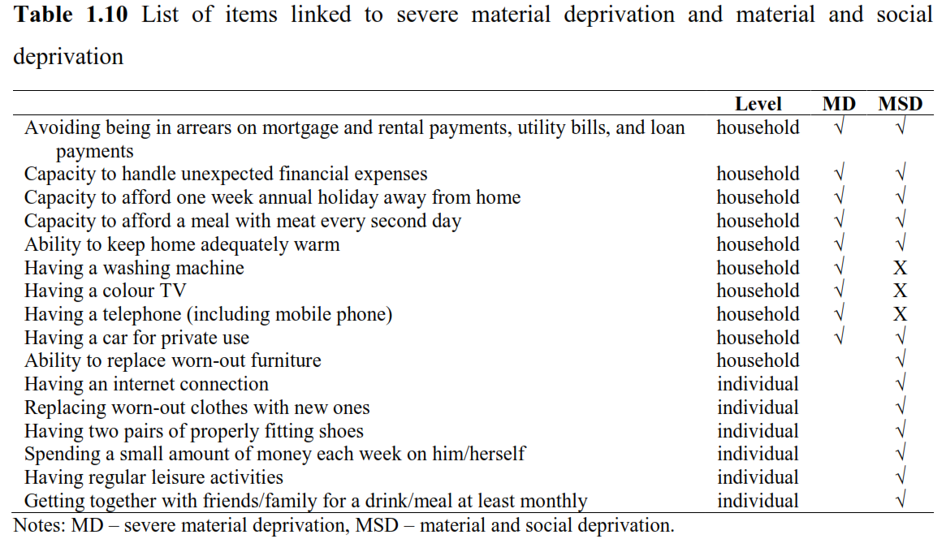
In 2017, the EU adopted the material and social deprivation (MSD) indicator. The threshold was set as a lack of five of thirteen items

Slide 38
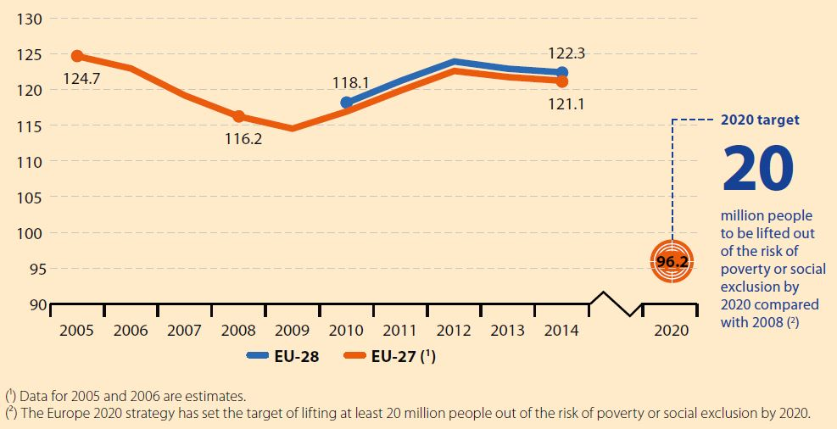
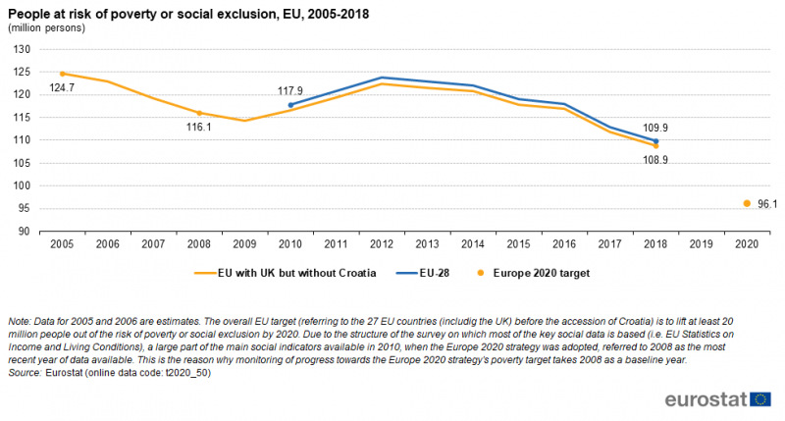
People at risk of poverty or social exclusion

Slide 39
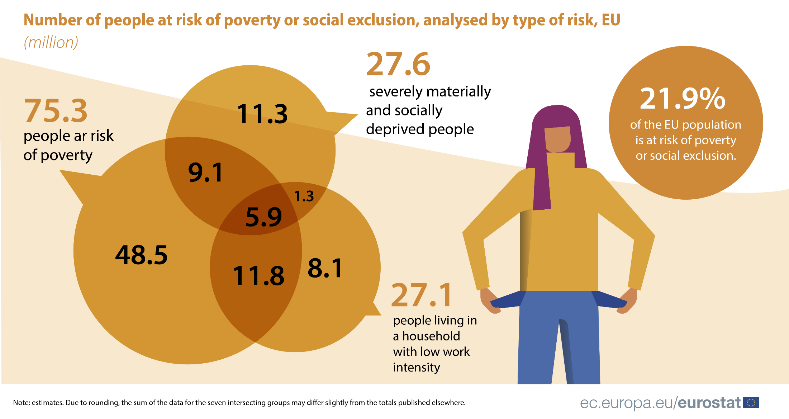
People at risk of poverty or social exclusion',
EU-28, 2020 (96.5 mil)
Notes:
http://ec.europa.eu/eurostat/statistics-explained/index.php/People_at_risk_of_poverty_or_social_exclusion

Slide 40
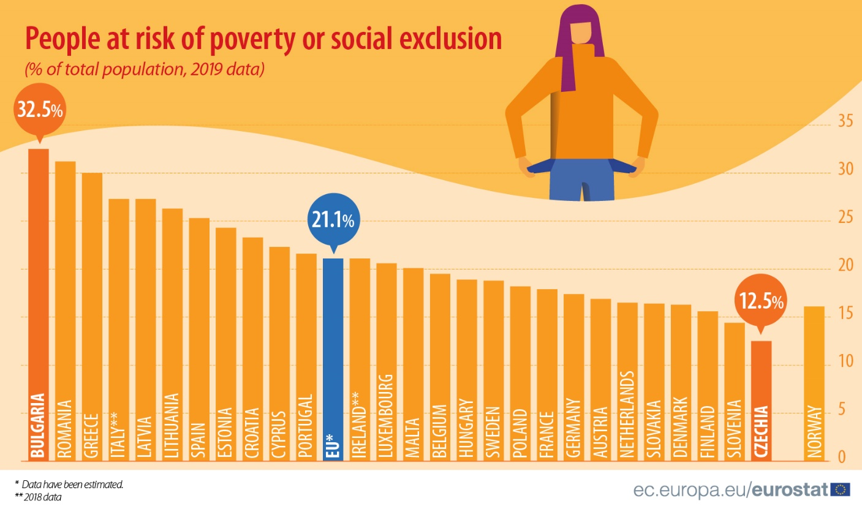
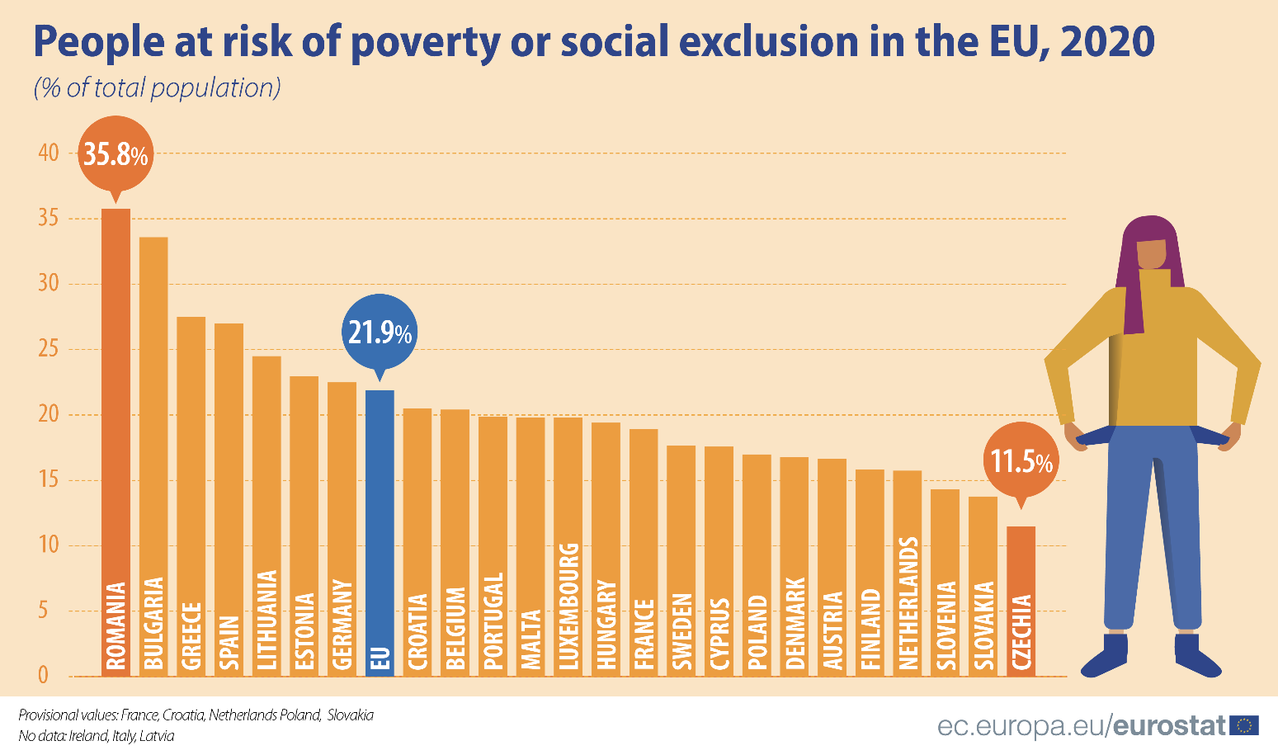

Slide 41
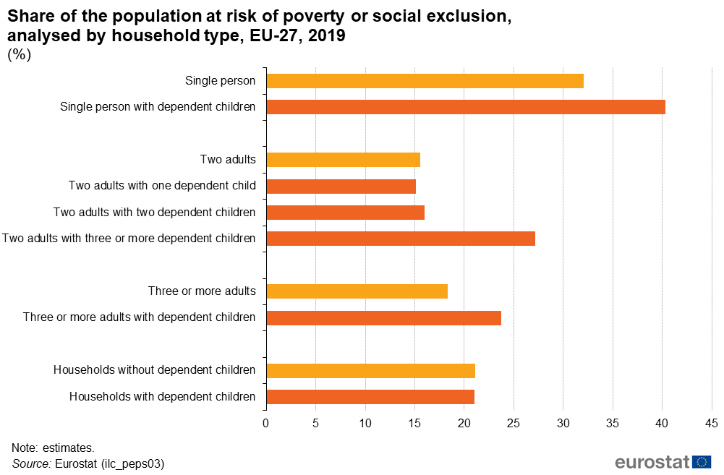
Poverty rates differ between groups

Slide 42
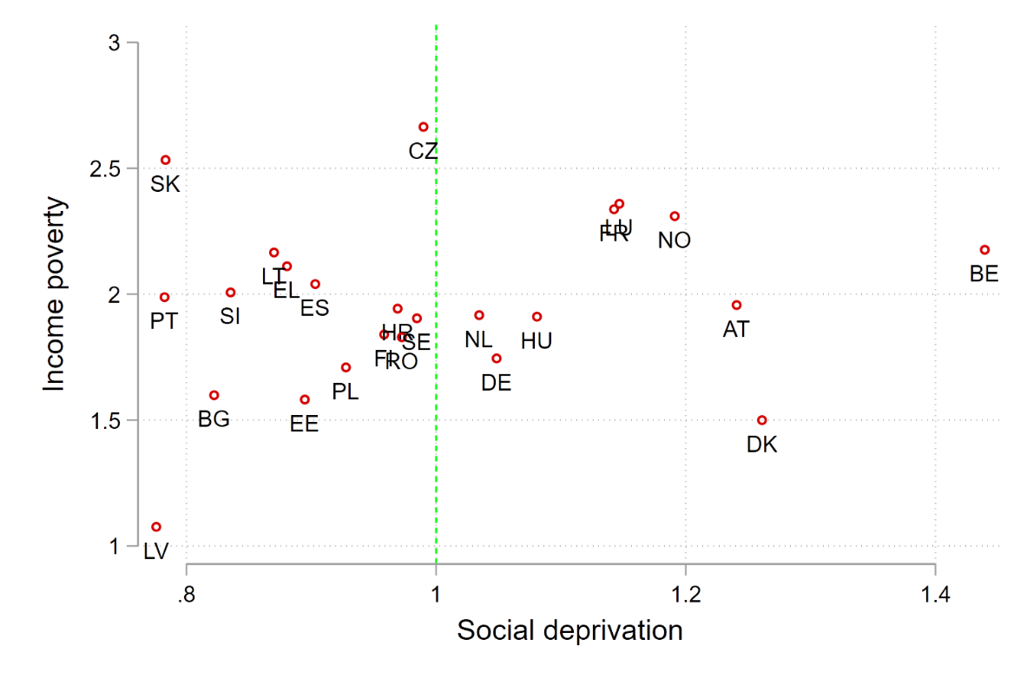
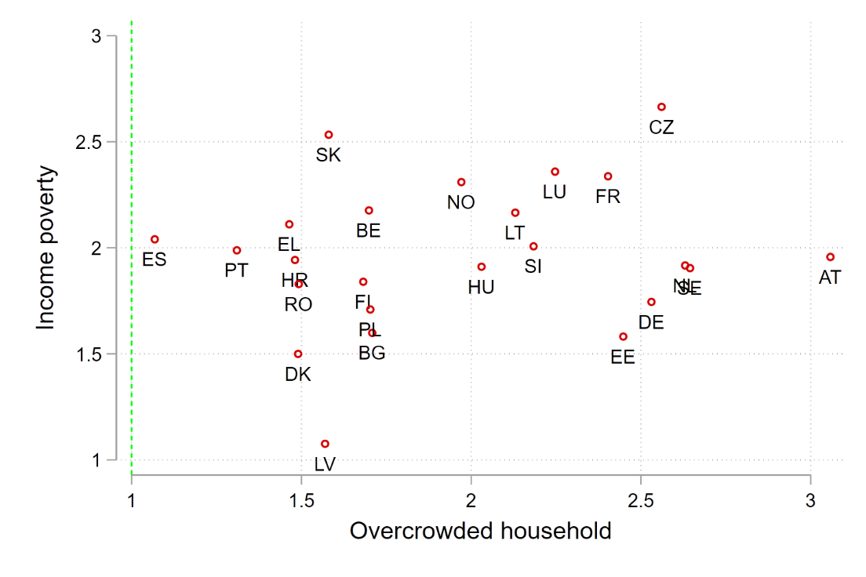
Vulnerability of single parent family, 2019
In Czechia incomplete families face 2.5x higher risk of income poverty and are 2.5 time more likely to live in overcrowded household relative to the average family (represented by green line)
Social deprivation is a problem to single parent families in Scandinavian and Benelux countries.
Note: Social deprivation includes persons who cannot meet with friends/family (relatives) for a drink/meal at least once a month or cannot regularly participate in a leisure activity.

Slide 43
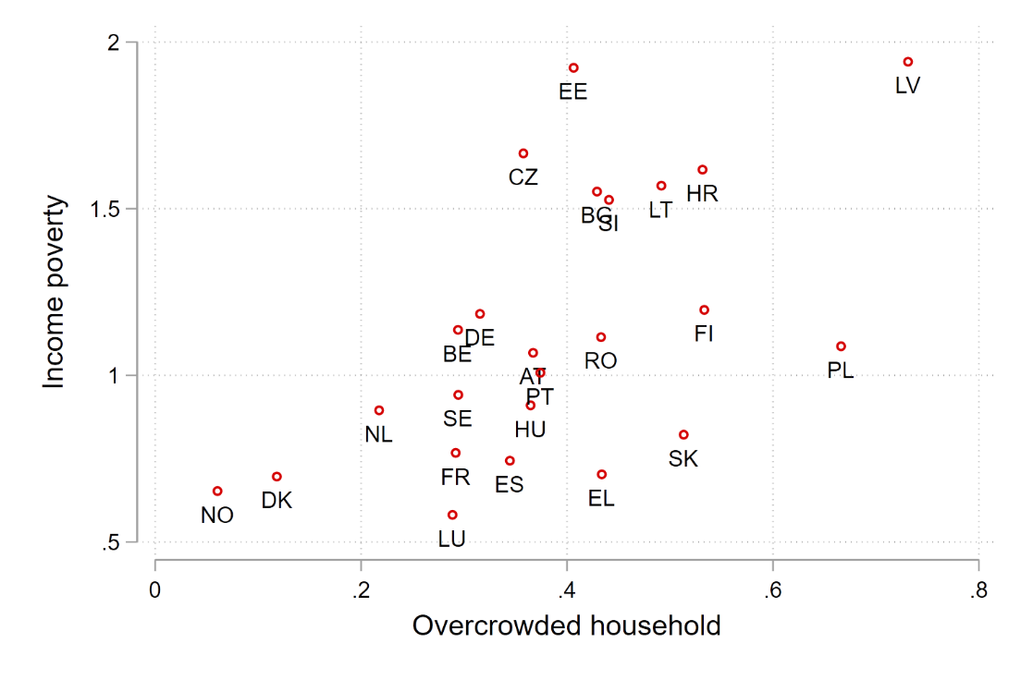
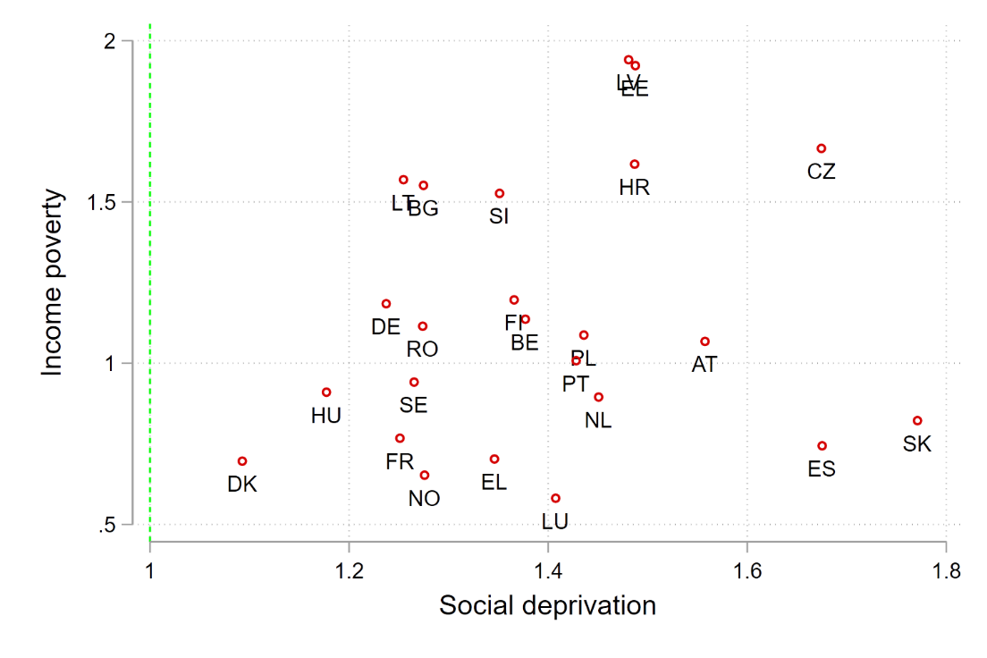
Vulnerability of older people (65+), 2019
Elderly face low risk (at least by 50%) of living in overcrowded household but they suffers from the higher level of social deprivation. In most Central European countries elderly face higher risk of from income poverty.
Note: Housing quality (overcrowded household) includes persons who do not have enough rooms compared to the size of household. For example, a household of a single parent with two children is considered overcrowded unless the family has a living room and two separate bedrooms.

Slide 44
Limitations of poverty measures
Cut-off point is a rather arbitrary process
Poverty gap (or Depth of poverty) measures the intensity of poverty. It gives the total resources needed to bring all the poor to the level of the poverty line (under perfect targeting).
The length of time people have been poor
i.e. the duration and persistence of poverty.
Multi-dimensional nature of poverty: indebtedness, joblessness, poor health, inadequate housing or access to public services.
Social benefits can drastically reduce poverty.

Slide 45
Persistent poverty
Persistent poverty rates measure the percentage of the population that are at-risk-of-poverty in the current year and at least 2 out of the 3 preceding years. This is the definition used by the European Commission as part of their indicators to monitor poverty and social exclusion across the EU.

Slide 46
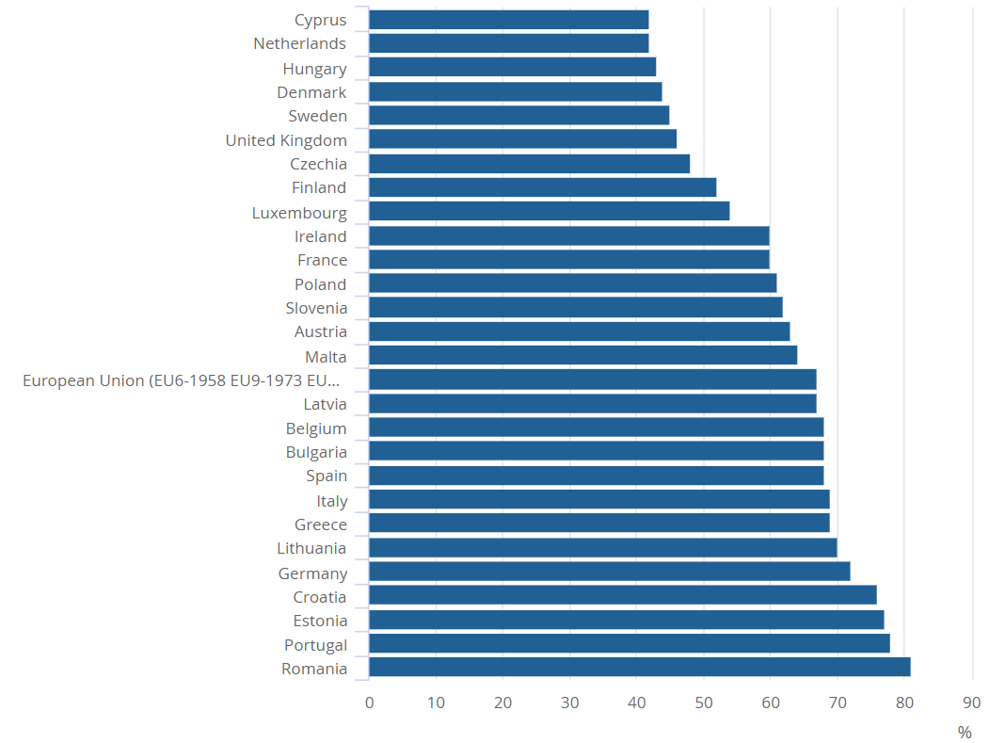
Proportion of those in poverty who are persistently in poverty,
Persistent poverty rates measure the percentage of the population that are at-risk-of-poverty in the current year and at least 2 out of the 3 preceding years.
In many countries half of those in poverty are in persistent poverty.
In Czechia individuals are overall less likely to enter poverty but stay longer in poverty than in Hungary.
https://www.ons.gov.uk/peoplepopulationandcommunity/personalandhouseholdfinances/incomeandwealth/articles/persistentpovertyintheukandeu/2017

Slide 47
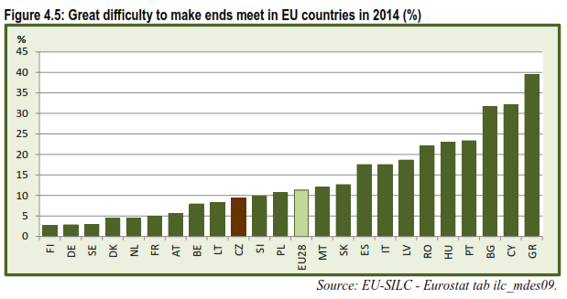
Subjective indicators of poverty

Slide 48
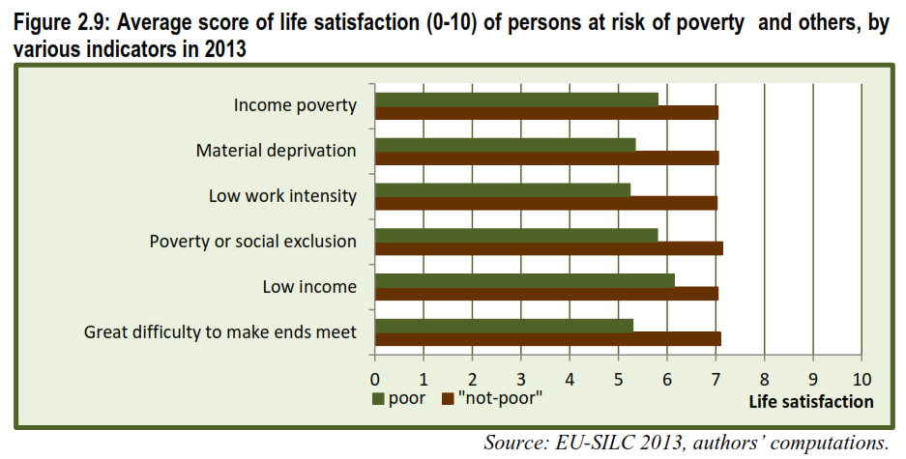
Being poor = being unhappy
Figures illustrate the situation in the Czech Republic.

Slide 49
Other difficulties
Is income equally distributed within the household? Women have lower income but responsibility for the expenditure on children.
Standard surveys do not capture groups typically at very high-risk poverty and social exclusion.
e.g. Roma and immigrants are underrepresented in data.

Slide 50
Conclusions
Instant indicators of poverty are essential for identifying social risks in the society and
for preparing public policy.
The very equal societies in Europe tend to have the lowest levels of poverty.
Adequate minimum income levels and good access to services are essential.

Slide 51
Extreme poverty today exists only in
Countries in Latin America and South Asia
Developing countries
Developed countries
Still exists in all countries

Slide 52
How does Eurostat measure the material deprivation?
Each country has its own definition of national poverty line and material deprivation.
Household is materially deprived when the purchasing power of disposable household income falls below the 60% of median equalized disposable income.
Household is materially deprived when it cannot afford adequate housing and a meal with meat at least once a week.
Household is materially deprived when its members cannot afford certain material goods.

