Slide 1
The social-psychological reality of conspiracy beliefs: How the sense of precarity and adherence to conspiracy beliefs are intertwined
Lena Adamus
[magdalena.adamus@econ.muni.cz]
18.11.2024 Brno

Slide 2
Definitions: conspiracy and epistemically suspect beliefs
Surge of ESB

Slide 3
Definitions: conspiracy and epistemically suspect beliefs
Surge of ESB
ESB (epistemically suspect beliefs) cover a wide range of irrational, paranormal, conspiracy and pseudoscientific beliefs that contradict standard scientific and naturalistic views about the world and have potentially negative societal impact

Slide 4
Definitions: conspiracy and epistemically suspect beliefs
Surge of ESB
ESB (epistemically suspect beliefs) cover a wide range of irrational, paranormal, conspiracy and pseudoscientific beliefs that contradict standard scientific and naturalistic views about the world and have potentially negative societal impact
Misinformation and disinformation

Slide 5
Definitions: conspiracy and epistemically suspect beliefs
Surge of ESB
ESB (epistemically suspect beliefs) cover a wide range of irrational, paranormal, conspiracy and pseudoscientific beliefs that contradict standard scientific and naturalistic views about the world and have potentially negative societal impact
Conspiracy mentality
conspiracy beliefs
Irrational beliefs

Slide 6
Definitions: conspiracy and epistemically suspect beliefs
Globally more than 20% of people believe in at least one COVID-related conspiracy theory
Surge of ESB
ESB (epistemically suspect beliefs) cover a wide range of irrational, paranormal, conspiracy and pseudoscientific beliefs that contradict standard scientific and naturalistic views about the world and have potentially negative societal impact
Conspiracy mentality
conspiracy narratives
Irrational beliefs

Slide 7
Definitions: conspiracy and epistemically suspect beliefs
Globally more than 20% of people believe in at least one COVID-related conspiracy
Decreased science acceptance
Surge of ESB
ESB (epistemically suspect beliefs) cover a wide range of irrational, paranormal, conspiracy and pseudoscientific beliefs that contradict standard scientific and naturalistic views about the world and have potentially negative societal impact
Conspiracy mentality
conspiracy narratives
Irrational beliefs

Slide 8
Definitions: conspiracy and epistemically suspect beliefs
Globally more than 20% of people believe in at least one COVID-related conspiracy
Decreased science acceptance
Surge of ESB
ESB (epistemically suspect beliefs) cover a wide range of irrational, paranormal, conspiracy and pseudoscientific beliefs that contradict standard scientific and naturalistic views about the world and have potentially negative societal impact
Increased non-normative socio-political behaviour
Conspiracy mentality
conspiracy narratives
Irrational beliefs

Slide 9
Definitions: conspiracy and epistemically suspect beliefs
Globally more than 20% of people believe in at least one COVID-related conspiracy
Decreased science acceptance
Surge of ESB
ESB (epistemically suspect beliefs) cover a wide range of irrational, paranormal, conspiracy and pseudoscientific beliefs that contradict standard scientific and naturalistic views about the world and have potentially negative societal impact
Increased non-normative socio-political behaviour
Conspiracy mentality
conspiracy narratives
Irrational beliefs
Prejudice against certain social groups

Slide 10
Conspiracy beliefs, theories, mentality and real-life conspiracies

Slide 11
Conspiracy beliefs, theories, mentality and real-life conspiracies
Conspiracy

Slide 12
Conspiracy beliefs, theories, mentality and real-life conspiracies
Conspiracy
theory
Conspiracy

Slide 13
Conspiracy beliefs, theories, mentality and real-life conspiracies
Conspiracy
theory
Conspiracy
belief
Conspiracy

Slide 14
Conspiracy beliefs, theories, mentality and real-life conspiracies
Conspiracy
theory
Conspiracy
belief
Conspiracy mentality
Conspiracy

Slide 15
Conspiracy beliefs, theories, mentality and real-life conspiracies
Conspiracy
theory
Conspiracy
belief
Conspiracy mentality
Conspiracy
Uscinski, 2018

Slide 16
Conspiracy beliefs, theories, mentality and real-life conspiracies
Conspiracy
theory
Explanations of events or circumstances pinpointing a powerful group as culprits acting secretly and maliciously for their own benefit and against the common good
Uscinski, 2018

Slide 17
Conspiracy beliefs, theories, mentality and real-life conspiracies
Conspiracy
theory
Explanations of events or circumstances pinpointing a powerful group as culprits acting secretly and maliciously for their own benefit and against the common good
Uscinski, 2018

Slide 18
Conspiracy beliefs, theories, mentality and real-life conspiracies
Conspiracy
theory
A theory need to not be necessarily false to be considered conspiracist.
Uscinski, 2018

Slide 19
Conspiracy beliefs, theories, mentality and real-life conspiracies
Conspiracy
theory
The key aspect is the lack of sufficient evidence supporting it
Uscinski, 2018

Slide 20
Conspiracy beliefs, theories, mentality and real-life conspiracies
Conspiracy
theory
Conspiracy
belief
Uscinski, 2018

Slide 21
Conspiracy beliefs, theories, mentality and real-life conspiracies
Conspiracy
theory
Conspiracy
belief
An individual’s belief in a specific conspiracy theory
Uscinski, 2018

Slide 22
Conspiracy beliefs, theories, mentality and real-life conspiracies
Conspiracy
theory
Conspiracy
belief
Conspiracy mentality
Uscinski, 2018

Slide 23
Conspiracy beliefs, theories, mentality and real-life conspiracies
Conspiracy
theory
Conspiracy
belief
Conspiracy mentality
General disposition to see events as caused by conspiracies
Uscinski, 2018

Slide 24
Conspiracy beliefs, theories, mentality and real-life conspiracies
Conspiracy
theory
Uscinski, 2018

Slide 25
Conspiracy beliefs, theories, mentality and real-life conspiracies
Once proven a conspiracy theory can be considered an actual conspiracy
Conspiracy
theory
Uscinski, 2018

Slide 26
Conspiracy beliefs, theories, mentality and real-life conspiracies
Once proven a conspiracy theory can be considered an actual conspiracy
Conspiracy
theory
Conspiracy
Uscinski, 2018

Slide 27
Antecedents of CBs
Why people endorse CBs?

Slide 28
Antecedents of CBs
Why people endorse CBs?
Information deficit model
(see Ecker et al., 2022)

Slide 29
Antecedents of CBs
Why people endorse CBs?
Information deficit model
(see Ecker et al., 2022)
Individual level variables
(see Stasielowicz, 2022)

Slide 30
Antecedents of CBs
Why people endorse CBs?
Information deficit model
(see Ecker et al., 2022)
Socio-demographic characteristics, cognitive ability, conspiracy thinking, uncertainty avoidance, need for structure and closure, coping strategies, anxiety, powerlessness, values and beliefs
Individual level variables
(see Stasielowicz, 2022)

Slide 31
Antecedents of CBs
Why people endorse CBs?
Information deficit model
(see Ecker et al., 2022)
Existential threat model
(see van Prooijen, 2020)
Individual level variables
(see Stasielowicz, 2022)

Slide 32
Antecedents of CBs
Why people endorse CBs?
Information deficit model
(see Ecker et al., 2022)
Existential threat model
(see van Prooijen, 2020)
Individual level variables
(see Stasielowicz, 2022)
The existential threat model assumes that the experience of existential threats triggers sense-making processes that may eventually result in the endorsement of CBs blaming outgroups for the situation

Slide 33
Antecedents of CBs
Why people endorse CBs?
Information deficit model
(see Ecker et al., 2022)
Existential threat model
(see van Prooijen, 2020)
Individual level variables
(see Stasielowicz, 2022)
The existential threat model assumes that the experience of existential threats triggers sense-making processes that may eventually result in the endorsement of CBs blaming outgroups for the situation

Slide 34
Structural factors

Slide 35
Structural factors
Structural factors

Slide 36
Structural factors
Structural factors
= social or institutional conditions that shape individuals’ opportunities and experiences in society;

Slide 37
Structural factors
Structural factors
= social or institutional conditions that shape individuals’ opportunities and experiences in society;
Why they are important?

Slide 38
Structural factors
Structural factors
= social or institutional conditions that shape individuals’ opportunities and experiences in society;
Why they are important?
Variation in the type and strength of endorsed CBs between the countries;

Slide 39
Structural factors
Structural factors
= social or institutional conditions that shape individuals’ opportunities and experiences in society;
Why they are important?
Variation in the type and strength of endorsed CBs between the countries;
Objective conditions vs subjective appraisal

Slide 40
Definitions: precarity
Precarity

Slide 41
Definitions: precarity
Understood as subjective appraisal of economic insecurity and uncertainty
Precarity

Slide 42
Definitions: precarity
Understood as subjective appraisal of economic insecurity and uncertainty
Precarity
Multidimensional phenomenon associated with social status

Slide 43
Definitions: precarity
Apart from subjective
appraisal of the financial situation (also referred to as financial insecurity), the experience of precarity
encompasses relative deprivation
Understood as subjective appraisal of economic insecurity and uncertainty
Precarity
Multidimensional phenomenon associated with social status

Slide 44
Definitions: precarity
Apart from subjective
appraisal of the financial situation (also referred to as financial insecurity), the experience of precarity
encompasses relative deprivation (i.e., a belief they are worse off compared to their desired social status),
Understood as subjective appraisal of economic insecurity and uncertainty
Precarity
Multidimensional phenomenon associated with social status

Slide 45
Definitions: precarity
Apart from subjective
appraisal of the financial situation (also referred to as financial insecurity), the experience of precarity
encompasses relative deprivation,
social exclusion and marginalization,
Understood as subjective appraisal of economic insecurity and uncertainty
Precarity
Multidimensional phenomenon associated with social status

Slide 46
Definitions: precarity
Apart from subjective
appraisal of the financial situation (also referred to as financial insecurity), the experience of precarity
encompasses relative deprivation,
social exclusion and marginalization, low prestige and esteem,
Understood as subjective appraisal of economic insecurity and uncertainty
Precarity
Multidimensional phenomenon associated with social status

Slide 47
Definitions: precarity
Apart from subjective
appraisal of the financial situation (also referred to as financial insecurity), the experience of precarity
encompasses relative deprivation,
social exclusion and marginalization, low prestige and esteem, and limited mobility across hierarchically
arranged social rungs
Understood as subjective appraisal of economic insecurity and uncertainty
Precarity
Multidimensional phenomenon associated with social status

Slide 48
Definitions: precarity
Apart from subjective
appraisal of the financial situation (also referred to as financial insecurity), the experience of precarity
encompasses relative deprivation,
social exclusion and marginalization, low prestige and esteem, and limited mobility across hierarchically
arranged social rungs and as such is persistently associated with the sense of existential threat
Understood as subjective appraisal of economic insecurity and uncertainty
Precarity
Multidimensional phenomenon associated with social status

Slide 49
Definitions: precarity
Precarity
Poverty

Slide 50
Definitions: precarity
Precarity
Poverty
Poverty, once accommodated, may be less of a stressor compared to acute economic shocks and the experience of economic anxiety (Adamus & Grežo, 2021)
Notes:
The research also explains that people experiencing economic anxiety may become (excessively) suspicious of certain groups – particularly economic, social and political elites – whom they believe to be hostile and responsible for the dire socioeconomic situation. Consequently, CBs become psychological defensive or coping mechanisms (Bukowski et al., 2017; Johnson-Schlee, 2019; Jolley & Paterson, 2020; Kraus et al., 2012; Marchlewska et al., 2017) used as an explanation of an individual’s disadvantaged position in society (Adam-Troian et al., 2023). The blame shifting may be associated with lower trust towards institutions and the establishment as being responsible for exploiting and plotting against ordinary people (Jovančević & Milićević, 2020; Meuer & Imhoff, 2021; Wagner-Egger et al., 2022). The literature posits that people experiencing economic anxiety report an enhanced sense of anomie, which, in turn, elicits distrust in authorities and the political system, a sense of loss of control, resignation and powerlessness (Adam-Troian et al., 2023; Ballafkih et al., 2017; Salvador Casara et al., 2022). This may be further aggravated by perceptions of inequality and relative deprivation (Jetten et al., 2022; Salvador Casara et al., 2022; Willis et al., 2022). Both inequality and deprivation are seen as a threat to one’s economic resilience and, thus, seeking to regain control over life circumstances, individuals may more easily fall prey to CBs (Adger et al., 2020).

Slide 51
Definitions: precarity
Precarity
Poverty
People experiencing economic anxiety may become (excessively) suspicious of certain groups – particularly economic, social and political elites – whom they believe to be hostile and responsible for the dire socioeconomic situation.

Slide 52
Definitions: precarity
Precarity
Poverty
Consequently, CBs become psychological defensive or coping mechanisms (Bukowski et al., 2017; Johnson-Schlee, 2019; Jolley & Paterson, 2020; Kraus et al., 2012; Marchlewska et al., 2017) used as an explanation of an individual’s disadvantaged position in society (Adam-Troian et al., 2023). The blame shifting may be associated with lower trust towards institutions and the establishment as being responsible for exploiting and plotting against ordinary people (Jovančević & Milićević, 2020; Meuer & Imhoff, 2021; Wagner-Egger et al., 2022).
People experiencing economic anxiety may become (excessively) suspicious of certain groups – particularly economic, social and political elites – whom they believe to be hostile and responsible for the dire socioeconomic situation.
Notes:
The literature posits that people experiencing economic anxiety report an enhanced sense of anomie, which, in turn, elicits distrust in authorities and the political system, a sense of loss of control, resignation and powerlessness (Adam-Troian et al., 2023; Ballafkih et al., 2017; Salvador Casara et al., 2022). This may be further aggravated by perceptions of inequality and relative deprivation (Jetten et al., 2022; Salvador Casara et al., 2022; Willis et al., 2022). Both inequality and deprivation are seen as a threat to one’s economic resilience and, thus, seeking to regain control over life circumstances, individuals may more easily fall prey to CBs (Adger et al., 2020).

Slide 53
Definitions: precarity
Precarity

Slide 54
Definitions: precarity
Associated psychological concepts:
Economic/financial anxiety
Financial worry
Precarity

Slide 55
Definitions: precarity
Associated psychological concepts:
Economic/financial anxiety
Financial worry
Precarity

Slide 56
Why should precarity be associated with CBs?
Precarity

Slide 57
Why should precarity be associated with CBs?
At the individual level:
Precarity

Slide 58
Why should precarity be associated with CBs?
At the individual level:
Precarity
Precarity may be associated with various harmful outcomes:

Slide 59
Why should precarity be associated with CBs?
At the individual level:
Precarity
Precarity may be associated with various harmful outcomes:
decline in mental and physical health,

Slide 60
Why should precarity be associated with CBs?
At the individual level:
Precarity
Precarity may be associated with various harmful outcomes:
decline in mental and physical health,
lower educational attainment,

Slide 61
Why should precarity be associated with CBs?
At the individual level:
Precarity
Precarity may be associated with various harmful outcomes:
decline in mental and physical health,
lower educational attainment,
deterioration of cognitive abilities, such as analytic and scientific thinking
(de Bruijn & Antonides, 2020; Fiksenbaum et al., 2017; Haushofer & Fehr, 2014).

Slide 62
Why should precarity be associated with CBs?
At the individual level:
Precarity
These outcomes are among protective factors that insulate against the endorsement of CBs (Erlich et al., 2023; Swami et al., 2014).

Slide 63
Why should precarity be associated with CBs?
At the individual level:
Precarity
These outcomes are among protective factors that insulate against the endorsement of CBs (Erlich et al., 2023; Swami et al., 2014).
Thus, if precarity has debilitating effects on cognition, then it is possible for its damaging consequences to include an enhanced CBs endorsement as well.

Slide 64
Why should precarity be associated with CBs?
At the group level:
Precarity

Slide 65
Why should precarity be associated with CBs?
At the group level:
Precarity
Precariat experiences enhanced levels of existential threats associated with permanent (financial) insecurity and...

Slide 66
Why should precarity be associated with CBs?
At the group level:
may thus show more anti-establishment sentiments and distrust towards political elites (outgroups) whom they hold responsible for the dire situation.
Precarity
Precariat experiences enhanced levels of existential threats associated with permanent (financial) insecurity and...

Slide 67
Why should precarity be associated with CBs?
At the group level:
may thus show more anti-establishment sentiments and distrust towards political elites (outgroups) whom they hold responsible for the dire situation.
Precarity
Precariat experiences enhanced levels of existential threats associated with permanent (financial) insecurity and...
This may make people who experience precarity more prone to endorse CBs and, in line with the sociofunctional model, use them to explain their own disadvantaged position, shift the blame from themselves, identify the malevolent culprits, and demand that they be punished (Adam- Troian et al., 2023; Douglas et al., 2019; Gabriel et al., 2023; Standing, 2011; van Prooijen, 2023; van Prooijen & van Vugt, 2018).

Slide 68
Understaning the relationships between precarity and CBs

Slide 69
Understaning the relationships between precarity and CBs
Adam-Troian et al., (2023). Of precarity and conspiracy:
Introducing a socio-functional model of conspiracy beliefs

Slide 70
Understaning the relationships between precarity and CBs
Replication Adam-Troian et al., 2023
Adam-Troian et al., (2023). Of precarity and conspiracy:
Introducing a socio-functional model of conspiracy beliefs

Slide 71
Understaning the relationships between precarity and CBs
Adamus et al., 2024
Conspiracy
beliefs

Slide 72
Understaning the relationships between precarity and CBs
Adamus et al., 2024
Experience of precarity
Conspiracy
beliefs

Slide 73
Understaning the relationships between precarity and CBs
Adamus et al., 2024
Institutional
trust
Experience of precarity
Conspiracy
beliefs

Slide 74
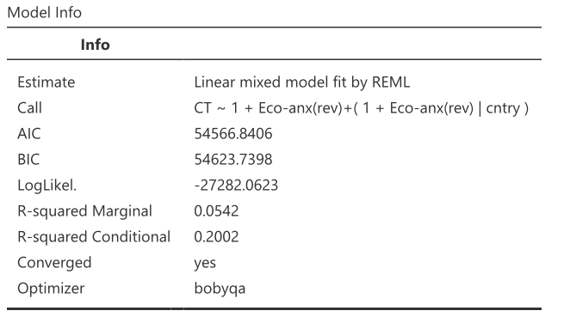
Understaning the relationships: Doom & Gloom

Slide 75
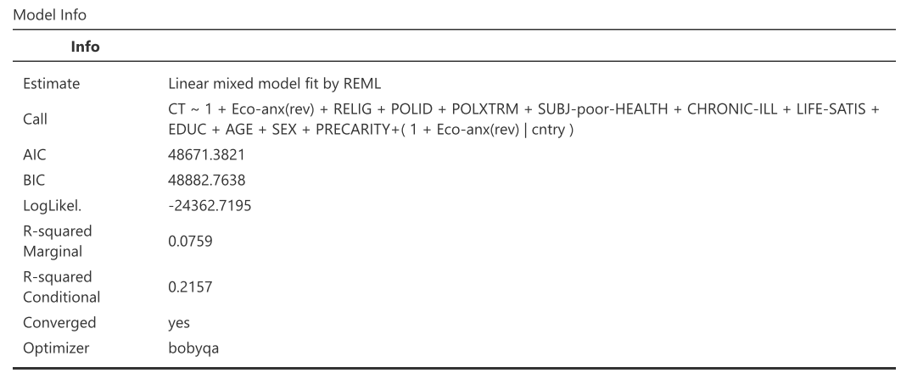
Understaning the relationships: Doom & Gloom

Slide 76
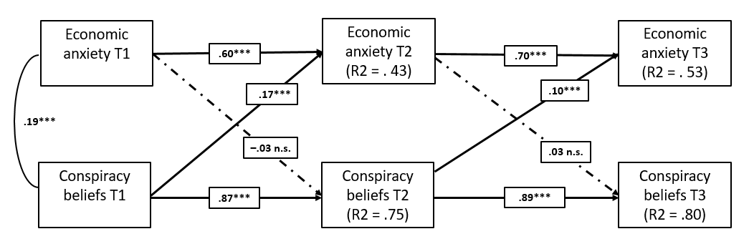
Understaning the relationships: Doom & Gloom

Slide 77
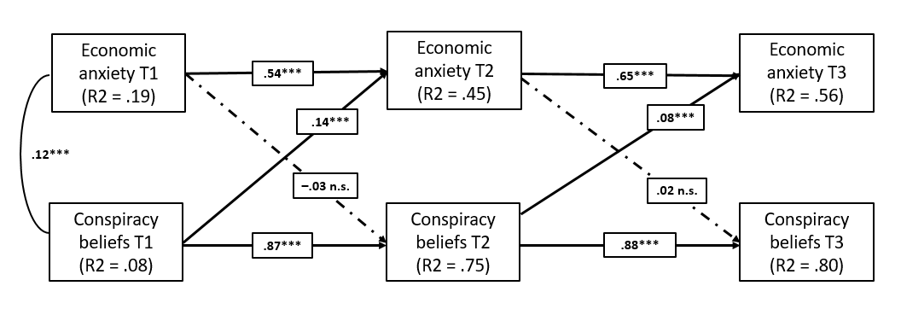
Understaning the relationships: Doom & Gloom

Slide 78
Understaning the relationships: Doom & Gloom
age, gender, education and subjective socio-economic status measured in the first wave of the data collection

Slide 79
Understaning the relationships
Institutional
trust
Experience of precarity
Conspiracy
beliefs

Slide 80
Understaning the relationships: LongiRepli
Model fit: x2(7) = 7.53, p = .376, CFI = 1.00, TLI = 1.00, RMSEA = .009, SRMR = .010
sx3 = .21***
Precarity T1
Precarity T2
Precarity T3
sx1 = .51***
sx2 = .54***
b3 = –.11**
b4 = –.03
–.11**
c2 = –.01
–.08*
c1 = –.05**
sm3 = .34***
a2 = .01
a1 = .00
Institutional trust T1
Institutional trust T2
Institutional trust T3
.17***
sm1 = .81***
sm2 = .54***
.09**
a3 = –.06*
a4 = –.07**
–.72***
c3 = .10*
c4 = .08*
–.20***
b1 = –.22***
b2 = –.08***
Conspiracy beliefs T1
Conspiracy beliefs T2
Conspiracy beliefs T3
sy1 = .69***
sy2 = .52***
sy3 = .35***
Indirect presumed longitudinal path: a1*b2 = –.00, p = .96
Indirect opposite longitudinal path: a3*b4 = .00, p = .40

Slide 81
The social psychological reality of CBs

Slide 82
The social psychological reality of CBs
Sense-making processes and conspiracy mentality may be an inherent aspect of human psychology but they manifest themselves more easily under specific structural conditions.

Slide 83
The social psychological reality of CBs
Structural factors and their associations with individual characteristics and experiences of existential threats would open an interesting avenue for understanding the psychology of CBs and developing more effective anti-CBs interventions

Slide 84
Structural factors
quality of democratic institutions and governance

Slide 85
Structural factors
quality of democratic institutions and governance
corruption

Slide 86
Structural factors
quality of democratic institutions and governance
corruption
socioeconomic inequality

Slide 87
Structural factors
quality of democratic institutions and governance
corruption
socioeconomic inequality
economic development and GDP per capita

Slide 88
Structural factors
quality of democratic institutions and governance
corruption
socioeconomic inequality
economic development and GDP per capita
precarity and economic anxiety

Slide 89
Structural factors
quality of democratic institutions and governance
corruption
socioeconomic inequality
economic development and GDP per capita
precarity and economic anxiety
institutional trust

Slide 90
Structural factors
quality of democratic institutions and governance
corruption
socioeconomic inequality
economic development and GDP per capita
precarity and economic anxiety
institutional trust
anomie

Slide 91
Structural factors
quality of democratic institutions and governance
corruption
socioeconomic inequality
economic development and GDP per capita
precarity and economic anxiety
institutional trust
anomie
(e.g., Alper, 2023; Cordonier et al., 2021; Hornsey et al., 2023; Hornsey & Pearson, 2022; Jetten et al., 2022)

Slide 92
Structural factors
quality of democratic institutions and governance
corruption
socioeconomic inequality
economic development and GDP per capita
precarity and economic anxiety
institutional trust
anomie
(e.g., Alper, 2023; Cordonier et al., 2021; Hornsey et al., 2023; Hornsey & Pearson, 2022; Jetten et al., 2022)

Slide 93
Structural factors
quality of democratic institutions and governance
corruption
socioeconomic inequality
economic development and GDP per capita
precarity and economic anxiety
institutional trust
anomie
(e.g., Alper, 2023; Cordonier et al., 2021; Hornsey et al., 2023; Hornsey & Pearson, 2022; Jetten et al., 2022)

Slide 94
The outline
Conspiracy beliefs

Slide 95
The outline
Individual-level factors
Conspiracy beliefs

Slide 96
The outline
Individual-level factors
Existential
threats
Conspiracy beliefs

Slide 97
The outline
Individual-level factors
Existential
threats
Conspiracy beliefs
Structural-level factors

Slide 98
The outline
Individual-level factors
Existential
threats
Conspiracy beliefs
Subjective appraisal of structural factors
Structural factors

Slide 99
The outline
Individual-level factors
Existential
threats
Conspiracy beliefs
Structural-level factors
Subjective appraisal

Slide 100
The outline
Individual-level factors
Existential
threats
Conspiracy beliefs
Structural-level factors
Subjective appraisal

Slide 101
The outline
Individual-level factors
Existential
threats
Conspiracy beliefs
?
Structural-level factors
Subjective appraisal

Slide 102
The outline
Individual-level factors
?
Existential
threats
Conspiracy beliefs
Structural-level factors
Subjective appraisal

Slide 103
The outline
Individual-level factors
Existential
threats
Conspiracy beliefs
Structural-level factors
Subjective appraisal

Slide 104
The outline
Individual-level factors
Existential
threats
Conspiracy beliefs
?
Structural-level factors
Subjective appraisal

Slide 105
The outline
?
Individual-level factors
Existential
threats
Conspiracy beliefs
Structural-level factors
Subjective appraisal

Slide 106
The outline
Individual-level factors
Existential
threats
Conspiracy beliefs
Structural-level factors
Subjective appraisal

Slide 107
The outline
Individual-level factors
Existential
threats
Conspiracy beliefs
Structural-level factors
Subjective appraisal

Slide 108
The outline
Individual-level factors
Existential
threats
Conspiracy beliefs
Structural-level factors
Subjective appraisal

