Slide 1
Product and Service Dominant Logic
Introduction to Service Science
© Leonard Walletzký

Slide 2
History of economics paradigms
Economics Offering | Commodity Goods | Packaged Goods | Commodity Services | Consumer Services | Business Services
Economy | Agrarian | Industrial | Service | Experience | Transformation
Economic Function | Extract | Make | Deliver | Stage | Co-create value growth
Nature of Offering | Fungible | Tangible | Intangible | Memorable | Effectual
Key Attribute | Natural | Standard | Custom | Personal | Value growth relationship
Method of Supply | Stored in Bulk | Inventory of product | Delivered on demand | Reveal over duration | Sustained over time
Settler | Trader | Manufacturer | Provider | Stager | Collaborator
Buyer | Market | Customer | Client | Guest | Collaborator
Factors of Demand | Characteristics | Features | Benefits | Sensations | Capabilities (Cultural values)

Slide 3
Product dominant logic paradigms
A manufacturer develops a product
The manufacturer makes the product
The product is given to the market
A consumer buys the product
The consumer uses the product
The supplier eventually provides additional support of the product
The consumer gets rid of the product

Slide 4
Product dominant logic
The process is considered as an ownership transfer
The producer and buyer are not closely connected
  They are in touch only in the moment of ownership transfer
The product is tangible and it is easy to convert it to money
The major task in production is an optimization of product quantity according to fixed and variable costs
The main goal is to achieve maximum profit in short term
Only difference for the services is immateriality

Slide 5
Service Economy
Service is
  Associated with the work that servants did for their masters
  Set of the benefits delivered from accountable service provider, mostly in close coaction with his service suppliers, generated by the functions of technical systems and/or by distinct activities of individuals, commissioned acording to the needs of his service customers
  Application of specialized competencies through deeds, processes and performances for benefit of another entity or entity itself (Vargo and Lush)
  Application of competencies for the benefit of another, meaning that service is kind of action, performance or promise that is exchanged for value between provider and client (Spohrer)

Slide 6
Service dominant logic
The emphasis is not on tangible product
  Is on services the customer can get
No matter if the service is realized through the product or someone else to perform the service
Ownership is not important
The customer obtain benefits by renting to:
  use a physical object
  hire the labor and expertise
  pay for access to facilities and networks

Slide 7
Service dominant logic
Customers do not buy goods or services
  They buy offerings which render services that create value
Traditional division between goods and services is outdated
  Activities render services
  Things render services
The shift in focus to services leads to shift from producer perspective to customer perspective

Slide 8
Service system
Provider
  Individual
  Organization
  Technology that provider is responsible for
Client
  Individual
  Organization
  Portion of reality owned by Client
Target
  The reality to be transformed or operated on by Provider for sake of Client
  People, dimensions of business
  Dimensions of products, technology artefacts & environment
  Information, codified knowledge

Slide 9
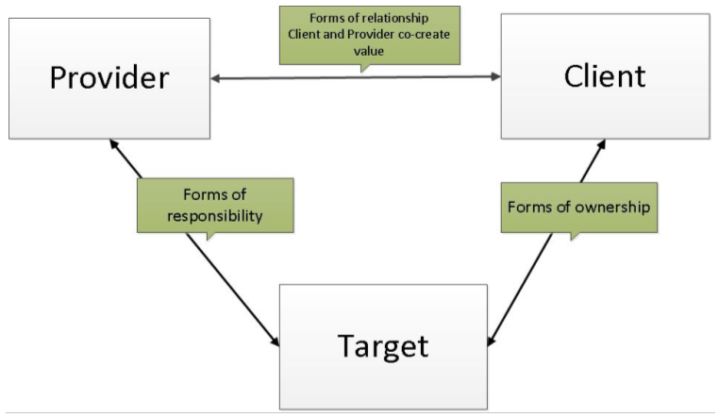
Service system

Slide 10
Basic Service Economy Paradigms
Service is the fundamental basis of exchange
The customer is always a co-creator of the value
All social and economics actors are the resource integrators
Value is always uniquely and phenomenologically determined by the beneficiary

Slide 11
Service is the fundamental basis of exchange
The application of operant resources
  The seller uses his resources to provide the service
The basis for all exchange
  There is not possible to simply exchange the product without using services or this possibility is only marginal
Service is exchanged for service
  Services must be used on both sides of the market to finish the transaction

Slide 12
The customer is always a co-creator of the value
The role of the customer is interactional
The customer can not be ignored
Without interaction with the customer the transaction can not be finished

Slide 13
All social and economics actors are the resource integrators
Value creation is network of networks
The sellers needs to buy other services
The integration of the resources is kind of the service

Slide 14
Value is always uniquely and phenomenologically determined by the beneficiary
Value is
  Idiosyncratic
  Experiential
  Contextual
  Meaning laden
The provider is not able to set the value alone

Slide 15
Advanced SDL Paradigms
Indirect exchange masks the fundamental basis of exchange
Goods are distribution mechanism for service provision
Operant resources are the fundamental source of competitive advantage
All economies are service economies
The enterprise cannot deliver value, but only value proposition
A service-centered view is inherently customer oriented and relational

Slide 16
Comparsion
Product Dominant Logic
Customer is value destroyer
Customer has limited power to impact quality or features
Customer is motivated to destroy goods to buy new one
Seller is maximizing short time profit
Service Dominant Logic
Customer is value co-creator
Customer communicate with seller about all features of the service
Long time relationship is preferred
Seller is maximizing the long time profit

Slide 17
Conclusion
Product Dominant Logic
Service Dominant logic
The paradigms of PDL and SDL
The examples of PDL and SDL

