Slide 1


Slide 2

Hadoop implementation of MapReduce computational model
Ján Vaňo

Slide 3
What is MapReduce?
A computational model published in a paper by Google in 2004
Based on distributed computation
Complements Google‘s distributed file system (GFS)
Works with key:value pairs

Slide 4
Why MapReduce?
It is the ‚answer‘ for Big Data problem
Runs on commodity hardware
Very scalable solution

Slide 5
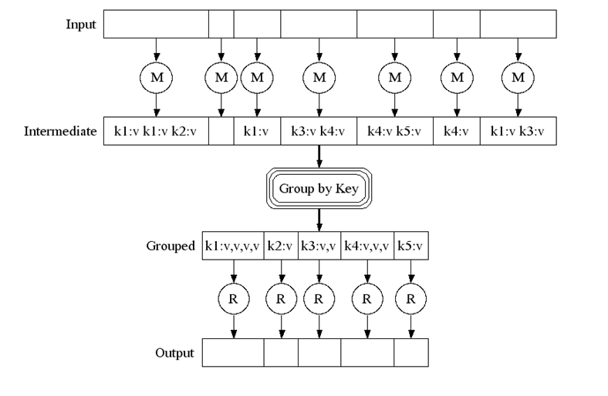
MapReduce model

Slide 6
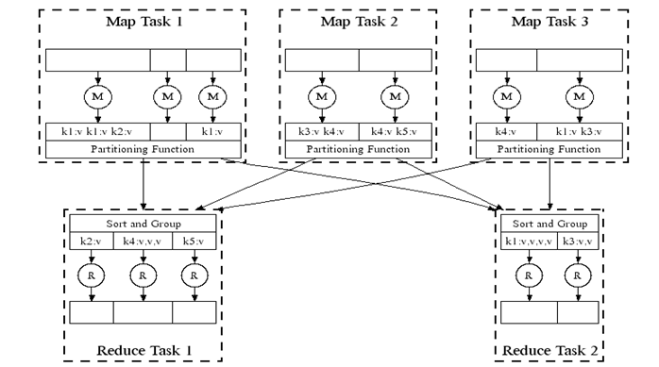
MapReduce model

Slide 7
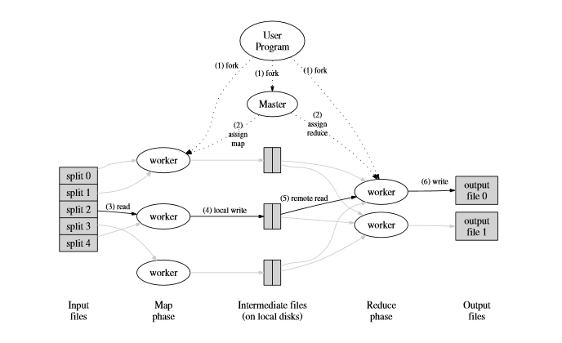
MapReduce model

Slide 8
MapReduce alternatives
Hadoop – Top-level Apache project
Spark – University of Berkeley project
Disco – Open source Nokia project
MapReduce-MPI – US Department of Energy project
MARIANE – academic project of University of Binghamton
Phoenix – University of Stanford project
BashReduce - MapReduce for std. Unix commands

Slide 9
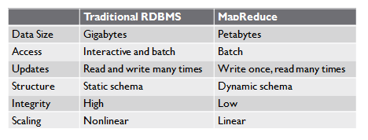
MapReduce vs. RDBMS

Slide 10
Data Structure
Structured Data – data organized into entities that have a defined format.
  Realm of RDBMS
Semi-Structured Data – there may be a schema, but often ignored; schema is used as a guide to the structure of the data.
Unstructured Data – doesn’t have any particular internal structure.
MapReduce works well with semi-structured and unstructured data.

Slide 11
What is Hadoop?
Software platform that lets one easily write and run applications that process vast amounts of data
Hadoop is most popular implementation of MapReduce so far

Slide 12
Why Hadoop?
It has been Apache top-level project for a long time (6 years)
Hadoop Ecosystem
Hadoop exclusive technologies

Slide 13
Why Hadoop?
Scalable: It can reliably store and process petabytes
Economical: It distributes the data and processing across clusters of commonly available computers (in thousands)
Efficient: By distributing the data, it can process it in parallel on the nodes where the data is located
Reliable: It automatically maintains multiple copies of data and automatically redeploys computing tasks based on failures

Slide 14
Brief history
2002 - Project Nutch started (open source web search engine) – Doug Cutting
2003 - GFS (Google File System) paper published
2004 - Implementation of GFS started
2004 - Google published MapReduce paper
2005 - Working implementations of MapReduce and GFS (NDFS)
2006 - System applicable beyond realm of search
2006 - Nutch moved to Hadoop project, Doug Cutting joins Yahoo!
2008 - Yahoo!s production index generated by 10,000 core Hadoop cluster
2008 - Hadoop moved under Apache Foundation
April 2008 - Hadoop broke world record - fastest sorting of 1 TB of data (209 seconds, previously 297)
November 2008 - Google's implementation sorted 1 TB in 68 seconds
May 2009 - Yahoo! team sort 1 TB in 62 seconds

Slide 15
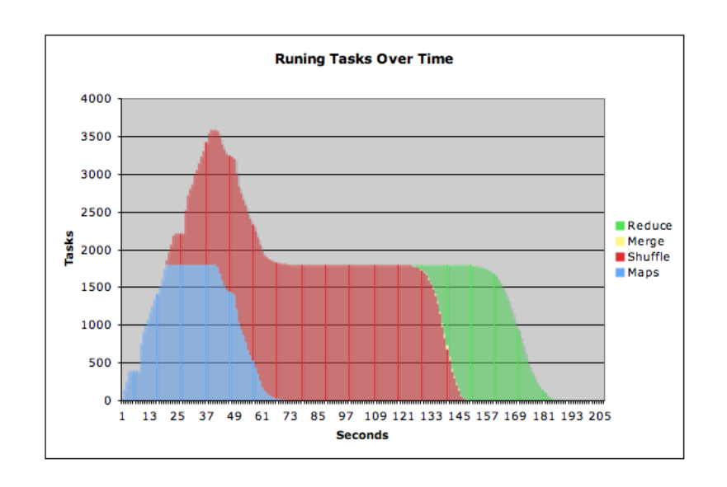
1TB sort by Hadoop

Slide 16













Who uses Hadoop?

Slide 17
Assumptions
Hardware will fail
Processing will be run in batches. Thus there is an emphasis on high throughput as opposed to low latency
Applications that run on HDFS have large data sets. A typical file in HDFS is gigabytes to terabytes in size
It should provide high aggregate data bandwidth and scale to hundreds of nodes in a single cluster. It should support tens of millions of files in a single instance
Applications need a write-once-read-many access model
Moving Computation is Cheaper than Moving Data
Portability is important

Slide 18
Hadoop modules
Hadoop Common - contains libraries and utilities needed by other Hadoop modules
Hadoop Distributed File System (HDFS) - a distributed file-system that stores data on the commodity machines, providing very high aggregate bandwidth across the cluster
Hadoop MapReduce - a programming model for large scale data processing
Hadoop YARN - a resource-management platform responsible for managing compute resources in clusters and using them for scheduling of users' applications
  Provides base for MapReduce v2

Slide 19
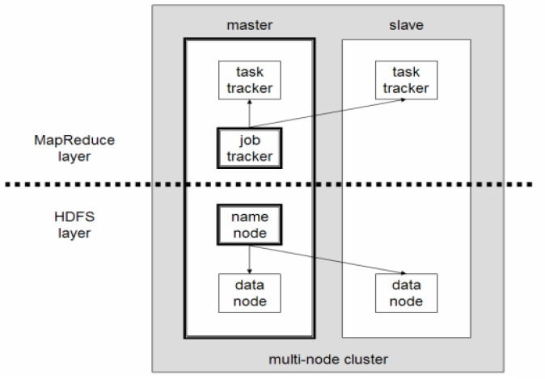
Hadoop architecture

Slide 20
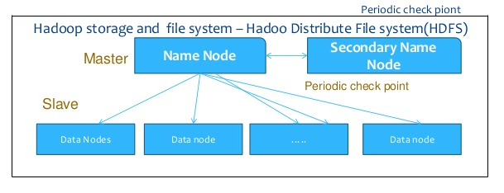
HDFS architecture

Slide 21
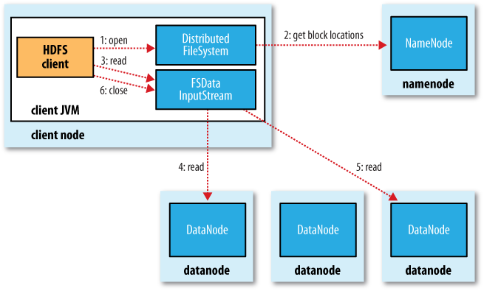
HDFS architecture (reading)

Slide 22
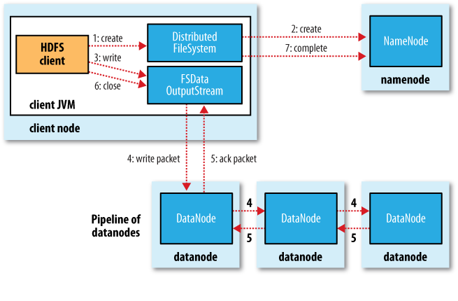
HDFS architecture (writing)

Slide 23
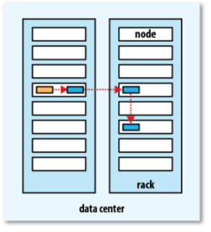
Data replication in HDFS

Slide 24
How to use Hadoop MapReduce?
Implement 2 basic functions:
  Map
  Reduce
Implement Driver class

Slide 25
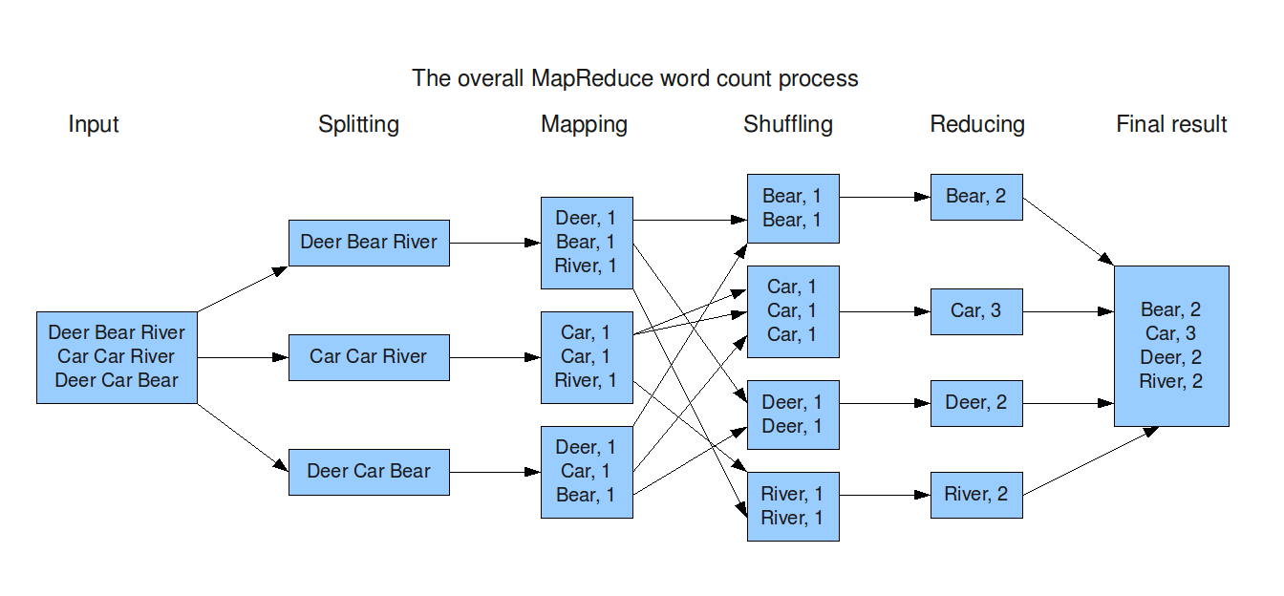
MapReduce structure

Slide 26
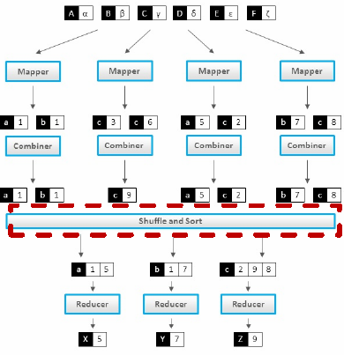
MapReduce structure

Slide 27
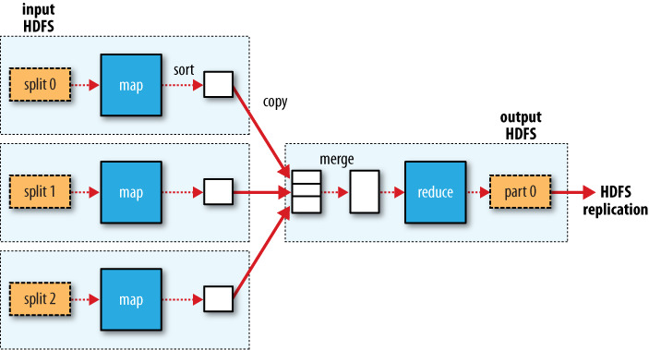
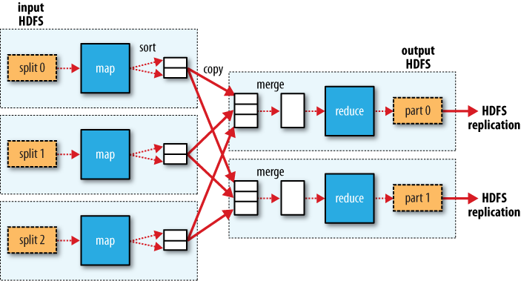
MapReduce structure

Slide 28
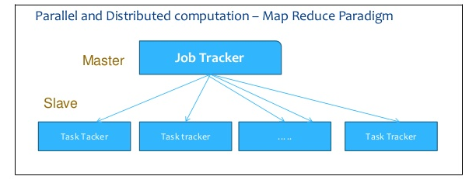
Job submission (MapReduce v1)

Slide 29
Job submission (MapReduce v1)
Client applications submit jobs to the Job tracker
The JobTracker talks to the NameNode to determine the location of the data
The JobTracker locates TaskTracker nodes with available slots at or near the data
The JobTracker submits the work to the chosen TaskTracker nodes
The TaskTracker nodes are monitored. If they do not submit heartbeat signals often enough, they are deemed to have failed and the work is scheduled on a different TaskTracker

Slide 30
Job submission (MapReduce v1)
A TaskTracker will notify the JobTracker when a task fails. The JobTracker decides what to do then: it may resubmit the job elsewhere, it may mark that specific record as something to avoid, and it may may even blacklist the TaskTracker as unreliable
When the work is completed, the JobTracker updates its status
Client applications can poll the JobTracker for information

Slide 31
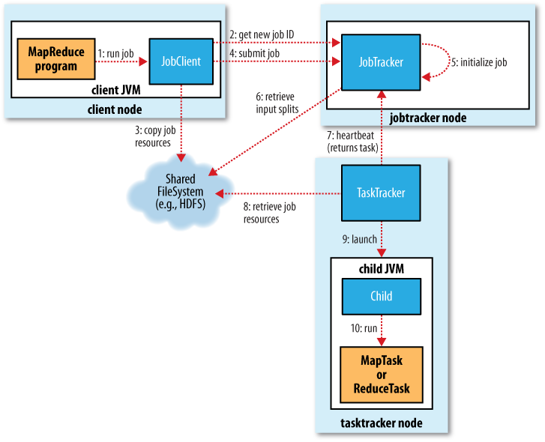
Job flow (MapReduce v1)

Slide 32
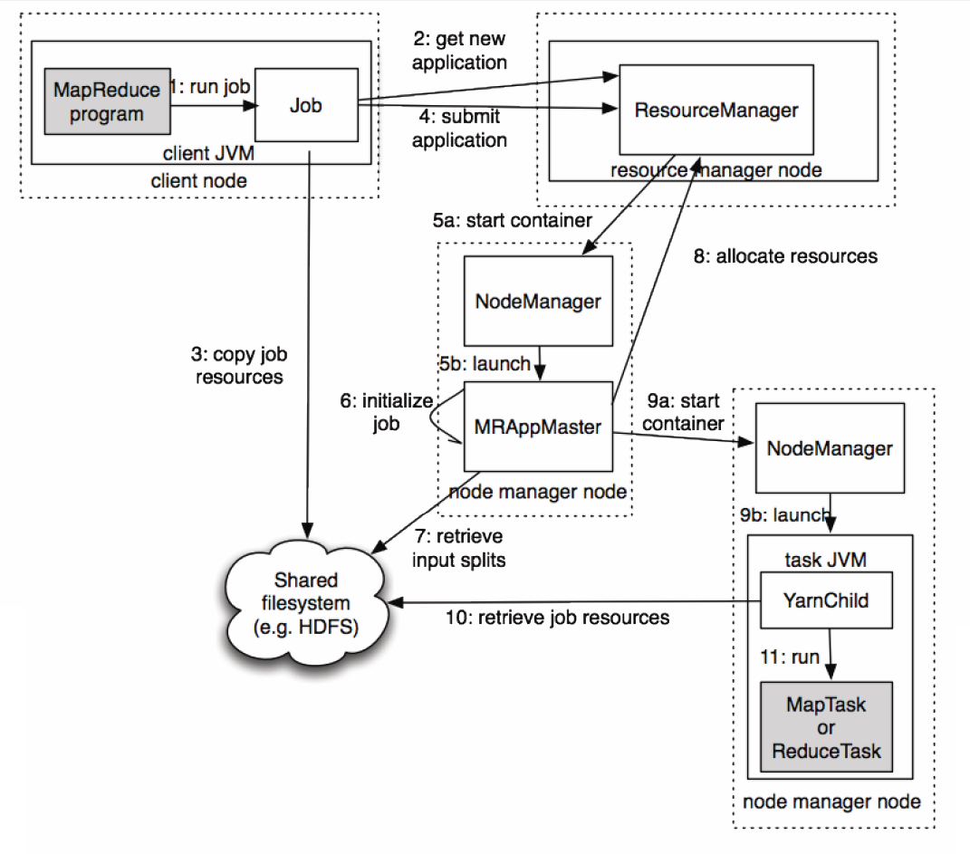
Job flow (MapReduce v2)

Slide 33
Hadoop Ecosystem
Apache Avro (serialization system for persistent data)
Apache Pig (high-level dataflow querying language)
Apache Hive (data warehouse infrastructure)

Slide 34
Hadoop Ecosystem
Apache HBase (database for real-time access)
Apache Sqoop (tool for moving data from SQL to Hadoop or opposite)
Apache ZooKeeper (distributed coordination service providing high availability) – library for building distributed systems

Slide 35
Hadoop exclusive technologies
YARN – Yet Another Resource Negotiator
HDFS federation – possibility of partitioning namespace across several namenodes to support high number of files
HDFS high-availability – techniques for for removing the namenode as the single point of failure

Slide 36
Examples of production use
Yahoo! : More than 100,000 CPUs in ~20,000 computers running Hadoop; biggest cluster: 2000 nodes (2*4cpu boxes with 4TB disk each); used to support research for Ad Systems and Web Search
Facebook: To store copies of internal log and dimension data sources and use it as a source for reporting/analytics and machine learning; 320 machine cluster with 2,560 cores and about 1.3 PB raw storage

Slide 37
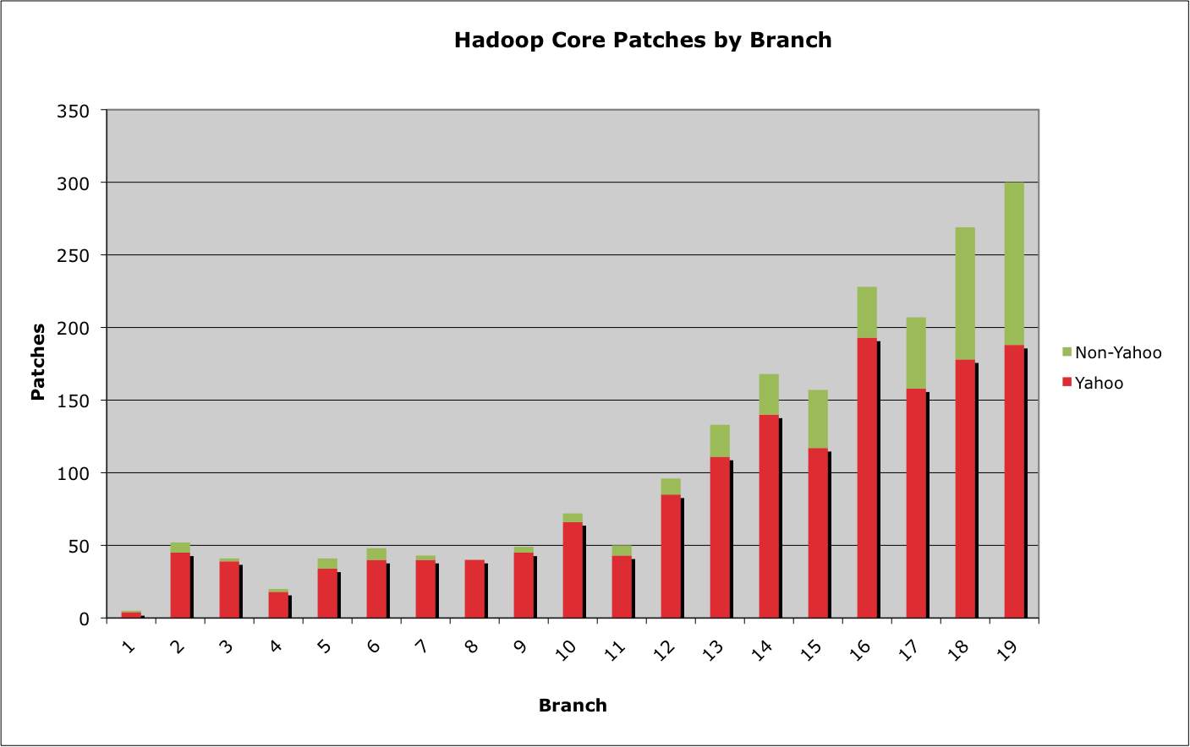
Size of releases

Slide 38
Hadoop
+ Framework for applications on large clusters
+ Built for commodity hardware
+ Provides reliability and data motion
+ Implements a computational paradigm named Map/Reduce
+ Very own distributed file system (HDFS) (very high aggregate bandwidth across the cluster)
+ Failures handles automatically

Slide 39
Hadoop
- Time consuming development
- Documentation sufficient, but not the most helpful
- HDFS is complicated and has plenty issues of its own
- Debugging a failure is a "nightmare"
- Large clusters require a dedicated team to keep it running properly
- Writing a Hadoop job becomes a software engineering task rather than a data analysis task

