Slide 1

Multi-object Similarity Query Evaluation
Michal Batko

Slide 2
Motivation
Applications where we have
  multiple samples of the search object
  best match to any of the given objects
Examples
  Multiple camera shots
    Tourist takes multiple pictures of a building
  Face recognition
  3D scanned input
  …

Slide 3
Multi-object Query Definition
Regular similarity query-by-example
  one query object + parameters
Multi-object query Q({q₁, q₂, …, q_{n}}, params)
  several query objects + parameters
  goal is to find the results that are best
  with respect to any of the query objects
k = 5
r
q2
q2
r
q1
q1
Range query – R({q1,q2}, r)
kNN query – kNN({q1,q2}, k)

Slide 4
State of the Art
Relational databases
  Optimizations for searching multiple values in indexes
Text search
  Special case: multiple query documents
    Combined vector of keywords (cannot just boost the frequencies)
Multi-modal search
  Specialization of the technique:
    Only one domain, minimum aggregation function
Vector space approach
  Compute a new single-query object
Tree structure evaluation extension
  Multiple paths of a tree are traversed

Slide 5
Base-line Approach
(Multi-modal search)
Evaluate a separate query for each query object
Merge the results
Pros
  Use engine without modification
  Can evaluate any query
Cons
  Same part of the index is likely visited multiple times
  Parallelization drawback
Multi-object query
q₁
q₂
Query
Query
Search engine
Result 1
Result 2
Merged result

Slide 6
Vector space approach
Compute a single query
  Can be centroid of the queries or some specialized algorithm that utilizes other knowledge about the space
Execute as normal single query
Pros
  Use engine without modification
Cons
  Need to specify the query merging algorithm
  Approximation
Multi-object query
q₁
q₂
q₁+q₂
Search engine
Result

Slide 7
Tree-based approach
Modify tree traversal
  In each branch, traverse if any of the query objects matches
Pros
  Efficient, precise
  Data are accessed once
Cons
  Specialized structure is needed
  Usable for “prunable” queries
    such as range query
    modification for kNN exists
      traverse to most likely leaf for each query
      use the radius to backtrack
Multi-object query
q₁
q₂
Search engine
Result

Slide 8
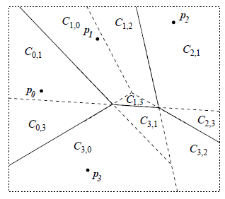
Hash-based approach
(M-Index)
Inspired by the tree multi-object search
  Compute the hash function for each query object
    If a tree is used to compute the hash, use tree m-o-q
  Expand the accessed buckets to the neighbors
    Using the heuristic for computing the adjacent cell probability
  Sort the buckets according to the minimum distance to the set of query objects
    Could be incorporated into the heuristic?

Slide 9
Hash-based approach
(M-Index)

Slide 10
Conclusion
Multi-object query
  Potentially useful in various application
  Not much studied in context of similarity search
Algorithm for M-Index can be designed
  Heuristic for finding the best-match buckets needs to be properly specified and evaluated
Explore the properties of Voronoi space
  Can the promising cells be identified directly?

