Slide 1
Annotation Framework & ImageCLEF 2014
Jan Botorek, Petra Budíková
10. 3. 2014

Slide 2
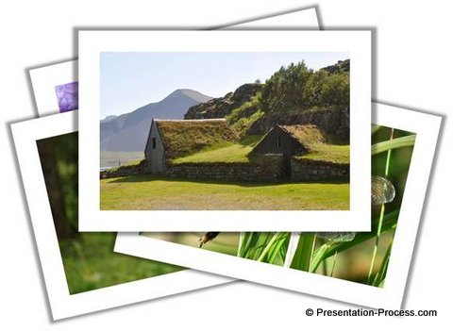


Annotation Tool
WordNet
Visual Concept Ontology
MUFIN visual object search
Annotation tool + MUFIN
House
Nature
Forest
Tree
…
Profimedia

Slide 3

What is ImageCLEF?
Competition regarding cross-language annotation and retrieval of images
Different areas of interest:
  Robot vision – object recognition
  Plant identification
  Medical image identification
  Concept Image Annotation
    Goal: From a given set of concepts, select those that are relevant for an input image

Slide 4
  Concept Image Annotation in 2014
Focus on scalability – no manually labeled training data
Noisy training data downloaded from internet are only available
Development data – 10000 images with ground truth concepts
Participants are allowed to use no manually labeled training data that was created directly for machine learning
  Profiset is OK, since it is a by-product of another activity (image selling)
4

Slide 5
CLEF Annotation Task vs. our annotation tools
Our long-time research objective: general image annotation without well-labeled training data
  „Big Data approach“
  Primarily focused on description of noun objects
  Difficult to evaluate
CLEF: Annotation contest with ground truth
  Considers nouns, adjectives and verbs
  Participants typically use model-based approaches
5

Slide 6
Competition’s benefits for us
Evaluation of our tools on a well-known ground truth
  Images of numerous types and situations are included in the CLEF collection as a training and development material.
Compare our ideas to solution with other teams
Utilize our current approach to the image annotation process in the practice
  With a feedback from the initiators
Long-time objective: journal paper about search-based annotation, CLEF results as part of evaluation
6

Slide 7
What we plan to utilize?
WordNet-based relations
  Must be accustomed to the given word types (not just nouns)
WordNet-based word similarity metrics
Visual Concept Ontology
Similar Images search – powered by MUFIN
Co-occurrence relations among words within Profimedia dataset
  Constructed by Institute of Formal and Applied Linguistics (MFF UK)
7

Slide 8
WordNet vs. co-occurence
WordNet – fundamental technology
  Meanings, relations, multiple word types
  Hypernymy, antonymy, part-whole, gloss…
  “language” point of view
Co-occurrence table of related words
  Constructed from very large text corpora (linguists from MFF UK)
  For each word that occurrs in Profiset descriptions, we have 100 most co-occurred words
    No word types attached
  “human/database” point of view
8

Slide 9
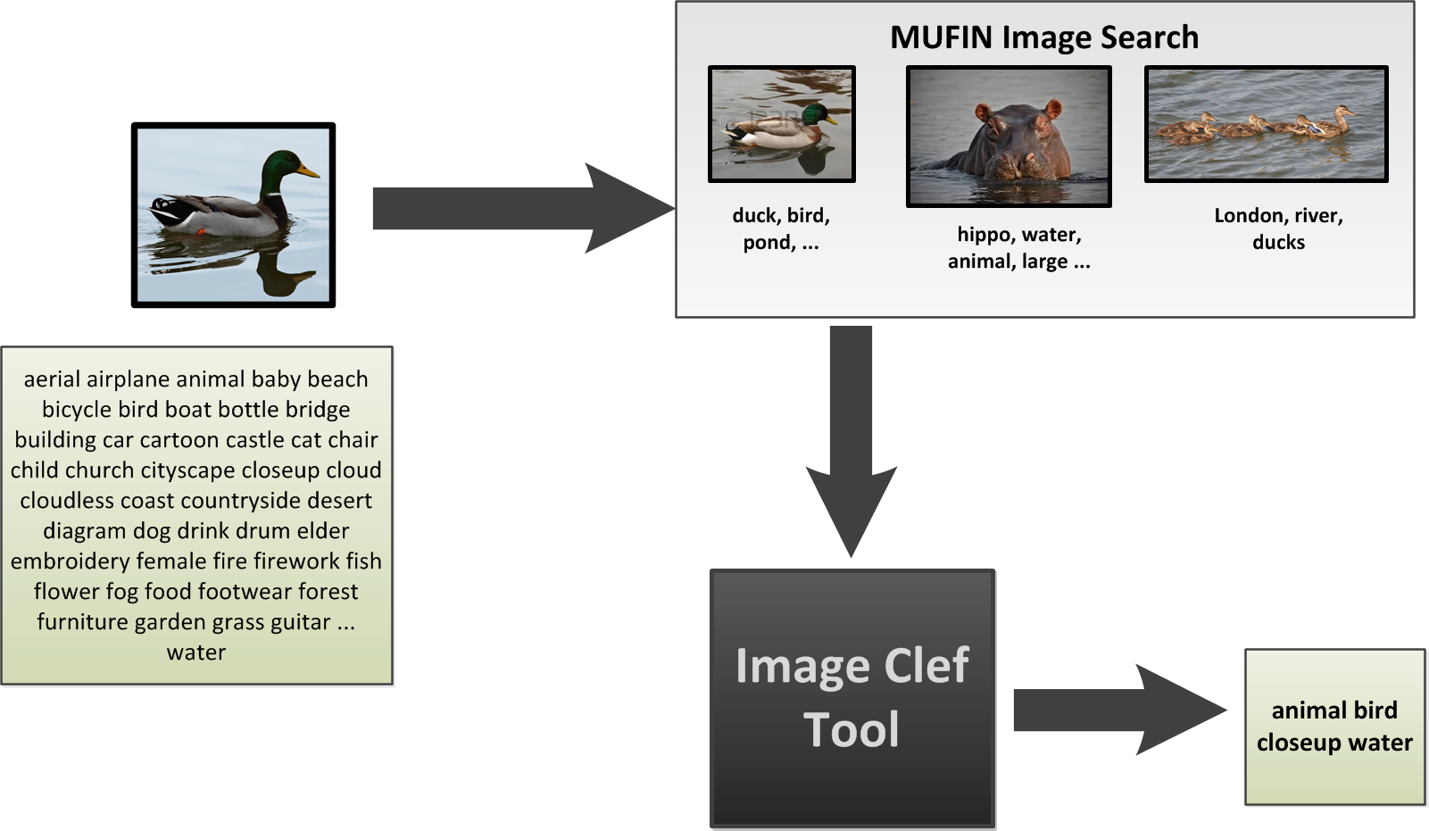
Our approach I. Overall View
?
9

Slide 10
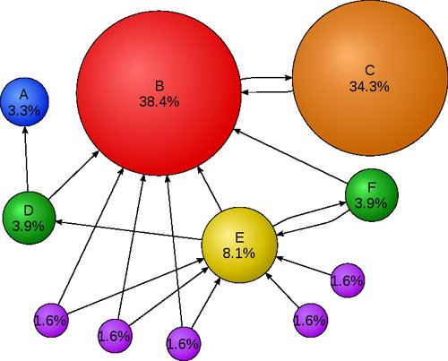
Our approach II.
Network example
distribute probabilities – PageRank style
10

Slide 11
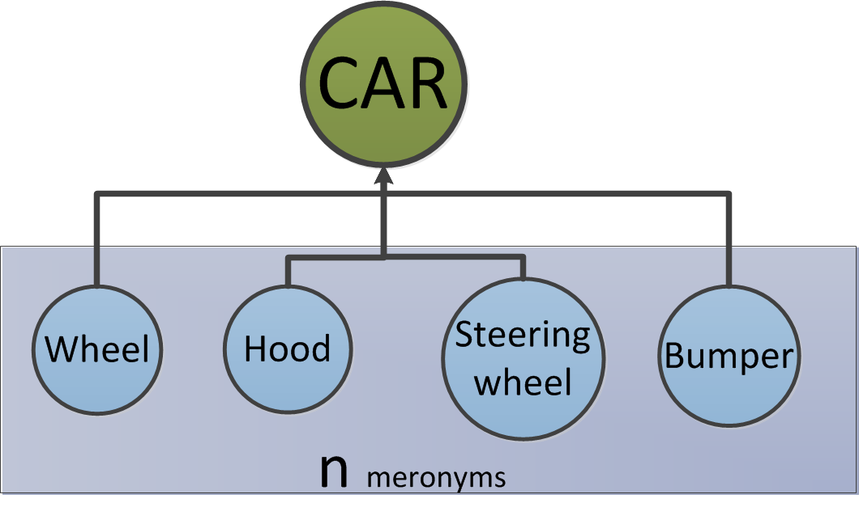
Our approach III.
The probability-transfer network
The probability-transfer coefficients of links between individual nodes are defined for different types of relations: hypernymy, synonymy, meronymy, word co-occurrence, …
E.g. Meronyms (whole -> parts): (1-l)/n
l: calibration constant
11

Slide 12
Our approach IV.
Algorithm steps
1) Assign probability values to initial nodes
2) Build the network
  Extend initial nodes by related synsets AND co-occurred words
  Assign “probability-transfer coefficients” to links between nodes (determined by the type of relationship)
3) “Page-ranking” process
  Run a process where synsets will mutually boost one another’s probability values
4) Select the most probable synsets
12

Slide 13
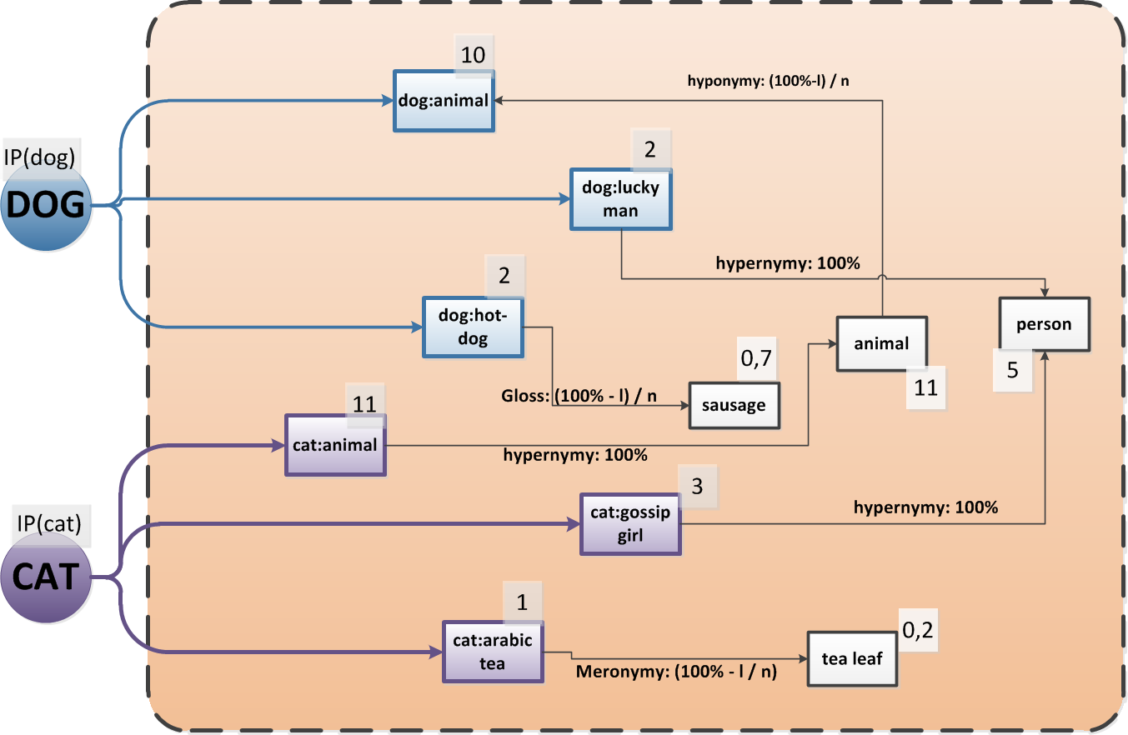
Our approach V: Network example

Slide 14
Our approach VI.
Unresolved issues
Calibration of probability-transfer coefficients
  What constants should be used?
Initial step: assignment of initial probabilities for particular annotation words
Details of the probability transfer algorithm
Final step: Selecting of the most probable concepts
14

Slide 15
Summary
Problem
  Select descriptive words of given image from a predefined set of concept words
Our approach
  Construction of a network of synsets; a node (synset) influences another’s probability by mutual relations
    Inspired by page-ranking algorithm
Main research objectives
  Design and construct a model of the synset network
  Define and calibrate relations (links) among nodes in the network (synsets)
15

