Slide 1
Business Model Patterns
Based on book Business Model Generation by A. Osterwalder & Y. Pigneur

Slide 2
Business Model Pattern
By A. Osterwalder & Y. Pigneur
“Pattern in architecture is the idea of capturing architectural design ideas as archetypal and reusable descriptions.”
Business Models with similar characteristics, similar arrangements of business model Building Blocks, or similar behaviors can be distilled into the form of Business Model Pattern.
Christopher Alexander, Architect

Slide 3
The Long Tail (1)
coined by Chris Anderson
Long Tail Business Models are about selling less of more
focus on offering a large number of niche products, each of which sells relatively infrequently
aggregate sales of niche items can be as lucrative as the traditional model whereby a small number of bestsellers account for most revenues
Long Tail business models require low inventory costs and strong platform to make niche content readily available to interested buyers.

Slide 4
The Long Tail (2)
By A. Osterwalder & Y. Pigneur
# of Sales
Top 20%
Focus on a small number of products each selling in high volume.
Long Tail
Focus on a large number of products, each selling in low volumes.
# of Products

Slide 5
The Long Tail Enablers
according to Chris Anderson
Democratization of tools of production
falling technology costs gave individuals access to tools that were prohibitively expensive just few years ago
amateurs can record movies, produce short films, design simple software
Democratization of distribution
Internet dramatically lowered inventory, communications, and transaction costs, opening up new markets for niche digital products.
Falling search costs to connect supply with demand

Slide 6
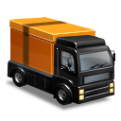
The Long Tail Example Lulu.com
By A. Osterwalder & Y. Pigneur
KP
KA
VP
CR
CS
-
Platform Development
Logistics
Self-Publishing Services
Marketplace for Niche Content
Communities of Interest
Online Profile
Niche Authors
Niche Audiences
KR
CH
Platform
Print-on-demand Infrastructure
Lulu.com
C$
R$
Platform Management & Development
Sales Commissions (Low)
Publishing Service Fees
Notes:
Publishing services:
* marketing packages
* distribucni packages – dostanete se eBay, Amazon.com
* book reviews
* pre-publish packages – better cover, better formatting, ePub conversion, editorial quality review
Other examples: eBay, Youtube, Netflix

Slide 7
Multi-Sided Platforms
By A. Osterwalder & Y. Pigneur
Multi-Sided Platforms (MSPs) bring together two or more distinct but interdependent groups of customers.
MSPs are of value to one group of customers only if the other groups of customers are also present
MSP creates value by facilitating interactions between the different groups
A MSP grows in value to the extent that it attracts more users, a phenomenon known as the network effect.
Known for long time, but proliferated with the rise of information technology.

Slide 8
Multi-Sided Platforms Examples
By A. Osterwalder & Y. Pigneur
Segments linkage examples
Credit cards providers link
merchants with cardholders
Computer OS producers link
HW manufacturers, application developers, and users
Newspapers link
readers with advertisers
Video gaming consoles producers link
game developers with players
The key is that the platform must attract and serve all groups simultaneously in order to create value.
MSPs often face a “chicken and egg” dilemma.

Slide 9
MSPs: Chicken and Egg Dilema Solution
By A. Osterwalder & Y. Pigneur
Subsidizing one of the Customer Segment
by inexpensive or free VP to attract users of the platform’s other side
Examples
Metro newspapers
Microsoft
Question to be answered:
which side to subsidize and how to price correctly?
can we attract sufficient numbers of customers for each side of the platform?
which side is more price sensitive?
can that side be enticed by a subsidized offer?
will the other side of the platform generate sufficient revenues to cover the subsidies?
Notes:
Metro – started in 1995, focused on city commuters focused on young people travelling to work not used to pay for traditional newspaper, therefore they attracted advertiser very quickly
Microsoft – how it makes money? why did Windows happen to be global OS? offered Windows SDK for free and had an OEM aggreement with the OS producers

Slide 10
MSP Example Google.com
By A. Osterwalder & Y. Pigneur
KP
KA
VP
CR
CS
-
Platform Management
Managing Services
Expanding Reach
Targeted Ads
Free Search
Monetizing Content
Google.com
Advertisers
Web Surfers
Content Owners
KR
CH
Search Platform
Google.com
C$
R$
Platform Costs
Keyword Auctions
Free

Slide 11
MSP Example PSP/Xbox
By A. Osterwalder & Y. Pigneur
KP
KA
VP
CR
CS
High Performance Console
Console Audience
Hardcore Gamers
Game Developers
KR
CH
C$
R$
Platform Costs
HW Sales At Loss
Royalties
Notes:
Soustredme se pouze na VP, CS a R$
Console audience ~ Hardcore gamers

Slide 12
MSP Example Wii’s Double impact
By A. Osterwalder & Y. Pigneur
KP
KA
VP
CR
CS
“Family Console”
Access To Console users & Cheap Game Development Costs
Casual Gamers
Game Developers
KR
CH
C$
R$
Platform Costs
Profitable HW Sales
Royalties
Notes:
Different focus
Fun Factor

Slide 13
FREE as Business Model
By A. Osterwalder & Y. Pigneur
In the Free Business Model at least one substantial CS is able to continuously benefit from a free-of-charge offer
Non-paying customers are financed by another part of the business model or by another CS
However, to make profit, an organization offering free products or services must still generate revenues somehow
The question is
how can you systematically offer something for free and still earn substantial revenues?
Notes:
Examples: Metro, Flickr, Open Source, Skype, Google, Free Mobile Phones

Slide 14
Free Business Model Patterns
By A. Osterwalder & Y. Pigneur
Free based on MSP (e.g. Advertising)
Freemium model
provides basic services for free and premium services for a fee
typical for web based services
Bait & Hook
free or inexpensive initial offer lures customers into repeat purchases
see previous slides

Slide 15
Freemium Example Open Source (Red Hat)
By A. Osterwalder & Y. Pigneur
KP
KA
VP
CR
CS
Open Source (Linux) development community
Software support services
Software versioning & testing
Free (Linux) open source based software
Continuously upgraded, services & guaranteed Software
Self-service & direct access to engineers
Self-service users
Enterprise clients
KR
CH
Red Hat (linux) Software
RedHat.com
Red Hat global branches
C$
R$
Elements of a service company
Free software
Professional Subscriptions

Slide 16
Skype Free Services
By A. Osterwalder & Y. Pigneur
KP
KA
VP
CR
CS
Payment Providers
Distribution Partners
Telco Partners
SW Development
Free Internet & Video Calling
Cheap calls to phones (SkypeOut)
Mass Customized
Web Users Globally
People who want to call phones
KR
CH
Software Developers
Software
Skype.com
Headset Partnerships
C$
R$
Software Development
Complaint Management
Free
SkypeOut Pre-paid or Subscription
HW Sales
Notes:
less 10% of customers pays
5+ years old
400 million+ users
100 billion+ free calls generated
2008 revenues of USD 550 mio.

Slide 17
Bait & Hook Examples Free mobile phones
By A. Osterwalder & Y. Pigneur
KP
KA
VP
CR
CS
Device Manufacturers
Services
Free Phones
Subscription
Contractual Lock-in
Customers
KR
CH
Network
C$
R$
Network
Phones
Services
N x monthly subscription
1 x Free
Notes:
Printers providers HP, Espon, Canon

Slide 18
Multiple Business Model
By A. Osterwalder & Y. Pigneur
How to implement inovative business models within long-established organizations?
They already have their business models
It is necessary to find synergy across business models
Integration
Autonomy
Separation
Notes:
Examples: Metro, Flickr, Open Source, Skype, Google, Free Mobile Phones

Slide 19
The Nespresso Success Model
Nescafé
By A. Osterwalder & Y. Pigneur
KP
KA
VP
CR
CS
Retailers
Production Marketing
Dolce Gusto. Mulit-beverage machine & pods
Nescafé: Quality instant coffe
Retail
On-line shop
Mass Market
KR
CH
Manufacturing Plants Brand protfolio
Retail
C$
R$
Marketing & sales production
Sales Through Reatil (Lower margin)
Notes:
Printers providers HP, Espon, Canon

Slide 20
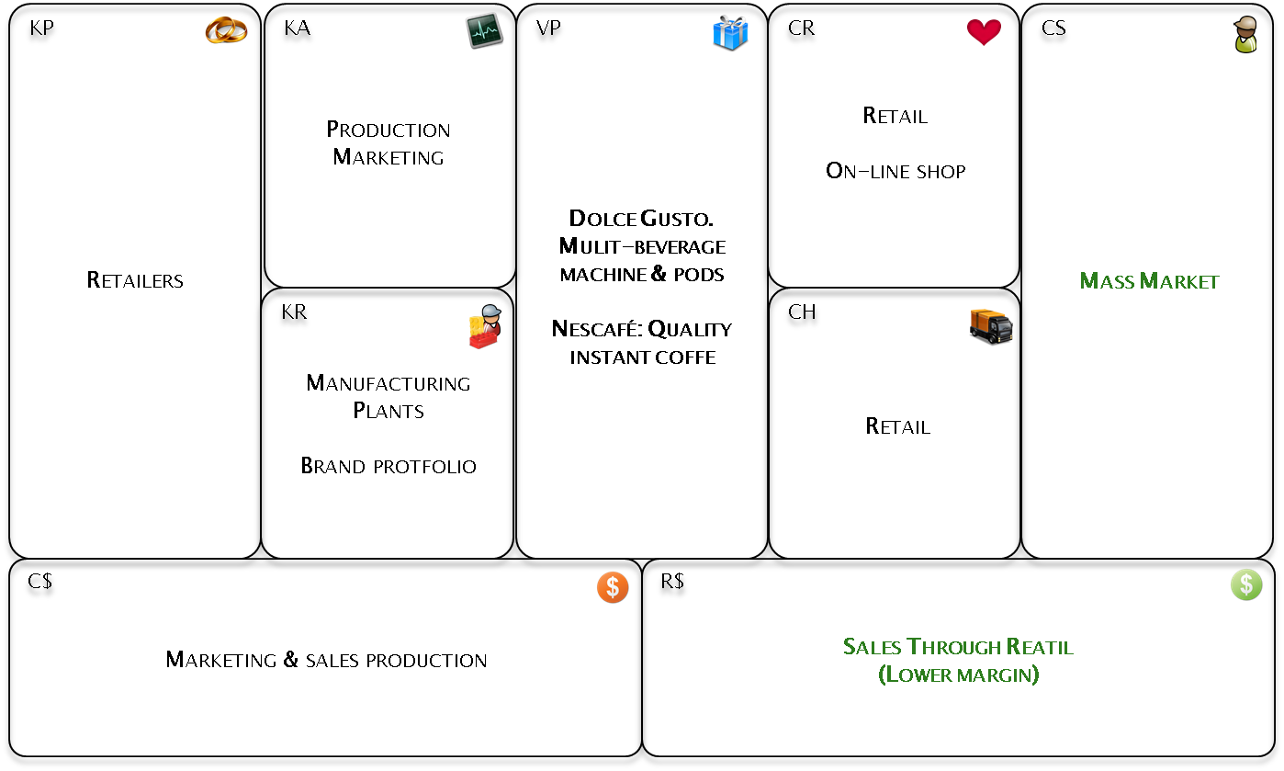
Nespresso
The Nespresso Success Model
KP
KA
VP
CR
CS
Coffee machine manufacturers
Production Marketing
Logistics
High-ned restaurant quality espresso at home
Nespresso club
Households
Office market
CH
Nespresso.com
Nespresso Boutiques
Call center
Retail (Machines only)
Mail Order
KR
Distribution channels
Patents on system
Brand
Production plants
C$
R$
Manufacturing
Marketing
Distribution & channels
Main revenues: capsules
Others: Machines & accessories

