Slide 2
Introduction Of
Company
KFC, founded and also known as Kentucky Fried Chicken, is a chain of fast food restaurants based in Louisville, Kentucky, in the United States. KFC has been a brand and operating segment, termed a concept of Yum! Brands since 1997 when that company was spun off from PepsiCo as Tricon Global Restaurants Inc.
KFC primarily sells chicken pieces, wraps, salads and sandwiches. While its primary focus is fried chicken, KFC also offers a line of grilled and roasted chicken products, side dishes and desserts. Outside the USA, KFC offers beef based products such as hamburgers or kebabs, pork based products such as ribs and other regional fare.

Slide 3

Type Industry Founded Founder(s) Headquarters Key people Products Revenue Employees Parent Website | Wholly owned subsidiary Restaurants 1930 (original) (North Corbin, Kentucky) 1952 (franchise)(South Salt Lake, Utah) Harland Sanders Louisville,Kentucky ,U.S. Roger Eaton , President Harvey R.Brownlea, COO James O’Reilly, VP for Marketing Fried Chicken, grilled chicken , related Southern foods US $520.3 million (2007) 24,000 (2007) Yumi Brands KFC.com

Slide 4

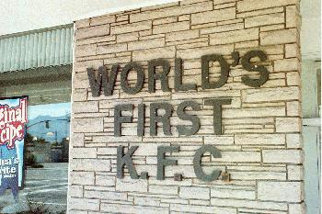
The company was founded as Kentucky Fried Chicken by Colonel Harland Sanders in 1952, though the idea of KFC's fried chicken actually goes back to 1930. Although Sanders died in 1980, he remains an important part of the company's branding and advertisements, and "Colonel Sanders" or "The Colonel" is a metonym for the company itself. The company adopted KFC, an abbreviated form of its name, in 1991. Newer and remodeled restaurants will adopt the new logo and name, while older stores will continue to use the 1980s signage. Additionally, Yum! continues to use the abbreviated name freely in its advertising.
The first KFC restaurant, situated in South Salt Lake, Utah and since replaced by a new KFC on the same site

Slide 5
COMPETITIVE ANALYSIS

Slide 6
ECONOMIC ANALYSIS
All actual and potential buyers of a product are included
Buyers have a need to satisfy their demands through exchange
Industry(a collection of seller)
Product and communication
Market (a collection of buyers)
Money and information

Slide 7
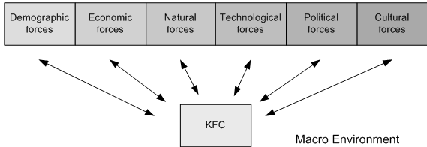
MACRO ENVIRONMENT
KFC operates in a larger macro environment of forces that creates opportunities
A company such as KFC usually cannot influence trends in the macro environment, as they affect people and organizations on a larger scale.
However, KFC has to carefully examine macro environmental trends and must create competitive responses to such trends.
There are six major macro environmental forces

Slide 8
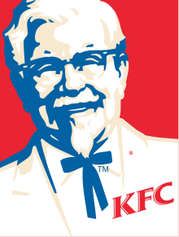
MICRO ENVIRONMENT
Company
Competitors
The microenvironment consists of all
forces that are close to KFC, and on
which KFC has an impact.
They directly
affect KFC’s ability to serve its
Customers.
Three major components influence KFC’s micro environment
Consumers

Slide 9
MARKETING STRATEGIES OF KFC
According to KFC, kids become the future permanents customers and we know very well that without any marketing strategy no marketing program and no product is successful because we depend upon customers, customer not depend on us.
KFC is following Niche Marketing and Societal Marketing techniques.
KFC possess a western culture because some of the Indian people are also following that culture.
KFC are moving from Divisional Level to the District level by opening branches
KFC also offer free home delivery.
KFC open their outlets on reachable places.
KFC menu consists of more than 30 products.
KFC gives more priority to Family.

Slide 10
MARKETING
There are 4 P’s of marketing
Production : KFC has the special raspy for chicken products that is why, KFC known as a chicken specialist all over the globe. KFC target the Asia and east side because they observe that they people are like the chicken products, so they enter in the market due to the demand of their chicken products.
Pricing : KFC during pricing their products keep the different points in the mind like they adopt the cost base price strategy. Pricing of the product includes the Government taxes and excise duties and then they come at final stage of determine the price of their products. KFC prices of products are a bit high according to the market segment and it is also compatible to the standards of their products.
Total Pounds of Chicken Served in KFC Restaurant Annually =1.914 Billion
Total KFC Chicken Pieces Sold Annually = 5.89 Billion
Total Retail Sales = $8.9 Billion
Sales Price of per Chicken Piece =$1.51

Slide 11
Promotion : KFC uses the bill boards the major source of advertisement and one of the most important thing that they uses media especially the newspapers to promote their products. They are also creating awareness among the masses about their existing product range as well they tell us about the future projects.
4. Placement : For, KFC the placement of the product is not important but the placement of the restaurant is important we can easily judge that the KFC target the place for their restaurant, which is well known and is in the Porsche area where the income level of the people is high then the middle class level. Because the prices of the KFC products is high with comparison to the local products manufacturer who are dealing in the same kind of product in which KFC is dealing but the prices of the KFC is high due to special taste, high quality, and due to international brand, it is the world recognized fast food restaurant all around the world. So, for the placing strategy, KFC chose the well income class area for their restaurants.

Slide 12

KFC IN INDIA!
KFC is the largest brand of Yum Restaurants, a company that owns other leading brands like Pizza Hut, Taco Bell, A&W and Long John Silver. Renowned worldwide for it’s finger licking good food, KFC offers its signature products in India too! In India, KFC is growing rapidly and today has presence in 21 cities with close to 107 restaurants.

Slide 13
Target market
Geography: India Metros and Tier II Cities
Demography: Urban people of both genders aged between 15 to 45 years of age.
Income Group: A,B and C income groups.
Psychographic: People who have a busy lifestyle and are influenced by western culture

Slide 14
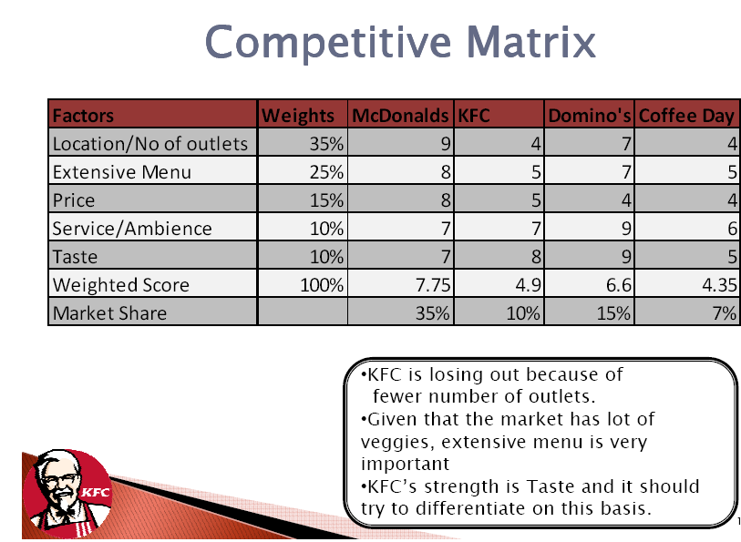

Slide 15
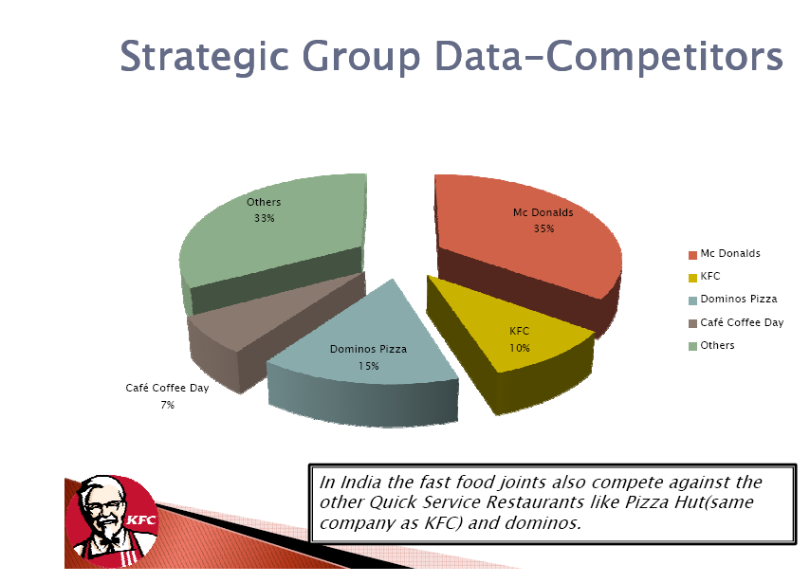

Slide 16
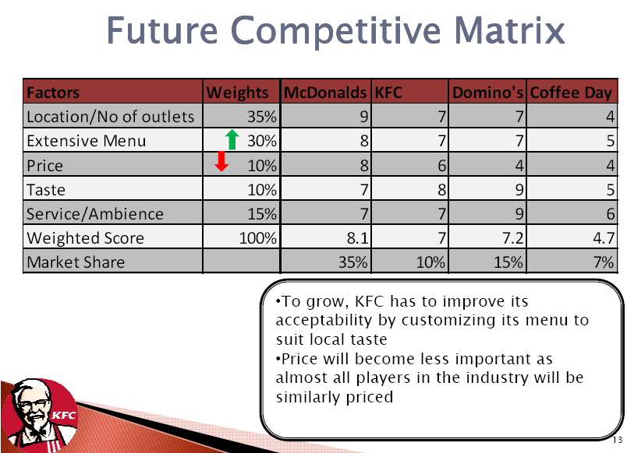

Slide 17
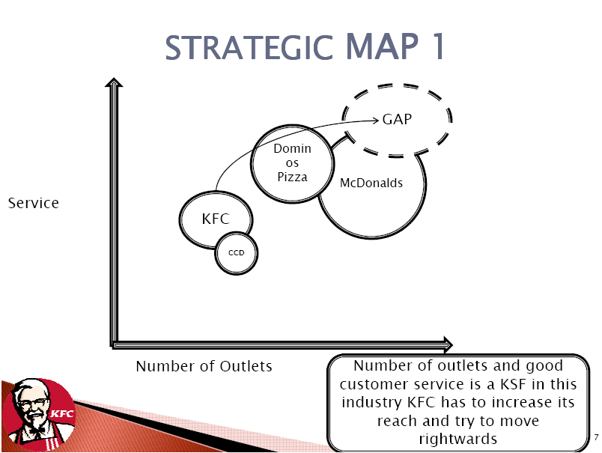

Slide 18
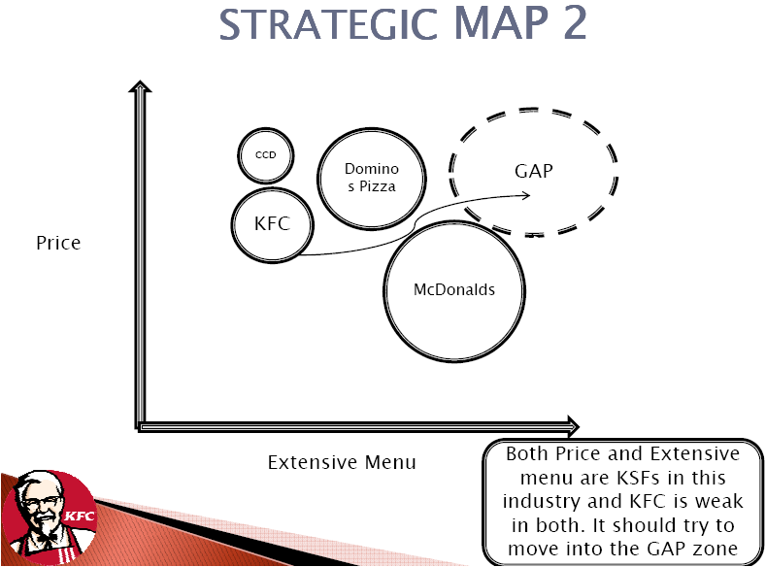

Slide 19
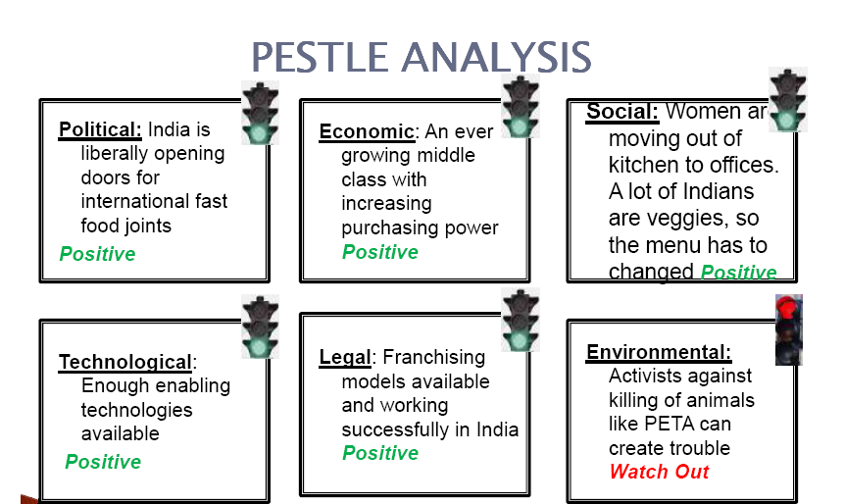


Slide 20
SWOT ANALYSIS

Slide 21
Strengths
Delicious and well liked recipes.
Strongest category among nearest competitors.
Well Global Penetration.
Well recognised brand logo.
Strong Cash Flow via franchisee and license fee.

Slide 22
Weakness
Most KFC items have close substitutes in market.
No product innovations.
Lack of control in joint venture arrangements.
Inconsistent quality of service in many outlets.

Slide 23
Opportunities
Undeveloped markets in many countries.
Increased 18-25 age group.
Increasing trends to take meal out of homes.

Slide 24
Threats
Other cheap alternatives available.
Bird flu.
Cannibalization of own products.
Changing health trends of customers.
High calorie food.

Slide 25
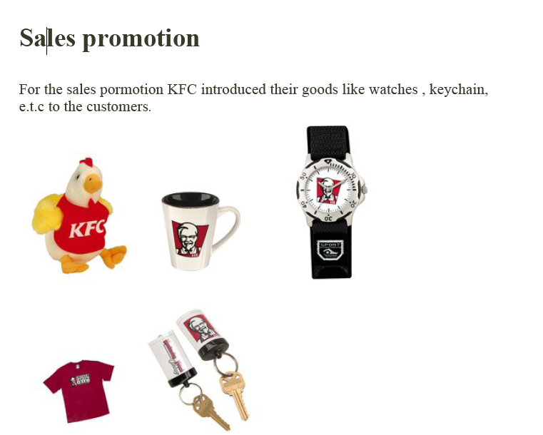

Slide 26
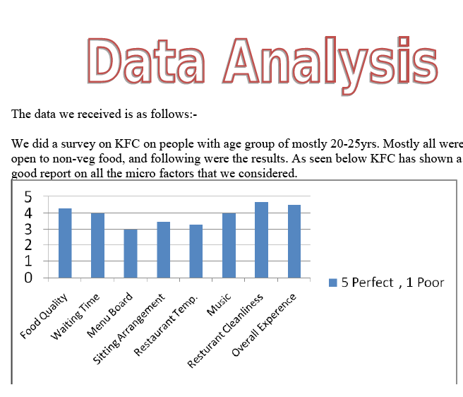

Slide 27
