Slide 1
PB173 - Tématický vývoj aplikací v C/C++ Domain specific development in C/C++
Skupina: Aplikovaná kryptografie a bezpečné programování
Petr Švenda svenda@fi.muni.cz
Konzultace: A406, Úterý 13:00-13:50

Slide 2
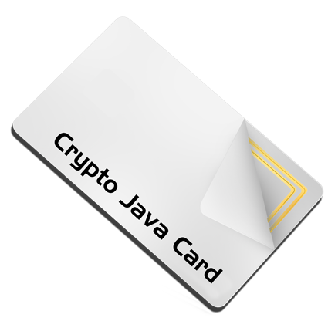
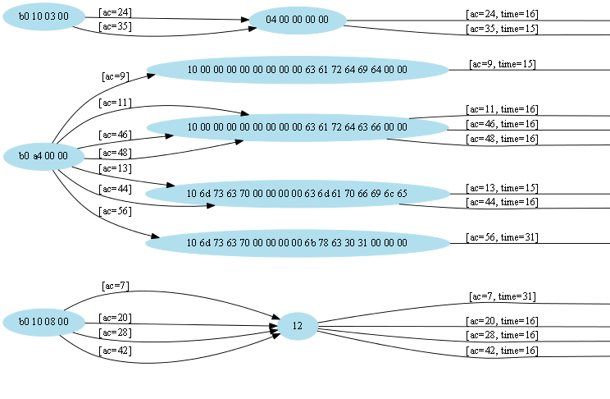
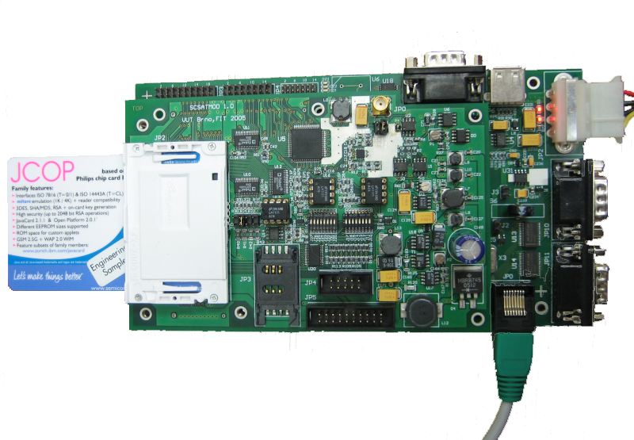
Security programming
Power analysis

Slide 3
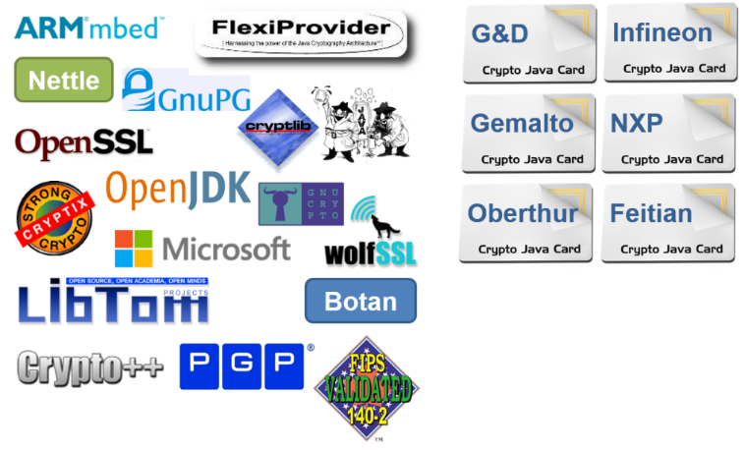
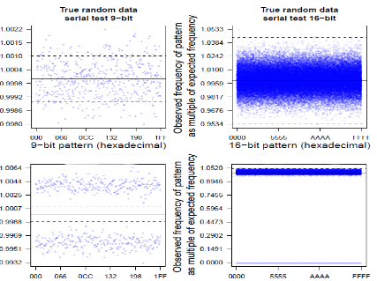
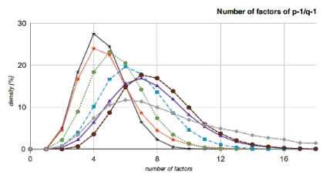
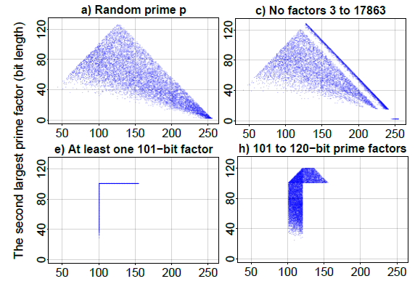
7 implementation choices observable in public keys
60+ million fresh RSA keypairs
22 sw. libraries
16 smart cards
Distribution of primes (MSB)
Large factors of p-1 / p+1
Bit stream statistics
Number of factors
and more…
(biased bits of public modulus, “mask”)
Notes:
1M keys relatively easy for sw libs, but harder for smartcards (some broken, but at least hundreds thousands keys obtained)

Slide 4
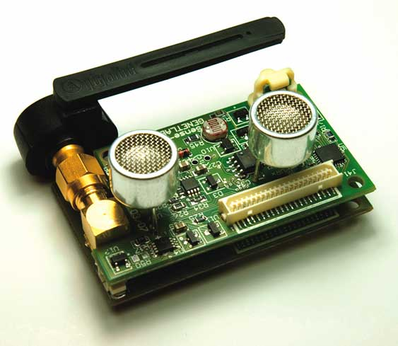
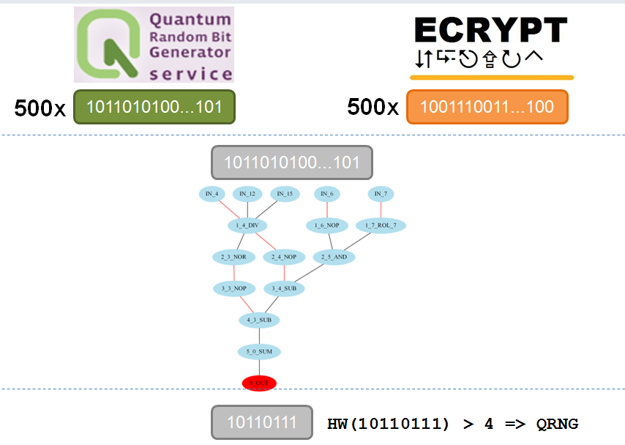
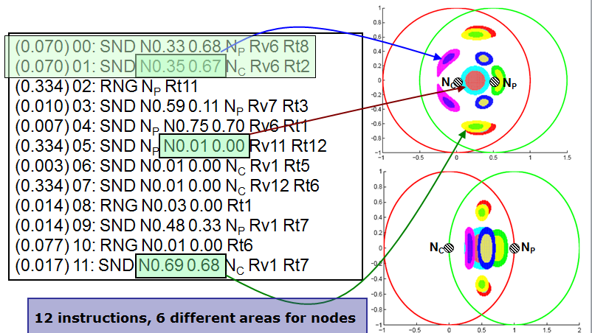
+
Genetic programming
Distributed computing
⇒
Secrecy amplification protocols for WSN
Random distinguisher for crypto fncs

Slide 5
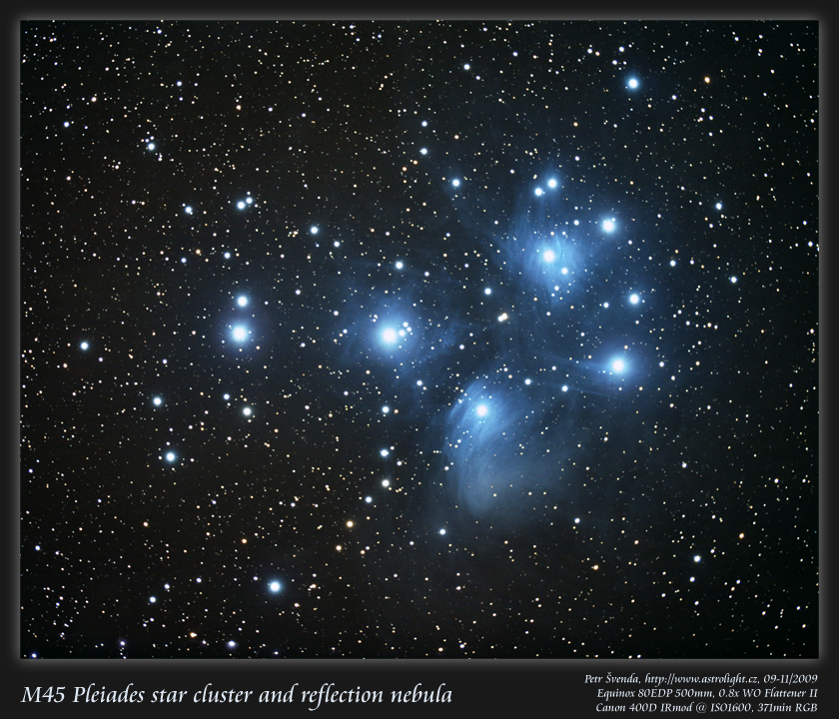
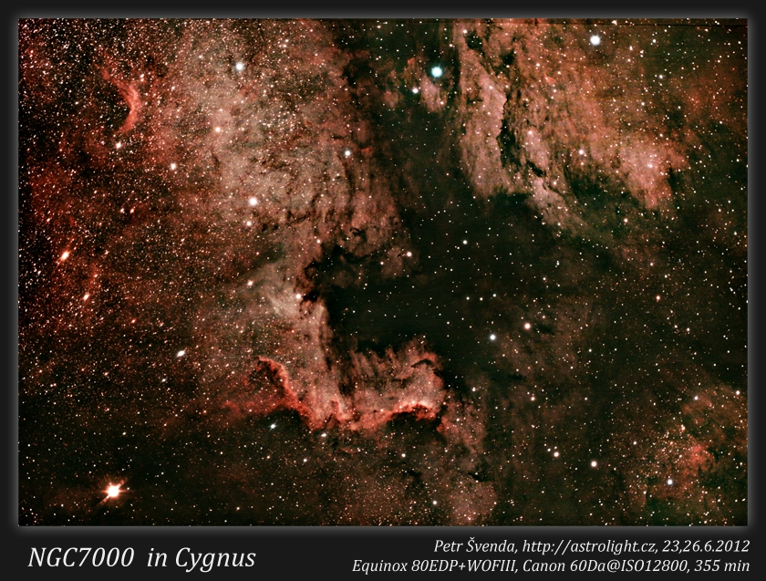
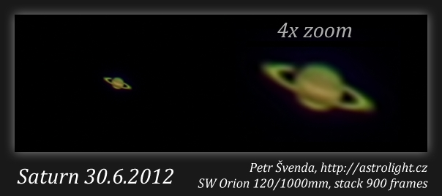
Something about me...
http://astrolight.cz

Slide 6
Organizační informace

Slide 7
Co je cílem předmětu
Získat zkušenosti s implementací většího programu
Používat vývojové nástroje
Naučit se dobré programátorské postupy
programování obecně
ale speciálně v oblasti bezpečnostních aplikací
Získat praktické postřehy z implementací kryptografických aplikací
co nakonec ve firmě vyžadují

Slide 8
Co není cílem předmětu
Detailní ovládnutí konkrétní technologie
zabrousíme do různých oblastí
Pokročilé zvládnutí celého vývojového procesu
to jednoduše nestihneme
Vysvětlovat základy kryptografie nebo srovnávat všechny možné varianty řešení problému
hlavně se budeme snažit prakticky programovat

Slide 9
Organizační
Formality výuky
každotýdenní dvojhodinovka
evidovaná účast, 2 neúčasti bez omluvení OK
Způsob výuky
cca 30 min./týdně úvod do problematiky
zbytek vaše programování přímo na hodině
z mé strany průběžná konzultace nad vznikajícími problémy
default Windows (ale můžete pracovat i na jiné platformě)
Samostatná práce
v týmech, průběžná tvorba většího projektu
dodělávání práce z hodiny
pravidelné bodované předvádění stavu projektu (každé cvičení)

Slide 10
Organizační (2)
Používané nástroje
IDE, verzovací nástroje (git), Doxygen, debugger, analýza a kontrola kódu (CppCheck, Coverity)
GitHub + TravisCI + Coverity
Ne vše je striktně dané – ptejte se a použijte svoje oblíbené
Hodnocení
účast
průběžná práce (10 bodů týdně)
prezentace celého projektu (30 bodů)
možné bonusy
max. 130 bodů, zisk alespoň 85 bodů na kolokvium

Slide 11
Rozdělení do týmů
2-3 osoby
Společná práce, ale každý prezentuje svůj přínos
Iniciální prezentace domácího úkolu na dalším cvičení
zapracování připomínek, prezentace a hodnocení na dalším cvičení
Využití sdíleného repozitáře (GitHub) + CI (Travis)
Rozdělení provedeme až po 14 dnech
Po ustálení zapsaných studentů (ve třetím týdnu)

Slide 12
Celkový přehled
Základní podklady v ISu
Může se ale částečně měnit
uvidíme dle reálné obtížnosti, rychlosti postupu a zájmu
Můžete otevřít vlastní řešený problém!

Slide 13
How good YOU are in English?
Apology for all my mistakes, please.

Slide 14
Organization
Seminars + assignments + project
Assignments
Assigned regularly (nearly) every week
Initial assigments individual work
Most of assignments team work
expected workload: 4+ hours/week/participant
Network lab available to students
Project: secure videoconferencing architecture

Slide 15
Attendance
Seminars
Attendance obligatory
Absences must be excused at the department of study affairs
2 absences are ok
Assignments and projects
Partially done at seminar
Completed during students free time (e.g. at the dormitory)
Access to network lab and CRoCS lab is possible
Cooperation between team members necessary

Slide 16
Course resources
Slides (PDF) available in IS
IS = Information System of the Masaryk University
Assignments (what to do) available in IS
Submissions done also via IS
Additional tutorials/papers/materials from time to time will also be provided in IS
To better understand the issues discussed
Recommended literatures
To learn more …

Slide 17
Plagiarism
Projects
Must be worked out by a team of 3 students
Every team member must show his/her contribution
Plagiarism, cut&paste, etc. is not tolerated
Plagiarism is use of somebody else words/programs or ideas without proper citation
IS helps to recognize plagiarism
If plagiarism is detected student is assigned -5 points
In more serious cases the Disciplinary committee of the faculty will decide

Slide 18
Short questionnaire
Do you know difference between symmetric and asymmetric cryptography?
Do you known difference between block and stream cipher?
Do you know DES and AES algorithm?
Do you know ECB and CBC encryption mode?
Do you know principle of hash functions?
Do you know MD5, SHA-1/2/3 algorithm?
Do you known concept of digital signature?
Do you know what perfect forward secrecy means?

Slide 19
Cryptographic libraries

Slide 20
Cryptographic libraries - overview
Why not to implement own crypto algorithm/protocol
Adequate complexity of library
How to get authentic source code
Common libraries: OpenSSL, mbed TLS
How to use library

Slide 21
Do NOT implement your own algorithms
Time consuming (probably already done before)
Functional problems
Low performance
Security problems due to bugs
Security problems due to missing defence against implementation attacks

Slide 22
Do NOT implement your own protocols
Do not design algorithms/protocols by yourself
Try to find existing standards
NIST, RSA PKCS, RFC, ISO/ANSI
Try not to deviate from standards
compatibility and compliance
no need for (time consuming) specification of detailed your scheme
small change can have big security impacts

Slide 23
Use well-known implementations
Use well-known libraries
OpenSSL, PolarSSL, GnuPG, BouncyCastle (Java)
Or implementation of algorithms from well-established authors (for uncommon algs)
Brian Gladman, Eric A. Young …

Slide 24
Complexity matters
Complexity of library implementation should match your needs
usually, you need only one or two algorithms
Multiprocessor or CPU-independent implementation can be overkill
and just increase risk of error
Do you really need library with object-oriented design?
Large libraries are not always the most suitable ones
OpenSSL is complex and interconnected
e.g., AES is extractable much easier from mbedTLS (PolarSSL) than from OpenSSL

Slide 25
Code authenticity
Source code signature
Do you really have original binary/source codes?
MD5/SHA1 hash (where to get “correct” hash value?)
GPG/PGP
Generate your own GPG/PGP signature keys
sign your code releases (on GitHub)

Slide 26
Which one you like more? Why?
ARM mbed TLS
/**
* \brief Output = HMAC-SHA-512( hmac key, input buffer )
*
* \param key HMAC secret key
* \param keylen length of the HMAC key
* \param input buffer holding the data
* \param ilen length of the input data
* \param output HMAC-SHA-384/512 result
* \param is384 0 = use SHA512, 1 = use SHA384
*/
void sha512_hmac( const unsigned char *key, size_t keylen,
const unsigned char *input, size_t ilen,
unsigned char output[64], int is384 );
OPENSSL
unsigned char *HMAC(const EVP_MD *evp_md, const void *key, int key_len,
const unsigned char *d, size_t n, unsigned char *md,
unsigned int *md_len);

Slide 27
Common libraries – OpenSSL
Pros:
Very rich library
lots of algorithms, protocols, paddings
not “just” SSL
well tested functionally & security over time!
significant amount of existing examples on web
Cons:
API is complex and sometimes harder to understand
(started as Eric Young’s personal attempt to learn BigInts ☺)
relatively low-level functions (can be pros!)
code is significantly interconnected
not suitable for extraction of single algorithm
poor official documentation

Slide 28
Common libraries – mbed TLS
(Formerly PolarSSL)
Pros:
API is simple and clear
Easy to extract single algorithm
Now widely used, reasonably tested
Cons:
fewer supported algorithms and standards
dual licensing, but not BSD-like license

Slide 29
How to use library
Extract code and compile alone
some work with extraction
small, clean and self-containing result
Compile against whole library
usually easy to do
but dependence on possibly unused code
Link statically against dynamic library
dll/so must be always present to run program

Slide 30
How to use library (2)
Link dynamically against dynamic library
try to open dll file and obtain function handle
Link against service provider functions
Cryptography Service Providers in particular
API for listing of available service providers (CryptEnumProviders)
standardized functions provided by providers http://msdn.microsoft.com/en-us/library/aa380252%28v=VS.85%29.aspx#service_provider_functions

Slide 31
Security implications of (dynamic) libraries
Library can be forged and exchanged
Library-in-the-middle attack easy
data flow logging
input/output manipulation
Library outputs can be less checked than user inputs
feeling that library is my “internal” stuff and should play by „my“ rules
Library function call can be behind logical access controls
Library can contain bugs
Serious development also needs 3rd party libraries control process

Slide 32
Practical assignment

Slide 33
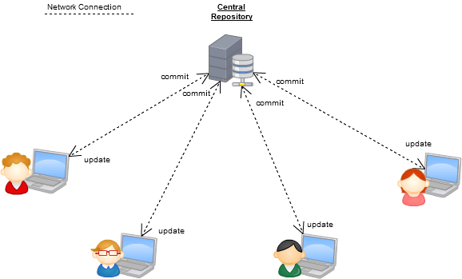
SVN style – central repository
https://programmers.stackexchange.com/questions/35074/im-a-subversion-geek-why-should-i-consider-or-not-consider-mercurial-or-git-or

Slide 34
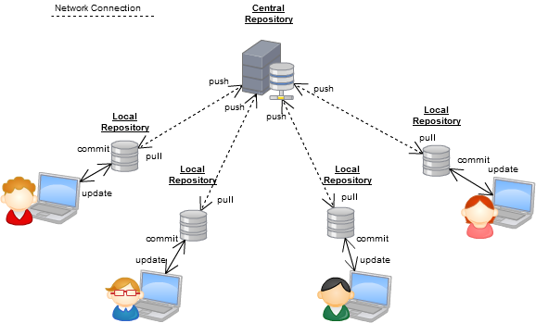
GIT-style – distributed repository
https://programmers.stackexchange.com/questions/35074/im-a-subversion-geek-why-should-i-consider-or-not-consider-mercurial-or-git-or

Slide 35
Setup your GitHub repository
Setup your GitHub account and repository
E.g., PB173 test
.gitignore C++
License MIT
Create first milestone (Issues→Set milestone→Create…)
Create first issue (Labels, Milestone, Assignee)
“Setup initial repo files”
Install git locally (GitHub client, TortoiseGit…)
Git Clone (your repository)
Into local directory

Slide 36
Use your GitHub repository
Create small project (your favourite IDE)
Commit, Push
Try to modify some files locally
Commit, Push
Try to modify some files in repo via web interface
Simulated parallel modification by other developer
Git Pull / Sync
Close your first issue ☺

Slide 37
Practical assignment
Download mbed TLS (formerly PolarSSL) library
and check signature (gpg --verify)
Write small project (mbed TLS based)
read, encrypt and hash supplied file, write into out file
read, verify hash and decrypt file
use AES-128 in CBC mode and SHA2-512
use PKCS#7 padding method for encryption (RFC 3852)
Start with New Project+mbedTLS+AES
Questions

Slide 38
Submissions, deadlines
Commit into your GitHub repository (frequently ☺)
Upload application source codes as single zip file into IS
Use GitHub’s download ZIP feature
Homework vault (Crypto - 1. homework (AES+SHA2))
DEADLINE: 27.2. 12:00 (first part)
application capable to read, encrypt, decrypt, hash
Text file containing description how you did PGP signature verification (whole process including import of public keys etc.)
0-5 points assigned
DEADLINE 5.3. 12:00 (second part)
addition of unit tests
0-5 points assigned

