Slide 1
PV204 Security technologies
File and disk encryption
Milan Brož xbroz@fi.muni.cz
Petr Švenda svenda@fi.muni.cz
Faculty of Informatics, Masaryk University
Notes:
1

Slide 2
Data storage encryption
Lecture
  File and disk encryption
  Distributed storage encryption
  Abstraction layers, hardware acceleration
  Cryptography basic principles
    Confidentiality and integrity protection
    Encryption modes
    Key management
  Tool examples (Windows, Linux, Android)
  Attacks and common issues
Lab – disk encryption attack examples
2
| PV204 File and disk encryption

Slide 3
File and disk encryption
motivation &
Storage layers overview
3
| PV204 File and disk encryption
Notes:
3

Slide 4
Motivation
Offline, "Data at Rest" protection
notebook, external drives, data in cloud, backups
Key removal = easy data disposal
Confidentiality protection
company policy to encrypt all mobile devices
prevents data leaks (stolen device)
Integrity protection (not often yet)
4
| PV204 File and disk encryption

Slide 5
Overview
(Distributed) Storage Stack
layers accessing storage through blocks (sectors)
near future: non-volatile byte-addressable memory
distributed => adding network layer
Full Disk Encryption (FDE)
  self-encrypted drives
  (software) sector-level encryption
Filesystem-level encryption
general-purpose filesystem with encryption
cryptographic file systems
5
| PV204 File and disk encryption

Slide 6
Storage stack & encryption layers
Userspace | Application | (Application specific)
OS kernel | Virtual file-system (directories, files, …) | File-system encryption
 | Specific file-system (NTFS, ext4, XFS, …)
 | Volume Management (partitions, on-demand allocation, snapshots, deduplication, …) | Disk encryption
 | Block layer (sectors I/O)
 | Storage transport (USB, SCSI, SAS, SATA, FC, …) | HW-based disk encryption (self-encrypted drives, chipset-based encryption)
 | Device drivers
“Hardware” | Hardware (I/O controllers, disks, …)
6
| PV204 File and disk encryption

Slide 7
Clustered and distributed storage
Clustered => cooperating nodes
  Distributed => storage + network
  Software Defined Storage/Network (SDS, SDN)
  - commodity hardware with abstracted storage/network logic
  - encryption is “just” one logic function
  - usually combination with classic storage (and encryption)
7
| PV204 File and disk encryption

Slide 8
Distributed storage & encryption
Shared volumes (redundancy)
=> disk encryption
Clustered file-system
=> file-system encryption
Distributed Object Store
  Direct object encryption or
  Underlying storage encryption
8
| PV204 File and disk encryption

Slide 9
Cloud storage & encryption
Many users with shared storage backend
Compression & Deduplication & Snapshots …
Encryption on client side (end-to-end)
- efficiency for deduplication/compression is lost
~ in future homomorphic encryption?
Encryption on server side
- confidentiality for clients is partially lost
- server has access to plaintext
9
| PV204 File and disk encryption

Slide 10
Full Disk Encryption (FDE)
Block device – transparent disk sector level
  Disk, partition, VM disk image
  Ciphertext device / virtual plaintext device
  Atomic unit is sector (512 bytes, 4k, 64k)
  Consecutive sector number
  Sectors encrypted independently
One key decrypts the whole device
  Media (volume) key – one per device
  Unlocking passphrases/keys
  Usually no integrity support (only confidentiality)
10
| PV204 File and disk encryption

Slide 11
Filesystem-level Encryption
File/Directory
  Atomic unit is filesystem block
  Blocks are encrypted independently
  Generic filesystems with encryption
    Some metadata can be kept in plaintext
    (name, size, …)
  Cryptographic filesystems
    Metadata encrypted
    ~ stacked layer over generic filesystem
Multiple keys / multiple users
11
| PV204 File and disk encryption

Slide 12
File vs. disk encryption
Full disk encryption
+ for notebook, external drives (offline protection)
+ transparent for filesystem
+ no user decision later what to encrypt
+ hibernation partition and swap encryption
- more users – whole disk accessible
- key disclosure – complete data leak
- usually no integrity protection
12
| PV204 File and disk encryption

Slide 13
File vs. disk encryption
Filesystem based encryption
+ multiple users
+/- user can decide what to encrypt
+ copied files keeps encryption in-place
+ more effective (only really used blocks)
+ should provide integrity protection (not always!)
- more complicated sw, usually more bugs
- unusable for swap partitions
13
| PV204 File and disk encryption

Slide 14
File vs. disk encryption
Combination of disk & file encryption
Distributed storage
  Must use also network layer encryption
  Difference in network and storage encryption
  (replay attack resistance, integrity protection, …)
14
| PV204 File and disk encryption

Slide 15
File and disk encryption
CryptogRaphy
15
| PV204 File and disk encryption
Notes:
15

Slide 16
Cryptography algorithms primitives
Symmetric encryption
  block ciphers
  cipher block mode
  hash algorithms
Key management
  Random Number Generators (RNG)
  Key Derivation Functions (KDF)
  Asymmetric cryptography
Deniable encryption / Steganography
16
| PV204 File and disk encryption

Slide 17
Data confidentiality & integrity
Confidentiality
Data are available only to authorized users.
Integrity
Data are consistent.
Data has not been modified by unauthorized user.
=> All modifications must be detected.
Note: replay attack (revert to old snapshot) detection
cannot be provided without separate trusted store.
17
| PV204 File and disk encryption

Slide 18
Data integrity / authenticated encryption
Poor man's authentication (= no authentication)
  User is able to detect unexpected change
  Very limited, cannot prevent old content replacement
Integrity – additional overhead
  Where to store integrity data?
  Encryption + separate integrity data
  Authenticated modes (combines both)
18
| PV204 File and disk encryption

Slide 19
File and disk encryption
DATA ENCRYPTION modes
19
| PV204 File and disk encryption
Notes:
19

Slide 20
Symmetric encryption (examples)
AES, Serpent, Twofish, …
Encryption-only modes
  Storage encryption mostly CBC, XTS
  Length-preserving encryption, block tweak
Authenticated modes (encryption + integrity)
  Integrity protection often on higher layer.
Storage standards IEEE 1619 and FIPS/NIST
20
| PV204 File and disk encryption

Slide 21
Propagation of plaintext changes
A change in the plaintext sector should transform to randomly-looking change in the whole ciphertext sector.
Solutions:
  Ignore it ☺ and decrease granularity of change
    => change location inside ciphertext sector
  Use wide mode (encryption block size = sector size)
    requires at least 2x encryption loop
    modes are patent encumbered
  Additional operations
    Elephant diffuser in Windows Bitlocker
21
| PV204 File and disk encryption

Slide 22
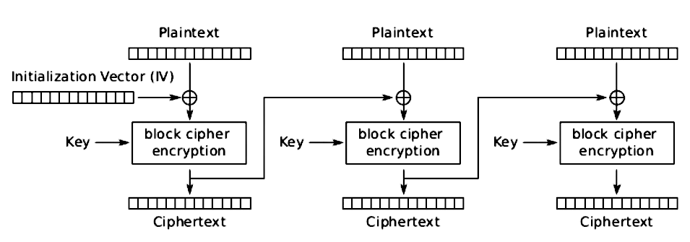
Cipher-Block-Chaining (CBC) mode
Blocks cannot be encrypted in parallel
Blocks can be decrypted in parallel
Tweak must be non-predictable (watermarking!)
plaintext disk / file-system block …
AES block
block tweak
ciphertext disk / file-system block …
22
| PV204 File and disk encryption

Slide 23
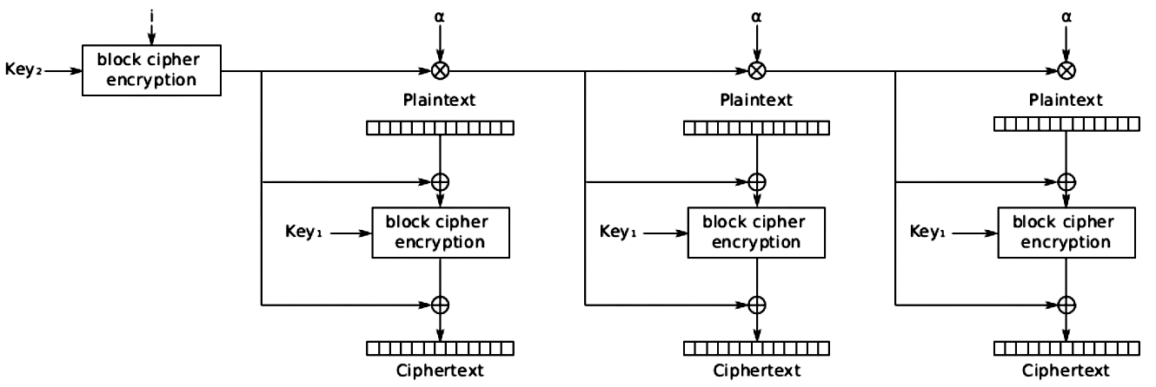
XOR-Encrypt-XOR (XEX/XTS) mode
Encryption/decryption can be run in parallel
Tweak can be predictable nonce – sector number (offset)
block tweak
ciphertext disk / file-system block …
23
| PV204 File and disk encryption

Slide 24
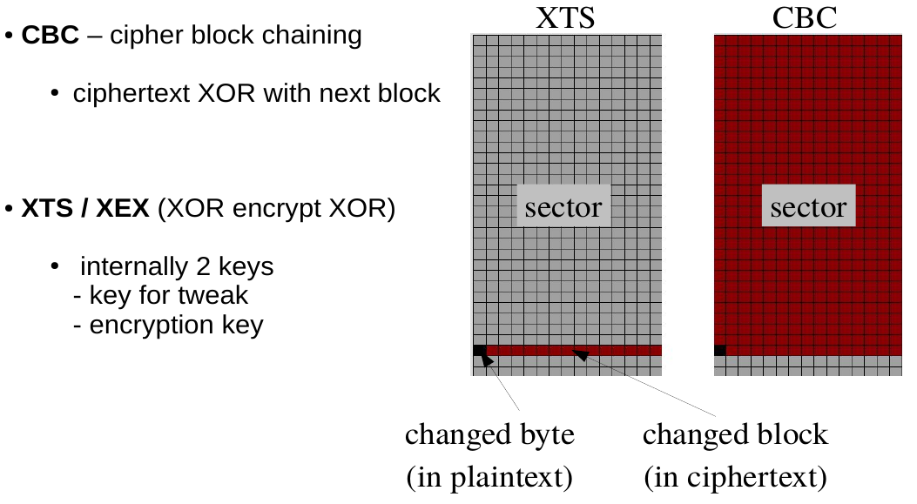
CBC and XTS change propagation
xxx
24
| PV204 File and disk encryption

Slide 25
Steganography / deniable encryption
Plausible deniability:
existence of encrypted file/disk is deniable
if adversary cannot prove that it exists
Steganography
hiding data in another data object
Steganographic file-systems
Deniable disk encryption
25
| PV204 File and disk encryption

Slide 26
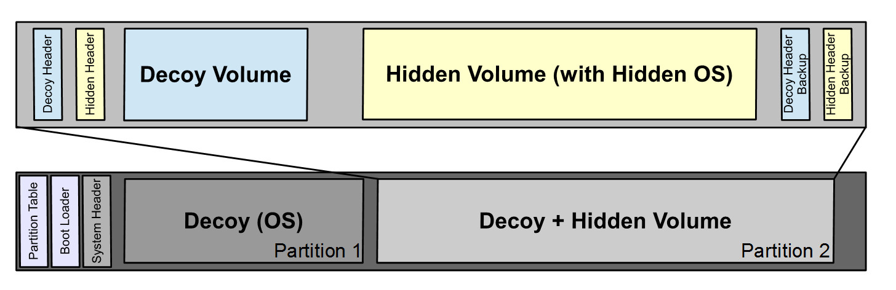
Trivial example: TrueCrypt hidden disk
FAT linear allocation
Hide another disk in unallocated space
26
| PV204 File and disk encryption

Slide 27
Deniable encryption problems
Side-channels
tracking activity that cannot be explained for decoy system
  Software: link to recently open documents, …
  Suspicious parameters (FAT), disabled TRIM, …
  Hardware: internal SSD block allocations
  (access to “unused” areas)
Social engineering / “rubber hose” analysis
Incompatibility with new drives (TRIM)
27
| PV204 File and disk encryption

Slide 28
File and disk encryption
Key Management
28
| PV204 File and disk encryption
Notes:
28

Slide 29
Key generation
Encryption key (~ Media Encryption Key – MEK)
  Used to encrypt device
    change means complete reencryption
  Usually generated by secure RNG
Unlocking key (~ Key Encryption Key – KEK)
  Used to unlock key store, token, …
  Independent key change (MEK remains the same)
  Usually derived from passphrase
    PBKDF2 (Password Based Key Derivation)
    scrypt, Argon2 (memory-hard KDFs)
29
| PV204 File and disk encryption

Slide 30
Key storage
Outside of encrypted device / filesystem
  Another device, file, token, SmartCard, TPM
  On a key server (network)
  Protected by another key (KEK).
On the same disk (with encrypted data)
  metadata (header)
  brute force and dictionary attack resistance
Integration with key management tools
  LDAP, Active Directory, ...
Combination of above
30
| PV204 File and disk encryption

Slide 31
Key removal and recovery
Key removal (wipe of key) = data disposal
  intended (secure disk disposal)
  unintended (error) => complete lost of data
Key recovery
  Trade-off between security and user-friendly approach
  Metadata backups
  Multiple metadata copies
  Key Escrow (key backup to different system)
  Recovery key to regenerate encryption key
31
| PV204 File and disk encryption

Slide 32
File and disk encryption
Common tools
32
| PV204 File and disk encryption
Notes:
32

Slide 33
Examples of HW-based encryption
Self-encrypting drives (SED)
  Encryption on the same chip providing media access
Chipset-based encryption
  Encryption on controller chip (e.g. USB bridge)
Hardware acceleration
  AES-NI, accelerators, ASICs, GPUs, …
Secure hardware / tokens
  HSM, TPM, SmartCards, ...
33
| PV204 File and disk encryption

Slide 34
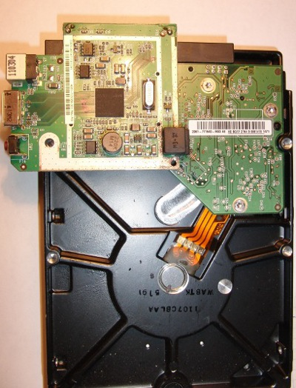
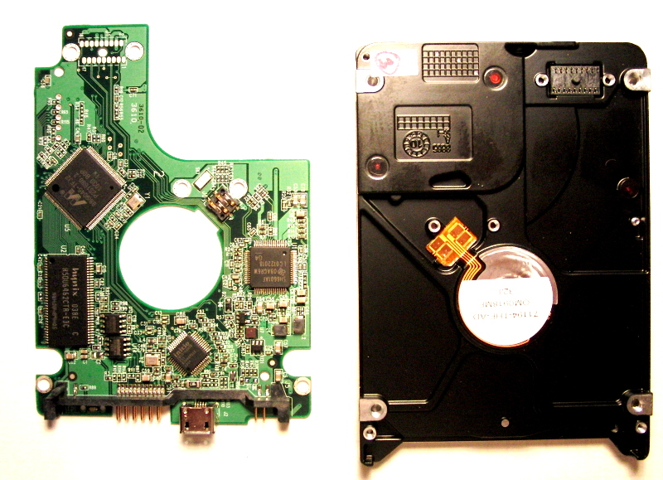
Examples of HW-based encryption
SATA disk
Encryption on USB-bridge
34
| PV204 File and disk encryption

Slide 35
Examples of tools – filesystem encryption
Windows EFS
Linux eCryptfs
    POSIX-compliant stacked encrypted file-system
ZFS (Solaris and ports)
    supports GCM/CCM authenticated modes
35
| PV204 File and disk encryption

Slide 36
Examples of tools – full disk encryption
  Windows Bitlocker
    Optionally eDrive – self-encrypting drives
    Combination with secure boot and TPM
  TrueCrypt / VeraCrypt
  Linux LUKS / dm-crypt
  Linux dm-crypt / dm-verity / dm-integrity
  used for Android encryption / verified boot
  MacOS FileVault
36
| PV204 File and disk encryption

Slide 37
File and disk encryption
Attack EXAMPLES
37
| PV204 File and disk encryption
Notes:
37

Slide 38
Attacks always get better, they never get worse.
Against algorithm design
  Wrongly used encryption mode
  Insufficient initialization vector
To implementation
  Insufficient entropy (broken RNG)
  Weak derivation from weak passwords
  Side channels
Obtaining key or passphrase in open form
  Cold Boot
  “Black bag analysis” - Malware, key-logger
  Social engineering
  “Rubber-hose cryptoanalysis”
38
| PV204 File and disk encryption

Slide 39
Integrity attacks
No integrity protection
  Inserted random block
  => undetected data corruption
  Inserted block from other part of disk
  Random error (RAM bit flip)
  => “silent data corruption”
Weak integrity protection
  Inserted previous content of (ciphertext) block
  => replay attack
39
| PV204 File and disk encryption

Slide 40
Example: Sony PlayStation attack
No need to know the exact key value
Device works as decryption service
Make disk image
Write your own file
Make second image and make diff (location file)
Insert data you want into file’s place
Start PS and ask for your file
  Decrypted new data
  Key is same for all blocks
40
| PV204 File and disk encryption

Slide 41
Example: Disk encryption
Some chipsets use ECB mode
Weak key derivation (brute-force possible)
Trivial unlocking mode (1-bit password is ok/bad)
Weak key-escrow (backup key in EEPROM, …)
SED – switch power attacks
Cold boot – key in memory
Key loggers
Weak RNG (key is not random)
…
41
| PV204 File and disk encryption

Slide 42
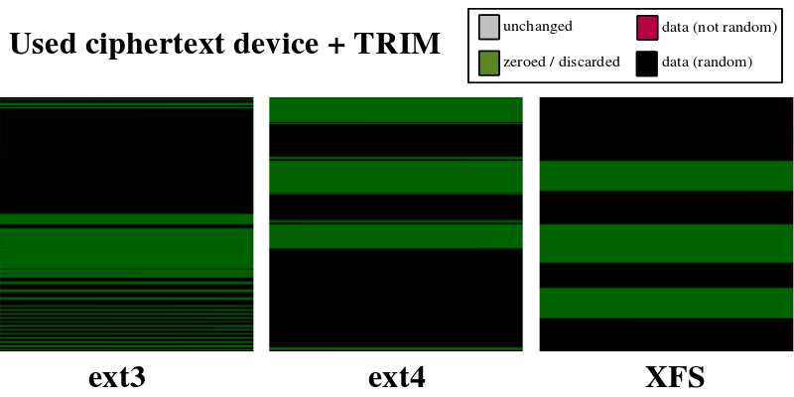
TRIM / discard and encryption
TRIM informs SSD drive about unused space
Unused space is detectable
Pattern recognition example
Incompatible with deniable encryption
42
| PV204 File and disk encryption

Slide 43

Lab
43
| PV204 File and disk encryption

Slide 44
Laboratory – FDE attack examples
Basic understanding of some tools and hw
VeraCrypt, LUKS, chip-based encryption
Scanning memory image for encryption key
ColdBoot attack principle
Advanced: flawed algorithm and watermarking Revealing TrueCrypt hidden disk existence (CBC)
HW key-logger attack
44
| PV204 File and disk encryption

Slide 45
Homework assignment (bonus)
Analyse pv204_assignment.tc
- VeraCrypt 1.19 encrypted container (compatible with TrueCrypt 7.1a)
- The volume is protected by a 9-character long password,
that begins with "pv204_XXX" where X means digit [0-9].
Find the password and unlock the volume.
Investigate encryption keys and header salt.
Describe found problems (max one A4 doc).
Please read notes in assignment archive!
Submit before May 17, 2017 6am (full number of points).
Every additional started day (24h) means 1.5 points penalization.
45
| PV204 File and disk encryption

