Slide 1
Advertising on the Web
Advanced Search Techniques for Large Scale Data Analytics
Pavel Zezula and Jan Sedmidubsky
Masaryk University
http://disa.fi.muni.cz

Slide 2
Online Algorithms
Classic model of algorithms
  You get to see the entire input, then compute some function of it
  In this context, “offline algorithm”
Online Algorithms
  You get to see the input one piece at a time, and need to make irrevocable decisions along the way
  Similar to the data stream model

Slide 3
Online Bipartite Matching

Slide 4
Example: Bipartite Matching
1
a
2
b
3
c
Boys
4
d
Girls
Nodes: Boys and Girls; Edges: Preferences
Goal: Match boys to girls so that maximum
number of preferences is satisfied

Slide 5
Example: Bipartite Matching
1
a
2
b
3
c
Boys
4
d
Girls
M = {(1,a),(2,b),(3,d)} is a matching
Cardinality of matching = |M| = 3

Slide 6
Example: Bipartite Matching
1
a
2
b
3
c
Boys
4
d
Girls
M = {(1,c),(2,b),(3,d),(4,a)} is a
perfect matching
Perfect matching … all vertices of the graph are matched
Maximum matching … a matching that contains the largest possible number of matches

Slide 7
Matching Algorithm
Problem: Find a maximum matching for a given bipartite graph
  A perfect one if it exists
There is a polynomial-time offline algorithm based on augmenting paths (Hopcroft & Karp 1973, see http://en.wikipedia.org/wiki/Hopcroft-Karp_algorithm)
But what if we do not know the entire
graph upfront?

Slide 8
Online Graph Matching Problem
Initially, we are given the set boys
In each round, one girl’s choices are revealed
  That is, girl’s edges are revealed
At that time, we have to decide to either:
  Pair the girl with a boy
  Do not pair the girl with any boy
Example of application:
Assigning tasks to servers

Slide 9
Online Graph Matching: Example
1
a
(1,a)
2
b
(2,b)
(3,d)
3
c
4
d

Slide 10
Greedy Algorithm
Greedy algorithm for the online graph
matching problem:
  Pair the new girl with any eligible boy
    If there is none, do not pair girl
How good is the algorithm?

Slide 11
Competitive Ratio
For input I, suppose greedy produces matching M_{greedy} while an optimal
matching is M_{opt}
Competitive ratio =
min_{all possible inputs I} (|M_{greedy}|/|M_{opt}|)
(what is greedy’s worst performance over all possible inputs I)

Slide 12
Analyzing the Greedy Algorithm
Consider a case: M_{greedy}≠ M_{opt}
Consider the set G of girls
matched in M_{opt} but not in M_{greedy}
Then every boy B adjacent to girls
in G is already matched in M_{greedy}:
  If there would exist such non-matched
  (by M_{greedy}) boy adjacent to a non-matched
  girl then greedy would have matched them
Since boys B are already matched in M_{greedy} then
(1) |M_{greedy}|≥ |B|
M_{opt}
1
a
M_{greedy}
2
b
3
c
4
d
B={ }
G={ }

Slide 13
Analyzing the Greedy Algorithm
M_{opt}
Summary so far:
  Girls G matched in M_{opt} but not in M_{greedy}
  (1) |M_{greedy}|≥ |B|
There are at least |G| such boys
(|G| ≤ |B|) otherwise the optimal
algorithm couldn’t have matched all girls in G
  So: |G| ≤ |B| ≤ |M_{greedy}|
By definition of G also: |M_{opt}| ≤ |M_{greedy}| + |G|
  Worst case is when |G| = |B| = |M_{greedy}|
|M_{opt}| ≤ 2|M_{greedy}| then |M_{greedy}|/|M_{opt}| ≥ 1/2
1
a
M_{greedy}
2
b
3
c
4
d
B={ }
G={ }
Notes:
This is a general proof.
We make no assumptions about the structure of the bipartite graph.

Slide 14
Worst-case Scenario
1
a
(1,a)
2
b
(2,b)
3
c
4
d

Slide 15
Web Advertising

Slide 16

History of Web Advertising
Banner ads (1995-2001)
  Initial form of web advertising
  Popular websites charged
  X$ for every 1,000
  “impressions” of the ad
    Called “CPM” rate
    (Cost per thousand impressions)
    Modeled similar to TV, magazine ads
  From untargeted to demographically targeted
  Low click-through rates
    Low ROI for advertisers
CPM…cost per mille
Mille…thousand in Latin

Slide 17
Performance-based Advertising
Introduced by Overture around 2000
  Advertisers bid on search keywords
  When someone searches for that keyword, the highest bidder’s ad is shown
  Advertiser is charged only if the ad is clicked on
Similar model adopted by Google with some changes around 2002
  Called Adwords

Slide 18
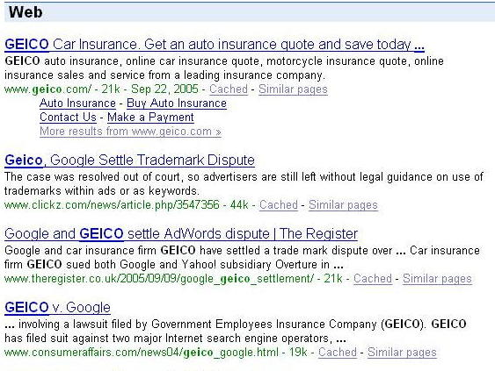
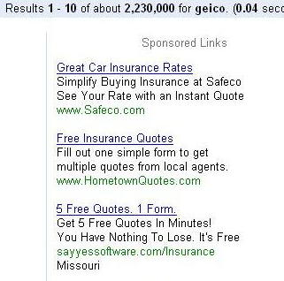
Ads vs. Search Results

Slide 19
Web 2.0
Performance-based advertising works!
  Multi-billion-dollar industry
Interesting problem:
What ads to show for a given query?
  (Today’s lecture)
If I am an advertiser, which search terms should I bid on and how much should I bid?
  (Not focus of today’s lecture)

Slide 20
Adwords Problem
Given:
  1. A set of bids by advertisers for search queries
  2. A click-through rate for each advertiser-query pair
  3. A budget for each advertiser (say for 1 month)
  4. A limit on the number of ads to be displayed with each search query
Respond to each search query with a set of advertisers such that:
  1. The size of the set is no larger than the limit on the number of ads per query
  2. Each advertiser has bid on the search query
  3. Each advertiser has enough budget left to pay for the ad if it is clicked upon

Slide 21
Adwords Problem
A stream of queries arrives at the search engine: q₁, q₂, …
Several advertisers bid on each query
When query q_{i} arrives, search engine must pick a subset of advertisers whose ads are shown
Goal: Maximize search engine’s revenues
  Simple solution: Instead of raw bids, use the “expected revenue per click” (i.e., Bid*CTR)
Clearly we need an online algorithm!

Slide 22
The Adwords Innovation
Advertiser
Bid
CTR
Bid * CTR
A
$1.00
1%
1 cent
B
$0.75
2%
1.5 cents
C
$0.50
2.5%
1.125 cents
Click through
rate
Expected
revenue

Slide 23
Complications: Budget
Two complications:
  Budget
  CTR of an ad is unknown
Each advertiser has a limited budget
  Search engine guarantees that the advertiser
  will not be charged more than their daily budget

Slide 24
Complications: CTR
CTR: Each ad has a different likelihood of being clicked
  Advertiser 1 bids $2, click probability = 0.1
  Advertiser 2 bids $1, click probability = 0.5
  Clickthrough rate (CTR) is measured historically
    Very hard problem: Exploration vs. exploitation
    Exploit: Should we keep showing an ad for which we have
    good estimates of click-through rate
    or
    Explore: Shall we show a brand new ad to get a better sense of its click-through rate

Slide 25
Greedy Algorithm
Our setting: Simplified environment
  There is 1 ad shown for each query
  All advertisers have the same budget B
  All ads are equally likely to be clicked
  Value of each ad is the same (=1)
Simplest algorithm is greedy:
  For a query pick any advertiser who has
  bid 1 for that query
  Competitive ratio of greedy is 1/2

Slide 26
Bad Scenario for Greedy
Two advertisers A and B
  A bids on query x, B bids on x and y
  Both have budgets of $4
Query stream: x x x x y y y y
  Worst case greedy choice: B B B B _ _ _ _
  Optimal: A A A A B B B B
  Competitive ratio = ½
This is the worst case!
  Note: Greedy algorithm is deterministic – it always
  resolves draws in the same way
Notes:
Is greedy deterministic or randomized (it is deterministic!!)

Slide 27
BALANCE Algorithm [MSVV]
BALANCE Algorithm by Mehta, Saberi, Vazirani, and Vazirani
  For each query, pick the advertiser with the
  largest unspent budget
    Break ties arbitrarily (but in a deterministic way)

Slide 28
Example: BALANCE
Two advertisers A and B
  A bids on query x, B bids on x and y
  Both have budgets of $4
Query stream: x x x x y y y y
BALANCE choice: A B A B B B _ _
  Optimal: A A A A B B B B
In general: For BALANCE on 2 advertisers Competitive ratio = ¾

Slide 29
Analyzing BALANCE
Consider simple case (w.l.o.g.):
  2 advertisers, A₁ and A₂, each with budget B (≥1)
  Optimal solution exhausts both advertisers’ budgets
BALANCE must exhaust at least one
advertiser’s budget:
  If not, we can allocate more queries
    Whenever BALANCE makes a mistake (both advertisers bid on the query), advertiser’s unspent budget only decreases
    Since optimal exhausts both budgets, one will for sure get exhausted
  Assume BALANCE exhausts A₂’s budget,
  but allocates x queries fewer than the optimal
  Revenue: BAL = 2B - x
Notes:
Why exhausts budget:
-- remember, optimal exhausts both budgets
GENERAL PROOF

Slide 30
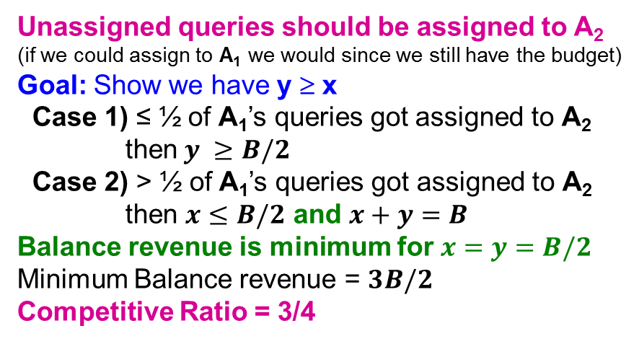
Analyzing Balance
Queries allocated to A₁ in the optimal solution
B
Queries allocated to A₂ in the optimal solution
A₁
A₂
Optimal revenue = 2B
Assume Balance gives revenue = 2B-x = B+y
x
B
Unassigned queries should be assigned to A₂
(if we could assign to A₁ we would since we still have the budget)
Goal: Show we have y ≥ x
Case 1) ≤ ½ of A₁’s queries got assigned to A₂
then $y ≥B/2$
Case 2) > ½ of A₁’s queries got assigned to A₂
then $x≤B/2$ and $x+y=B$
Balance revenue is minimum for $x=y=B/2$
Minimum Balance revenue = $3B/2$
Competitive Ratio = 3/4
y
x
A₁
A₂
Not
used
x
B
y
x
A₁
A₂
Not
used
BALANCE exhausts A₂’s budget
Notes:
Whatever is not used should be assigned to A2 (since if we could assign to A1 we would since we still have the budget)
CASE 1) Less than half of A1’s queries got assigned to A2. So y>B/2
CASE 2) If more than half of A1’s queries got assigned to A2.
Consider last of A1s queries assigned to A2. At that time B2 > B1.
At that time B2 < ½. Since more than half of A1’s queries got assigned to A2 (this means the remaining budget had to be <1/2).
So B1<1/2.

Slide 31
BALANCE: General Result
In the general case with N advertisers, worst competitive ratio of BALANCE is 1–1/e = approx. 0.63
  Interestingly, no online algorithm has a better competitive ratio!

Slide 32
Recommender Systems:
Content-based Systems & Collaborative Filtering

Slide 33


Example: Recommender Systems
Customer X
  Buys Metallica CD
  Buys Megadeth CD
Customer Y
  Does search on Metallica
  Recommender system suggests Megadeth from data collected about customer X

Slide 34










Recommendations
Examples:
Search
Recommendations
Items
Products, web sites,
blogs, news items, …

Slide 35
From Scarcity to Abundance
Shelf space is a scarce commodity for traditional retailers
  Also: TV networks, movie theaters,…
Web enables near-zero-cost dissemination
of information about products
  From scarcity to abundance
More choice necessitates better filters
  Recommendation engines
  How Into Thin Air made Touching the Void
  a bestseller: http://www.wired.com/wired/archive/12.10/tail.html
Notes:
In 1988, a British mountain climber named Joe Simpson wrote a book called Touching the Void, a harrowing account of near death in the Peruvian Andes. It got good reviews but, only a modest success, it was soon forgotten. Then, a decade later, a strange thing happened. Jon Krakauer wroteInto Thin Air, another book about a mountain-climbing tragedy, which became a publishing sensation. SuddenlyTouching the Void started to sell again.
Random House rushed out a new edition to keep up with demand. Booksellers began to promote it next to their Into Thin Air displays, and sales rose further. A revised paperback edition, which came out in January, spent 14 weeks on theNew York Times bestseller list. That same month, IFC Films released a docudrama of the story to critical acclaim. NowTouching the Void outsells Into Thin Air more than two to one.
What happened? In short, Amazon.com recommendations. The online bookseller's software noted patterns in buying behavior and suggested that readers who liked Into Thin Airwould also like Touching the Void. People took the suggestion, agreed wholeheartedly, wrote rhapsodic reviews. More sales, more algorithm-fueled recommendations, and the positive feedback loop kicked in.

Slide 36
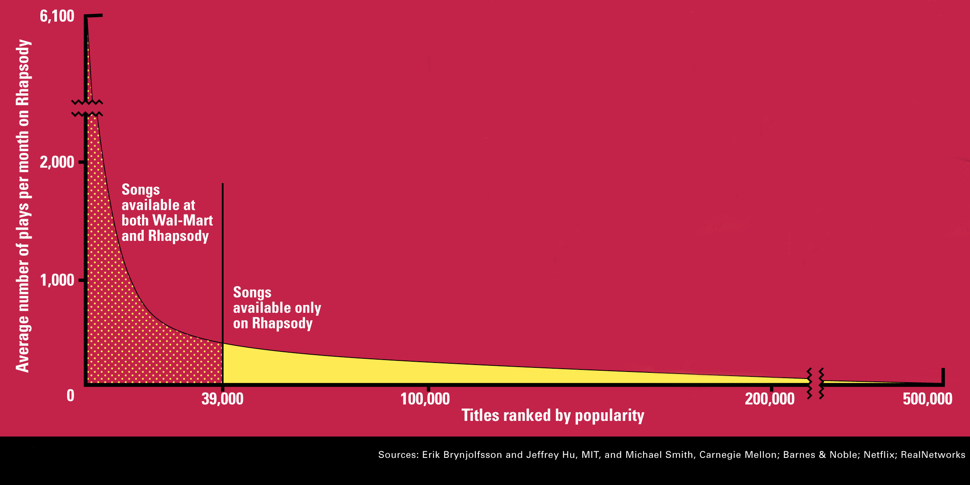
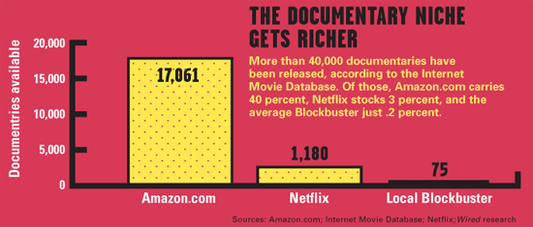
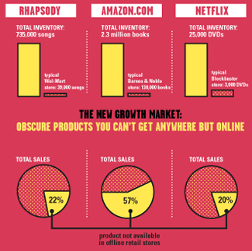
Sidenote: The Long Tail
Source: Chris Anderson (2004)

Slide 37
Types of Recommendations
Editorial and hand curated
  List of favorites
  Lists of “essential” items
Simple aggregates
  Top 10, Most Popular, Recent Uploads
Tailored to individual users
  Amazon, Netflix, …

Slide 38
Formal Model
X = set of Customers
S = set of Items
Utility function u: X × S → R
  R = set of ratings
  R is a totally ordered set
  e.g., 0-5 stars, real number in [0,1]

Slide 39
Utility Matrix
Avatar
LOTR
Matrix
Pirates
Alice
Bob
Carol
David

Slide 40
Key Problems
(1) Gathering “known” ratings for matrix
  How to collect the data in the utility matrix
(2) Extrapolate unknown ratings from the
known ones
  Mainly interested in high unknown ratings
    We are not interested in knowing what you don’t like
    but what you like
(3) Evaluating extrapolation methods
  How to measure success/performance of
  recommendation methods

Slide 41
(1) Gathering Ratings
Explicit
  Ask people to rate items
  Doesn’t work well in practice – people
  can’t be bothered
Implicit
  Learn ratings from user actions
    E.g., purchase implies high rating
  What about low ratings?

Slide 42
(2) Extrapolating Utilities
Key problem: Utility matrix U is sparse
  Most people have not rated most items
  Cold start:
    New items have no ratings
    New users have no history
Three approaches to recommender systems:
  1) Content-based
  2) Collaborative
  3) Latent factor based
Notes:
Latent factor based – predict recommendations that the user has not seen yet by building a system working well on known ratings and hope it predicts unknown ratings also well

Slide 43
Content-based
Recommender Systems

Slide 44
Content-based Recommendations
Main idea: Recommend items to customer x similar to previous items rated highly by x
Example:
Movie recommendations
  Recommend movies with same actor(s),
  director, genre, …
Websites, blogs, news
  Recommend other sites with “similar” content

Slide 45
Plan of Action
Item profiles
likes
build
recommend
match
Red
Circles
Triangles
User profile
Notes:
Item profile = vector of item features (e.g., one dimension = 0/1 whether it is red color, or not)
User profile = e.g., average over item profiles

Slide 46
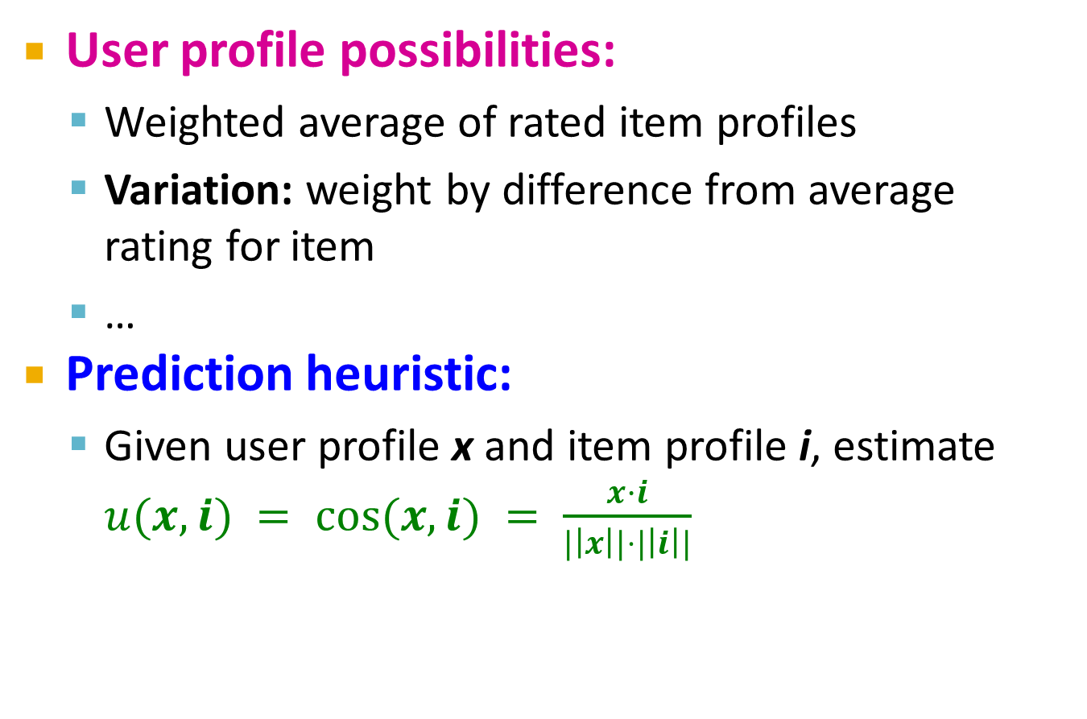
User Profiles and Prediction
User profile possibilities:
  Weighted average of rated item profiles
  Variation: weight by difference from average
  rating for item
  …
Prediction heuristic:
  Given user profile x and item profile i, estimate $u(x,i) = cos⁡(x,i) = \frac{x·i}{|\left|x\right||⋅|\left|i\right||}$

Slide 47
Collaborative Filtering
  Harnessing quality judgments of other users

Slide 48
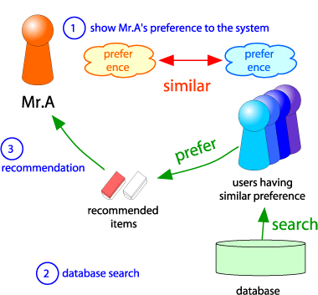
Collaborative Filtering
Consider user x
Find set N of other
users whose ratings
are “similar” to
x’s ratings
Estimate x’s ratings
based on ratings
of users in N
x
N

