Slide 1

PV204 Security technologies
Labs: JavaCard platform
Petr Švenda svenda@fi.muni.cz
Faculty of Informatics, Masaryk University

Slide 2
Laboratory
Programming basic JavaCard 2.x applet (JavaCard)
  NetBeans environment, JavaCard convertor
  jcardsim.org simulator
Pre-prepared simple communication application
  Java javax.smartcardio.*;
  Used already during the lab last week
Upload and communication with real JavaCard
  AppletPlayground for quick compile and convert into cap file
  GlobalPlatformPro tool for upload of cap file to card
  SimpleAPDU project to communicate with card

Slide 3
Masterplan for today
10 minutes project gettogether
Pre-prepared project for NetBeans
  Debugging of applet with simulated card (jcardsim.org)
Compilation of applet from the command line
  ant-javacard, GlobalPlatformPro for installation
  Select applet and obtain random data
Quick switch from simulated to real card
Automation via gradle template
  Use from command line
  Import into IntelliJ IDEA

Slide 4
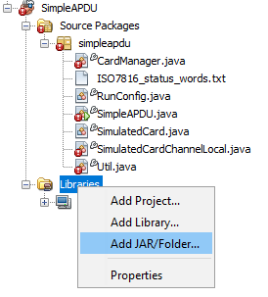
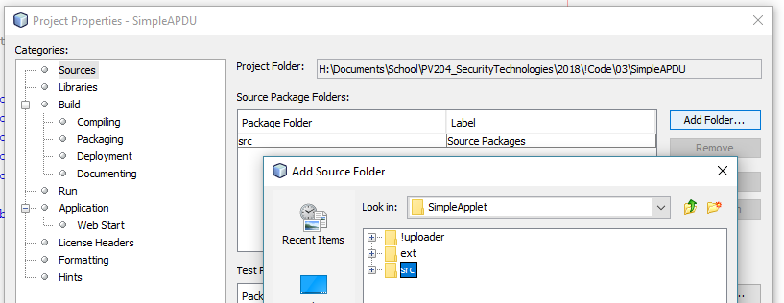
Setup SimpleAPDU [NetBeans]
Run NetBeans and import existing project
  File → Open project → SimpleAPDU
  (Now contains only host application)
Add jar library file with simulator
  Libraries→Add JAR→\lib\jcardsim-3.0.5-SNAPSHOT.jar
Add link to folder with on-card applet
  File → Project properties → Sources → Add folder
  Add SimpleApplet\src

Slide 5
Setup SimpleAPDU [NetBeans]
Project properties → Run → VM Options
  -enableassertions -noverify
  (required when custom compilation of jcardsim is used)
Project should now compile
Try to run in debug mode
  Place breakpoint inside applet’s code

Slide 6
Simulated card (jcardsim)

Slide 7
Task: demoGetRandomDataCommand()
Example code with single APDU command
Simulated card is used
Investigate the code, observe the values returned
Place breakpoints and observe in debugger:
  SimpleApplet constructor
  process() method
  Random() method

Slide 8
Tasks: demoEncryptDecrypt()
Investigate method demoEncryptDecrypt
Task 1: Prepare and send APDU with 32 bytes of data for encryption, observe output
Task 2: Extract the encrypted data from the card's response. Send APDU with this data for decryption
  Compare data for encryption with the decrypted data
Task 3: What is the value of AES key used inside applet? Use debugger to figure this out
Task 4: Prepare and send APDU for setting different AES key, then encrypt and verify

Slide 9
Conversion and upload to real card

Slide 10
Task: Create cap file and upload to card
Navigate to SimpleApplet folder
  src folder contains applet’s source code in SimpleApplet.java
  jcbuild.xml contains configuration for conversion with ant-javacard project
Folder with applet sources (level before package)
Path and name for resulting cap file
<target name="build" description="Builds the CAP file with SimpleApplet">
<javacard jckit="${JC222}">
<cap output="!uploader/SimpleApplet.cap" sources="src/" aid="73696d706c65">
<applet class="applets.SimpleApplet" aid="73696d706c656170706c6574"/>
</cap>
</javacard>
</target>
Package AID
Applet main class (including package name)
Applet AID

Slide 11
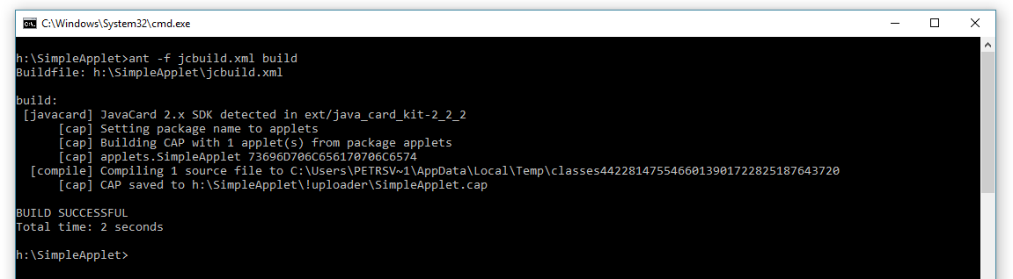
Task: Create cap file and upload to card
Compile & Convert
  Execute on cmd line: ant -f jcbuild.xml build
If OK, SimpleApplet.cap is created in !uploader folder

Slide 12
Task: Create cap file and upload to card
http://github.com/martinpaljak/GlobalPlatformPro
List already loaded applets
  java -jar gp.jar –list -d
Uninstall previous version of SimpleApplet
  java -jar gp.jar -uninstall SimpleApplet.cap -d
Install SimpleApplet.cap
  java -jar gp.jar -install SimpleApplet.cap -d
Use applet (commands in SimpleAPDU code)

Slide 13
Problem: what with other applets on card?
List already loaded applets
  java -jar gp.jar –list -d
Find package_AID and run:
  java -jar gp.jar –deletedeps –delete package_aid
  This will –deletedeps will also delete all applets from target package
E.g., our SimpleApplet can be also remove by
  gp –deletedeps –delete 73696d706c65

Slide 14
Be aware – real card can be blocked
Too many unsuccessful authentication requests
>gp --list -debug
# Detected readers from SunPCSC
[*] Alcor Micro USB Smart Card Reader 0
SCardConnect("Alcor Micro USB Smart Card Reader 0", T=*) -> T=0, 3BF71800008031F
E45736674652D6E66C4
SCardBeginTransaction("Alcor Micro USB Smart Card Reader 0")
A>> T=0 (4+0000) 00A40400 00
A<< (0018+2) (56ms) 6F108408A000000003000000A5049F6501FF 9000
A>> T=0 (4+0008) 80500000 08 6265E168FB2639C1
A<< (0028+2) (118ms) 00003126960097543174010200103595AC1420213D2969EA8B8C41F3 90
00
openkms.gp.GPException: STRICT WARNING: Card cryptogram invalid!
Card: 3D2969EA8B8C41F3
Host: DB1E6E1E71958A15
!!! DO NOT RE-TRY THE SAME COMMAND/KEYS OR YOU MAY BRICK YOUR CARD !!!
at openkms.gp.GlobalPlatform.printStrictWarning(GlobalPlatform.java:156)
at openkms.gp.GlobalPlatform.openSecureChannel(GlobalPlatform.java:471)
at openkms.gp.GPTool.main(GPTool.java:348)

Slide 15
Be aware – real card can be blocked
Don’t write script that executes many authentications at once (cycle, multiple commands)
If unsuccessful one/two authentication is detected, then as for help, please!!!

Slide 16
Use of real card

Slide 17
Tasks: demoUseRealCard()
Change from simulator to real card
  runCfg.setTestCardType(RunConfig.CARD_TYPE.PHYSICAL);
Task 5: Obtain random data from real card
Task 6: Set new key value and encrypt on card

Slide 18
Gradle template

Slide 19
Usage of gradle template
Intended for automatic conversion and tests
  Used by TravisCI…
IntelliJ IDEA can import project from gradle scripts
  Interactive debugging, test coverage…
Download complete zip
  https://github.com/crocs-muni/javacard-gradle-template-edu/releases/download/v0.2.0-edu/javacard-gradle-template-edu.zip
Read README.md carefully!
  ./gradlew buildJavaCard --info --rerun-tasks
  ./gradlew test --info --rerun-tasks

Slide 20


Integration with TravisCI
+
.travis.yml
language: java
jdk:
- oraclejdk8
script:
- ./gradlew check --info
- ./gradlew buildJavaCard --info

Slide 21
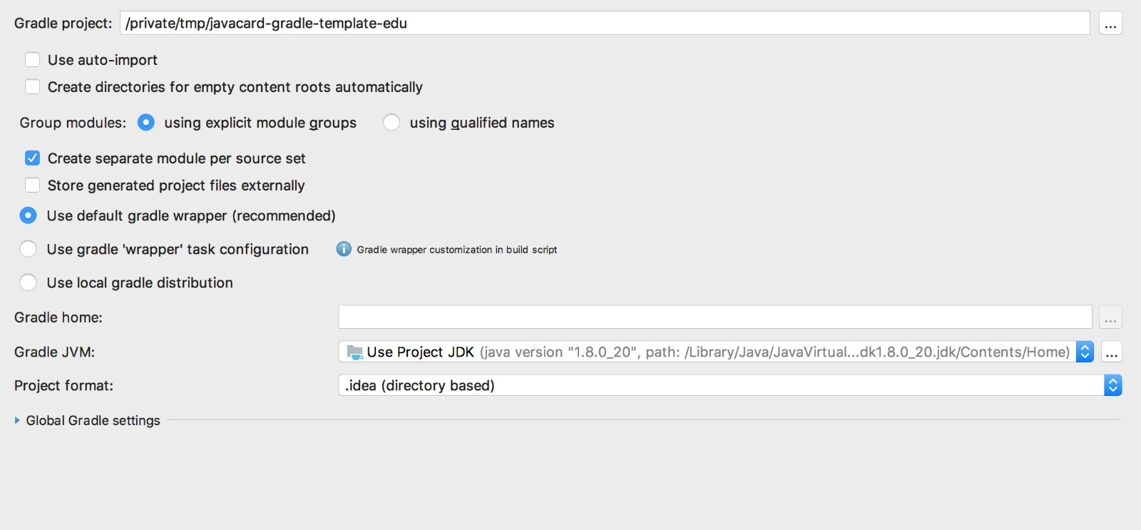
Gradle + IntelliJ IDEA
IntelliJ IDEA supports import of gradle –based projects (simpler IDE NetBeans not)
Debugging with simulated card works as in NetBeans

Slide 22
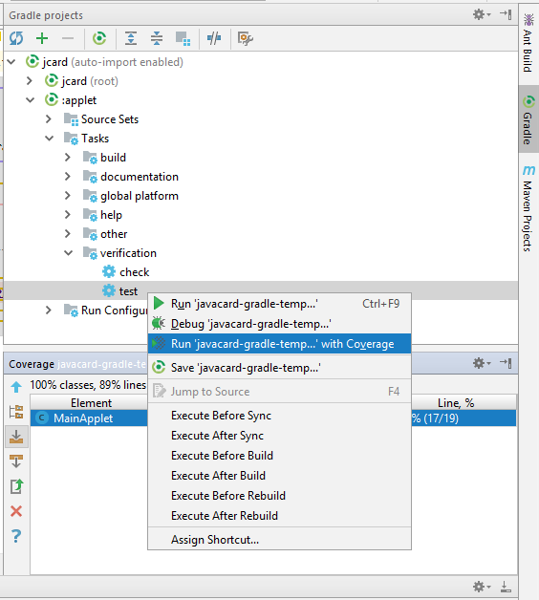
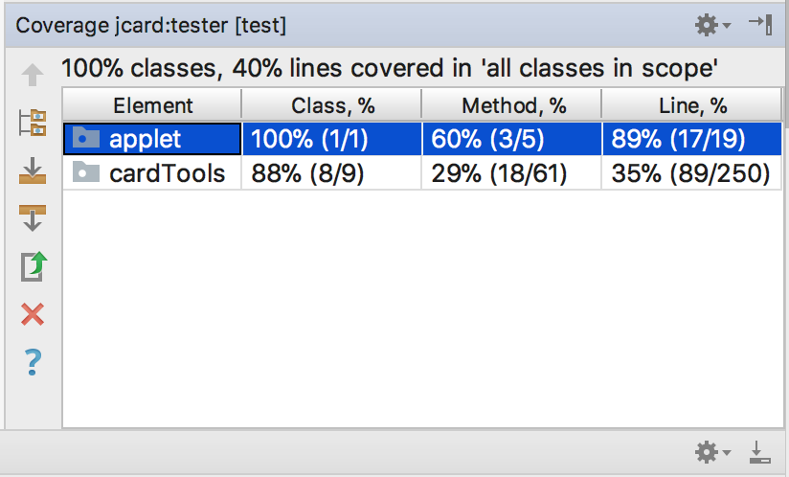
Test coverage: Gradle + IntelliJ IDEA
Go to Gradle plugin in IntelliJ IDEA
Tasks → verification → test
RClick → run with coverage

Slide 23
Homework

Slide 24
Homework – Secure signature card
Create secure signature applet and PC application
  Signature key (RSA-2048b) is generated on-card
  Applet will sign data only after PIN verification (OwnerPIN)
  Data for signature are provided using APDU command(s)
  Generated signature is returned back to user application
  Remove all unnecessary code (no leftover from examples!)
Produce short (1xA4) text description of solution
Discuss padding oracle attack against your code
Measure the speed of signature on real card [bonus point]
Submit before 15.3. 23:59 into IS HW vault
  Soft deadline: -1.5 points for every started 24 hours

Slide 26
Troubleshooting – jcardsim simulator
Don’t forget to add jcardsim-3.0.5-SNAPSHOT.jar
Use debugger – insert breakpoint directly into applet’s method
Local vs. remote simulator jcardsim
  Only single card can be simulated as local one (CAD.getCardInterface())
  We will use and debug only one card (so local is fine)
  Multiple cards can be used as remote simulators (sockets)

