Slide 1

PV204 Security technologies
Team projects
Petr Švenda
Faculty of Informatics, Masaryk University, Brno, CZ

Slide 2
Project idea
Improve existing cryptographic libraries
Select existing open-source cryptographic library
Generate large number of RSA and ECC keys
Analyze cryptographic operations for side-channel leakage
Implement support for hardware tokens
(Try to push changes to upstream repository)

Slide 3
Teams
3 people per team
  Formed today (within group), available in IS
Teams must use GitHub for cooperation
  Distribute work load evenly between all members
  Contribution from all team members must be visible in git (git commits from each member)
  Your evaluation will be partially based on your participation
Teams may use existing code, but must make clear attribution to the original author(s)

Slide 4
Basic hints on successful team work
Form team from people with similar expectations
  intended effort, final mark, interactions…
Plan your work (GitHub milestones + issues)
Don’t overcommit and fulfil your promises
Agree on 4 personal session to work on project (at least 1 hour each) and block time in your calendar
  Mail me the dates
Every seminar 10 minutes reserved for team sync
  Update your GitHub project milestones…

Slide 5
Projects – timeline (details on next slides)
Select target library, fork/create repository (4.3.2019)
  No duplicate libraries allowed, predefined list, FIFO, mail me!
Collect 1 million RSA and 1 million ECC keys: 5 points (14.3.2019)
  Store resulting keys (public and private, primes…) + measured timing + graphs
  Plot graphs: histogram of MSB and LSB, histogram timing
  Keygen code, keys, report (max. 2 pages A4) + presentation (your seminar)
Analyze crypto operations for side-channel leakage: 7 points (4.4.2019)
  Time side-channel (random inputs, mostly zeroes, mostly binary ones…)
  Bonuses: cache-based side-channel; pull requests with fix
  Report (max. 4 pages A4) + presentation (your seminar group)
Implement support for hardware tokens: 8 points (19.4.2019)
  Key generation in hardware token (PKCS#11, JavaCard…)
  Sign & encrypt operation using key stored inside token
At least 10 points (total) from the project required

Slide 6
Project: Key collection

Slide 7
Collect 1 million RSA and ECC keys
Investigate library code, locate key generation methods
Write small program collecting generated keypairs
  10⁶ RSA-512b keys
  10⁴ RSA-1024b, 10⁴ RSA-2048b
  10⁶ ECDSA (NIST P-256) keys
  Store resulting keys (format on next slides)
Plot graphs using generated keys
  histogram of MSBs and LSB, timing histogram

Slide 8
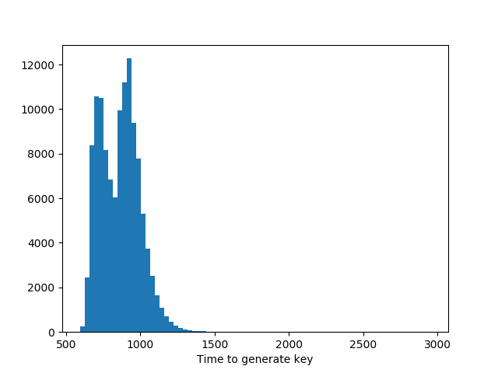
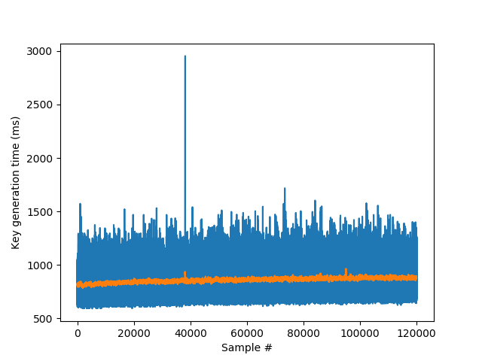
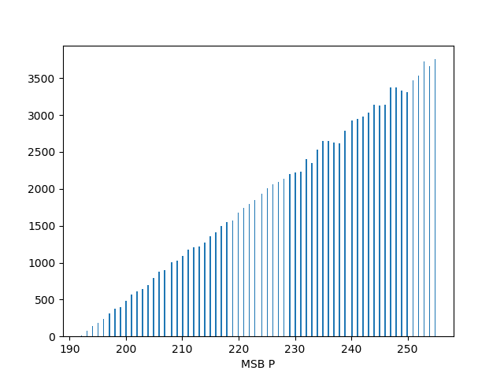
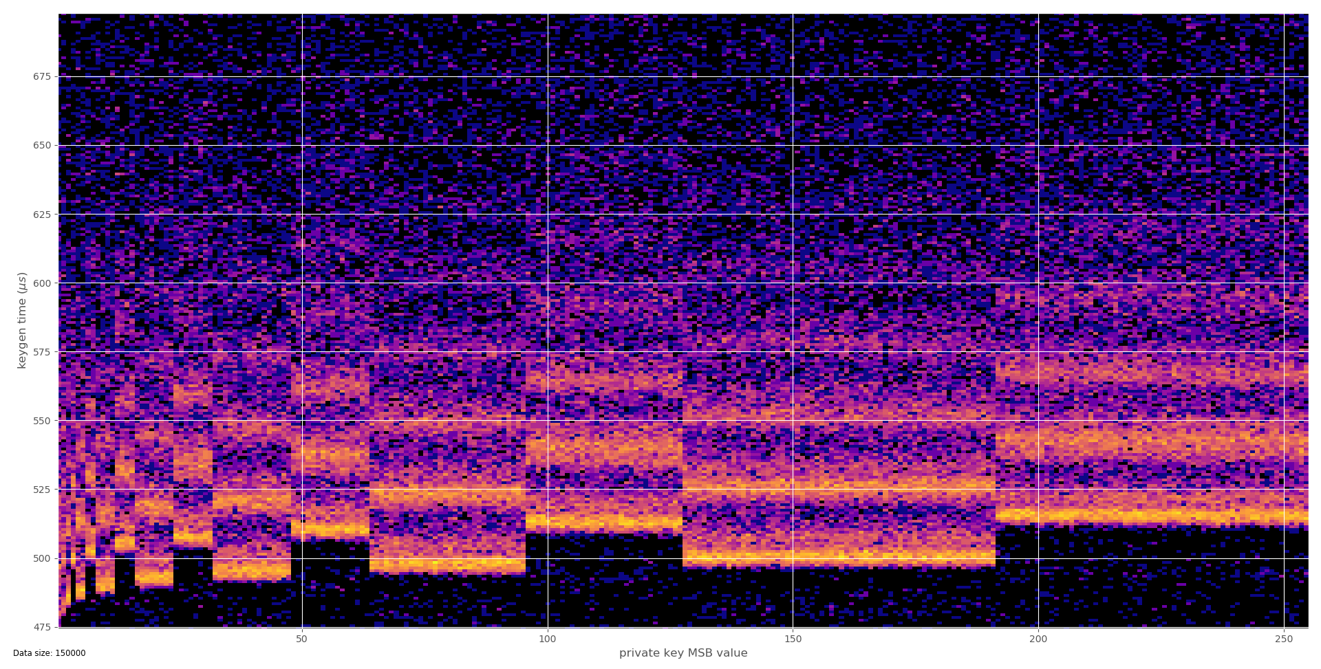
Keygen time for
generated keys
Histogram of
keygen times
Heatmap of private keys MSB
to keygen time
Histogram of
MSB of prime P

Slide 9
RSA key format
CSV Format, hexadecimal coding
id;n;e;p;q;d;t1;
id – simple counter: 1, 2 ….
n – modulus
e – public exponent
p – first prime
q – second prime
d – private exponent
t1 – time to generate key (ns)

Slide 10
ECC key format
CSV Format, hexadecimal coding
id;e;d;t1;
id – simple counter: 1, 2 ….
e – public key
d – private key
t1 – time to generate key (ns)

Slide 11
Libraries available for selection

Slide 12
BearSSL
  https://bearssl.org/
  Michal Čech, Šimon Doucha a Martin Bulák
BoringSSL
  http://www.boringssl.com/
  Mária Micháliková, Darek Cidlinský, + one other
Amazon s2n
  https://github.com/awslabs/s2n
  Jan Kvapil, Vladmír Sedláček, Ondřej Krčma
Apple coretls
  https://opensource.apple.com/tarballs/coreTLS/
  ??
Apple corecrypto
  https://developer.apple.com/security/
  Tomáš Šlancar, Xichu Zhang + one other

Slide 13
mbedTLS
Pedro Gomes
GO language crypto
  https://golang.org/
  ??
Mozilla NSS
  https://hg.mozilla.org/projects/nss
  ??
GNU TLS
  https://gnutls.org/
  Martin Frian, Pedro Gomes, Peter Sekan
WolfSSL
  https://www.wolfssl.com/
  Daniel Filakovsky, Antonin Dufka, Jakub Bartolomej
LibreSSL
  https://www.libressl.org/
  Natália Gregušková (422562), Daniela Belajová (445323), Nikola Šedivcová (433396)
Nettle
  http://www.lysator.liu.se/~nisse/nettle/
  Richard Kalinec, Ondřej Zoder a Filip Gontko

