Slide 1


PV204 Security technologies
Cryptographic smartcards, attacks against two-factor
Petr Švenda svenda@fi.muni.cz @rngsec
Centre for Research on Cryptography and Security, Masaryk University

Slide 2
Smart cards
Lecture:
  PC/SC communication framework, APDU
  Basic platforms – JavaCard & .net card & MULTOS, comparison
  Secure channel protocol (authentication, session keys, APDU protection), SCP
  Attacks against two-factor authentication
Lab
  Creating secure channel protocol
  Communicating with smart cards

Slide 3
Mind path for lecture
Smart cards are typical example of secure element → what smart card can be → what smart card is capable of
How to communicate with cards
  Contact (ISO7816-2) / contactless (ISO/IEC 14443)
  Low level transmission (T=0/T=1, ISO 7816-4)
  Logical packets (APDU)
  Standardized API on card (OpenPlatform, PIV, OpenPGP, ePassport)
  Standardized API on host (PC/SC, PKCS#11/15)
  Secure channel with card (OpenPlatform SCP’03, BAC, EAC)
What are cards capable of – supported algorithms, speed
What sc can be used for
  Digital signatures – generate and use private key (+ attacks), key encryption on card
  Two-factor authentication, access control (challenge-response protocol) (+attacks)
  Secure environment (code protection, trusted element - tokenization) (+attacks)

Slide 4

Check-in activity: how to stay awake
Any idea what we can do, prepare, try… to help us stay awake?
(5 minutes)

Slide 5
Overview
What smart cards are?
What smart cards are capable of?
How to manage smart cards?
Lightweight secure channel protocols
Two-factor authentication and some attacks

Slide 6
What A Smart card is?
Smart card basics

Slide 7
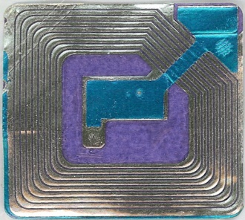
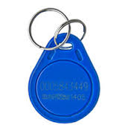
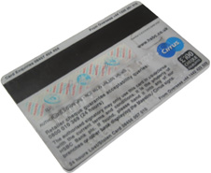
Basic types of (smart) cards
Contactless “barcode”
  Fixed identification string (RFID, < 5 cents)
Simple memory cards (magnetic stripe, RFID)
  Small write memory (< 1KB) for data, (~10 cents)
Memory cards with PIN protection
  Memory (< 5KB), simple protection logic (<$1)

Slide 8
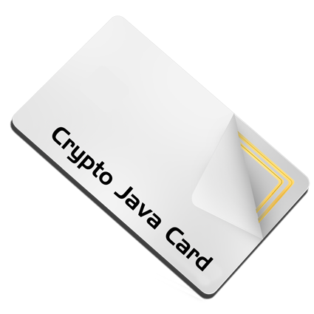

Basic types of (smart) cards (2)
Cryptographic smart cards
  Support for (real) cryptographic algorithms
  Mifare Classic ($1), Mifare DESFire ($3)
User-programmable cryptographic smart cards
  JavaCard, .NET card, MULTOS cards ($2-$30)
Chip manufacturers: NXP, Infineon, Gemalto, G&D, Oberthur, STM, Atmel, Samsung...
We will mainly focus on these two categories

Slide 9
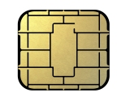
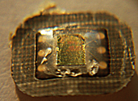

Cryptographic smart cards
CRYPTO
RNG
chip
CPU
contacts
contacts
ROM
SRAM
SC is quite powerful device
  8-32 bit processor @ 5-50MHz
  persistent memory 32-100s kB (EEPROM)
  volatile fast RAM, usually <<20kB
  truly random generator, cryptographic coprocessor (3DES, AES, RSA-2048...)
~10 billion units shipped in 2018 (EUROSMART)
  mostly smart cards, telco, payment and loyalty...
  ~1.5 billion contactless (EUROSMART)
Intended for physically unprotected environment
  NIST FIPS140-2 standard, security Level 4
  Common Criteria EAL4+/5+
EEPROM

Slide 10
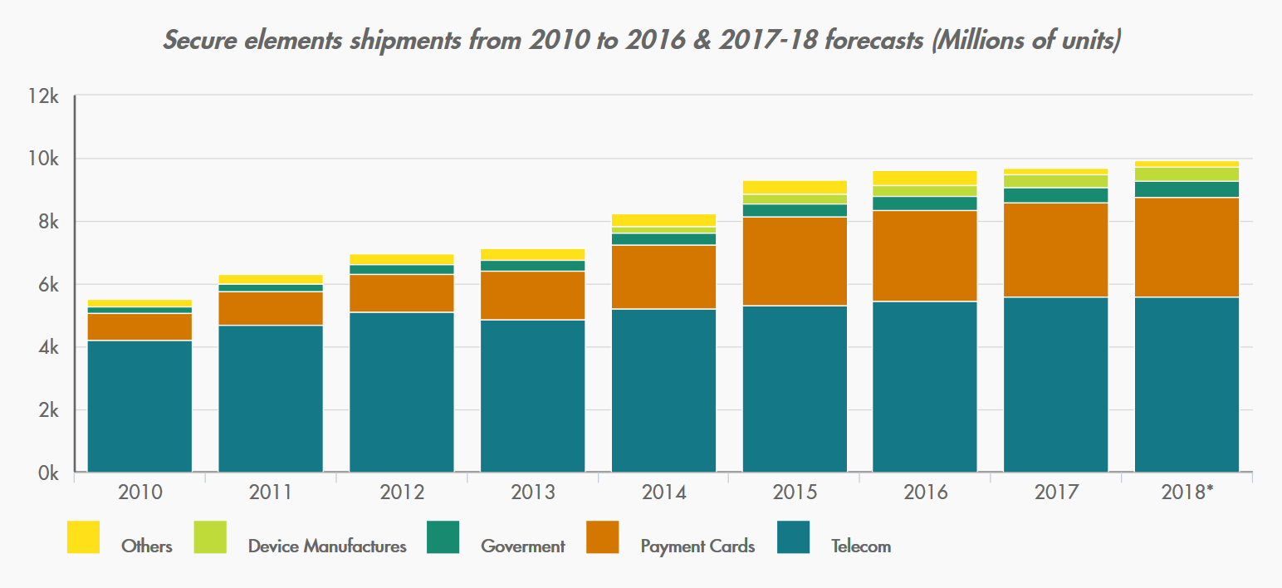
Payment
Telco
http://www.eurosmart.com/facts-figures.html

Slide 11

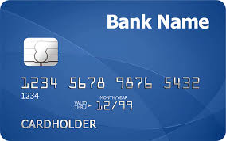

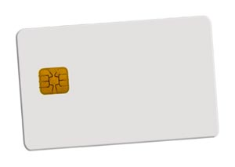
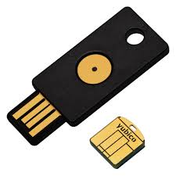
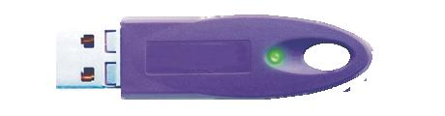
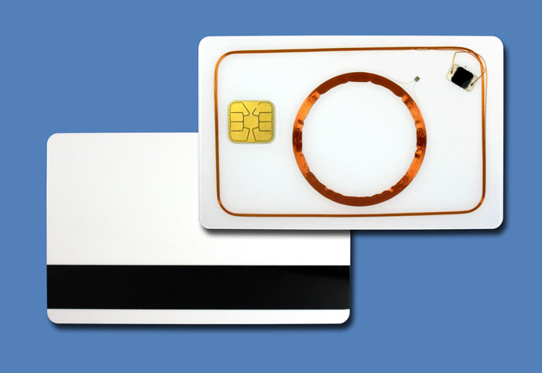
Smart cards forms
Many possible forms
  ISO 7816 standard
  SIM size, USB dongles, Java rings…
Contact(-less), hybrid/dual interface
  contact physical interface
  contact-less interface
  hybrid card – separate logics on single card
  dual interface – same chip accessible contact & c-less

Slide 12
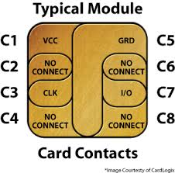

  Contact vs. contactless
Contact cards (ISO7816-2)
  I/O data line, voltage and GND line
  clock line, reset lines
Contactless cards
  ISO/IEC 14443 type A/B, radio at 13.56 MHz
  Chip powered by current induced on antenna by reader
  Reader → chip communication - relatively easy
  Chip → reader – dedicated circuits are charged, more power consumed, fluctuation detected by reader
  Multiple cards per single reader possible

Slide 13
Smart cards are used for…
GSM SIM modules
Digital signatures
Bank payment card (EMV standard)
System authentication
Operations authorizations
ePassports
Multimedia distribution (DRM)
Secure storage and encryption device
…

Slide 14
Smart card is highly protected device
  Intended for physically unprotected environment
  NIST FIPS140-2 standard, security Level 4
  Common Criteria EAL4+/5+
Tamper protection
  Tamper-evidence (visible if physically manipulated)
  Tamper-resistance (can withstand physical attack)
  Tamper-response (erase keys…)
Protection against side-channel attacks (power,EM,fault)
Periodic tests of TRNG functionality
Approved crypto algorithms and key management
Limited interface, smaller trusted computing base (than usual)
  http://csrc.nist.gov/groups/STM/cmvp/documents/140-1/140val-all.htm

Slide 15
Main advantages of crypto smart cards
High-level of security (CC EAL5+, FIPS 140-2)
Fast cryptographic coprocessor
Programmable secure execution environment
Secure memory and storage
On-card asymmetric key generation
High-quality and very fast RNG
Secure remote card control

Slide 16
Smartcards used in wider system

Slide 17
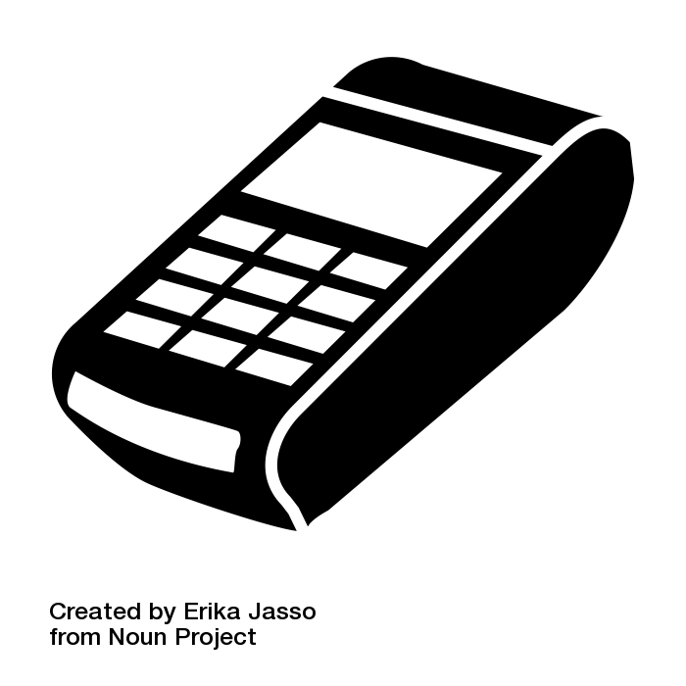
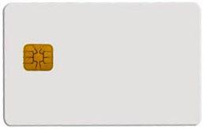

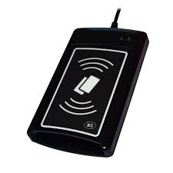

Big picture – terminal/reader and card
Merchant payment
Digital signature
What principles and standards are used?

Slide 18
Group activity: smartcard stack
(Imagine e.g., digital signature application with private key on smartcard)
Organize and glue floating items into smartcard stack
Use internet… (but don’t google for my slides from previous years ☺)
Annotate with own comment (what is the item about)
(15 minutes)
Combine results found by groups
(5 minutes)

Slide 19
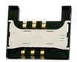

Slide 20
GPPro
GnuPG
Browser (TLS client authentication)
C/C# WinSCard.h
Java java.smartcardio.*
Python pyscard
SCardListReaders
SCardTransmit
API: PC/SC
OpenSC
ISO7816-4
ISO7816-1
APDU
PC/SC-lite
PKCS#11
ISO7816-2,3 (T=0/1)
ISO 14443 (T=CL)
13.56 MHz
API: EMV CAP
API: GSM 11.11
Personal Identity Verification (PIV)
NIST FIPS140-2
GlobalPlatform
OpenPGP
ICAO 9303
MultOS
ISO7816-8
.NET for smartcards
JavaCard

Slide 21
PC application
with direct control:
GnuPG, GPShell
PC application via library:
browser TLS, PDF sign…
Custom app with
direct control
Libraries
PKCS#11, OpenSC, JMRTD
Smartcard control language API
C/C# WinSCard.h, Java java.smartcardio.*, Python pyscard
System smartcard interface: Windows’s PC/SC, Linux’s PC/SC-lite
Manage readers and cards, Transmit ISO7816-4’s APDU
Readers
Contact: ISO7816-2,3 (T=0/1)
Contactless: ISO 14443 (T=CL)
APDU packet
API: EMV, GSM, PIV, OpenPGP, ICAO 9303 (BAC/EAC/SAC)
OpenPlatform, ISO7816-4 cmds, custom APDU
Card application 1
Card application 2
Card application 3
SC app programming:
JavaCard, MultOS, .NET

Slide 22

Big picture - components
User application
OS smart card API
User application
  Merchant terminal GUI
  Banking transfer GUI
  Browser TLS
  …
Card application
  EMV applet for payments
  SIM applet for GSM
  OpenPGP applet for PGP
  …
smart card reader
contact(less)
transmission
Card I/O manager
Card application
Card OS

Slide 23
Main standards
User application
OS smart card API
ISO7816 1-4
  Card physical properties ISO7816-1
  Physical layer communication protocol ISO7816-2-3
  Data packet format (APDU)
PC/SC, PC/SCLite (host side)
  Readers/cards management
  Transmission of logical APDU packets
  C/C# WinSCard.h, Java java.smartcardio.*, Python pyscard
PKCS#11
  standardized interface on host side
  card can be proprietary
GlobalPlatform
  remote card management interface
  secure installation of applications
smart card reader
contact(less)
transmission
Card I/O manager
Card application
Card OS

Slide 24
Card’s programming platforms
User application
OS smart card API
MultOS
  Multiple supported languages, native compilation
  Often bank cards
JavaCard (details in 3rd lecture)
  open programming platform from Sun
  applets portable between cards
Microsoft .NET for smartcards
  Similar to JavaCard, but C#
  Applications portable between cards
  Limited market penetration
smart card reader
contact(less)
transmission
Card I/O manager
Card application
Card OS

Slide 25
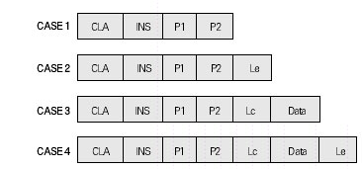
APDU (Application Protocol Data Unit)
APDU is basic logical communication datagram
  header (5 bytes) and up to ~256 bytes of user data
Format specified in ISO7816-4
Header/Data format
  CLA – instruction class
  INS – instruction number
  P1, P2 – optional data
  Lc – length of incoming data
  Data – user data
  Le – length of the expected output data
Some values of CLA/INS/P1/P2 standardized
Custom values used by application developer

Slide 26
What values of APDU header are used?
Standardized values for selected application
  Improves interoperability
  https://web.archive.org/web/20180721010834/http://techmeonline.com/most-used-smart-card-commands-apdu/
Custom commands for proprietary application
  Your own API

Slide 27
Selected software components
PC/SC (MS API: SCardxx, Java: java.smartcardio.*)
PC/SCLite (implementation of PC/SC for Linux/MAC)
OpenSC – proxy component between proprietary tokens and PKCS#11 interface
SoftHSM – virtual PKCS#11-compliant card

Slide 28
Smartcard algorithms and performance

Slide 29
Common algorithms
Basic - cryptographic co-processor
  Truly random data generator
  3DES, AES128/256
  MD5, SHA1, SHA-2 256/512
  RSA (up to 2048b common, 4096 possible)
  ECC (up to 192b common, 384b possible)
  Diffie-Hellman key exchange (DH/ECDSA)
Custom code running in secure environment
  E.g. HMAC, OTP code, re-encryption
  Might be significantly slower (e.g., SW AES 50x slower)

Slide 30
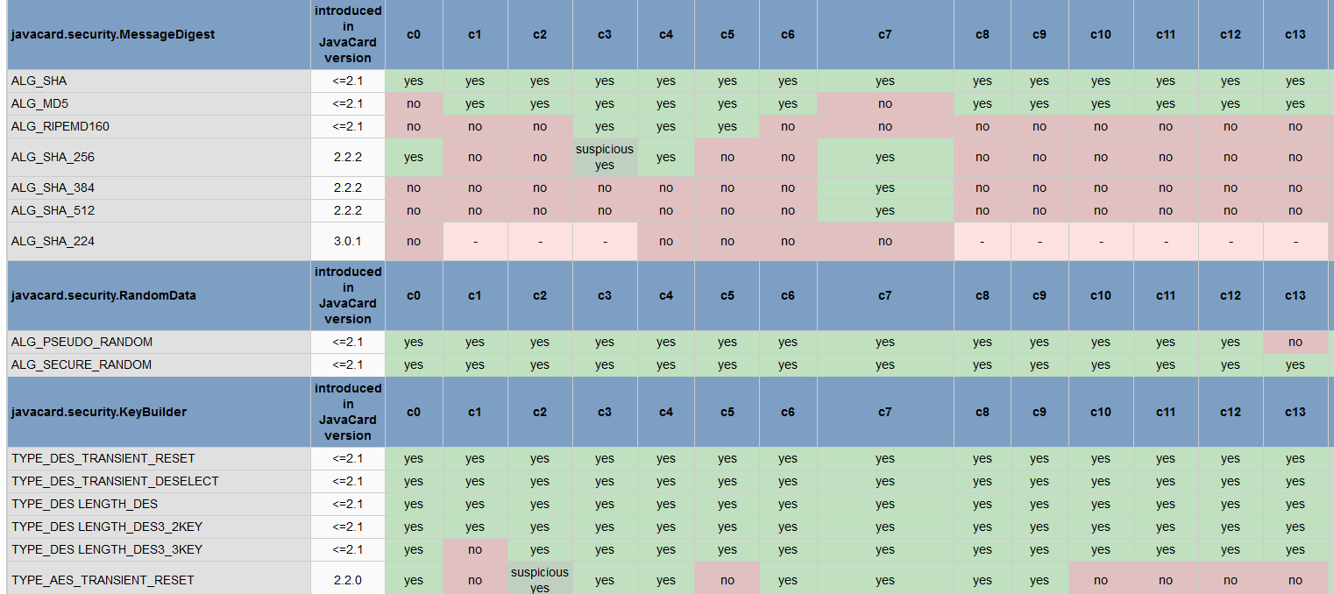
Cryptographic operations
Supported algorithms (JCAlgTester, almost 90 cards)
  https://github.com/crocs-muni/JCAlgTest
  https://www.fi.muni.cz/~xsvenda/jcsupport.html

Slide 31
What is the typical performance?
Hardware differ significantly
  Clock multiplier, memory speed, crypto coprocessor…
Typical speed of operation is:
  Milliseconds (RNG, symmetric crypto, hash)
  Tens of milliseconds (transfer data in/out)
  Hundreds of millisecond (asymmetric crypto)
  Seconds (RSA keypair generation)
Operation may consists from multiple steps
  Transmit data, prepare key, prepare engine, encrypt
  → additional performance penalty

Slide 32
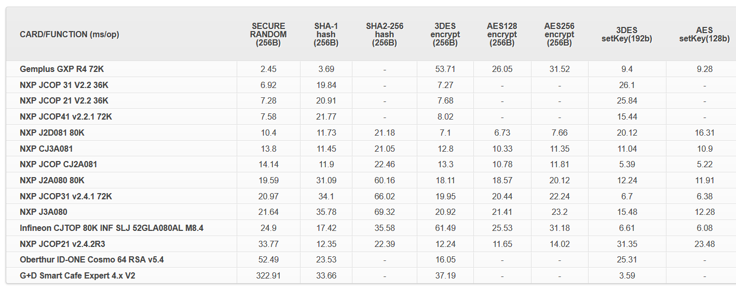
Performance tables for common cards
https://jcalgtest.org
Is faster always better?
Visit https://jcalgtest.org
What influences the speed?

Slide 33
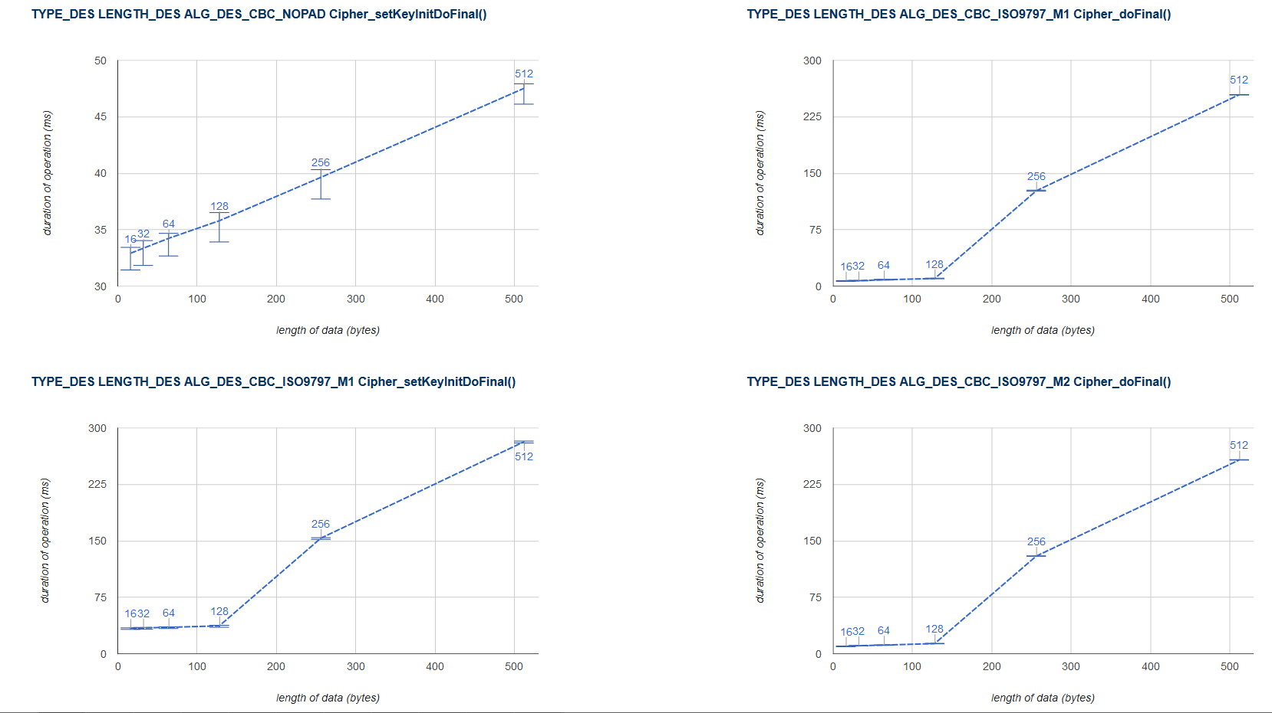
Performance with variable data lengths
https://jcalgtest.org
Limited memory and resources
may cause non-linear dependency on a processed data length

Slide 34
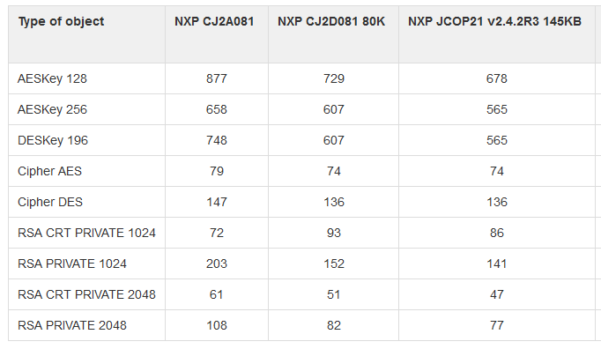
How many cryptographic engines?

Slide 35
Smart card management
What functionality would require?

Slide 36
Motivation
How to upload, install and remove applications?
Who should be allowed to upload/remove apps?
What if multiple mutually distrusting apps on card?
How to update application in already issued card?
Need for cross-platform interoperable standard
  Many manufactures and platform providers

Slide 37

Globalplatform

Slide 38
GlobalPlatform
Specification of API for card administration
  Upload/install/delete applications
  Card lifecycle management
  Card security management
  Security mechanisms and protocols
Newest is GlobalPlatform Card Specification v2.3
  December 2015
  Previous versions also frequently used
  http://www.globalplatform.org/specificationscard.asp

Slide 39

GlobalPlatform – main terms
Card Manager
Security
Domain 1
Security
Domain 2
Smart card life cycle
  OP_READY, INITIALIZED (prepared for personalization)
  SECURED (issued to user, use phase)
  CARD_LOCKED (temporarily locked (attack), unlock to SECURED)
  TERMINATED (logically destroyed)
Card Manager (CM)
  Special card component responsible for administration and card system service functions (cannot be removed)
Security Domain (SD)
  Logically separated area on card with own access control
  Enforced by different authentication keys

Slide 40
GlobalPlatform – main terms
Card Manager
Security
Domain 1
Security
Domain 2
Card Content (apps,data) Management
  Content verification, loading, installation, removal
Security Management
  Security Domain locking, Application locking
  Card locking, Card termination
  Application privilege usage, Security Domain privileges
  Tracing and event logging
Command Dispatch
  Application selection
  (Optional) Logical channel management
Applet 2
Applet 3
Applet 1

Slide 41
Smart card life cycles
The smart card passes various logical life cycle states between manufacture and final destruction
Life cycle states define which operations can be performed with the card
The card Life Cycle States OP_READY and INITIALIZED are intended for use during the Pre-Issuance phases of the card’s life.
The states SECURED, CARD_LOCKED and TERMINATED are intended for use during the Post-Issuance phase of the card although it is possible to terminate the card at any point during its life.

Slide 42
Smart card life cycles
OP_READY – card is ready for uploading of key diversification data, any application and issuer specific structures.
INITIALIZED – card is fully prepared but not yet issued to card holder.
SECURED – card is issued to card holder. Card management is possible only through Security domain (installation of signed applets etc.).
CARD_LOCKED – card is locked due to some security policy and no data management can be performed. Card can be locked by Security domain and later unlocked as well (switch back to SECURED state).
TERMINATED – card is logically “destroyed“ due to card expiration or detection of the severe security thread.

Slide 43
Global Platform APDU commands
DELETE – delete uniquely identifiable object (e.g. JavaCard applet)
STORE_DATA – upload content of single data object
GET_DATA - used to retrieve a single data object
SET_STATUS – set Life Cycle status
GET_STATUS – return Life Cycle status
INSTALL – initiate installation, typically (JavaCard) applet
LOAD – upload file from PC to smart card, e.g. JavaCard cap file
PUT_KEY – update value of specified key

Slide 44
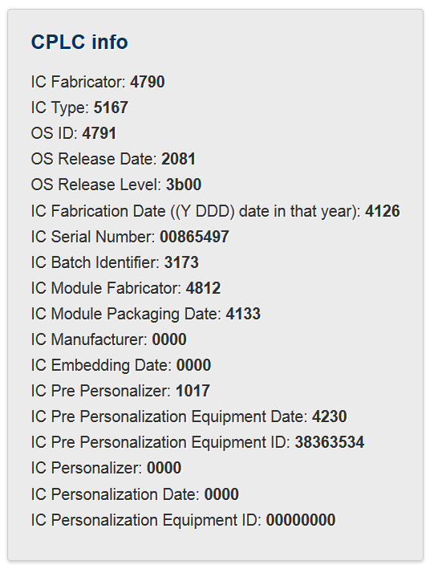
Card Production Life Cycle (CPLC)
Manufacturing metadata
Dates (OS, chip)
Circuit serial number
(not mandatory)
GlobalPlatform APDU
  80 CA 9F 7F 00
  gppro --info
ISO7816 APDU
  00 CA 9F 7F 00

Slide 45
Two factor authentication

Slide 46
Two-factor authentication
Two factors with tokens/smart cards
  Token (smart card, phone) + Knowledge (PIN, Password)
Authorize transaction with card and PIN
Authenticate with password and SMS
Authenticate user with One-Time Password (OTP) generated on mobile phone (stored secret key) after screen unlock (pattern)
U2F token (password + token + button press)
…
How to attack two-factor?

Slide 47

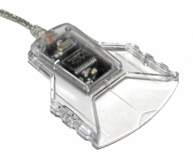
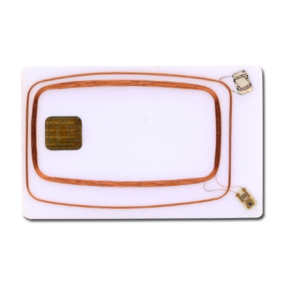
Application uses PC/SC interface (SCardxx)
User application
winscard.dll
reader driver
USB driver
APDU

Slide 48
Where to log communication?
In-application logging
User application
winscard.dll
“Stub” winscard.dll logging
reader driver
Virtual reader
In-card logger
USB driver
HW USB sniffer
APDU
SW USB sniffer
HW ISO7816 T=0/1

Slide 49

APDUPlay project (https://www.fi.muni.cz/~xsvenda/apduinspect.html)
based on ApduView utility (by Fernandes)
User application
[begin]
SCardTransmit (handle 0xEA010001)# apduCounter:0#
totalBytesINCounter:1#
transmitted:00 a4 04 00 0a a0 00 00 00 28 80 10 30 01 ff
responseTime:31#
SCardTransmit result:0x0#
received:6a 81
SCardTransmit (handle 0xEA010001)# apduCounter:1#
totalBytesINCounter:16#
…
winscard.dll (stub)
original.dll

Slide 50
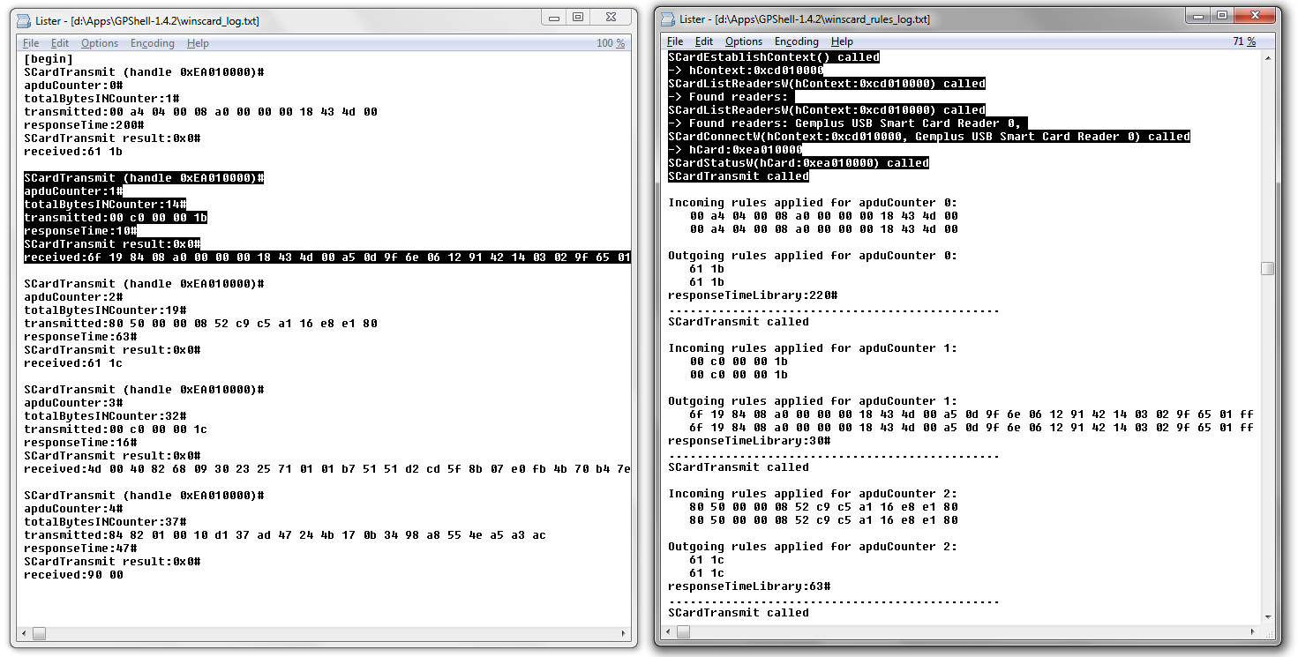
What can you do then…
Log all APDU send via SCardTransmit()
Log all SCardXXX function calls

Slide 51
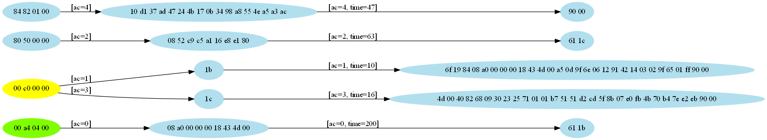
Visualize logged APDU’s

Slide 52
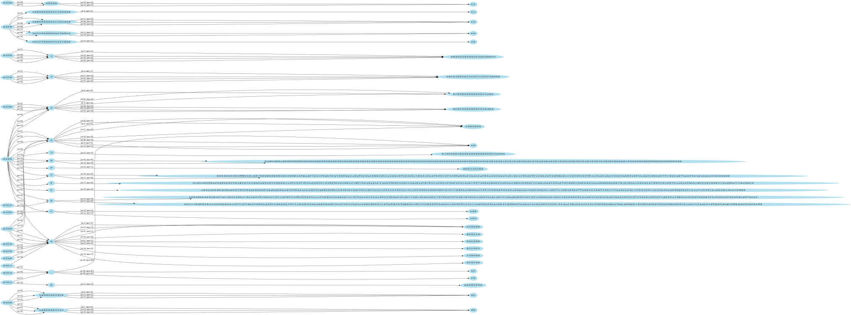
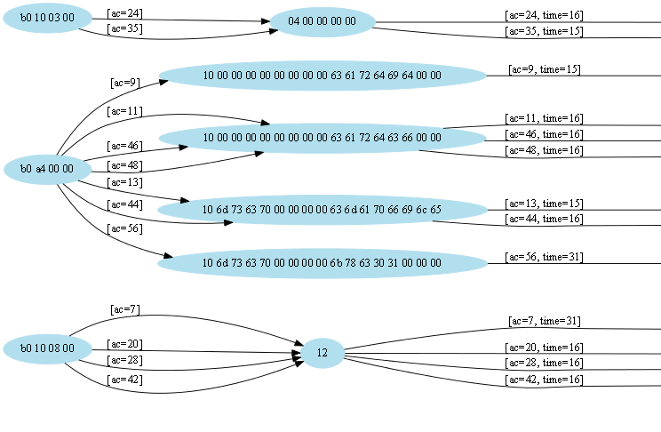

Slide 53

For attacking two-factor, logging is usually not enough
Manipulate incoming/outgoing APDUs
  modify packet content (change receiver account number)
  replay of previous packets (pay twice)
  simulate presence of smart card
  …
00 a4 04 00 08 01 02 03 04 05 06 07 08
winscard.dll (stub)
90 00
[RULE1]
MATCH1=in=1;t=0;cla=00;ins=a4;p1=04;
ACTION=in=0;data0=90 00;le=02;

Slide 54
German banking malware (2009)
Two-factor authorization of transactions (chipTAN/cardTAN)
Application code injection
  modifies info about transaction and balance shown to user in browser
  intercepts/modifies transaction data for signature by smart card
  http://www.cio.com/article/2429854/infrastructure/german-police--two-factor-authentication-failing.html
The Fairy Tale of “What You See Is What You Sign” - Trojan Horse Attacks on Software for Digital Signatures (2001)
  http://www.hanno-langweg.de/hanno/research/scits01p.pdf
  Importance of physical PIN-pad and display of transaction amount independently

Slide 55
German banking malware
User application
Code inject application
winscard.dll
reader driver
USB driver
APDU

Slide 56
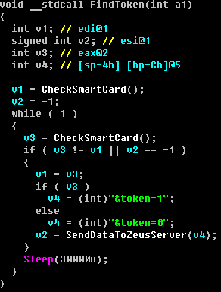
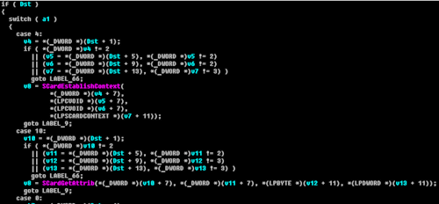
ZeuS smartcard support module
ZeuS Banking Trojan (2010, 2012)
  Analysed by A. Matrosov, Group-IB and others
  http://www.welivesecurity.com/2010/11/05/dr-zeus-the-bot-in-the-hat/
  http://www.secureworks.com/cyber-threat-intelligence/threats/zeus/
Smart card controlled via PC/SC interface

Slide 57
ZeuS smartcard support module
User application
Malicious app
Malicious application
winscard.dll
reader driver
USB driver
APDU

Slide 58
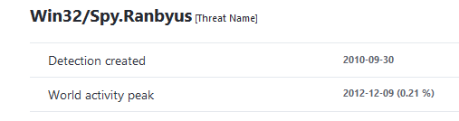
Win32/Spy.Ranbyus
Analysed by A. Matrosov
  http://www.welivesecurity.com/2012/06/05/smartcard-vulnerabilities-in-modern-banking-malware/
Scans for available smart cards, info send to C&C
  uses PC/SC SmartCard API for scan
  later redirects communication on USB level (FabulaTech USB for RD installed)

Slide 59
Win32/Spy.Ranbyus
User application
Malicious app
Malicious application
winscard.dll
reader driver
USB driver
APDU
Remote USB redirection

Slide 60

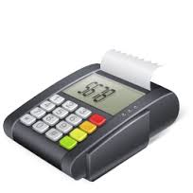

Skimmers, PoS hacks
Manipulated PoS firmware:
Magnetic skimmer (+ send data over GSM)
MitM: chip→verified by signature
APDU

Slide 61
Recall U2F how can you attack U2F if PC/SC layer is controlled?

Slide 62
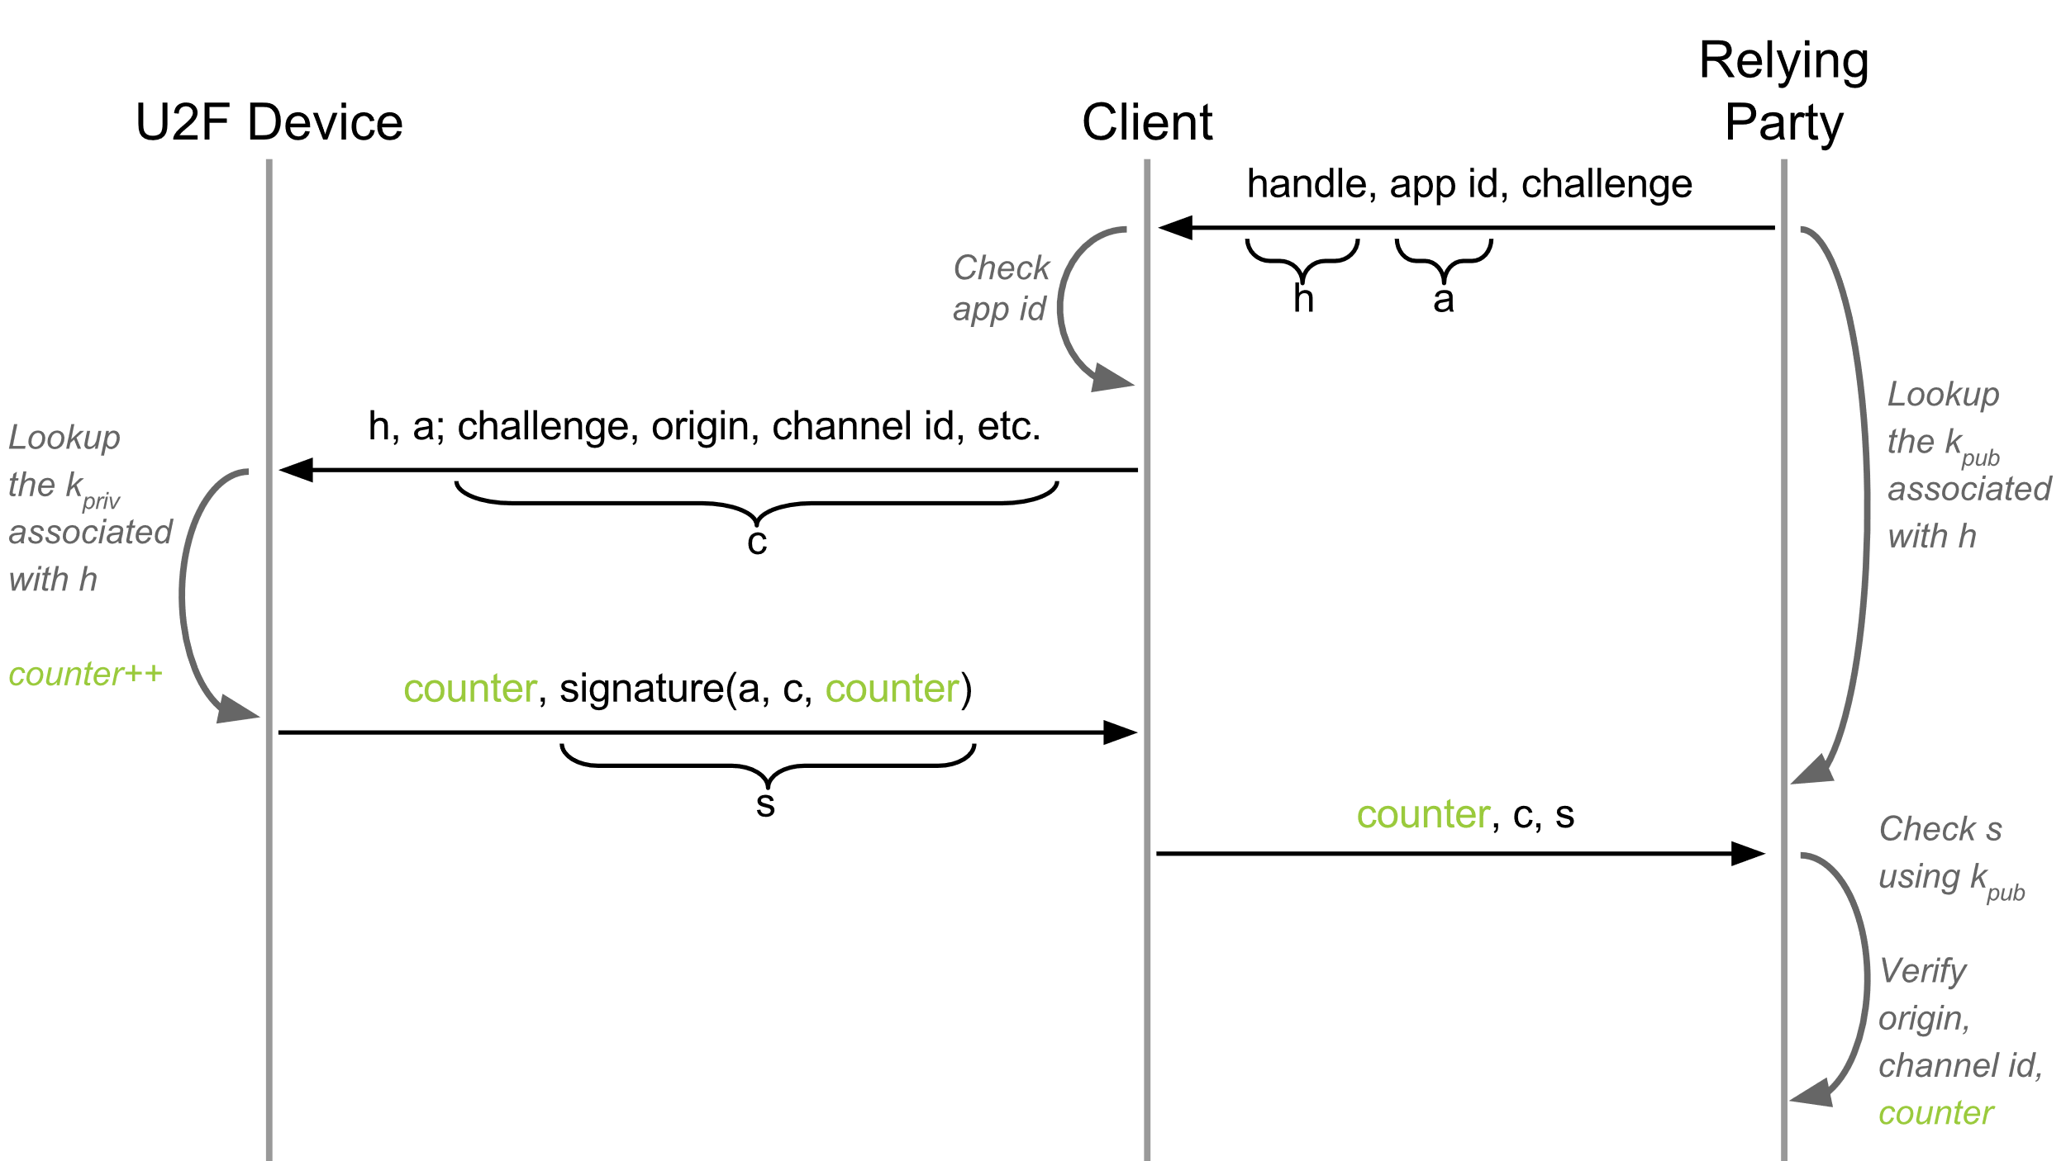


FIDO U2F protocol
Malicious PC/SC
https://developers.yubico.com/U2F/Protocol_details/Overview.html

Slide 63
Secure channel Protocol (for smartcards)
How to authenticate and communicate securely?

Slide 64
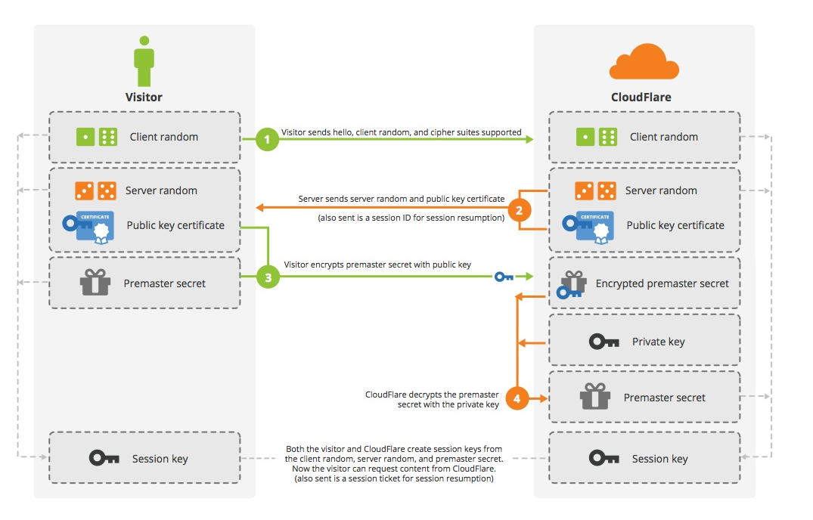
TLS handshake
Credit: Cloudflare

Slide 65
Why not to use TLS all the time?
Requires asymmetric cryptography
  Unsuitable for slower devices
Requires long keys
  Unsuitable for devices with small memory
Requires significant data overhead (~6.5KB)
  http://netsekure.org/2010/03/tls-overhead/
More lightweight protocols exist
  RFID / smartcards / IoT…
Note: TLS can be fully implemented on smartcards (but slow)
  https://github.com/gilb/smart_card_TLS

Slide 66
Secure channels – questions to ask
What attacker model is assumed?
Integrity protection? Encryption? Authentication?
One-side or mutual authentication?
What kind of cryptography is used?
What keys are required/pre-distributed?
Additional trust hierarchy required?
Is necessary to generate random numbers/keys?
What if keys are compromised? Forward secrecy?

Slide 67
What attacker model is assumed?
Integrity protection? Encryption? Authentication?
One-side or mutual authentication?
What kind of cryptography is used?
What keys are required/pre-distributed?
Additional trust hierarchy required?
Is necessary to generate random numbers/keys?
What if keys are compromised? Forward secrecy?

Slide 68
Common lightweight SCPs
OpenPlatform SCP’01,’02 (3DES-based)
OpenPlatform SCP‘10 (RSA-based)
OpenPlatform SCP’03 (AES-based)
ISO/IEC 7816-4 Secure Messaging
ePassports Basic Access Control (3DES-based)
ePassports Extended Access Control (3DES,RSA,DH,SHA1/2-based)

Slide 69
Example: GlobalPlatform SCP’03
Mutual authentication (based on symmetric crypto)
Session key derivation (based on long-term keys)
  NIST SP 800-108
Message (APDU) confidentiality and integrity MAC
INITIALIZE UPDATE
  Random challenge, card’s computations
EXTERNAL AUTHENTICATE
  Terminal response
Secure messaging
What are problems with
usage of symmetric crypto?

Slide 70
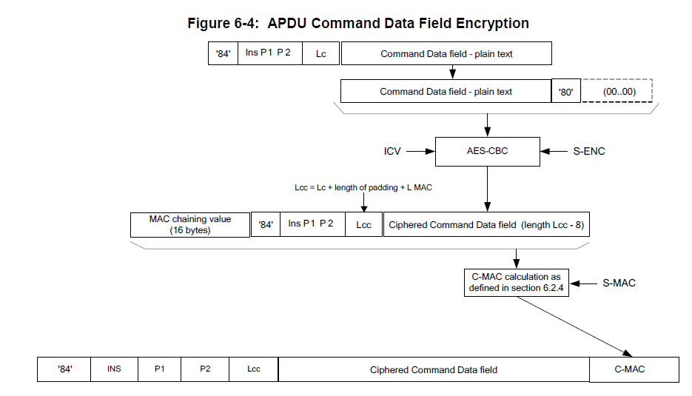
Secure Channel Protocol '03‘, Card Specification v2.2 – Amendment D, GPC_SPE_014

Slide 71
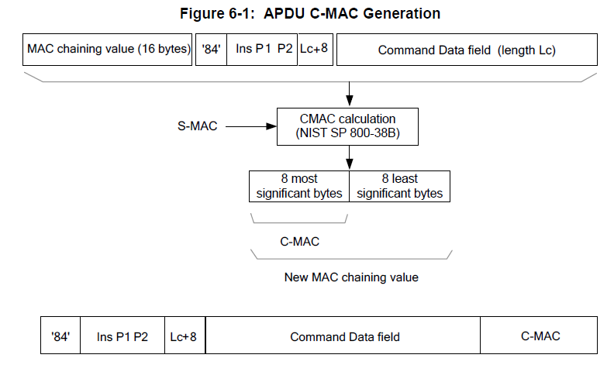
Secure Channel Protocol '03‘, Card Specification v2.2 – Amendment D, GPC_SPE_014

Slide 72
ePassport protocols (ICAO 9303)
Significantly more complex trust model
  Passport, Inspection terminal, Trusting countries, Distrusting countries
  Multiple sensitivity levels (basic info / fingerprint / iris)
  Combination of symmetric and asymmetric cryptography
Basic Access Control (BAC) protocol
  SCP-like protocol, static key is content from MRZ
Extended Access Control (EAC) protocol
  Terminal authentication (RSA/ECDSA, SHA-1/2)
  Chip authentication (DH/ECDSA key)
  PACE protocol to establish session keys
Active Authentication (AA) protocol

Slide 73
Mandatory reading
When Organized Crime Applies Academic Results
  A Forensic Analysis of an In-Card Listening Device
  https://eprint.iacr.org/2015/963.pdf
Which academic attacks is of concern?
What system is targeted?
How is attack carried out? Is it protocol flaw?
What can prevent this attack vector?

Slide 74

Conclusions
Smartcards are highly secure and capable modules
  Programmable
  Accessible (cost, API…)
Protocol stack between PC application and smartcard
  PC/SC, APDU transfer, GlobalPlatform, JavaCard
Two-factor authentication is not silver bullet
  But way better than password alone!
Questions

