Slide 1


PV204 Security technologies
Rootkits, reverse engineering of binary applications
Petr Švenda svenda@fi.muni.cz @rngsec
Centre for Research on Cryptography and Security, Masaryk University

Slide 2
What is planned for this lecture?
Rootkits (and defences)
Reverse engineering (of binary applications)

Slide 3
K. Thompson – Reflections on Trusting Trust
Subverted C compiler (Turing Award Lecture, 1983)
  Adds additional functionality for selected compiled programs
  E.g., login cmd: log password or allow user with specific name
Inspection of login’s source code will not reveal any issues
Adds malicious functionality of compiler into binary of compiler compiled with already subverted compiler
  Inspection of source code of compiler will not reveal any problem
How can we detect modified login binary?
  Expected hash, digital signatures, deterministic build…
  What if signature verification tool is also modified?
W32/Induc-A infected compiler for Delphi (2009)
  Active at least a year before discovery

Slide 4
Rootkits

Slide 5
Rootkit definition
Root-kit
  root user *nix systems
  kit set of tools to operate/execute commands
Rootkit is piece or collection of software
  Designed to enable access where it would be otherwise denied
  Tries to hide(“cloak”) its presence in system
Installed after obtaining privileged access
  Privileged escalation, credentials compromise, physical access…
Rootkit != exploit (rootkit usually installed after exploit)
Rootkit is usually accompanied with additional payload
  Payload does the actual (potentially malicious) work

Slide 6
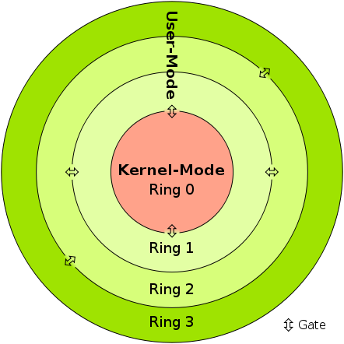
Protection rings
Idea: introduce separate runtime levels
  Crash in level X causes issue only in levels >=X
  Direct support provided by CPU architectures (0/3)
    Instructions which can be executed only in given ring
Ring 3: unprivileged user programs
Ring 2/1: device drivers (currently sparsely used)
Ring 0: kernel programs
Performance penalty associated with ring switching
  In practice, only 3 and 0 are commonly used
0-3 Captures only rings/levels starting with OS
  Levels -1/-2/-3 introduced for layers below OS
Sven, Licensed under CC BY-SA 3.0 via Commons

Slide 7
Rootkit
Ring level
Ring “3+”
Managed code rootkits
Managed code (runtime, JVM)
Ring 3
User-mode rootkits
User-mode
Ring 1,2
Device drivers
Kernel rootkits
Ring 0
OS kernel, device drivers
Ring -1
Hypervisory-level rootkits
Hypervisory-level (VT-x, AMD-V)
Ring -2
System Management Mode, BIOS
SMM abuse, bootkits
Ring -3
Firmware, hardware
FW/HW rootkits

Slide 8
Principal ways of detection of rootkits
Detection running inside system, same or higher level
  Flaws in rootkit cloaking, use of some side-channel leakage (of rootkit)
Detection running inside system, lower level
  Not controlled by rootkit, rootkit cannot cloak itself
Detection via (offline) image of system / memory
  Rootkit is not running => cannot cloak itself

Slide 9
Types of offensive software (wrt OS)
Alternative taxonomy – how interfaced with system
Category | Interface to system | Location | Examples
Type 0 | Existing APIs | Rings 3, 0 | Filter driver, Browser helper objects, injected DLL/thread
Type I | Modified static components | Rings 3, 0 | Hooking, patching, bootkits
Type II | Modified dynamic components | Rings 3, 0 | Direct kernel object modification, Rogue callbacks
Type III | Outside of the system | Rings -1, -2,-3 | Rogue hypervisor, firmware mod
J. Rutkowska, Introducing Stealth Malware Taxonomy

Slide 10
Detection of rootkits
Signature-based
  Files, mutexes… present on infected system
Behavioural-based (lecture 7)
  Communication, hooks, latency…
Integrity checking
  Detected modification of critical system files
  Prevent execution of modified files
  Memory dumps (lecture 8)
  Detect rootkit when not running (!cloaked)
  Rootkit detection tools (lectures 7,8)

Slide 11
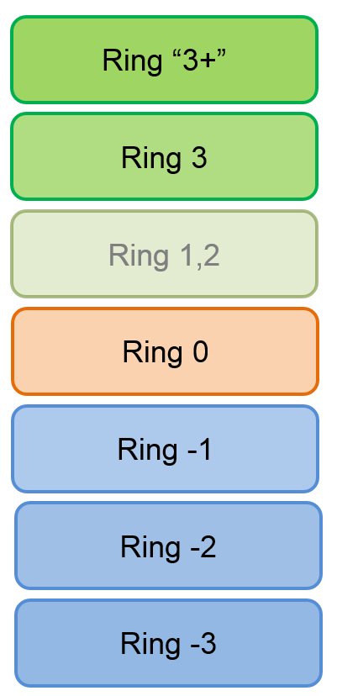
User-mode rootkits (Ring 3)
Injects payload into other user applications
  Injection of modified dlls (user app will use different CreateFile)
  Modification of applications (modification of CreateFile)
Interception of messages
  RegisterWindowMessage()
Function hooking
  More generic hooks (SetWindowsHookEx()) – window manager
  User application-specific hooks (plugins, example browser hook)
File-system filters
  Detect access to files by user application

Slide 12
Managed code rootkits (MCR) (Ring 3)
Ring 3 (level for runtime / VM)
Targets runtime environments for interpreted code
  .NET VM, Java VM and Dalvik runtime…
Large attack surface for MCR
  Attacking runtime class libraries
  Attacking JIT compiler
  Abusing runtime instrumentation features
  Extending language with malware API
  Object-oriented malware (inside OO runtime)
E. Metula: Managed Code Rootkits (Syngress)

Slide 13
Kernel-mode rootkits (Ring 0)
Runs with highest system privileges
  Usually device drivers and loadable modules
  Device drivers in MS Windows
  Loadable kernel modules in Linux
Direct kernel object manipulation
  Data structures like list of processes…
  System Service Descriptor Table (SSDT) hook [Microsoft]
  System call table hook [Linux]
Operating system may require mandatory drivers signing
  More difficult to insert malicious driver
  Still possible (compromised private keys: Stuxnet & Realtek’s keys)

Slide 14
Rootkits below OS level

Slide 15
Hypervisory-level rootkits (Ring -1)
Virtual-machine based rootkit (VMBR)
  Type II hypervisors (VM on ordinary OS host)
Based on CPU hardware virtualization features
  Intel VT or AMD-V
Rootkit hosts original system as virtual machine
  And intercepts all relevant hardware calls
Examples: SubVirt, BluePill (AMD-V, Intel VT-x)

Slide 16
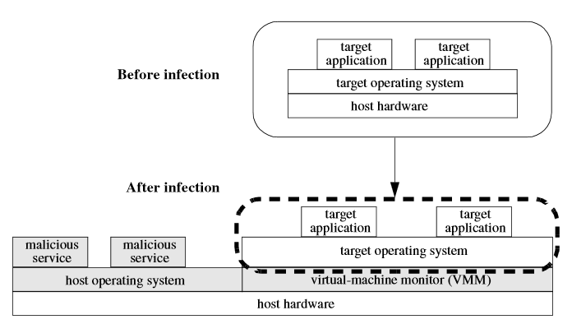
Hypervisory-level rootkits (Ring -1)
King et al: SubVirt: Implementing malware with virtual machines

Slide 17
Defense against hypervisory-level rootkits
Run detection/prevention on lower level
Detect by timing differences of operations
  System is emulated => side-channel info (timings…)
Read and analyze HDD physical memory
  After physical removal from (infected) computer
Boot from safe medium (CD, USB, network boot)
  inspect before VMBR loads
  But VMBR can emulate shutdown / reboot
    Physical power unplug recommended
Trusted boot (based on TPM, lecture 07)

Slide 18
System Management Mode abuse (R.-2)
System Management Mode (SMM)
  x86 feature since Intel 386, all normal execution is suspended
  Used for power management, memory errors, hardware-assisted debugger…
  High-privilege mode (Ring -2)
SMM entered via system management interrupt (SMI)
  System cannot override or disable the SMI
Target for rootkits
  Modify memory, loaders, MBR…

Slide 19
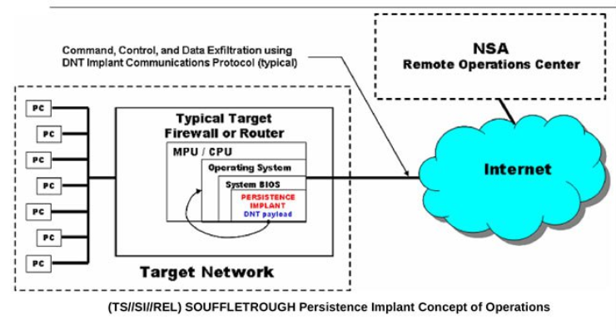
SMM Example: SOUFFLETROUGH implant
https://en.wikipedia.org/wiki/NSA_ANT_catalog
http://leaksource.info/2013/12/30/nsas-ant-division-catalog-of-exploits-for-nearly-every-major-software-hardware-firmware/

Slide 20
Bootkit rootkits (Ring -2)
Bootkit = Rootkit + Boot capability
Infect startup code
  Master Boot Record (MBR)
  Volume Boot Record (VBR)
  Boot sector, BIOS routines…
“Evil maid” attack
  Can be used to attack full disk encryption
  Assumption: user will left device physically unattended
  Legitimate bootloader replaced (+ key capture)

Slide 21

Full-disk encryption compromise
Full-disk encryption used to encrypt all data
Laptop powered down to prevent Coldboot or FireWire-based attacks (read key from memory)
Laptop left unattended (“Evil maid” enters)
  USB used to read part of first sector of disk
  If TrueCrypt/Bitlocker loader, then insert malicious bootloader
User is prompted with forged bootloader
  Password is stored
How to transfer saved password / data to attacker?
  Second visit of Evil maid
http://theinvisiblethings.blogspot.co.uk/2009/10/evil-maid-goes-after-truecrypt.html

Slide 22
Bootkit defenses
Prevention of physical access
  Problematic for portable devices
Trusted boot (static vs. dynamic root of trust)
  Refer to Lecture 07 (Trusted boot)
  But bootloader must authenticate itself to user
    E.g., present image encrypted by key stored in TPM
    Before user enters its password
Defense by external verification of bootloader integrity
  verify relevant unencrypted parts of disk (external USB)

Slide 23
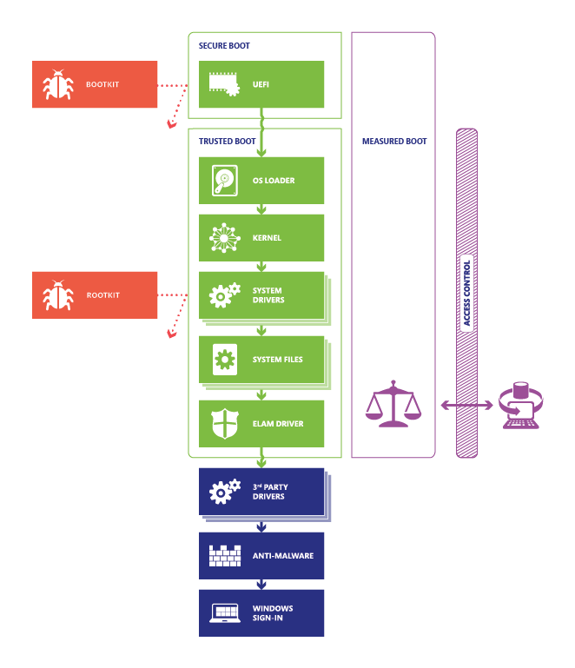
http://technet.microsoft.com/en-US/windows/dn168167.aspx

Slide 24
Firmware / hardware rootkits (Ring -3)
Persistent malware image in hardware
  Network card, router, hard drive…
Can run even after removal of device from target computer
  Once device is powered again

Slide 25
Anti-forensic techniques
How rootkits protects itself?
Common system API functions used for hooking
Hiding files
Hiding processes
RAM only rootkits
Data destruction
Data concealment
Data transformation and fabrication

Slide 26
Legitimate uses

Slide 27
Legitimate uses of rootkits
To whom is legitimacy measured?
Hide true nature of network “honeypots”
Protection of AV software against termination of inspected malware
Anti-theft protections
Digital rights management?

Slide 28
Sony BMG Extended copy protection
Rootkit developed for (and approved) by Sony
  Intended to limit possibility for disk copy
  Users were not notified (silently installed after CD insert)
  Digital rights management for Sony
  To hide itself, any file starting with $sys$ was hidden
Detected by M. Russinovich’s RootkitRevealer
  After public disclose, other malware started to hide itself by naming its files as $sys$ (user was already “infected”)
Sony released patch for removal (web-based uninstaller)
  Even more serious flaw introduced (any visited page can install and run program)
  Resulted in class-action lawsuit against Sony BMG

Slide 29
Reverse engineering

Slide 30
Reverse engineering
A process of knowledge or design extraction from final product (usually man-made)
Engineering:
  Mental model → blueprints/source-code → product/binary
Reverse engineering (back engineering):
  From product back to knowledge or design
  Blueprints/source-code might be also recreated
Not necessary/possible to perfectly recreate design
  Engineering might be loose transformation
  Back engineering might not be perfect/complete

Slide 31
Reverse engineering is general process
We will focus on software binaries only

Slide 32
Reverse engineering - legal issues
Reverse engineering is legal when
  Own binary without documentation
  Anti-virus research, Forensics…
  Interoperability, Fair use, education
Problem with some copyright laws
  not only selling circumvented content, but also attempt to circumvent is illegal (USA’s DMCA)
EFF Coders’ Rights Project Reverse Engineering FAQ
  Legal doctrines, Risky aspects, Selected decisions
  https://www.eff.org/issues/coders/reverse-engineering-faq

Slide 33
How to start reverse engineering
Learn basic concepts (compilers, memory, OS…)
See how source-code translates into binary
Try tools on simple examples (own code, tuts)
Utilize other knowledge (communication logs…)
Have fun! ☺

Slide 34
Basics
Debugger vs. debugger with binary modification capabilities
  E.g., Visual Studio vs. OllyDbg
Disassembler vs. debugger
  Static vs. dynamic code analysis
Disassembler vs. decompiler
  Native code → assembler → source code
Native code vs. bytecode
  Different instruction set, different execution model
Registry-based vs. stack-based execution

Slide 35

  Compilation to native binary (C/C++)
Preprocessing "gcc -E hello.c > hello.i"
  Macro expansion, include insertion…
Compilation "gcc -s hello.i"
  Syntactic code control, most errors reported here
Assembly "as hello.s -o hello.o"
  Compilation from assembler to native executable
Link "gcc hello.o"
  Substitution of relative addresses by absolute
Ordinary build executes all steps together

Slide 36
Mixed source code/assembler in IDE
Most current IDE supports mixed source code/assembler instructions mode (Visual Studio, QT Creator...)
  Mode is usually available only during a debugging
  Write simple code (e.g., if then else condition), insert breakpoint and start debugging
Switch to mixed mode
  Visual Studio→RClick→Go to disassembly
  QTCreator→Debug→Operate by Instruction
Easy way to learn how particular source code is translated into assembler code

Slide 37
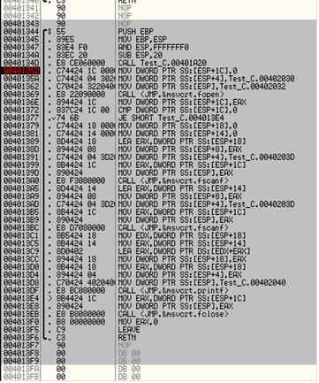
#include <stdio.h>
int main() {
FILE* file = NULL;
file = fopen("values.txt", "r");
if (file) {
int value1 = 0;
int value2 = 0;
fscanf(file, "%d", &value1);
fscanf(file, "%d", &value2);
value1 = value1 + value2;
printf("Result: %d", value1);
}
fclose(file);
}
Dump of assembler code for function main:
2 int main() {
0x00401344 <+0>: push %ebp
0x00401345 <+1>: mov %esp,%ebp
0x00401347 <+3>: and $0xfffffff0,%esp
0x0040134a <+6>: sub $0x20,%esp
0x0040134d <+9>: call 0x401a20 <__main>
3 FILE* file = NULL;
0x00401352 <+14>: movl $0x0,0x1c(%esp)
4 file = fopen("values.txt", "r");
0x0040135a <+22>: movl $0x402030,0x4(%esp)
0x00401362 <+30>: movl $0x402032,(%esp)
0x00401369 <+37>: call 0x401c90 <fopen>
0x0040136e <+42>: mov %eax,0x1c(%esp)
...
17 }
0x004013f5 <+177>: leave
0x004013f6 <+178>: ret
End of assembler dump.
Original C source code

Slide 38
Most common instructions/structures
Most common ASM instructions
  Load/Store from to registers: MOV, LEA
  Arithmetic: ADD, INC…
  Relational: CMP, TEST
  Jumps: JMP, J*
  Functions: CALL, RET
Example of typical structures (C→ ASM)
  Conditional jump, for loop, function call…
  Familiarize via mixed source code/assembler in IDE
  Be aware of debug/release differences

Slide 39
Jump operation
Jump operation
  Unconditional JMP – jump every time
  Conditional - based on the current value of flag(s)
JA* Jump if (unsigned) above - CF=0 and ZF=0
JB* Jump if (unsigned) below - CF=1
JE** Jump if equal - ZF=1
JG* Jump if (signed) greater - ZF=0 and SF=OF (SF=SignFlag)
JGE*Jump if (signed) gtr or equal - SF=OF
JL* Jump if (signed) less - SF != OF (!= is not)
JLE* Jump if (signed) less or equal - ZF=1 and OF != OF
JMP** Jump - Jumps always
JNE** Jump if not equal - ZF=0

Slide 40
Conditional branching
Conditional branching is usually realized by two consecutive operations:
  Comparison operation setting Flags register
  a) Conditional jumping operation to address based on Flags (Branch 1)
  B) If not jumped then Branch 2 code is directly present starting with a next instruction, or unconditional jump JMP to Branch 2 is present

Slide 41
Comparison operations
CMP EAX, -1 - will set flag(s) in Registers
  Zero and Sign flags are usually of interest
  If two values are same (EAX == -1), Zero flag is set to 1
TEST A, B (usually TEST EAX, EAX)
  logical AND operation
  results not saved, Flags are set
  TEST EAX, EAX will test if value in EAX is equal to 0
    If EAX == 0 then Zero flag == 1, 0 otherwise

Slide 42
  Compilation to bytecode (Java, C#)
Source code compiled into intermediate bytecode
  Java bytecode, .NET CLI ...
Intermediate code interpreted by virtual machine
Just-in-time compilation
  Intermediate code is compiled by VM into native code
  Improve performance significantly
  Relevant for dynamic analysis, not for static analysis
Usually easier to understand then assembler code

Slide 43
Structure of Executable

Slide 44
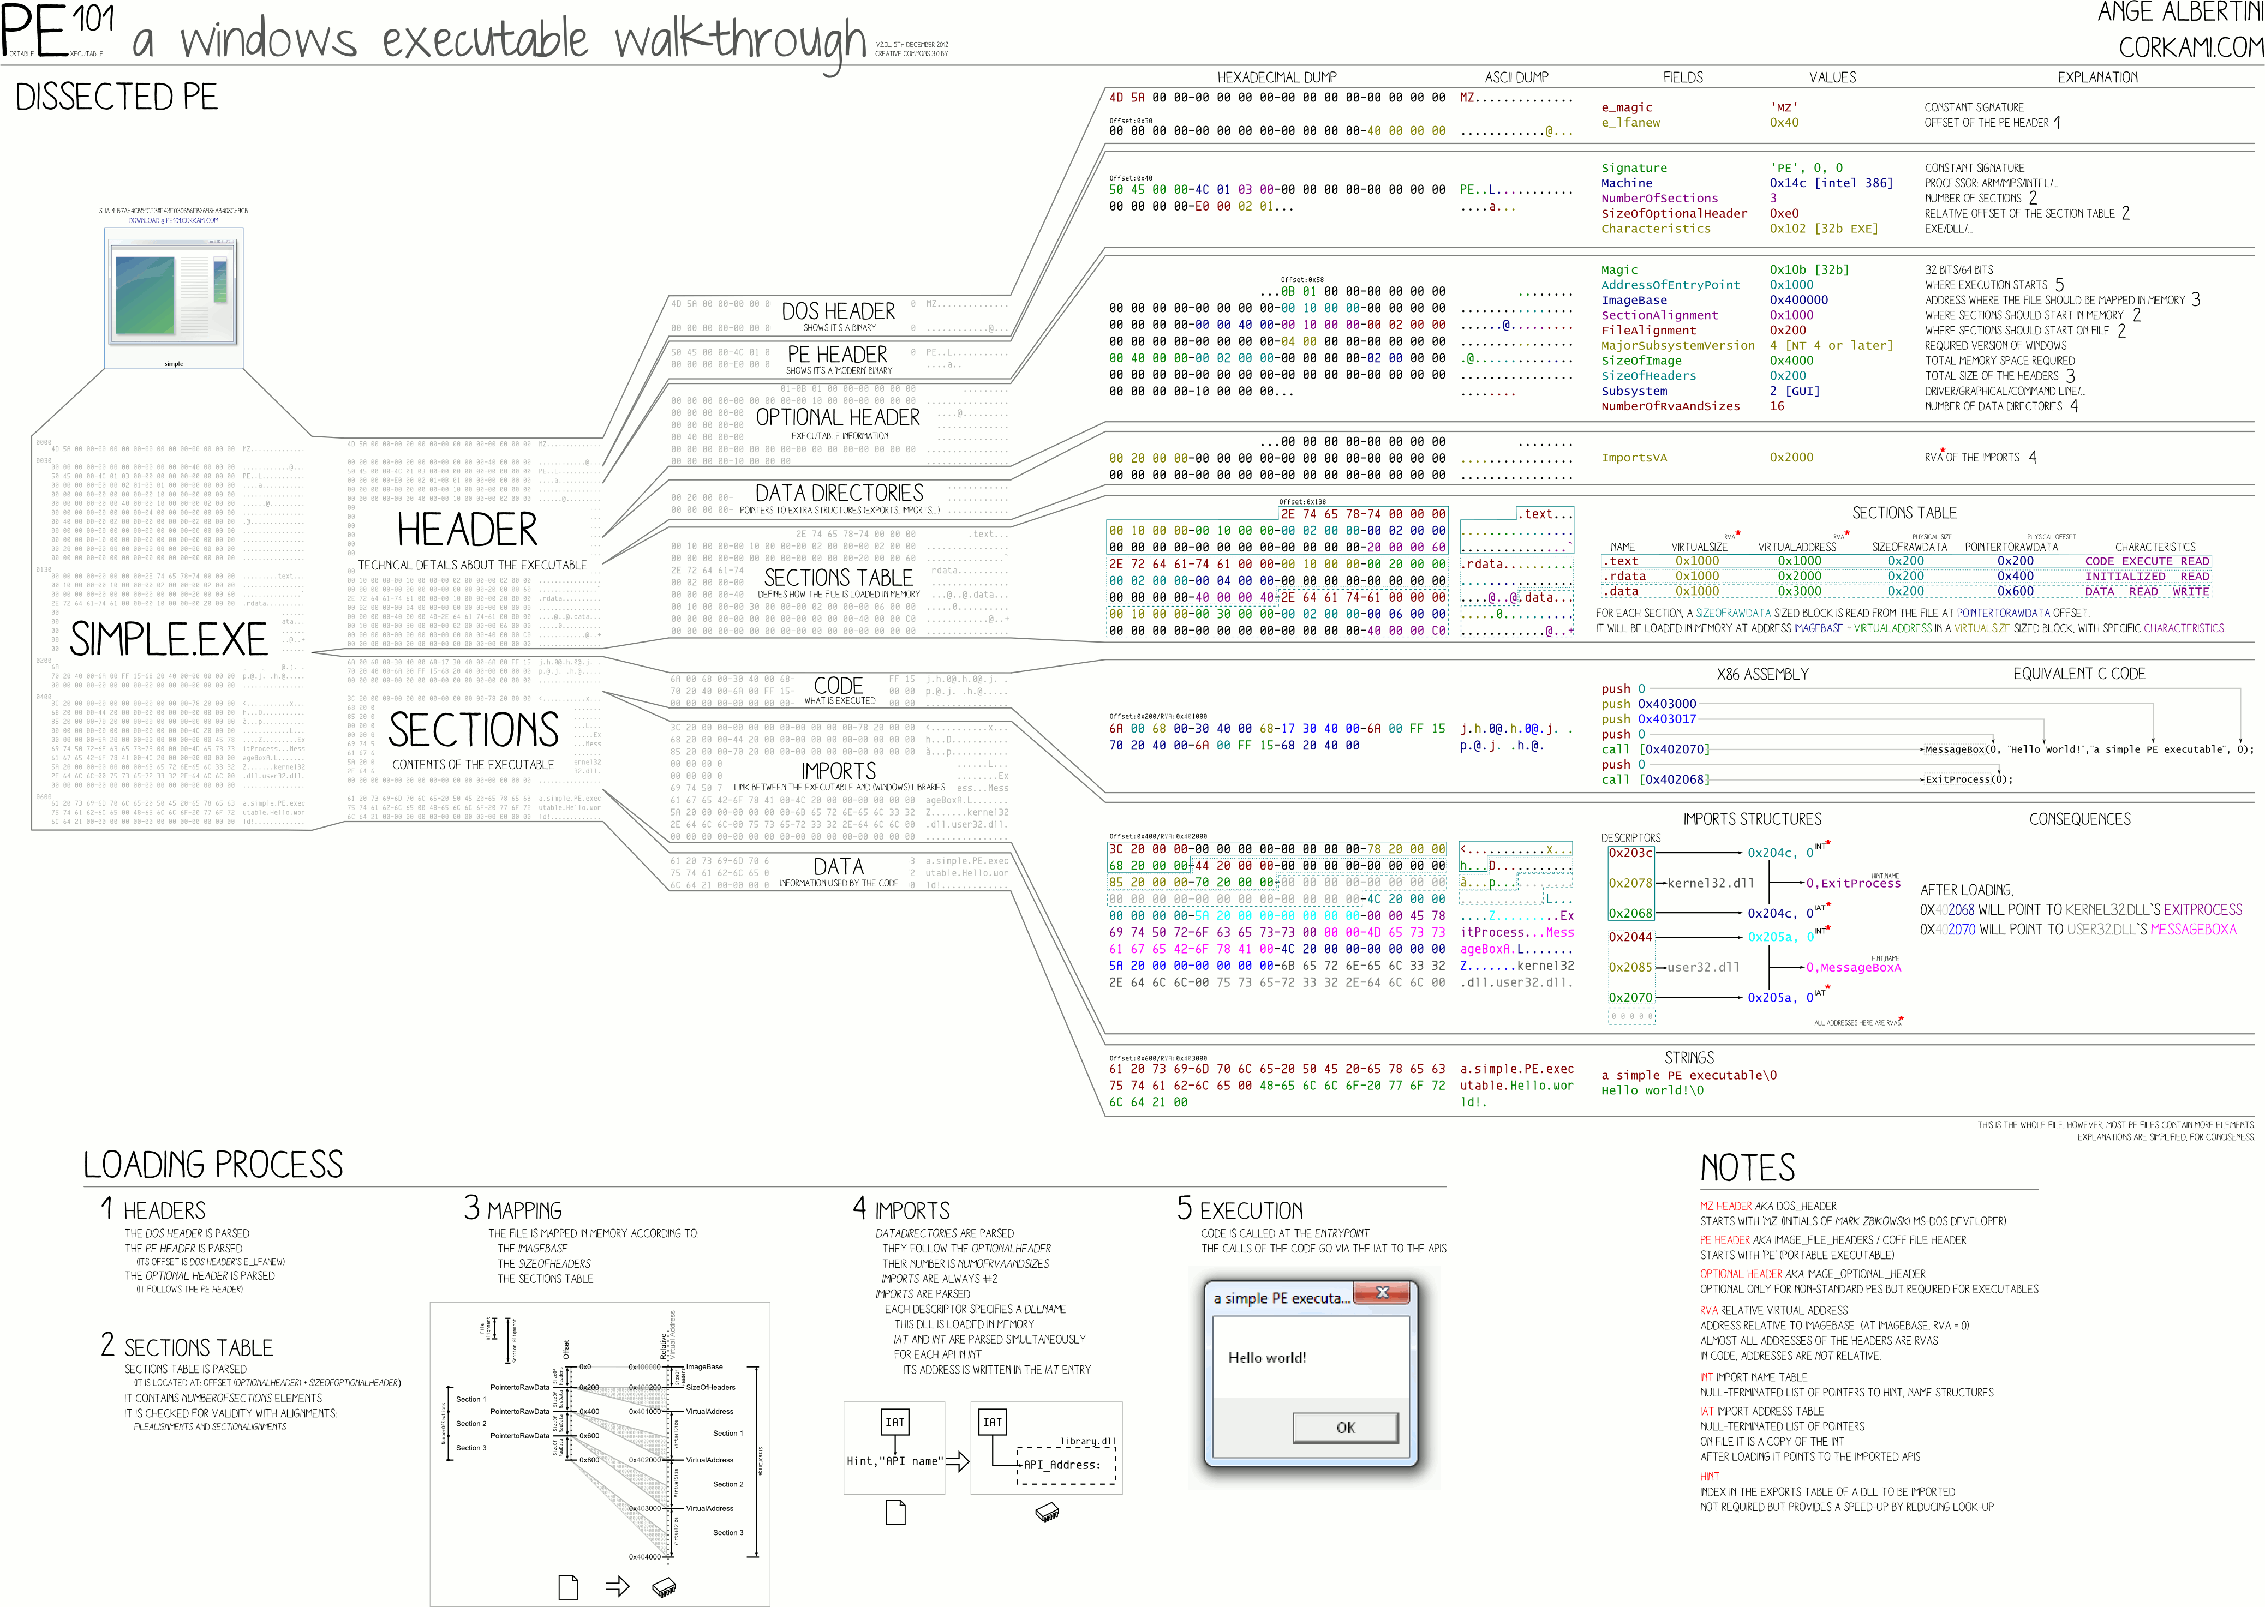
Structure of Win32 binary executable
PE File Format

Slide 45
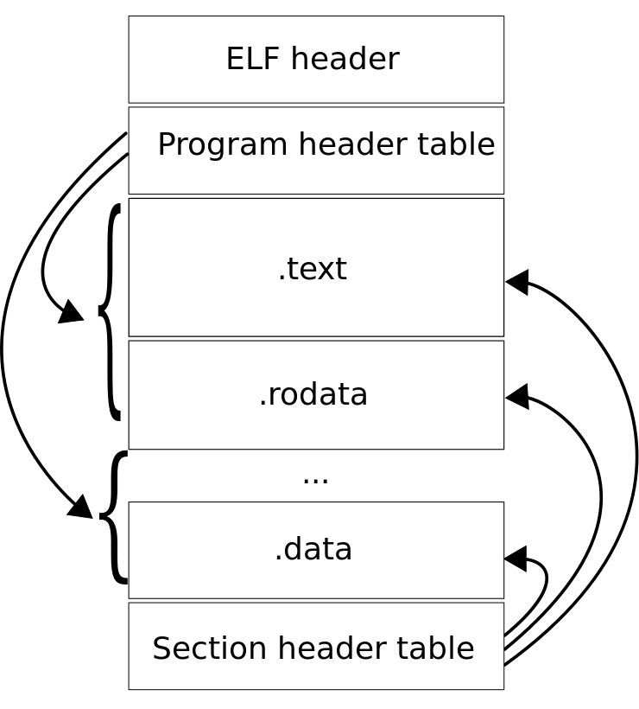
Structure of Linux binary executable
ELF format
"Elf-layout--en" by Surueña - Own work.
Licensed under CC BY-SA 3.0 via Commons

Slide 46
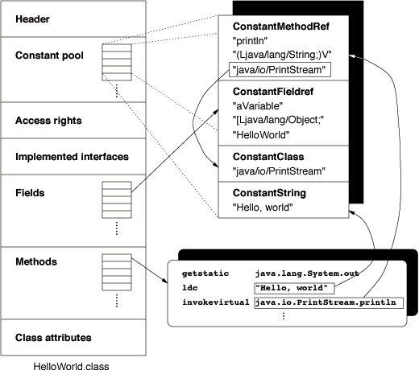
Structure of Java bytecode classfile
https://commons.apache.org/proper/commons-bcel/manual.html

Slide 47
Registry vs. stack-based execution

Slide 48
Registry-based execution
Values loaded (mov) from RAM to CPU registers
CPU operation (add, inc, test…) is executed
Resulting value is stored back (mov) to RAM
Name of the registers
  EAX 32bit, AX 16bit, AH/AL 8bit
  EIP ... next address to execute (instruction pointer)
  EBX ... usually loop counter
Registers
  Z – zero flag, C – carry flag, S – sign flag…

Slide 49


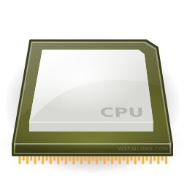
Add two numbers from file (HDD)
in.txt
"10 20"
Read values from HDD into RAM memory
  fscanf(file, "%d", &value);
Move value from RAM memory to CPU registry
  MOV 0x48(%esp),%eax
  MOV 0x44(%esp),%edx
Execute CPU instruction (e.g., ADD)
  ADD %edx,%eax
Transfer result from CPU register to RAM memory
  MOV %eax, 0x48(%esp)
Save result from RAM memory to file
  fprintf(file, "%d", value);
10
20
10
30
20
value = value + value2;
30
out.txt
"30"

Slide 50
Stack-based execution
Bytecode contains sequence of operations
Bytecode contains constants
All intermediate values stored on stack
Interpret:
Reads next operation from bytecode
Pop operand(s) for next operation from top of stack
Executes operation
Push result of operation on top of stack
No registers are used
  all operands for current operation at the top of the stack

Slide 51
Example: JavaCard bytecode
.method Encrypt(Ljavacard/framework/APDU;)V 129 {
.stack 6;
.locals 3;
.descriptor Ljavacard/framework/APDU; 0.10;
L0: aload_1;
invokevirtual 30;
astore_2;
aload_1;
invokevirtual 42;
sstore_3;
sload_3;
bspush 8;
srem;
ifeq L2;
L1: sspush 26384;
invokestatic 41;
goto L2;
L2: getfield_a_this 1;
aload_2;
sconst_5;
sload_3;
getfield_a_this 10;
sconst_0;
invokevirtual 43;
pop;
getfield_a_this 10;
sconst_0;
aload_2;
sconst_5;
sload_3;
invokestatic 44;
pop;
aload_1;
sconst_5;
sload_3;
invokevirtual 45;
return;
}
// ENCRYPT INCOMING BUFFER
void Encrypt(APDU apdu) {
byte[] apdubuf = apdu.getBuffer();
short dataLen = apdu.setIncomingAndReceive();
short i;
// CHECK EXPECTED LENGTH (MULTIPLY OF 64 bites)
if ((dataLen % 8) != 0)
ISOException.throwIt(SW_CIPHER_DATA_LENGTH_BAD);
// ENCRYPT INCOMING BUFFER
m_encryptCipher.doFinal(apdubuf, ISO7816.OFFSET_CDATA, dataLen,
m_ramArray, (short) 0);
// COPY ENCRYPTED DATA INTO OUTGOING BUFFER
Util.arrayCopyNonAtomic(m_ramArray, (short) 0, apdubuf,
ISO7816.OFFSET_CDATA, dataLen);
// SEND OUTGOING BUFFER
apdu.setOutgoingAndSend(ISO7816.OFFSET_CDATA, dataLen);
}
Original JavaCard source code
Resulting JavaCard bytecode

Slide 52
Disassembling
Recovering information from binary executables

Slide 53
Disassembling of native binaries
Reversing process of compilation
  Back from native code to ASM
Compilation/assembly is loose process:
  Variable/function names
  Unused structures
  Performance optimization applied during compilation
Wide range of native platforms
  Differences in support and performance of disassemblers
Bytecode is already on the level of “disassembled” binaries (usually easier to understand)

Slide 54
Structured code vs. sequence of executed ops
Structured code contains code for all branches
  runnable binary/bytecode
Information loss in compiled binary
  Stripped metadata and debugging symbols
  Compiler optimizations
Sequence of executed instructions only from the branches taken
  E.g., power analysis of smart card with recognized operations
  If loop was executed, then only linear sequence of instructions is observed corresponding to the number of loop iterations

Slide 55
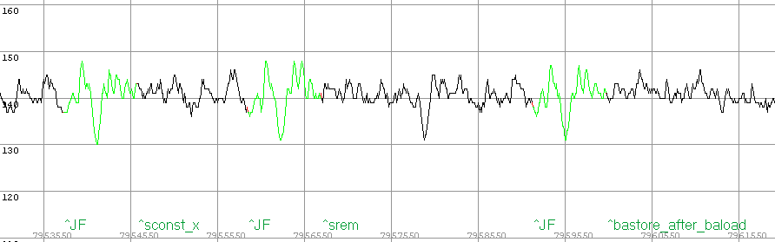
Structured code vs. sequence of executed ops
(bytecode)
getfield_a_this 0;
sconst_0;
baload;
sconst_1;
srem;
bastore;
(source code)
m_ram1[0] = (byte) (m_ram1[0] % 1);
compiler
oscilloscope
(power trace)
Bytecode reconstruction
(partial bytecode)
…; sconst_???; baload; sconst_???; srem; bastore;…

Slide 56

Tool: OllyDbg
Free disassembler and binary debugger
  Works with Windows 32b binaries only
  OllyDbg 64b version in development (but last update in 2014 ☹)
Easy to start with, many tutorials
Designed to make changes in binary easy
  Change of jumps/data (valid PE is recreated)
http://www.ollydbg.de/

Slide 57

Tool: IDA Pro
Interactive Disassembler is legendary full-fledged disassembler with ability to disassemble many different platforms
Free version available for non-commercial uses
  http://www.hex-rays.com/idapro/idadownfreeware.htm
Free version disassemble only Windows binaries
Very nice visualization and debugger feature (similar as OllyDbg)

Slide 58

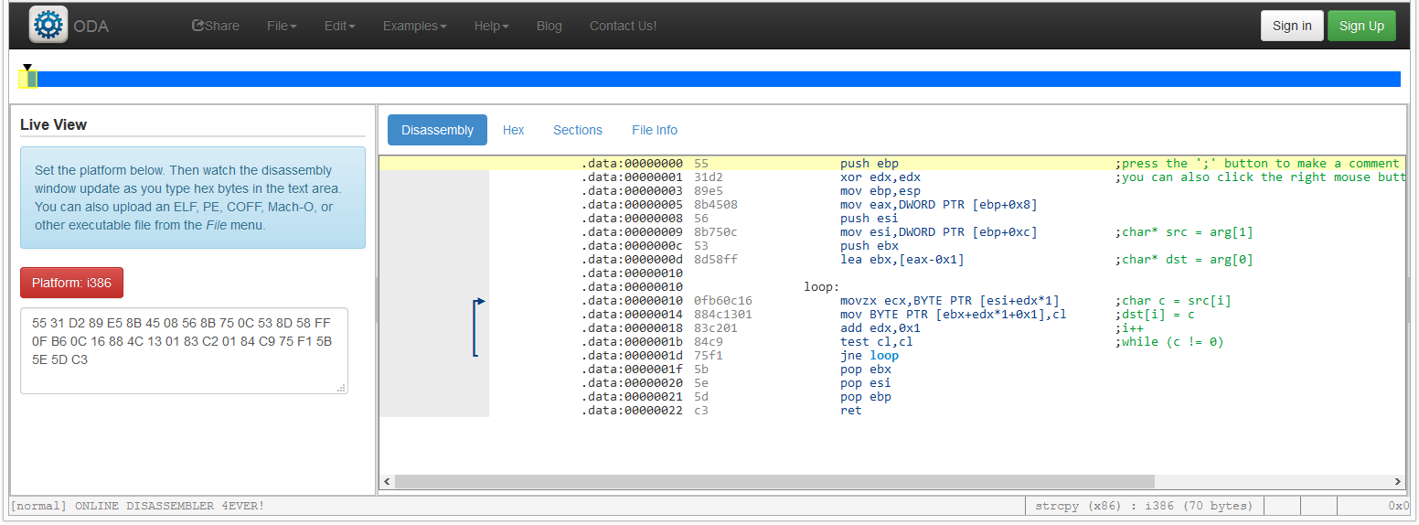
Tool: Online disassembler (ODA)
https://www.onlinedisassembler.com/odaweb/

Slide 59
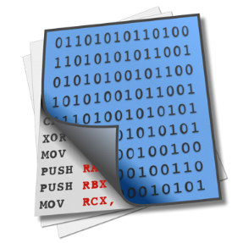
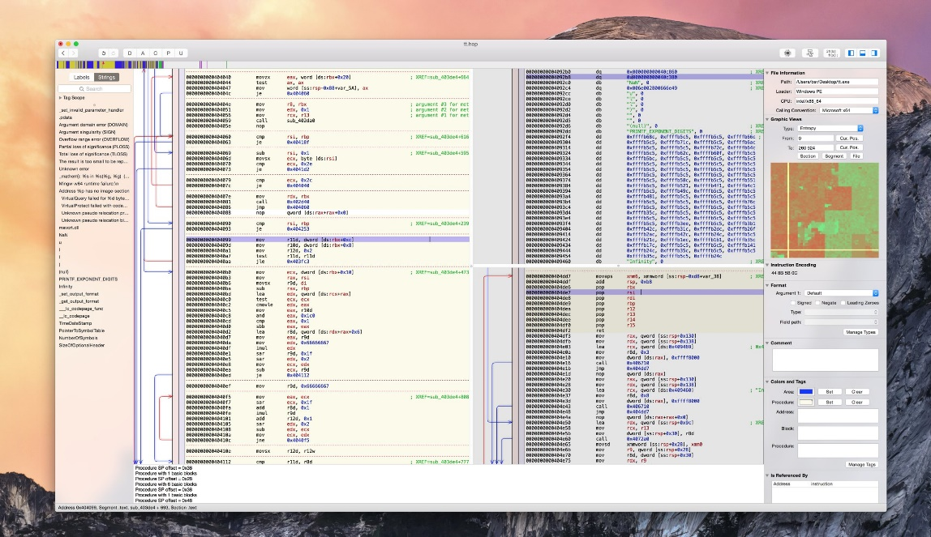
Tool: Hopper diassembler and debugger
Linux and OS X reverse engineering tool
  Older version supported Windows, but not anymore
http://www.hopperapp.com
Additional support for Objective-C

Slide 60
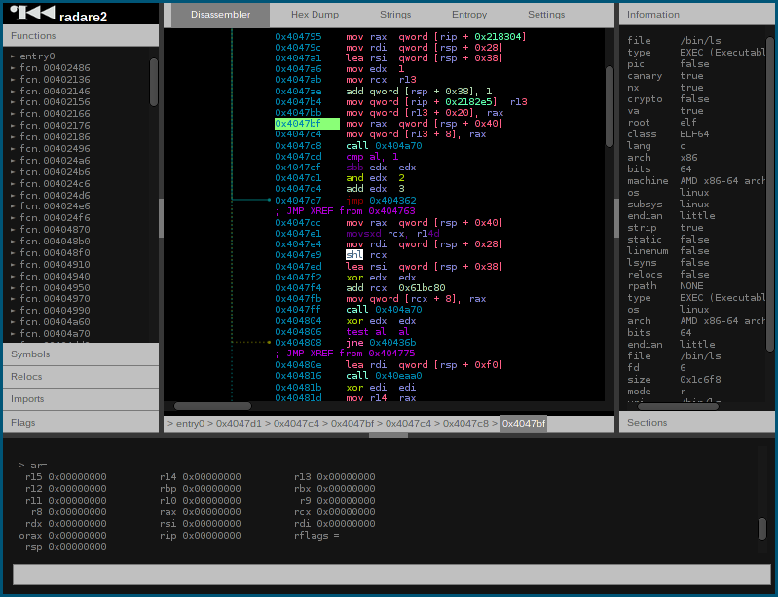
Radare
https://www.radare.org/r/
Multiplatform
Very good support for multiple file formats and platforms
(Unfair ☺) comparison with other tools
  https://www.radare.org/r/cmp.html

Slide 61
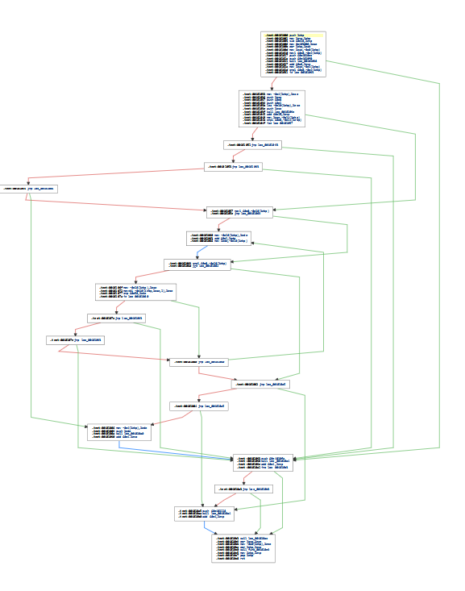
Control flow graph
Graph representation of control flow
Separated functions/blocks
  connection by jump instructions

Slide 62
Decompilation
Native code decompilation
  Decompiler produces source code from binary/ASM/bytecode code
  Decompiler needs to do disassembling first and then try to create code that will in turn produce binary code you have at the beginning
  Resulting code will NOT contain information removed during compilation (comments, function names, formatting...)
Bytecode decompilation
  usually much easier (more information preserved)
  Mapping between source code and bytecode is less ambiguous
  Compilation of decompiled bytecode produces similar bytecode

Slide 63
Decompiler tools
C/C++
  IDA
  REC Studio 4.0, http://www.backerstreet.com/rec/rec.htm
  Retargetable Decompiler, https://retdec.com/
  Ghidra – diassembler by NSA https://github.com/NationalSecurityAgency/ghidra
Java bytecode
  DJ Java Decompiler, http://neshkov.com/dj.html
  Java Decompiler, http://jd.benow.ca/
.Net bytecode
  dotPeek, https://www.jetbrains.com/decompiler/
  ILSpy, http://ilspy.net/

Slide 64
Resources
Reverse Engineering for Beginners
  http://beginners.re/Reverse_Engineering_for_Beginners-en.pdf
  Great resource, many examples, tutorials
Tutorials for You: http://www.tuts4you.com
The Reverse Code Engineering Community: http://www.reverse-engineering.net/
Disassembling tutorial http://www.codeproject.com/KB/cpp/reversedisasm.aspx

Slide 65
Summary
Several levels where rootkit can be placed (CPU rings)
Rootkits cloaks itself and run malicious functionality
  Detection on higher/same level difficult (but possible if cloaking is not perfect)
  Try to detect on lower level (root is not “running”)
  Trusted boot (TPMs…) attempts to prevent/detect rootkit execution
Reverse engineering of binaries
  Compilation is lossy process (debug symbols, optimizations…)
  Different platforms have different binaries (registry/stack-based execution, instructions, function calling conventions…)
  Disassembling: binary -> assembler
  Decompilation: assembler -> source code

