Slide 1
PV204 Security technologies
In-Memory Malware Analysis
Václav Lorenc
Security Operations Center Manager, Oracle + NetSuite

Slide 2
Notes:
https://xkcd.com/1328/

Slide 3
Agenda
Basic intro
  No x86 assembly required
  No malware (de)obfuscation magic
How does the OS look “inside”?
  Processes and other data structures
  How the memory is organized
Common tools used for analysis
Searching for system “oddities”
  What are the important system indicators?
Real samples discussed and analyzed! (Labs)

Slide 4
Why memory analysis?
It’s fun!
Acquiring evidence for legal investigations
  It used to be different in the past
Technical simplification of reverse engineering
  No binary obfuscation present – the code has to run
Incident response activities
  Easy way how to learn more about the attackers
  Malicious binary may only be present in memory
  Fast: RAM is (usually) smaller than full hard-drive images

Slide 5
Notes:
https://xkcd.com/1353/

Slide 6
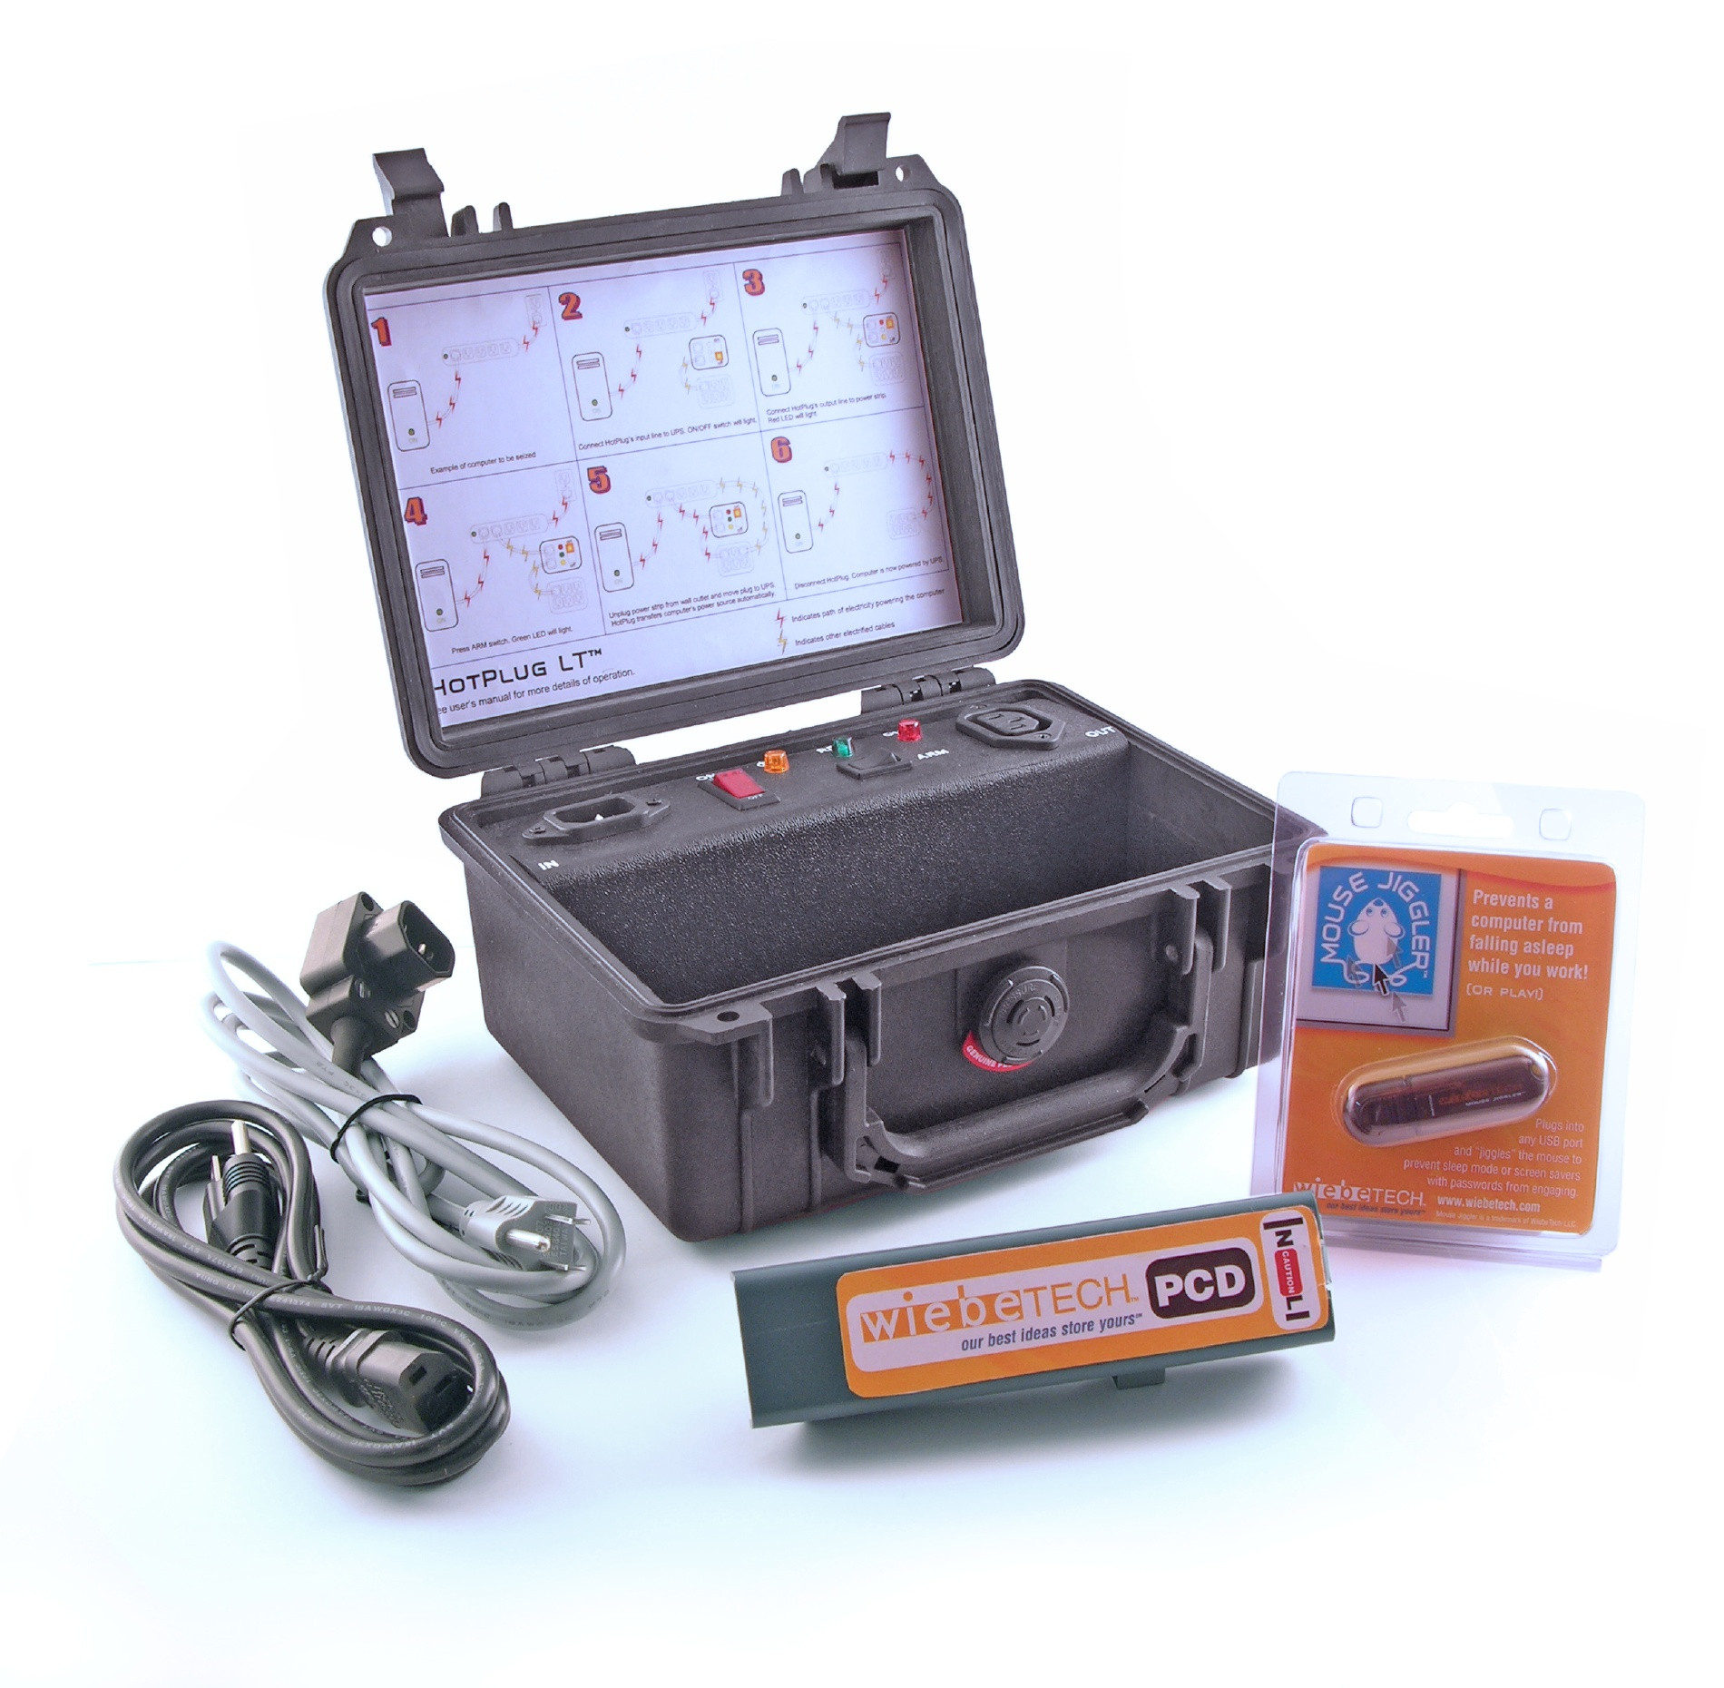

Slide 7
Challenges in Reverse Engineering (RE)
Assembly language (for multiple platforms)
  Plus undocumented instructions (or behavior)
Anti-debugging tricks
  Exceptions, interrupts, PE manipulations, time checking, ...
Anti-VM tricks
  Uncommon behavior of known instructions
  Registry detections, HW detections
Code obfuscation/packing
  The most challenging to overcome, mostly

Slide 8
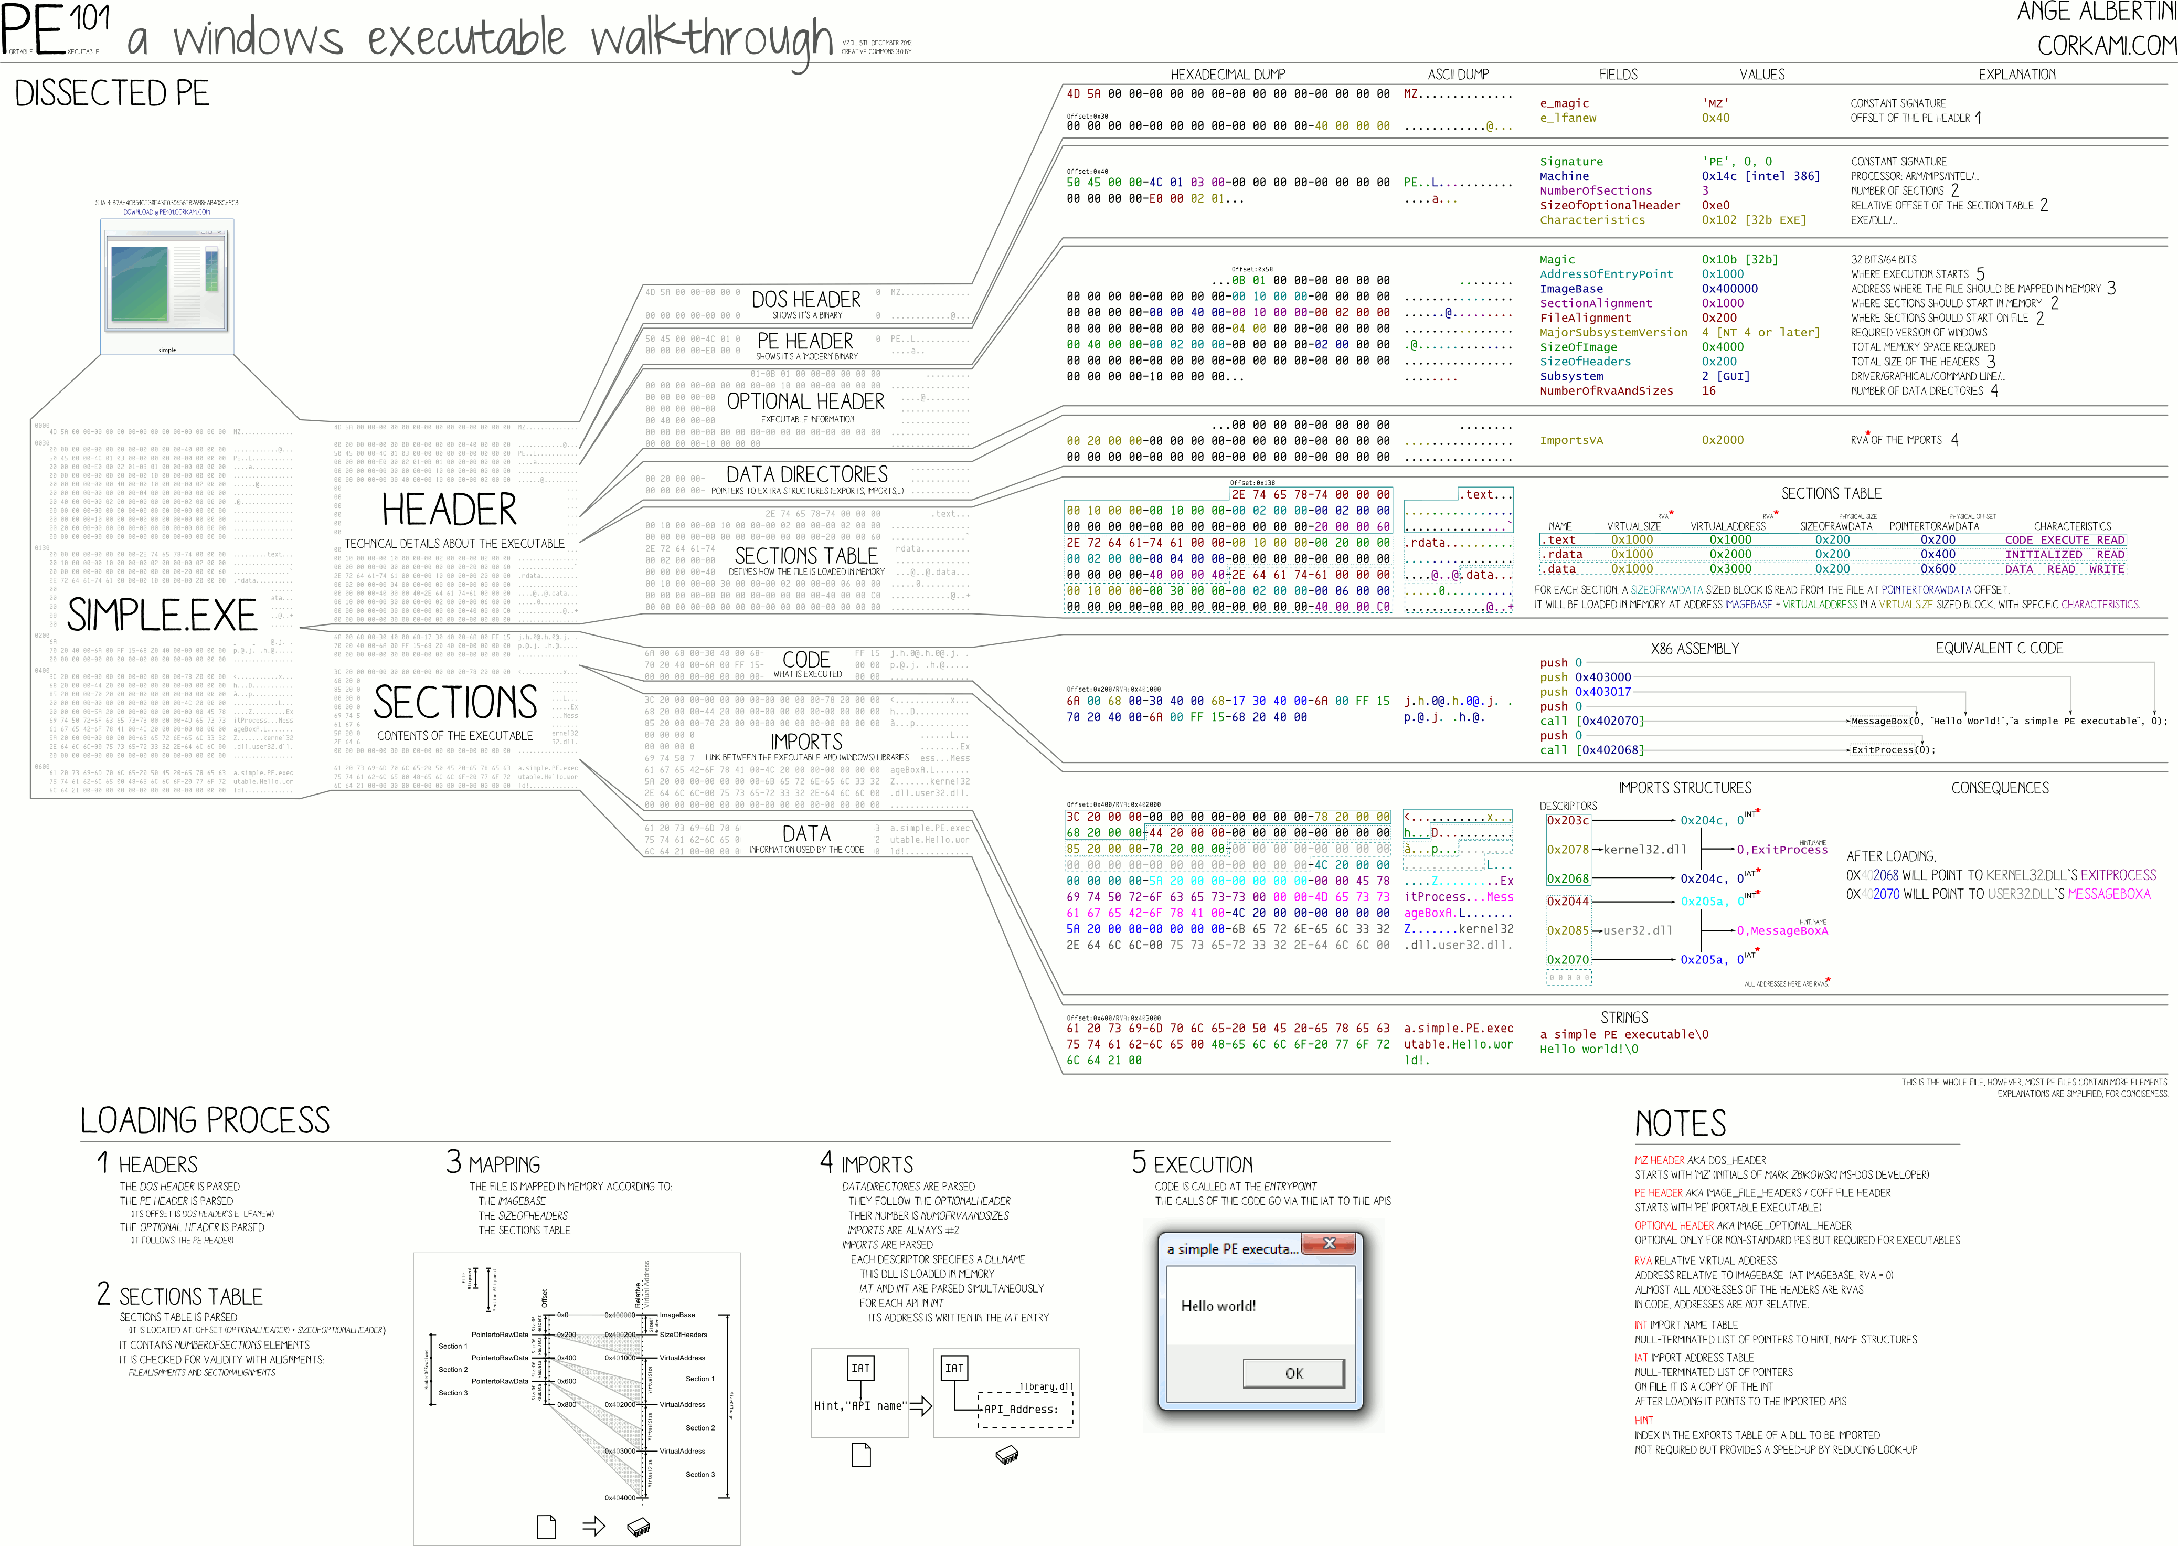
PE File Format

Slide 9
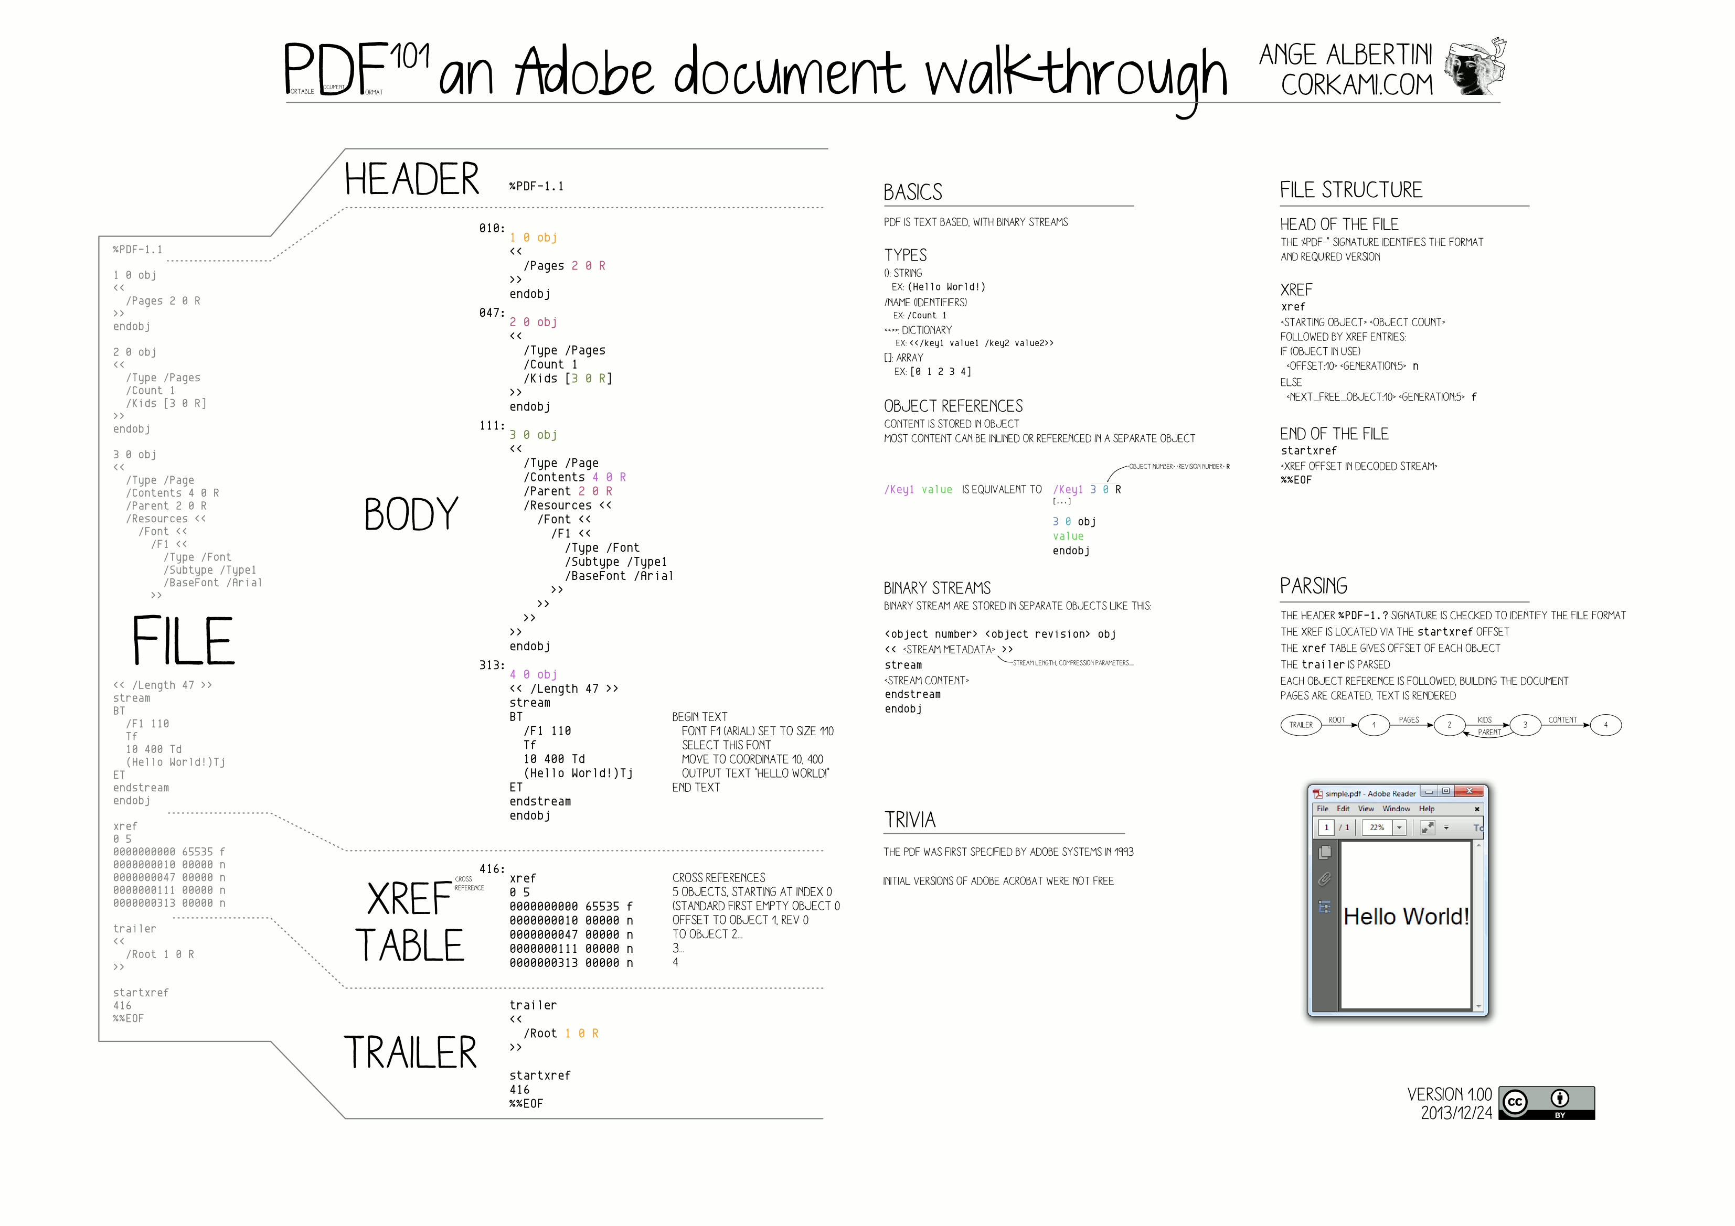
PDF File Format

Slide 10
‘cause reverse engineering ninjas are busy
MEMORY ANALYSIS…

Slide 11
x86/x64 Memory organization
Physical memory
  RAM; what we really have installed
Virtual memory
  Separation of logical process memory from the physical
  Logical address space > physical (e.g. swap)
  Address space shared by several processes, yet separated
Paging vs. Segmentation
  Possible memory organization approaches

Slide 12
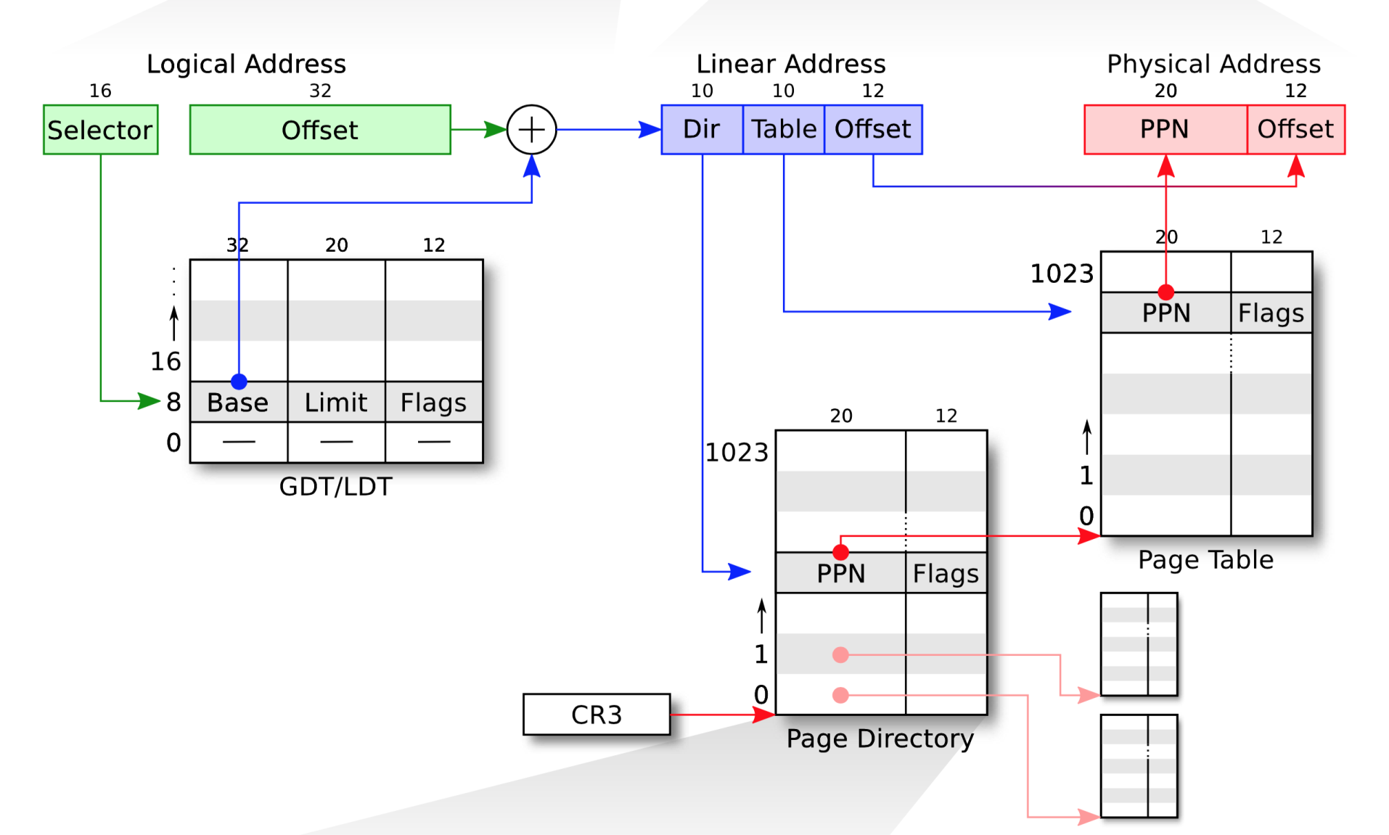
Segmentation
Paging
Physical Address

Slide 13
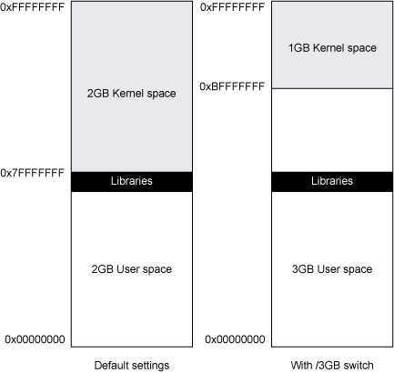
Win32 Address Space

Slide 14
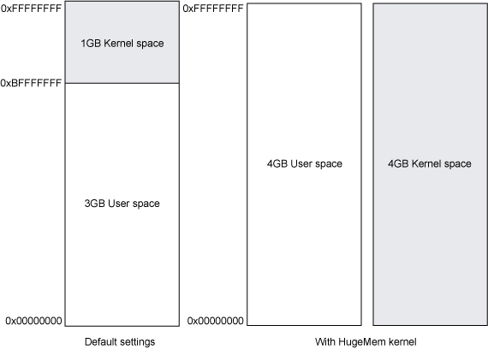
Linux Address Space

Slide 15
Notes:
https://minnie.tuhs.org/CompArch/Lectures/week06.html

Slide 16
Notes:
https://xkcd.com/138/

Slide 17
Operating System Data Structures
How the OS knows about processes, files, …?
  A lot of ‘metadata’ for important data
  Based on C/C++ data structures (see MSDN documentation)
(Double-)linked list
  Another common data structure (not only in OS)
  Method for implementing lists in computer memory
Direct Kernel Object Manipulation (DKOM)
  Used for manipulating the structures to hide malicious stuff

Slide 18
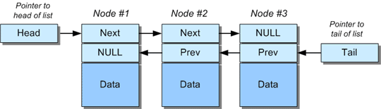
Double Linked Lists

Slide 19
DKOM – Direct Kernel Object Manipulation
Dozens of various (double-)linked lists in Windows
  Maintained by kernel
  Processes, threads, opened files, memory allocations, …
DKOM is used by rootkits
  Hiding from the sight of the user
Rootkit paradox
  Rootkits need to run on the system
  … and need to remain hidden at the same time
Memory analysis can help to discover DKOM
  Anti-analysis techniques are known as well
Notes:
http://www.blackhat.com/presentations/bh-usa-04/bh-us-04-butler/bh-us-04-butler.pdf

Slide 20
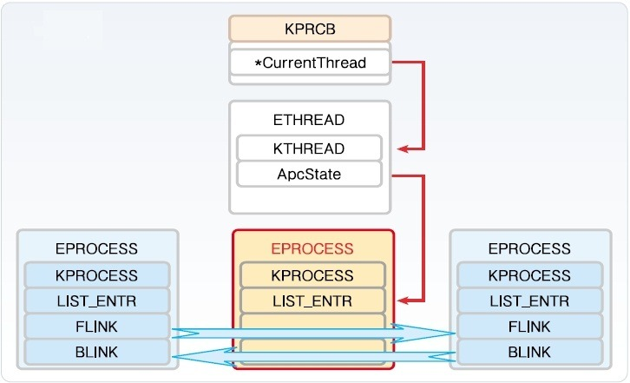
Windows
Process Structures

Slide 21
Interesting OS Structures
Suspicious Memory Pages
Processes
Threads
Sockets (Connections)
Handles (Files)
Modules/Libraries
Mutexes
LSA (Local Security Authority)
Registry
…

Slide 22
Memory Pages
Various ‘flags’
  Read/write/executable pages
  Helping OS to organize memory efficiently
Executable + Writable pages
  Why is it bad?
Process Injection technique
  Allocating a memory that can be modified (unpacked, decoded, decrypted) and executed.
  Used by legitimate processes too (Windows OLE)

Slide 23
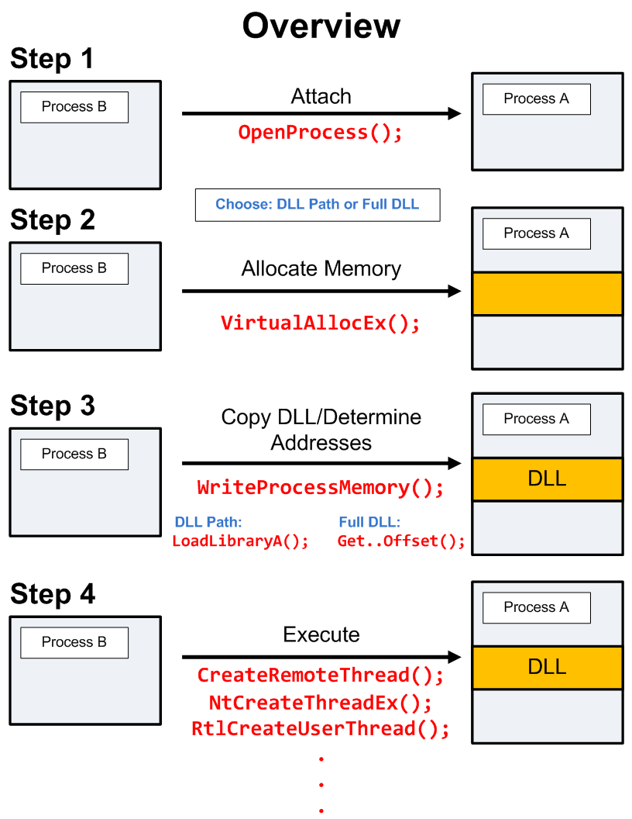
DLL/Process Injection
So that Internet Explorer behaves like a malicious process…

Slide 24
Notes:
https://www.endgame.com/blog/technical-blog/ten-process-injection-techniques-technical-survey-common-and-trending-process

Slide 25
And now something completely…
PRACTICAL

Slide 26
Notes:
https://xkcd.com/1197/

Slide 27
Memory (re)sources
Live RAM
  The most common source for analysis
  Easier to obtain from virtualized hosts
Paging file/Swap
  Used by operating systems to allocate more memory then available RAM
Hibernation file
Memory crash dumps
  Limited analysis options

Slide 28
Memory Acquisition
VM?
Yes
Memory Dump
Snapshot
Clone
No
Running?
No
Hibernation File
Page File (Swap)
Crash Dumps
Yes
Got root?
Dumping locally
Remote access?
Cost / Benefits
Tool Footprint
Yes
No
FireWire
PCI Probes

Slide 29
Memory Acquisition
Virtual Machines
  VMWare, VirtualBox, …
  VirtualBox –dbg –startvm “MalwareVM” (and .pgmphystofile command or vboxmanage debugvm)
Directly from the system! (if we have permissions to do that)
  windd, fastdump, dumpit, memorize, winpmem
  Or we can hibernate the system (hiberfil.sys)
Remotely
  Encase Enterprise, Mandiant Intelligent Response, Access Data FTK
Common issues
  Unsupported OS (Linux, MacOS; 32bit/64bit)
  Swap (portions of memory on drive)
  Malware not running inside a virtual machine

Slide 30
Memory Acquisition (2)
Local memory acquisition notes
  Unless you have plenty of money, try to get root/admin access to the host
  Better to acquire to external storage (USB, network)
  The lower tool’s memory footprint, the better
  If you run malware in VM, better have less RAM
    Faster analysis
    .. And configure no swap for the system too
    However: malware can check for the available memory

Slide 31
Memory Acquisition (3)
Remote memory acquisition
  Very useful for fast Incident Response
  Requires enterprise licenses for the commercial tools
  Acquisition is done over network
  Agents already in memory, no extra memory demands
Open source alternative?
  GRR (Google Rapid Response)
    Still in development, primarily Incident Response tool
    Allows remote memory acquisition
  Rekall (still a beta)

Slide 32
Memory Analysis Tools
Mandiant Redline
  Free, available for Windows
HBGary/CounterTack Responder (CE/Pro)
  Community Edition available against registration
Volatility Framework
  Open source, no GUI
Google Rekall
  Open source, ‘Volatility done right’, GUI
  Google supported (part of GRR agent)

Slide 33
Mandiant/FireEye Redline
Free tool for Incident Response
  Not open-source, though
  .NET executable (runs only under Windows)
Nice and simple user interface
  Very nice analysis workflow
  Perfect for searching for string information
  Rates the level of suspiciousness over processes
Sad things
  Memory analysis not reliable, process rating as well

Slide 34
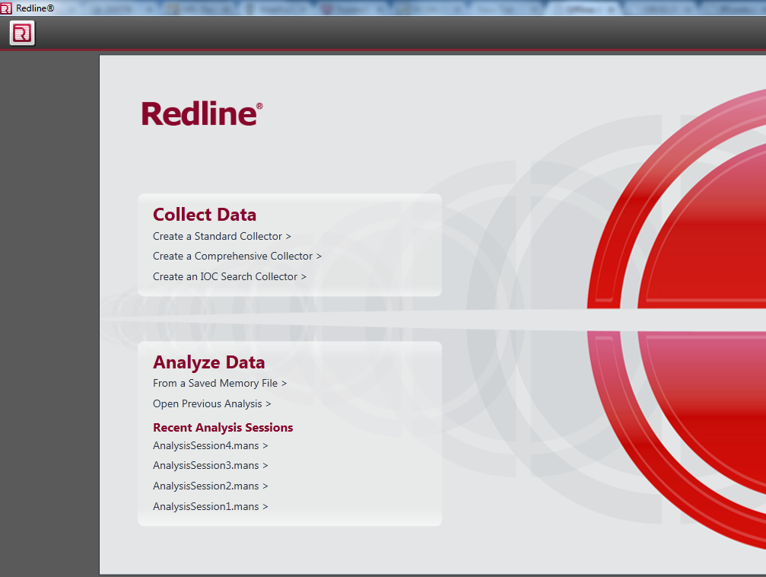
Redline: Start

Slide 35
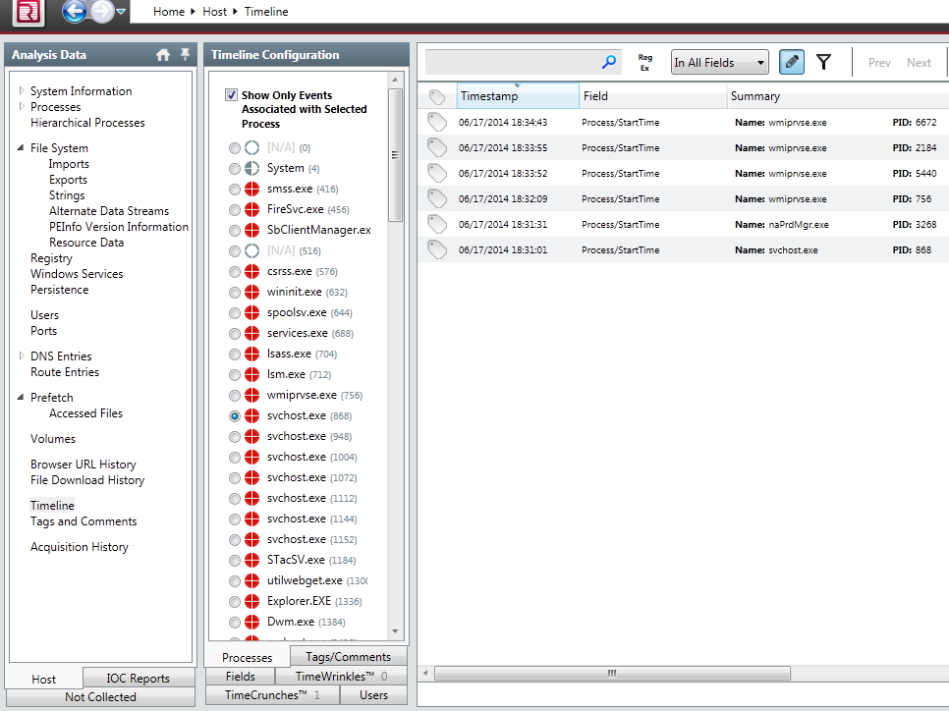
Redline: Timeline

Slide 36
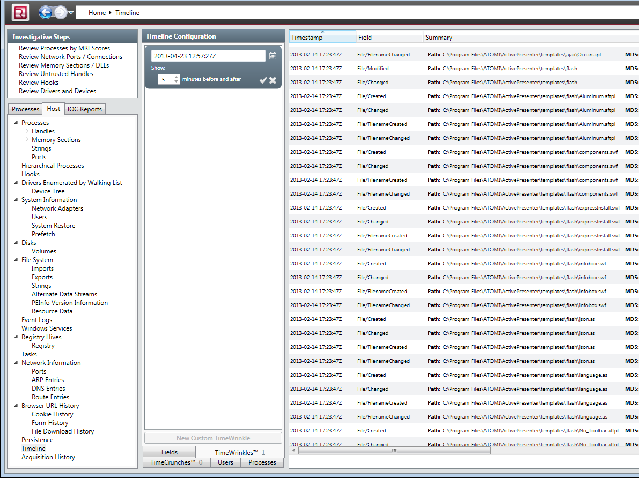
Redline: Time Wrinkles

Slide 37
HBGary Responder (Pro/CE)
Professional Tool
  Very expensive
  Yet not very well maintained in the last few years
Windows only
  .NET written, supports only Windows images
‘Killer’ features
  Digital DNA
    automatic rating of suspicious processes
  Visual ‘Canvas’ debugger
Supports the analysis of (unpacked) binaries
Replaced with CounterTack Responder Pro

Slide 38
HBGary Responder Pro -- DDNA
Examples of the ‘reasoning’ behind DDNA
  Does the process communicate over TCP/IP?
  Does it manipulate with registry?
  Did the analysis reveal any known bad stuff (strings, IPs, mutexes?)
  Does the process access any other process in the system?
  Does it access some system-critical process?
  Did the analysis find any evidence of obfuscation?
Notes:
Obsolete and unavailable at for a long time, but it had interesting features – and there’s a professional alternative already: https://www.gosecure.net/responder-pro
https://cdn2.hubspot.net/hubfs/150964/CounterTack_DDNA_SCMagazine_030117-1.pdf?t=1495723489966&__hstc=&__hssc=&hsCtaTracking=18aabc2a-88fc-46f2-9de8-4de89e22de86%7Cb02adedf-d309-4687-870d-eee1b1675455

Slide 39
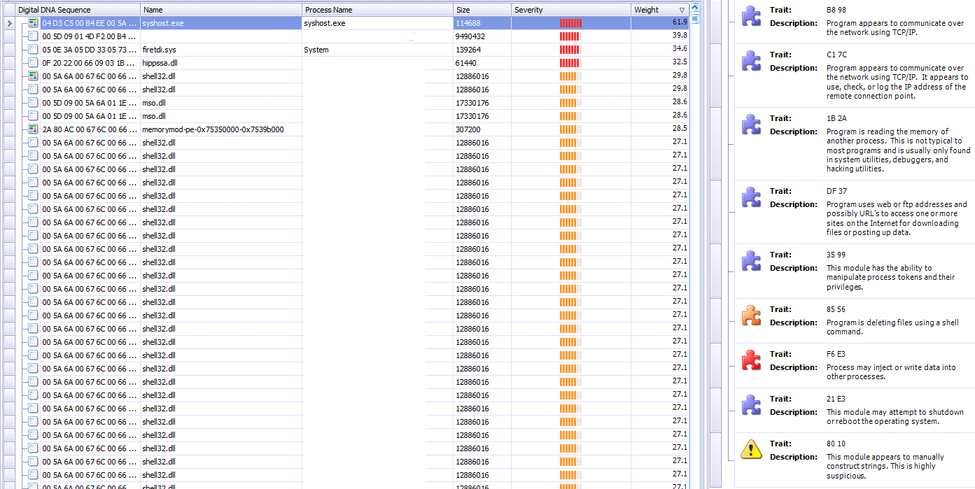
Responder Pro: DDNA

Slide 40
Responder Pro: DDNA

Slide 41
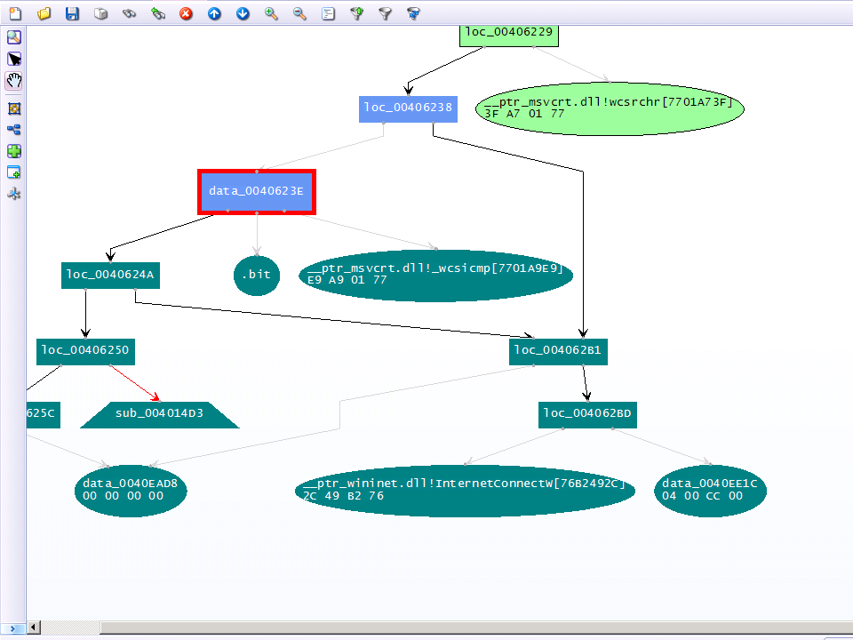
Responder Pro: Canvas

Slide 42
Volatility Framework
Open source tool
  GPL licensed
Written in Python
  Available for variety of platforms (Linux, Windows, Mac OS)
  Can be automated; many contributed plugins
Supports analysis of memory dumps from various OSs
  Windows, Linux, MacOS, Android
  Both 32-bit and 64-bit versions
Command-line driven
Two (experimental) web GUIs

Slide 43
Google Rekall
Another open source tool
Supported by Google
  Included as a part of GRR (Google Rapid Response) agent
Originally based on the code of Volatility
  Shared commands
  Different architectural concepts
Proof-of-concept GUI
  Better workflows

Slide 44
Additional Important Tools
Strings
  Both *nix and Windows
  Extracts strings information from the file
  Can be used in cooperation with Volatility/Rekall
  Beware of text encoding! (ascii, utf-8, …)
Foremost
  Forensic tool
  Can extract various data files from an image (or process)
    Images, executables, documents, …

Slide 45
Forensic analysis of RAM?
Are there any benefits?
Collecting forensic evidence
  Executable images
  PDF/Doc documents
    Possible origin of the infection?
  Images
  URLs
Getting approximate timeline
  Works better on servers (always online, higher uptime, way more RAM)

Slide 46
What to search for in Operating System?
Command & Control (C2) communication
Hidden processes
Process/DLL injection evidence
Non-standard/infamous binaries/mutexes
Open sockets and files
Registry records
Command-line history
Encryption keys!

Slide 47
Known Bad Mutexes
Conficker: .*-7 and .*-99
Sality.AA: Op1mutx9
Flystud.??: Hacker.com.cn_MUTEX
NetSky: 'D'r'o'p'p'e'd'S'k'y'N'e't'
Sality.W: u_joker_v3.06
Poison Ivy: )!VoqA.I4 (and 10 thousand others)
Koobface: 35fsdfsdfgfd5339
Notes:
http://hexacorn.com/examples/2014-12-24_santas_bag_of_mutants.txt

Slide 48
Known Good Processes/Locations
Process Name | Expected Path
lsass.exe | \windows\system32
services.exe | \windows\system32
csrss.exe | \windows\system32
explorer.exe | \windows
spoolsv.exe | \windows\system32
smss.exe | \windows\system32
svchost.exe | \windows\system32
iexplore.exe | \program files \program files (x86)
winlogon.exe | \windows\system32

Slide 49
Operational Security (OpSec)
Basics of OpSec
  “Think before you act” mentality
  Limited information sharing
Specifics of memory analysis
  You can often upload acquired executables to VirusTotal
    MD5/SHA1 of the dump is different from the executable
    This doesn’t apply for documents/HTML pages!
  However, incomplete binaries still can infect your system!
    Running in VM or other OS is recommended

Slide 50
Recommended Analysis Process
Use Internet! (Google, VirusTotal, …)
Make notes!
  What OS is being analyzed? (imageinfo)
  Network connections? (+ whois records, …)
  Processes (hidden, odd, non-standard; timestamps, …)
  Mutexes (+ files open)
  Dump processes when needed (OpSec!)
  Strings (URIs, C-like strings %s %d, domains, …)
Summarize your findings in final report

Slide 51
More information
Web pages of this course
  https://dior.ics.muni.cz/~valor/pv204
Additional resources
  Public memory images for analysis
  Reverse Engineering for Beginners (amazing PDF doc)
  REMnux: All you need to start with RE
  ContagioDump blog (for additional malware samples)
  Malware Traffic Analysis (both traffic & samples)

Slide 52
Answers & Questions
Thank you for your attention.

Slide 53

Lab

Slide 54
Lab Requirements
Oracle VirtualBox
  And enough space on your hard drive (12 GB at least)
Volatility Framework
Mandiant Redline
Unix tools
  strings, foremost
Your favorite text editor for notes
Javascript/PDF analysis tools

Slide 55
Recommended Analysis Process
Use Internet! (Google, VirusTotal, …)
Make notes!
  What OS is being analyzed?
  Network connections? (+ whois records, …)
  Processes (hidden, odd, non-standard; timestamps, …)
  Mutexes (+ files open)
  Strings (URIs, C-like strings %s %d, domains, …)
  …
Summarize your findings in final report

Slide 56
Volatility Framework – cheat sheet
psxview (search for hidden processes)
apihooks
driverscan
ssdt / driverirp / idt
connections / connscan (WinXP, active network connections)
netscan (Win7, opened network sockets and connections)
pslist / psscan (process listing from WinAPI vs. EPROCESS blocks)
malfind / ldrmodules (code injection + dump / DLL detection)
hivelist (registry lookup and parsing) / hashdump
handles / dlllist / filescan (filelist / DLL files / FILE_OBJECT handles)
cmdscan / consoles (cmd.exe history / console buffer)
shimcache (application compatibility info)
memdump / procmemdump / procexedump

Slide 57
Analysis: xp-infected.vmem
Recommended tools
  Volatility, Rekall (or Redline)
Objectives:
  Get familiar with memory of your first infected system

Slide 58
Analysis: win7_x64.vmem
Recommended tools
  Volatility, Rekall (or Redline)
Objectives:
  Get familiar with memory of Win7 x64 system
  Can you see any differences from the previous sample?

Slide 59
Analysis: zeus.vmem
Recommended tools
  Volatility, Rekall
Objectives:
  Find suspicious network connections
  Find process responsible for the network activity
  Can you figure out what infections this

Slide 60
Analysis: zeus2x4.vmem
Recommended tools
  Volatility, Rekall
Objectives:
  Find suspicious network connections
  Find process responsible for the network activity
  Can you figure out what infections this
  Can you dump the virus configuration?

Slide 61
Analysis: bob.vmem
Recommended tools
  Volatility, Rekall, Foremost, Strings
Objectives:
  Find suspicious network connections
  Find process responsible for the network activity
  Can you figure out what caused the infection?
  Can you dump the initial source vector?
  What known vulnerability (CVE) has been exploited?

Slide 62
More information
Web pages of this course
  https://dior.ics.muni.cz/~valor/pv204
Additional resources
  Public memory images for analysis
  Reverse Engineering for Beginners (amazing PDF doc)
  REMnux: All you need to start with RE
  ContagioDump blog (for additional malware samples)
  Malware Traffic Analysis (both traffic & samples)

Slide 63
Answers & Questions
Thank you for your attention.

