Slide 1
SOLUTIONS
Exercises on Block3:
Link Analysis – PageRank
Advertising
Recommender Systems
Advanced Search Techniques for Large Scale Data Analytics
Pavel Zezula and Jan Sedmidubsky
Masaryk University
http://disa.fi.muni.cz

Slide 2
PageRank (1) – Assignment
For the following graph
  Compute the PageRank of each page, assuming no taxation
A
B
C

Slide 3
PageRank (1) – Recap
Each link’s vote is proportional to the importance of its source page
If page j with importance r_{j} has n out-links, each link gets r_{j} / n votes
Page j’s own importance is the sum of the votes on its in-links
i
k
r_{i}/3
r_{k}/4
j
r_{j}/3
r_{j} = r_{i}/3+r_{k}/4
r_{j}/3
r_{j}/3

Slide 4
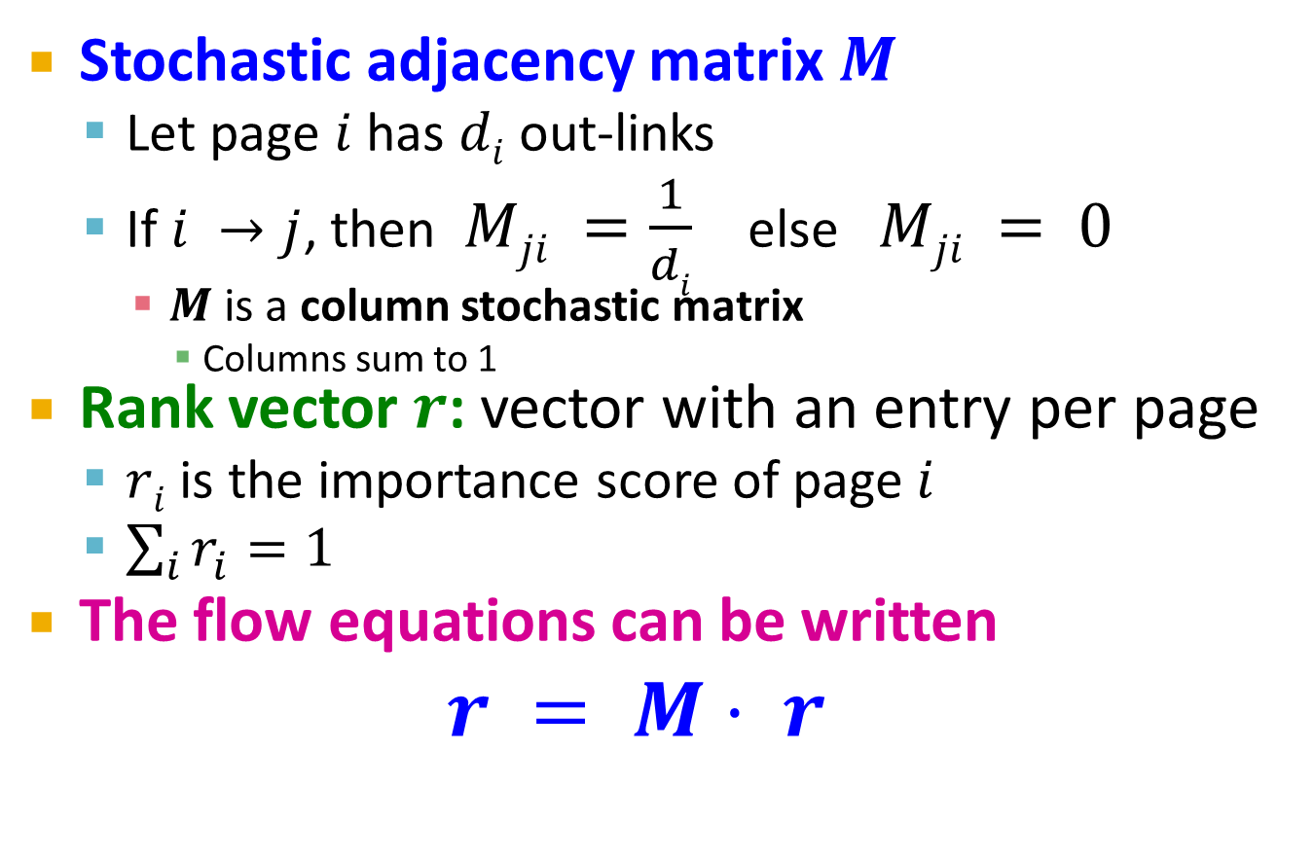
PageRank (1) – Recap
Stochastic adjacency matrix $M$
  Let page $i$ has $di$ out-links
  If $i →j$, then $Mji =\frac{1}{di}$ else $Mji = 0$
    $M$ is a column stochastic matrix
      Columns sum to 1
Rank vector $r$: vector with an entry per page
  $ri$ is the importance score of page $i$
  $\sum_{i}{r_{i}^{}=1}$
The flow equations can be written
$r = M⋅ r$

Slide 5
PageRank (1) – Recap
Given a web graph with n nodes, where the nodes are pages and edges are hyperlinks
Power iteration: a simple iterative scheme
  Suppose there are N web pages
  Initialize: r⁽⁰⁾ = [1/N,….,1/N]^{T}
  Iterate: r^{(t+1)} = M ∙ r^{(t)}
  Stop when |r^{(t+1)} – r^{(t)}|₁ < ε
d_{i} …. out-degree of node i
    |x|₁ = ∑_{1≤i≤N}|x_{i}| is the L1 norm
    Can use any other vector norm, e.g., Euclidean

Slide 6

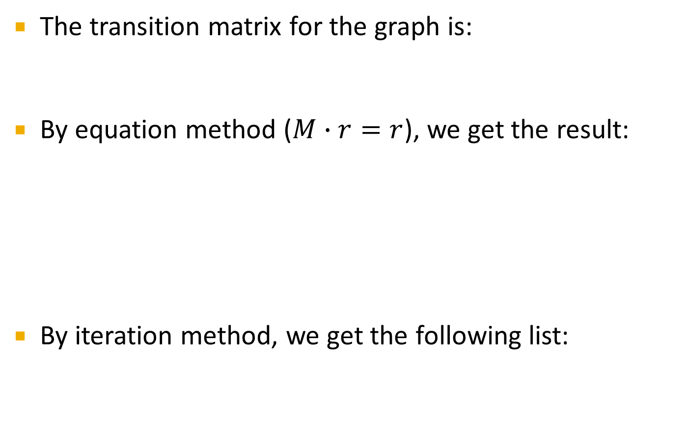

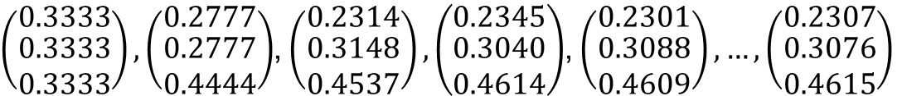



PageRank (1) – Solution
The transition matrix for the graph is:
By equation method ($M∙r=r$), we get the result:
By iteration method, we get the following list:
$$M=\left(\begin{matrix}1/3 & 1/2 & 0 \\ 1/3 & 0 & 1/2 \\ 1/3 & 1/2 & 1/2\end{matrix}\right)$$
$$\begin{matrix}A=\frac{1}{3}A+\frac{1}{2}B \\ B=\frac{1}{3}A+\frac{1}{2}C \\ C=\frac{1}{3}A+\frac{1}{2}B+\frac{1}{2}C \\ A+B+C=1\end{matrix}$$
$$\begin{matrix}A=\frac{3}{13} \\ B=\frac{4}{13} \\ C=\frac{6}{13}\end{matrix}$$
$$r={\left(\begin{matrix}\frac{3}{13} & \frac{4}{13} & \frac{6}{13}\end{matrix}\right)}^{T}$$
$$⇒$$
$\left(\begin{matrix}0.3333 \\ \begin{aligned}0.3333 \\ 0.3333\end{aligned}\end{matrix}\right),\left(\begin{matrix}0.2777 \\ \begin{aligned}0.2777 \\ 0.4444\end{aligned}\end{matrix}\right)$, $\left(\begin{matrix}0.2314 \\ \begin{aligned}0.3148 \\ 0.4537\end{aligned}\end{matrix}\right),\left(\begin{matrix}0.2345 \\ \begin{aligned}0.3040 \\ 0.4614\end{aligned}\end{matrix}\right)$, $\left(\begin{matrix}0.2301 \\ \begin{aligned}0.3088 \\ 0.4609\end{aligned}\end{matrix}\right),…,\left(\begin{matrix}0.2307 \\ \begin{aligned}0.3076 \\ 0.4615\end{aligned}\end{matrix}\right)$

Slide 7
PageRank (2) – Assignment
For the following graph
  Set up the PageRank equations, assuming β = 0.8
  Order nodes by PageRank from highest to lowest
4
6
1
2
3
5

Slide 8
PageRank (2) – Recap
The Google solution for spider traps: At each time step, the random surfer has two options
  With prob. β, follow a link at random
  With prob. 1-β, jump to some random page
  Common values for β are in the range 0.8 to 0.9
Surfer will teleport out of spider trap
within a few time steps
y
y
a
m
a
m

Slide 9
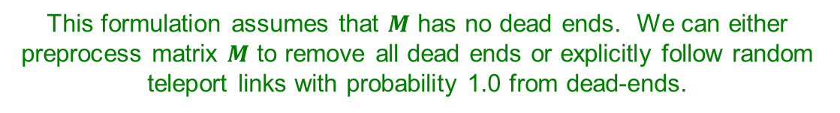
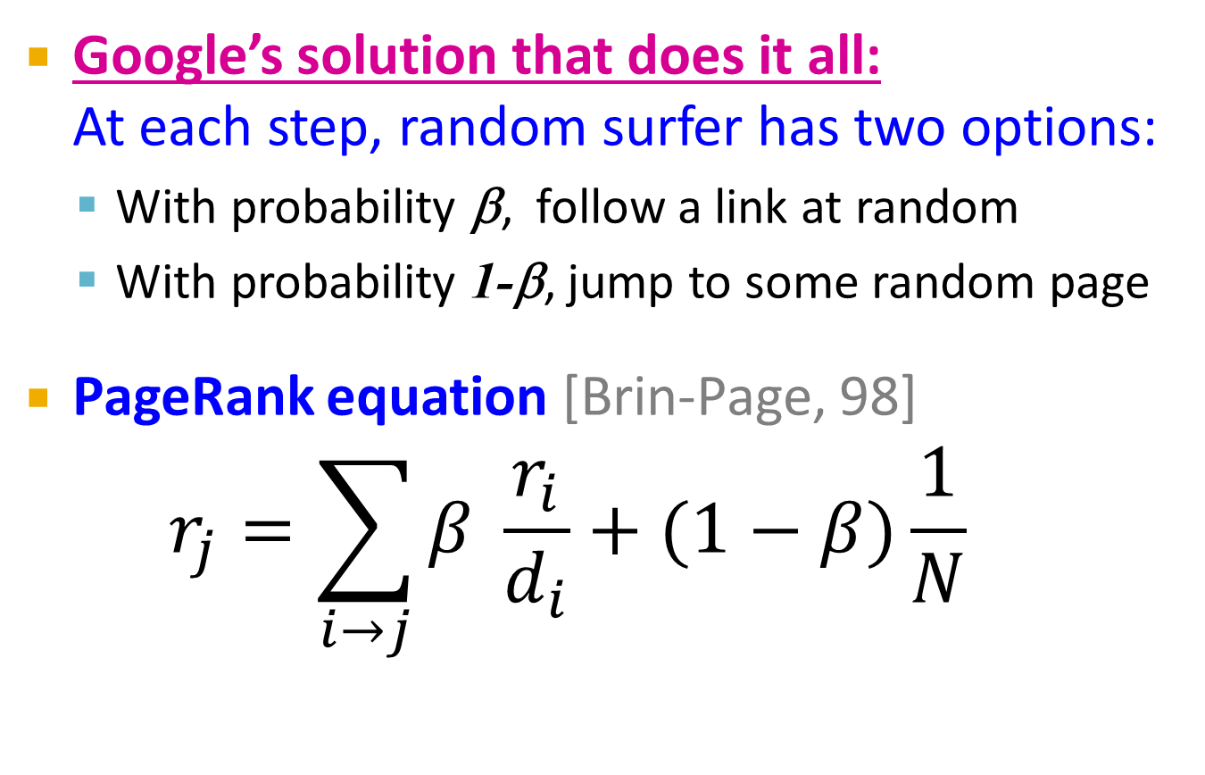
PageRank (2) – Recap
Google’s solution that does it all:
At each step, random surfer has two options:
  With probability β, follow a link at random
  With probability 1-β, jump to some random page
PageRank equation [Brin-Page, 98]
$r_{j}=\sum_{i→j}{β \frac{r_{i}}{d_{i}}}+(1−β)\frac{1}{N}$
d_{i} … out-degree
of node i
This formulation assumes that $M$ has no dead ends. We can either preprocess matrix $M$ to remove all dead ends or explicitly follow random teleport links with probability 1.0 from dead-ends.

Slide 10
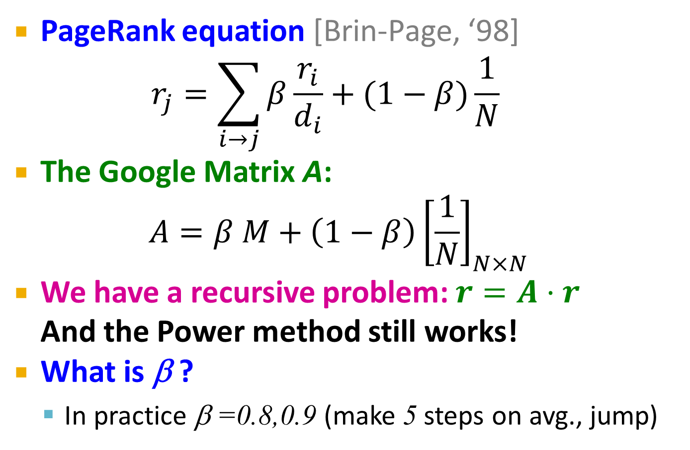
PageRank (2) – Recap
PageRank equation [Brin-Page, ‘98]
$r_{j}=\sum_{i→j}{β\frac{r_{i}}{d_{i}}}+(1−β)\frac{1}{N}$
The Google Matrix A:
$$A=β M+\left(1−β\right){\left[\frac{1}{N}\right]}_{N×N}$$
We have a recursive problem: $r=A⋅r$
And the Power method still works!
What is β ?
  In practice β =0.8,0.9 (make 5 steps on avg., jump)
[1/N]_{NxN}…N by N matrix
where all entries are 1/N

Slide 11
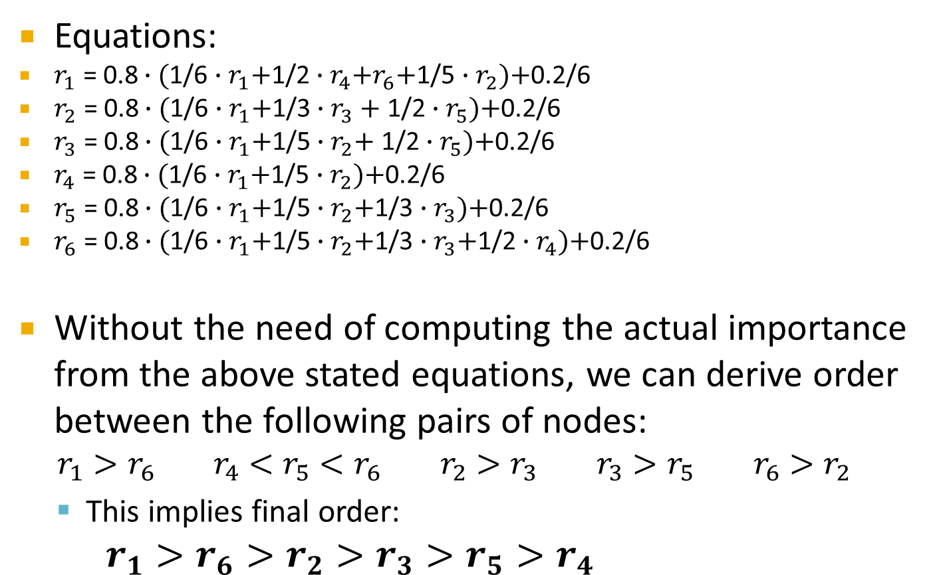
PageRank (2) – Solution
Equations:
$r_{1}\text{ = 0.8}∙\text{(}\text{1/6}∙r_{1}\text{+}\text{1/2}∙r_{4}\text{+}r_{6}\text{+}\text{1/5}∙r_{2}\text{)+}\text{0.2/6}$
$r_{2}\text{ = 0.8}∙\text{(}\text{1/6}∙r_{1}\text{+}\text{1/3}∙r_{3}+\text{1/2}∙r_{5}\text{)+}\text{0.2/6}$
$r_{3}\text{ = 0.8}∙\text{(}\text{1/6}∙r_{1}\text{+}\text{1/5}∙r_{2}\text{+}\text{ 1/2}∙r_{5}\text{)+}\text{0.2/6}$
$r_{4}\text{ = 0.8}∙\text{(}\text{1/6}∙r_{1}\text{+}\text{1/5}∙r_{2}\text{)+}\text{0.2/6}$
$r_{5}\text{ = 0.8}∙\text{(}\text{1/6}∙r_{1}\text{+}\text{1/5}∙r_{2}\text{+}\text{1/3}∙r_{3}\text{)+}\text{0.2/6}$
$r_{6}\text{ = 0.8}∙\text{(}\text{1/6}∙r_{1}\text{+}\text{1/5}∙r_{2}\text{+}\text{1/3}∙r_{3}\text{+}\text{1/2}∙r_{4}\text{)+}\text{0.2/6}$
Without the need of computing the actual importance from the above stated equations, we can derive order between the following pairs of nodes:
$$r_{1}>r_{6} r_{4}<r_{5}<r_{6} r_{2}>r_{3} r_{3}>r_{5} r_{6}>r_{2}$$
  This implies final order:
$r_{1}>r_{6}>r_{2}>r_{3}>r_{5}>r_{4}$

Slide 12
PageRank (3) – Assignment
For the following graph
  Assuming β = 0.8, compute the topic-sensitive PageRank for the following teleport sets:
    {A}
    {A, C}
A
B
C
D

Slide 13
PageRank (3) – Recap
Random walker has a small probability of teleporting at any step
Teleport can go to:
  Standard PageRank: Any page with equal probability
    To avoid dead-end and spider-trap problems
  Topic Specific PageRank: A topic-specific set of “relevant” pages (teleport set)
Idea: Bias the random walk
  When walker teleports, she pick a page from a set S
  S contains only pages that are relevant to the topic
    E.g., Open Directory (DMOZ) pages for a given topic/query
  For each teleport set S, we get a different vector r_{S}

Slide 14
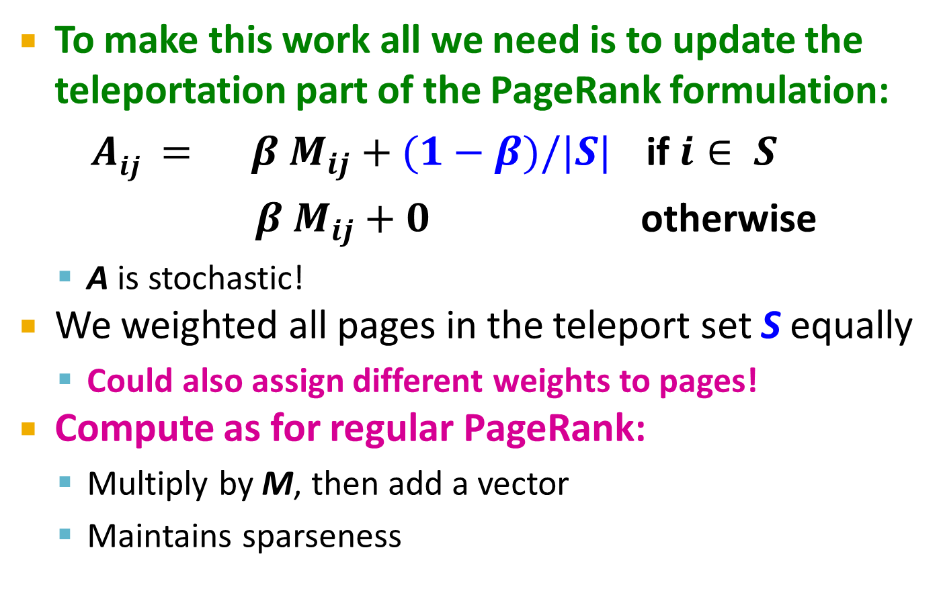
PageRank (3) – Recap
To make this work all we need is to update the teleportation part of the PageRank formulation:
    $Aij = β M_{ij}+(1−β)/|S|$ if $i∈ S$
    $β M_{ij}+0$ otherwise
  A is stochastic!
We weighted all pages in the teleport set S equally
  Could also assign different weights to pages!
Compute as for regular PageRank:
  Multiply by M, then add a vector
  Maintains sparseness

Slide 15
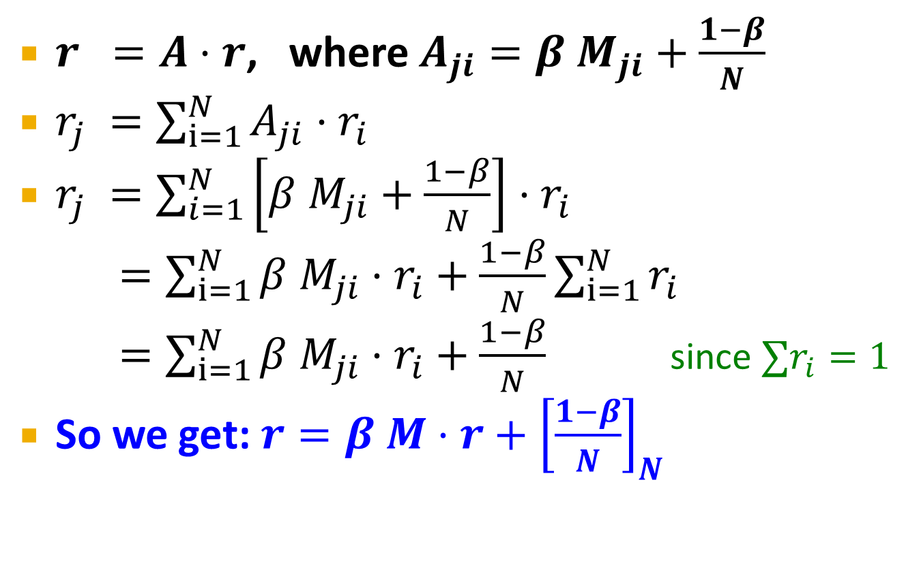
PageRank (3) – Recap
$r =A⋅r$, where $A_{ji}=β{ M}_{ji}+\frac{1−β}{N}$
$r_{j} =\sum_{i=1}^{N}{A_{ji}⋅r_{i}}$
$r_{j} =\sum_{i=1}^{N}{\left[β{ M}_{ji}+\frac{1−β}{N}\right]⋅r_{i}}$
$=\sum_{i=1}^{N}{β{ M}_{ji}⋅r_{i}+\frac{1−β}{N}}\sum_{i=1}^{N}{r_{i}}$
$=\sum_{i=1}^{N}{β{ M}_{ji}⋅r_{i}+\frac{1−β}{N}}$ since $∑r_{i}=1$
So we get: $r=β M⋅r+{\left[\frac{1−β}{N}\right]}_{N}$
Note: Here we assumed M has no dead-ends
[x]_{N} … a vector of length N with all entries x

Slide 16
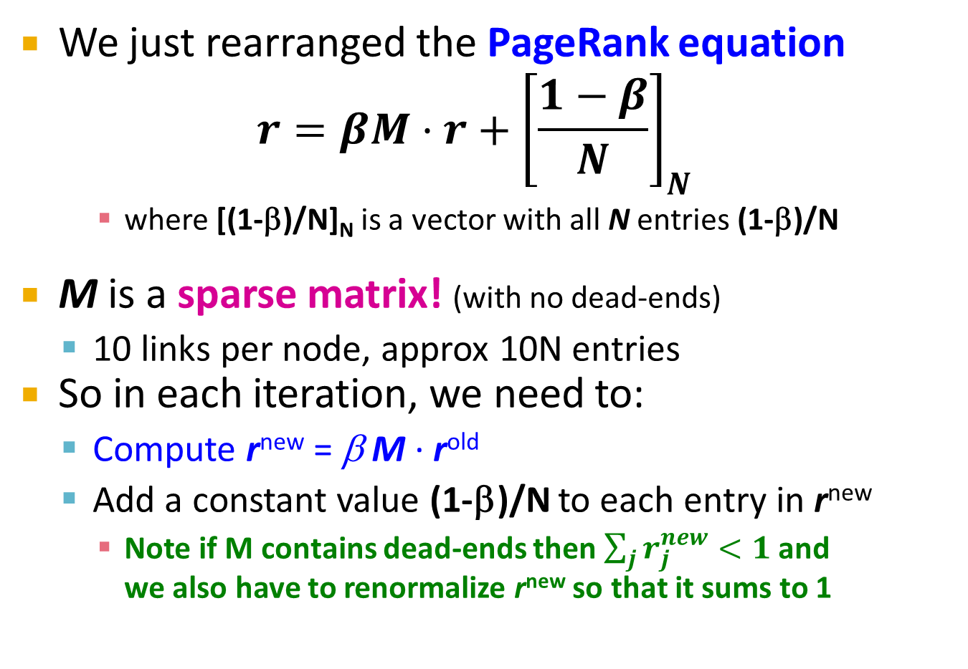
PageRank (3) – Recap
We just rearranged the PageRank equation
$$r=βM⋅r+{\left[\frac{1−β}{N}\right]}_{N}$$
    where [(1-β)/N]_{N} is a vector with all N entries (1-β)/N
M is a sparse matrix! (with no dead-ends)
  10 links per node, approx 10N entries
So in each iteration, we need to:
  Compute r^{new} = β M ∙ r^{old}
  Add a constant value (1-β)/N to each entry in r^{new}
    Note if M contains dead-ends then $\sum_{j}{r_{j}^{new}}<1$ and
    we also have to renormalize r^{new} so that it sums to 1

Slide 17






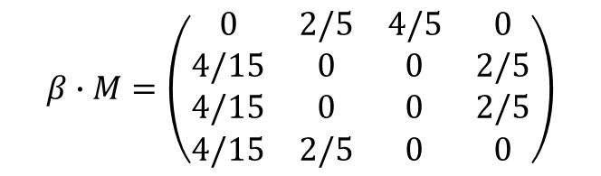
PageRank (3) – Solution 1/4
The transition matrix for the graph is:
  Computing PageRank for teleport set {A} using equations:
$$M=\left(\begin{matrix}0 & 1/2 & 1 & 0 \\ 1/3 & 0 & 0 & 1/2 \\ 1/3 & 0 & 0 & 1/2 \\ 1/3 & 1/2 & 0 & 0\end{matrix}\right)$$
$$β∙M=\left(\begin{matrix}0 & 2/5 & 4/5 & 0 \\ 4/15 & 0 & 0 & 2/5 \\ 4/15 & 0 & 0 & 2/5 \\ 4/15 & 2/5 & 0 & 0\end{matrix}\right)$$
$$\left(1−β\right)∙\left(\begin{matrix}1 \\ 0 \\ 0 \\ 0\end{matrix}\right)=\left(\begin{matrix}1/5 \\ 0 \\ 0 \\ 0\end{matrix}\right)$$
$$\begin{matrix}A=\frac{2}{5}B+\frac{4}{5}C+\frac{1}{5} \\ B=\frac{4}{15}A+\frac{2}{5}D \\ C=\frac{4}{15}A+\frac{2}{5}D \\ D=\frac{4}{15}A+\frac{2}{5}B \\ A+B+C+D=1\end{matrix}$$
$$⇒$$
$$r={\left(\begin{matrix}\frac{3}{7} & \frac{4}{21} & \frac{4}{21} & \frac{4}{21}\end{matrix}\right)}^{T}$$
$$⇒$$

Slide 18

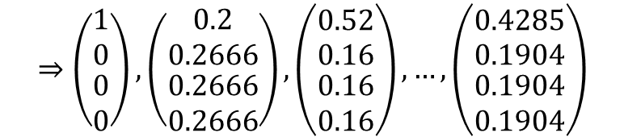

PageRank (3) – Solution 2/4
The transition matrix for the graph is:
  Computing PageRank for teleport set {A} using iterations:
  We can initialize vector r in different ways; however, the sum of values must equal to 1, e.g., $r^{\left(0\right)}={\left(\begin{matrix}1 & 0 & 0 & 0\end{matrix}\right)}^{T}$
$$M=\left(\begin{matrix}0 & 1/2 & 1 & 0 \\ 1/3 & 0 & 0 & 1/2 \\ 1/3 & 0 & 0 & 1/2 \\ 1/3 & 1/2 & 0 & 0\end{matrix}\right)$$
$$β∙M=\left(\begin{matrix}0 & 2/5 & 4/5 & 0 \\ 4/15 & 0 & 0 & 2/5 \\ 4/15 & 0 & 0 & 2/5 \\ 4/15 & 2/5 & 0 & 0\end{matrix}\right)$$
$$\left(1−β\right)∙\left(\begin{matrix}1 \\ 0 \\ 0 \\ 0\end{matrix}\right)=\left(\begin{matrix}1/5 \\ 0 \\ 0 \\ 0\end{matrix}\right)$$
$$r^{(1)}=β∙M∙r^{\left(0\right)}+\left(\begin{matrix}1/5 \\ 0 \\ 0 \\ 0\end{matrix}\right)$$
$$⇒$$
$$⇒\left(\begin{matrix}1 \\ 0 \\ \begin{aligned}0 \\ 0\end{aligned}\end{matrix}\right),\left(\begin{matrix}0.2 \\ 0.2666 \\ \begin{aligned}0.2666 \\ 0.2666\end{aligned}\end{matrix}\right),\left(\begin{matrix}0.52 \\ 0.16 \\ \begin{aligned}0.16 \\ 0.16\end{aligned}\end{matrix}\right),…,\left(\begin{matrix}0.4285 \\ 0.1904 \\ \begin{aligned}0.1904 \\ 0.1904\end{aligned}\end{matrix}\right)$$

Slide 19




PageRank (3) – Solution 3/4
The transition matrix for the graph is:
  Computing PageRank for teleport set {A,C} using equations:
$$M=\left(\begin{matrix}0 & 1/2 & 1 & 0 \\ 1/3 & 0 & 0 & 1/2 \\ 1/3 & 0 & 0 & 1/2 \\ 1/3 & 1/2 & 0 & 0\end{matrix}\right)$$
$$β∙M=\left(\begin{matrix}0 & 2/5 & 4/5 & 0 \\ 4/15 & 0 & 0 & 2/5 \\ 4/15 & 0 & 0 & 2/5 \\ 4/15 & 2/5 & 0 & 0\end{matrix}\right)$$
$$\left(1−β\right)∙\left(\begin{matrix}1/2 \\ 0 \\ 1/2 \\ 0\end{matrix}\right)=\left(\begin{matrix}1/10 \\ 0 \\ 1/10 \\ 0\end{matrix}\right)$$
$$\begin{matrix}A=\frac{2}{5}B+\frac{4}{5}C+\frac{1}{10} \\ B=\frac{4}{15}A+\frac{2}{5}D \\ C=\frac{4}{15}A+\frac{2}{5}D+\frac{1}{10} \\ D=\frac{4}{15}A+\frac{2}{5}B \\ A+B+C+D=1\end{matrix}$$
$$⇒$$
$$r={\left(\begin{matrix}\frac{27}{70} & \frac{6}{35} & \frac{19}{70} & \frac{6}{35}\end{matrix}\right)}^{T}$$
$$⇒$$

Slide 20



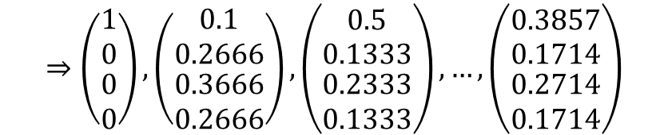
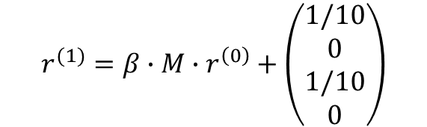
PageRank (3) – Solution 4/4
The transition matrix for the graph is:
  Computing PageRank for teleport set {A,C} using iterations:
  We can initialize vector r in different ways; however, the sum of values must equal to 1, e.g., $r^{\left(0\right)}={\left(\begin{matrix}1 & 0 & 0 & 0\end{matrix}\right)}^{T}$
$$M=\left(\begin{matrix}0 & 1/2 & 1 & 0 \\ 1/3 & 0 & 0 & 1/2 \\ 1/3 & 0 & 0 & 1/2 \\ 1/3 & 1/2 & 0 & 0\end{matrix}\right)$$
$$β∙M=\left(\begin{matrix}0 & 2/5 & 4/5 & 0 \\ 4/15 & 0 & 0 & 2/5 \\ 4/15 & 0 & 0 & 2/5 \\ 4/15 & 2/5 & 0 & 0\end{matrix}\right)$$
$$\left(1−β\right)∙\left(\begin{matrix}1/2 \\ 0 \\ 1/2 \\ 0\end{matrix}\right)=\left(\begin{matrix}1/10 \\ 0 \\ 1/10 \\ 0\end{matrix}\right)$$
$$r^{(1)}=β∙M∙r^{\left(0\right)}+\left(\begin{matrix}1/10 \\ 0 \\ 1/10 \\ 0\end{matrix}\right)$$
$$⇒$$
$$⇒\left(\begin{matrix}1 \\ 0 \\ \begin{aligned}0 \\ 0\end{aligned}\end{matrix}\right),\left(\begin{matrix}0.1 \\ 0.2666 \\ \begin{aligned}0.3666 \\ 0.2666\end{aligned}\end{matrix}\right),\left(\begin{matrix}0.5 \\ 0.1333 \\ \begin{aligned}0.2333 \\ 0.1333\end{aligned}\end{matrix}\right),…,\left(\begin{matrix}0.3857 \\ 0.1714 \\ \begin{aligned}0.2714 \\ 0.1714\end{aligned}\end{matrix}\right)$$

Slide 21
Advertising (1) – Assignment
Suppose the BALANCE algorithm with bids of 0 or 1 only, to a situation where advertiser
  A bids on query words x and y
  B bids on query words x and z
  Both have a budget of $2. Decide whether the following sequences of queries are certainly handled optimally by the algorithm:
    yzyy
    xyyz
    xyzx

Slide 22
Advertising (1) – Recap
BALANCE Algorithm by Mehta, Saberi, Vazirani, and Vazirani
  For each query, pick the advertiser with the
  largest unspent budget
    Break ties arbitrarily (but in a deterministic way)

Slide 23
Advertising (1) – Recap
Two advertisers A and B
  A bids on query x, B bids on x and y
  Both have budgets of $4
Query stream: x x x x y y y y
BALANCE choice: A B A B B B _ _
  Optimal: A A A A B B B B
In general: For BALANCE on 2 advertisers Competitive ratio = ¾

Slide 24
Advertising (1) – Solution
Yes (for input sequence: yzyy)
  Balance choice: yzy ($3) Optimal: yzy ($3)
No (for input sequence: xyyz)
  If the x is assigned to A, then the second y cannot be satisfied, while the optimum assigns all four queries
  Balance choice: xyz ($3) Optimal: xyyz ($4)
Yes (for input sequence: xyzx)
  Whichever advertiser is assigned the first x, the other will be assigned the second x, thus using all four queries
  Balance choice: xyzx ($4) Optimal: xyzx ($4)

Slide 25
Recomm. Systems (1) – Assignment
Bookstore has enough ratings to use a more advanced recommendation system
  Suppose the mean rating of books is 3.4 stars
  Alice has rated 350 books and her average rating is 0.4 stars higher than average users' ratings
  Animals Farm, is a book title in the bookstore with 250,000 ratings whose average rating is 0.7 higher than global average
  What is a baseline estimate of Alice's rating for Animals Farms?

Slide 26
Recomm. Systems (1) – Solution
Baseline estimate of Alice's rating for Animals Farms:
r = 3.4 + 0.7 + 0.4 = 4.5

Slide 27
Recomm. Systems (2) – Assignment
Computers A, B and C have the following features:
  Assuming features as a vector for each computer, e.g., A’s vector is [3.06, 500, 6], we can compute the cosine distance between any two vectors
  Scaling dimensions can prefer some components
  Assume 1 as the scale factor for processor speed, α for the disk size, and β for the main memory size and compute:
    The cosines of angles between pairs of vectors (in terms of α and β)
Feature | A | B | C
Processor speed | 3.06 | 2.68 | 2.92
Disk size | 500 | 320 | 640
Main-memory size | 6 | 4 | 6

Slide 28
Recomm. Systems (2) – Recap
Item profiles
likes
build
recommend
match
Red
Circles
Triangles
User profile
Notes:
Item profile = vector of item features (e.g., one dimension = 0/1 whether it is red color, or not)
User profile = e.g., average over item profiles

Slide 29
Recomm. Systems (2) – Recap
User profile possibilities:
  Weighted average of rated item profiles
  Variation: weight by difference from average
  rating for item
  …
Prediction heuristic:
  Given user profile x and item profile i, estimate $u(x,i) = cos⁡(x,i) = \frac{x·i}{|\left|x\right||⋅|\left|i\right||}$

Slide 30
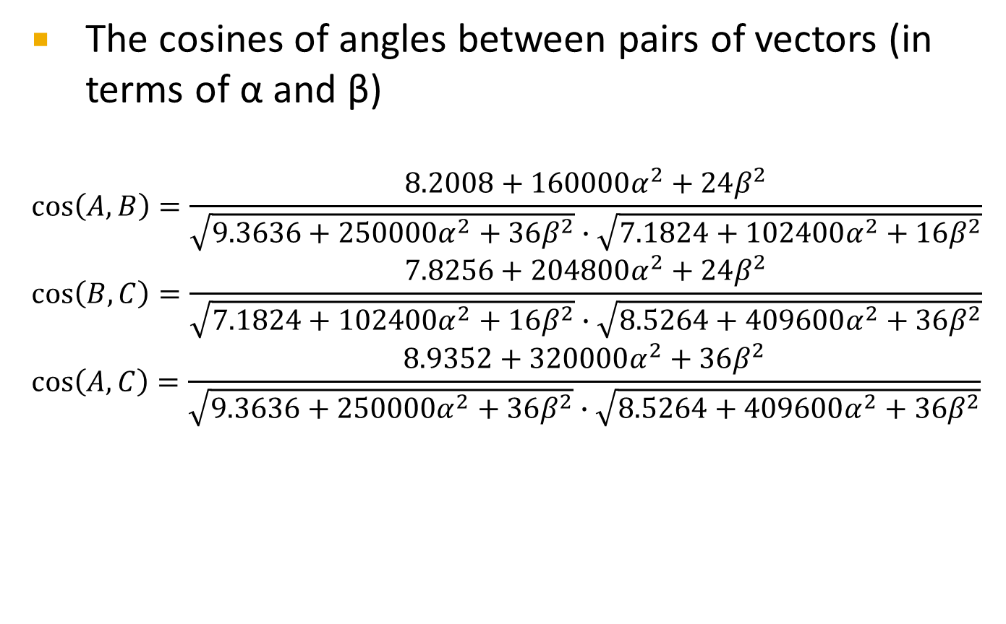
Recomm. Systems (2) – Solution
The cosines of angles between pairs of vectors (in terms of α and β)
$$\cos\left(A,B\right)=\frac{8.2008+160000α^{2}+24β^{2}}{\sqrt{{9.3636+250000α}^{2}+36β^{2}}∙\sqrt{7.1824+102400α^{2}+16β^{2}}}$$
$$\cos\left(B,C\right)=\frac{7.8256+204800α^{2}+24β^{2}}{\sqrt{{7.1824+102400α}^{2}+16β^{2}}∙\sqrt{8.5264+409600α^{2}+36β^{2}}}$$
$$\cos\left(A,C\right)=\frac{8.9352+320000α^{2}+36β^{2}}{\sqrt{{9.3636+250000α}^{2}+36β^{2}}∙\sqrt{8.5264+409600α^{2}+36β^{2}}}$$

Slide 31
Recomm. Systems (3) – Assignment
A user has rated the three computers as follows:
  A: 4 stars, B: 2 stars, C: 5 stars
Tasks:
  Normalize the ratings for this user
  Compute a user profile for the user, with the following features
Feature | A | B | C
Processor speed | 3.06 | 2.68 | 2.92
Disk size | 500 | 320 | 640
Main-memory size | 6 | 4 | 6

Slide 32
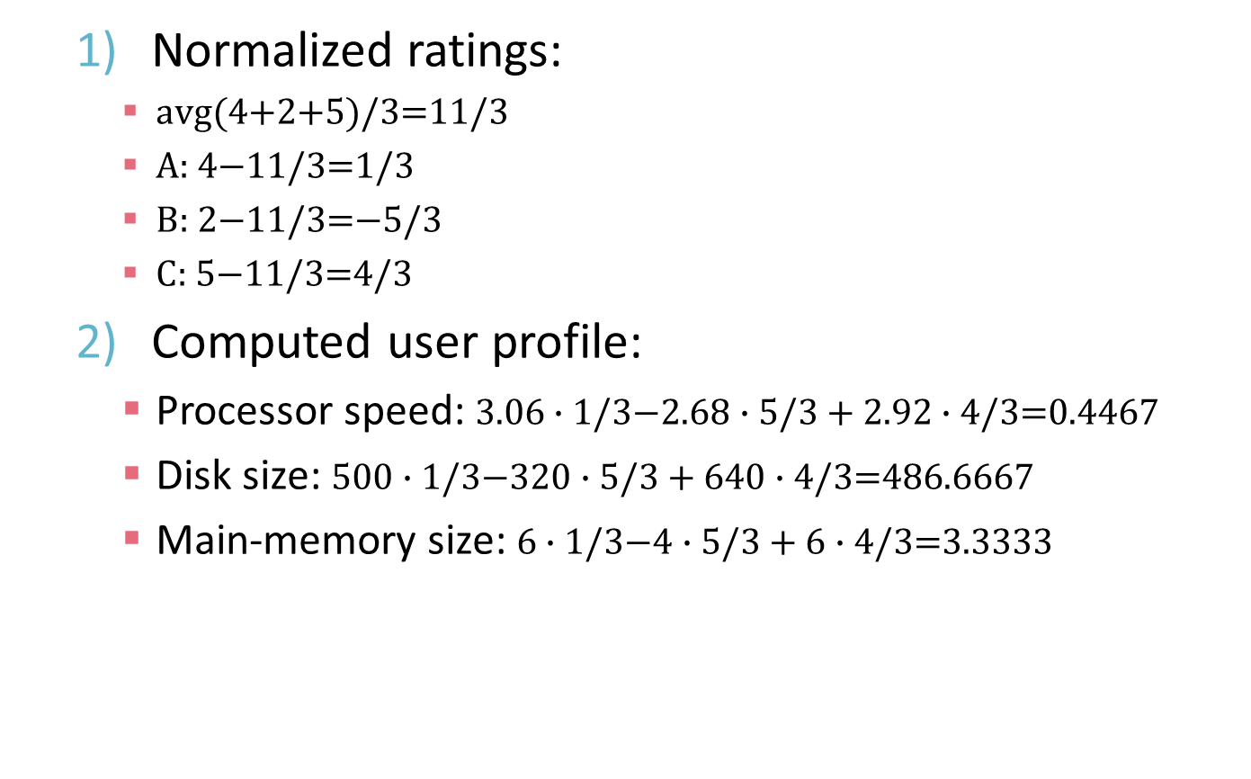
Recomm. Systems (3) – Solution
  Normalized ratings:
    $\text{a}\text{vg}\text{(4+2+5)/3=11/3}$
    $\text{A}\text{: 4−1}\text{1/3=1/3}$
    $\text{B}\text{: }\text{2}\text{−11/3=}\text{−}\text{5}\text{/3}$
    $\text{C}\text{: }\text{5}\text{−11/3=}\text{4}\text{/3}$
  Computed user profile:
    Processor speed: $3.06∙1\text{/3}\text{−}\text{2.68}∙5/3+2.9\text{2}∙4\text{/3=0.4467}$
    Disk size: $500∙1\text{/3−}320∙5/3+640∙4\text{/3=}\text{486}\text{.}\text{66}\text{67}$
    Main-memory size: $6∙1\text{/3−}4∙5/3+6∙4\text{/3=}\text{3}\text{.}\text{3333}$

