Slide 1


PV204 Security technologies
Authentication: passwords, OTP, FIDO U2F
Petr Švenda svenda@fi.muni.cz @rngsec
Centre for Research on Cryptography and Security, Masaryk University

Slide 2
Course trivia: PV204_00_CourseOverview_2020.ppt

Slide 3
Authentication & Authorization

Slide 4
Basic terms
Identification
  Establish what the (previously unknown) entity is
Authentication
  Verify if entity is really what it claims to be
Authorization (access control)
  Define an access policy to use specified resource
  Check if entity is allowed (authorized) to use resource
Authentication may be required before an entity allowed to use resource to which is authorized

Slide 5
Options for authentication
Something you:
  Know (password, key)
  Have (token, smartcard)
  Are (biometrics)
Combination of multiple options – two-factor authentication (or more)
Registration phase (how is new user added)
Verification phase (how is user’s claimed identity verified)
Recovery phase (what if user forgot/lost authentication credentials)

Slide 6

Group activity
Form group of 3-4 members (mix, not your neighbours)
  Introduce yourself with your name
Discuss and write down on paper:
  What method(s) you use for authentication (password…)
  Is server using other authentication factor?
  How you store the authentication secret? (brain-only…)
Time limit: 5 minutes
Now return back to your original seat (if you wish ☺)

Slide 7
Passwords

Slide 8
Mode of usage for passwords
Verify by direct match (provided_password == expected_password?)
  Example: HTTP basic access authentication
  Be aware of plaintext storage on server
  Be aware of potential side-channels (mismatch on Xth character)
Verify by match of derived value (hash(password | salt))
  Be aware of rainbow tables and brute-force crackers
Derive key: Password → cryptographic key
  Example: key = PBKDF2(password)
Used to establish authenticated key
  Example: Password + Diffie-Hellman → authenticated key…

Slide 9
Problems associated with passwords
How to create strong password?
How to use password securely?
How to store password securely?
Same value is used for the long time (exposure)
Value of password is independent from the target operation (e.g., authorization of bank transfer request)
…

Slide 10
Where the passwords can be compromised?
Client side (malware on user computer)
Database storage
  Cleartext storage
  Backup data (“tapes”)
  Server compromise, misconfiguration
Host machine (memory, history, cache)
Network transmission (network sniffer, proxy logs)
Hardcoded secrets (inside app binary)
Difficult to detect compromise and change after the exposure

Slide 11
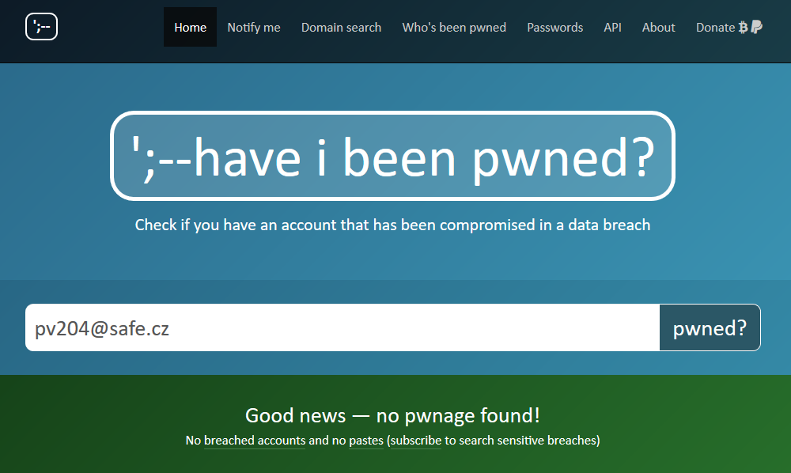
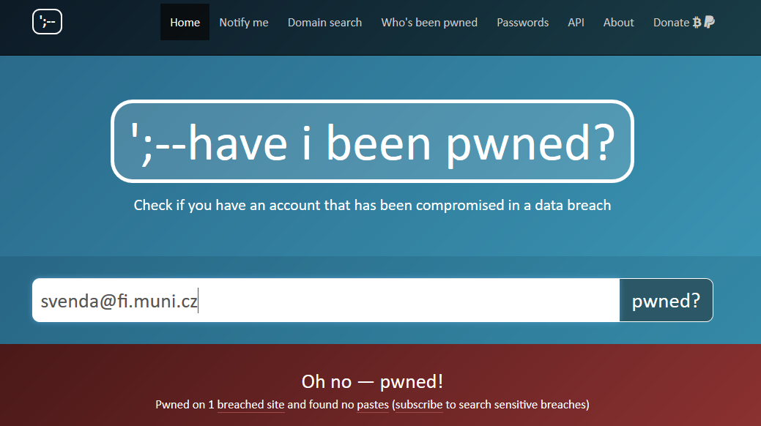
https://haveibeenpwned.com/ (Troy Hunt)
Total pwned accounts: 9,490,577,236
Collection #1: 772,904,991 accounts!

Slide 12
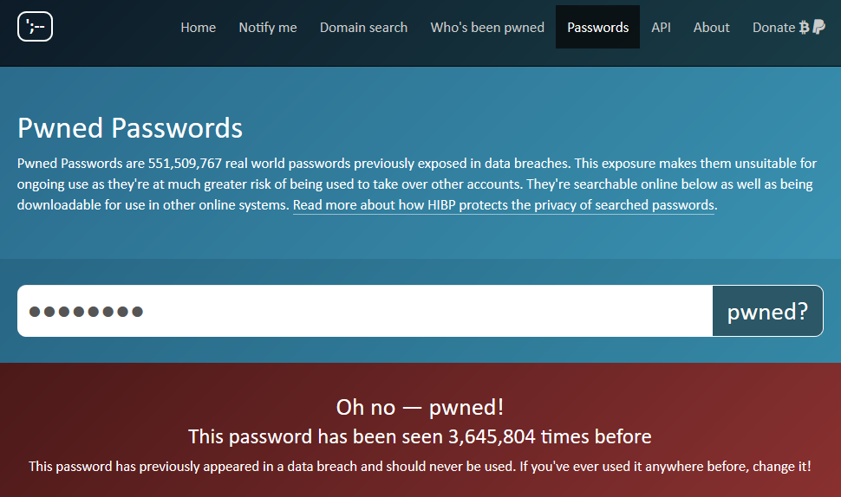
https://haveibeenpwned.com/Passwords
Check how many times was given password found in leaked datasets
password

Slide 13
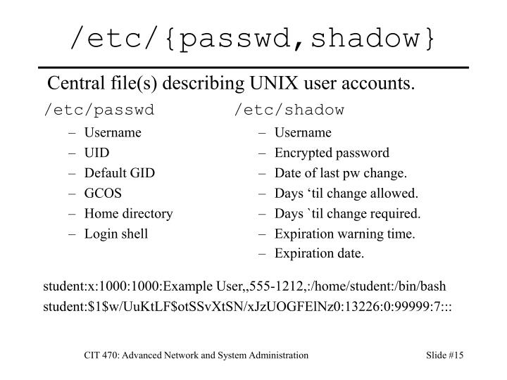
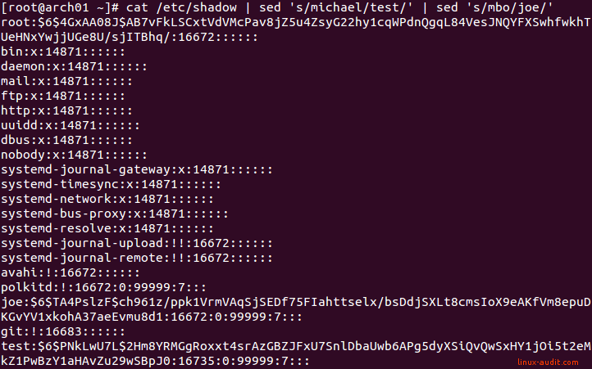
Joe; insecure

Slide 14

(Hashed-)Password cracking
Scenario: dump of database with password hashes, find original password
Password cracking attacks
  Brute-force attack (up to 8 characters)
  Dictionary attack (inputs with higher probability tried first)
  Patterns: Dictionary + brute-force (Password[0-9]*)
  Rainbow tables (time-memory trade-off)
  Parallelization (many parallel cores)
  GPU/FPGA/ASIC speedup of cracking
Tools
  Generic: John the Ripper, Brutus, RainbowCrack…
  Targeted to application: TrueCrack, Aircrack-NG…

Slide 15
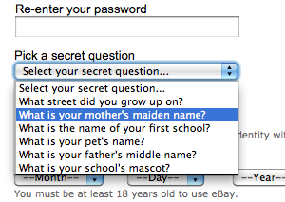
Passwords reality (from many breaches + pwd cracking)
User has usually weak password
  >60% were (dictionary) brute-forced
Server/service is frequently compromised
  Server-side compromises are now very frequent
Users do not use unique passwords
  Gawker/root.com leak: 76% had the exact same password
Different authentication channels may not be independent
  Web-browsing + SMS on smart phones?
Account recovery is often easier to guess than original password

Slide 16
Insecure password handling … what is the attack?
Verify by direct match (provided_password == expected_password?)
  Attack: compromise plain passwords on server
pwdTag_{i} = SHA-2(“password”)
  Same passwords from multiple users => same resulting pwdTag
  Attack: Large pre-computed “rainbow” tables allow for very quick check common passwords
pwdTag_{i} = SHA-2(“password” | salt)
  Use of rainbow tables “prevented” by addition of random (and potentially public) salt
  Attack: dictionary-based brute-force still possible
pwdTag_{i} = AES(“password”, secret_key)
  Attack: If secret_key is leaked => direct decryption of all stored pwdTags => passwords

Slide 17
Password “hardening” ideas
Slowdown cracking attempts (less potential passwords tried)
Enable users to have long, random and unique passwords
Have unique password for every authentication attempt
Replace passwords with something else (e.g., smartcard)
Bind response to server domain name (to prevent phishing)

Slide 18
Idea: Slowdown cracking attempts

Slide 19
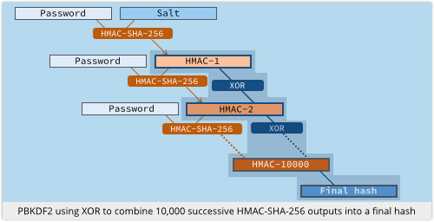
Derivation of secrets from passwords
PBKDF2 function, widely used
  Password is key for HMAC
  Salt added
  Many iterations to slow derivation
Problem with custom-build hardware (GPU, ASIC)
  Repeated iterations not enough to prevent bruteforce
  (or would be too slow on standard CPU – user experience)
Solution: function which requires large amount of memory
Source: https://nakedsecurity.sophos.com

Slide 20
scrypt – memory hard function
Design as a protection against cracking hardware (usable against PBKDF2)
  GPU, FPGA, ASICs…
  https://github.com/wg/scrypt/blob/master/src/main/java/com/lambdaworks/crypto/SCrypt.java
Memory-hard function
  Force computation to hold r (parameter) blocks in memory
  Uses PBKDF2 as outer interface
Improved version: NeoScrypt (uses full Salsa20)

Slide 21
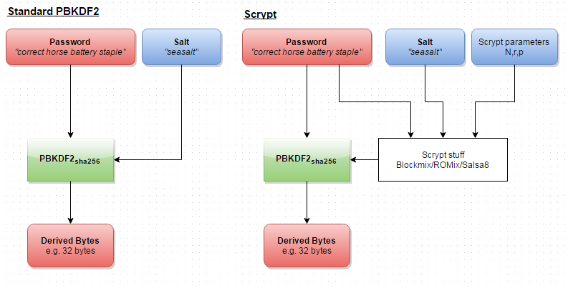
Reuse of external PBKDF2 structure
https://www.reddit.com/r/crypto/comments/3dz285/password_hashing_competition_phc_has_selected/

Slide 22
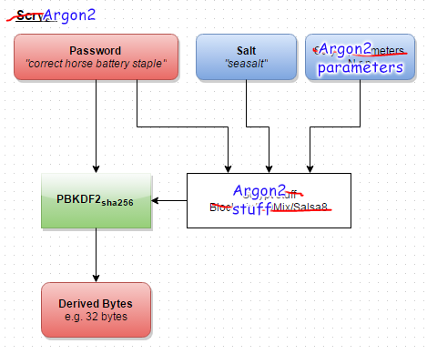
Argon2
Password hashing competition (PHC) winner, 2013
https://www.reddit.com/r/crypto/comments/3dz285/password_hashing_competition_phc_has_selected/

Slide 23
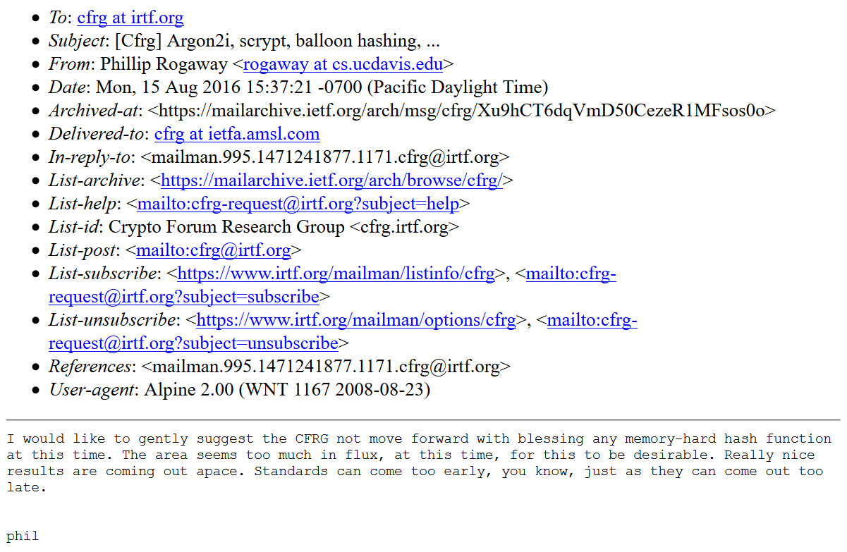
Problem solved?
Problem: situation with PHC winner still unclear in 2019 ☹
https://www.ietf.org/mail-archive/web/cfrg/current/msg08439.html

Slide 24
Idea: LONG, random and unique passwords

Slide 25
Password managers

Slide 26
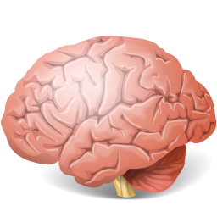



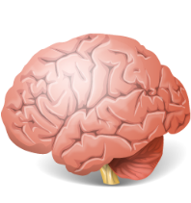



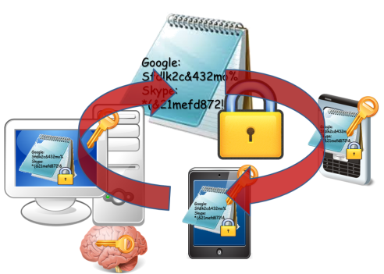

Evolution of password (managers)
Pαs$w0rd
Human memory only
Write it down on paper
Write it into file
Use local password manager
Pαs$w0rd01
Google:
Sfdlk2c&
Skype:
*(&21mefd
Google:
Sfdlk2c&432mo%
Skype:
*(&21mefd872!&
Google:
Sfdlk2c&432mo%
Skype:
*(&21mefd872!&

Slide 27


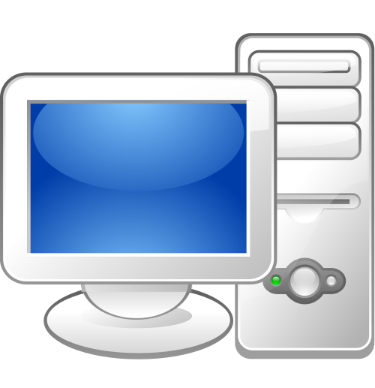


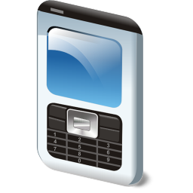

Remote password managers
KeePass+Dropbox
LastPass
1Password
MozillaSync
…
Google:
Sfdlk2c&432mo%
Skype:
*(&21mefd872!&

Slide 28
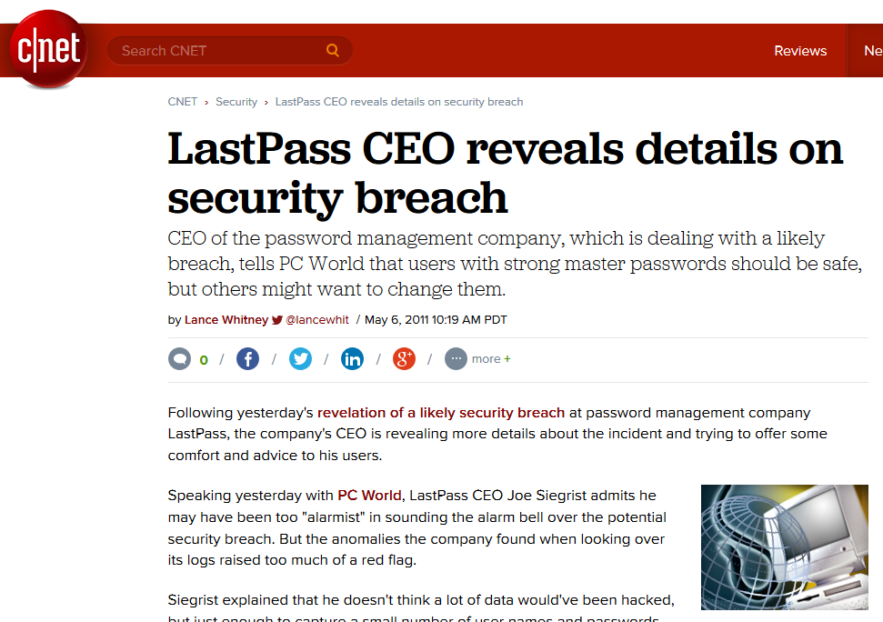
But passwords are encrypted, right?

Slide 29
Password manager for multiple devices
Case study

Slide 30
Functional and security assumptions
Functional
  User stores fixed secrets (passwords…)
  User has multiple connected devices
  Easy to use ☺
Security
  Service can’t be trusted
  User chooses weak password
  Devices can be lost (and later revoked)
  User has independent channel (phone)

Slide 31
Main security design principles
Treat storage service as untrusted and perform security sensitive operations on client
Make necessary trusted component as small as possible
Prevent offline brute-force, but don’t expect strong password from user
  add entropy from other source
Make transmitted sensitive values short-lived
Trusted hardware can provide additional support

Slide 32
Public-key cryptography indirection
Google:
Sfdlk2c&432mo%
Google:
Sfdlk2c&432mo%
Skype:
*(&21mefd872!&
K
K
K
Priv_U
Pub_U
KEK
K = H(‘Password’)
KEK = H(‘Password’)
Password
Password

Slide 33


Public-key crypto indirection
Google:
Sfdlk2c&432mo%
K’,K’’,K’’’…
K
[K’]Pub_U
K
Priv_U
Pub_U
KEK
Public-key crypto indirection allows for asynchronous change of K
KEK = H(‘Password’)
Long private key can be also stored on Service
Password

Slide 34
Weak password?
Google:
Sfdlk2c&432mo%
Google:
Sfdlk2c&432mo%
K
Users tend to have weak passwords…
K
Priv_U
K
Priv_U
K
Pub_U
KEK
KEK
Attacker has motivation for attacking the Service!
KEK = H(‘Password’)
KEK = H(‘Password’)
Password
Password

Slide 35
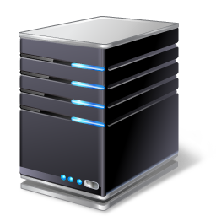

Trusted server/element
Google:
Sfdlk2c&432mo%
K
User1:SecretData
User2:SecretData’
…
K
Priv_U
Pub_U
KEK
SecretData1,
SecretData2,
SecretData3…
Threshold crypto
SecretData
KEK = H(‘Password’
| SecretData)
Separate trusted entities provide additional data
Password
Notes:
Problems:
- Attacker may compromise SecretData during transit
- Trusted server must accept network connections from whole world => larger attack surface

Slide 36



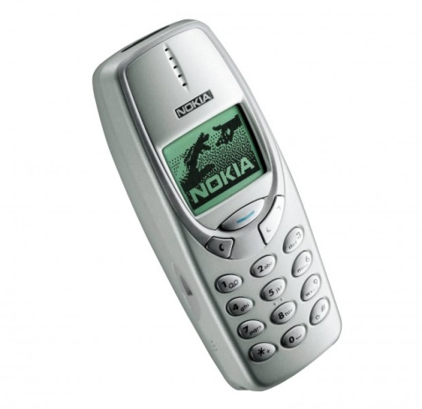
Google:
Sfdlk2c&432mo%
K
SecretData
User1:SecretData
User2:SecretData’
…
K
Priv_U
Pub_U
KEK
SecretData
SMS:
KEK = H(‘Password’ | SecretData)
Password

Slide 37
Multiple devices
Google:
Sfdlk2c&432mo%
K
K
Priv_U
Pub_U
KEK
KEK
KEK
KEK
Dev1
Dev2
Dev3
Dev3
Dev1
Dev2

Slide 38

Other operations
Device management (new, remove, revoke)
Device authentication
Group management (users, boards, secrets)
Password change, private key change
Access recovery
…
Devil is in the details…

Slide 39
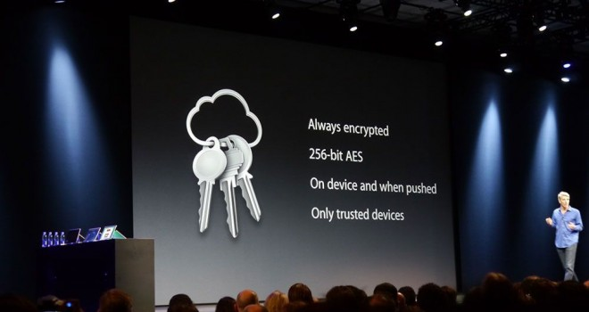
Do we have some implementations?
Apple’s service showcased in 2013
Lack of details until iOS Security report 02/2014
  https://www.apple.com/business/docs/iOS_Security_Guide.pdf
https://blog.cryptographyengineering.com/2016/08/13/is-apples-cloud-key-vault-crypto/ (M.Green)
Apple iCloud Keychain

Slide 40
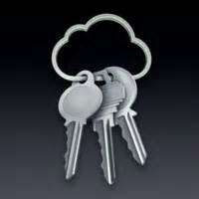
Apple’s iCloud Keychain
Multiple similarities to the described example
  Layer of indirection via asymmetric cryptography
  Support for multiple devices
  Asynchronous operations via application tickets
  Authorization and signature of additional devices
  User phone registered and required
Still reliance on user’s (potentially weak) password
  But limited number of tries allowed
Trusted component of iCloud realized via internal HSM
  Recovery mode with 4 digit code (default, can be set longer)
  HSM will decrypt recovery key only after code validation
  Note: only 4 digits is not an issue here – HSM enforce limited # retries

Slide 41
Idea: Have unique password for every authentication attempt

Slide 42
One-time Passwords

Slide 43

Recall: Problems associated with passwords
How to create secure password?
How to use password securely?
How to store password securely?
Same value is used for the long time (exposure)
Value of password is independent from target operation (e.g., authorization of request)
…
One-time passwords tries to address these issues

Slide 44
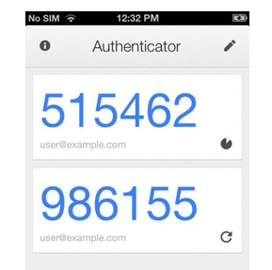
HMAC-based One-time Password Algorithm (RFC 4226)
HMAC-based One-time Password Algorithm (HOTP)
  Secret key K
  Counter (challenge) C
  HMAC(K,C) = SHA1(K ⊕ 0x5c5c… ∥ SHA1(K ⊕ 0x3636… ∥ C))
  HOTP(K,C) = Truncate(HMAC(K,C)) & 0x7FFFFFFF
  0x7FFFFFFF mask to drop most significant bit (portability)
  HOTP-Value = HOTP(K,C) mod 10^{d} (d … # of digits)
Many practical implementations
  E.g., Google Authenticator
https://en.wikipedia.org/wiki/HOTP

Slide 45
HOTP – items, operations
Logical operations
  Generate initial state for new user and distribute key
  Generate HOTP code and update state (user)
  Verify HOTP code and update state (auth. server)
Security considerations of HOTP
  Client compromise
  Server compromise
  Repeat of counter/challenge
  Counter mismatch tolerance window

Slide 46
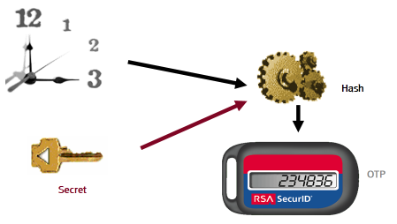
Time-based One-time Password Algorithm
Very similar to HOTP
  Time used instead of counter
Requires synchronized clocks
  In practice realized as time window
Tolerance to gradual desynchronization possible
  Server keeps device’s desynchronization offset
  Updates with every successful login
Sylvain Maret

Slide 47
OCRA: OATH Challenge-Response Algorithm
Initiative for Open Authentication (OATH)
OCRA is authentication algorithm based on HOTP
OCRA code = CryptoFunction(K, DataInput)
  K: a shared secret key known to both parties
  DataInput: concatenation of the various input data values
    Counter, challenges, H(PIN/Passwd), session info, H(time)
  Default CryptoFunction is HOTP-SHA1-6
  https://tools.ietf.org/html/rfc6287
Don’t confuse with Oauth (delegation of authentication)
  The OAuth 2.0 Authorization Framework (RFC6749)
  TLS-based security protocol for accessing HTTP service

Slide 48
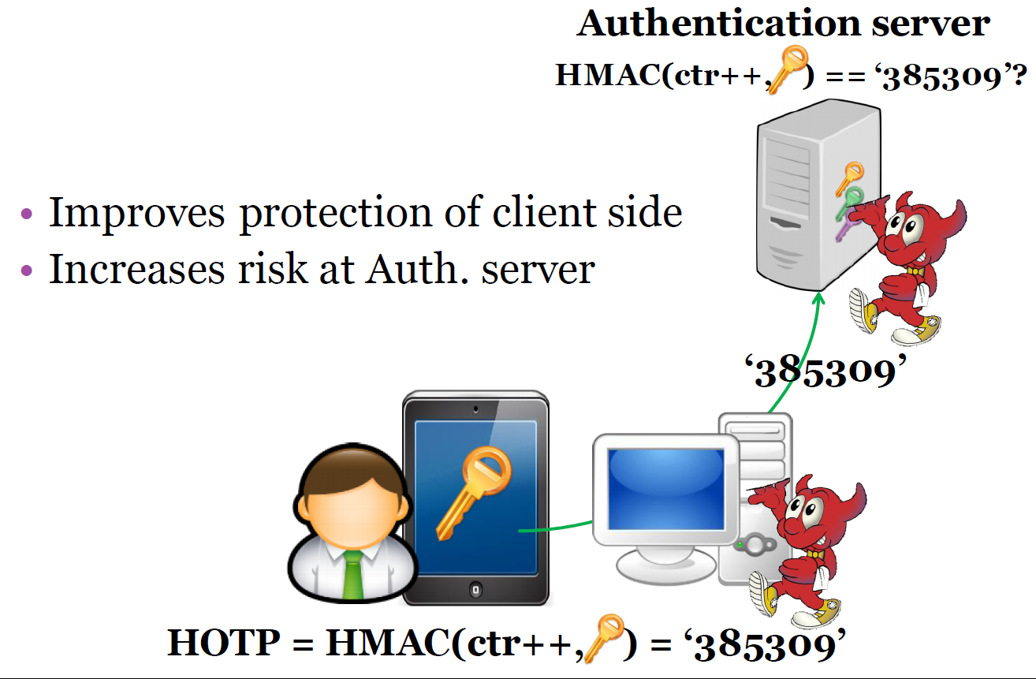

Slide 49
Increased risk at *OTP verification server
More secure against client compromise
  Using OTP instead of passwords, KDF(time|key),
But what if server is compromised?
  database hacks, temporal attacker presence
  E.g., Heartbleed – dump of OTP keys
Possible solution
  Trusted hardware on the server
  OTP code verified inside trusted environment
  OTP key never leaves the hardware

Slide 50
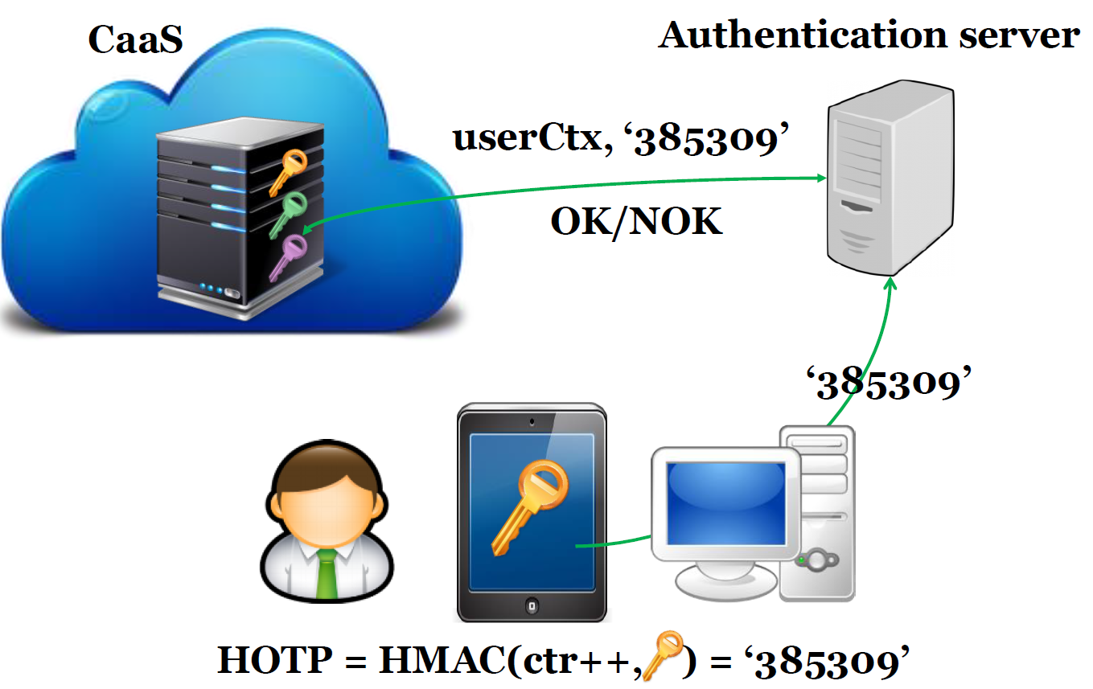
Problems:
1. Is OTP code fresh?
2. Is OTP generated for correct domain (not phishing)?

Slide 51
Possible password replacements
Cambridge’s TR – wide range of possibilities listed
  The quest to replace passwords: a framework for comparative evaluation of Web authentication schemes
  https://www.cl.cam.ac.uk/techreports/UCAM-CL-TR-817.pdf
Many different possibilities, but passwords are cheap to start with, a lot of legacy code exists and no mechanism offers all benefits
Mandatory reading: UCAM-CL-817
  At least chapters: II. Benefits, V. Discussion
  Whole report is highly recommended

Slide 52
Idea: Replace password by smartcard with asymmetric keypair, challenge-response protocol and prevent phishing

Slide 53
FIDO U2F protocol

Slide 54
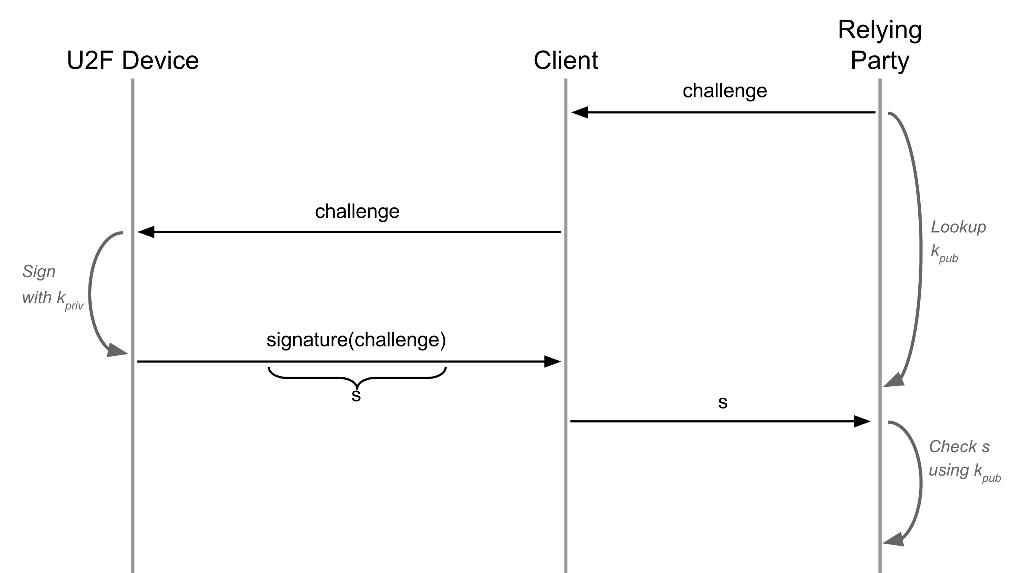
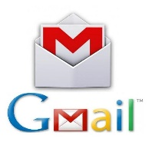


Revision 1: ECC-based challenge-response
Problems: phishing, MiTM…
https://developers.yubico.com/U2F/Protocol_details/Overview.html

Slide 55
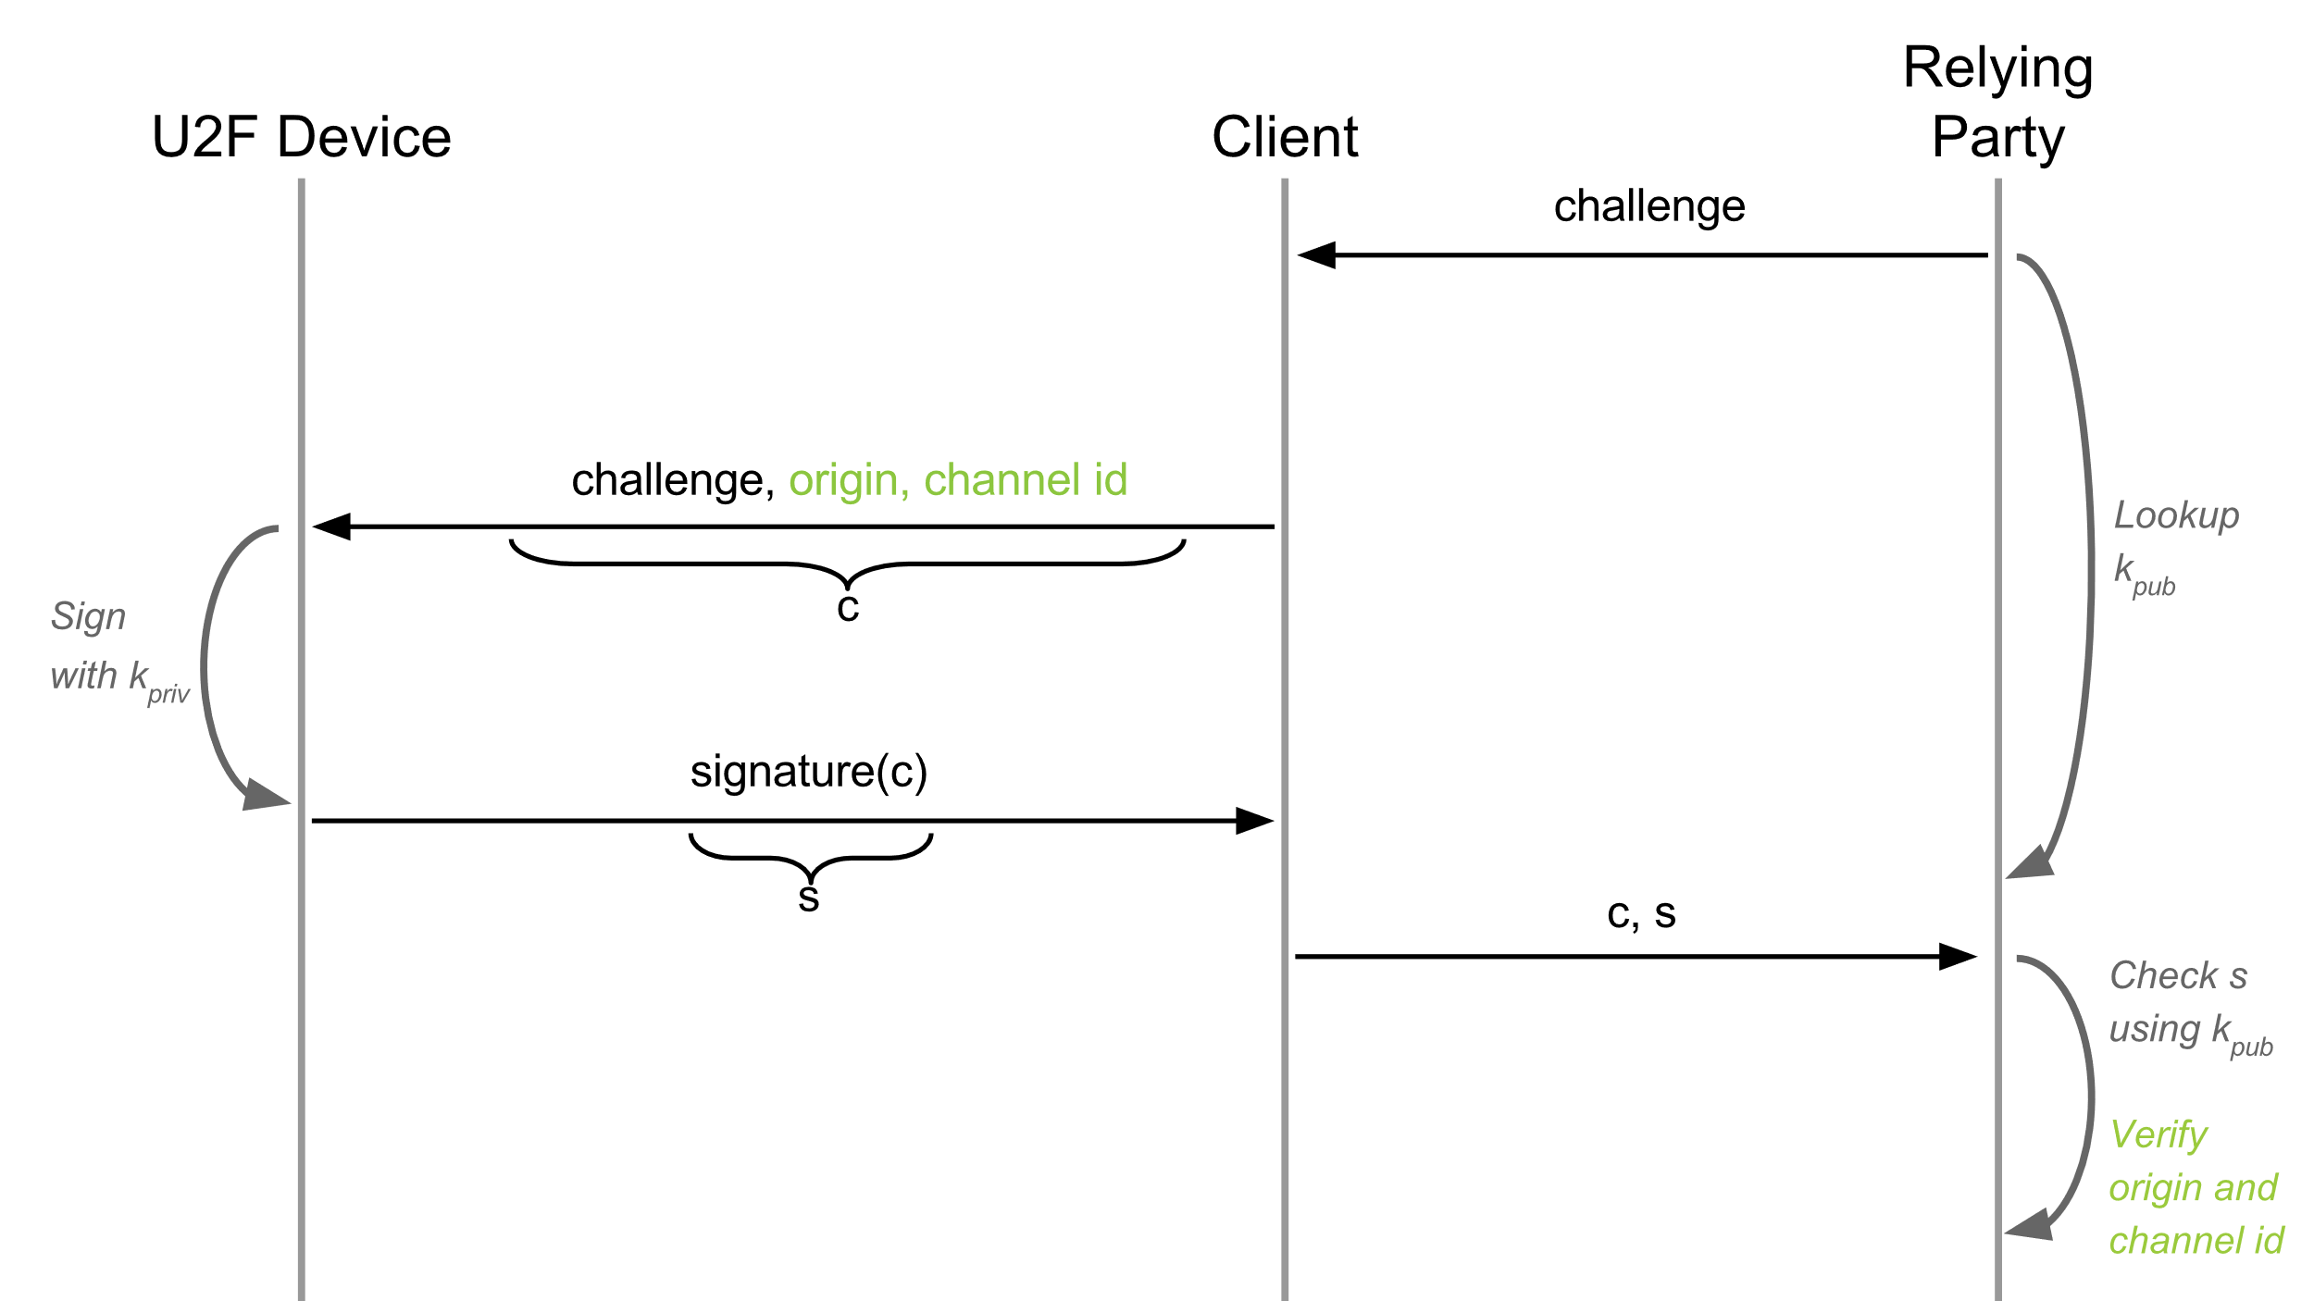
Revision 2: URI + TLS channel id added
https://accounts.google.com/ServiceLogin
Problem: using same device => detectable by services (same k_{pub})
https://developers.yubico.com/U2F/Protocol_details/Overview.html

Slide 56
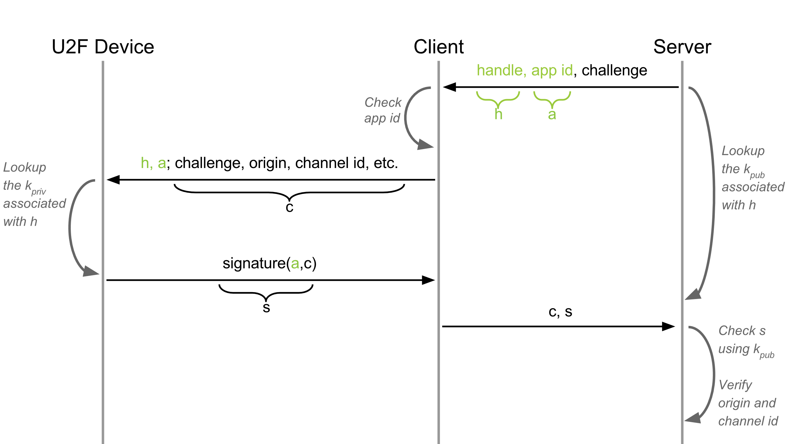
Revision 3: Application-specific key added
new key pair and key handle for each registration
Problem: Undetectable device cloning
https://developers.yubico.com/U2F/Protocol_details/Overview.html

Slide 57
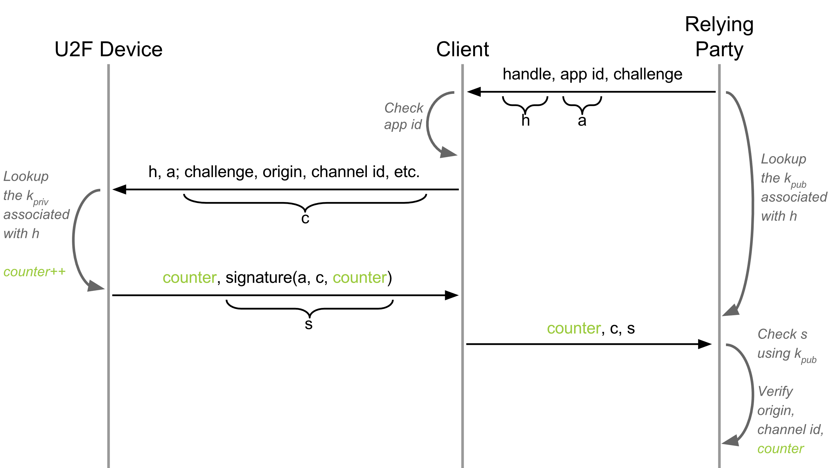
Revision 4: Authentication counter added
Incremental counter
Option: What if server wants to verify device properties before register?
https://developers.yubico.com/U2F/Protocol_details/Overview.html

Slide 58
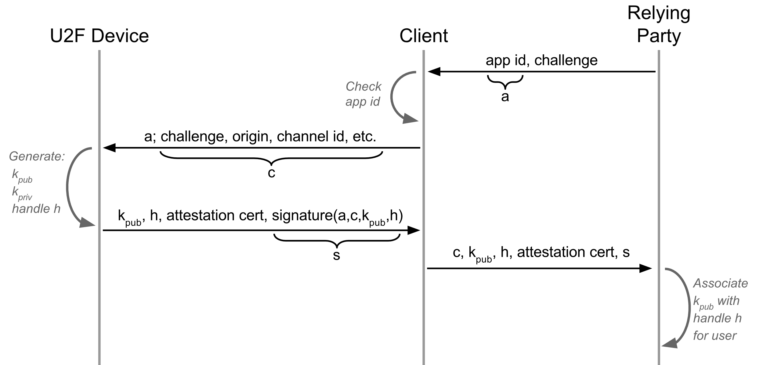
Revision 5: Device attestation added
Attestation certificate signed with TTP
ECDSA NIST secp256r1 used
https://developers.yubico.com/U2F/Protocol_details/Overview.html

Slide 59
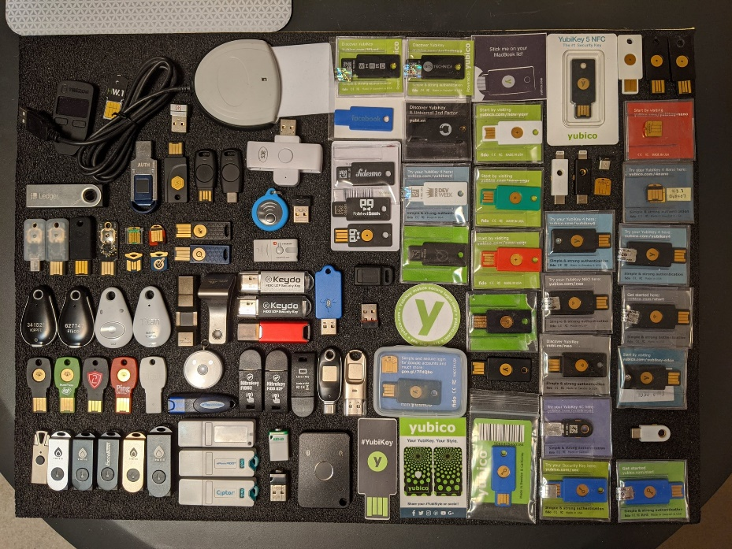
FIDO U2F – current state
FIDO alliance of major companies
U2F -> FIDO2 project (more than “just” U2F)
Original U2F protocol extended and moved under W3 as WebAuthn
  https://www.w3.org/TR/webauthn/
Large selection of tokens now available (including open-hardware)
Android announced systematic support for FIDO U2F (02/2019)
  Android phone acts as U2F token
  https://www.wired.com/story/android-passwordless-login-fido2

Slide 60
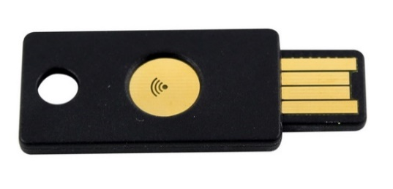
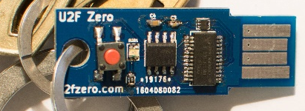
FIDO U2F devices
Why have button? Is missing display problem?
Recent problem: direct WebUSB API in Chrome
  Malware bypass U2F API checking the URL
  Legitimate URL is send from malicious page
  https://www.wired.com/story/chrome-yubikey-phishing-webusb/
  APDU-level communication: https://npmccallum.gitlab.io/post/u2f-protocol-overview/
Well known is Yubikey, but open-source hardware and software-only implementations also possible
  https://github.com/conorpp/u2f-zero

Slide 61
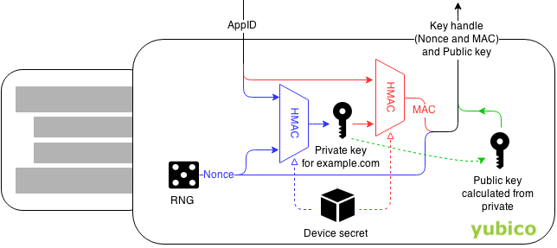

Always dig for implementation details
How are ECC keys generated and stored?
Yubikey saves storage memory by deriving ECC private keys from master secret instead of randomly generating new one
  Possible as the ECC private key is random value
Device secret generated during manufacturing
What is the possible attack
https://developers.yubico.com/U2F/Protocol_details/Key_generation.html

Slide 62
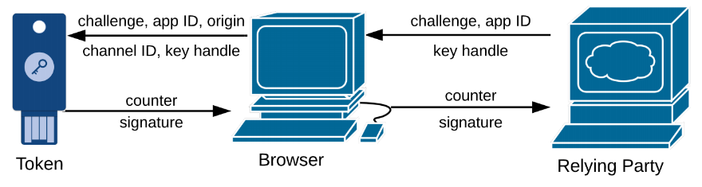
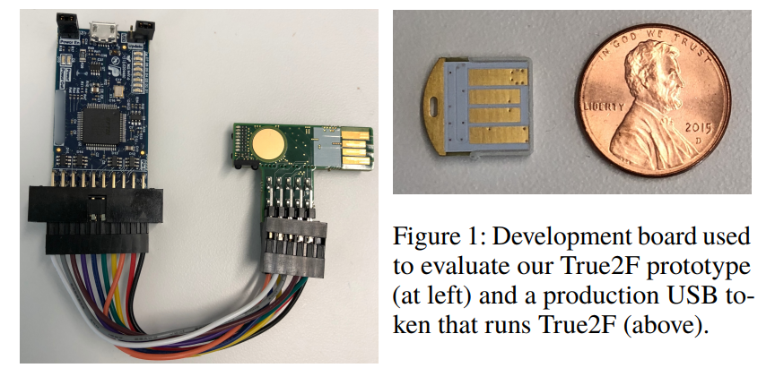
True2F FIDO U2F token
https://arxiv.org/pdf/1810.04660.pdf
Yubikey 4 has single master key
  To efficiently derive keypairs for separate Relying parties (Google, GitHub…)
  Inserted during manufacturing phase (what if compromised?)
Additional SMPC protocols (protection against backdoored token)
  Secure Multi-Party Computation (SMPC) will be covered later
  Verifiable insertion of browser randomness into final keypairs
  Prevention of private key leakage via ECDSA padding
Backward-compatible (Relying party, HW)
Efficient: 57ms vs. 23ms to authenticate

Slide 63
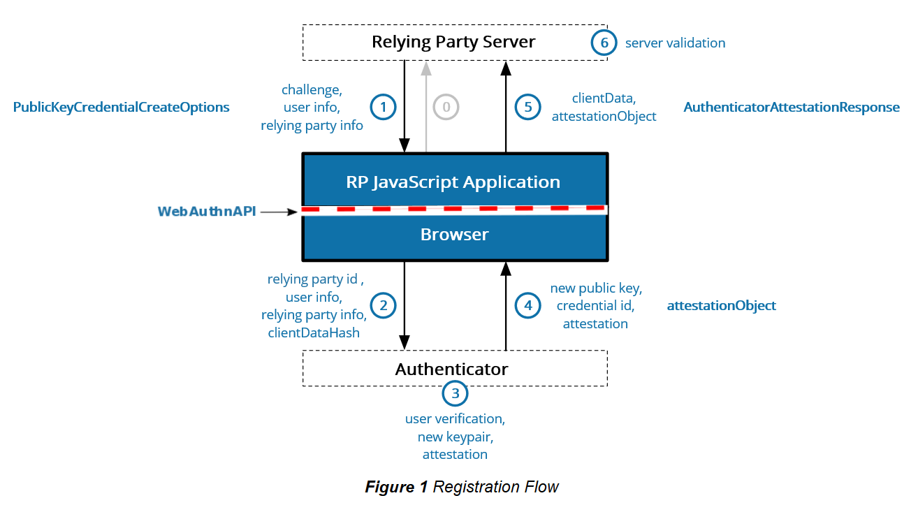
WebAuthn
An API for accessing Public Key Credentials Level 1
https://www.w3.org/TR/webauthn/
Similar, but more complex standard than U2F => expect additional problems (not yet scrutinized enough)

Slide 64
Activity:
Think about one or two surprising things from this lecture
I want to hear at least 5 of these, tell me please ☺

Slide 65
Summary
Passwords have multiple issues, but are hard to be replaced
Major server-side breaches now very common
Important to use passwords securely (guidelines)
One-time passwords and tokens getting more used
Password manager with synchronization over multiple devices is not straightforward, but doable (e.g., Apple’s iCloud Keychain)
Mandatory reading: UCAM-CL-817
  At least chapters: II. Benefits, V. Discussion
  Whole report is highly recommended

Slide 67
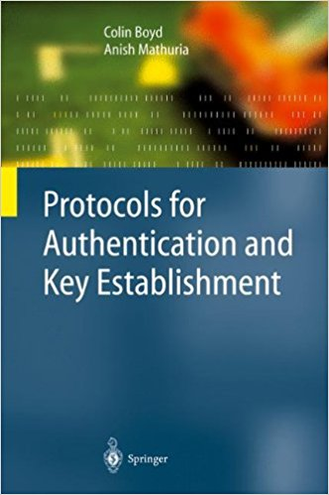
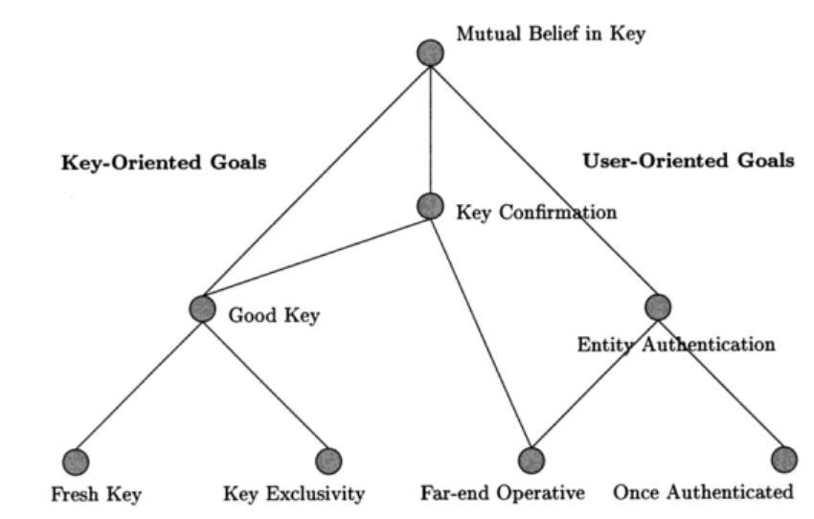
Hierarchy of authentication and key establishment goals
Protocols for Authentication and Key Establishment By Colin Boyd, Anish Mathuria

Slide 68
Common (mis-)Assumptions
User has strong password
Server/service is hard to compromise
User have unique passwords
Different authentication channels are independent
Recovery

Slide 69
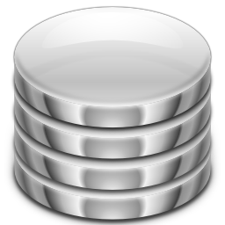

Human is still the weakest link
Google:
Sfdlk2c&432mo%
Skype:
*(&21mefd872!&
Google:
Sfdlk2c&432mo%
Skype:
*(&21mefd872!&
More than 60% of users have weak passwords
password123

Slide 70
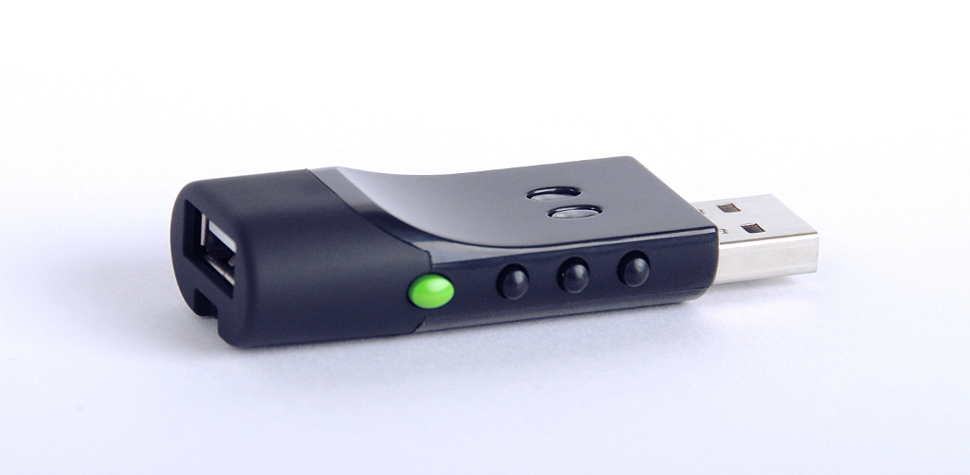
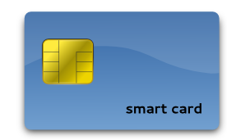
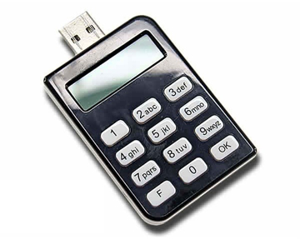
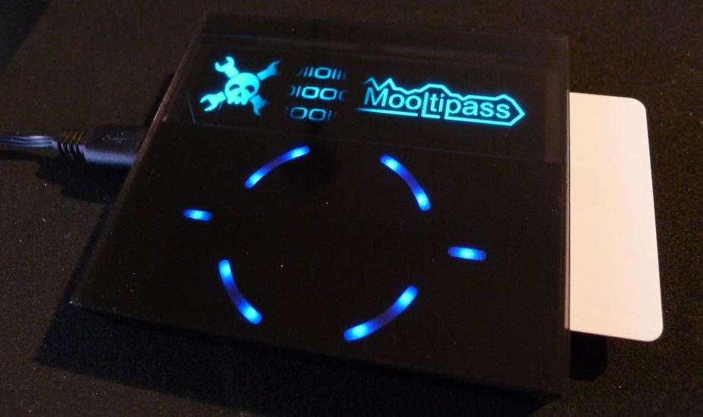
Hardware tokens
SmartArchitects’s Password sCrib
Evergreen password lock
Price, usability, compatibility…
Hack-a-Day’s Mooltipass

Slide 71
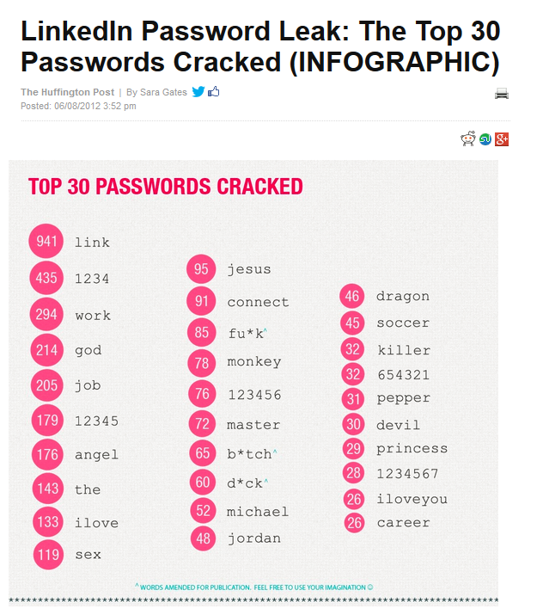
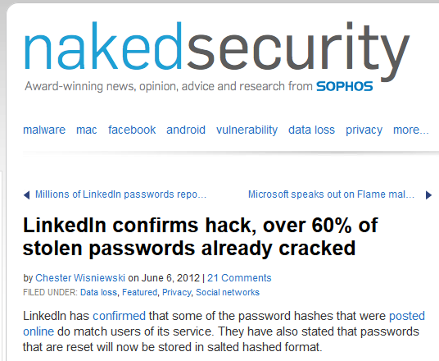
User has strong password

Slide 72
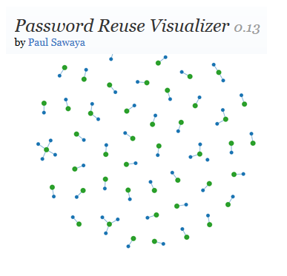
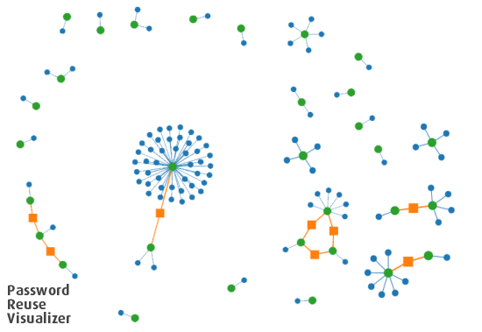
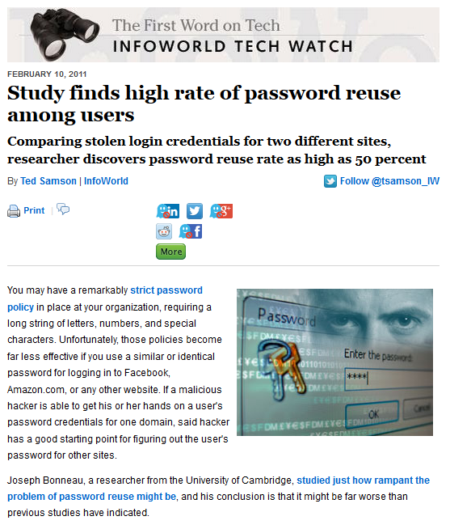
User have unique passwords…
Study: Gawker vs. root.com passwords leak
“…[from successfully cracked passwords] 76% used the exact same password. A further 6% used passwords differing by only capitalisation or a small suffix (e.g. ‘password’ and ‘password1′).”, J. Bonneau
http://www.lightbluetouchpaper.org/2011/02/09/measuring-password-re-use-empirically/

Slide 73
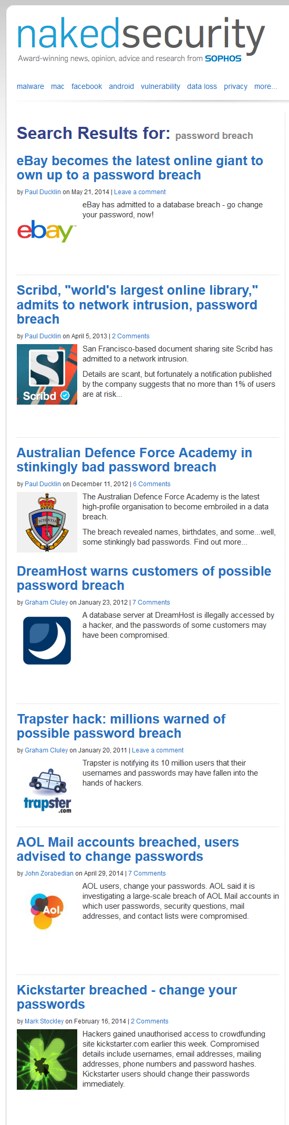
Service is hard to compromise?

Slide 74



Services follow the best security principles
Service implementation is correct and bug-free

Slide 75






Different authentication channels are independent

Slide 76




Security can be maintained “forever”
Allow for some form of risk management

Slide 77


Access recovery is as secure as primary one
Recovery info shared over multiple services…

Slide 78
Password cracking defenses
Don’t transmit or store in plaintext
Process password on client, transmit only digest
Don’t encrypt, hash instead
Use salt to prevent rainbow tables attack
Use memory-hard KDF algorithms
  To slow down custom build hardware
  Use strong KDF to derive keys (PBKDF2→Argon2)
Use password-authenticated key exchange instead of password check

Slide 79
Handling passwords in source code
Limiting memory exposure
  Load only when needed
  Erase right after use
  Pass by reference / pointer to prevent copy in memory
  Derive session keys
Don’t hardcode password into application binary
Nice presentation (K. Kohli, examples how NOT to): http://www.slideshare.net/amiable_indian/insecure-implementation-of-security-best-practices-of-hashing-captchas-and-caching-presentation

Slide 80

Hard-coded password might be visible both in application binary and memory

Slide 81
Alternative to hardcoded passwords/keys
Don’t use passwords ☺
Ask the user for a password
Keep secrets in a separate file
Encrypt stored secrets
Store secrets in protected database
Use already existing authentication credentials
CERN guidelines
  https://security.web.cern.ch/security/recommendations/en/password_alternatives.shtml

