Slide 1
PV204 Security technologies
File and disk encryption
Milan Brož xbroz@fi.muni.cz
Petr Švenda svenda@fi.muni.cz
Faculty of Informatics, Masaryk University
Notes:
1

Slide 2
Data storage encryption
Lecture
  File and disk encryption
  Distributed storage encryption
  Abstraction layers, hardware acceleration
  Cryptography basic principles
    Confidentiality and integrity protection
    Encryption modes
    Key management
  Tool examples
  Attacks and common issues
Lab – disk encryption attack examples
2
| PV204 File and disk encryption

Slide 3
File and disk encryption
motivation &
Storage layers overview
3
| PV204 File and disk encryption
Notes:
3

Slide 4
Motivation
Offline, "Data at Rest" protection
notebook, external drives, data in cloud, backups
Key removal = easy data disposal
Confidentiality protection
company policy to encrypt all mobile devices
prevents data leaks (stolen device)
Data integrity protection (not often yet)
4
| PV204 File and disk encryption

Slide 5
Overview
(Distributed) Storage Stack
layers accessing storage through blocks (sectors)
near future: non-volatile byte-addressable memory
distributed => adding network layer
Full Disk Encryption (FDE)
  self-encrypted drives
  (software) sector-level encryption
Filesystem-level encryption
general-purpose filesystem with encryption
cryptographic file systems
5
| PV204 File and disk encryption

Slide 6
Storage stack & encryption layers
Userspace | Application | (Application specific)
OS kernel | Virtual file-system (directories, files, …) | File-system encryption
 | Specific file-system (NTFS, ext4, XFS, …)
 | Volume Management (partitions, on-demand allocation, snapshots, deduplication, …) | Disk encryption
 | Block layer (sectors I/O)
 | Storage transport (USB, SCSI, SAS, SATA, FC, …) | HW-based encryption self-encrypted drives, inline (slot) encryption, chipset-based encryption, hardware security module
 | Device drivers
“Hardware” | Hardware (I/O controllers, disks, …)
6
| PV204 File and disk encryption

Slide 7
Clustered and distributed storage
Clustered => cooperating nodes
  Distributed => storage + network
  Software Defined Storage/Network (SDS, SDN)
  - commodity hardware with abstracted storage/network logic
  - encryption is “just” one logic function
  - usually combination with classic storage (and encryption)
7
| PV204 File and disk encryption

Slide 8
Distributed storage & encryption
Shared volumes (redundancy)
=> disk encryption
Clustered file-system
=> file-system encryption
Distributed Object Store
  Direct object encryption or
  Underlying storage encryption
8
| PV204 File and disk encryption

Slide 9
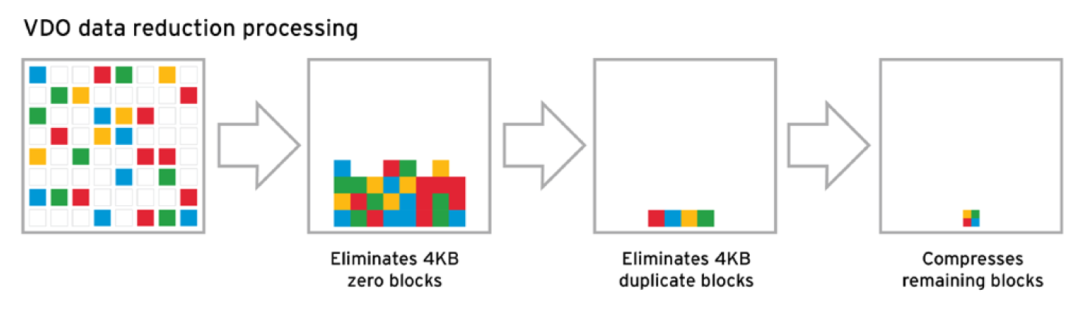
Cloud storage – common features
Deduplication – avoid to store repeated data
Compression – generic algorithms
- special case: zeroed blocks
Data snapshots (in time)
- COW (copy on write)
9
| PV204 File and disk encryption

Slide 10
Cloud storage & encryption
Encryption with storage backend and
compression & deduplication & snapshots …
Encryption on client side (end-to-end)
- efficiency for deduplication/compression is lost
~ in future homomorphic encryption?
Encryption on server side
- confidentiality for clients is partially lost
- server has access to plaintext
10
| PV204 File and disk encryption

Slide 11
Full Disk Encryption (FDE)
Block device – transparent disk sector level
  Disk, partition, VM disk image
  Ciphertext device / virtual plaintext device
  Atomic unit is sector (512 bytes, 4k, 64k)
  Consecutive sector numbers
  Sectors encrypted independently
One key decrypts the whole device
  Media (volume) key – one per device
  Unlocking passphrases/keys
  Usually no integrity support (only confidentiality)
11
| PV204 File and disk encryption

Slide 12
Filesystem-level Encryption
File/Directory
  Atomic unit is filesystem block
  Blocks are encrypted independently
  Generic filesystems with encryption
    Some metadata can be kept in plaintext
    (name, size, …)
  Cryptographic filesystems
    Metadata encrypted
    ~ stacked layer over generic filesystem
Multiple keys / multiple users
12
| PV204 File and disk encryption

Slide 13
File vs. disk encryption
Full disk encryption
+ for notebook, external drives (offline protection)
+ transparent for filesystem
+ no user decision later what to encrypt
+ hibernation partition and swap encryption
- more users – whole disk accessible
- key disclosure – complete data leak
- usually no integrity protection
13
| PV204 File and disk encryption

Slide 14
File vs. disk encryption
Filesystem based encryption
+ multiple users
+/- user can decide what to encrypt
+ copied files keeps encryption in-place
+ more effective (only really used blocks)
+ should provide integrity protection (not always!)
- more complicated sw, usually more bugs
- unusable for swap partitions
14
| PV204 File and disk encryption

Slide 15
File vs. disk encryption
Combination of disk & file encryption
Distributed storage
  Must use also network layer encryption
  Difference in network and storage encryption
  (replay attack resistance, integrity protection, …)
15
| PV204 File and disk encryption

Slide 16
File and disk encryption
CryptogRaphy
16
| PV204 File and disk encryption
Notes:
16

Slide 17
Cryptography algorithms primitives
Symmetric encryption
  block ciphers
  cipher block mode
  hash algorithms
Key management
  Random Number Generators (RNG)
  Key Derivation Functions (KDF)
  Asymmetric cryptography
Deniable encryption / Steganography
17
| PV204 File and disk encryption

Slide 18
Data confidentiality & integrity
Confidentiality
Data are available only to authorized users.
Integrity
Data are consistent.
Data has not been modified by unauthorized user.
=> All modifications must be detected.
Note: replay attack (revert to old snapshot) detection
cannot be provided without separate trusted store
(TEC – Tamper Evident Counter, Merkle tree root hash, …)
18
| PV204 File and disk encryption

Slide 19
Data integrity / authenticated encryption
Poor man's authentication (= no authentication)
  User is able to detect unexpected change
  Very limited, cannot prevent old content replacement
Integrity – additional overhead
  Where to store integrity data?
  Encryption + separate integrity data
  Authenticated modes (combines both)
19
| PV204 File and disk encryption

Slide 20
File and disk encryption
DATA ENCRYPTION modes
20
| PV204 File and disk encryption
Notes:
20

Slide 21
Symmetric encryption (examples)
AES, Cammelia, Adiantum,
Serpent, Twofish, (Specks, Kuznyechik, …)
Encryption-only modes
  Storage encryption mostly CBC, XTS
  Length-preserving encryption, block tweak
Authenticated modes (encryption + integrity)
  Integrity protection often on higher layer.
Storage standards like IEEE 1619 and FIPS/NIST
21
| PV204 File and disk encryption

Slide 22
Propagation of plaintext changes
A change in the plaintext sector should transform to randomly-looking change in the whole ciphertext sector.
Solutions:
  Ignore it ☺ and decrease granularity of change
    => change location inside ciphertext sector
  Use wide mode (encryption block size = sector size)
    requires at least 2x encryption loop
    modes are patent encumbered
  Additional operations
    Elephant diffuser in Windows Bitlocker
    Google Adiantum (cipher composition)
22
| PV204 File and disk encryption

Slide 23


Encryption example – AES-XTS
plaintext
ciphertext
23
| PV204 File and disk encryption

Slide 24


Wrongly used modes – ciphertext patterns
ECB mode
AES-XTS & constant IV
24
| PV204 File and disk encryption

Slide 25
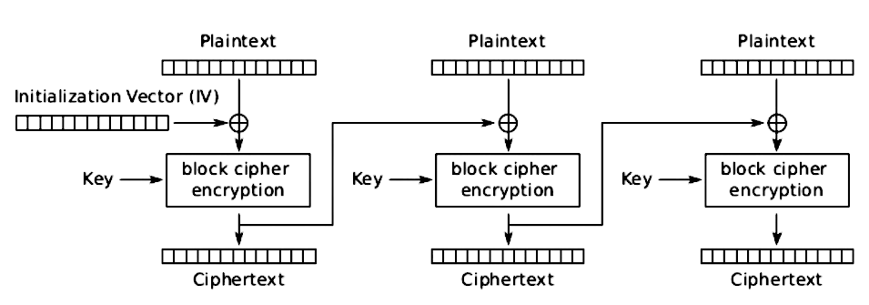
Cipher-Block-Chaining (CBC) mode
Blocks cannot be encrypted in parallel
Blocks can be decrypted in parallel
Tweak must be non-predictable (watermarking!)
plaintext disk / file-system block …
AES block
block tweak
ciphertext disk / file-system block …
25
| PV204 File and disk encryption

Slide 26
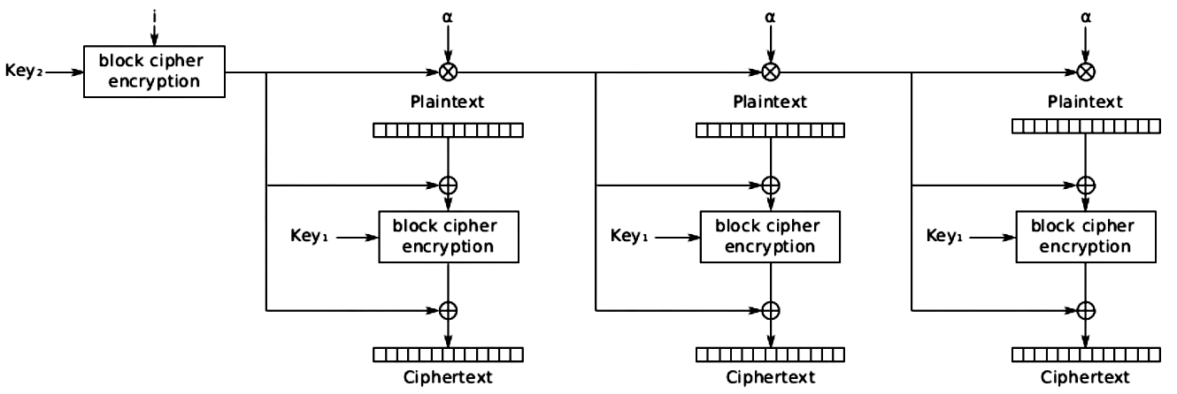
XOR-Encrypt-XOR (XEX/XTS) mode
Encryption/decryption can be run in parallel
Tweak can be predictable nonce – sector number (offset)
block tweak
ciphertext disk / file-system block …
26
| PV204 File and disk encryption

Slide 27
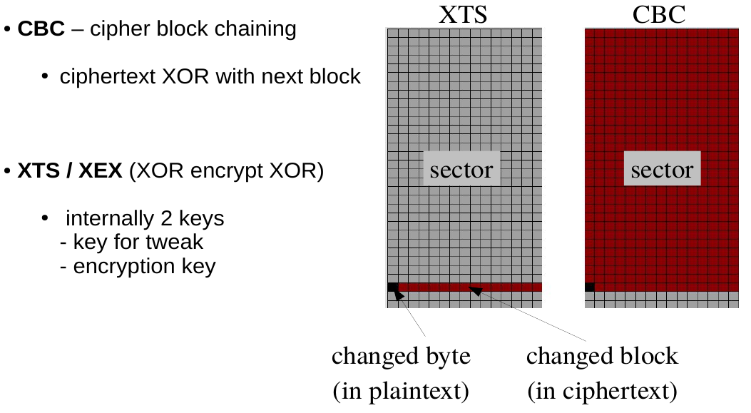
CBC and XTS change propagation
xxx
27
| PV204 File and disk encryption

Slide 28


AES-XTS IV mode – sector# vs random
Every 64 byte changed (ciphertext differences)
IV is sector number
randomized IV
28
| PV204 File and disk encryption

Slide 29
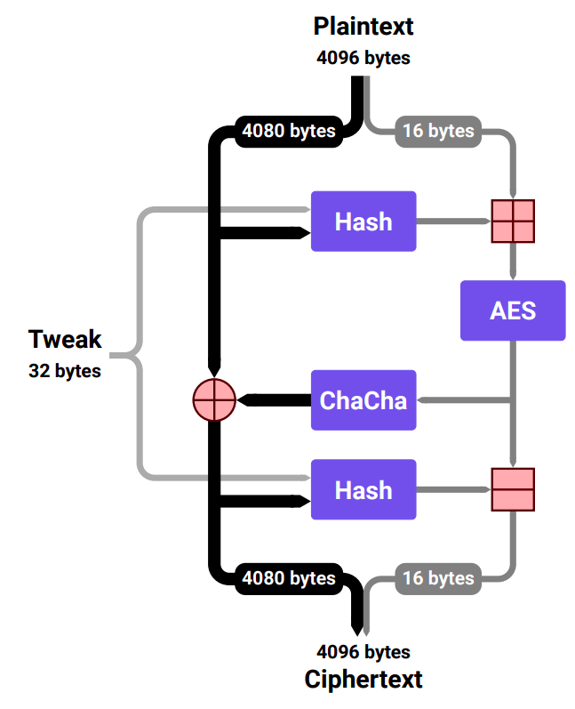
Adiantum
Low-end mobile
device disk / file encryption
Wide “mode”
HBSB composition:
  Hash – NHPoly1305)
  Block Cipher – AES
  Stream Cipher – XChaCha12,20
  Hash – NHPoly1305
Key derivation
  K_{AES}|| K_{NHPoly} = XChaCha(K,1|0..0)
K_{NHPoly}
Block #
K_{AES}
K
disk / fs block
https://eprint.iacr.org/2018/720
https://security.googleblog.com/2019/02/introducing-adiantum-encryption-for.html
29
| PV204 File and disk encryption

Slide 30
Steganography / deniable encryption
Plausible deniability:
existence of encrypted file/disk is deniable
if adversary cannot prove that it exists
Steganography
hiding data in another data object
Steganographic file-systems
Deniable disk encryption
30
| PV204 File and disk encryption

Slide 31
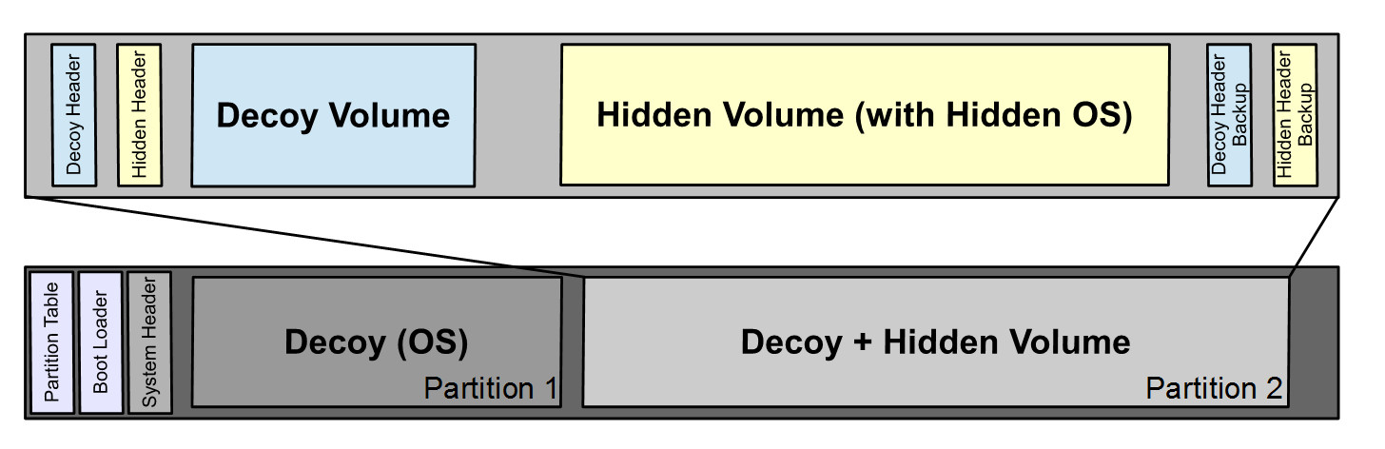
Trivial example: VeraCrypt hidden disk
FAT linear allocation
Hide another disk in unallocated space
31
| PV204 File and disk encryption

Slide 32
Deniable encryption problems
Side-channels
tracking activity that cannot be explained for decoy system
  Software: link to recently open documents, …
  Suspicious parameters (FAT), disabled TRIM, …
  Hardware: internal SSD block allocations
  (access to “unused” areas)
Social engineering / “rubber hose” analysis
Incompatibility with new drives (TRIM)
32
| PV204 File and disk encryption

Slide 33
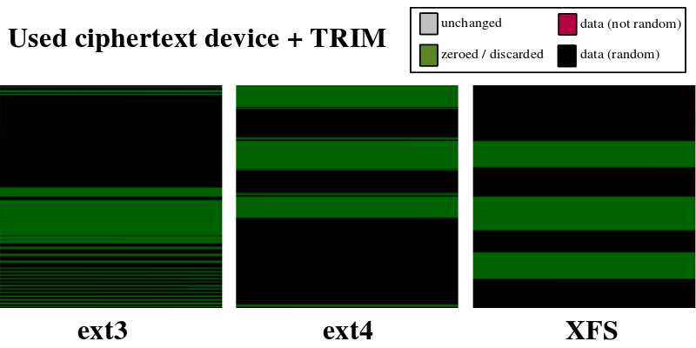
TRIM / discard and encryption
TRIM informs SSD drive about unused space
Unused space is detectable
Pattern recognition example
Incompatible with deniable encryption
33
| PV204 File and disk encryption

Slide 34
File and disk encryption
Key Management
34
| PV204 File and disk encryption
Notes:
34

Slide 35
Key generation
Encryption key (~ Media Encryption Key – MEK)
  Used to encrypt device
    change means complete reencryption
  Usually generated by a secure RNG
Unlocking key (~ Key Encryption Key – KEK)
  Independent key change (MEK remains the same)
  Can be derived from passphrase
    PBKDF2 (Password Based Key Derivation)
    scrypt, Argon2 (memory-hard KDFs)
  Can use key wrapping
35
| PV204 File and disk encryption

Slide 36
Key storage
Outside of encrypted device / filesystem
  Another device, file, token, SmartCard, TPM, HSM
  On a key server (network)
  Protected by another key (KEK).
On the same disk (with encrypted data)
  Metadata on-disk – key slots
  Brute force and dictionary attack resistance
Integration with key management tools
  LDAP, Active Directory, ...
Combination of above
36
| PV204 File and disk encryption

Slide 37
Key removal and recovery
Key removal (wipe of key) = data disposal
  intended (secure disk disposal)
  unintended (error) => complete lost of data
Key recovery
  Trade-off between security and user-friendly approach
  Metadata backups
  Multiple metadata copies
  Key Escrow (key backup to different system)
  Recovery key to regenerate encryption key
37
| PV204 File and disk encryption

Slide 38
File and disk encryption
Common tools
38
| PV204 File and disk encryption
Notes:
38

Slide 39
Examples of HW-based encryption
Self-encrypting drives (SED), OPAL standard
  Encryption on the same chip providing media access
Inline encryption
  HW Encryption, slots for keys (through OS context)
Chipset-based encryption
  Encryption on controller chip (e.g. USB bridge)
Hardware acceleration
  AES-NI, accelerators, ASICs, GPUs, …
Secure hardware / tokens
  HSM, TPM, SmartCards, ...
39
| PV204 File and disk encryption

Slide 40
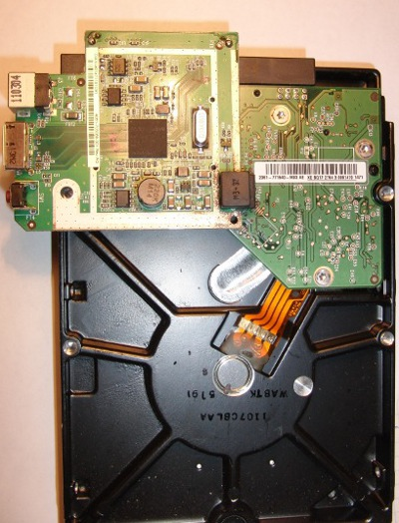
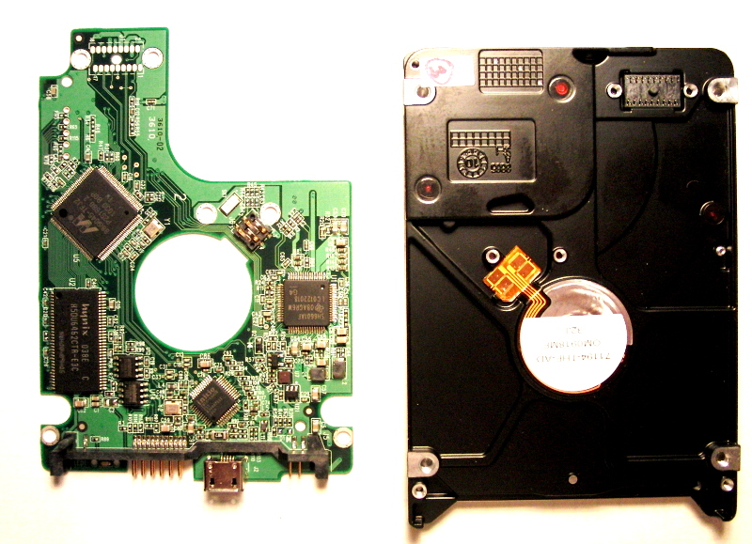
Examples of HW-based encryption
SATA disk
Encryption on USB-bridge
40
| PV204 File and disk encryption

Slide 41
Examples of tools – filesystem encryption
Windows EFS
Linux
    eCryptfs – stacked encrypted file-system
    fscrypt API – support in ext4, F2FS, UBIFS
ZFS (Solaris and ports)
    supports GCM/CCM authenticated modes
41
| PV204 File and disk encryption

Slide 42
Examples of tools – full disk encryption
  Windows Bitlocker
    Optionally eDrive – self-encrypting drives
    Combination with secure boot and TPM
  VeraCrypt
  Linux LUKS / dm-crypt
  MacOS FileVault
42
| PV204 File and disk encryption

Slide 43
File and disk encryption
Attack EXAMPLES
43
| PV204 File and disk encryption
Notes:
43

Slide 44
Attacks always get better, they never get worse.
Against algorithm design
  Wrongly used encryption mode
  Insufficient initialization vector
To implementation
  Insufficient entropy (broken RNG)
  Weak derivation from weak passwords
  Side channels
Obtaining key or passphrase in open form
  Cold Boot
  “Black bag analysis” - Malware, key-logger
  Social engineering
  “Rubber-hose cryptoanalysis”
44
| PV204 File and disk encryption

Slide 45
Integrity attacks
No integrity protection
  Inserted random block
  => undetected data corruption
  Inserted block from other part of disk
  Random error (RAM bit flip)
  => “silent data corruption”
Weak integrity protection
  Inserted previous content of (ciphertext) block
  => replay attack
45
| PV204 File and disk encryption

Slide 46
Example: Disk encryption
Some chipsets use ECB mode
Weak key derivation (brute-force possible)
Trivial unlocking mode (1-bit password is ok/bad)
Weak key-escrow (backup key in EEPROM, …)
SED – switch power attacks
SED – ransomware and unconfigured passphrase
Cold boot – key in memory
Key loggers
Weak RNG (key is not random)
…
46
| PV204 File and disk encryption

Slide 47

Lab
47
| PV204 File and disk encryption

Slide 48
Laboratory – FDE attack examples
Basic understanding of some tools and hw
VeraCrypt, LUKS, chip-based encryption
Scanning memory image for encryption key
ColdBoot attack principle
Optional: flawed algorithm and watermarking Revealing TrueCrypt hidden disk existence (CBC)
HW key-logger attack
48
| PV204 File and disk encryption

