Slide 1
Management by Competencies
Strategic continuum

Slide 2
Previously on MbC
Leaders
Managers
Workers

Slide 3
The Elements of Strategic Frame
Strategic frame
Business hypothesis
Mission
Strategy
Vision
Values and Rules
(C) J. Plamínek

Slide 4
Business Hypothesis
Strategic frame
Business hypothesis
Vision
Mission
Values and Rules
Strategy
Gains trust of investors, owners, managers, workers
Identifies business opportunities in surrounding environment
Clarifies why intended business will generate sufficient income to sustain itself in the future
Includes trend estimations of target customers behavior and other subjects considering development in environment
Delimits a space where the company will operate and describes the position which company want to fill
business, market, political, technological, economical, ecological and social

Slide 5
Mission
Strategic frame
Business hypothesis
Mission
Values and Rules
Vision
Strategy
Indicates the benefits for customers, suppliers, employees
Offers products and services to satisfy needs of the subjects
Appeals to wider customer groups
Attracts attention rather than explain usefulness exactly

Slide 6
Vision
Strategic frame
Business hypothesis
Mission
Values and Rules
Vision
Strategy
Answers the question: What the business and company will look like in a distant future?
Reflects feelings and ideas of leaders
(emotional perspective)
Includes measurable parameters and its values indicating achievement of vision
(rational perspective)

Slide 7
Values and Rules
Strategic frame
Business hypothesis
Mission
Values and Rules
Vision
Strategy
Focus on potential ways leading to achievement of goals outlined in vision
Emotionally, it is a set of shared and felt values which company ought to obey when realizing the vision
examples: Give-Take Matrix compliance, exploit any flaw in law at all costs
Shared values are rationalized into the set of clear rules which observance is measurable
example: every contract must be revised by XY from the perspective of Give-Take Matrix compliance

Slide 8
Strategy
Strategic frame
Business hypothesis
Mission
Values and Rules
Vision
Strategy
Defines specific business activities which enable to sustain success of company both in the presence and in the future
markets to operate on, customers and clients to serve, competitive advantage to gain
The parts of the strategy focused on the presence and on the future have to be clearly distinguished
to avoid confusion of managers
to prepare step changes to surprise both clients and competitors

Slide 9
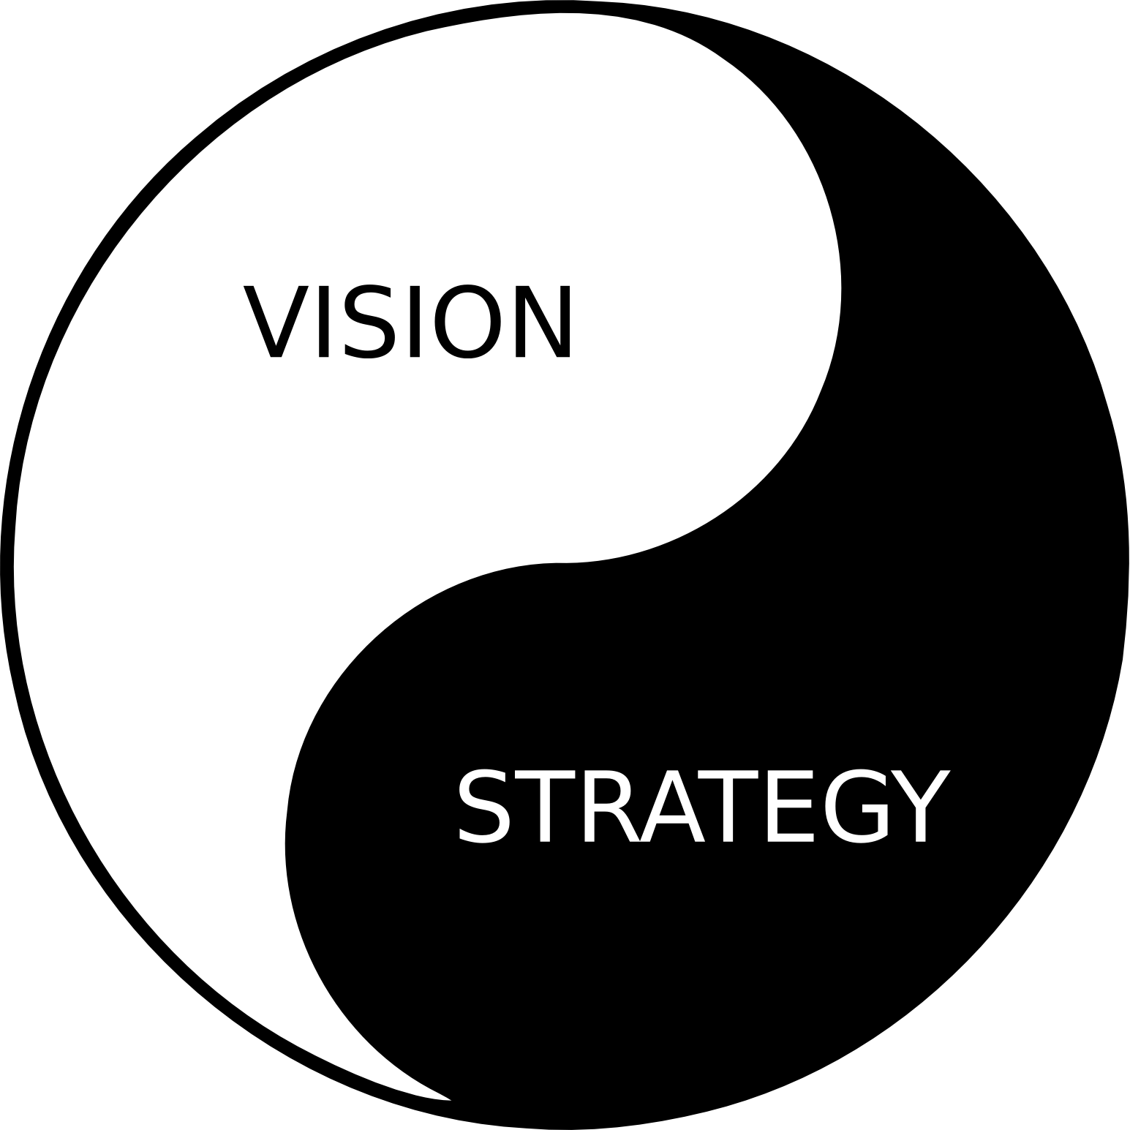
Vision and Strategy
Strategic frame
Business hypothesis
Mission
Values and Rules
Vision
Strategy
A vision without a plan
is just a dream.
A plan without a vision
is just a drudgery.
But a vision with a plan can change the world.

Slide 10
Strategic continuum
Strategic frame
Business hypothesis
Mission
Values and Rules
Vision
Strategy
 | Operational Strategic Interval | First DSI* | Second DSI* | Third DSI*
Leaders (define strategy) | defined | defined | defining | training resources
Managers (design processes) | defined | defining | training resources | -
Workers (performance) | realizing | training resources | - | -
* DSI – Developing Strategic Interval
here and now
(C) J. Plamínek

Slide 11
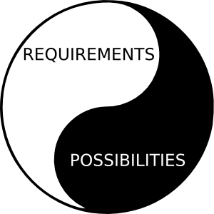
Operational Strategic
Interval (OSI)
Strategic frame
Business hypothesis
Mission
Values and Rules
Vision
Strategy
 | OSI | FDSI | SDSI | TDSI
Leaders | defined | defined | defined | resources
Managers | defined | defined | resources | -
Workers | realized | resources | - | -
Company
benefits from current competitive advantage
delivers products or services through defined processes with all necessary resources
Workers
directly realize current strategy
Managers
“only” monitor and tune the performance
generates profit for owners and further development
Leaders
practically do not interfere
Notes:
Period when company benefits from current competitive advantage
To do so, it has defined products or services, processes and secured all necessary resources
Company generates profit for owners and to secure enough resources to ensure development in other strategic continuum intervals
Workers directly realize current strategy
Managers only monitor and tune the performance
Leaders do not interfere

Slide 12
First Developing
Strategic Interval (FDSI)
Strategic frame
Business hypothesis
Mission
Values and Rules
Vision
Strategy
 | OSI | FDSI | SDSI | TDSI
Leaders | defined | defined | defined | resources
Managers | defined | defined | resources | -
Workers | realized | resources | - | -
Company
Managers
Workers
prepare their resources to meet new requirements
Leaders
consult FDSI-strategy with managers
prepares itself to realize upcoming step change bringing new competitive advantage formulated by FDSI-strategy
(re)define (new) products and services, (re)design (new) processes and projects, procure necessary resources, key performance indicators, ...
(re)define (new) requirements
validates FDSI-strategy

Slide 13
Second Developing
Strategic Interval (SDSI)
Strategic frame
Business hypothesis
Mission
Values and Rules
Vision
Strategy
 | OSI | FDSI | SDSI | TDSI
Leaders | defined | defined | defined | resources
Managers | defined | defined | resources | -
Workers | realized | resources | - | -
Company
Leaders
Managers
may help with creating feasibility studies of SDIS-strategy being newly formulated
Workers
specialists may help with creating feasibility studies of SDIS-strategy being newly formulated
seek for and design new step change bringing new competitive advantage – a core of SDSI-strategy to be
revise strategic frame
use intuition, invention, creativity in the following contexts: needs of current and potential customers, trends in society, technology, politics, economy, ...
seek for new opportunities, business hypotheses and essential competitive advantages
prepare their resources to meet new requirements

Slide 14
Attention Distribution in Strategic Continuum
 | Operational Strategic Interval | First DSI* | Second DSI* | Third DSI*
Leaders (define strategy) | defined | defined | defining | training resources
Managers (design processes) | defined | defining | training resources | -
Workers (performance) | realizing | training resources | - | -
* DSI – Developing Strategic Interval
primary focus
secondary focus

Slide 15
Living Strategic Frame
Strategic Frame shows the future of the company
Strategic Frame is key instrument to keep all involved subject oriented and motivated
Strategic Frame has to be continuously updated to always show the future
Once it stops to show the future, all its orientation and motivation potential disappears

Slide 16


Strategic Frame from the management perspective
I
I
I
Strategic frame
Business hypothesis
Vision
Mission
Values and Rules
Strategy
I
I
I
I
I
I
I
I ... intention (goal, objective, milestone)
Lecture Introduction

Slide 17
Change achieving
DC
Plan
Do
Check
Act
SF
BH
M
VR
V
S
DC...Deming Cycle
How to track the change?
T
SQ
Change Vector
Change vector

Slide 18
Definition of Performance Indicators
T
SQ
To know WHAT to do is not enough
It is important to know WHETHER and HOW we are doing
Therefore MbC operates with system of indicators on every level of management
  in accordance with development of company and people, the target values for indicators are determined that enable continuous monitoring and management of improvement
Balanced Score Card utilization
Change vector

Slide 19
Balanced Score Card Motivation
Balanced Score Card (BSC)
  introduced in 1990’s by Robert Kaplan and David Norton
  reaction to popular cost-cutting projects
Cost-cutting Projects substantially improved cost-related financial indicators in fiscal year
  and consultancy companies made well getting good profit share
However, in next years cost-cut companies
  have seen a huge drop in their performance
  loose much of their ability to react to changes (stability)
  become less vital, i.e. able to continuously succeed
Therefore BSC
  introduced new kinds of indicators to existing ones to connect corporate strategy with all operational areas of within the enterprise
Balanced Scorecard
Notes:
finanční ukazatele jsou pro většinu lidí málo srozumitelné, neodráží výsledky v jednotlivých úlohách na dostatečné úrovni podrobnosti
Robert Kaplan a David Norton poukázali, že zásadní zlepšení finančních ukazatelů firmy může být předzvěstí problémů s konkurenceschopností a navrhli doplnění finančních ukazatelů o ukazatele nefinanční.
Aby celý systém fungoval musí ukazatele měřit něco, co má smysl vzhledem k cílům, jichž má firma dosáhnout. Tyto cíle musí být definovány, pak vývoj ukazatelů indikuje

Slide 20
Balanced Score Card Example Template
TOP management
financial indicators
revenues -> profit/loss <- costs
customer indicators
number of new customers
average size of order
new products ratio
number of loyal customers
...
internal processes indicators
average time to market
number of complaints – quality
product cost
service innovation pace
...
management of
primary process,
logistics,
development,
IT, ...
management of
sales
and marketing
learning and growth indicators
competencies/resources
abilities attitudes qualities
all managers
Balanced Scorecard
Notes:
arrows stands for causality relationships

Slide 21
Balance Score Card and MbC
Learning and grow indicator are of the big importance
focuses on competences that employees must have to successfully fulfill financial, customer, process or others
these indicators focus the happening in the world of possibilities whereas the others the world of requirements
TM
FI
S’n’M
CI
IPI
PMs
LGI
all M
Balanced Scorecard

Slide 22
Balance Score Card and MbC (cont’d)
BSC is tool primarily for managers
  but also communication mean with leaders, owners, shareholders
shareholders, owners, ...
BSC may be foundation of monitoring system
Goals
Ways
Results
Monitoring system
Correction system
S
E
U
D
Feedback
Balanced Scorecard

Slide 23
Summary
System of Corporate Ideas
Strategic Continuum
  OSI, FDSI, SDSI, TDSI
  to enable to seek for and define new step changes
  to prevent confusing the presence and the future strategies
Living strategic Frame
Change vector
Balanced Scorecard

