Slide 1




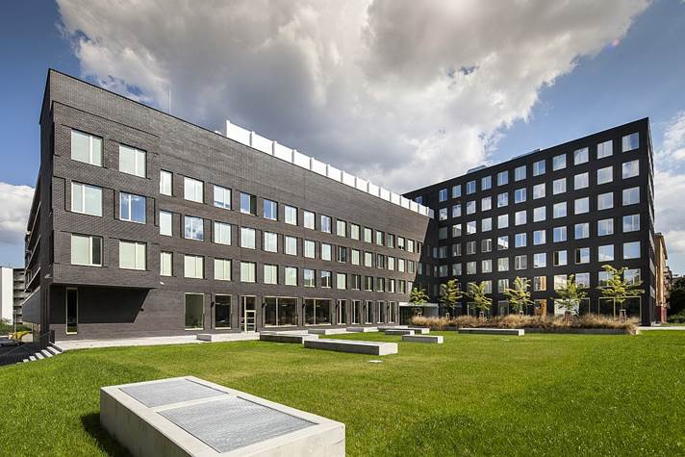
Marketing Strategy in Service Business
- margrimaldi@unisa.it -

Slide 2




Programme
Marketing and Service Marketing: origins, evolutions & trends
Service Theories: from S-D logic & Service Science to service ecosystems & service systems
Many-to-Many Marketing
Marketing Plan
Value co-creation
Unconventional marketing
Case studies
Examples
Exercises

Slide 3

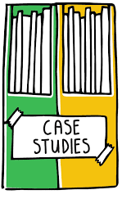
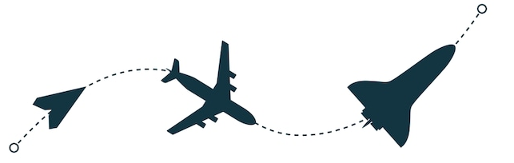
Agenda: Lesson 1
Marketing: origins, evolution and definitions
Service Marketing: the advent of service-dominant mind-set
New trends:
    Experiential marketing
    Relational marketing
Case studies and examples

Slide 4
1.1
Marketing: origins, evolution, definitions

Slide 5
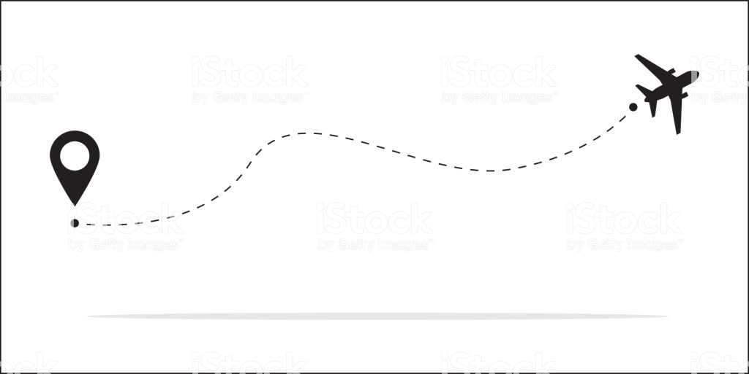

Definition of Marketing
AMA (1985):
“Marketing is the process of planning and executing the design of offering (product), pricing, promotion and distribution of goods, ideas and services designed to create exchanges that meet the individual and organizational objectives”
Over time,
Marketing has been conceptualized as a
(n)
Business function
Process
Orientation

Slide 6
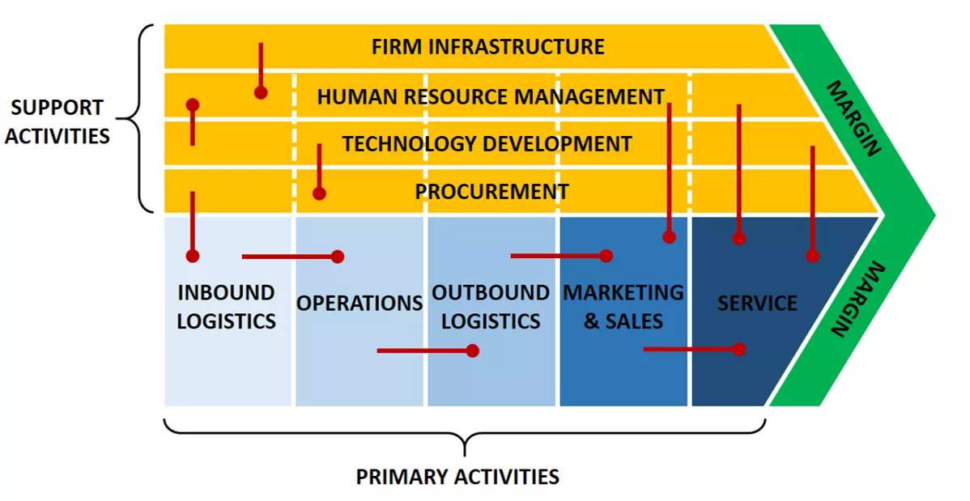
(1) Marketing: a business function?
Porter’s Value chain (1985)

Slide 7

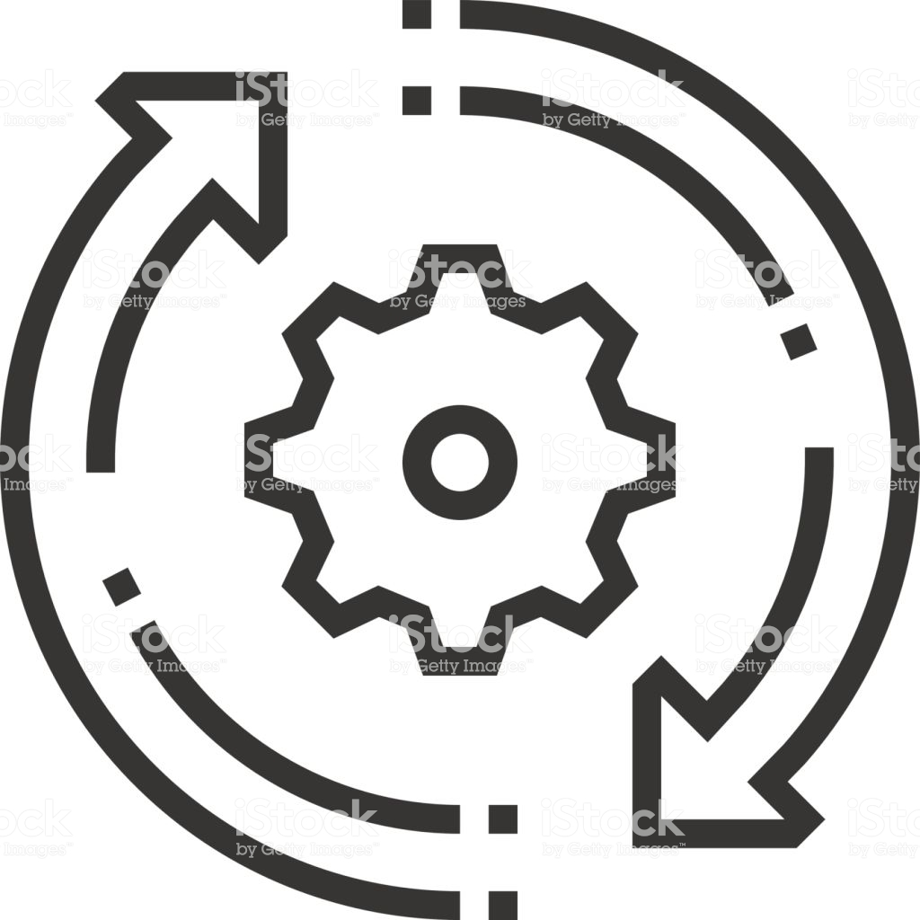
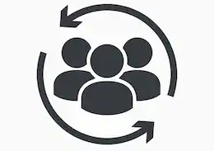
(2) Marketing as a process
SISTEMA INFORMATIVO DIREZIONALE ED OPERATIVO
Market
Analysis
Marketing is a process which consists
of different strategic and tactical choices:
Products Design
Study of the selected market(s)
Research on demand’s evolution and trends, analysis of competitors and identification of business opportunities
Adaptation of processes and production to potential customers
Creation of demand for new products
Selling
Allocation of products for different sales channels
Demand
Promotion
Notes:
Le decisioni strutturare sono decisioni che si presentano di continuo e diventano un fatto di routine, quelle destrutturare hannocarattere saltuario e si riferiscono a situazioni complesse, dove il decisore deve perseguire più obiettivi che potrebbero essere in conflitto tra di loro

Slide 8
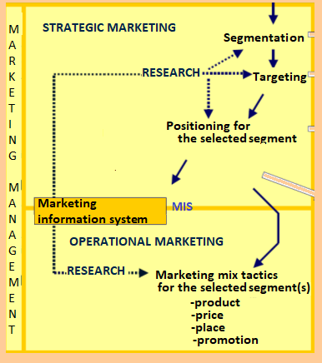
Marketing Management
What ?
Which value?
Value proposition
For Whom ?
Creating value
S
E
L
E
C
T
I
O
N
Consumers
gap
Segments
Selection of different «levels» of benefits
required by users
gap
s1
s2
s3
Target
gap
st
HOW?
gap
Can be value translated into
products for the selected targets?
gap
THROUGH?
Which kind of marketing mix
Value can be spread and take shape?

Slide 9
Purchasing Process
Purchasing Process
Purchasing Motivations
    Rational motivation (price-quality)
    Emotional motivation (feelings)
    Advocacy motivation (Loyalty)
Indirect competition (Needs)
Direct competition (Products & Brand)
Relationship between:
OFFERED BENEFITS/REQUIRED BENEFITS
PRODUCT PRICE/ CUSTOMERS SPENDING
Notes:
Le decisioni strutturare sono decisioni che si presentano di continuo e diventano un fatto di routine, quelle destrutturare hannocarattere saltuario e si riferiscono a situazioni complesse, dove il decisore deve perseguire più obiettivi che potrebbero essere in conflitto tra di loro

Slide 10


(3) Marketing as an Orientation
Focus
Product-Market
Production Orientation
Production Process
Process & product standardization
D>O
Goods
Selling
ENDOGENOUS
Product Orientation
Product features
To sell what can be produced
Selling orientation
Ways to attract consumers
Efficiency of production
O>D
Marketing Orientation
Users’ needs
Business’ survival
Research on consumers:
To product the goods wich can be sold
Needs
Products
EXOGENOUS
Notes:
Le decisioni strutturare sono decisioni che si presentano di continuo e diventano un fatto di routine, quelle destrutturare hannocarattere saltuario e si riferiscono a situazioni complesse, dove il decisore deve perseguire più obiettivi che potrebbero essere in conflitto tra di loro

Slide 11
(3) Marketing as an Orientation
Redefining the role of Marketing in Value chain

Slide 12
(3) Marketing as an Orientation
Product orientation
Production capacity
Production
Selling
CUSTOMERS
Marketing orientation
New needs of users
Study of demand
New business opportunities
Production PLANNING
Production
CUSTOMERS
Selling
Needs of POTENTIAL users
F e e d b a c k
Notes:
Le decisioni strutturare sono decisioni che si presentano di continuo e diventano un fatto di routine, quelle destrutturare hannocarattere saltuario e si riferiscono a situazioni complesse, dove il decisore deve perseguire più obiettivi che potrebbero essere in conflitto tra di loro

Slide 13
(3) Marketing as an Orientation
Complex selection and diffusion of values, personality, story and identity (brand)
Translation of value into a coherent culture to be spread within and oustide the organization
Value orientation
Corporate culture
STRATEGY
TACTICS
TACTICS
Governance
Organization
Stakeholder
Management

Slide 14
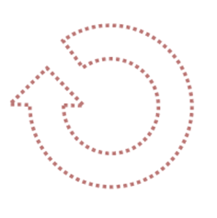
Value Proposition and Creation
Marketing orientation redefines the entire organization and permeates the strategic objectives and decision-making
Customers
Partners
Media
Selection of
resources
Suppliers
Distributors
STAKEHOLDERS’ SATISFACTION
Public Administration
Shareholder
Employees
VALUE
Creation
Competitive Advantage
Value is the complex set of economic, functional, psychological and social benefits that customers want to receive (or receive actually) in exchange for the money spent (or for the money they want to spend) to enjoy a good or service

Slide 15
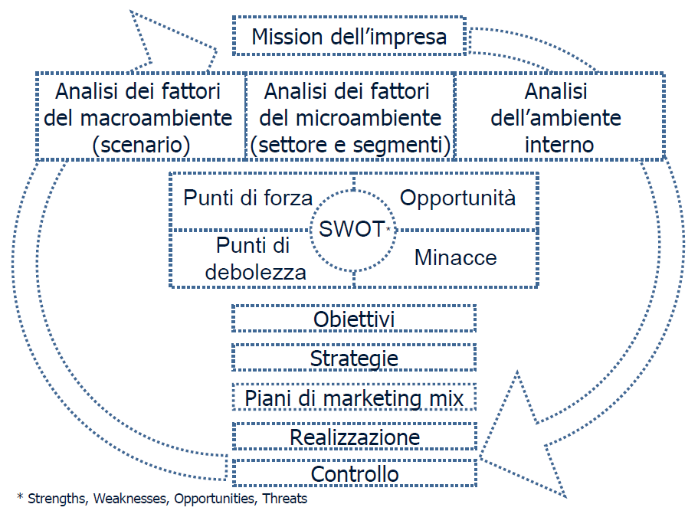
Marketing for Value Creation & Diffusion
VALUE
Mission
VALUE
Analysis of macro-environment (scenario)
Analysis of micro-environment (market/segment)
Analysis of internal environment
RESEARCH & ANALYSIS
VALUE
STRENGTH
Opportunities
VALUE
Weaknesses
THREATS
Strategic
marketing
Goals
MARKETING PLANNING
Strategy
Marketing mix
Operational
Execution
VALUE
Control

Slide 16
Different kinds of Marketing
To address needs
To come to light
To stand out
Status Symbol
UNDIFFERENTIATED MARKETING (MASS)
DIFFERENTIATED
OR SEGMENTATED
MARKETING
CONCENTRATED OR NICHE
MARKETING
MICRO-MARKETING OR ONE-TO-ONE MARKETING
concentrated
multiple
Confined market
Personalization
Undefined Marketing
Basic needs
of market
Differentiated needs
Small
Target
Broad
Target

Slide 17
Undifferentiated Marketing
Differentiated
Marketing
Concentrated
Marketing
Target: whole market
Offering: single
Marketing plan: standard
Communication: undifferentiated
Distribution channels: Mass
Target: one or more segments
Offering: differentiated for each target
Marketing plan: One for each target
Communication/ Distribution channels: differentiated for target
Target: a single segment or a sub-section
Offering: focused
Marketing plan: unique for the target selected
Communication/ Distribution channels: tailored for the target
Goal: to «nurture» a specific market
Goal: to attract the highest possible number of customers
Goal: to conquer big segments of market
Pros: costs reduction; better knoweldge of the segment; enhancement of the image.
Cons: dissolution of segment or modification of tastes
Pros: targeted marketing activities
Cons: high costs (multiple offering)
Pros: costs and price
Cons: high competition

Slide 18

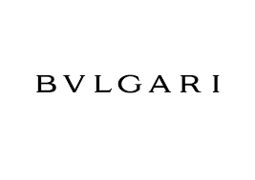
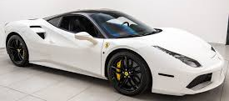
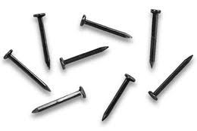

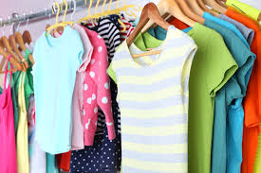
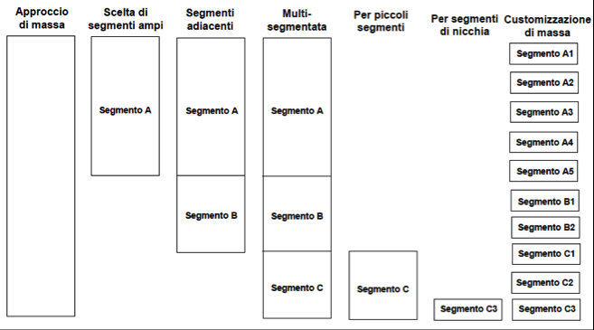
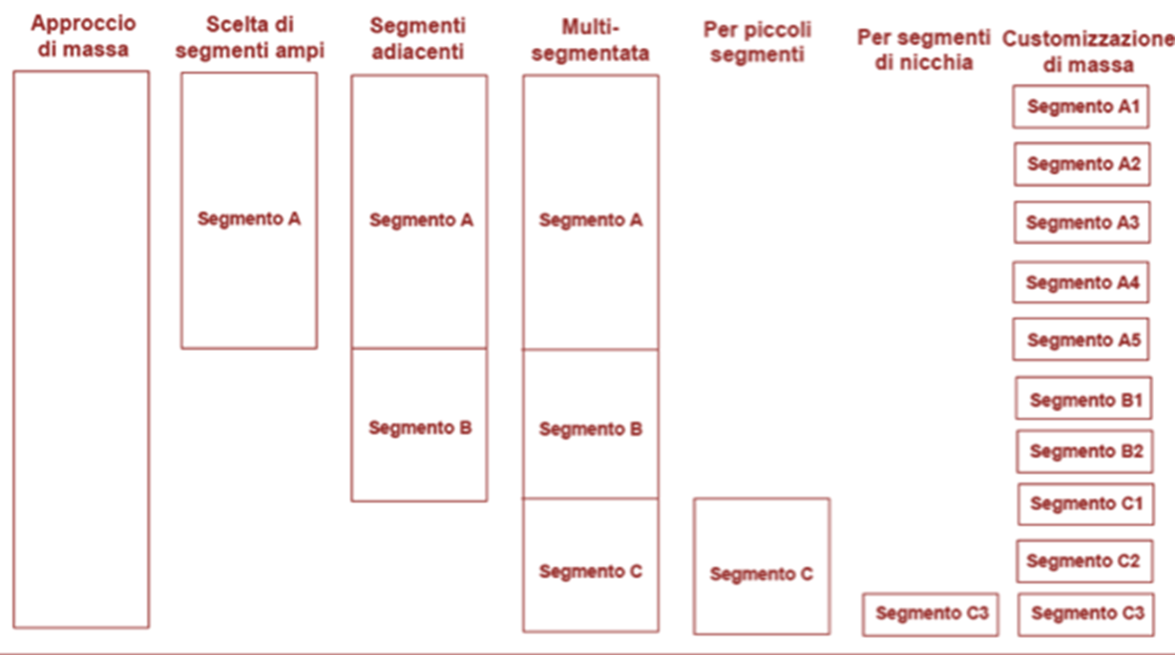
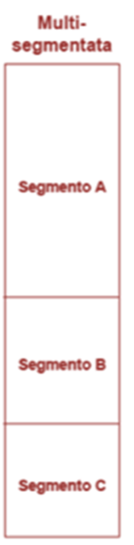
Different approaches for different orientations
PRODUCTION ORIENTATION
PRODUCT ORIENTATION
SELLING ORIENTATION
MARKETING ORIENTATION
Mass approach
broad segments
Adjacent segments
Multi- segmentation
For small segments
Mass customization
For niche segment
Segment A1
Segment A2
Segment A
Segment A
Segment A
Segment A3
Segment A4
Segment A5
Segment B1
Segment B
Segment B
Segment B2
Segment C1
Segment C
Segment C
Segment C2
Segment C3
Segment C3

Slide 19

Different kinds of marketing
Mass customers
Standard goods
Unidirectional communication
«Capture» of customers
Undifferentiated Marketing
Market
X
Unique segment
Differentiated Marketing
X
Different segments
X
X
X
Individual customer
Unique product and tailored production
One-to-one communication
Users’ loyalty
Niche
Xa
Single customer
Concentrated Marketing

Slide 20
Evolution of Marketing Focus
Managerial (Kotler, Keller and Brady 1967)
internal
Organizational (Grönroos, 1983)
Collaboration-oriented
(Hakansson and Snehota, 1989)
….and
Service-Dominant
(Vargo and Lusch)
Relational (Gummesson, 1997)
Value-based and co-creation-based
(Prahalad and Ramaswamy, 2004)
(Ballantyne and Varey, 2006)
external

Slide 21

New definitions of Marketing
AMA (1985):
“Marketing is the process of planning and executing the design of offering (product), pricing, promotion and distribution of goods, ideas and services designed to create exchanges that meet the individual and organizational objectives”
AMA (2004):
“Marketing is an organizational function and a set of processes aimed at creating, communicating, and delivering value to customers and managing relationships with customers in order to benefit from the organization and related stakeholders.”

Slide 22
Evolution of Marketing Mix
Over time, different models have been adopted by practitioners and scholars for the definition and study of the marketing mix:
McCarthy, 1964:
- Product, Price, Promotion, Place
Kotler, 1986:
- Product, Price, Promotion, Place, Public Relations, Politics
Booms and Bitner, 1981:
- Product, Price, Promotion, Place, People, Physical Evidence, Process
p
Lauterborn, 1990:
- Consumer, Cost, Communication, Convenience
Kotler, 2018:
- Customers, Company, Collaborators, Competitors, Context
c
https://www.youtube.com/watch?v=S_UWzR_dPeM

Slide 23
1.2
Service Marketing

Slide 24
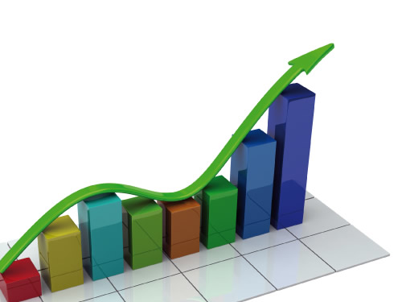


The advent of Service Era
Servicizing
(White et al., 1999)
Servitization
(Vandemerwe & Rada, 1988)
Servicescape
(Bitner & Brown, 2006)
Revolution in contemporary hypercompetitive and dynamic markets based on the new centrality of service and on the preeminence of the immaterial aspects of consumption.
Triggers
ECONOMIC
INFORMATIONAL
SOCIAL
Complexity and
Market saturation
Sustainable competitive advantage based on know- how
ICT diffusion
Impact of new technologies on the traditional value chain
Beyond the economic profit:
Prosumers pay increasing attention to the social outcome of businesses

Slide 25


Service research: toward systems perspective
This revolution leads to the metamorphosis of traditional marketing and managerial paradigms determining the emergence of a shared:
Holistic view
Systemic approach centred on collaboration among companies, customer engagement and knowledge exchange among all the actors aimed at value co- creation.
Parallel shifts
Service: From good- centred logic to service- centred logic;
Value: From product orientation to value orientation;
Firm: From single firm to network firms.

Slide 26


Service dimension: from good-centred logic to service-centred logic
Services ⊆ Products
Products ⊆ Service
Service as a particular kind of products
Products as components of a total offering of service
Say (1982)
“Services are activities consumed in the same moment of production”
Grönroos (1990)
“The physical goods become one element among others in a total service offering [..]This means that physical goods marketing and services marketing converge, but services-oriented thinking will dominate”
Lovelock (1983)
IHIP: 4 characteristics aimed at distinguishing service from product (inseparability, heterogeneity, intangibility, perishability)

Slide 27


(2) Value dimension: from product orientation to value orientation
D > O
D = O
O > D
Product orientation
Marketing/
Customer orientation
Value orientation
Mass production (taylorism): immediate economic profit
To produce in order to sell
“Customers do not
look for goods and services per se: they look for solutions that
serve their own value-generating processes” (Grönroos, 2000).
To co- create value and exchange knowledge with customers and other stakeholders
Customers are not anymore viewed as an undifferentiated mass
To produce only what can be sold
Selling orientation
To sell what is produced

Slide 28

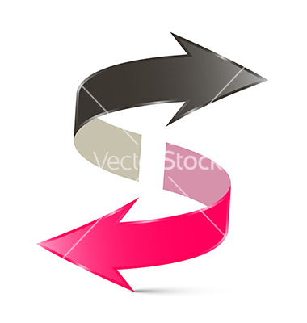
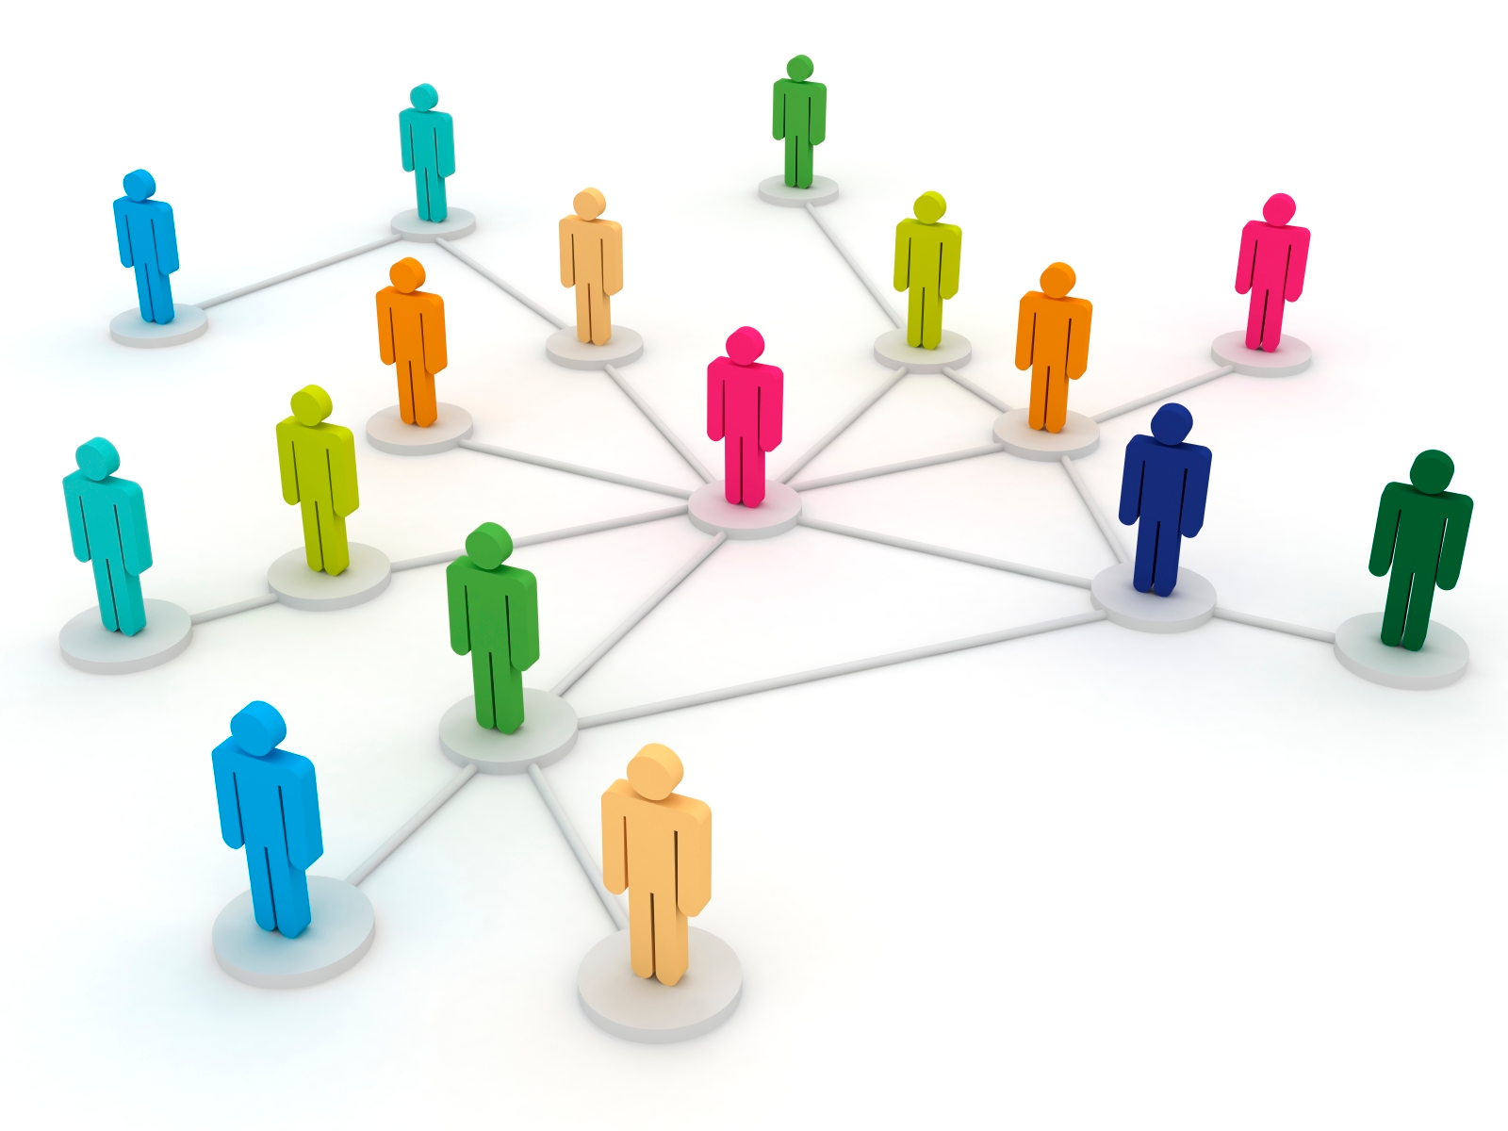
(3) Organizational dimension: from individual to network view
Monocentric view
Endogenous perspective
The mass market phase in which organizations do not study consumer’s attitude and desires and do not establish relationships with users.
Dualistic view
One-to-one marketing/ Relationship marketing (Grönroos, 1990)
Interactions between users and providers have a strong impact on marketing decisions. So, companies aims at building durable relationships with customers.
Network view
Many to many marketing = Network theory
(Richardson, 1972; Castells,1996; Capra, 2002)
Not only customers and other stakeholders contribute to value co- creation, but also the social networks in which they live.
Companies build relational networks to generate an offering not anymore based only on goods, service or information but grounded on the unique knowledge exchanged among all the actors.

Slide 29
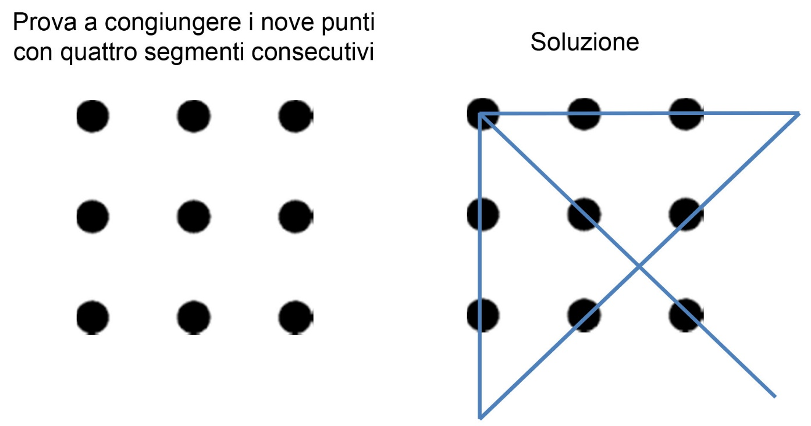
A new mindset for innovation
In order to be able to gain new market shares and to adopt more effective marketing strategies, a growing need for "UNCONVETIONALITY" is emerging in recent years.
Get out of the box, think differently, innovate the way of doing innovation.
29

Slide 30
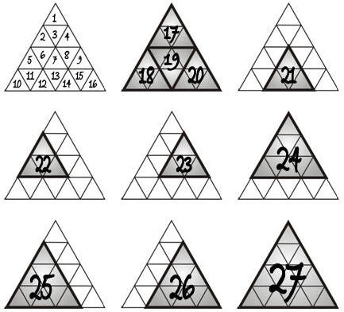
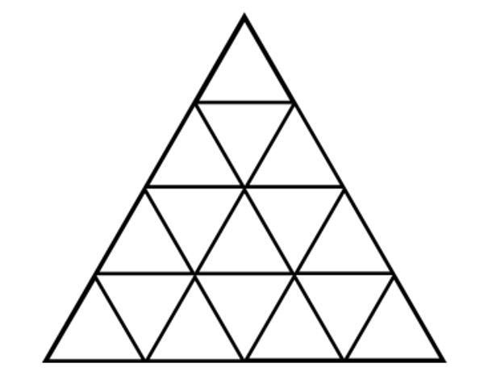
How many triangles do you see?

Slide 31
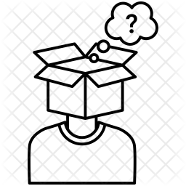
To think outside the box
Conversation "E-FREE"
Set up a normal conversation without using any word containing the letter E. Without pauses between sentences. Example:
Person 1: "What do you want to do now?"
Person 2: "I do not know, what about lunch? I know a good fast food."
You're constantly looking for the right words to say that your sentence makes sense and you're E-free. It is a thought outside the box.

Slide 32

Add numbers… Quick!
Quickly adding small numbers to your head (4 + 7 + 9 + 3 + 2 + 2 + 8 + 5 + 8 ...) forces you to continually change the information you need to work with and remember.
As the numbers are added, the overall total changes constantly and to get to the next total you need to focus exclusively on the current total and the next number you are adding.

Slide 33
Changing the Perspective
Products
(output)
Services
(Processes and applied competences)
Goods
(tangibles)
Services
(Intangibles)
Indirects
(Goods)
Directs

Slide 34


From G-D logic to S-D Logic
Products ≠ Services
Good-dominant logic
Service-dominant logic
Services are «extra» features added to products
Production-Selling orientation
PUSH MODEL
Customer orientation
Co-creation and resources integration (Knowledge)
«Narrow» perspective
(shareholders; direct stakeholders)
«Broader» systems view
(multi-stakehoklder)
Value is not produced anymore exclusively by providers, but is negotiated between and among all the stakeholders
«Internal» Production
Service outputs are co-created and co-produced collaboratively
Unidirectional and dyadic relationships
MANY-TO-MANY
Relationships networks
Goods are means to provide service in a totalizing service offering
Consumers are benefeciaries/passive receivers of products
Consumers are strategic resources for companies and participate actively in value co-creation

Slide 35

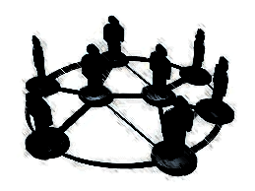
The evolution of Service
Phase
Definition of service
Neoclassical
(1890-1930)
Value lies in products.
Services are activities consumed in the same moment of production
Service are a particular kind of goods
G-D LOGIC
Hard sell orientation
(1930-1960)
Services are a set of activities more or less intangible that take place in the interaction bewteen users and companies
Services are a cosmetic adjunct to tangible goods
Marketing orientation (1960-1985)
IHIP Model: 4 differences Goods vs services→ (1.intangibility;
2. heterogeneity; 3.inseparability; 4. perishability)
S-D LOGIC
Services are the real object of exchange and are co-created by each actor engaged
Service era
(1985…)
Value is not IN products but it is negotiated collaboratively and built in progress during the experience of service delivery

Slide 36

The origins of Service
Adam Smith, The Wealth of nations (1776)
Market and exchanges focus on two key dimensions:
Industrial production of tangible goods as activities targeted at value creation;
Efficiency and “division of labour”: manual labour based on differentiated capabilities and competencies.
The foundation of economic exchange is the application of intellectual and material capabilities of actors that act «for» the benefit of other actors (what will be identified next as «service» in S-D logic).

Slide 37
The origins of Service
The key assumption that tangible goods own a transportable and transferable value leads to the distinction between:
PRODUCTIVE GOODS
Tangible goods with nominal value (market price) which makes easier to assess and measure the exchange of value.
These goods contribute directly to the wealth of a nation.
UNPRODUCTIVE GOODS
Goods which cannot increase the surplus of a nation and involve the provision of a non-standardized service with unquantifiable value (e.g. lawyers, doctors, etc.).

Slide 38

Criticism of Classical economic theory
Say, Traité d'économie politique, 1821
Production does not generate tangible outputs but create utility and benefits (value in-use)
Mill, Principles of Political Economy, 1848
The work is «productive» even if not targeted to the production of tangible objects

Slide 39

Criticism of Classical economic theory
Jean-Baptiste Say→ UTILITY: internal feature of material goods
Underestimation of the differences between value-in-exchange and value-in-use (seen as interchangeable).
PRICE
PERCEIVED VALUE
UTILITY
Mill and the utilitarianism: The price that customers want to pay is the perceived value, which, in turn, is based on utility, as a property of the object exchanged.

Slide 40
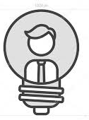
Criticism of Good-dominant mindset
Frédéric Bastiat, Harmonies of Political Economy (1850)
Pioneer of Service-Dominant logic, who shifts the attention to:
Users’ needs and satisfaction;
Value as personal acknoweldgement and (comparative) assessment of the different mutual benefits provided by different services.
BUT
Bastiat’s thought has not been formalized as an «autonomous» economic theory

Slide 41

Good-dominant logic in brief
The goal of economic activities is to produce and distribute goods that can be sold
The goods should acquire utility (value) thanks to production and distribution processes and provide consumers with higher value than competitors’ propositions
The company should target all the decisions at the maximization of the profit deriving from sales
The goods should be standardized and manufactured far from the market to enhance control and maximize production efficiency
Goods can be stored before customer’s demand and, then, can be delivered to consumers in exchange for a certain profit.

Slide 42
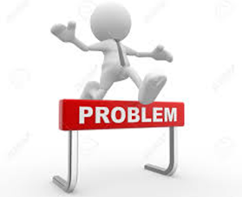
Good-dominant logic: main limitations
G-D Logic
GOODS
COMPANY
VALUE-IN-EXCHANGE
Linear and unidirectional model;
Clear opposition USER vs PROVIDER;
Little consideration for social value;
Underestimation of the role of context and of relationships in exchanges.

Slide 43

G-D logic: a «myopic» vision
Over time……
The mounting hypercompetition of markets and the complexity of context led to the adoption of a broader,
all-encompassing and systems vision
Introduction of service management and service marketing as «autonomous» research areas
…until the «explosion» of
SERVICE-DOMINANT LOGIC

Slide 44

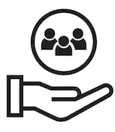
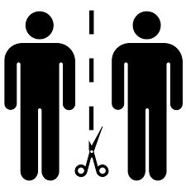
From customer orientation to S-D logic
The development of customer orientation is just one of the main triggers that fostered the rise of services:
→ The study of consumer behavior and the assumption that consumer choice is more than just a function of the maximization of benefits related to the utility of the goods
→ The growing social and economic ​​development deriving from the service economy
→The overcoming of the distinction between customers and providers and the inclusion of “generic actors” in the co-creation of value.

Slide 45

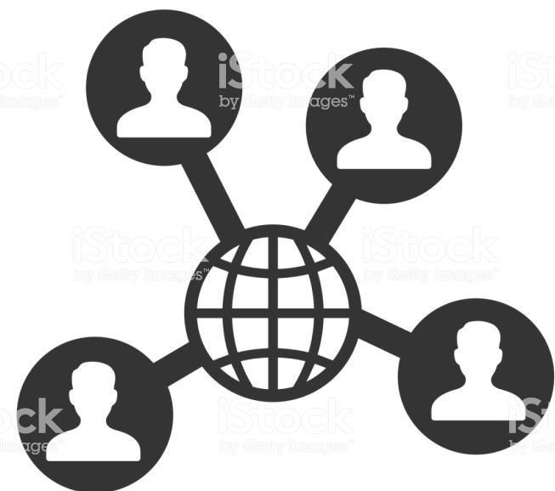
Transactions vs Relationships
Service-dominant logic derives from relational marketing (Berry, 1983), then merged into Nordic School (Gummesson and Gronröos, 1994) which focuses on two key concepts:
Shift from dyadic relationships (economic transactions) to many-to-many approach that reconceptualizes companies as complex networks of relationships and interconnected actors
The value deriving from exchanges is interactional and depends on the context in which interactions occur and in which experiences are developed
(Pine and Gilmore, 1999)→ experiential marketing

Slide 46

S-d logic: (Redefining) key concepts
SERVICE
«application» of resources for the benefit of other actors, as the basis of economic exchange
GOODS
tools/means to provide service
VALUE
Always co-created by providers and many beneficiaries…
…always determined exclusively by beneficiary

Slide 47
S-D logic : main insights
S-D Logic
Services
Networks
Value-in-use &
In-Context
From value-in-exchange to value-in-use and in-context
From product orientation to customer orientation
From transaction to relationships

Slide 48
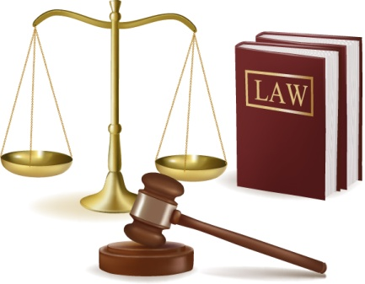





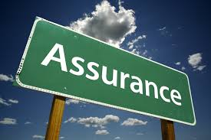



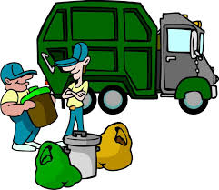
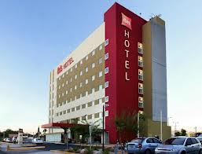
Everything is…Service

Slide 49
From S-D logic: Definition of Service
Application of specialized skills and competences
through
actions, processes and performance
aimed at
producing benefits
for
themselves and for third parties
…..directly or indirectly connected
Vargo and Lusch (2004), p.2

Slide 50
The process of value co-creation
Value co-creation
Supplier
Producer
Consumer
Value destroying
Value from supply chain
Value from co-production

Slide 51

Value
Value-in-use
Value-in-context
Co-creation
Win-win
Mutual benefits
- RESULTS/EFFECTS -

Slide 52
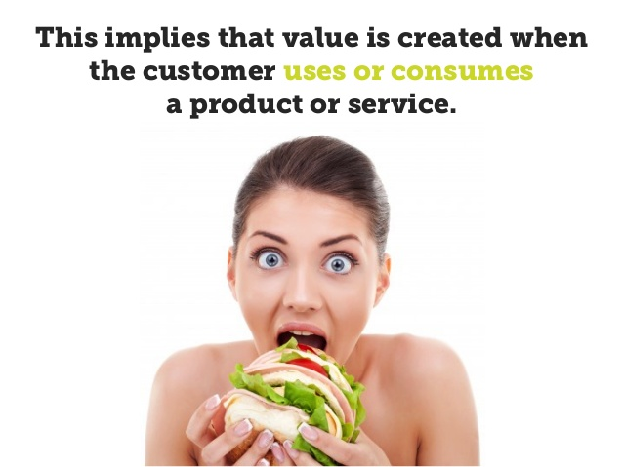
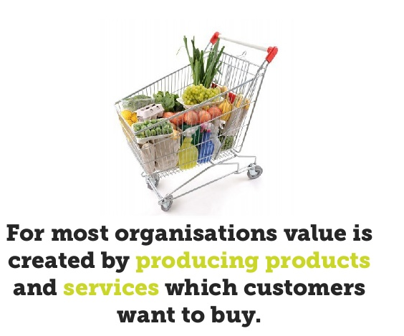
From consumers
but

Slide 53
Relationships with Market
From the Market
With the Market
To the Market
Client Management & Market Management
Collaboration with customer
“Matter in Motion”
endogenous
exogenous
collaborative
A
B
B
A
A
B

Slide 54

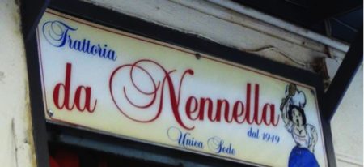
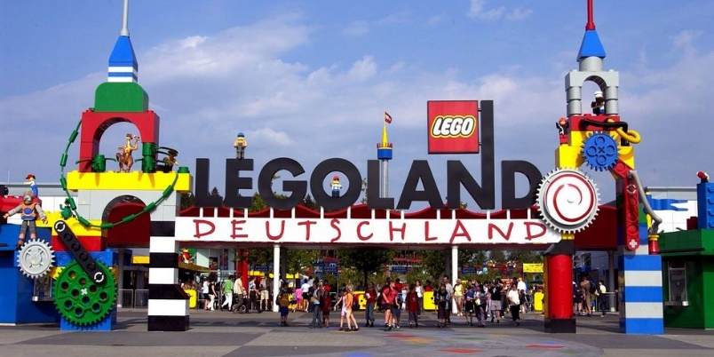
Multi-actors contribution

Slide 55


The different shades of marketing
The shifts
from:
to:
Production-selling orientation
Marketing orientation
G-D logic
S-D logic
Value-in-exchange
Value-in-use & value-in-context
Dyad
Network
Service-dominant logic’s Ancestors
Relationship Marketing
Experiential Marketing

Slide 56
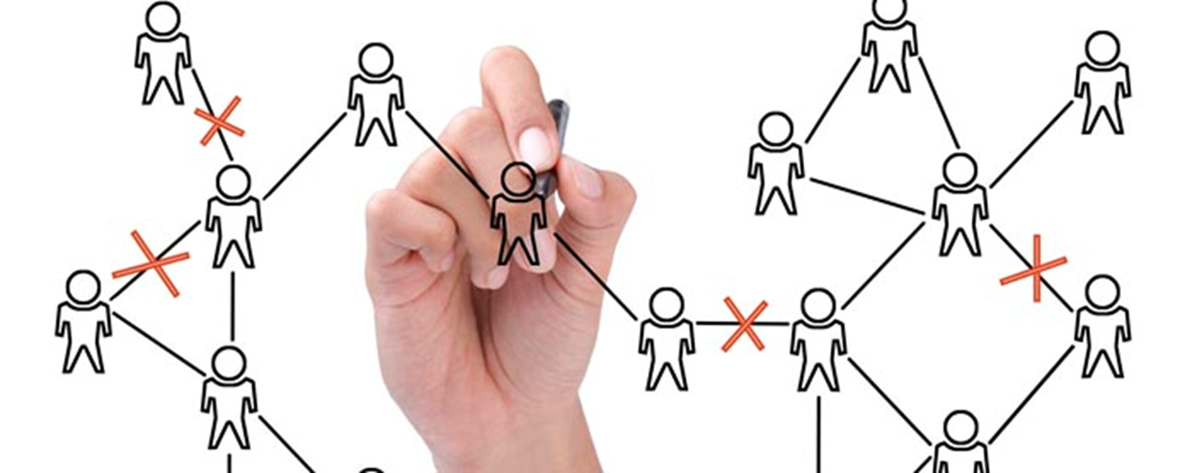
1.3
Relationship Marketing

Slide 57
Relationship marketing: origins
After 1960...
After 1990...
After 2000...
CUSTOMERS ORIENTATION
Relational Marketing (RM)
Customer Relationship Management (CRM)
Many-to-many approach
Network orientation
Focus on multi-levelled networks of actors/ stakeholders
Customers as the pivot, the focus of attention in the market
The focus is on the relationships
between two key actors
Customer
Customer
Provider
Customers
Providers

Slide 58
Relationship marketing: origins
Hakansson (1979)
Establishing, negotiating and managing relationships with stakeholders is essential to obtain sustainable competitive advantage based on long-term agreements.
The management of relationships between the company and the main stakeholders is entrusted to marketing which should represent the “sensitive soul” of the company capable of understanding, adapting, proposing, measuring.
Kotler (1992)
Focus on long-term objectives and relationships

Slide 59
Relationship marketing: origins
Berry (1983)
Service is created, built and developed to start, maintain and improve relationships with users
Bendapudi and Berry (1997)
Four variables influence the characteristics of relationships:
1. Environmental dimensions
environment
I
N
T
E
R
A
C
T
I
O
N
Providers
Consumers
2. Service providers’ main features
3. Consumers interested in the service
4. Interactive dimension

Slide 60
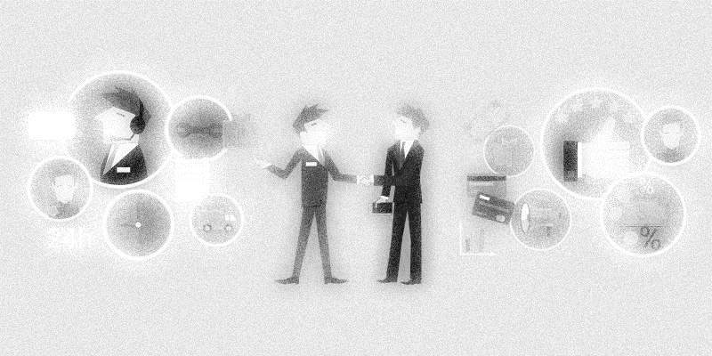
Relationship Marketing
PASSIVE
Marketing
Active
Marketing
Marketing
=
Selling
Relationship
Marketing

Slide 61

Relationship Marketing
Aim: to increase the value of relationships with customers through the enhancement of users’ loyalty
Definition: Creation, development, maintenance and optimization of relationships between customers and organizations
Selection and analysis of specific targets (not anymore broad segments) to reduce the asymmetry between the company and every single user through multi-channel strategies: from classic media (telephone/ print) to web communication
Bidirectional relationships and increased knowledge of users

Slide 62
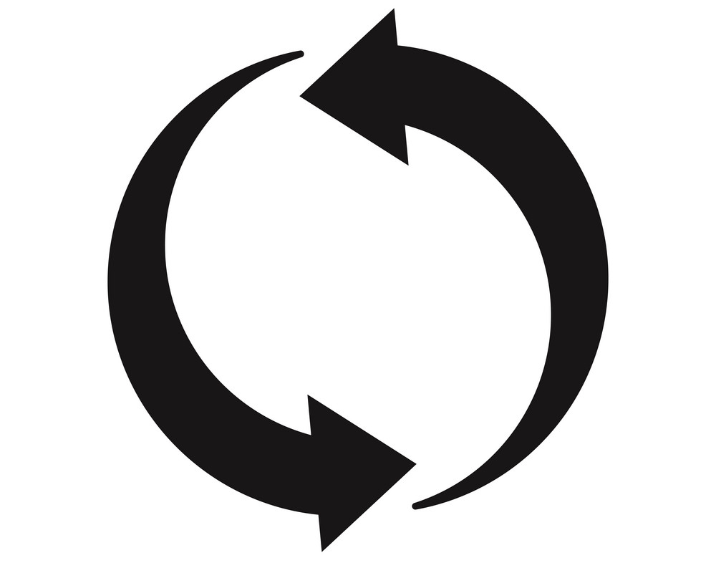
Relationship Marketing: a new mindset
A change in the managerial approach to relationships with users and stakeholder is needed
Systems thinking, new paradigm that provides businesses with cognitive and rational tools that identify and foresight new ideas to design offering aligned with customers’ expectation and value
Shfit to a collaborative approach to relationships that pursues total value maximization and subjective value maximization to improve:
- Synergistic relationships in the value chain;
- Long term part.nerships that contribute to system’s well-being.

Slide 63
Relationship Marketing
Identification of strategies to establish durable relationships consumers-brands
THROUGH the involvement of target users in long term programmes that provide immediate benefits and sense of belonging to brand
One-to-one: direct relations between
consumers- companies and brand-targets

Slide 64

  Personalizing Relationships
ONE-TO- ONE RELATIONSHIPS
Personalization of relationships with users, seen as unique individual entities with specific needs.
Customers (especially B2B) become partners of organizations and contribute to the design of value proposition for theirselves, for the organizations, for other customers
Development and creation of relationships based on interactivity, connection and mutual learning
New technologies, social networks and IT systems contribute to engage customers in business decision- making

Slide 65

  Personalizing Relationships
To optimize relationships, personalizing strategies are needed
Creation of different targets with different needs for different actions and service offering;
Knowledge on users’ requirements, needs and tastes;
Bidirectional communication.

Slide 66
  Customer Relationship Management
Berry, 1999 Pride and Ferrel, 2005; Schael, 2005
Operational translation of relationship marketing
Model for that all-encompasses pre-delivery and post-delivery
Key role of information systems and technology
Align systems with goals and strategies
Consolidate customer data
Re-evaluate and recalibrate CRM strategy
CRM
Personalize customer interactions
Study and segment customers

Slide 67

Relationship Marketing
Relationships can be developed over time through:
The sharing of a common language: that can enhance knowledge sharing and the exchange of information that increase marketing collaboration and the creation of a cohesive set of value
A coherent culture: based on common trust and shared purposes that allow at reducing uncertainty and opportunistic behaviors of partners

Slide 68

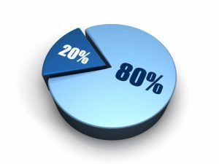
Relationship Marketing
To retain customers (and obtain loyalty) is better than acquire new ones with the reduction of service quality
The aim of relationship marketing is to establish, strengthen and renew over time stable and durable relationships with customers to create and regenerate constantly the production of mutual benefits

Slide 69
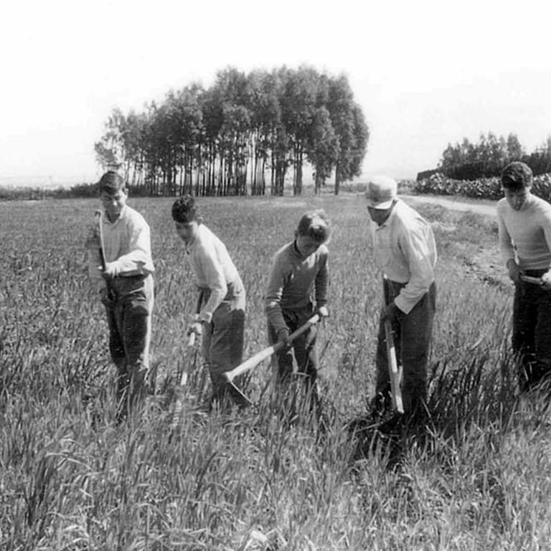
RESOURCES - WHY?
Recurrent in our literature
Useful in practice (limited)

Slide 70

Resource integration in S-D Logic
Resources are not inherently “ valuable, ” but become more or less valuable depending on the context of their integration
(Chandler and Vargo, 2011).
Resources are not, they become
(Zimmerman, 1951; Vargo & Lusch, 2014 )

Slide 71

Information
Time
Capabilities
Relationship

Slide 72
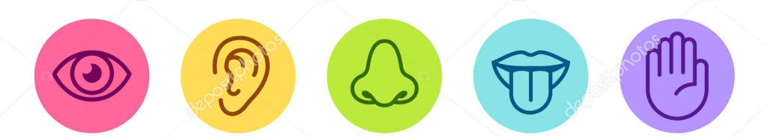
1.4
Experiential Marketing

Slide 73
Marketing as experience
The «traditional» marketing strategies (STP- segmentation, positioning and targeting) and tactics (the 4 Ps) are reread
the lens of experience which permeates service with a totalizing experience
THROUGH
Experiences can turn the moment of consumption into a memorable event
Experiential reframing of the processes of delivery and brand management
Mehrabian and Russell, 1974; Pine and Gilmore, 1998;
Schmitt, 1999; Addis, 2007

Slide 74



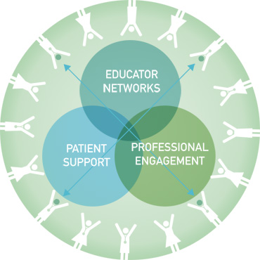
Marketing as experience

Slide 75

Marketing as experience
Schmitt (1999), Experiential Marketing
“Today, customers take functional features and benefits, product quality and a positive brand image as a given. Products, communications and marketing campaigns should “dazzle” their senses, touch their hearts, and stimulate their minds.
They want products, communications, and campaigns that they can relate to and that they can incorporate into their lifestyles” (p. 57)
“ To provide customers with engaging and attractive experiences can allow companies at gaining the edge over competitors, in a way that the “simple“ satisfaction cannot guarantee»

Slide 76


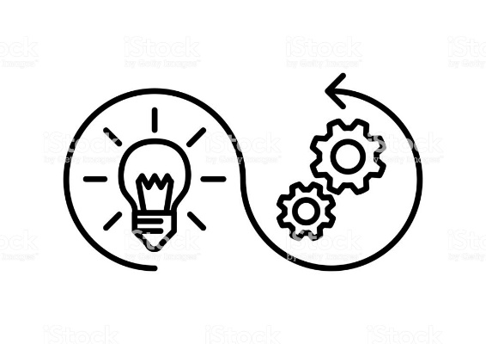
Customer Experience Management
ANALYSIS
Study of the experiences that customers lived and can live through consumption
STRATEGY
Building of experiential positioning
DESIGN
Planning of Brand Experience
IMPLEMENTATION
Activation of relationships with customers that enter the experience

Slide 77




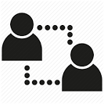
Schmitt’s Model (1999)
Sense
The first «level» that builds the sensorial experiences by using the 5 senses (taste, smell, touch, hearing and sight)
Think
Creation of experiences for the mind that stimulate intellectual, creative and problem- solving capabilities
Feel
Emotional experiences related to the brand that evoke and recall emotions and customers’ internal feelings
Act
Impact on corporeal experiences, lifestiles, interactions
Relate
Connection of individuals with themselves, other individuals and culture. This level all-encompasses the features of the other levels.

Slide 78
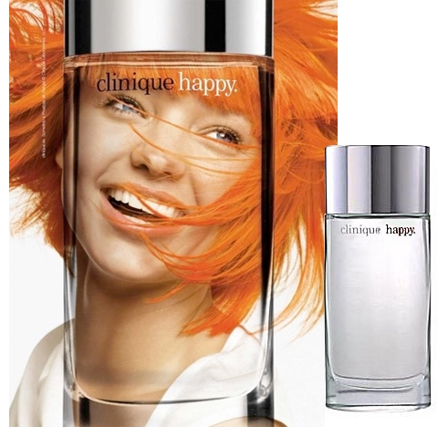
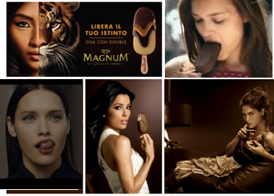
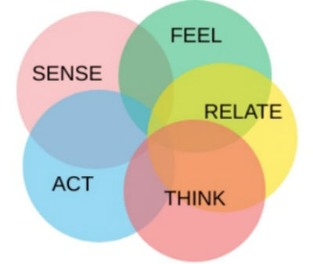



Schmitt’s Model (1999)
Strategic Experiential Modules
SEM

Slide 79


Coca Cola
  Evergreen brand which symbolizes the american way of life
  The company turned a drink into a state of mind, a status symbol, a cult product for youngsters worldwide
  The brand embodies the value of friendship, fun, happiness

Slide 80



Coca Cola: Sense
Sense
Product
Glass coke bottle
Aluminum Can
«Taste the feeling»
Place
Core values
The brand «enter» the cities (3D Poster Time Square)
Coca Cola Freesyle Fountain Machine
Multisensoriality
Hedonism
Promotion
«Taste the feeling» campaign

Slide 81






Coca Cola: Think
Think
Product
Green Packaging
Healthy Low Sugar Coke
Coca Cola «Life»
«Keep it going. Recycle»
«Go green!»
Place
Zero Consumption Vending machines
Core values
Promotion
Sustainability
Inclusion
Diversity
Equal opportunities
Social campaign

Slide 82






Coca Cola: Feel
Feel
Product
«Artistic» Packaging
Kiss the
happiness
Place
Happiness Machine
«To deliver happiness»
Core values
https://www.youtube.com/watch?v=A45sjUX7mp0
https://www.youtube.com/watch?v=lqT_dPApj9U
Happiness
Fun
Promotion
100 years
Marilyn Monroe
Elvis Presley
Ray Charles
Storytelling

Slide 83







Coca Cola: Act
Act
Product
Water Bottles
Limited edition of cans
(Olympic games and Football Championship)
“Coca-Cola is where sport is”
Core values
https://www.youtube.com/watch?v=_ajONMjOC9s
Place
Basket player vending machines (Olympic Games)
Dynamism
«Boost» for movement
Active and sporty lifestyle
Promotion
Merchandising
Sponsorship (FIFA World CUP)

Slide 84



Coca-Cola: Relate
Relate
Product
Can with people’s names
«Coca Cola
is for everyone»
Place
Core values
Vending machines with locking bottles
https://youtu.be/P7ADWd9Psag
Community
Empowerment
Participation
Universality
Promotion
«Share a coke» 2018

Slide 85

Marketing as experience
https://www.youtube.com/watch?v=BbgrHnbgoDU

Slide 86



Marketing as experience
https://www.youtube.com/watch?v=rhEpoq-nSYA
Starbucks Reserve Roastery, MILAN

Slide 87




Marketing as experience
https://www.youtube.com/watch?v=ojmne-cs6EI

Slide 88

Marketing as experience
https://www.youtube.com/results?search_query=SPRITE+SHOWER

Slide 89

THANK YOU.
Questions? Comments?
Mara Grimaldi
margrimaldi@unisa.it

