Slide 1



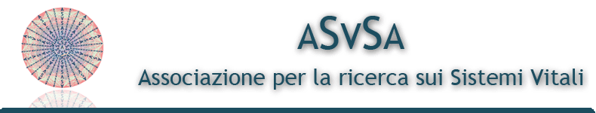
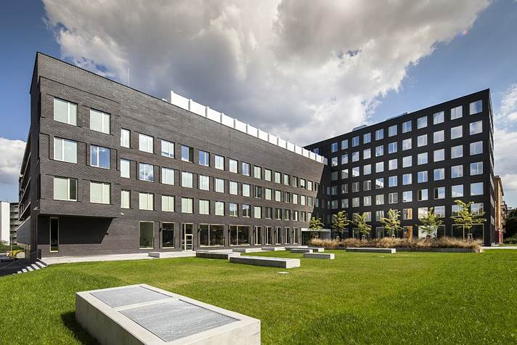
Marketing Strategies
in Service Business
- margrimaldi@unisa.it -

Slide 2




Programme
Marketing and Service Marketing: origins, evolutions & trends
Service Theories: from S-D logic & Service Science to service ecosystems & service systems
Marketing Plan
Many-to-Many Marketing
Value co-creation
Unconventional marketing
Case studies
Examples
Exercises

Slide 3

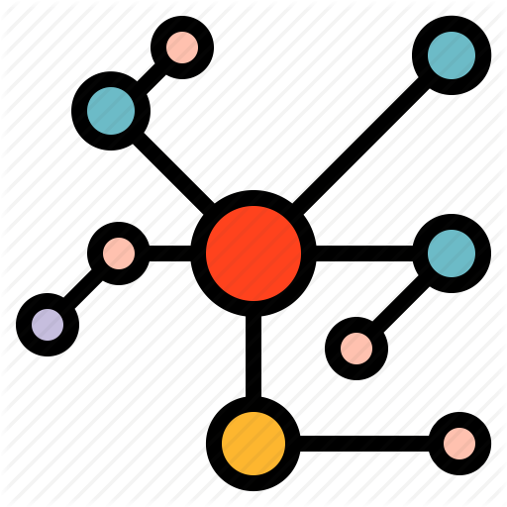


Agenda: Lesson 4
Many-to-many marketing: from network theories to Total Relationship Marketing
Value co-creation
New trends:
    Unconventional marketing
    Guerrilla marketing
    Viral Marketing
    Neuro-marketing
Case studies and examples

Slide 4
4.1
Many-to-Many Marketing

Slide 5
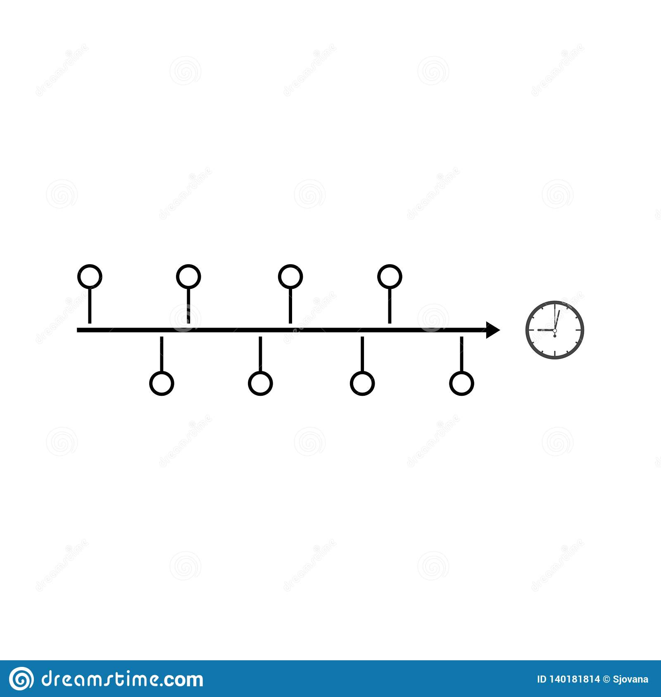
Evolution in Marketing
1960s-present
Marketing management of consumer goods
plus
1970s-present
Services marketing and management
plus
1980s-present
Relationship marketing, CRM, one-to-one
plus
2000s-present
Quality management, excellence, value, satisfaction
Synergistically result in...
S-D logic, service science, many-to-many networks
Notes:
The framework that inspire S-D logic (network theory, rel mkt, systems theory) do not disappear but there has been a constant adding of value over time until S-D logic

Slide 6

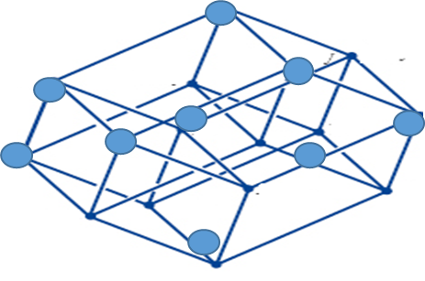
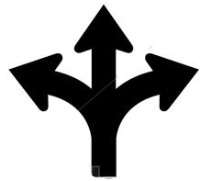
Service Networks
resources allocation and distribution
Collaboration strategies and alliances
Service Network
Embeddedness:
actors cannot be considered apart from others or from their context.
Need for a
Proactive Approach
to Innovation

Slide 7

Service Networks
In line with a relational optic of business performance, network theories consider actors as:
dynamic, operant and active resources
enabling reticular/networked interactions
embedding organizations and their activities in many-to-many relationships
System’s relationships lead business actors to a necessary mutual satisfaction for the attainment of value co-creation and competitiveness.
Fonte: Valdani E., Busacca B., Micro & Macro Marketing, 3/95.

Slide 8
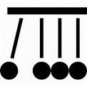
Service Networks
In service networks features, multiple solutions of value are generated through interactions, which can increase firm’s ability to communicate with individual customers and the capacity to obtain advantages.
Actors in service networks are affected (or positively influenced) by many system’s elements (like technological, economical, political and social influences).
As the model of service systems emphasizes, technology is one of the key lever for resource and knowledge integration and for the enhancement of skills in complex networks.
Fonte: Valdani E., Busacca B., Micro & Macro Marketing, 3/95.

Slide 9
INFORMATION
Technologies tools
Loyalty
Feedback
Know-how
Notes:
Global players add to this complexity even more complex elements, depending on the dimension of the business, the diversity of their localization, and the involved figure. Hence value chain’s global players is of course complex, and its performance involves many actors, representing system whose governance is difficult and challenging.
Zara, with its strategic behaviour and its M&A operations has managed to valorise both the competitive advantages of a global chain (at an international level) and the ones related to a service value network (on a local basis).

Slide 10

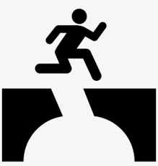
The Relationship Marketing
Relationship marketing involves a change in the management of relationships with customers and other stakeholders.
Cooperation
Collaboration
From «exchange» transactions..
...to strategic relationships
The search for the maximization of total system’s value does not affect the maximization of each actor’s subjective value thanks to some coordination mechanisms:
The sharing of a common language;
The development of an homogeneus culture.

Slide 11
Relationship Marketing
Integrated Marketing
To strengthen the quality of the offering:
Alignment of the service provided with the service designed and conceived
Compliance with customer’s needs
Marketing Mix
Internal Marketing
Relational Marketing
Total Relationship Marketing
Management’s integration of traditional marketing strategies with relational and internal marketing strategies
Notes:
In order to strengthen the quality levels of the offer, and to constantly align the service provided with the service designed and conceived, in line with customer needs, management could integrate traditional marketing strategies, with relational and internal marketing strategies: This is how the integrated approach to marketing is born, resulting from the integration between the three different marketing settings

Slide 12
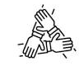
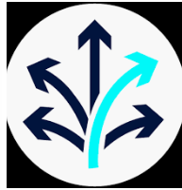
Total relationship Marketing
Gummesson (1999)
Strategic alliances with co-makers (suppliers, employees, customers, other companies) to increase loyalty and satisfaction
Networks based on interactions and long term win-win relationships to create joint value
Organization’s flexibility: softening of boundaries, reduction in management costs and proactive adaptation to emerging environmental condition
Process-based view and dynamic capabilities to overcome rigidity and hierarchy
Notes:
Data l’esigenza delle imprese di un maggior contatto con il mercato, per accrescerne la soddisfazione e la fedeltà, nel tempo si è imposta sempre di più una crescente flessibilità strategica stimolando alleanze sistematiche ed il funzionamento di una rete di rapporti collaborativi con tutte le altre parti del processo di creazione del valore (fornitori, co-makers, personale interno, clienti, altri stakeholders) arrivando alla definizione di un nuovo concept di marketing. Il Marketing Relazionale Totale è dunque il marketing basato sulle relazioni, il network e l’interazione; esso è rivolto, dunque, a relazioni di lungo termine a somma positiva con i singoli clienti e gli altri stakeholder ed il valore si crea congiuntamente tra le parti coinvolte. Secondo tale approccio, l’impresa moderna è caratterizzata da elevata flessibilità organizzativa, con fini rapidi e mobili, bassi costi di gestione e rapida flessibilità di adattamento alle condizioni ambientali emergenti: si tratta di un’impresa di processo dove il ruolo della gerarchia, delle strutture e delle risorse fisiche è ridotto in favore di risorse immateriali e competenze che agevolano la predisposizione dell’impresa all’adattamento dinamico.

Slide 13

The Internal Marketing
The contribution to the quality of the product offered involves, directly or indirectly, all the players in the system, in order to strengthen in all employees a strong culture of relational marketing service, it is necessary to complement internal marketing actions (e.g. training and communication plan).
Internal marketing
Enhancement of employee’s and management's attention to the customer.
The first customer of any organization is represented by internal staff, which must be first satisfied. Explaining and sharing times, methods, and activities, the clear definition of tasks, duties and roles, create a positive atmosphere (high levels of cooperation, trust and satisfaction), which strongly influences the quality perceived by the end customer.

Slide 14
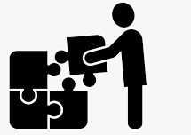
The Integrated Marketing
In order to strengthen the quality levels of the offer and to constantly align the service delivered with the designed and conceived service, in line with customer needs…
Integration of the traditional marketing strategies (4P) with relational marketing strategies and internal marketing
External marketing
Traditional marketing management, that aims at creating expectations and at making promises to the outside market.
Internal marketing
Creating a culture of service and customer orientation among the members of the organization lays the foundation for the maintenance of promises with customers.
Relational marketing
Managing relationships between Personnel and Users of the Service establish lasting and profitable relationships with customers, and thus, fulfills the promises made.

Slide 15

Total Relationship Marketing
The need for businesses to increase user’s satisfaction and loyalty stimulates systematic alliances and collaborative relationships with all the other parties in value creation process (suppliers, co-makers, internal staff, customers, other stakeholders)
Total relationship marketing
high organizational flexibility, with rapid and mobile purposes;
low management costs;
rapid adaptation and flexibility to emerging environmental conditions;
low hierarchy, structures and attention to physical resources in favor of intangible resources and skills that facilitate dynamic adaptation.
based on relationships, network and interaction;
aimed at long-term positive relationships with individual customers and other stakeholder;
joint creation of value between the parties involved.

Slide 16
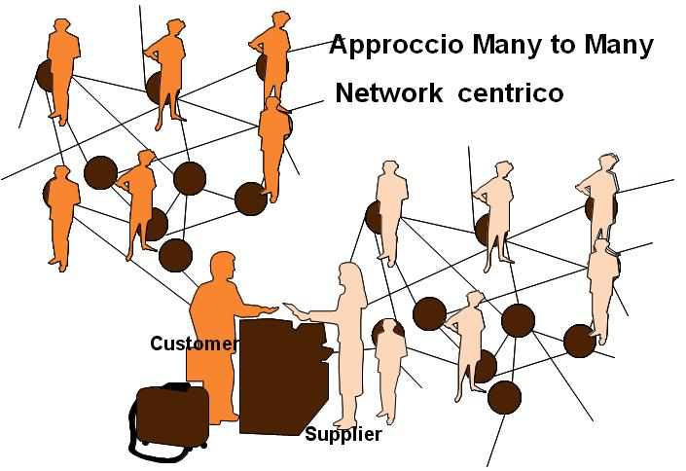
The Many-to-Many Marketing
Lifestyles
Experience
Attitude
Strategic and managerial capabilities
Technical competencies
Skills
Beliefs
Fonte: Valdani E., Busacca B., Micro & Macro Marketing, 3/95.
Many-to-many marketing defines and analyses the network aspect of marketing.

Slide 17
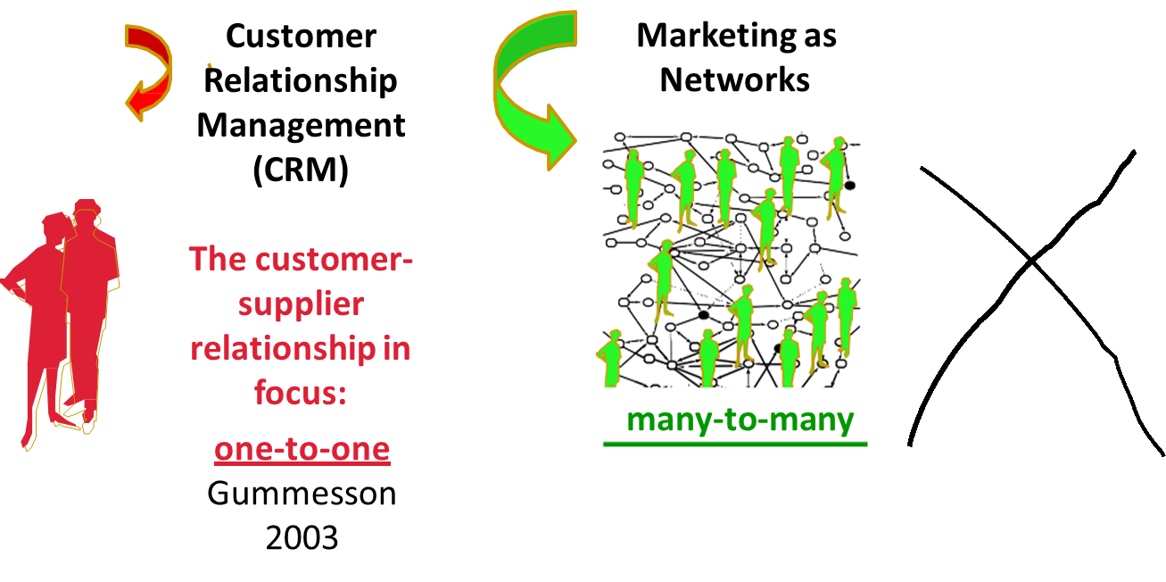
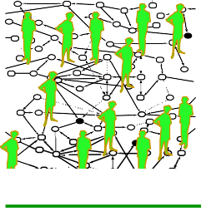
The Many-to-Many Marketing

Slide 18

The Many-to-Many Marketing
From relational and system’s point of view, competitive behaviour today seems to be based no longer upon dyadic relationships between actors, but rather upon a many-to-many relational and system pattern daily involving supplier and customer networks with dense and intricate connections, win-win based and service-oriented.
Total Relationship Marketing
Gummesson (1999)
Broadening of the perspective on marketing management grounded on the interactional focus
Relationships exist only if there are at least 2 parties;
Interactions are relationships activated in the encounter that establish a contact;
Networks are complex systems of relationships, that act as a lens to intrepret society.

Slide 19
Total Relationship Marketing
Mega- relationships
Special market relationship
Classical market relationship
Nano-
Relationships
Market relationships
Non-Market relationships

Slide 20



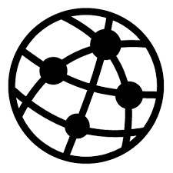
(1) Classic Market Relationships
The classic dyad→ the relationship between the supplier and producer is the basis of business.
The classic triad→ the drama of the customer – supplier – competi­tor triangle
Competition is a central ingredient of the market economy.
The classic network- distribution channels and the modern channel management including goods, services, people and information consists of a interconnected relationships.
20

Slide 21



(2) Special Market Relationships
A condition for success is the understanding of the customer’s customer; and what sup­pliers can do to help their customers become successful.
To create a long-term sustaining relationship, it has become increasingly common to enlist customers as members of various loyalty programmes.
Production and delivery of services involve the customer in an interactive relationship with the service provider, often referred to as the moment of truth (Service encounter).
21

Slide 22


(3) Mega Relationships
Non market relationship go beyond classical relationships firms- stakeholders- shareholders to involve personal and social networks, lobbies, government, institutions that ask for and release resources (legitimacy) and at the same time share rules release
Alliances change the market mechanisms and mean closer relationships and collaborations between companies. Competition through collaboration is necessary to make the market economy work.
Knowledge can be the most strategic and critical resource and knowledge acquisition is often the rationale for alliances.
Relationships with governments, legislators and influential individuals make marketing feasible on an operational level.
The media can be supportive or damaging to marketing and they are particularly influential in forming public opinion.

Slide 23


(4) Nano-Relationships
Market mechanisms are brought inside the company: internal as well as external relationships of a new kind emerge in a process that encompasses
the relationships between internal customers and internal suppliers.
Internal marketing can be seen as a part of relationship marketing as it gives indirect and necessary support to the relationships with external customers.
External providers reinforce the marketing function by supplying a series of services, such as those offered by advertising agencies and market research institutes
The quality concept is a bridge between design, manufacturing and other tech­nology- based activities and marketing.

Slide 24
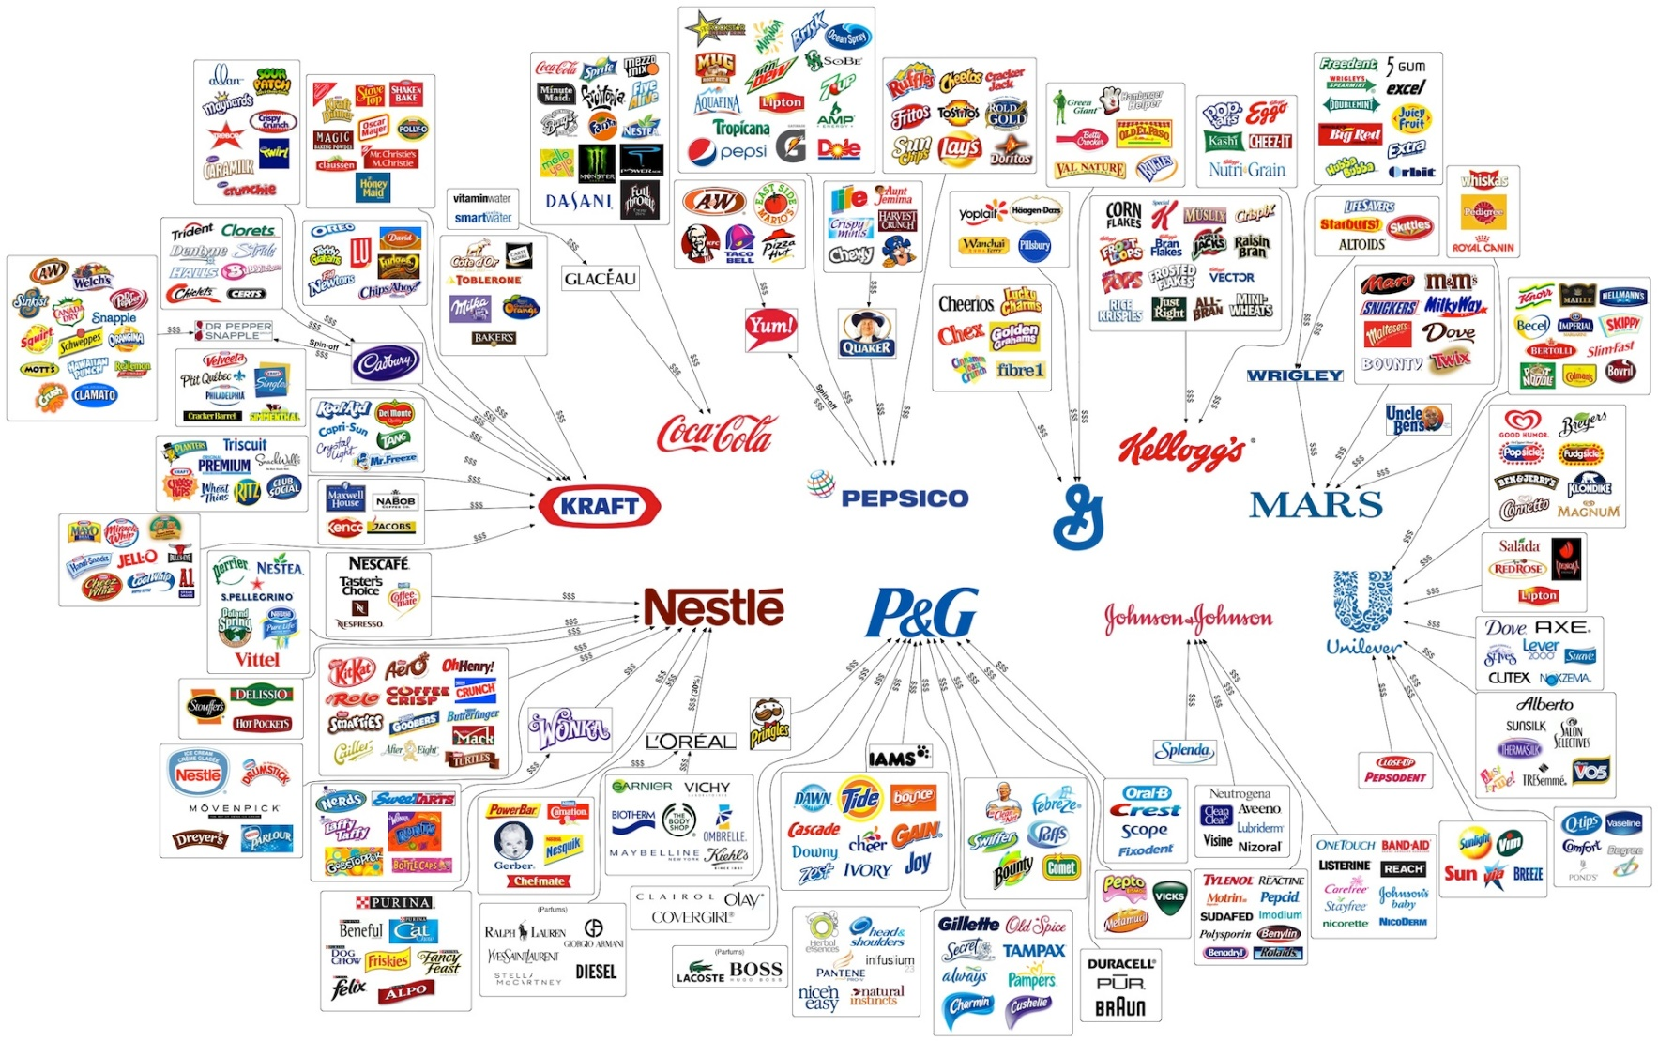
Implications for Marketing Strategies and Tactics

Slide 25
The Many-to-Many Marketing
Service
Value
Network
Notes:
As far as traditional conceptualisation of the value chain, within a service value network the distinctive resource are related not only to individual actors’ capacities, but also to every actor’s ability to reconfigure its own service systems in accordance with its own competitive strategies and with the other actors; thus, every actor daily work to perform a benefit for the whole system, every system represent the result of common effort of its active elements.

Slide 26
From value chain to value network
S-D logic replaces the conventional supply chain with service value networks (Allee, 2000).
Supplying
Production
Consumption
Firms can only make value propositions
Value co-created is “product” in the use, transformation and consumption
Service actualizes through mutual benefits and mutual satisfaction
Value-in-
context
Value-in-use
Value-in- exchange
Value is not embedded only in production process
Value is the synergistic outcome of a complex interactive process
Value is perceived by users
in their context
According to systems thinking and service logic, Service Science explores how service value is created in a network context and how the structure and dynamics of the value network, as well as customer expectations, influence service (eco)systems complexity

Slide 27
From value chain to value network
From
Relationships
Value creation
Relationship marketing
Systems interactions
Value propositions based on interaction mechanims
To
Many-to-many approach
& Total relationship marketing
Everything influences everything
Many-to-many logic of reticular interactions
To
Service Value Network
All businesses are relational service activities
Mutual satisfaction co-creation processes
Fonte: Valdani E., Busacca B., Micro & Macro Marketing, 3/95.

Slide 28
4.2
Value co-creation in Service
28

Slide 29
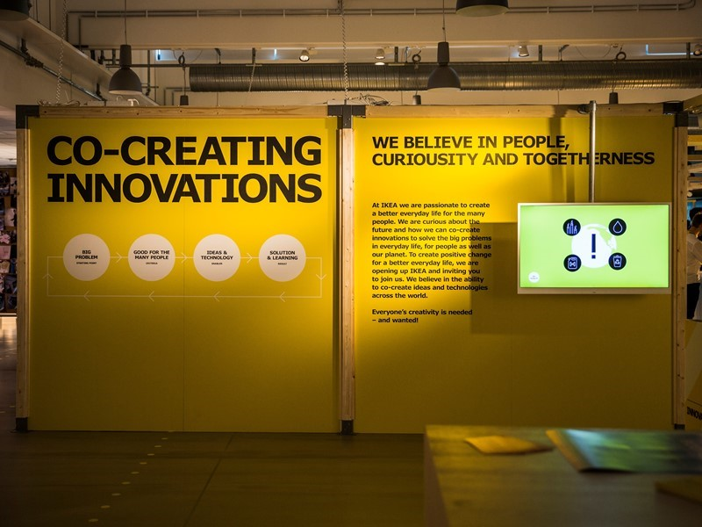
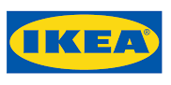
Value co-creation
‘Co-Create IKEA’, a digital platform encouraging customers and fans to develop new products.
IKEA’s co-creation platform focuses on four specific areas:
Asking customers for product idea suggestions
Running IKEA Bootcamps to work with entrepreneurs
Collaborating with university students on product solutions
Connecting with innovation labs around the world
If a suggestion for furniture or product design is successful, IKEA may license the technology or agree to invest in future products. For designers and technically talented fans, this creates a strong incentive: to gain exposure through the world’s largest furniture retailer.
29

Slide 30
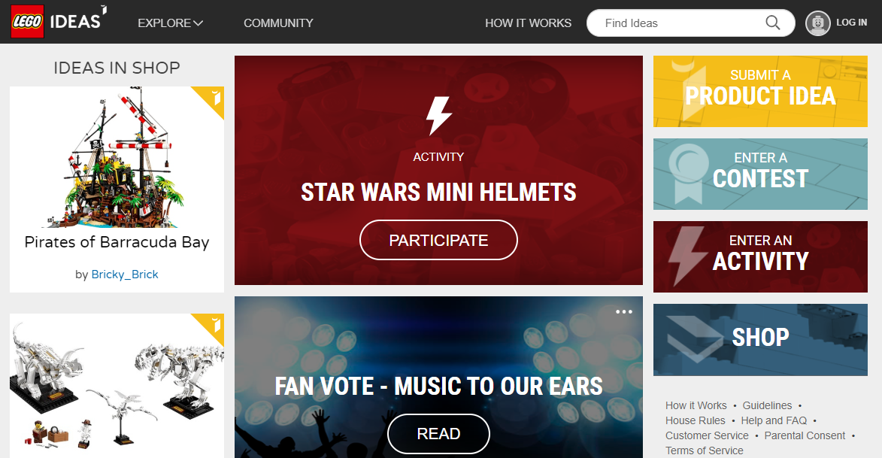

Value co-creation
https://ideas.lego.com/
‘LEGO Ideas is an online community which brings together passionate fans and creators from around the world to imagine, iterate, and evaluate ideas for new LEGO kits. It is a great example of open innovation and co-creation, where members have actively participated in the journeys of several successful products from idea to development.
The LEGO Group first dove into the online open innovation space in the early days of crowdsourcing when they launched LEGO Cuusoo in 2008, where Japanese fans shared their own LEGO creations that ultimately made their way onto toy store shelves.
LEGO Ideas officially launched in April 2014
30

Slide 31

Overcoming the past
«producer vs. consumer»
One of the most improper conceptualization of G-D logic is the contrast between “producer-consumer”, in which:
some actors (ex. companies)
“produce” (create) value (value-added),
while others (es. consumers) “consume” (destroy) that value (value-destroyers)
…
once consumed any product will no longer have the initial value.
31

Slide 32
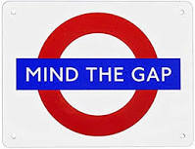
About Value Creation
The continuous tension to value creation represents the basilar activity of firm’s business process and decision-making, which influence the decisions as well as behavior of all the systems (value culture).
The focus of value creation and the new interpretation on value co-creation should be both:
internal (resources improvement);
external (collaborative relationships).

Slide 33
Co-creation advantages
Customers are key strategic resources for product improvement and are, thus, prosumers, fundamental for competitive supplies.
Production
Experiences
Resource
Co-creation
Service ICTs
Knowledge
Information
Partners
Clients
The value creation process involves users in a personal consumption process, considering them as real strategic value co-creators, thus suggesting that firms may be the integrators and managers of necessary resources for the benefit of competitive behaviour.

Slide 34

Why Value?
Value creation processes suggest a change of roles→ today, an important part of the process is played by customers, who are not viewed just as value destroyers (or value receivers) but are instead considered key actors, engaged from the early stages of the production process and not only in the final consumption stage.
Customers do not acquire value directly from purchase but derive it from products’ use, transformation and consumption
A firm doesn’t autonomously create value for clients, but can only offer value propositions, experiencing them and transforming them into value through use.
34

Slide 35

Effects on value creation & competitiveness
the consumer is no longer seen exclusively as a target (value destroyer);
companies have a right only to make their value proposals (value proposition);
consumers are considered real factors of production (value co-creator) within a complex system of service delivery (service system);
consumers are able to benefit not only from the products purchase, but also from processing, use and consumption of the same (value in use), revealing their role as active (participant) in the value generation process
The rules of business competition changed: the more companies are able to create value, the more competitive they can be, since they can be able to engage users in co-creative purposes, through sustainable value propositions.

Slide 36
Service Value Chain or Service Value Networks?
A networked System based on service-centered logic should evolve continuously:
Suppliers (and Sub-Suppliers)
Producers (Co-Suppliers)
Clients (Co-Producers)
Deliverers (all kind)
Customers (Prosumers)

Slide 37

S-D logic and centrality of «Market-ing»
In S-D logic the main purpose of enterprise is to serve itself by serving others, by integrating its internal and exterrnal resources available from public and market sources, to create additional resources to be applied for the benefit of other actors (individuals, family, companies, etc.).
Service opportunities change because the available resources continuously change

Slide 38
S-D logic and centrality of «Market-ing»
In S-D logic marketing, value creation is not anymore a responsability of a single department, but it’s a major function of the organization: to connect with other businesses and offer them a service in a constantly changing market.
This is «market-ing».
38

Slide 39
Co-production vs Co-creation
Integration with market resources
Direct supplying of offering
Supplier of operand and operant resources
Co-production
Beneficiary of service
Co-creation
Value-in-context
Supplying of service THROUGH goods
Market integration
https://www.youtube.com/watch?v=Az6D6vzfFrU&t=15s
39

Slide 40
Case studies and examples
40

Slide 41

Case study: Education ecosystem
Acceptance of key Values & Guidelines
Co-development of Didactic Activities
Reconfiguring Learning Experience
Joint Policy-Making
Social Practices
(Engagement, Social Inclusion, E.democracy)
Interactions
Information about Programme and Policies
New Practices, Value Models, Modalities to Manage Public Services, Development of Talents
New competencies- Skills
sharing
integrating
transforming
Alining individual values-objectives/ ECOSYSTEMS finalities and goals
(co-) learning
(co-) innovation
Notes:
For instance, in smart communities that pursue sustainability outcomes, value co-creation (And viable value co-creation) can act as drivers for sustainable value and innovation that can develop across the three contetxs in this way:
At a micro level
Users’ compliance refers mainly to the acceptance of ethical value (at an individual level) that should comply with the attainment of community sustainable goals. Interactions can be mediated thanks to ICTs and the main informational resource can be increasing awareness of environmental goals and enhanced technological competencies
2) At meso level
Stakeholder’s engagement increases and actors are involved in the design of a harmonized set of smart projects in which ICTs are integrated synergistically to realize community development.
New ways of experiencing the territories thanks to citizenship and e-democracy can be introduced. Knowledge exchanges can give birth to the synergistic creation of new skills to 1) manage multi-level systems; 2) use technologies; 3) interact with others; 4) pursue sustainable outcome
3) At macro-level----Then, based on the sharing of common smart values, joint decision-making and policy-making activities are performed and users’ provide their ideas and insights to improve services and the entire community. Each member can become potentially a decision-maker by expressing its own creative interpretation regarding a new product or service or providing resolution for a given social or environmental challenge.
The integration of innovative insights from many sources should be optimized by multi-level governance thanks to the constant search for the compliance between individual objectives and values with overall system’s goal (phase 3). This alignment is the driving force that can lead to the transition from the decisions co-established at meso-level to the co-development of policies at macro-level. To enable this passage, the innovative ideas and suggestions arising from users should be co-evaluated to align the shared values in the community with the overall goal of sustainable development.
Thanks to social inclusion and democratic , new cultural and social institutions can be created (environmental standards, law, services, policies, welfare state)
Lastly the process of co-innovation as a cycle can be renewed over time (the arrow in the figure). The smart communities can regenerate the smart culture produced through the constant renewal of values and knowledge to co-design gradually the foundations for a smart future.

Slide 42

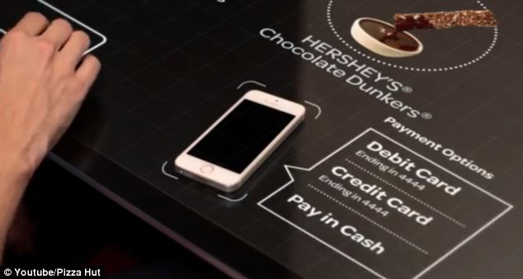
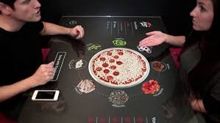
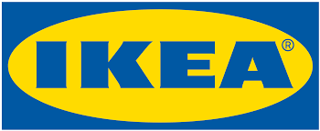
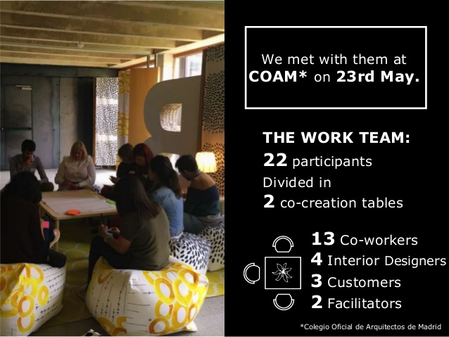
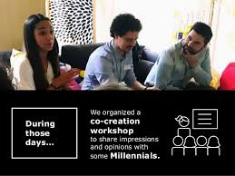
Examples: Value co-creation
Pizza Hut Table
https://www.youtube.com/watch?v=UzRZRyPReJk
IKEA
https://www.youtube.com/watch?v=fKfxBl_nu3c

Slide 43

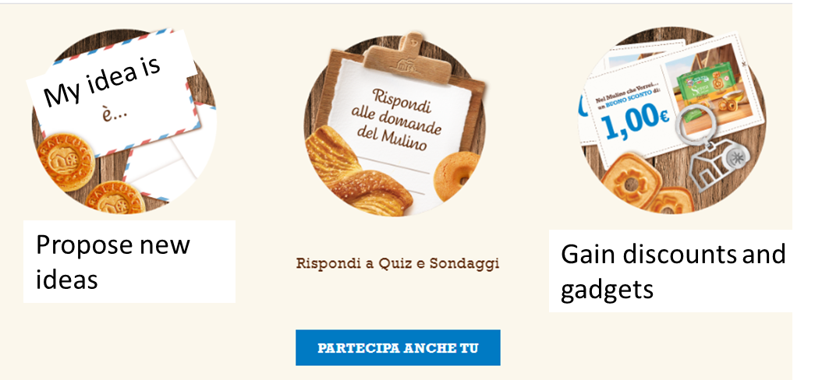

Examples: Value co-creation
https://www.nelmulinochevorrei.it/index.html
https://www.leonardocompany.com/it/innovation/innovation-award
https://www.youtube.com/watch?v=09wyJ_eMmF0&feature=youtu.be

Slide 44
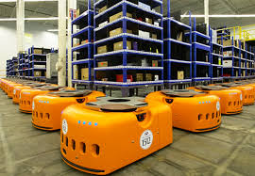
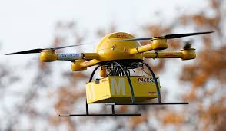
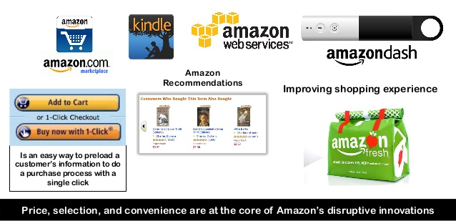

Example: Customization
https://www.youtube.com/watch?v=JXkMevbjga4

Slide 45
Network and co-creation
Evaluation of alternatives
PURCHASE
E- shopping
Portals
Communiteis
Social networks
Review sites
Metasearch & comparations
Assistance
Security of transaction
Sms/ e-mail confirmation
VALUE
Inormation research
Service
E- relation
LOYALTY
POST-DELIVERY
Feedback (reviews, rankings. ratings); WOM; E-crm

Slide 46


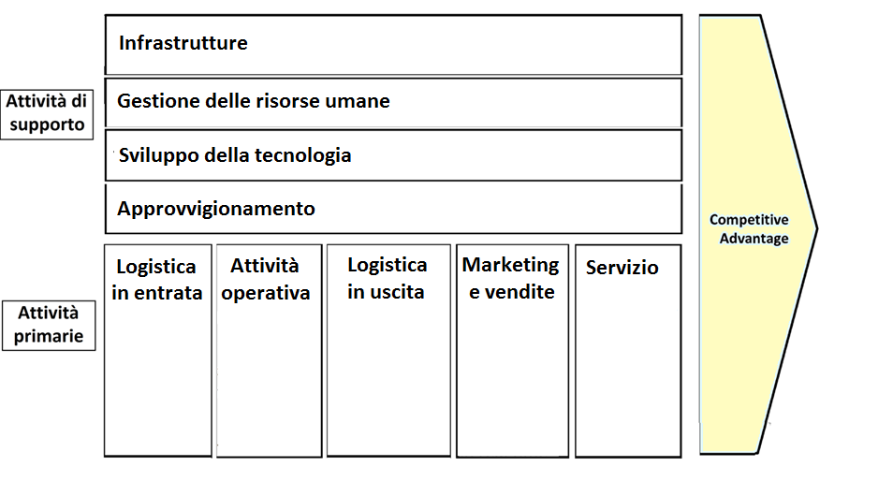
Firm’s infrastructure
Network of on-line/digital relationships
Secondary activities
HUMAN RESOURCE MANAGEMENT
Technology development
R&D agreements- ICTs tools
Procurement
drone
INBOUND LOGISTICS
Operations
Outbound LOGISTICS
Marketing and sales
SERVICE
Primary activities
Robot
Scheduling
Shipping
Shop window
Banners
Recommend. system
Capillary distribution
drone
Global logistics network
Go cash
desk
4.0 E-commerce (smart tv)
ERP
One-to-one & personalized marketing

Slide 47
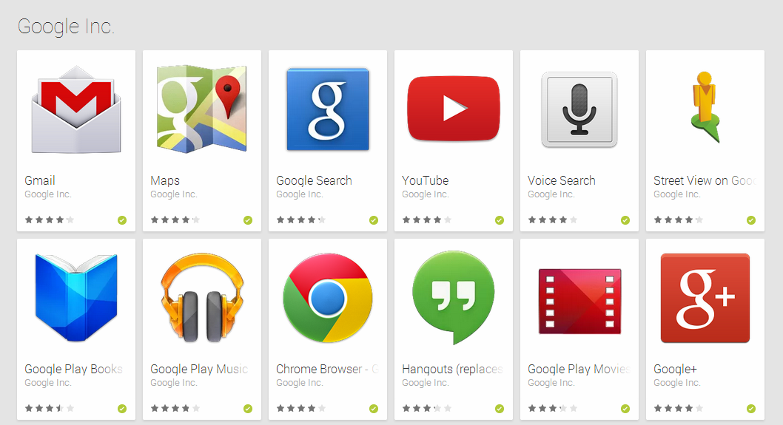
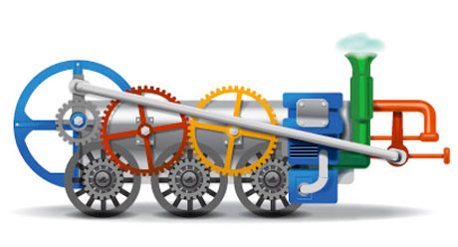
Example: Connectivity

Slide 48
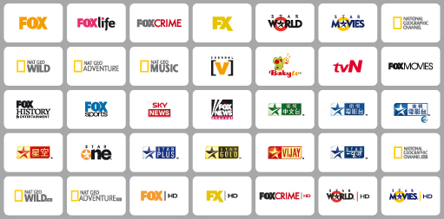

Example: Variety & assortment

Slide 49
4.3
Marketing.
Recent advances

Slide 50
4.3.1
Unconventional Marketing

Slide 51



Marketing 3.0
Marketing 1.0 (product)
industrial era (D > O: volumes, quantity)
Marketing 2.0 (customer)
‘O Reilly, 2001 (O>D: interacting with consumers) informational and internet era: active users, prosumers
Marketing 3.0 (soul)
Globalization era: (Kotler, 2010) the brand interprets and prevents user’s and societal needs (ethics & Corporate Social Responsibility)

Slide 52
Toward marketing 4.0
Kotler (2017)
information based on data that sheds light on new purchasing habits and on the three main subcultures: young people, women and "citizens of the Net";
rethinking customer engagement in the digital age, through humanistic marketing, the creation of conversations with customers and omnichannel strategies.
discover how 4.0 marketing increases productivity by involving customers in all their activities in digital markets
52

Slide 53

Unconventional Marketing
Set of strategic and tactics decisions in contemporary marketing aimed at:
Creating emotion
Enhancing memorability (awareness)
Developing uniqueness
Shocking and astonishing consumers
Enhancing users’ participation (engagement)

Slide 54
Unconventional marketing
Main features
Narrow set of receivers
High possibility to engage users
Selectivity
Target
Web
Multi-channel strategies
Marketing mix
54

Slide 55

Unconventional marketing
Management strategies and tactics coherent with the implementation of unconventional marketing:
FIT
  Tactics and actions upwards business strategies
  Integration of above the line- below the line media
  Integration offline online
CONTINUOUS COLLECTION OF DATA ALONG THE JOURNEY
55

Slide 56

UGC: user-generated content
Users are engaged in the definition of contents (ads, campaign, insights, design, offering) of businesses that lead to:
Collect insights
Enhance users engagement
To promote sharing of information and knowledge WITH and BETWEEN users
To monitor perception
To control Word-of-mouth
56

Slide 57
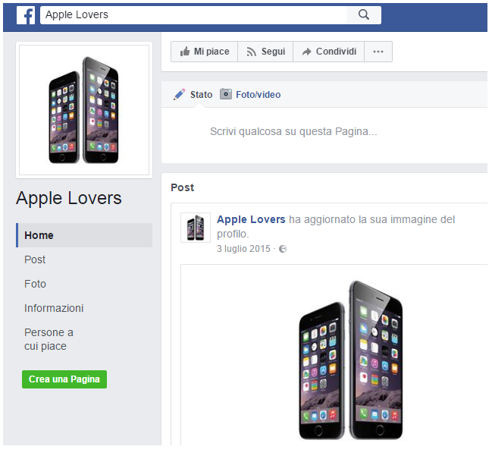
UGC
Unsolicited
https://www.facebook.com/Apple-Lovers-333551443482498/
57

Slide 58
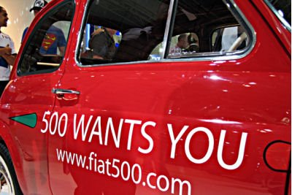

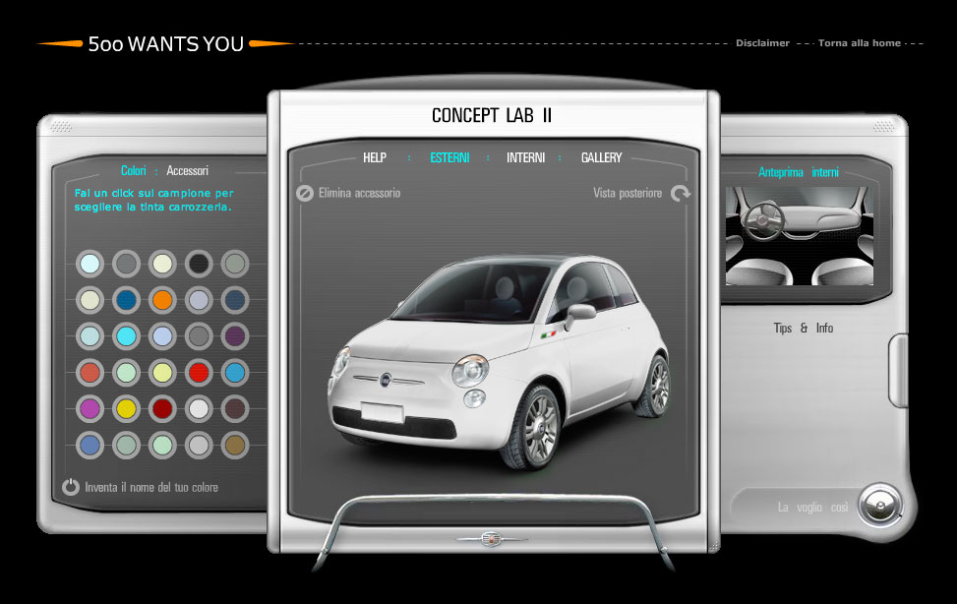
UGC
Solicited
Areas of intervention
Product
Communication
CSR
500 Wants you
MULTIMEDIA workshop
http://www.nelmulinochevorrei.it/
58

Slide 59
4.3.2
Guerrilla Marketing
59

Slide 60
Guerrilla Marketing
Non conventional communication activities that aim at pursuing conventional goals (Levinson, 1993)
Guerrilla marketing has the same advantages of unconventional marketing:
    To renew values and topics
    Emotional bonding, attractiveness, wonder
    Multi-channel communication: connectivity
    Maximum effort/ minimum investment of resources
CREATION
WEB
DIFFUSION
60

Slide 61
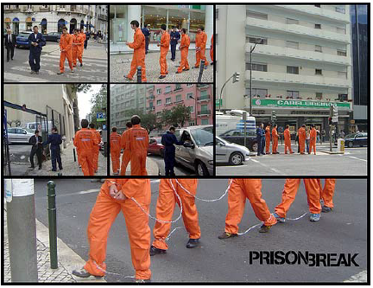
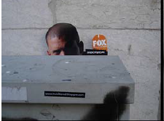
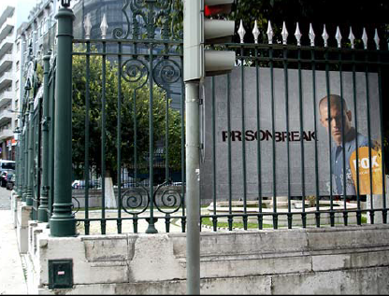
Guerrilla Marketing: TEASER
TEASER Phase
To create suspense
To create interest and to attract
GUERRILLA Phase
The brand shows, discloses itself and enters the city
CONSOLIDATION phase
Conventional activities:
commercials and ads
61

Slide 62
Guerrilla Marketing: TEASER
Unpredictability
Originality
Strong psychological approach
Little means available
Subversion of the pre-established order
Be everywhere and anyway

Slide 63
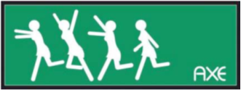
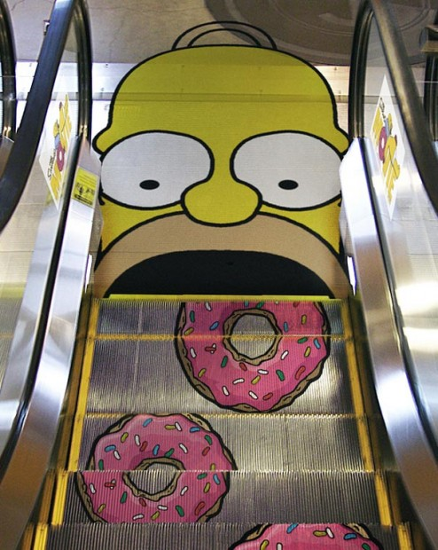
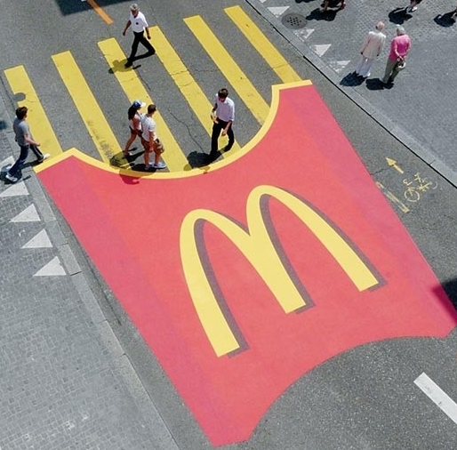
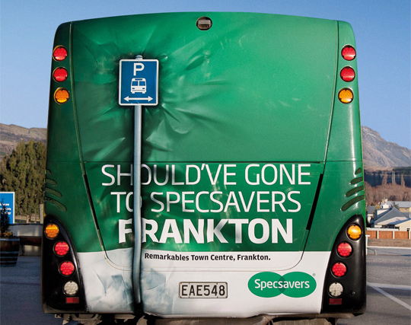
Guerrilla Marketing: STICKERING
Use of images and concepts shared through stickers
Public places and public means of transportations
63

Slide 64


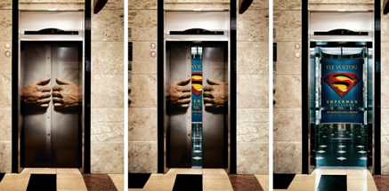

Guerrilla Marketing: STICKERING
To «reawaken» the interest
To surprise
To sensitize
To shock
64

Slide 65
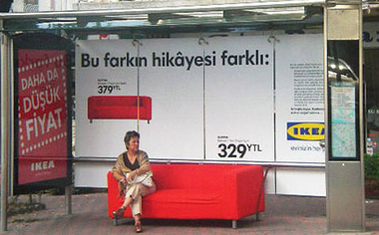
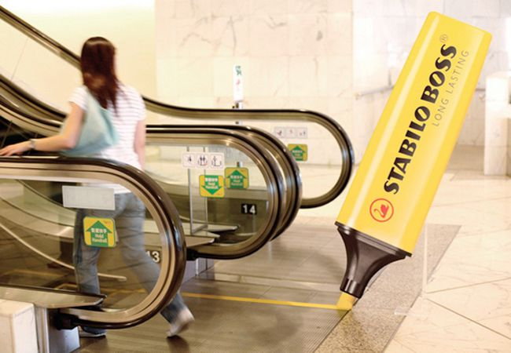
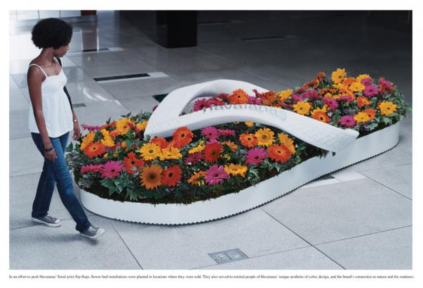
Guerrilla Marketing: STICKERING
Brands camouflage in daily context
Body art and tattoos
65

Slide 66
4.3.3
Viral marketing

Slide 67

Viral marketing: Word-of-mouth
Unconventional communication strategies based on the viral diffusion of contents through word-of-mouth
«The promotion targeted at everyone is useless. There is the need to target it at interested and influential people that, by sneezing, can spread the virus» (Godin, 2002)
Aims:
  To encourage interest and notoriety
  To engage (loyalty & reputation)
67

Slide 68
Word-of-mouth: on-line vs off-line
Differences
High frequency of interactions
Higher sense of belonging to the community
Commercial interests
Commonalities
To create loyalty between and among the actors
Creation of opinion leaders and legitimacy
«The consumers themselves are vehicles for brand’s and product’s promotion and put their reputation into the message» (Cottica e Fabbri, 2004)
68

Slide 69
4.3.4
Neuromarketing

Slide 70

Neuromarketing
Application of neuroscience and psychology to the analysis of users buying behaviors to detect changes in users’ behaviors and context and value
«To enter users’ minds» (Lee et al., 2007)
Interdisciplinarity:
medicine/ behavioral economy
70

Slide 71
Neuromarketing
AIMS:
To intercept and predict consumer behavior (and changes in attitudes and preferences)
To compare the brain reactions of consumers to certain stimuli and emotions
To investigate the brain mechanism that leads consumers to the decision and choice of value proposition
(Stimulus- Response)→ To connect specific feelings (affection) and behaviors (frontal lobe activation) performed by consumers with given impulses (vision of commercial)
71

Slide 72
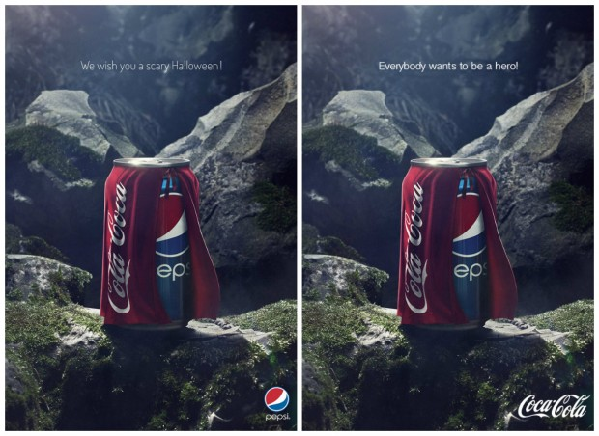

Neuromarketing: example
Pepsi Challenge (1975): 50% prefers PEPSI
Human neuroimaging lab, Houston (2003): 75% declared to prefer Coca Cola but choose PEPSI. (magnetic resonance)
Baylor College of Medicine, Texas (2004): Pre-frontal cortex (instinct and personality) Tastes and images are determinants of the choices
72

Slide 73

Guerriglia marketing (from spanish) is the definition coined by the American advertising Jay Conrad Levinson in 1984 in his book of the same name, to indicate a form of non-conventional and low-cost advertising promotion obtained through the creative use of aggressive means and tools that leverage the imaginary and psychological mechanisms end users.
73

Slide 74
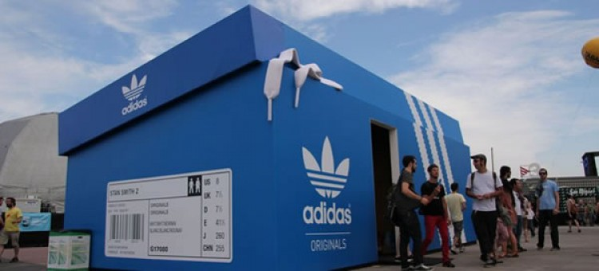

Slide 75
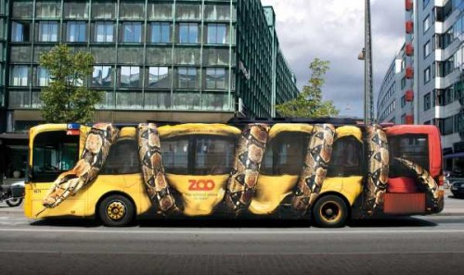

Slide 76


Slide 77


Slide 78


Slide 79



Slide 80


Slide 81


Slide 82


Slide 83
THANK YOU.
Questions? Comments?
Mara Grimaldi
margrimaldi@unisa.it

