Slide 1
Accessibility on Web
PV219, spring 2020

Slide 2
Agenda
Motivation / Why We Care?
Disabilities
Misconceptions
WAI-ARIA
WCAG / Legal Requirements
Making Accessible Content
Tooling and Testing
Demonstration
Summary

Slide 3
Motivation / Why We Care?
15 % of the global population report challenges in dealing with basic daily tasks and interactions (WHO)
>30 % of us will have some form of disability by the time we retire (StatsCan)
We all benefit from clear, logical, and user-friendly content and experiences
Accessible websites use semantic HTML and can help increase organic search traffic by as much as 50 %

Slide 4
Disabilities
There are three modes of disability:
Permanent Disability: This is when you are completely disabled. Example: blind, deaf and so.
Temporary Disability: This is simply a physical or mental disability which hinders your discharging of responsibilities for a short period of time.
Conditional or Situation Disability: This is simply when you are not able to do things due to the situation you find yourself in. Example: slow internet connection.

Slide 5
Disabilities
Category | Examples of Disabilities | Examples of Needs
Visual | Blind, low vision, color blindness | Screen reader, keyboard navigation, enlarged content, high contrast
Audial | Deaf, hearing impaired | Video captions, audio transcripts
Mobility | Limited motion, coordination | Keyboard navigation, large controls
Cognitive | Learning, memory, dyslexia | Simple content, layout, navigation

Slide 6
Assistive Technologies
Assistive technologies help users with disabilities increase, maintain, or improve their functional capabilities.
Screen readers
Eye tracking software
Keyboard shortcuts
Braille displays

Slide 7
Misconceptions in A11Y
“Web accessibility only helps a fraction of my users / the population.”
For instance, 3.8 million Canadians over 15 years old (14 %) live with disabilities
Big picture: There are significant overlaps between accessibility and usability that can benefit everyone.

Slide 8
Misconceptions in A11Y
“Web accessibility is expensive and time consuming.”
More research is required to create accessible sites, but designers and developers experienced in accessibility require less research time and bake these “extra features” in from the get-go
  Retrofitting inaccessible sites is a lot more time consuming (and funds) than building an accessible site from scratch
See W3C’s Financial Factors of web accessibility for more details.

Slide 9
Misconceptions in A11Y
“We don’t need to be compliant.”
Legislation (like the Czechia's Disabilities Act) is still evolving
Web accessibility lawsuits are steadily increasing in the U.S.
  The precedent has been set: a blind plaintiff unable to purchase products online has successfully sued Winn-Dixie, a major American grocery chain

Slide 10
WAI-ARIA
Web Accessibility Initiative – Accessible Rich Internet Applications is a technical specification published by the W3C that specifies how to increase the accessibility of web pages, in particular, dynamic content, and user interface components developed with Ajax, HTML, JavaScript, and related technologies.
Some practical tips are available in special document on W3C’s site.

Slide 11
WCAG
The Web Content Accessibility Guidelines are a series of internationally recognized (available also in Czech language) guidelines that are intended to help solve many problems that web users with disabilities face. Guiding principles are:
  Perceivable
  Operable
  Understandable
  Robust
Three levels of conformance: A, AA, AAA
Notes:
Vnímatelnost
Ovladatelnost
Zrozumitelnost
Robustnost

Slide 12
WCAG
Perceivability is converting non-textual content into text, which can then be processed by the assistive technology of the user’s choice. Think about: Alt text, Captions
  Orientation: Websites and applications must support both portrait and landscape modes, unless absolutely necessary. This allows users with visual disabilities to rotate their mobile devices to increase text size.
  Identify Input Purpose: Websites must include indications about what kind of data to enter in a field. This allows the browser to autofill some forms, and allows assistive technologies to better inform the user about the purpose of different fields.
  Identify Purpose: Similarly, interface components such as icons should have specific labels within the code that assistive technologies can interpret. For example, a button that returns the user to the main page should be labeled “home button.”
  Reflow: Websites must use responsive design so that the text can be enlarged while the layout is preserved.
  Non-Text Contrast: To assist users with low vision, active interface components and non-text content should have a contrast ratio of at least 3:1.
  Text Spacing: Users must be able to increase the spacing between lines, paragraphs ,and words without losing functionality.
  Content on Hover or Focus: A user should be able to be dismiss pop-up content that appears in a modal window or tooltip at will and without having to move the pointer hover or the keyboard focus.
Notes:
Informácie a súčasti užívateľských rozhraní musia byť prezentované tak, aby ich užívatelia boli schopní vnímať.

Slide 13
WCAG
Operability means to allow users to navigate focusable elements via the keyboard and activate them using the Return key. Make sure that you do not override browsers behavior or use an illogical focus order. Think about: Focus states, Keyboard navigation, Form labels, Avoid flashes or fast animations
  Character Key Shortcuts: Keyboard shortcuts that use a letter, punctuation, number, or symbol can be turned off or changed to use keys such as Ctrl and Alt instead.
  Timeouts: Websites must inform users of how much time they have before inactivity leads to data loss, unless the time limit is longer than 20 hours.
  Animation from Interactions: Users can turn off animations and videos, unless they are essential to the website’s functionality.
  Pointer Gestures: Users can replace complex gestures such as pinching and swiping with simpler gestures such as taps and long presses.
  Pointer Cancellation: Users must be able to easily cancel an accidental “down event” such as a click, tap, or long press.
  Label in Name: A label’s visible text and accessible name must match each other.
  Motion Actuation: Functionality that is accessible through motions such as shaking your mobile device must also be accessible through the user interface.
  Target Size: In most cases, clickable elements must be at least 44x44 pixels.
  Concurrent Input Mechanisms: Users should be able to switch between multiple input mechanisms, such as touch, keyboard, mouse, and speech.
Notes:
Všetky súčasti používateľského rozhrania a všetky navigačné prvky musia byť ovládateľné.

Slide 14
WCAG
Content that is understandable can be read and comprehended by users without undue effort. This means that the content should be understandable both by the users themselves and by assistive technologies such as screen readers. Think about: Link text, Form errors
  Readable: Some people with disabilities experience challenges when recognizing written words or when inferring the meaning of a word from context. Your web content should make this process as easy as possible by identifying the language(s) that text is written in as well as any unusual words or abbreviations.
  Predictable: Presenting your website content in a predictable order and having your site behave predictably are essential for people with disabilities to successfully use and navigate your site.
  Input Assistance: People with disabilities, and the assistive technologies they use, often make mistakes more easily when entering information. In order for them to understand the problem and correct the issue, websites should provide better error messages and help prevent errors whenever possible.
Notes:
Informácie a ovládanie používateľského rozhrania musia byť zrozumiteľné.

Slide 15
WCAG
The robustness can be satisfied automatically if you use semantic elements correctly for their intended purpose. Maximize compatibility with current and future user tools.
Think about: Semantics, Valid HTML
  Parsing: The content and code of your website should be well-formed. For example, content written in a markup language such as HTML or XML should have complete start and end tags and should nest elements correctly. This will help prevent display errors and problems with assistive technologies.
  Name, Role, and Value: User interface components such as form elements can have their name and role “programmatically determined” by an assistive technology. In addition, people with disabilities can use assistive technologies to set values, properties, and states on your website.
  Status Messages: Many websites make use of dynamic content such as status messages that are written in markup languages such as HTML and XML. This content must be presented to users of assistive technologies without necessarily receiving a visual focus. For example, if users are viewing their social media feeds, they can be alerted of a new post without the browser automatically scrolling up to display it to them
Notes:
Obsah musí byť dostatočne robustny, aby mohol byť spoľahlivo interpretovaný širokou škálou prístupových zariadení vrátane asistenčných technológií.

Slide 16
WCAG
Level A
High user impact
Low impact on presentation/functionality
Easy to implement
Captions are provided for all pre-recorded videos with audio

Slide 17
WCAG
Level AA
High user impact
Some impact on presentation/functionality
An audio description is provided for all pre-recorded videos with audio.

Slide 18
WCAG
Level AAA
Specific user impact
Some impact on presentation/functionality
Increased level of difficulty to implement
Sign language interpretation is provided for all pre-recorded videos with audio.

Slide 19
Legal Requirements
WCAG 2.0 is the de facto standard
Countries whose gov’t sites must comply with at least WCAG 2.0 Level A:
  Japan
  New Zealand
  All of the EU
Countries with broad accessibility laws that have been applied to the web
  USA (Lawsuits interpreting this as meeting WCAG Level A/AA)
  Australia (Gov’t interpreting this as meeting WCAG Level A)
  UK (Discrimination lawsuits settled out of court; Gov’t interpreting this as WCAG 2.0)

Slide 20
Making Accessible Content
Colors
The red-green color deficiency, affects approximately 8 % of the population. On the other hand users with learning disabilities, benefit greatly from color when used to distinguish and organize your content.
Be sure to use other visual indicators than colors (asterisk, question mark)
Use visual separation between block (whitespace, borders)

Slide 21
Making Accessible Content
Navigation
Navigation should be simple and consistent
Navigation links should come after the main content
  Or provide a link or method that allows users to skip repetitive navigation links
Display some content only to screen readers
  Use absolute positioning off the screen instead of display:none or visibility:hidden
Links should describe the linked page and make sense if read out of context
  Avoid "click here" or "more"
Buttons and tabs should be large enough for easy use

Slide 22
Making Accessible Content
Tables
Data tables: summary="…", <caption>, <th>, scope="col"
Layout tables: role="presentation"
Keep tables simple; minimize nested tables and cells spanning rows and column

Slide 23
Making Accessible Content
Online Forms
Easy to navigate, complete, and submit
  Instructions positioned before the form elements; clearly identify required fields
  Keyboard for navigation (e.g. Tab and arrows to move, Enter to submit) and logical tab order
  Label form fields (e.g. text, dropdowns): <label for="name">Name:</label><input type="text" id="name" name=“name" />
  Group related fields with <fieldset> and <legend> tags
  CAPTCHA alternatives
Error handling
  Validation: both client and server
  Error messages that clearly indicate the problem and solution
  Error correction should be easy
  Alternative way of providing the information requested, e.g. email

Slide 24
Making Accessible Content
Language
Indicating the language of content using the lang attribute on multilingual sites ensures assistive technology will read content with correct pronunciation.
Add a global language on the <html> tag.
Add a lang attribute to any in page content that differs in language.

Slide 25
Tooling and Testing
A few accessibility tests you can give yourself immediately:
Don't use a mouse
Zoom your page to 200 %
Use your site on a phone
Turn on high contrast
Free accessibility tools and assistive technology you can use: NVDA, TalkBack, Seeing AI, Google A11Y Tools, …

Slide 26
Tooling and Testing
Automated Tools
Accessibility Evaluation Tools (WAVE and aXe) analyze website markup against various WCAG criteria and run right in your browser.
These tools help to detect:
Missed heading levels
Empty links and alt text
Colour contrast issues

Slide 27
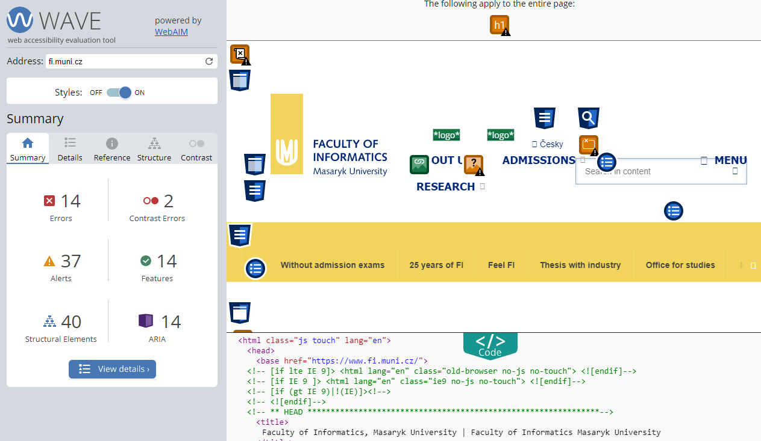
Tooling and Testing

Slide 28
Tooling and Testing
Vision simulators
See what users see by running vision simulators in the browser. These programs (Color Contrast Analyzer,
NoCoffee) help identify areas that may be failing WCAG contrast ratios or are generally problematic.

Slide 29
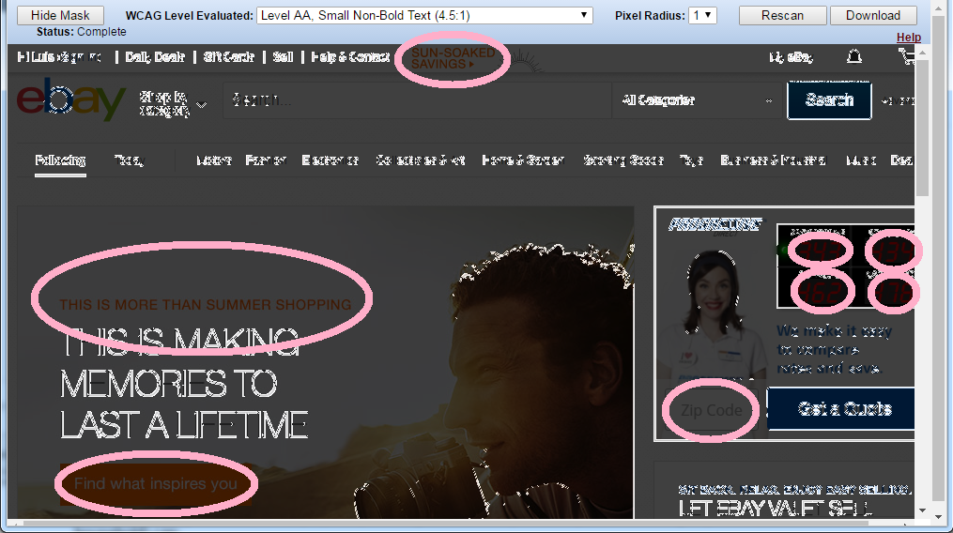
Tooling and Testing

Slide 30
Demonstration

Slide 31
Summary
Always have web accessibility at the back of your mind when building a website. That is ensure you are building for everyone that have access to the web.
The Teiresias Centre (MUNI)
BlindFriendly.cz (TyfloCentrum Brno)
Poslepu.cz (Radek Pavlíček)

