Slide 1
Similarity Searching for
Database Applications
Pavel Zezula
Masaryk University
Brno, Czech Republic

Slide 2
Outline of the talk
On the importance of similarity and searching
Principles of metric similarity searching
Similarity search applications:
  Searching in images of human faces
  Searching for image annotation
  Stream processing
  Searching in motion capture data

Slide 3
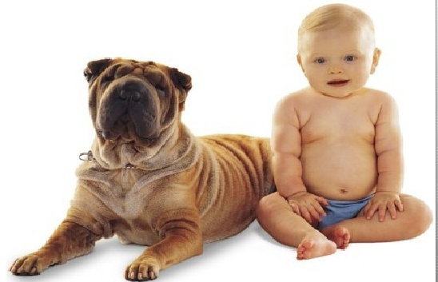
Real-life Similarity
Are they similar?

Slide 4
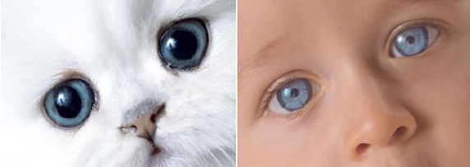
Real-life Similarity
Are they similar?

Slide 5
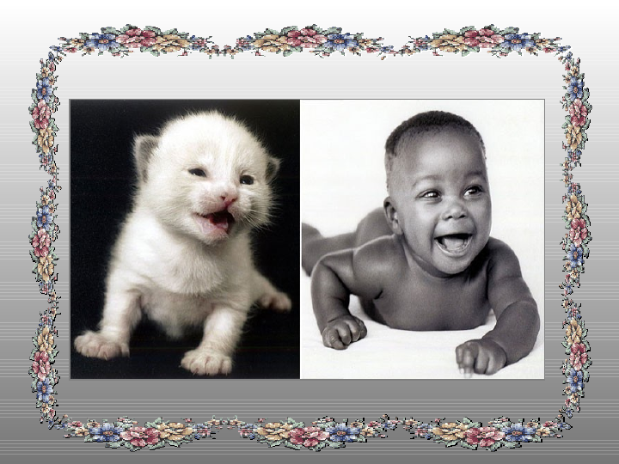
Real-life Similarity
Are they similar?

Slide 6
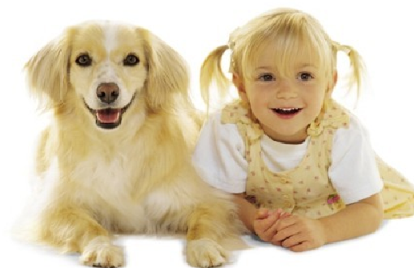
Real-life Similarity
Are they similar?

Slide 7
Real-Life Motivation
The social psychology view
Any event in the history of organism is, in a sense, unique.
Recognition, learning, and judgment presuppose an ability to categorize stimuli and classify situations by similarity.
Similarity (proximity, resemblance, communality, representativeness, psychological distance, etc.) is fundamental to theories of perception, learning, judgment, etc.
Similarity is subjective a context-dependent

Slide 8
Contemporary Networked Media
The digital data view
Almost everything that we see, read, hear, write, measure, or observe can be digital.
Users autonomously contribute to production of global media and the growth is exponential.
Sites like Flickr, YouTube, Facebook host user contributed content for a variety of events.
The elements of networked media are related by numerous multi-facet links of similarity.

Slide 9
Challenge
Networked media database is getting close to the human “fact-bases”
  the gap between physical and digital world has blurred
Similarity data management is needed to connect, search, filter, merge, relate, rank, cluster, classify, identify, or categorize objects across various collections.
WHY?
It is the similarity which is in the world revealing.

Slide 10
Similarity and the Big Data
Loads on a sharp rise – usage on decline
The (3V) problem of: Volume, Variety, Velocity
Issues:
  Acquisition: what to keep and what to discard
  Unstructured data: what content to extract
  Datafication: render into data many new aspects
  Inaccuracy: approximation, imprecision, noise

Slide 11
The Big Data problem
Shifts in thinking:
  from some to all (scalability)
  from clean to messy (approximate)
Technological obstacles: heterogeneity, scale, timeliness, complexity, and privacy aspects
Foundational challenges: scalable and secure data analysis, organization, retrieval, and modeling

Slide 12
Search – the goals
We search to get results (papers, books, …)
We ask to find answers (what time … )
We use filters so that the right staff finds us
We browse while wandering and way-finding in typically restricted space
In reality, we move fluidly between modes of
ask, browse, filter, and search

Slide 13
Search – some quantitative facts
85% of all web traffic comes from search engines
450+ million searches/day are performed in North America alone
70%+ of all searches are done on Google sites
Search is the most popular application
(second to E-mail??)

Slide 14
Search – some experience
60% of searchers NEVER go past 1st page of search results
The top three results draw 80% of the attention
The first few results inordinately influence query reformulation.

Slide 15
Search - as an interaction
When we search, our next actions are reactions to the stimuli of previous search results
What we find is changing what we seek
In any case, search must be:
fast, simple, and relevant

Slide 16
Search – changes our cognitive habits
  We are increasingly handing off the job of remembering to search engines
  When we expect information to be easily found again, we do not remember it well
  Our original memory of facts is changing to a memory of ways to find the facts

Slide 17


State of the art in
Metric Searching technology
Hanan Samet
Foundation of Multidimensional and
Metric Data Structures
Morgan Kaufmann, 2006
P. Zezula, G. Amato, V. Dohnal, and M. Batko
Similarity Search: The Metric Space Approach
Springer, 2005
Teaching material: http://www.nmis.isti.cnr.it/amato/similarity-search-book/

Slide 18



Similarity Search Conferences
9th SISAP 2016, October 24-26, Tokyo, Japan

Slide 19
The MUFIN Approach
MUFIN: MUlti-Feature Indexing Network
SEARCH
Extensibility
metric space
Scalability
P2P structure
data & queries
index structure
infrastructure
Independence
Infrastructure as a service

Slide 20
Extensibility: Metric Abstraction of Similarity
Metric space: M = (D,d)
  D – domain
  distance function d(x,y)
    ∀x,y,z ∈ D
    d(x,y) > 0 - non-negativity
    d(x,y) = 0 ⇔ x = y - identity
    d(x,y) = d(y,x) - symmetry
    d(x,y) ≤ d(x,z) + d(z,y) - triangle inequality

Slide 21
Examples of Distance Functions
L_{p} Minkovski distance (for vectors)
    L₁ – city-block distance
    L₂ – Euclidean distance
    L∞ – infinity
Edit distance (for strings)
    minimal number of insertions, deletions and substitutions
    d(‘application’, ‘applet’) = 6
Jaccard’s coefficient (for sets A,B)

Slide 22

Examples of Distance Functions
Mahalanobis distance
  for vectors with correlated dimensions
Hausdorff distance
  for sets with elements related by another distance
Earth movers distance
  primarily for histograms (sets of weighted features)
and many others

Slide 23
Similarity Search Problem
For X ⊆D in metric space M,
pre-process X so that the similarity queries
are executed efficiently.
  In metric space: no total ordering exists!

Slide 24
Basic Partitioning Principles
Given a set X ⊆ D in M=(D,d), basic partitioning principles have been defined:
  Ball partitioning
  Generalized hyper-plane partitioning
  Excluded middle partitioning

Slide 25
Ball Partitioning
Inner set: { x ∈ X | d(p,x) ≤ d_{m} }
Outer set: { x ∈ X | d(p,x) > d_{m} }
d_{m}
p

Slide 26
Generalized Hyper-plane
{ x ∈ X | d(p₁,x) ≤ d(p₂,x) }
{ x ∈ X | d(p₁,x) > d(p₂,x) }
p₂
p₁

Slide 27
Similarity Range Query
range query
  R(q,r) = { x ∈ X | d(q,x) ≤ r }
… all museums up to 2km from my hotel …
r
q

Slide 28
Nearest Neighbor Query
the nearest neighbor query
  NN(q) = x
  x ∈ X, ∀y ∈ X, d(q,x) ≤ d(q,y)
k-nearest neighbor query
  k-NN(q,k) = A
  A ⊆ X, |A| = k
  ∀x ∈ A, y ∈ X – A, d(q,x) ≤ d(q,y)
… five closest museums to my hotel …
k=5
q

Slide 29
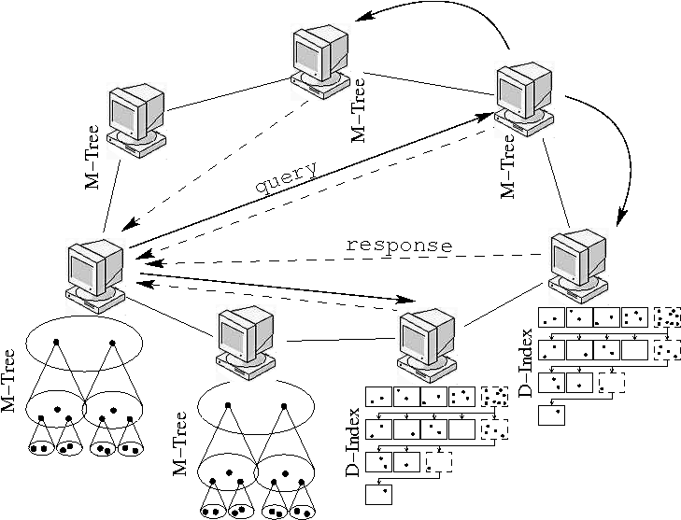
Scalability: Peer-to-Peer Indexing
Local search: Main memory structures
Native metric techniques: GHT*, VPT*
Transformation techniques: M-CAN, M-Chord

Slide 30



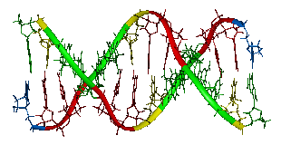
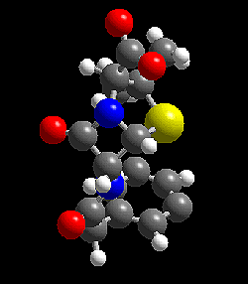
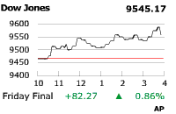
Infrastructure Independence: MESSIF
Metric Similarity Search Implementation Framework
Performance statistics
Distributed index structures
Centralized index structures
Metric space (D,d)
Operations
Storage
Communication
Net
Vectors
  L_{p} and quadratic form
Strings
  (weighted) edit and
  protein sequence
Insert, delete,
range query,
k-NN query,
Incremental k-NN
Volatile memory
Persistent memory

Slide 31
MUFIN demos
http://disa.fi.muni.cz/imgsearch/similar
http://www.pixmac.com/
http://disa.fi.muni.cz/twenga/
http://disa.fi.muni.cz/fingerprints/
http://disa.fi.muni.cz/subseq/
http://disa.fi.muni.cz/FaceMatch/
http://disa.fi.muni.cz/annotation/
http://disa.fi.muni.cz/motion-match/
http://disa.fi.muni.cz/profimedia-neural_network-20M/

Slide 32
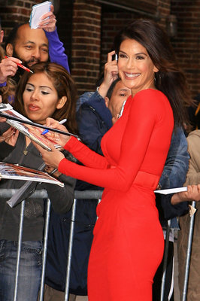




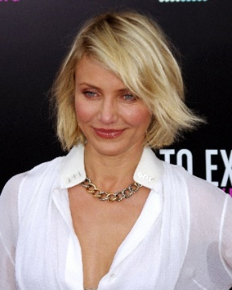






Similarity Search in Collections of Faces
<13.9, 9.5, -6.0, 712.1, …>
<17.9, 12.1, -9.1, 692.0, …>
<8.8, 7.7, -3.5, 570.8, …>
<14.4, 8.2, -8.4, 704.0, …>
<10.1, 5.8, 40.6, 99.6, …>
Merge of detected faces
<5.4, 1.2, -60.4, 88.0, …>
<45.1, 64.8, 90.6, 78.6, …>
Face detection with several technologies
Face description with several technologies
Features indexing by one technique
Fused features saving
Preprocessing
Face Detection
Features Extraction
Retrieval
Index
Fused features DB
Candidate
faces
Candidates
filtering
<13.9, 9.5, -6.0, 712.1, …>
<10.6, 78.9, -45.6, 101.3, …>
0.12
0.17
0.18
0.23
Query image

Slide 33
Fused Face Detection and Face Matching
Fused face detection:
  Faces detected by more technologies are taken into account
  Showcase: 3 technologies, compliance of at least two:
Fused face matching:
  Characteristic features from more technologies are available for each face
  Similarity of two faces evaluated by each technology is normalized into interval [0, 1]
  Normalized value expresses a probability that faces belong to the same person
  Highest probability is used to determine the similarity of faces
Software name | OpenCV | Luxand | Verilook | Compliance of at least 2
Recall / precision (%) | 55 / 89 | 64 / 83 | 73 / 83 | 64 / 96

Slide 34









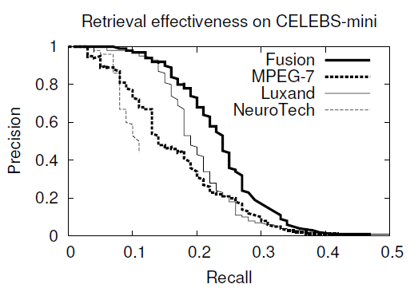
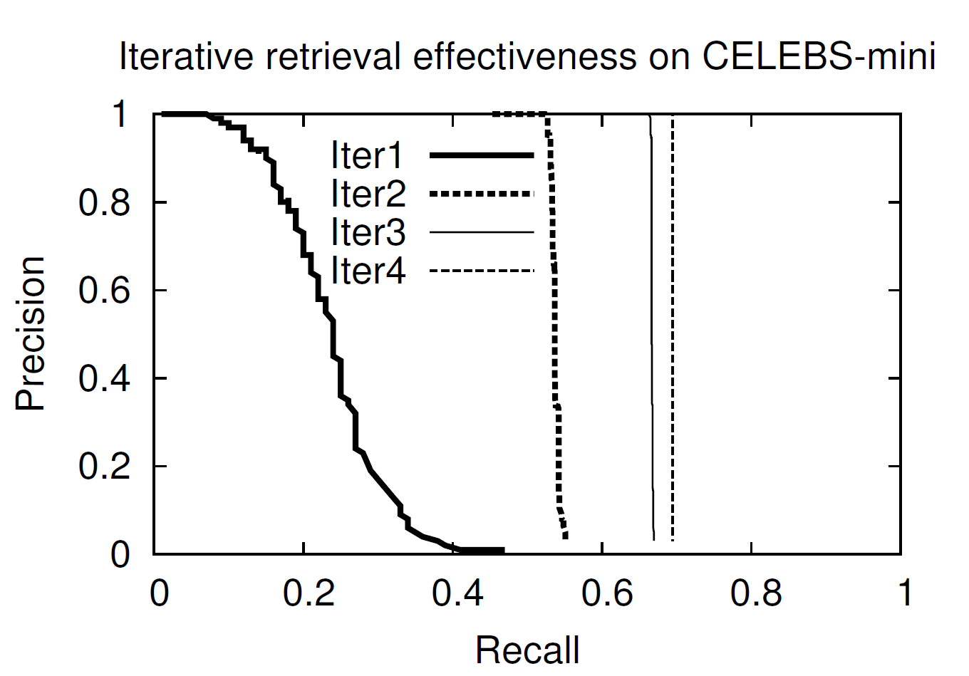
Face Matching Results, Relevance Feedback
User may improve results by marking correctly found faces in several iterations:
1st iteration
query
2nd iteration
query

Slide 35
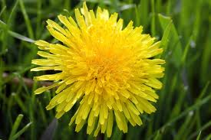
Search-based Image Annotation
Keyword-based image retrieval
  Popular and intuitive
  Needs pictures with text metadata
  Manual annotation is expensive
?
Need for automatic image annotation
We already have a strong tool – the similarity search
  For any input image, we can retrieve visually similar images
  Metadata of the similar images can be used to describe the original image
Search-based image annotation

Slide 36
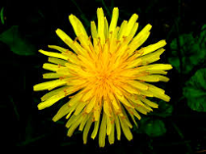


Search-based annotation principles
Annotated image collection
Similar annotated images
d = 0.2
d = 0.5
d = 0.6
?
Content-based
image retrieval
Yellow, bloom, pretty
Meadow, outdoors, dandelion
Mary’s garden, summer
Final candidate keywords
with probabilities
Semantic resources
Candidate
keyword
processing
Plant 0.3
Flower 0.3
Garden 0.15
Sun 0.05
Human 0.1
Park 0.1

Slide 37
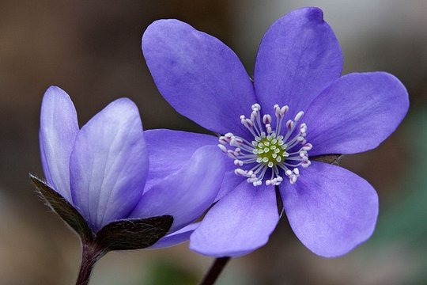
Content-based retrieval for annotations
What we need:
  Large collection of reliably annotated images: Profiset
    20 million general-purpose photos from the Profimedia photostock company
    Descriptive keywords for each photo provided by authors who want to sell the pictures → rich and reliable annotations
  Efficient and effective search: DeCAF descriptors and PPP-codes
    DeCAF: 4096-dimensional vector obtained from the last layer of a neural network image classifier
    PPP-codes: effective permutation-based metric space indexing method
Profiset keywords: botany, close, closeup, color, daytime, detail, exterior, flower, germany, hepatica, horticulture, laughingstock, liverwort, lobed, mecklenburg, nature, nobilis, outdoor, outside, plant, pomerania, purple, round, western

Slide 38
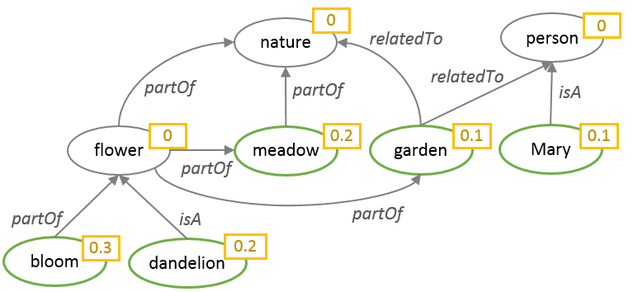
ConceptRank
Candidate keyword analysis inspired by Google PageRank
Uses semantic connections between candidate keywords to determine the probability of individual candidates
Main steps:
  Construct a graph of candidate keywords related by WordNet semantic links
    New candidates can be found during the WordNet exploration
  Apply biased random walk with restarts to compute the score of each keyword
    Keyword scores from the content-based search are included via the biased restart
Similar annotated images
d = 0.2
d = 0.5
d = 0.6
Yellow, bloom, pretty
Meadow, outdoors, dandelion
Mary’s garden, summer

Slide 39
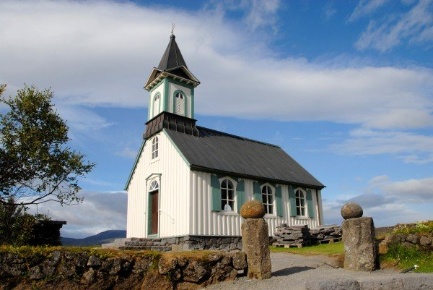
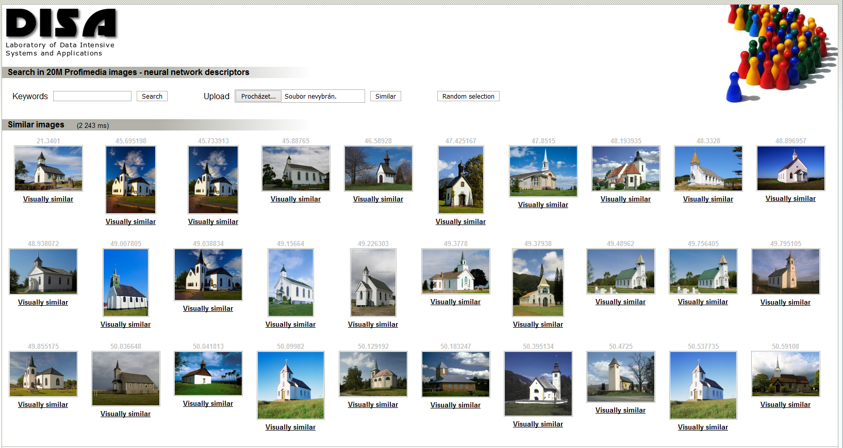
Example
Retrieve 100 similar images from Profiset
Merge their keywords, compute frequencies
Build the semantic network using WordNet
Compute the ConceptRank
Apply postprocessing & return 20 most probable keywords
Candidate keywords after CBIR
church, architecture, travel, europe, building, religion, germany, buildings, north, churches, christianity, america, religious, exterior, st, historic, world, tourism, united, usa, …
Semantic network
4 relationships: hypernym (dog → animal), hyponym (animal → dog), meronym (leaf → tree), holonym (tree → leaf)
270 network nodes, 471 edges
ConceptRank scores
building (2.53), structure (2.41), LANDSCAPE (2.10), BUILDINGS (1.87), OBJECT (1.84), NATURE (1.78), place_of_worship (1.75), church (1.74), Europe (1.68), religion (1.64), continent (1.51), …
Final keywords
building, structure, church, religion, continent, group, travel, island, sky, architecture, tower, person, belief, locations, chapel, christianity, tourism, regions, country, district

Slide 40
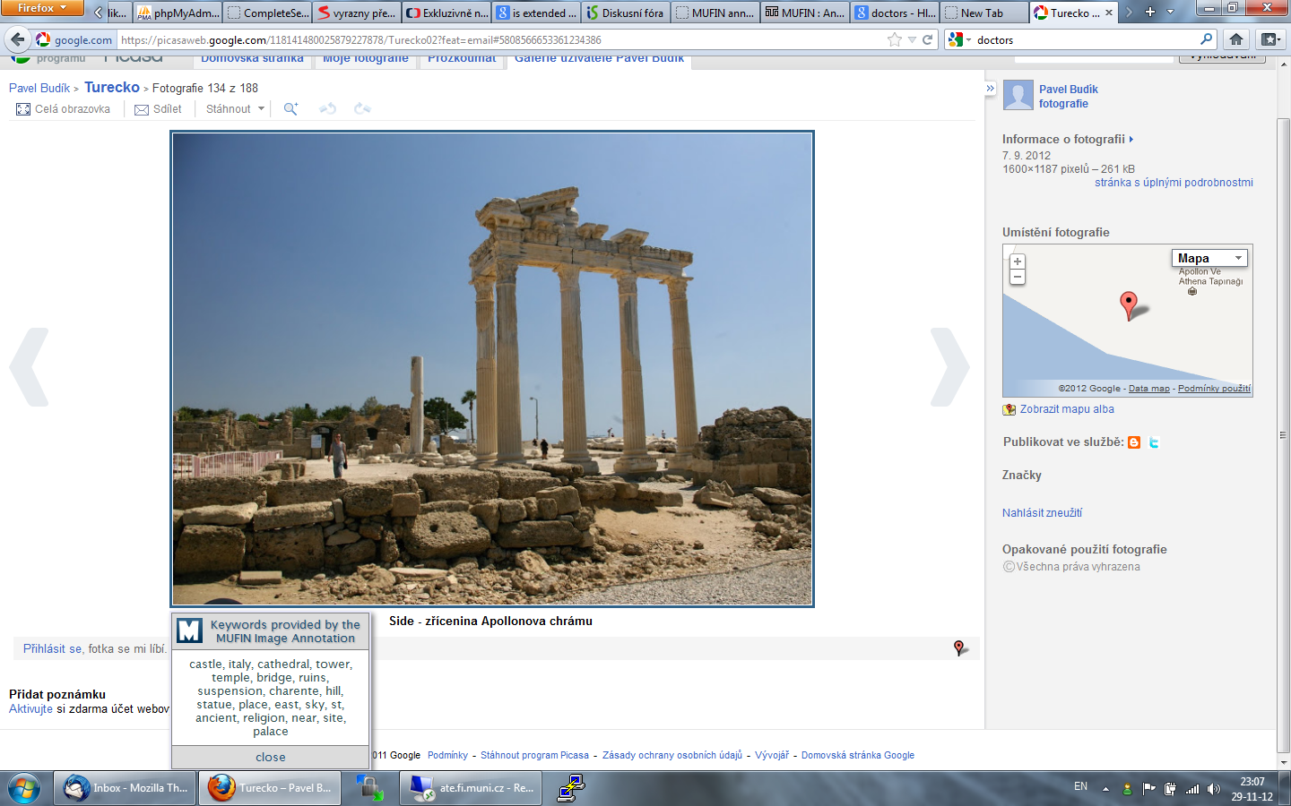
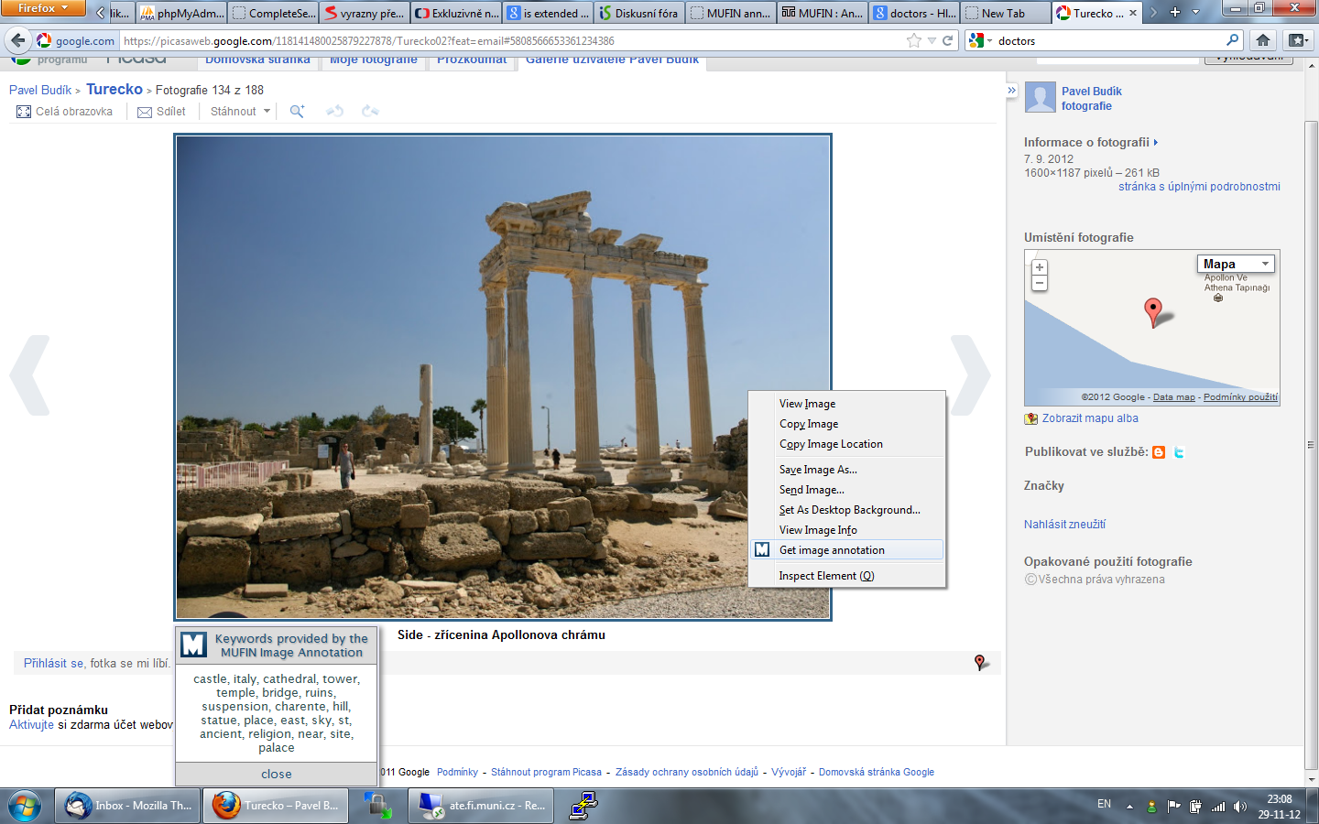

Annotations in use
Participation in the ImageCLEF 2014 Scalable Annotation Challenge
  2nd place, mean average precision of annotation approx. 60 %
Web demo & Mozilla addon
  http://disa.fi.muni.cz/prototype-applications/image-annotation

Slide 41
Similarity Search in Streams
Two basic approaches to explore data:
  Store, pre-process and search later, database processing
  Process (filter) continuously, stream processing
Examples of stream processing applications:
  Surveillance camera and event detection
  Mail stream and spam filter
  Publish/subscribe applications

Slide 42
Stream Processing Scenarios
Stream: potentially infinite sequence of data items (d₁, d₂, …) – tuples, images, frames, etc.
Basic scenarios:
  Data items processed immediately, possible data item skipping
  → minimize delay - e.g., event detection
  Process everything as fast as possible, delay possible to maximize throughput - our focus
Motivating examples with similarity searching
  Image annotation – annotate a stream of images collected by a web crawler
  Publish/subscribe applications – categorize a stream of documents by similarity searching

Slide 43

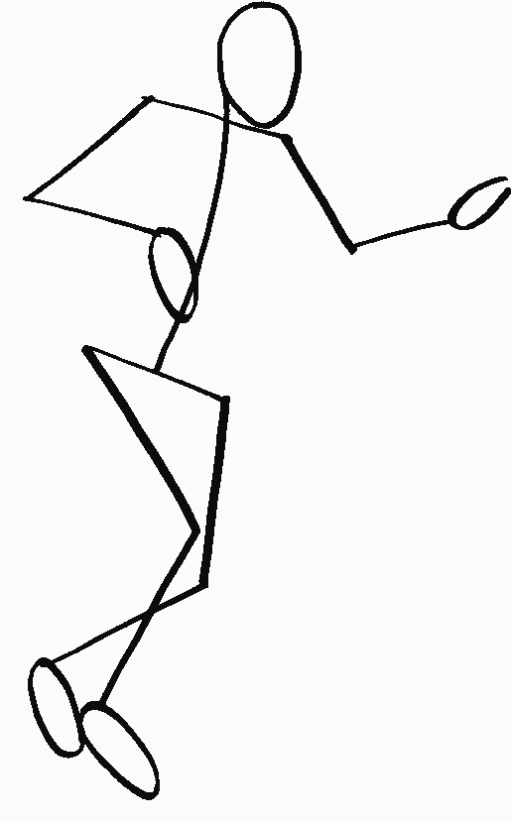

Processing Streams of Query Objects
Typical large-scale similarity search approach:
  partitioned data stored on a disk
  partition reads from a disk form the bottleneck
Idea: similar queries need similar sets of partitions → save accesses
Buffer: memory used for reordering (clustering) queries
Cache: memory containing previously read data partitions
Stream
Metric index
Buffer
Result
Query
Query
Cache
Disk

Slide 44
Experiment Results
100,000 processed 10-NN queries
DB: 1 mil. MPEG-7 descriptors
Buffer capacity: 8,000 queries
Cache size: 40,000 objects (4% of the DB)
100,000 processed 10-NN queries
DB: 10 mil. MPEG-7 descriptors
Buffer capacity: 10,000 queries
Cache size: 90,000 objects (0.9% of the DB)

Slide 45
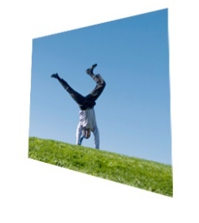
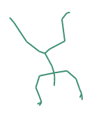

Similarity Search in Motion Capture (Mocap) Data
Digital representations of human motions, recorded by motion capturing devices for further use in a variety of applications.

Slide 46
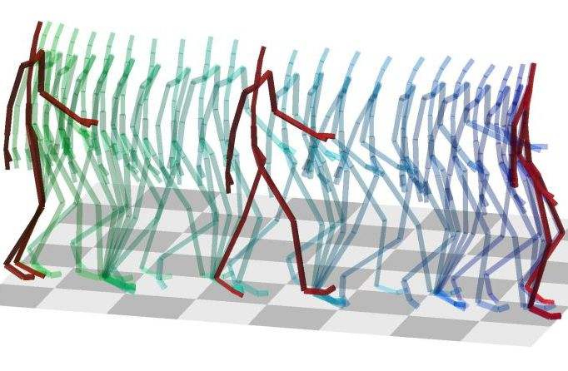
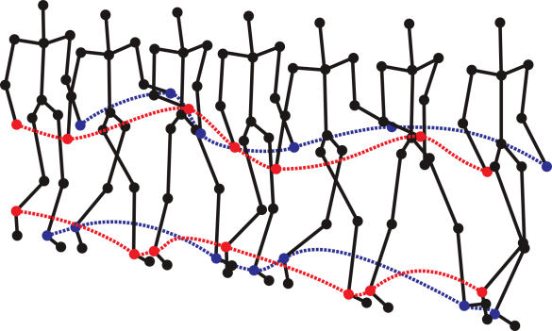
What Is Mocap
  Digital representation is depicted by series of coordinates of body joints in space-time.
    Complex multi-dimensional spatio-temporal data (3D space, 31 joints, 120 frames per second).
    Visualized by simplified human skeleton (stick figure), coordinates of joints stored as float numbers.
    1 minute of such motion data ≈ 669,600 float numbers.

Slide 47

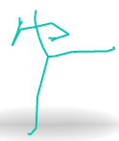
The Need for a Similarity Measure
  Almost every application of Mocap data
  (analysis, searching, action recognition, detection, synthesis, clustering)
  requires a pair-wise action comparison based on similarity.
  The challenge:
  Develop a measure
  for content-based similarity
  comparison of Mocap data.
?

Slide 48
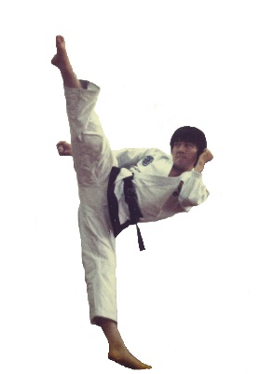
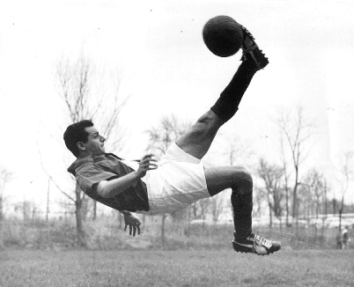
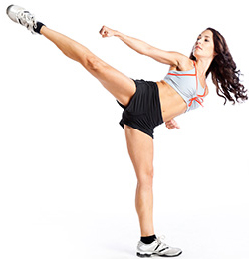
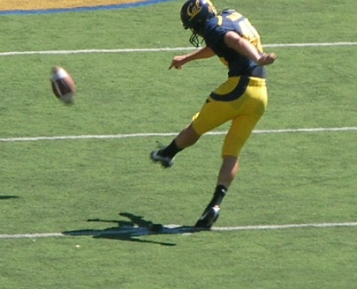
Motion Similarity Problems
The same action can be performed differently
    by different actors,
    in various styles,
    in various speed,
    or start at different body configurations.
  Similarity of motions is application-dependent
    e.g., general action recognition vs.
    person-identification
    there is no universal similarity model

Slide 49
Comparing Similarity in Motions
General Overview
1. DATA REPRESENTATION
absolute coordinates, relative distances, joint rotation angles or velocities
(quantization or dimensionality reduction might be applied)
+
2. WAYS OF COMPARISON
Distance-Based functions
Dynamic Time Warping
k-NN + L2
Machine Learning
Convolutional Neural Networks, Boltzmann M.
Support Vector Machines
Special structures
Motion and Action graphs
Temporal pyramids
Hidden Markov models
Notes:
https://docs.google.com/document/d/130MFzYC-hVFOCZhe58H7kcKkYuDPJp5p-D9gvWE8eU0/edit
DTW is not metric – but approximations exists for indexing

Slide 50
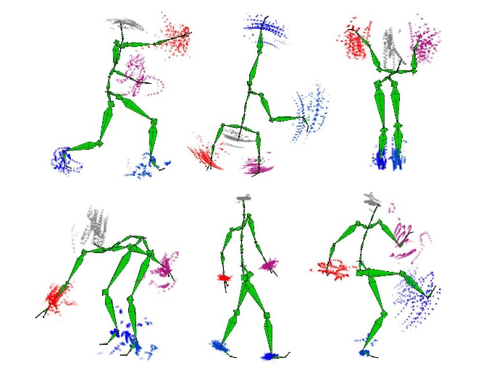
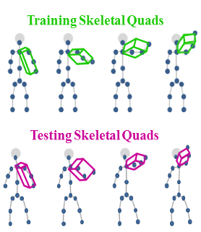
Comparing Similarity in Motions
Examples
  Joint positions features
  + Euclidean Distance
  (Krüger 2010)
  Fisher Vector
  + SVM classifier
  (Evangelidis 2014)
  Time Series
  + Dynamic Time Warping
  (Müller 2009)
Notes:
https://docs.google.com/document/d/130MFzYC-hVFOCZhe58H7kcKkYuDPJp5p-D9gvWE8eU0/edit

Slide 51
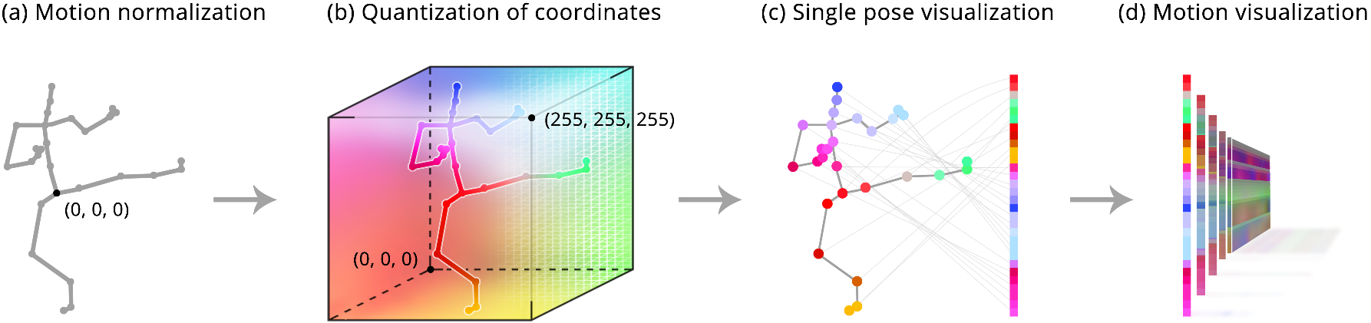
Our Approach – Motion Images
Every single-frame joint configuration is normalized (by centering and rotating), then transformed into a RGB stripe image while fully preserving skeleton configuration.
Notes:
We focus on body joints, not volumetric model nor skeleton bones
Why normalziation is important

Slide 52




Motion Images + Caffe
d = 13.17
d = 10.1
1) Effective transformation
from (dynamic) motion capture data into (static) images.
2) Extract fixed-size feature vector
using content-based image descriptors.
3) Index for fast and scalable search
1)
2)
<0, 0, 4.56, 0, 7.88, …>
3)
d = 14.2
d = 1.1
Motion
Motion Image
(hop-one-leg)
4096-dim
Caffe vector
Nearest neighbors

Slide 53
Similarity model: Caffe + L₂
Motion Images
4096-dimensional features
HDM05 dataset
2345 motions
120 fps, 31 joints
122 categories
Motion Images
1 motion = 1 image
Each image is rescaled to 256 x 256 px to fit as an input to the neural network.
Caffe Descriptors
Extracted using Convolutional Neural Network trained on 1.3M photographs
Network can be fine-tuned to the domain of motion images
Output of 7th layer is a 4096-dimensional vector
transform
extract
Caffe descriptors are fixed sized vectors extracted from motion images. They are compared for similarity by L₂ distance function.

Slide 54
Motion Images – Properties
  Pattern recognition is a mature concept nowadays
  many highly accurate computer vision techniques might be employed.
  The proposed similarity measure is robust and tolerant
  towards inferior data quality, execution speed and imprecise segmentation.
  Fixed-size feature vectors can be indexed in large scale
  evaluate a query in one year long Mocap data in less than a second
  Fixed-size feature vectors compress the original data

Slide 55
Sizes Compared
5 seconds of mocap
  3 x 31 x 120 x 5 = 57 600 floats
  ≈ 460 KB
1 image 256 x 256 px in png format
  ≈ 5-10 KB
1 caffe descriptor
  4096 floats ≈ 32 KB
  4096 bits ≈ 1 KB
1 mpeg7 descriptor
  256 floats ≈ 2 KB

Slide 56

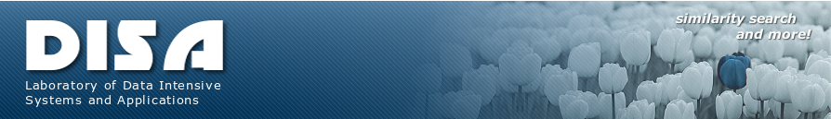
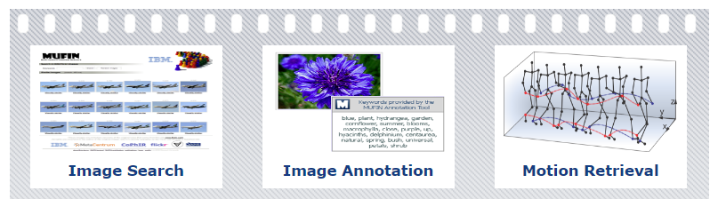
Laboratory of
Data Intensive Systems and Applications
disa.fi.muni.cz

