Slide 1
Practical example

Slide 2
SWOT

Slide 3
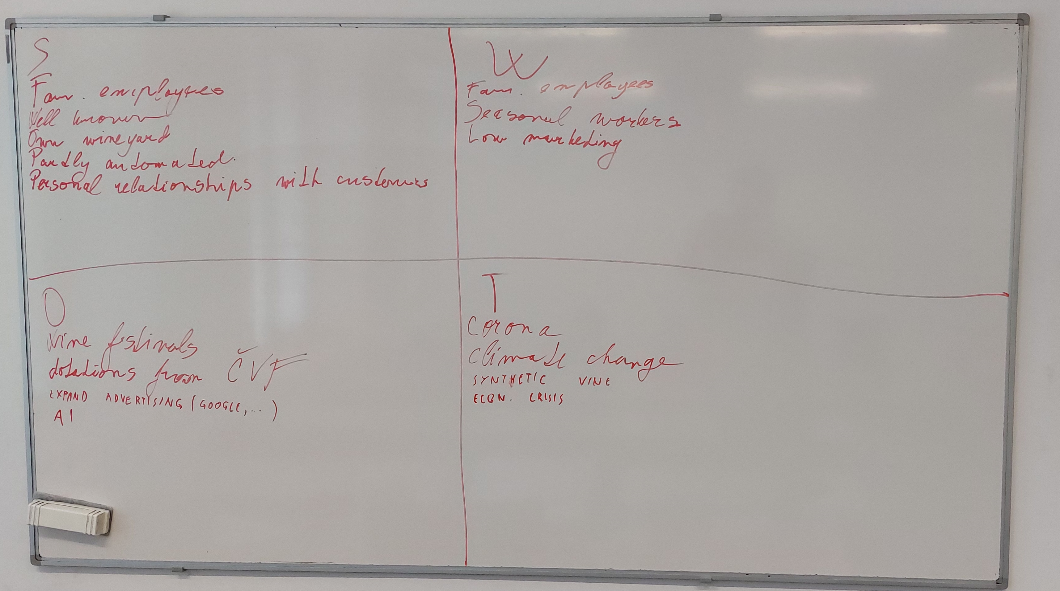
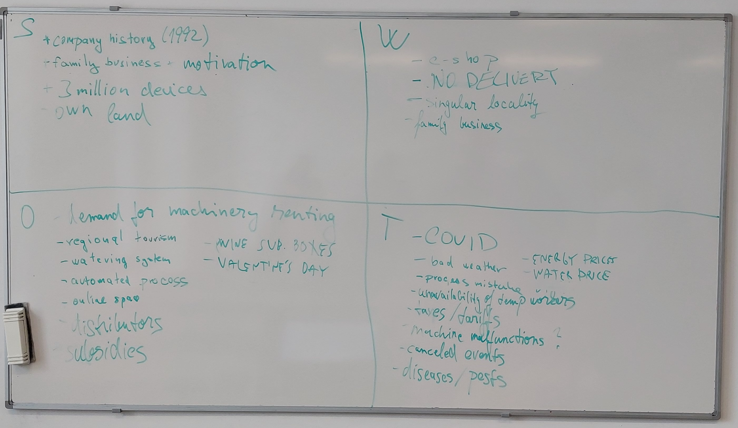
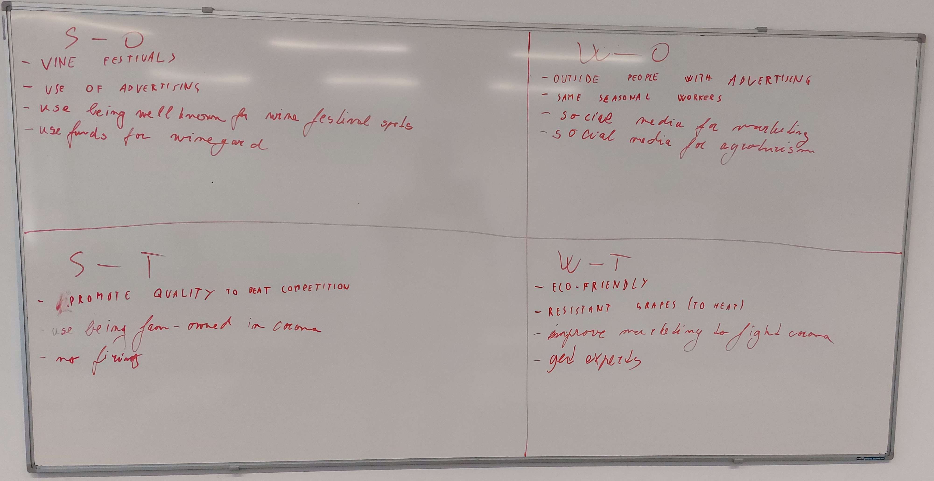
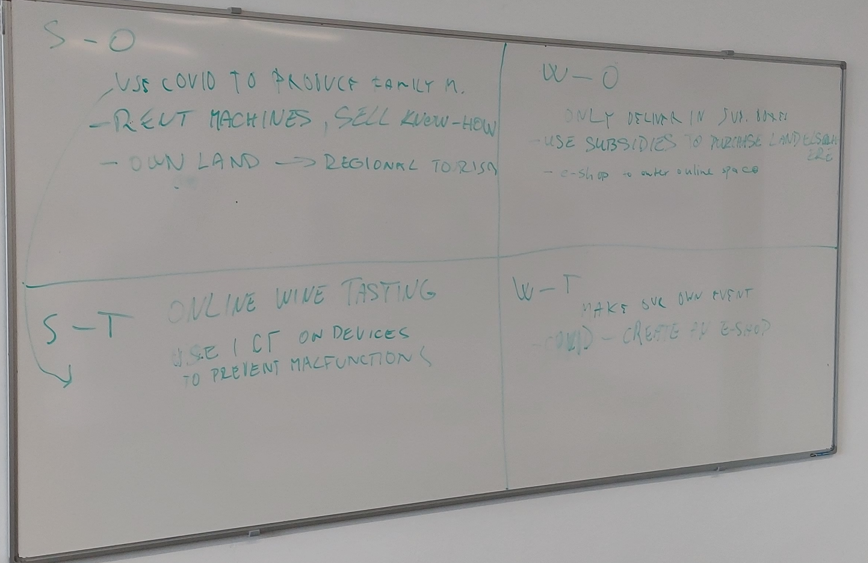

Slide 4
Company culture

Slide 5
Company culture
c_{re}( f₁+f₂ )=E
Company culture is the set of relationships between key factors essential for the company
Elements of culture
Symbols
Values
Rituals
Heroes
Examples of factors
interpersonal relationships
work environment
vision clarity
leader authority
organizational structure
level of formality
Benefits
work/life balance

Slide 6
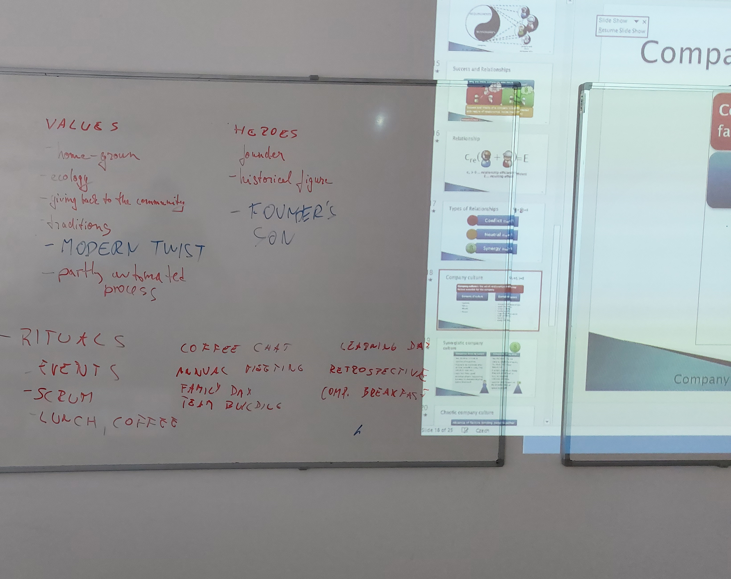
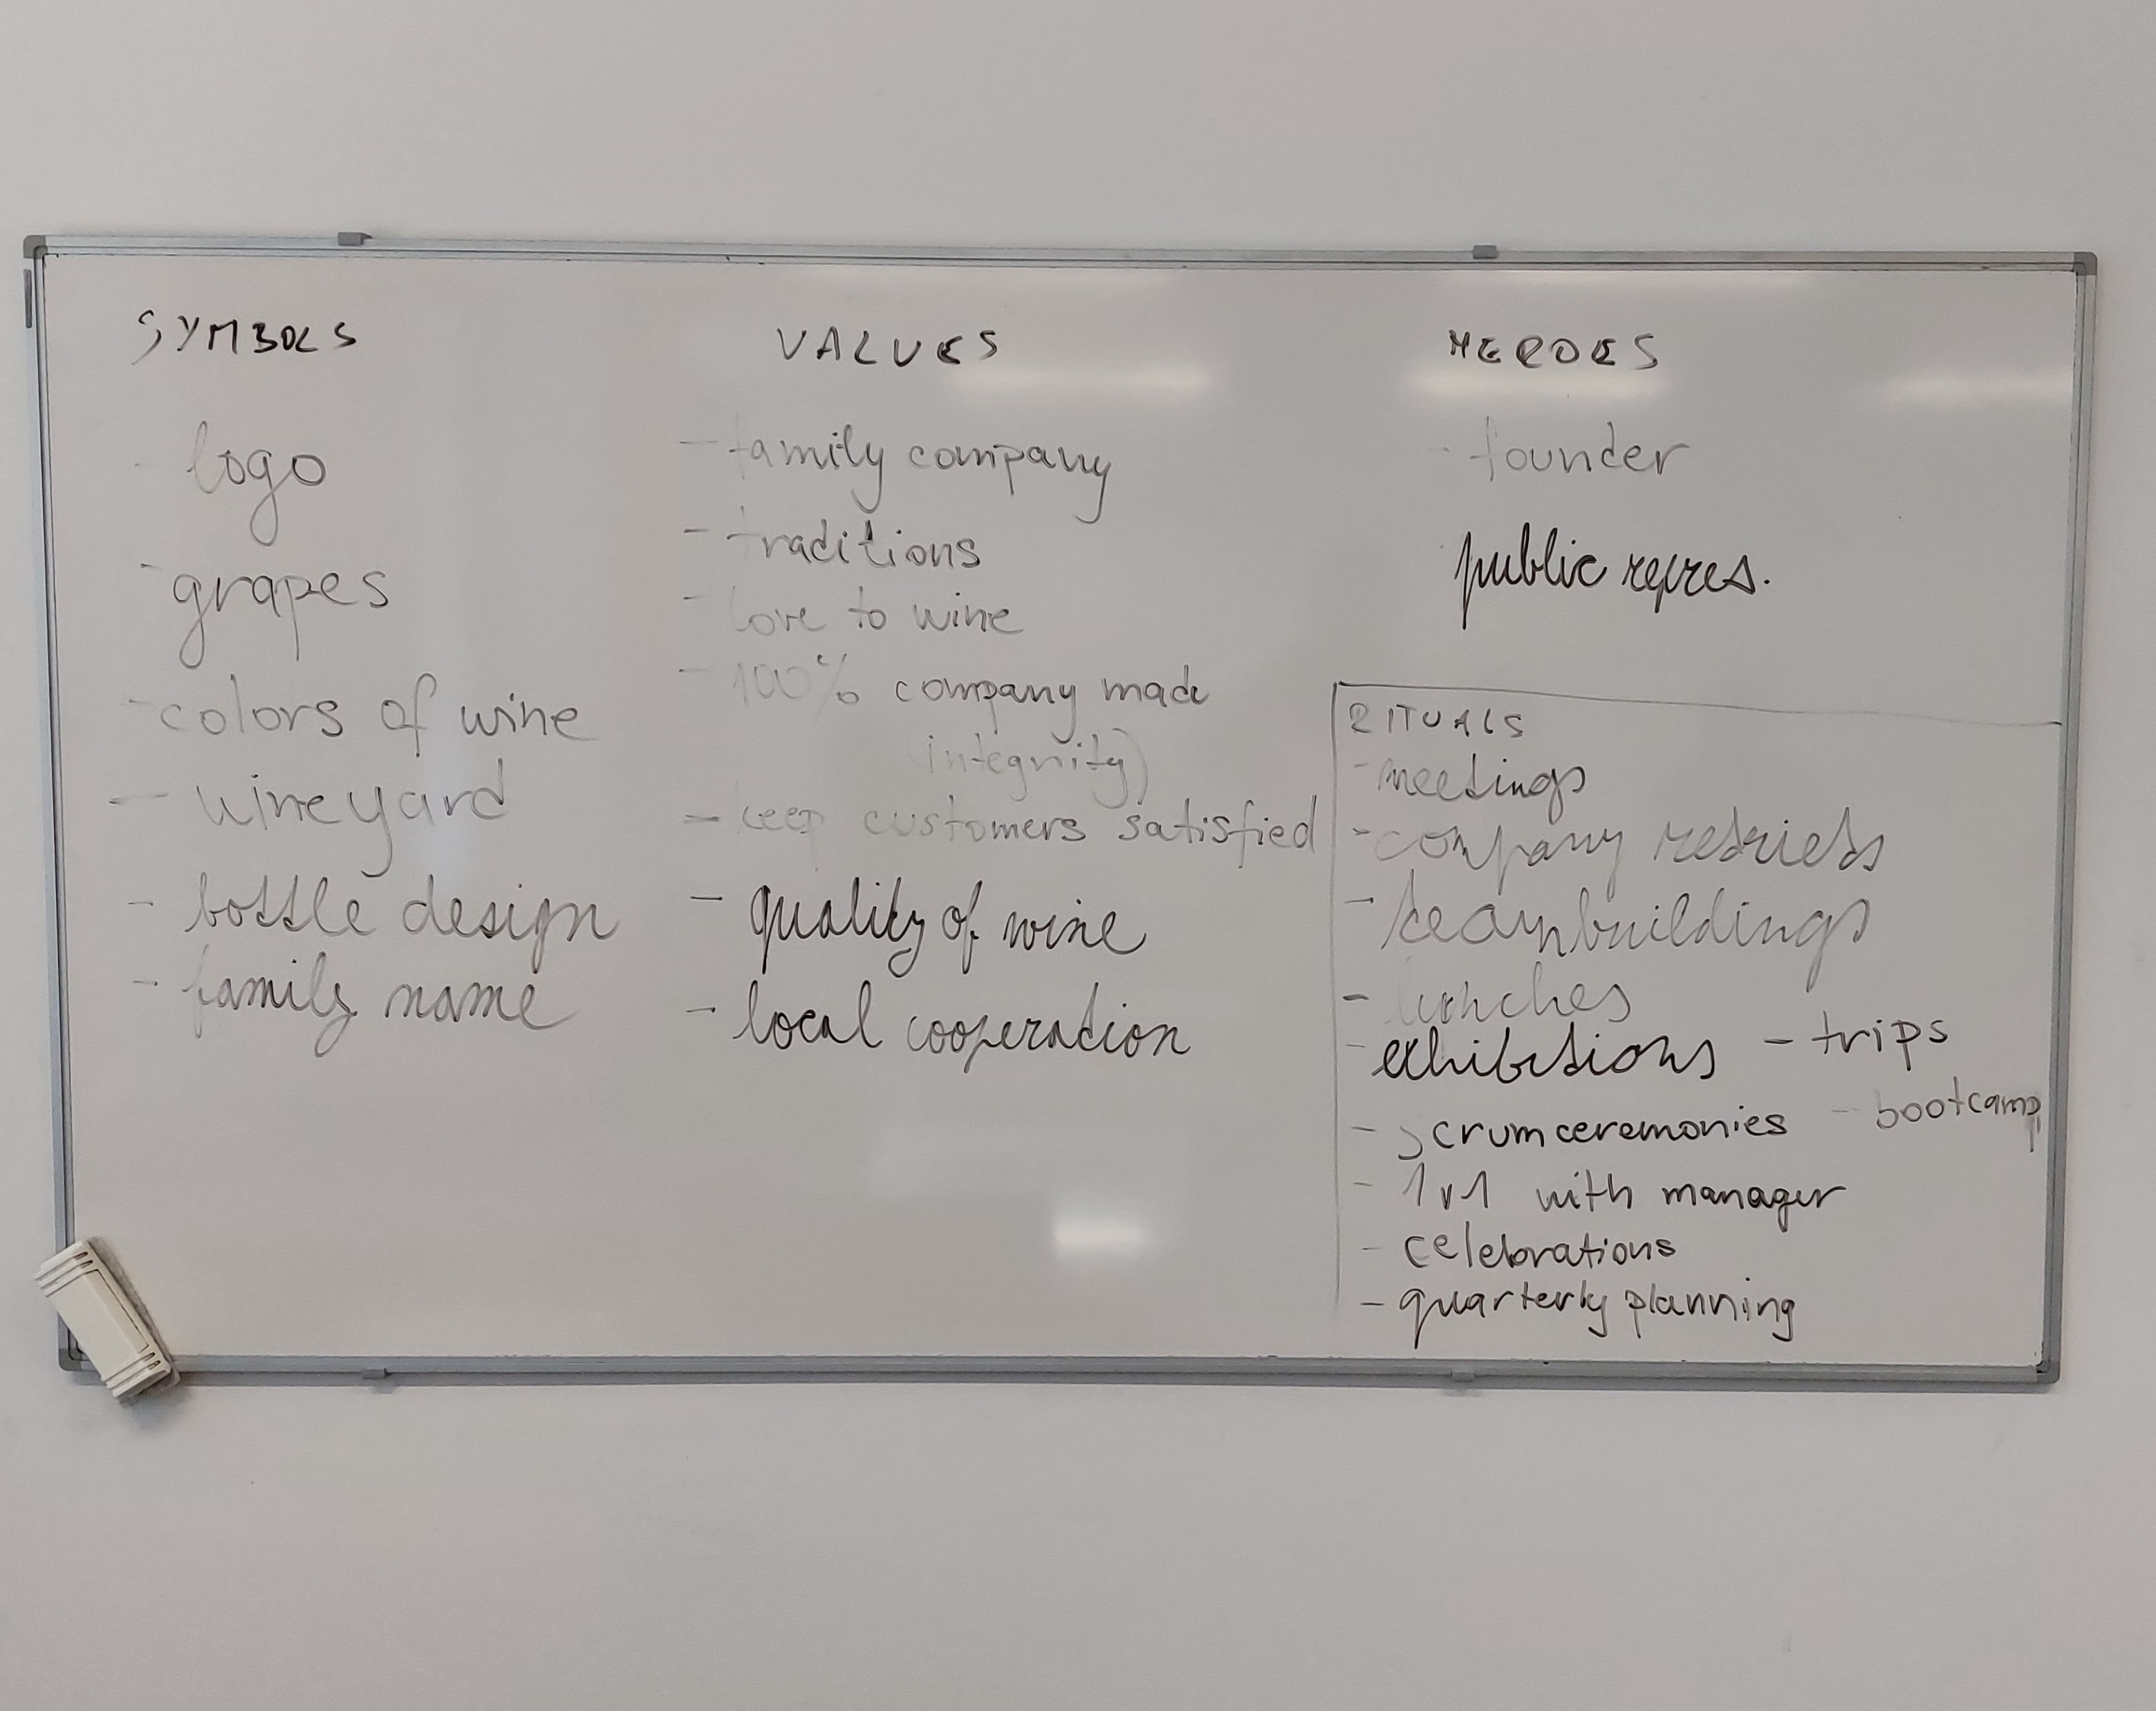

Slide 7
Pyramid of vitality

Slide 8
Pyramid of Vitality
VS
U
E
S
D
STABILITY
EFFECTIVITY
USEFULNESS
DYNAMICS
(C) J. Plamínek

Slide 9
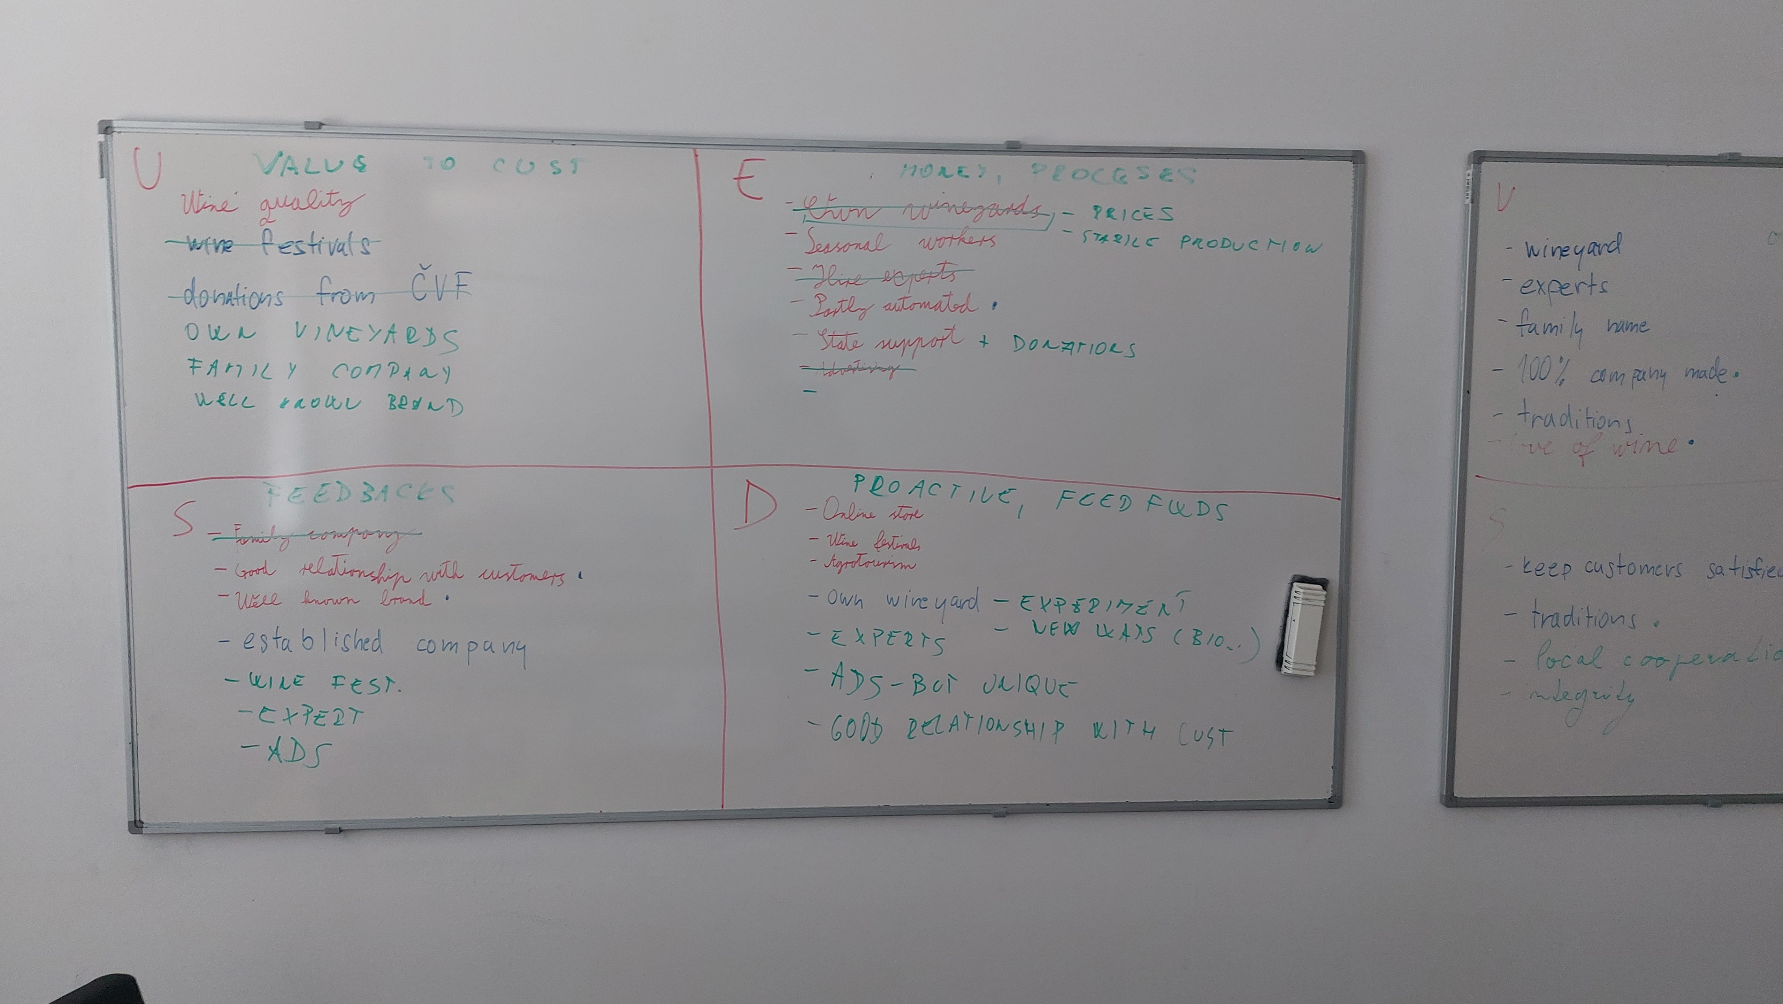
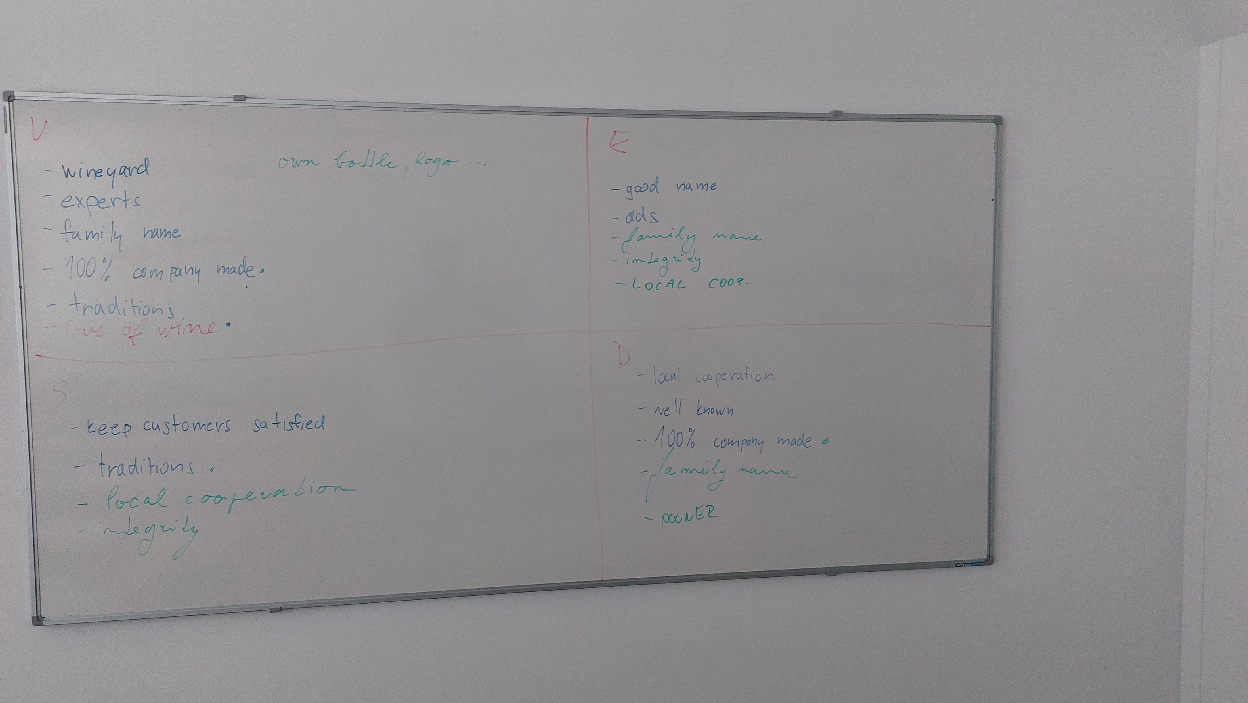
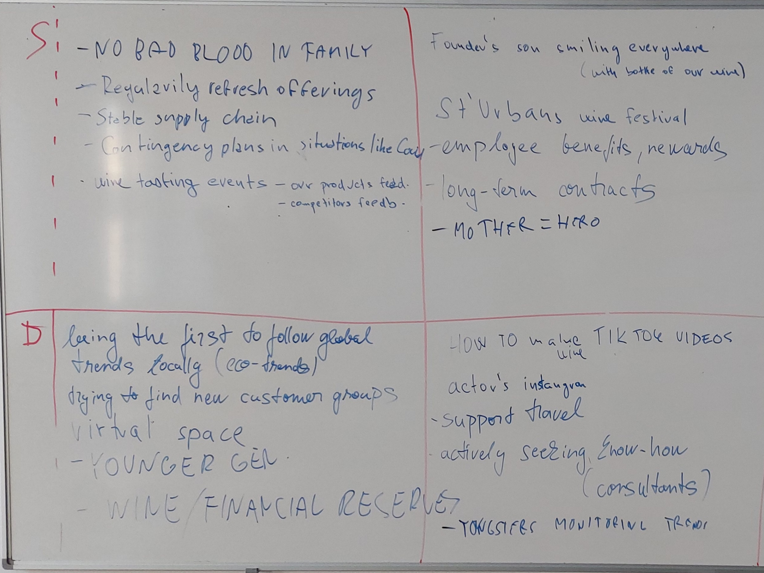
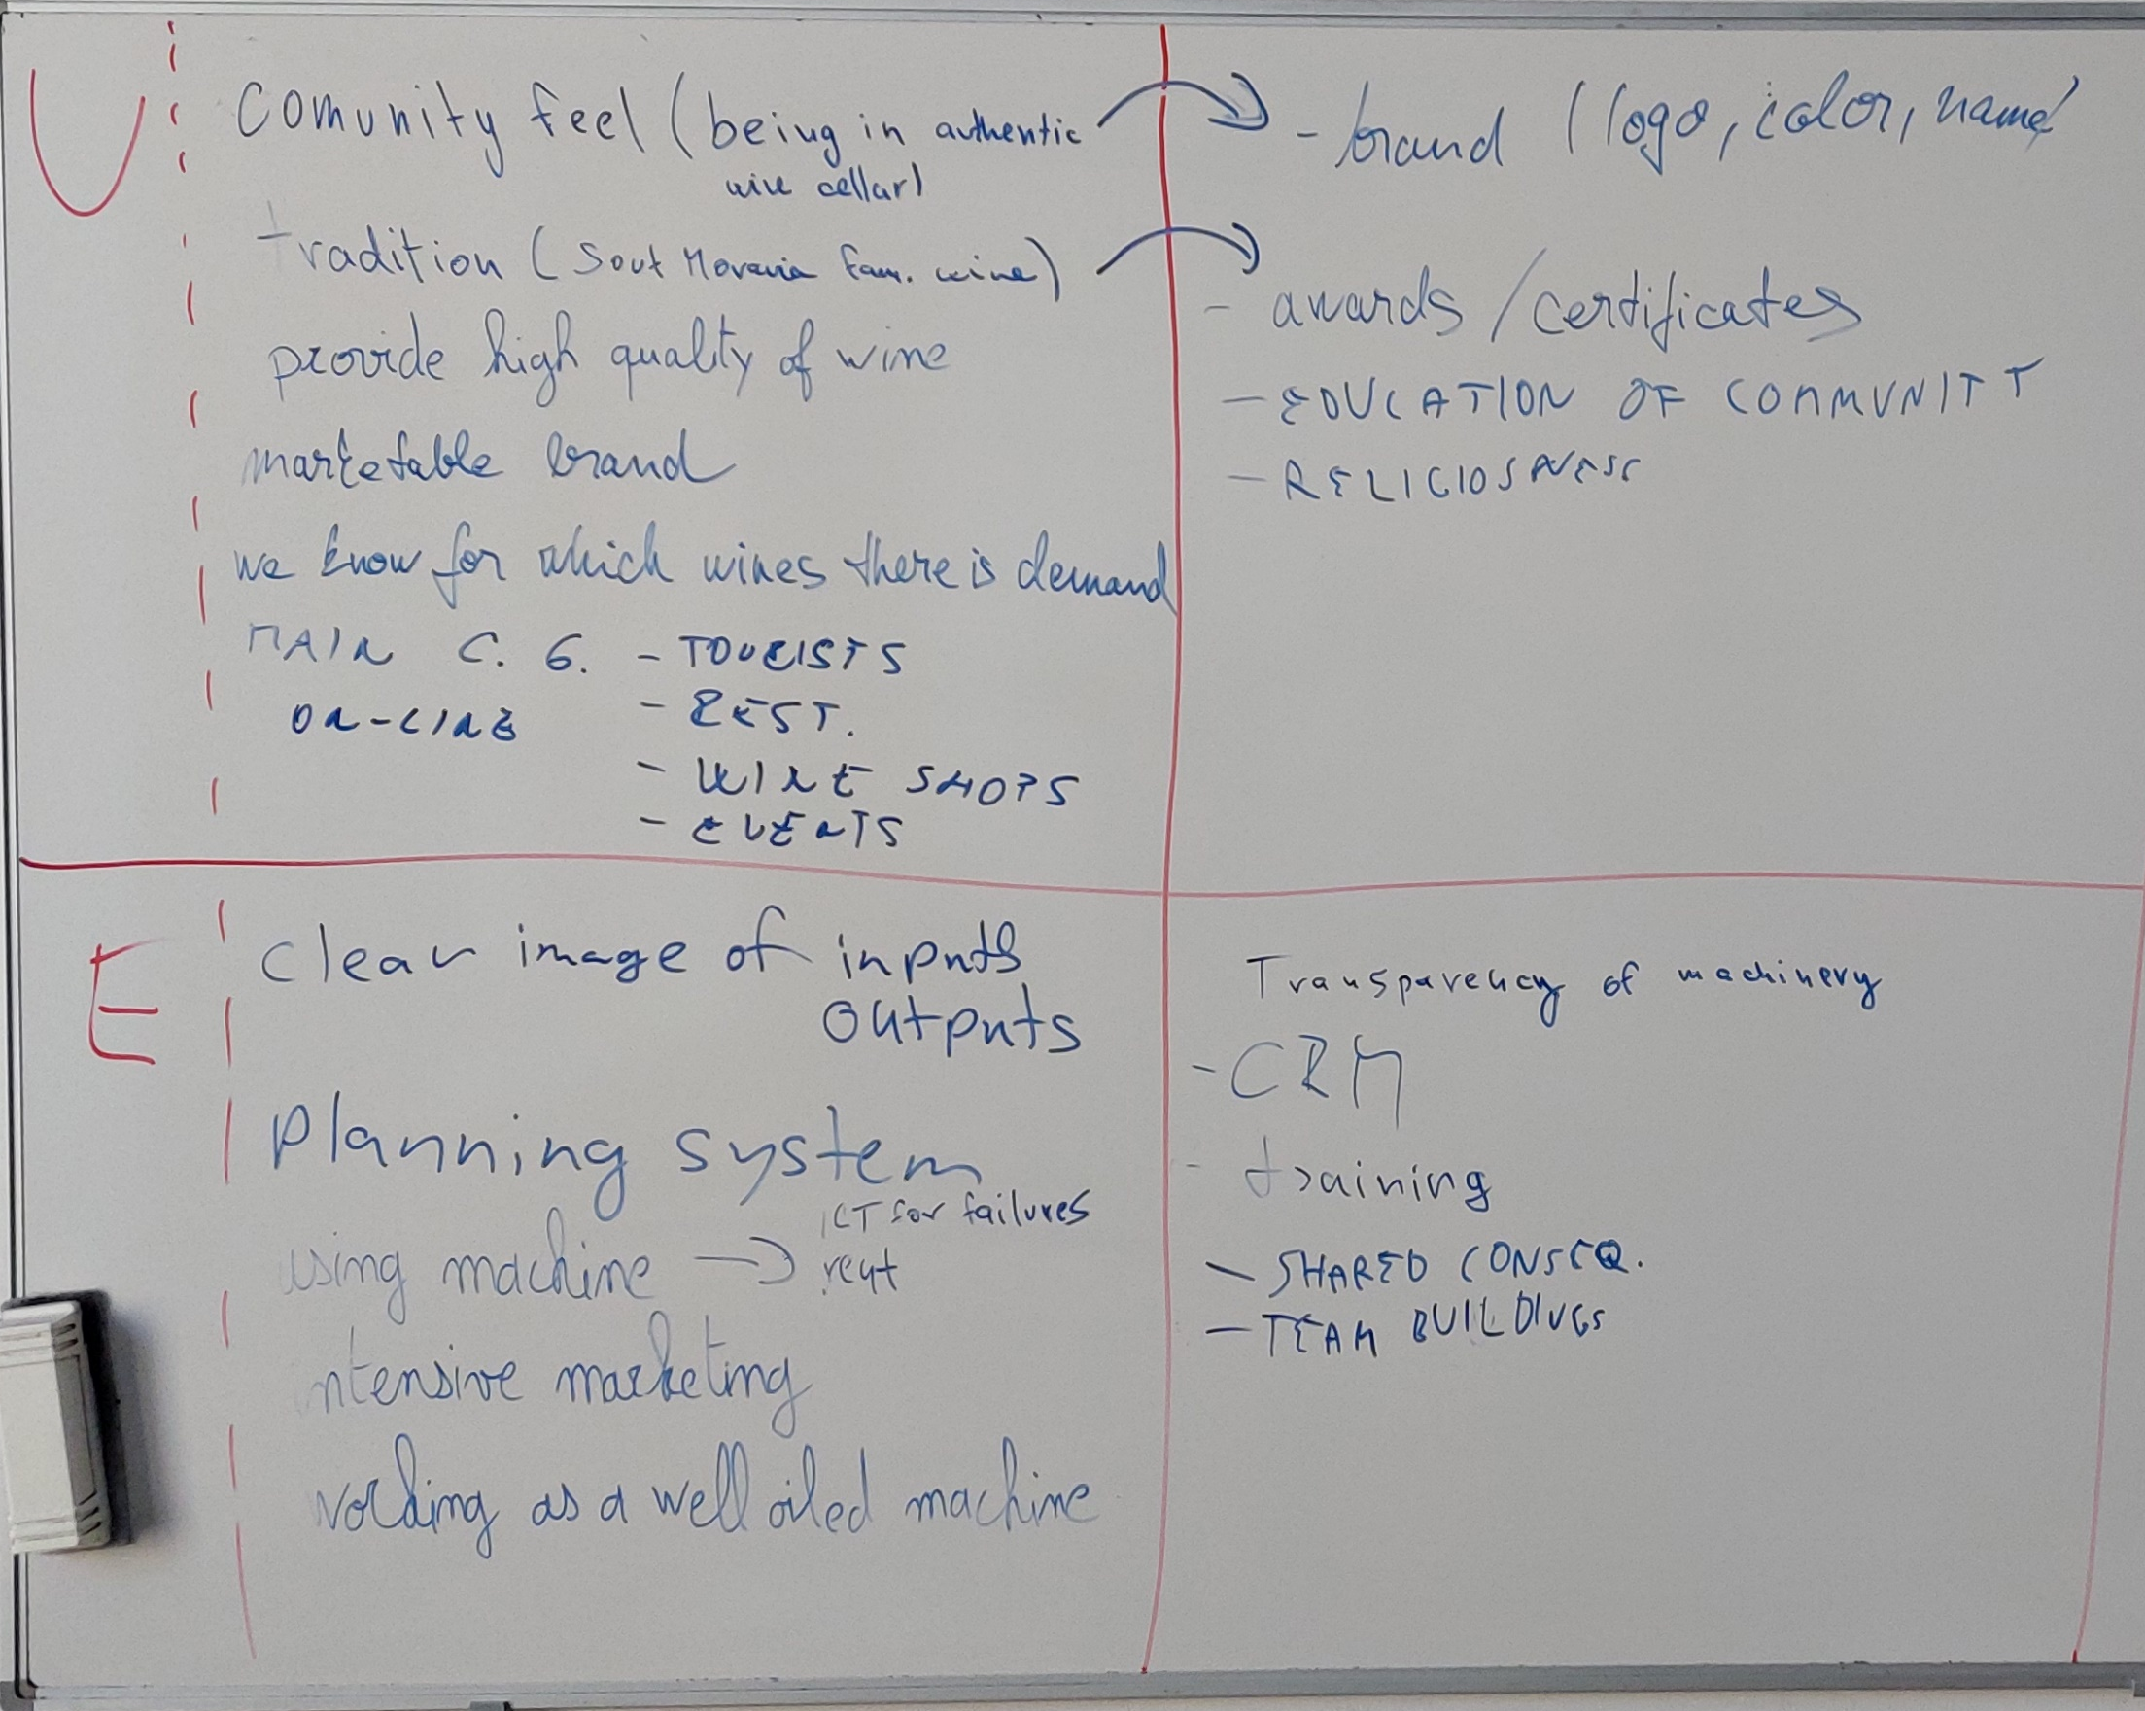

Slide 10
Strategic frame

Slide 11
The Elements of Strategic Frame
Strategic frame
Business hypothesis
Mission
Strategy
Vision
Values and Rules
(C) J. Plamínek

Slide 12
