Slide 1
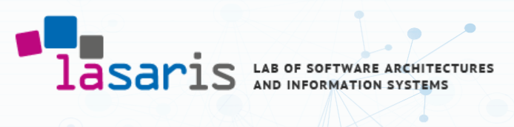

Blockchain-based Access Control for IoT in Smart Home Systems
Bacem Mbarek, PhD

Slide 2
Blockchain Integration in Smart Home
Smart home systems are featured by a variety of connected smart household devices, where Internet of Things (IoT) is one of the critical enablers in the smart home environment.
An effective access control in smart home systems is essential to prevent from unauthorized use of the available resources.
Most of the access control schemes in smart home systems are still lack of decentralized peer trust and hard to control the security and credibility of the smart home IoT network.
Introduction

Slide 3
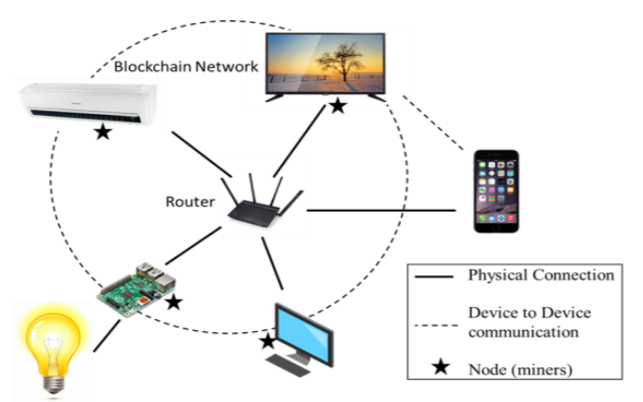
Smart Home
Smart home allows home appliances (such as television, air conditioner and refrigerator) to be connected to the internet and providing innovative and smart service to humans.
We can remotely control our home devices over the internet and information about our home can be directly reach to our smartphone.

Slide 4
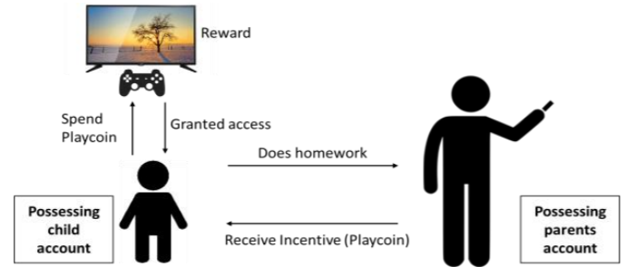
Parental Controls
Blockchain mechanism can be used to control children at home.
Parent can encourage good behaviors and discourage bad behaviors of children via tokens transferred via blockchain network.

Slide 5
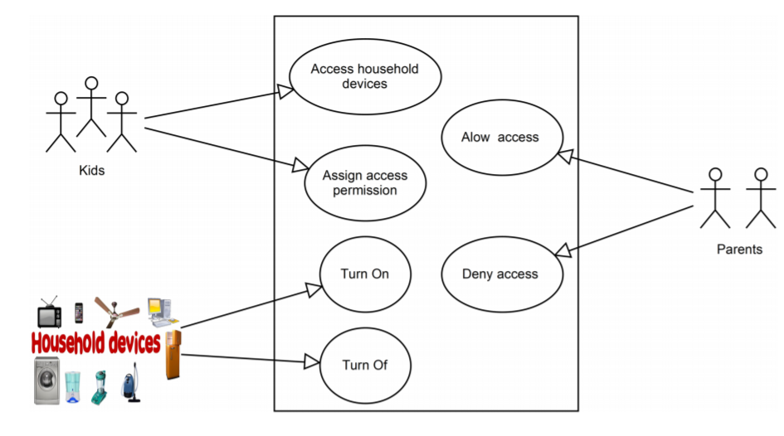
Blockchain Use in Home Automation
Children Incentives in Parental Control
Blockchain mechanism can be used to control children by their parent.
Parent can encourage good behaviors and discourage bad behaviors of children via tokens transferred via blockchain network.
Blockchain is capable of controlling the secure access and efficient data sharing in smart home systems.

Slide 6
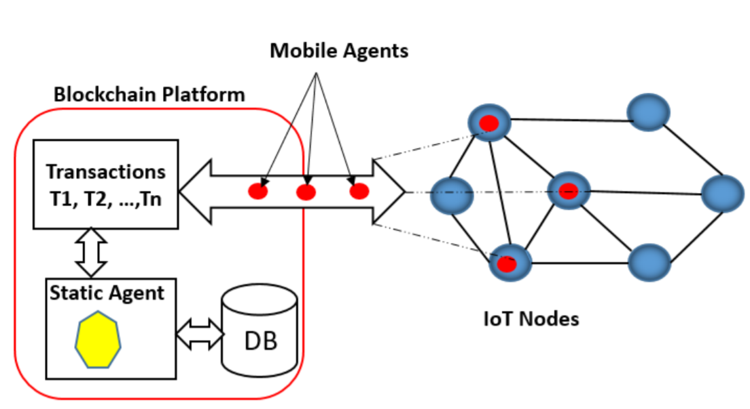
Contribution
We propose a Blockchain-based Access Control solution, named as BAC, which controls the access to smart home devices and ensures secure communications between the IoT devices and the householders [Ref 1].
[Ref 1]. MBAREK Bacem, GE Mouzhi, PITNER Tomáš, ‘Blockchain-based Access Control for IoT in Smart Home Systems’, DEXA 2020.
In order to increase Blockchain efficiency for smart home IoT network, the Blockchain platform will create two kinds of agents: (1) a static agent, and (2) a mobile agent

Slide 7
Architecture of Blockchain Agents-based Model
Static Agent is a static agent that will be implemented in each peer device of the Blockchain. Once the peer device receives a transaction such as a activity request, The peer device will use the static agent to verify and check the received transaction.
Mobile Agent is the agent that is created by the householder managers to control access to their household devices, as well as monitoring and detecting inappropriate using of household devices.

Slide 8
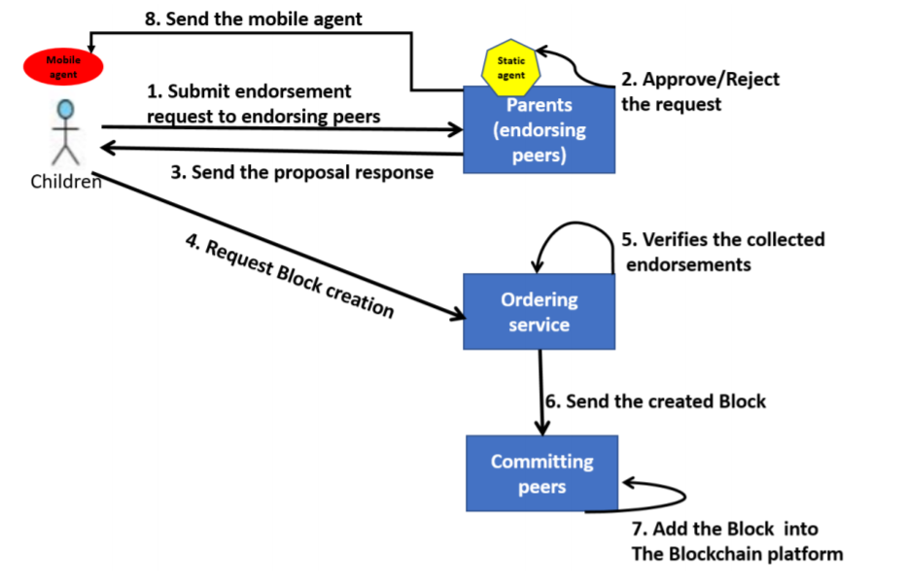
Agent-based Policy for the Blockchain Management

Slide 9
Conclusion
Blockchain is getting a lot of attention lately because of the rapid growth of connected device and cryptocurrency.
We proposed a cloud-free personal smart home by leveraging the security and privacy by using a blockchain technology.
We have proposed a Blockchain-based access control (BAC) mechanism for IoT in smart home systems. The BAC solution is mainly featured by integrating the Blockchain to IoT networks with agent embedded systems.

Slide 10
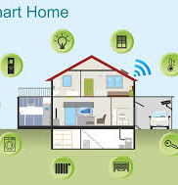
Future Directions
We first plan to conduct more experiments with various real-world IoT applications.
A user study will be conducted in a real-world smart home environment, and we will also intend to investigate the interoperability and the cost of implementing our solution compared to other solutions.

