Slide 1
Smart Service Project
Leonard Walletzký
PA181 Services - Systems, Modelling and Execution

Slide 2

Examples of data portals
Brno - https://data.brno.cz/en/
Prague – http://opendata.praha.eu/
European Data portal - https://www.europeandataportal.eu/en
Rome - https://dati.comune.roma.it/
Naples - http://www.comune.napoli.it/opendata

Slide 3
Important project info
The project must solve a real problem
It is highly recommended to use Open Data in your project (will be described in the last lesson)
Project must have clear description of the value for potential users
The project consists of two parts: demo and report
If the project is done by a group of students, in your project report, please write down who did what.
The demo should be developed and deployed on IBM Cloud. In case you choose other cloud solution, you need to describe why and guarantee access for the evaluators
The demo should be functioning, and we can try the demo.

Slide 4
Structure of the project report
You don‘t need 100% follow this structure, feel free to add something that suit your project
Project title
Scenario
Modelling – model the Scenario
Service used from IBM Cloud
Application with Link and snapshots, and also description of your application
Report Summary and who did what!
business model (Canvas or Lean Canvas)
Smart Service Canvas (mentioning all important contexts)
the problem you would like to solve
introduction for each service
What data / datasets you need for solution

Slide 5
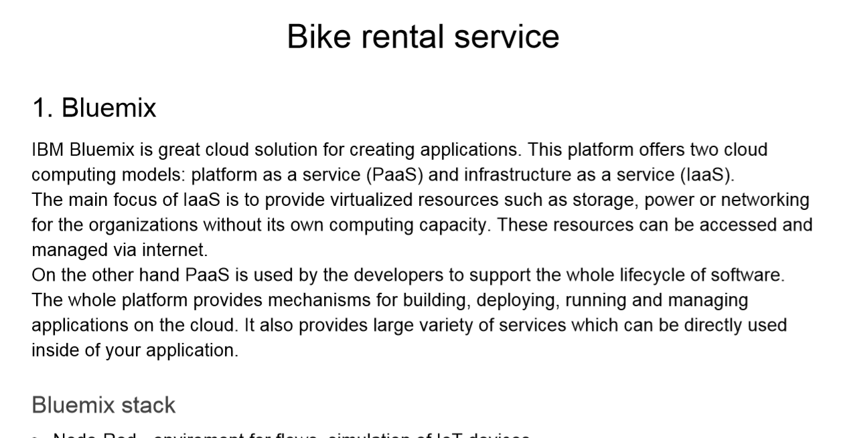
Example project 1
Example

Slide 6
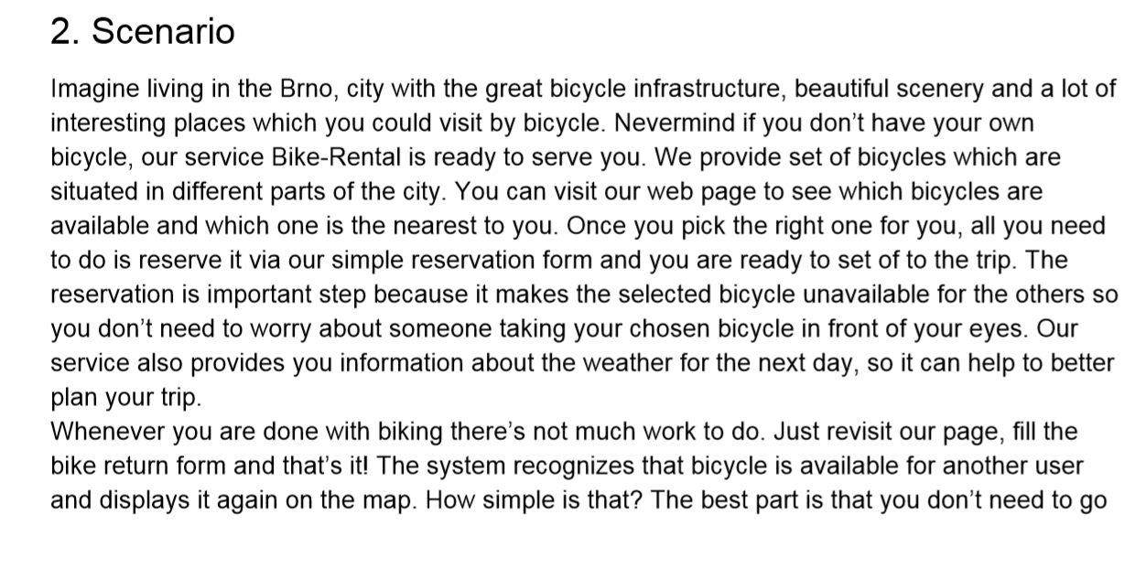
Example

Slide 7
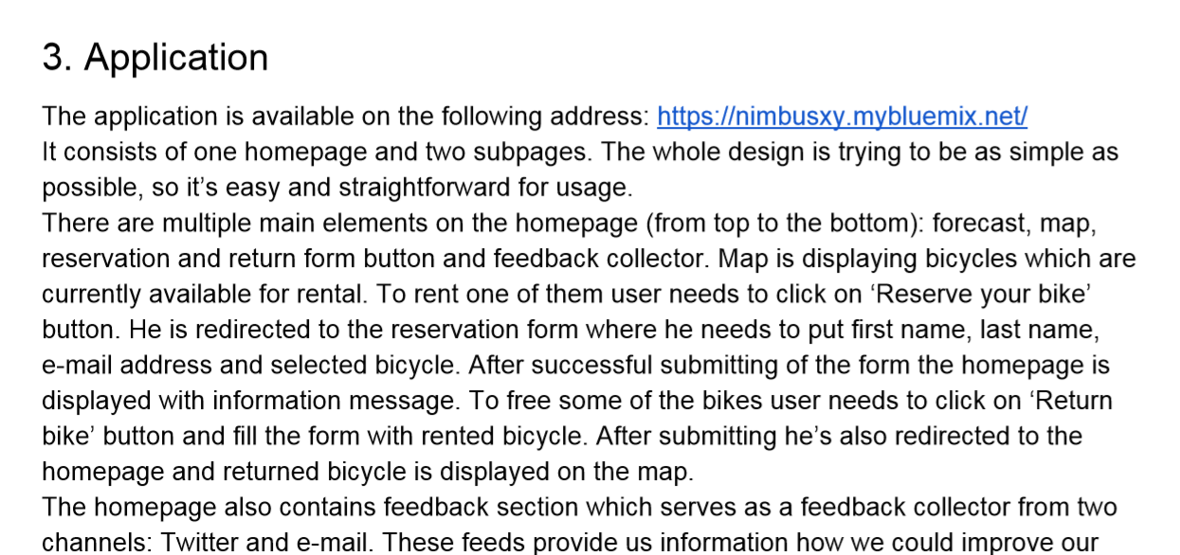
Example

Slide 8
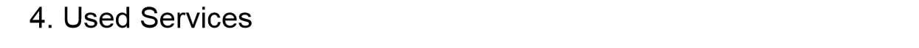
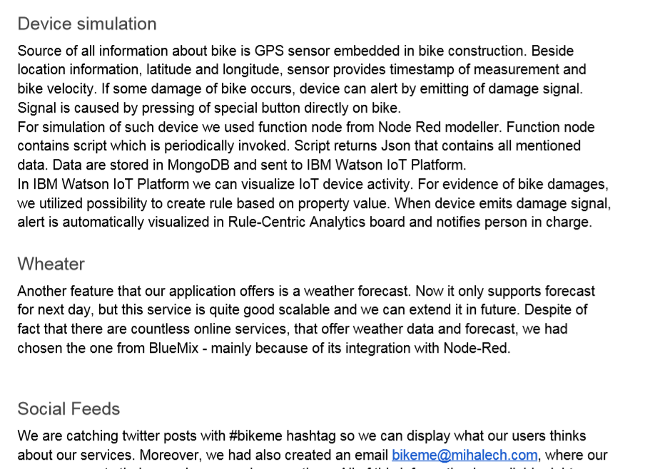
Example

Slide 9
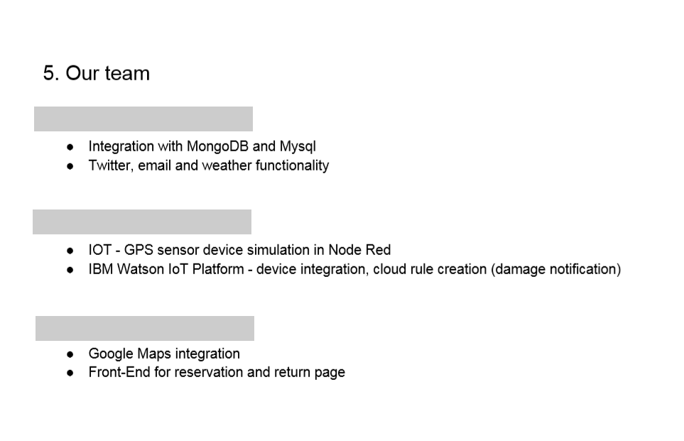
Example

Slide 10
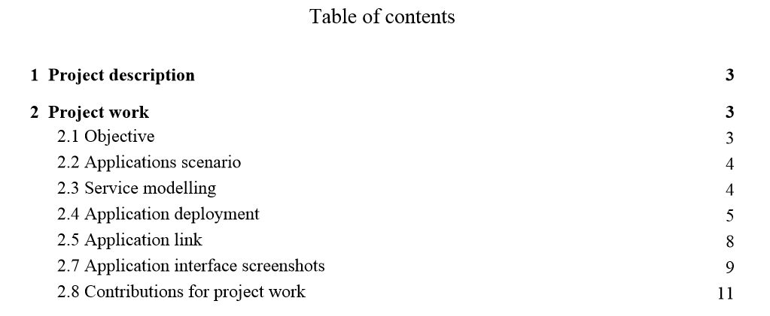
Example project 2
Example

Slide 11
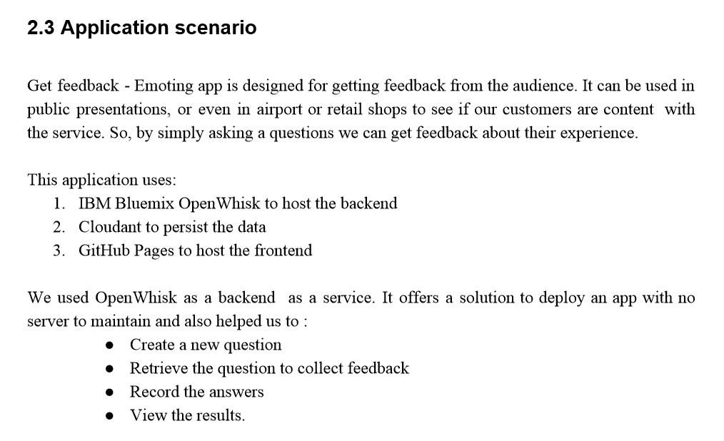
Example

Slide 12
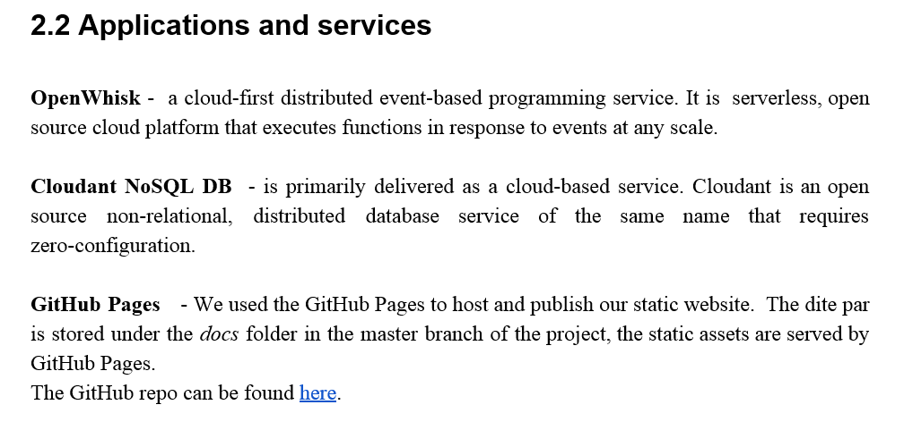
Example

Slide 13
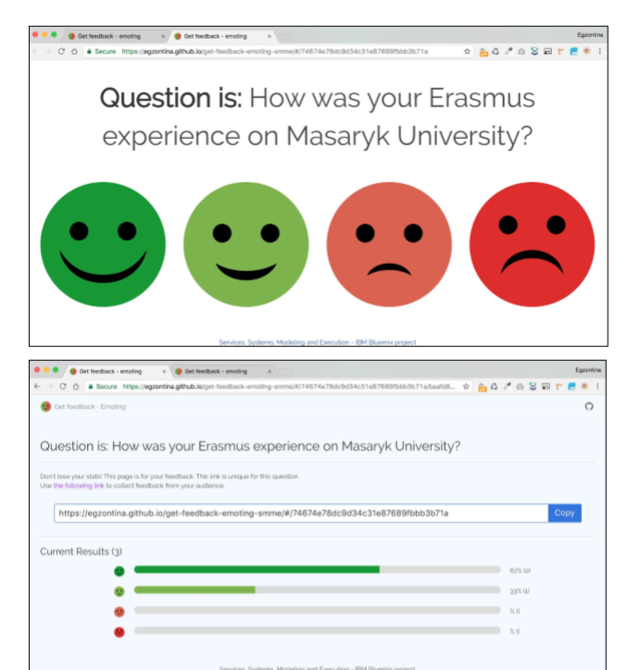
Snapshots
Example
You could also include application Snapshots to the report

Slide 14
IBM Presentations
The date of presentations will be announced this week: 8. -12.5.
The term will be in second half of June

