Slide 1
Frequent Itemset Mining & Association Rules
Advanced Search Techniques for Large Scale Data Analytics
Pavel Zezula and Jan Sedmidubsky
Masaryk University
http://disa.fi.muni.cz

Slide 2
Association Rule Discovery
Supermarket shelf management – Market-basket model:
Goal: Identify items that are bought together by sufficiently many customers
Approach: Process the sales data collected with barcode scanners to find dependencies among items
A classic rule:
  If someone buys diaper and milk, then he/she is
  likely to buy beer
  Don’t be surprised if you find six-packs next to diapers!

Slide 3
The Market-Basket Model
A large set of items
  e.g., things sold in a
  supermarket
A large set of baskets
Each basket is a
small subset of items
  e.g., the things one
  customer buys on one day
Want to discover
association rules
  People who bought {x,y,z} tend to buy {v,w}
    Amazon!
Input:
Output:
Rules Discovered:
{Milk} --> {Coke}
{Diaper, Milk} --> {Beer}

Slide 4
Applications – (1)
Items = products; Baskets = sets of products someone bought in one trip to the store
Real market baskets: Chain stores keep TBs of data about what customers buy together
  Tells how typical customers navigate stores, lets them position tempting items
  Suggests tie-in “tricks”, e.g., run sale on diapers
  and raise the price of beer
  Need the rule to occur frequently, or no $$’s
Amazon’s people who bought X also bought Y

Slide 5
Applications – (2)
Baskets = sentences; Items = documents containing those sentences
  Items that appear together too often could represent plagiarism
  Notice items do not have to be “in” baskets
Baskets = patients; Items = drugs & side-effects
  Has been used to detect combinations
  of drugs that result in particular side-effects
  But requires extension: Absence of an item
  needs to be observed as well as presence

Slide 6
More generally
A general many-to-many mapping (association) between two kinds of things
  But we ask about connections among “items”,
  not “baskets”
For example:
  Finding communities in graphs (e.g., Twitter)

Slide 7
Example:
Finding communities in graphs (e.g., Twitter)
Baskets = nodes; Items = outgoing neighbors
  Searching for complete bipartite subgraphs K_{s,t} of a big graph
How?
  View each node i as a
  basket B_{i} of nodes i it points to
  K_{s,t} = a set Y of size t that occurs in s buckets B_{i}
  Looking for K_{s,t} → set of support s and look at layer t – all frequent sets of size t
s nodes
t nodes
…
…
…
A dense 2-layer graph

Slide 8
Frequent Itemsets
Simplest question: Find sets of items that appear together “frequently” in baskets
Support for itemset I: Number of baskets containing all items in I
  (Often expressed as a fraction
  of the total number of baskets)
Given a support threshold s,
then sets of items that appear
in at least s baskets are called
frequent itemsets
Support of
{Beer, Bread} = 2

Slide 9
Example: Frequent Itemsets
Items = {milk, coke, pepsi, beer, juice}
Support threshold = 3 baskets
  B₁ = {m, c, b} B₂ = {m, p, j}
  B₃ = {m, b} B₄ = {c, j}
  B₅ = {m, p, b} B₆ = {m, c, b, j}
  B₇ = {c, b, j} B₈ = {b, c}
Frequent itemsets: {m}, {c}, {b}, {j},
{m,b}
, {b,c}
, {c,j}.

Slide 10
Association Rules
Association Rules:
If-then rules about the contents of baskets
{i₁, i₂,…,i_{k}} → j means: “if a basket contains all of i₁,…,i_{k} then it is likely to contain j”
In practice there are many rules, want to find significant/interesting ones!
Confidence of this association rule is the probability of j given I = {i₁,…,i_{k}}

Slide 11
Interesting Association Rules
Not all high-confidence rules are interesting
  The rule X → milk may have high confidence for many itemsets X, because milk is just purchased very often (independent of X) and the confidence will be high
Interest of an association rule I → j:
difference between its confidence and the fraction of baskets that contain j
  Interesting rules are those with high positive or negative interest values (usually above 0.5)
Notes:
If confidence is high then interest cannot be negative

Slide 12
Example: Confidence and Interest
  B₁ = {m, c, b} B₂ = {m, p, j}
  B₃ = {m, b} B₄= {c, j}
  B₅ = {m, p, b} B₆ = {m, c, b, j}
  B₇ = {c, b, j} B₈ = {b, c}
Association rule: {m, b} →c
  Confidence = 2/4 = 0.5
  Interest = |0.5 – 5/8| = 1/8
    Item c appears in 5/8 of the baskets
    Rule is not very interesting!

Slide 13
Finding Association Rules
Problem: Find all association rules with support ≥s and confidence ≥c
  Note: Support of an association rule is the support of the set of items on the left side
Hard part: Finding the frequent itemsets!
  If {i₁, i₂,…, i_{k}} → j has high support and confidence, then both {i₁, i₂,…, i_{k}} and
  {i₁, i₂,…,i_{k}, j} will be “frequent”

Slide 14
Mining Association Rules
Step 1: Find all frequent itemsets I
  (we will explain this next)
Step 2: Rule generation
  For every subset A of I, generate a rule A → I \ A
    Since I is frequent, A is also frequent
    Variant 1: Single pass to compute the rule confidence
      confidence(A,B→C,D) = support(A,B,C,D) / support(A,B)
    Variant 2:
      Observation: If A,B,C→D is below confidence, so is A,B→C,D
      Can generate “bigger” rules from smaller ones!
  Output the rules above the confidence threshold

Slide 15
Example
  B₁ = {m, c, b} B₂ = {m, p, j}
  B₃ = {m, c, b, n} B₄= {c, j}
  B₅ = {m, p, b} B₆ = {m, c, b, j}
  B₇ = {c, b, j} B₈ = {b, c}
Support threshold s = 3, confidence c = 0.75
1) Frequent itemsets:
  {b,m} {b,c} {c,m} {c,j} {m,c,b}
2) Generate rules:
  b→m: c=4/6 b→c: c=5/6 b,c→m: c=3/5
  m→b: c=4/5 … b,m→c: c=3/4
  b→c,m: c=3/6

Slide 16
Compacting the Output
To reduce the number of rules we can
post-process them and only output:
  Maximal frequent itemsets:
  No immediate superset is frequent
    Gives more pruning
  or
  Closed itemsets:
  No immediate superset has the same count (> 0)
    Stores not only frequent information, but exact counts

Slide 17
Example: Maximal/Closed
Frequent, but
superset BC
also frequent.
Support Maximal(s=3) Closed
A 4 No No
B 5 No Yes
C 3 No No
AB 4 Yes Yes
AC 2 No No
BC 3 Yes Yes
ABC 2 No Yes
Frequent, and
its only superset,
ABC, not freq.
Superset BC
has same count.
Its only super-
set, ABC, has
smaller count.

Slide 18
Finding Frequent Itemsets

Slide 19
Itemsets: Computation Model
Back to finding frequent itemsets
Typically, data is kept in flat files
rather than in a database system:
  Stored on disk
  Stored basket-by-basket
  Baskets are small but we have
  many baskets and many items
    Expand baskets into pairs, triples, etc.
    as you read baskets
    Use k nested loops to generate all
    sets of size k
Item
Item
Item
Item
Item
Item
Item
Item
Item
Item
Item
Item
Etc.
Items are positive integers, and boundaries between baskets are –1.
Note: We want to find frequent itemsets. To find them, we have to count them. To count them, we have to generate them.

Slide 20
Computation Model
The true cost of mining disk-resident data is usually the number of disk I/Os
In practice, association-rule algorithms read the data in passes – all baskets read in turn
We measure the cost by the number of passes an algorithm makes over the data

Slide 21
Main-Memory Bottleneck
For many frequent-itemset algorithms,
main-memory is the critical resource
  As we read baskets, we need to count
  something, e.g., occurrences of pairs of items
  The number of different things we can count
  is limited by main memory
  Swapping counts in/out is a disaster (why?)

Slide 22
Finding Frequent Pairs
The hardest problem often turns out to be finding the frequent pairs of items {i₁, i₂}
  Why? Freq. pairs are common, freq. triples are rare
    Why? Probability of being frequent drops exponentially
    with size; number of sets grows more slowly with size
Let’s first concentrate on pairs, then extend to larger sets
The approach:
  We always need to generate all the itemsets
  But we would only like to count (keep track) of those itemsets that in the end turn out to be frequent

Slide 23
Naïve Algorithm
Naïve approach to finding frequent pairs
Read file once, counting in main memory
the occurrences of each pair:
  From each basket of n items, generate its
  n(n-1)/2 pairs by two nested loops
Fails if (#items)² exceeds main memory
  Remember: #items can be
  100K (Wal-Mart) or 10B (Web pages)
    Suppose 10⁵ items, counts are 4-byte integers
    Number of pairs of items: 10⁵(10⁵-1)/2 = 5*10⁹
    Therefore, 2*10¹⁰ (20 gigabytes) of memory needed

Slide 24
Counting Pairs in Memory
Two approaches:
Approach 1: Count all pairs using a matrix
Approach 2: Keep a table of triples [i, j, c] = “the count of the pair of items {i, j} is c.”
  If integers and item ids are 4 bytes, we need approximately 12 bytes for pairs with count > 0
  Plus some additional overhead for the hashtable
Note:
Approach 1 only requires 4 bytes per pair
Approach 2 uses 12 bytes per pair
(but only for pairs with count > 0)

Slide 25
Comparing the 2 Approaches
4 bytes per pair
12 per
occurring pair
Triangular Matrix
Triples

Slide 26
Comparing the two approaches
Approach 1: Triangular Matrix
  n = total number items
  Count pair of items {i, j} only if i<j
  Keep pair counts in lexicographic order:
    {1,2}, {1,3},…, {1,n}, {2,3}, {2,4},…,{2,n}, {3,4},…
  Pair {i, j} is at position (i –1)(n– i/2) + j –1
  Total number of pairs n(n –1)/2; total bytes= 2n²
  Triangular Matrix requires 4 bytes per pair
Approach 2 uses 12 bytes per occurring pair
(but only for pairs with count > 0)
  Beats Approach 1 if less than 1/3 of
  possible pairs actually occur

Slide 27
Comparing the two approaches
Approach 1: Triangular Matrix
  n = total number items
  Count pair of items {i, j} only if i<j
  Keep pair counts in lexicographic order:
    {1,2}, {1,3},…, {1,n}, {2,3}, {2,4},…,{2,n}, {3,4},…
  Pair {i, j} is at position (i –1)(n– i/2) + j –1
  Total number of pairs n(n –1)/2; total bytes= 2n²
  Triangular Matrix requires 4 bytes per pair
Approach 2 uses 12 bytes per pair
(but only for pairs with count > 0)
  Beats Approach 1 if less than 1/3 of
  possible pairs actually occur
Problem is if we have too many items so the pairs
do not fit into memory.
Can we do better?

Slide 28
A-Priori Algorithm

Slide 29
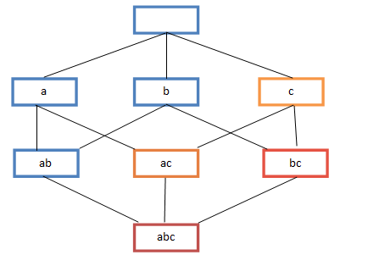
A-Priori Algorithm – (1)
A two-pass approach called
A-Priori limits the need for
main memory
Key idea: monotonicity
  If a set of items I appears at
  least s times, so does every subset J of I
Contrapositive for pairs:
If item i does not appear in s baskets, then no pair including i can appear in s baskets
So, how does A-Priori find freq. pairs?

Slide 30
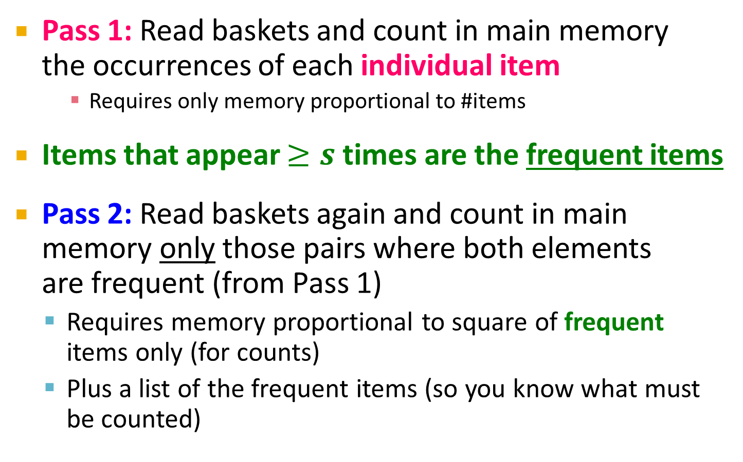
A-Priori Algorithm – (2)
Pass 1: Read baskets and count in main memory
the occurrences of each individual item
    Requires only memory proportional to #items
Items that appear $≥s$ times are the frequent items
Pass 2: Read baskets again and count in main memory only those pairs where both elements
are frequent (from Pass 1)
  Requires memory proportional to square of frequent items only (for counts)
  Plus a list of the frequent items (so you know what must be counted)

Slide 31
Main-Memory: Picture of A-Priori
Item counts
Frequent items
Counts of
pairs of frequent items (candidate pairs)
Main memory
Pass 1
Pass 2

Slide 32
Detail for A-Priori
You can use the triangular matrix method with n = number of frequent items
  May save space compared with storing triples
Trick: re-number frequent items 1,2,… and keep a table relating new numbers to original item numbers
Item counts
Frequent items
Old
item
#s
Counts of
pairs of
frequent items
Counts of pairs of frequent items
Main memory
Pass 1
Pass 2

Slide 33
Frequent Triples, Etc.
For each k, we construct two sets of
k-tuples (sets of size k):
  C_{k} = candidate k-tuples = those that might be frequent sets (support > s) based on information from the pass for k–1
  L_{k} = the set of truly frequent k-tuples
Count
the items
All pairs
of items
from L₁
Count
the pairs
All
items
To be
explained
Filter
Construct
Filter
Construct
C₁
L₁
C₂
L₂
C₃

Slide 34
Example
** Note here we generate new candidates by generating C_{k} from L_{k-1} and L₁.
But that one can be more careful with candidate generation. For example, in C₃ we know {b,m,j} cannot be frequent since {m,j} is not frequent
Hypothetical steps of the A-Priori algorithm
  C₁ = { {b} {c} {j} {m} {n} {p} }
  Count the support of itemsets in C₁
  Prune non-frequent: L₁ = { b, c, j, m }
  Generate C₂ = { {b,c} {b,j} {b,m} {c,j} {c,m} {j,m} }
  Count the support of itemsets in C₂
  Prune non-frequent: L₂ = { {b,m} {b,c} {c,m} {c,j} }
  Generate C₃ = { {b,c,m} {b,c,j} {b,m,j} {c,m,j} }
  Count the support of itemsets in C₃
  Prune non-frequent: L₃ = { {b,c,m} }
**

Slide 35
A-Priori for All Frequent Itemsets
One pass for each k (itemset size)
Needs room in main memory to count
each candidate k–tuple
For typical market-basket data and reasonable support (e.g., 1%), k = 2 requires the most memory
Many possible extensions:
  Association rules with intervals:
    For example: Men over 65 have 2 cars
  Association rules when items are in a taxonomy
    Bread, Butter → FruitJam
    BakedGoods, MilkProduct → PreservedGoods
  Lower the support s as itemset gets bigger

Slide 36
PCY (Park-Chen-Yu) Algorithm

Slide 37
PCY (Park-Chen-Yu) Algorithm
Observation:
In pass 1 of A-Priori, most memory is idle
  We store only individual item counts
  Can we use the idle memory to reduce
  memory required in pass 2?
Pass 1 of PCY: In addition to item counts, maintain a hash table with as many
buckets as fit in memory
  Keep a count for each bucket into which
  pairs of items are hashed
    For each bucket just keep the count, not the actual
    pairs that hash to the bucket!

Slide 38
PCY Algorithm – First Pass
FOR (each basket) :
FOR (each item in the basket) :
add 1 to item’s count;
FOR (each pair of items) :
hash the pair to a bucket;
add 1 to the count for that bucket;
Few things to note:
  Pairs of items need to be generated from the input file; they are not present in the file
  We are not just interested in the presence of a pair, but we need to see whether it is present at least s (support) times
New in PCY

Slide 39
Observations about Buckets
Observation: If a bucket contains a frequent pair, then the bucket is surely frequent
However, even without any frequent pair,
a bucket can still be frequent ☹
  So, we cannot use the hash to eliminate any
  member (pair) of a “frequent” bucket
But, for a bucket with total count less than s,
none of its pairs can be frequent ☺
  Pairs that hash to this bucket can be eliminated as candidates (even if the pair consists of 2 frequent items)
Pass 2:
Only count pairs that hash to frequent buckets

Slide 40
PCY Algorithm – Between Passes
Replace the buckets by a bit-vector:
  1 means the bucket count exceeded the support s
  (call it a frequent bucket); 0 means it did not
4-byte integer counts are replaced by bits,
so the bit-vector requires 1/32 of memory
Also, decide which items are frequent
and list them for the second pass

Slide 41
PCY Algorithm – Pass 2
Count all pairs {i, j} that meet the
conditions for being a candidate pair:
  Both i and j are frequent items
  The pair {i, j} hashes to a bucket whose bit in the bit vector is 1 (i.e., a frequent bucket)
Both conditions are necessary for the
pair to have a chance of being frequent

Slide 42
Main-Memory: Picture of PCY
Hash
table
Item counts
Frequent items
Bitmap
Hash table
for pairs
Counts of
candidate
pairs
Main memory
Pass 1
Pass 2
Notes:
Why hash table takes full space?
We want to make it as large as possible.
Why hash table bigger than bitmap?
Hash table contains counts

Slide 43
Main-Memory Details
Buckets require a few bytes each:
  Note: we do not have to count past s
  #buckets is O(main-memory size)
On second pass, a table of (item, item, count) triples is essential (we cannot use triangular matrix approach, why?)
  Thus, hash table must eliminate approx. 2/3
  of the candidate pairs for PCY to beat A-Priori
Notes:
Why? While we were able to use the triangular-matrix
method on the second pass of A-Priori if we wished, because the frequent items
could be renumbered from 1 to some m, we cannot do so for PCY. The reason
is that the pairs of frequent items that PCY lets us avoid counting are placed
randomly within the triangular matrix; they are the pairs that happen to hash
to an infrequent bucket on the ﬁrst pass. There is no known way of compacting
the matrix to avoid leaving space for the uncounted pairs.

Slide 44
Refinement: Multistage Algorithm
Limit the number of candidates to be counted
  Remember: Memory is the bottleneck
  Still need to generate all the itemsets but we only want to count/keep track of the ones that are frequent
Key idea: After Pass 1 of PCY, rehash only those pairs that qualify for Pass 2 of PCY
  i and j are frequent, and
  {i, j} hashes to a frequent bucket from Pass 1
On middle pass, fewer pairs contribute to buckets, so fewer false positives
Requires 3 passes over the data

Slide 45
Main-Memory: Multistage
First
hash table
Item counts
Freq. items
Freq. items
First
hash table
Bitmap 1
Bitmap 1
Second
hash table
Main memory
Bitmap 2
Counts of
candidate
pairs
Counts of
candidate
pairs
Pass 1
Pass 2
Pass 3
Hash pairs {i,j}
into Hash2 iff:
i,j are frequent,
{i,j} hashes to
freq. bucket in B1
Count pairs {i,j} iff:
i,j are frequent,
{i,j} hashes to
freq. bucket in B1
{i,j} hashes to
freq. bucket in B2
Count items
Hash pairs {i,j}

Slide 46
Multistage – Pass 3
Count only those pairs {i, j} that satisfy these candidate pair conditions:
  Both i and j are frequent items
  Using the first hash function, the pair hashes to
  a bucket whose bit in the first bit-vector is 1
  Using the second hash function, the pair hashes to a bucket whose bit in the second bit-vector is 1

Slide 47
Important Points
The two hash functions have to be independent
We need to check both hashes on the third pass
  If not, we would end up counting pairs of frequent items that hashed first to an infrequent bucket but happened to hash second to a frequent bucket

Slide 48
Refinement: Multihash
Key idea: Use several independent hash tables on the first pass
Risk: Halving the number of buckets doubles the average count
  We have to be sure most buckets will still not reach count s
If so, we can get a benefit like multistage,
but in only 2 passes

Slide 49
Main-Memory: Multihash
First hash
table
Second
hash table
Item counts
Freq. items
First
hash table
Bitmap 1
Main memory
Bitmap 2
Counts of
candidate
pairs
Counts of
candidate
pairs
Second
hash table
Pass 1
Pass 2

Slide 50
PCY: Extensions
Either multistage or multihash can use more than two hash functions
In multistage, there is a point of diminishing returns, since the bit-vectors eventually consume all of main memory
For multihash, the bit-vectors occupy exactly what one PCY bitmap does, but too many hash functions makes all counts > s

Slide 51
Frequent Itemsets in < 2 Passes
A-Priori, PCY, etc., take k passes to find frequent itemsets of size k
Can we use fewer passes?
Use 2 or fewer passes for all sizes,
but may miss some frequent itemsets
  Random sampling
  SON (Savasere, Omiecinski, and Navathe)
  Toivonen (see textbook)

