Slide 1


PV204 Security technologies
Secure channel protocols: From basic key establishment via Signal protocol to Noise framework
Petr Švenda svenda@fi.muni.cz @rngsec
Centre for Research on Cryptography and Security, Masaryk University
Please provide any corrections and comments here (thank you!):
https://drive.google.com/file/d/1SXnzLqYIucs-96uTx5VeXB2scI5o3lcC/view?usp=sharing

Slide 2
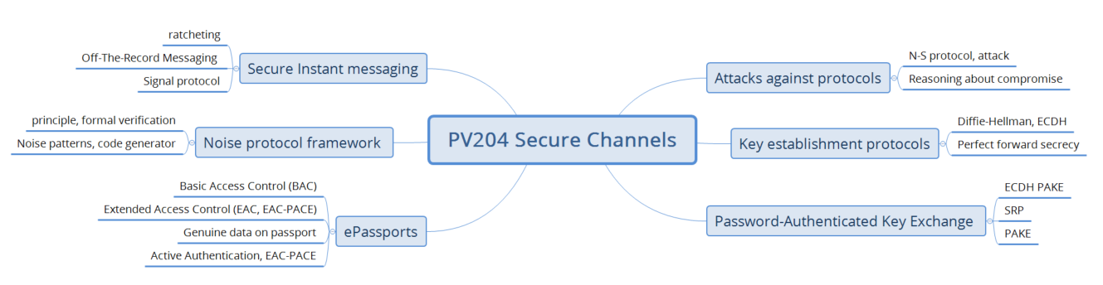

Slide 3
Key Establishment
Diffie-Hellman
ECDH
Electronic passports
Perfect Forward Secrecy
Future Secrecy
Password-authenticated
key exchange (PAKE)
BAC
Off-The-Record protocol (IM)
Extended Access Control
ECDH+PACE
Backward Secrecy
Signal protocol (IM)
Noise framework

Slide 4
Security protocols

Slide 5
Security protocols
Security protocol = composition of cryptoprimitives
“Security protocols are three line programs that people still manage to get wrong.” (R. Needham)
Many different aspects of security protocols
  Entity authentication
  Key agreement, establishment or distribution
  Data encryption and integrity protection
  Non-repudiation
  Secure multi-party computation (SMPC)
  …

Slide 6
Authentication (AUTH) vs. Key establishment (KE)
Early literature called protocols used to establish session keys as “authentication protocols”
Session keys can be established without authentication
  Example: non-authenticated Diffie-Hellman
Authentication is also possible without session keys
  Example: Challenge-response protocol like FIDO U2F
Common protocol workflow (e.g., TLS):
  Authenticate parties
  Establish session keys
  Use session keys to encrypt and authenticate messages
  (do it in as few messages as possible)

Slide 7
User vs. key-oriented goals
User-oriented authentication goals
  Entity authentication
  Strong entity authentication – fresh entity authentication
  Mutual authentication
Key-oriented goals
  Key establishment
  Key derivation
  Implicit key establishment
  Key confirmation
  Mutual belief in the key

Slide 8
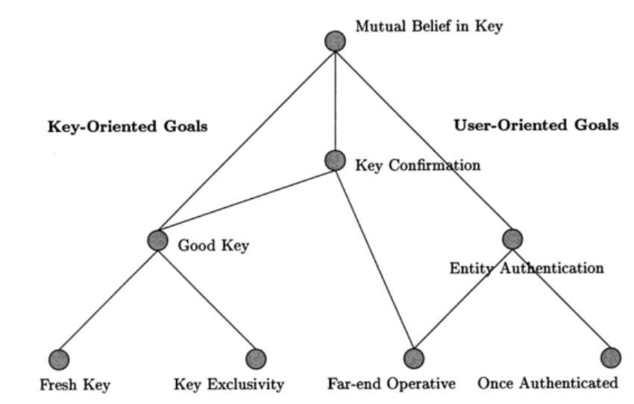
Hierarchy of AUTH&KE goals
Protocols for Authentication and Key Establishment By Colin Boyd, Anish Mathuria

Slide 9
Entity authentication
Entity = user, machine/device
Something entity knows (password, key…)
Something entity is (biometrics…)
Something entity have (smartcard…)
Multi-factor authentication
  More than one factor (password + smartcard)
  Aim to increase attacker’s cost to compromise multiple security layers (factors)

Slide 10
Protocol message components
Keys
  Long-term keys
  Session keys
Identifiers
  Protocol principals (Alice, Bob…)
Nonce(s)
  Random values, timestamps, counters
Components are combined by crypto mechanism(s)

Slide 11
Protocols and attacks

Slide 12
Typical models of adversary
Adversary controls the communication
  Between all principals
  Observe, alter, insert, delay or delete messages
Adversary can obtain session/long term keys
  used in previous runs
Malicious insider
  adversary is legitimate protocol principal
Attacker can obtain partial knowledge
  Secrets compromise, side-channels…
…

Slide 13

Needham–Schroeder protocol: symmetric
Basis for Kerberos protocol (AUTH, KE), 1978
  Two-party protocol (A,B) + trusted server (S)
  Session key K_{AB} generated by S and distributed to A together with part intended for B
  Parties A and B are authenticated via S
A → S: A, B, N_{A}
S → A: {N_{A}, K_{AB}, B, {K_{AB}, A}K_{BS}}K_{AS}
A → B: {K_{AB}, A}K_{BS}
B → A: {N_{B}, A}K_{AB}
A → B: {N_{B} - 1}K_{AB}
Which part ensures:
Authentication
Key confirmation
Freshness
Can you spot problem?

Slide 14
N-S symmetric: Problem?
Vulnerable to replay attack (Denning, Sacco, 1981)
If an attacker compromised older K_{AB} then
  {K_{AB}, A}K_{BS} can be replayed to B (step 3.)
  B will not be able to tell if K_{AB} is fresh
  Attacker will then impersonate A using old (replayed, compromised) key K_{AB}
Fixed by inclusion of nonce/timestamp N’_{B} generated by B (two additional steps before step 1.)
  Bob can now check freshness of {K_{AB}, A, N’_{B}}K_{BS}
What is required attacker model to perform the attack?

Slide 15
What is required attacker model?
Able to capture valid communication ({K_{AB}, A}K_{BS})
Able to compromise older K_{AB}
Actively communicate with B (reply ({K_{AB}, A}K_{BS})
But is an assumption of compromise
of old key realistic?

Slide 16
How (not) to reason about potential compromise
NO: all my (many) keys are in secure hardware and therefore I’m secure (no compromise possible)
  Nothing like perfect security exists
YES: assume compromise and evaluate impact
  Where the sensitive keys are
  How hard is to compromise them
  What will be the impact of the compromise
  Can I limit number/exposure of keys? For what price?

Slide 17

How to reason about attack and countermeasures?
Where does an attack come from (principle)?
  Understand the principles
Different hypothesis for the attack to be practical
  More ways how to exploit the same weakness
Attack’s countermeasures by cancel of hypothesis
  For every way you are aware of
Costs and benefits of the countermeasures
  Cost of the assets protected
  Cost for an attacker to perform attack
  Cost of a countermeasure
Important: Consider Break Once, Run Everywhere (BORE)

Slide 18
What if key is compromised?
Prevention, detection (is hard), reaction
Prevention of compromise
  Limit usage of a key
    master key → session keys (use secure key derivation function)
    Use PKI instead of many symmetric keys in trusted terminals
  Limit key availability
    Erase after use, no/limited copy in memory, trusted element
  Limited-time usefulness of keys (key update)
    (Perfect) forward secrecy: messages sent before is secure
Reaction on compromise
  stop using key, update and let know (revocation)

Slide 19
Needham–Schroeder protocol: asymmetric
Simple asymmetric AUTH & KE protocol
Designed by R. Needham and M. Schroeder (1978)
  (below is simplified version without PKI server S)
A → B: {A, N_{A}}PK_{B}
B → A: {N_{A}, N_{B}}PK_{A}
A → B: {N_{B}}PK_{B}
Which part ensures:
Authentication
Freshness
Key establishment
Can you spot the problem?

Slide 20
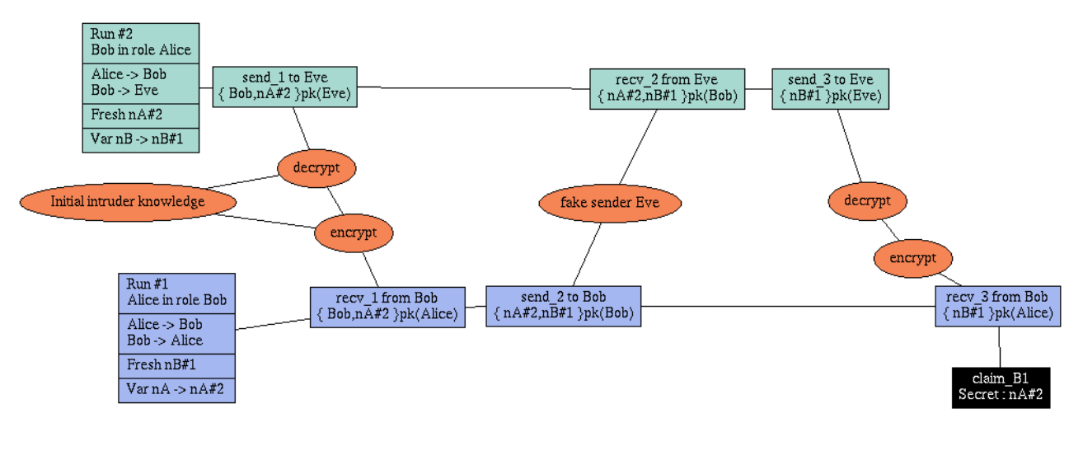
N-S asymmetric: Problem?
Discovered by G. Lowe 17 years after using formal verification method/tool

Slide 21
Formal verification of protocols
Negatives
Specific attacker model
  Different attacker (e.g., side-channels) => attack possible
Assumes perfect crypto-primitives
Sensitive to precise specification
Hard to express real-world complex protocols
  Search space too large
Positives
Automated process
Prevents basic and some advanced design flaws
Favours simple solutions
  Complexity is enemy of security
Is formal verification
panacea?
Proofs by formal verification now considered good practice and actively aimed for (e.g., TLS1.3)

Slide 22
Morale: Protocol design is very hard => use existing, proven ones

Slide 23
References
Security Protocols Open Repository
  http://www.lsv.ens-cachan.fr/Software/spore/
C. Cremer, Scyther tool
  https://github.com/cascremers/scyther/
Cas Cremer’s exercise sheet
  https://www.cs.ox.ac.uk/people/cas.cremers/scyther/scyther-exercises.html

Slide 24
N-S asymmetric: Fix
Fixed by addition of B’s identity into second step
A → B: {A, N_{A}}PK_{(B)}
B → A: {B, N_{A}, N_{B}}PK_{(A)}
A → B: {N_{B}}PK_{(B)}

Slide 25
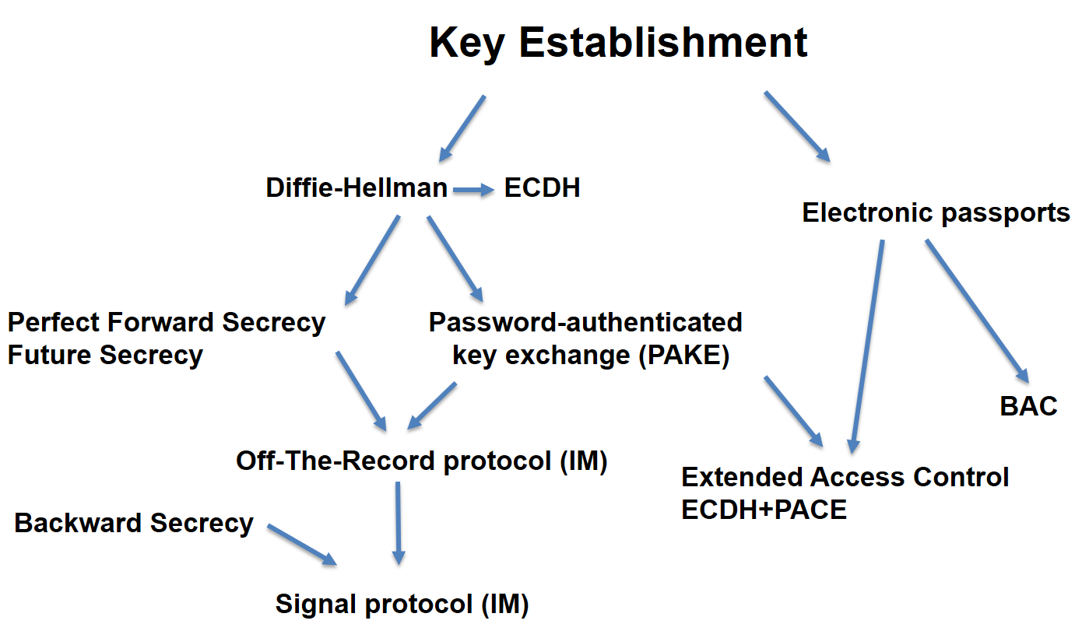
Key establishment

Slide 26
Methods for key establishment
Derive from pre-shared secret (PBKDF2)
Establish with help of trusted party (Kerberos, PKI)
Establish over insecure channel (Diffie-Hellman)
Establish over other (secure) channel (code book)
Establish over non-eavesdropable channel (BB84)
…

Slide 27
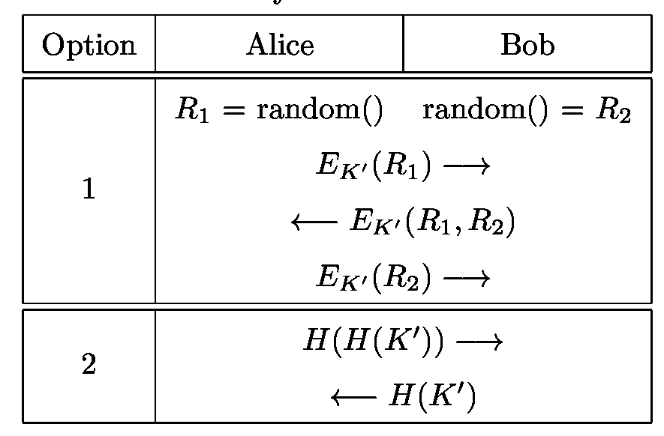
Methods for key confirmation
Goal: ensure that parties use same key value(s)
Implicit confirmation by use of valid key
  E.g., MAC by session key on future message is valid
Explicit confirmation by challenge-response
  Dedicated steps in protocol
http://www.themccallums.org/nathaniel/2014/10/27/authenticated-key-exchange-with-speke-or-dh-eke/

Slide 28
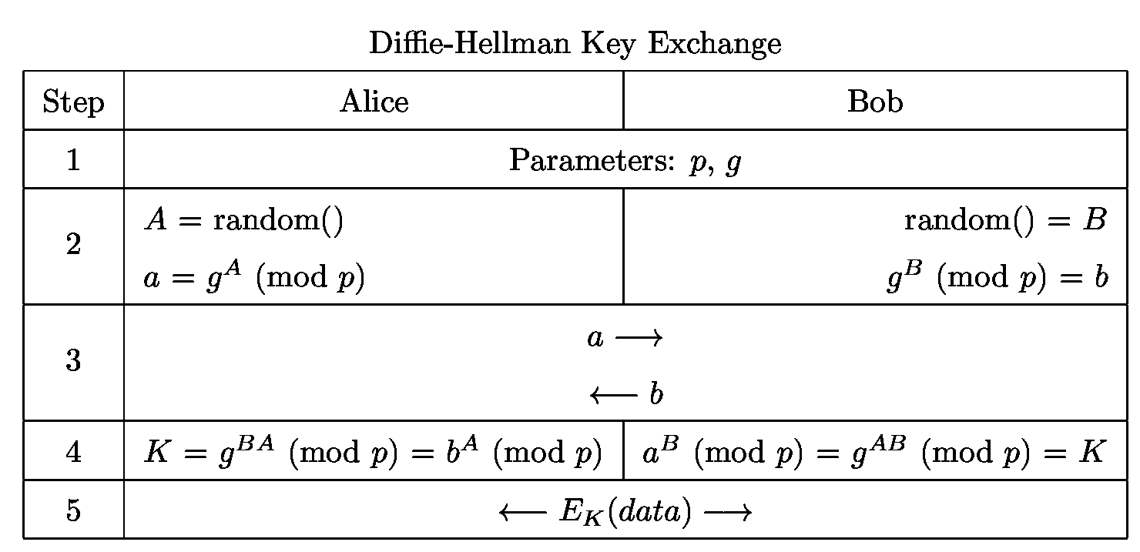
Diffie-Hellman key exchange
Which part ensures:
Key establishment
Key confirmation
Authentication
Cyclic group with large order,
generator g, large prime p
http://www.themccallums.org/nathaniel/2014/10/27/authenticated-key-exchange-with-speke-or-dh-eke/

Slide 29
Diffie-Hellman in practice
Be aware of particular p and g
  If g is widely used with length up to 1024b then precomputation is possible
    “Logjam” attack, [CCS’15]
    Huge precomputation effort, but feasible for large national agency
    Certain combination of g and p => fast discrete log to obtain A
  If p is really prime and g has larger order (Indiscrete logs, [NDSS17])
Variant of DH based on elliptic curves used (ECDH)
  ECDH is preferred algorithm for TLS, ePassport…
  ECDH is algorithm of choice for secure IM (Signal)

Slide 30
DH based on elliptic curves used (ECDH)
EC curve options:
Edwards curves (e.g., Ed25519)
NIST FIPS curves (e.g., NIST P-256)
… many options, see https://safecurves.cr.yp.to/
EC curve, G (base point)
A x G (scalar multiplication)
B x G
A x B x G
A x b
B x a
A x B x G
http://www.themccallums.org/nathaniel/2014/10/27/authenticated-key-exchange-with-speke-or-dh-eke/

Slide 31
Diffie-Hellman in practice
K is not used directly, but K’ = KDF(K) is used
  Original K may have weak bits
  Multiple keys may be required (K_{ENC}, K_{MAC})
Is vulnerable to man-in-the-middle attack (MitM)
  Attacker runs separate DH with A and B simultaneously
  (Unless a and b are authenticated)
DH can be used as basis for Password-Authenticated Key Exchange
DH can be used as basis for Forward/Backward/Future secrecy

Slide 32
Perfect forward secrecy

Slide 33
Forward secrecy - motivation
Assume that session keys are exchanged using long-term secrets
  Pre-distributed symmetric cryptography keys (SCP’02)
  Public key cryptography (PGP, TLS_RSA_...)
What if long-term secret is compromised?
  All future transmissions can be read
  Attacker can impersonate user in future sessions
  All previous transmissions can be compromised (if traffic was captured)
Can III. be prevented? (Forward secrecy)
Can I. be prevented? (Backward secrecy, “healing”)
Must not have past keys
Must not derive future keys deterministically

Slide 34
Forward/backward secrecy – how to
(Perfect) Forward Secrecy
  Compromise of long-term keys does not compromise past session keys
Solution: ephemeral key pair (DH/ECDH/RSA/…)
  Fresh keypair generated for every new session
  Ephemeral public key used to exchange session key
  Ephemeral private key is destroyed after key exchange
    Captured encrypted transmission cannot be decrypted
Long-term key is used only to authenticate ephemeral public key to prevent MitM
  E.g., MAC over DH share

Slide 35
Use of forward secrecy: examples
HTTPS / TLS
  TLS1.2: ECDHE-ECDSA, ECDHE-RSA…
  TLS1.3: TLS_ECDHE_ECDSA_WITH_xxx…
SSH (RFC 4251)
PAKE protocols: EKE, SPEKE, SRP…
Off-the-Record Messaging (OTR) protocol (2004)
Signal protocol (2015)
Noise protocol framework (2017)

Slide 36
Password-Authenticated Key Exchange (PAKE)

Slide 37
PAKE protocols - motivation
Diffie-Hellman can be used for key establishment
  Authentication ca be added via pre-shared (longterm) key
But why not directly derive session keys from pre-shared instead of running DH?
  Compromise of pre-shared key => compromise of all data transmissions (including past) => no forward secrecy
  Pre-shared key can have low entropy (password / PIN) => attacker can brute-force
Password-Authenticated Key Exchange (PAKE)
  Sometimes called “key escalation protocols”

Slide 38
PAKE protocols - principle
Goal: prevent MitM and offline brute-force attack
Generate asymmetric keypair for every session
  Both RSA and DH possible, but DH provides better performance in keypair generation
Authenticate public key by (potentially weak) shared secret (e.g., password or even PIN)
  Must limit number of failed authentication requests!
Exchange/establish session keys for symmetric key cryptography using authenticated public key

Slide 39
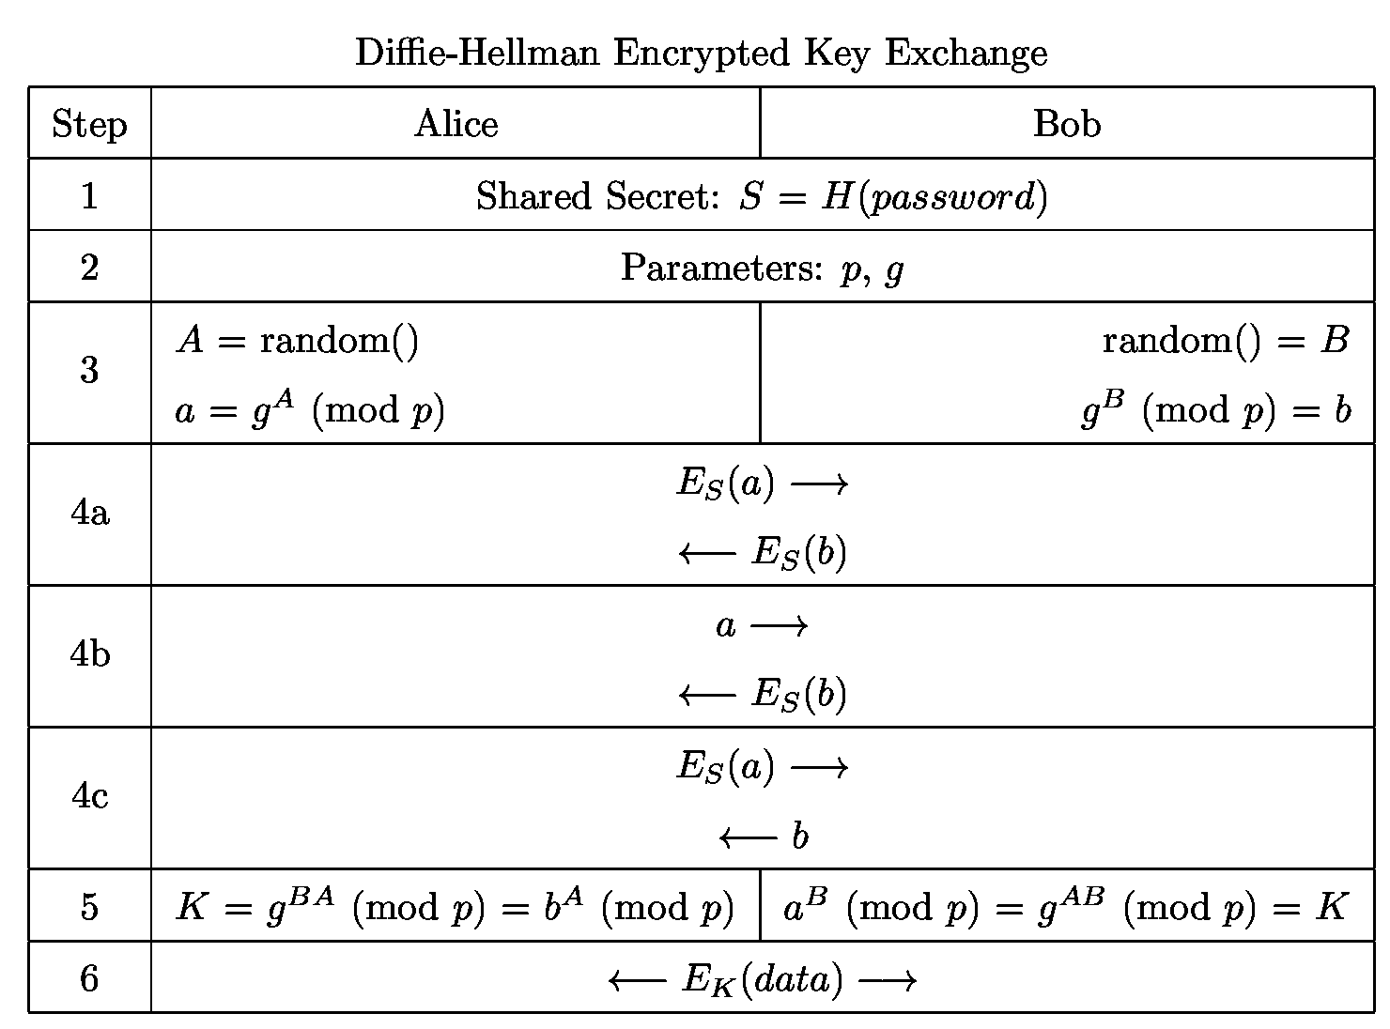
Diffie-Hellman Encrypted Key Exchange [PAKE]
To protect against offline bruteforce attack against the password used, an attacker must not be able to tell if the decrypted a’ is valid (any structure of a’ can reveal successful decryption)
http://www.themccallums.org/nathaniel/2014/10/27/authenticated-key-exchange-with-speke-or-dh-eke/
Various options a,b,c available

Slide 40
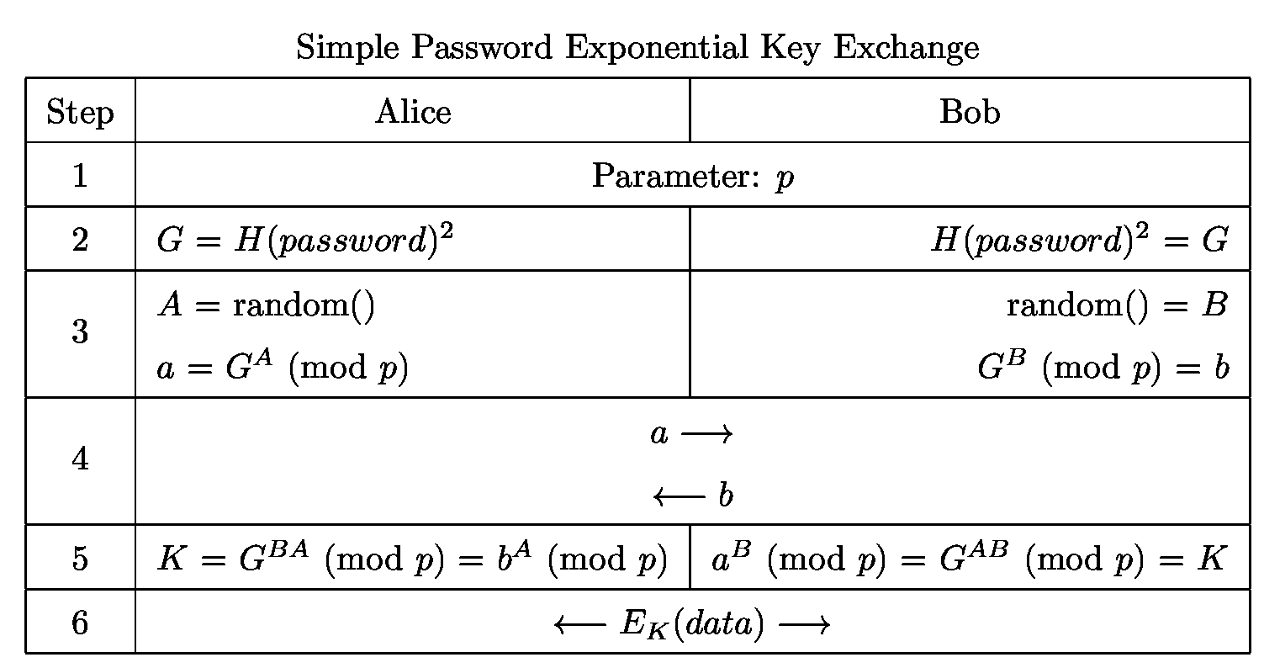
Simple Password Exponential Key Exchange (SPEKE)
http://www.themccallums.org/nathaniel/2014/10/27/authenticated-key-exchange-with-speke-or-dh-eke/

Slide 41
Secure Remote Password protocol (SRP), [aPAKE]
Earlier Password-Authenticated Key Exchange protocols (PAKEs) were patented: EKE, SPEKE… (patent expired in 2017)
Secure Remote Password protocol (SRP) 1998
  Designed to work around existing patents
  Royalty free, open license (Standford university), basis for multiple RFCs
  Several revisions since 1998 (currently 6a)
  Originally with DH, variants with ECDH exist
  Widely used, support in common cryptographic libraries
Apple uses SRP extensively in its iCloud Key Vault
Asymmetric Password Authenticated Key Exchange (aPAKE)

Slide 42
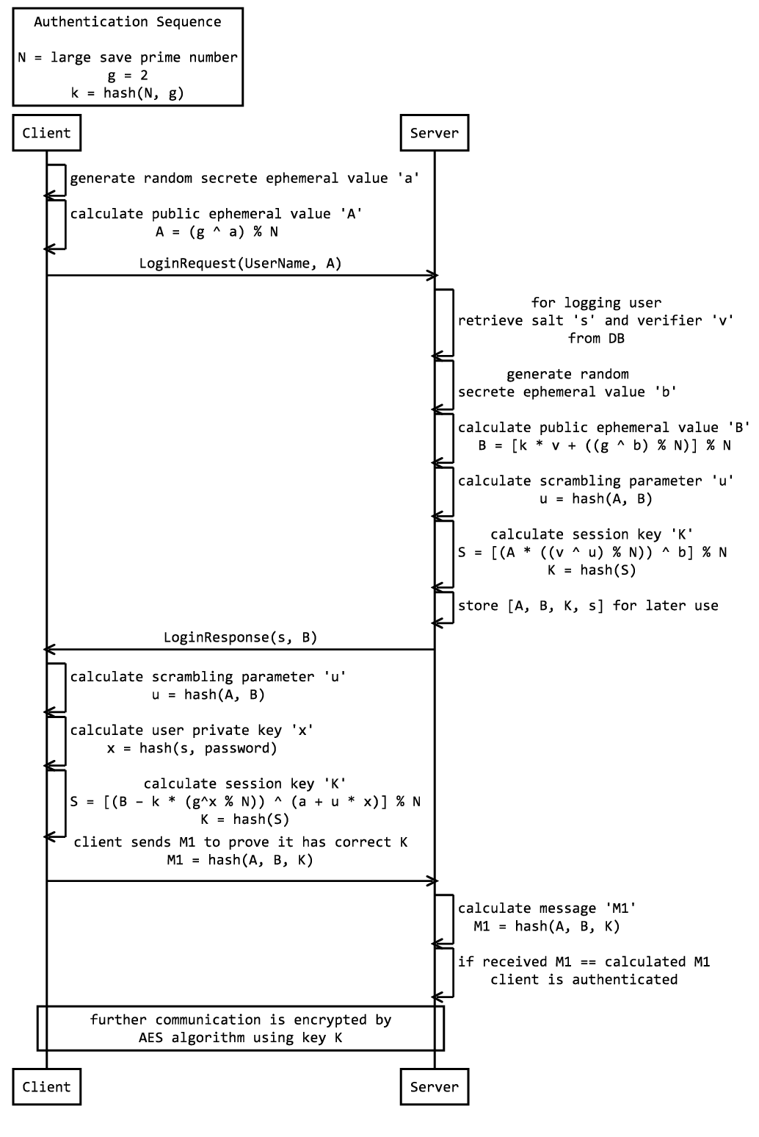
SRP is unnecessarily complex to work around existing patens
https://www.codeproject.com/KB/security/1082676/SrpAuthenticationSequence.png

Slide 43
PAKEs evolution
Properties
Only password
“PAKE” protocols
“aPAKE” protocols
Strong aPAKE (“SaPAKE”)
Compromised if server hack
Prevent MitM offline cracking, still server hack compromise
Like PAKE, but using salted hash instead of password, salt-specific precomputation possible
Prevent offline cracking and precomputation attack (using zero-knowledge proofs)
https://blog.cryptographyengineering.com/2018/10/19/lets-talk-about-pake/

Slide 44
Current state of the art SaPAKE
OPAQUE protocol (Eurocrypt 2018)
  https://eprint.iacr.org/2018/163.pdf
  https://blog.cryptographyengineering.com/2018/10/19/lets-talk-about-pake/
Prediction about future PAKE uptake
  https://emilymstark.com/2020/07/30/should-web-apps-use-pakes.html

Slide 45
Secure Instant messaging

Slide 46
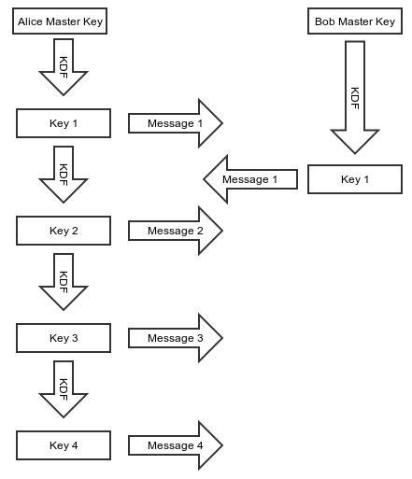

“Toy” protocol for protection of instant messaging
https://signal.org/blog/advanced-ratcheting/
Relatively short sessions with multiple messages
Perfect forward secrecy
  Ephemeral DH to establish Alice/Bob master keys
    Past keys/messages are secure
Derive next key within session by KDF (hash)
We also need “Future” secrecy
  Automatic self-healing after key compromise
  Next key must NOT be deterministically generated from previous ones
Key 2 is compromised
X
X
All subsequent session keys now compromised
X

Slide 47
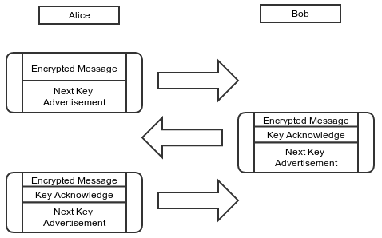
“Ratcheting” == new DH exchange for every message
https://signal.org/blog/advanced-ratcheting/

Slide 48
Off-The-Record Messaging (OTR), 2004
Protocol for protection of instant messaging
  Establish session, communicate, close (minutes/hours)
Perfect forward secrecy (using ephemeral DH keys)
  Also “future” secrecy: automatic self-healing after compromise
OTR “ratcheting” (new DH key for every session & new message)
Plausible deniability of messages
  Message MAC is computed, message send and received
  MAC key used to compute MAC is then publicly broadcast
  As MAC key is now public, everyone can forge past messages (will not affect legitimate users but can dispute claims of cryptographic message log in court)

Slide 49
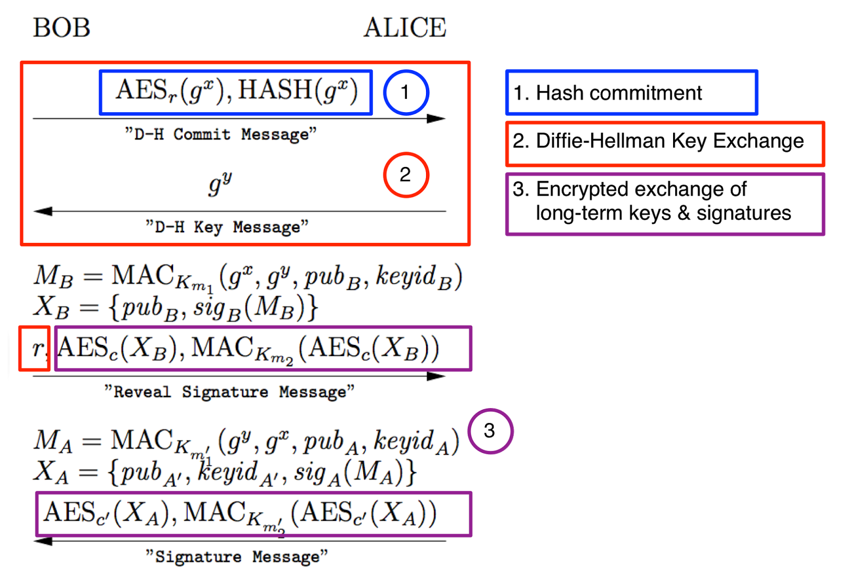
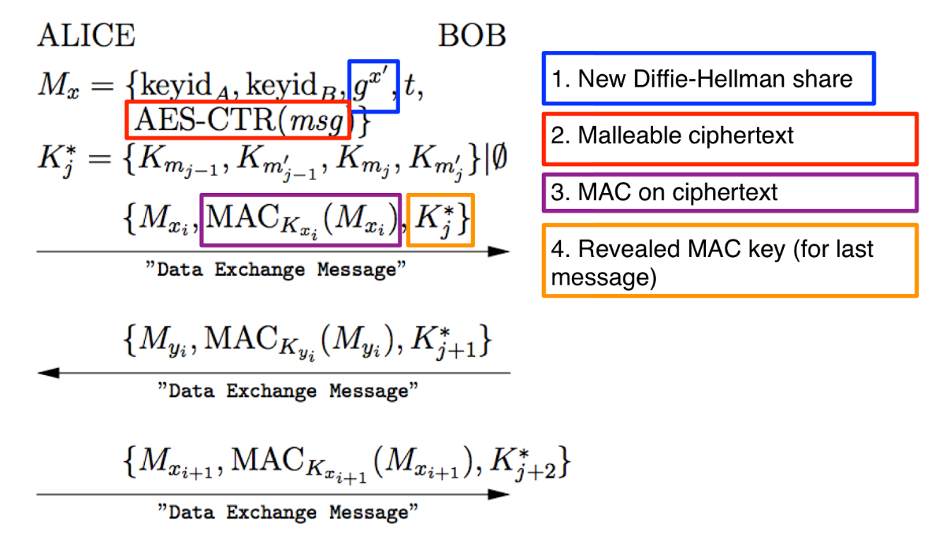
OTR protocol
See https://blog.cryptographyengineering.com/2014/07/26/noodling-about-im-protocols/ for details
Key exchange
Message exchange

Slide 50
OTR – some problems
How to work with asynchronous messages?
  OTR designed for instant messaging with short sessions
What if out-of-order message is received?
  OTR has counter to prevent replay
Window of compromise is extended
  Decryption key cannot be deleted until message arrives
…
Systematization of Knowledge: Secure Messaging (2015)
  Systematic mapping of Secure Messaging protocols
  http://www.ieee-security.org/TC/SP2015/papers-archived/6949a232.pdf

Slide 51
Signal protocol

Slide 52

The Signal protocol
https://signal.org/blog/advanced-ratcheting/
State-of-the-art of instant messaging protocols
  Used in Signal, WhatsApp, Facebook Messenger, Google Allo…
The Signal protocol provides:
  confidentiality, integrity, message authentication,
  participant consistency, destination validation,
  forward secrecy, backward secrecy (aka future secrecy)
  causality preservation, message unlinkability, message repudiation, participation repudiation and asynchronicity
  end-to-end encrypted group chats
Requires servers (but servers are untrusted wrt message privacy/integrity)
  relaying of messages and storage of public key material
ECDH with Curve25519, AES-256, HMAC-SHA256

Slide 53
The Signal protocol implementation
Authentication of users: 1) Trust on first use 2) Trusted party (PKI) 3) Fingerprint check using other channel (hex, QR code…)
Protection of messages
  Perfect forward secrecy and backward secrecy (ratcheting)
  New DH for (almost) every message (announced in the previous one)
  Message key derived both from long-term key and chain key
  Authenticated Encryption with deniability (MAC key broadcasted later)
Protection of metadata (but no strong anonymity such as in Tor)
  Message delivery time and communicating parties available
  Service provider may choose to keep or delete this information
Private contact discovery using Intel SGX
  https://signal.org/blog/private-contact-discovery/

Slide 54
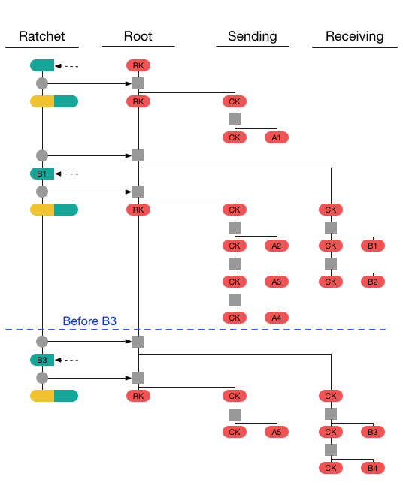


Message keys in Signal
https://signal.org/docs/specifications/doubleratchet/
Basic trick: combine frequent ECDH and hash chains
Root key(s) (RK)
  Established from last ECDH ratchet and previous RK
Chain key(s) (CK)
  Established from the most recent RK + hash chain
  KDF to derive next CK = HMAC-HASH(CK, "1")
Message key(s) (MK)
  Derived from CK as MK = HMAC-HASH(CKs, "0")
  Message A_{x} encrypted by MK_{x}
RK&CK compromise is “healed” by next ECDH
Out-of-order messages by storage of corresponding MK_{x}

Slide 55
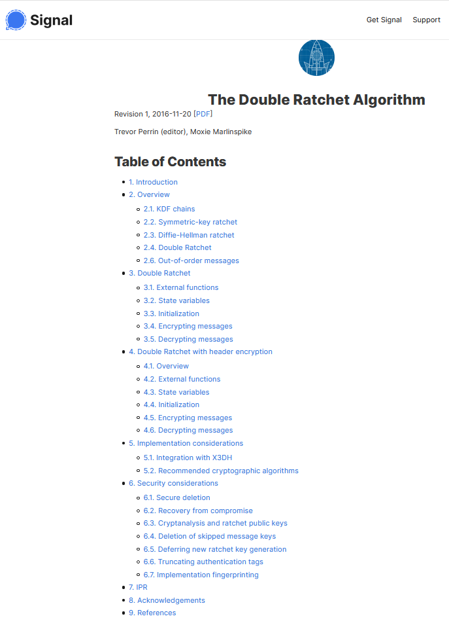
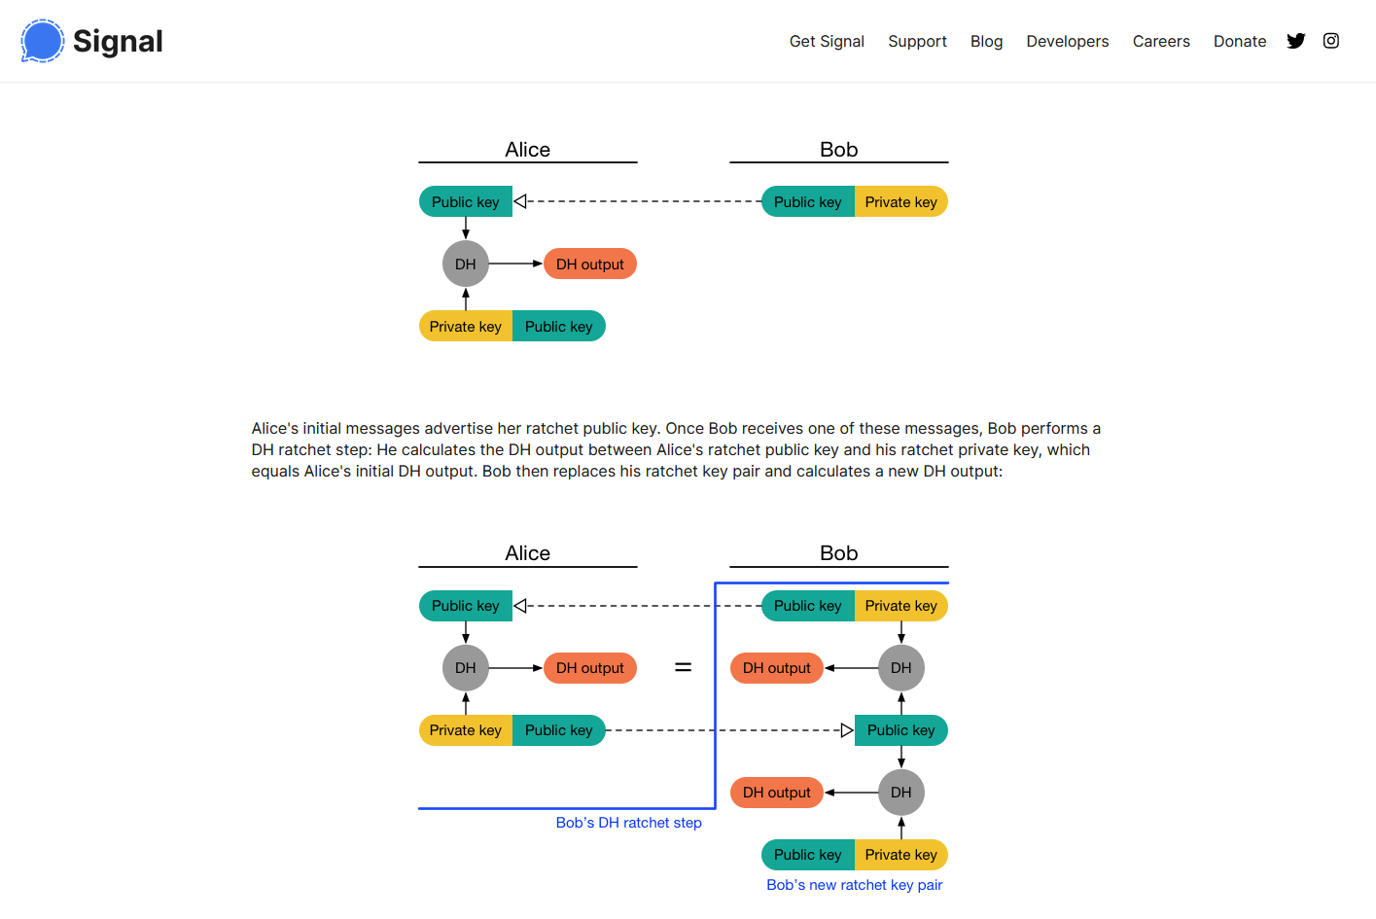
https://signal.org/docs/specifications/doubleratchet/

Slide 56
The Signal protocol – group messaging
Speaker consistency
Out-of-order resilience
Dropped message resilience
Computational equality
Trust equality
Subgroup messaging
Contractible and expandable group membership
Read more details at https://www.whatsapp.com/security/WhatsApp-Security-Whitepaper.pdf
https://en.wikipedia.org/wiki/Signal_(software)#Encryption_protocols

Slide 57
Noise protocol framework

Slide 58
Noise protocol framework (https://noiseprotocol.org/)
Do you have exactly same situation as Signal?
  Then use Signal’s code, but: different usage scenario, unnecessarily large code base…
What if different usage scenario is required with some changes needed?
  Custom changes to protocol are always risky
  (Signal is formally verified, but change may break the proof + change in assumptions)
And formally verified protocols is not enough – we need also secure implementation!
Ideally: custom, but formally verified protocol + generator of its code

Slide 59
Noise protocol framework (https://noiseprotocol.org/)
Ideally, formally verified protocol + generator of code
Noise protocol framework is exactly that
  T. Perrin (co-author of Signal’s double-ratchet protocol)
  https://noiseprotocol.org/noise.pdf + generator (https://noiseexplorer.com/)
  Used by WhatsApp since October 2020, Bitcoin Lighting protocol, I2P anonymity network, WireGuard VPN
Protocol designer to describe what needs using simple language or picks from already existing patterns (many of them)
Execute formal verification (ProVerif) to verify protocol claims
  E.g., claim: same shared key, one party authenticated for passive attacker
Run code generator to get complete code in target language

Slide 60
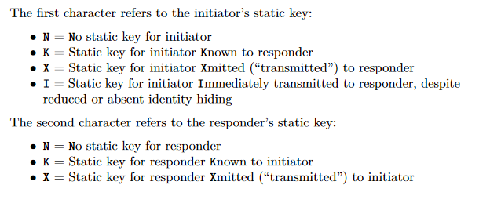
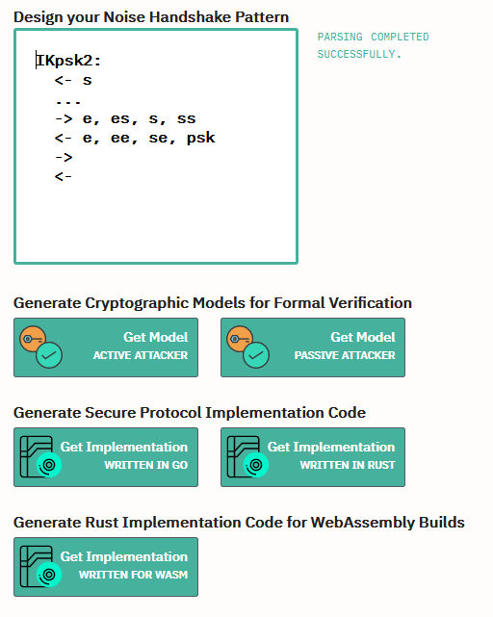
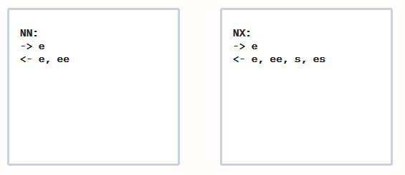
Some existing Noise patterns
https://noiseexplorer.com/patterns/NN/
https://noiseexplorer.com/patterns/NX/
https://noiseexplorer.com/patterns/IKpsk2/
Noise protocols use set of rules:
  If you already have some key, use it immediately to encrypt all subsequent messages
  When new entropy is available (ECDH), update current state (keys) => forward&backward secrecy
  Use AEAD for all message encryption
  …

Slide 61
Electronic passports and citizen ID cards
Credit: Slides partially based on presentation by Zdenek Říha

Slide 62
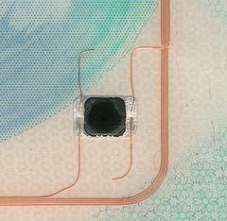
Passports of the first generation
Electronic passport
  Classical passport booklet + passive contactless smartcard
  (ISO14443, communication distance 0-10 cm)
  Chip & antenna integrated in a page or cover
Technical specification standardized by ICAO
  Standard 9303, 6th edition
  References many ISO standards
Data is organised in 16 data groups (DG) and 2 meta files
  DG1-DG16, EF.COM, EF.SOD
  Mandatory is DG1 (MRZ), DG2 (photo), EF.COM and EF.SOD (passive authentication)

Slide 63
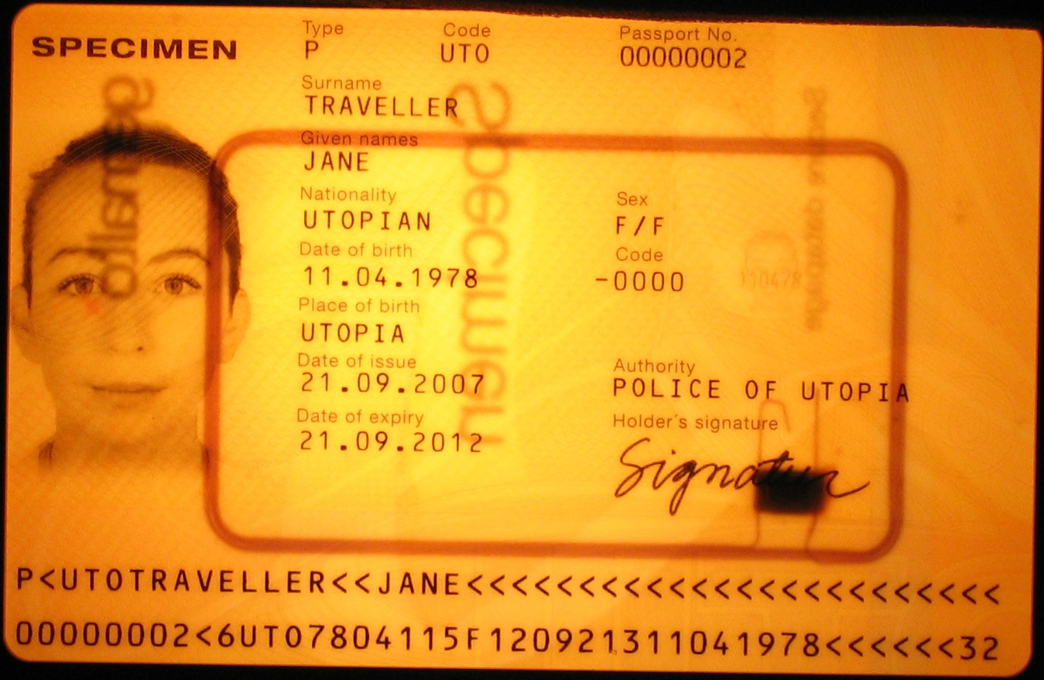
Chip and antenna

Slide 64
Data groups
Data group | Stored data
DG1 | Machine readable zone (MRZ)
DG2 | Biometric data: face
DG3 | Biometric data: fingerprints
DG4 | Biometric data: iris
DG5 | Picture of the holder as printed in the passport
DG6 | Reserved for future use
DG7 | Signature of the holder as printed in the passport
DG8 | Encoded security features – data features
DG9 | Encoded security features – structure features
DG10 | Encoded security features – substance features
DG11 | Additional personal details (address, phone)
DG12 | Additional document details (issue date, issued by)
DG13 | Optional data (anything)
DG14 | Data for securing secondary biometrics (EAC)
DG15 | Active Authentication public key info
DG16 | Next of kin

Slide 65
Protocols used in ePassports I.
SG: security goal, S: solution used
Authentication of inspection system to chip [BAC]
  Read basic digital data from chip (MRZ, photo)
  SG: Passport provides basic data only to local terminal with physical access to passport
  S: Auth. SCP, sym. crypto keys derived from MRZ [BAC]
Authorized access to more sensitive chip data
  SG: Put more sensitive data on chip (fingerprint, iris), but limit availability only to inspection systems of trustworthy countries
  S: Challenge-response auth. protocol [EAC,EAC-PACE], PKI + cross-signing between trustworthy states [EAC]

Slide 66
Protocols used in ePassports II.
SG: security goal, S: solution used
Genuine data on passport
  SG: Are data on passport unmodified?
  S: digital signatures, PKI [passive authentication]
Authentication of chip to inspection system
  SG: Is physical chip inside passport genuine?
  S: Challenge-response authentication protocol [AA, EAC-PACE]
Transfer data between chip and IS securely
  SG: attacker can’t eavesdrop/modify/replay
  S: secure channel [EAC, EAC-PACE]

Slide 67
Basic Access Control (BAC) protocol
Authentication&secure channel between inspection terminal and chip
  Based on symmetric crypto (3DES), similar to SCP’0x protocols
  Low computational requirements
Problem: anyone with access to MRZ can authenticate
Problem: MRZ has insufficient entropy
  Document number, birth date, expiration date used
  Theoretically 58/74 bits, but in practice about 32 bits
Offline attack (eavesdrop then crack)
  Eavesdrop valid communication between chip and reader
  Brute-force attack in less then hour (2³² ops, offline attack)
Online attacks against chip (att. model: found passport)
  Significantly slower, ~20 ms for every attempt

Slide 68
Extended Access Control (EAC) protocol
Based on asymmetric cryptography (RSA/DH/ECDSA)
Chip Authentication (CA) based on PACE protocol
  Password Authenticated Connection Establishment (PACE)
  Uses chip’s static DH/ECDSA key and terminal’s ephemeral DH key pair (perfect forward secrecy)
  Both parties combines chip’s public static and ephemeral public key into same key K
  Keys for encryption and MAC (K_{ENC}, K_{MAC}) are derived from exchanged K
How can be Terminal sure of authenticity of chip’s static key?
  Signed by Issuing country
Terminal Authentication (TA)
  Based on challenge-response protocol (RSA/ECDSA, SHA-1/2)
  Hash of the ephemeral DH key from previous step hashed with challenges

Slide 69
How Signal and ePassports compare?
Completely different usage scenario
  Instant messaging vs. person/terminal authentication
  Frequent software updates possible vs. 15 years passport validity
Different trust relations and participants structure
  N friends vs. many partially or fully distrusting participants
  Mostly online vs. mixed offline/online (even without clock!)
Underlying cryptographic primitives are shared
  Forward secrecy, ECDH, AES, SHA-2…
  Ratcheting and deniability not necessary for ePass

Slide 70
Still Want to design own protocol? ☺

Slide 71
Design of cryptographic protocols
Don’t design own cryptographic protocols
  Use existing and well-studied protocols (TLS, EAC-PACE…)
  Don’t remove “unnecessary” parts of existing protocols
Don’t implement existing/your protocol (if possible)
  Potential for error, implementation attacks…, use existing implementations
Follow all required checks on incoming messages
  Verification of cryptograms, check for revocation…
But more likely you will need to design own protocol than to design own crypto algorithm
  Always use existing protocol if possible

Slide 72
Conclusions
Design of (secure) protocols is very hard
  Understand what are your requirements
  Use existing protocols, e.g., TLS, Signal or EAC-PACE
  Use existing implementations (very hard to implement securely)
Resiliency against compromise of long-term secrets is crucial (forward secrecy)
Strong session keys authenticated by weak passwords (PAKEs)
Signal protocol is state-of-the-art and widely deployed (Instant messaging)
Electronic passport uses variety of protocols (Interesting and complex scenarios)
Mandatory reading
  M. Green, Noodling about IM protocols, http://blog.cryptographyengineering.com/2014/07/noodling-about-im-protocols.html
  M. Marlinspike, Advanced cryptographic ratcheting https://whispersystems.org/blog/advanced-ratcheting/

Slide 74
Design of protocols

Slide 75
Design of cryptographic protocols
Don’t design own cryptographic protocols
  Use existing well-studied protocols (TLS, EAC-PACE…)
  Don’t remove “unnecessary” parts of existing protocols
Follow all required checks on incoming messages
  Verification of cryptograms, check for revocation…
Don’t design and implement your own (if possible)
  Potential for error, implementation attacks…
But more likely you will need to design own protocol than to design own crypto algorithm
  Always use existing protocol if possible

Slide 76
Design principles I. (Abadi & Needham)
The conditions for a message to be acted should be clearly set out so reviewer can judge if they are acceptable.
  Documentation, diagrams, formal specification
Every message should say what it means, message interpretation should depend only on its content.
  “This is 2nd message of SCP’02 from A to B”
  No assumptions like next random chunk number should be encrypted 2nd message because I just received 1st message
Mention name of principal (“Alice01”)
  Prevents (if checked) unintended parallel runs of protocol
  Prevents reflection attack

Slide 77
Design principles II. (Abadi & Needham)
Be clear about why encryption is being done
  For confidentiality, not to “somewhat” ensure integrity
When signing encrypted data, it should not be inferred that signing entity knows data content
  No knowledge of encryption key
Be clear about properties of nonce
  random, never repeated, unpredictable, secret
  Random → almost never repeated unintentionally

Slide 78
Design principles III. (Abadi & Needham)
If predictable quantity is to be effective, it should be protected so that an intruder cannot simulate a challenge and later replay the message
  Counter as challenge → counter freshness verification necessary → state
If timestamps are used as freshness guarantees, then difference between local clocks at various machines must be much less then allowable age of message
  Otherwise an attacker can replay within time window
Key may have been used recently and yet be old and possibly compromised
  Clear session state after session end, check freshness

Slide 79
Design principles IV. (Abadi & Needham)
It should be possible to deduce which protocol and which run of that protocol a message belongs to including order number in the protocol
  Danger of parallel runs of same protocol
  MAC and chaining with fresh session keys prevents message mixing
Trust relation should be made explicit and there should be good reason for its necessity.
  Less trust needed → better security achieved

Slide 80
Design principles V. (Hanno Böck)
Always use an AEAD. No CBC, OFB, CFB. No "signatures are as good as an AEAD".
Stay away from PKCS #1 1.5. If you want to use RSA use PSS/OAEP, but maybe don't use RSA.
Don't use ECDSA, don't use any old ECC. Use X25519, Ed25519 or alike.
Don't use DSA, 64-bit-blocks, sha1/md5 and other old crap.
Think about duplicate nonces. If you can't easily avoid nonce repetition consider AES-SIV.
Still talk to a real cryptographer, but if you follow these you're already better than a lot of others :-)

Slide 81
Secure channel – typical composition
Exchange basic (public) parameters
Generate random challenges (freshness)
Use pre-distributed secrets and challenges to generate session keys (protect long term secrets)
Compute and verify authentication cryptograms (entity authentication)
Encrypted&MAC message(s) (Secure Messaging)
End secure channel (erase session keys)

Slide 82
SCP – what to take into account
Usage scenario and expected attackers
Confidentiality and integrity of command data
Network level attacks (replay…)
Atomicity of critical operations
Robustness against side channel attacks (time and power analysis, fault attacks…)
Robustness against incorrect attempts (limit, delay retries…)
Resilience against traffic analysis
API and implementation attacks

Slide 83
SCP – usage scenario and attacker model
What are the sensitive objects (keys, data, functions)?
What are these sensitive objects used for and what is the data flow of these objects?
What are the capabilities of the attackers (funding, tools, knowledge)?
What are the points where an attacker can observe the system (dump of exchanged messages, debugging, ...)?
Which parts of the system must be trusted to achieve required functionality (less the better)?

Slide 84
SCP – network attacks
Use HMAC or OMAC instead of simple hash only
Include command header/metadata into MAC
Pre-share two keys (encryption, mac) or derive from master instead of using only one
Use pre-shared keys only to derive session keys. Session keys are used than to generate cryptograms etc.
Session keys must be dependent on contributions from both parties. One party cannot force resulting key into specific value

Slide 85
SC – network attacks
Replay attack – hash chain better than counter only
Encrypt then MAC: MAC(ENC(data))
Close channel on error
Use GCM rather than CBC rather than ECB
Be aware of block swap in ECB mode, cut attack in CBC
Do not use XOR for combination of values – use hash/HMAC instead
Reflection attack: Do not use symmetric protocol messages (A→B cannot be reflected as B→A)

Slide 86
Electronic passports
- more details

Slide 87
Authorization and passports
Inspection terminal to read basic info from chip
Inspection terminal to read biometric data from chip
You to enter country based on chip data

Slide 88
Basic Access Control (BAC) protocol
Authentication&secure channel between inspection terminal and chip
  Based on symmetric crypto (3DES), similar to SCP’0x protocols
  Low computational requirements
Problem: anyone with access to MRZ can authenticate
Problem: MRZ has insufficient entropy
  Document number, birth date, expiration date used
  Theoretically 58/74 bits, but in practice about 32 bits
Offline attack (eavesdrop then crack)
  Eavesdrop valid communication between chip and reader
  Brute-force attack in less then hour (2³² ops, offline attack)
Online attacks against chip (att. model: found passport)
  Significantly slower, ~20 ms for every attempt

Slide 89
EAC – motivation
EU passports stores fingerprints (from 2009)
  More sensitive than facial photo => better protocol needed
Goal: not everyone with access to passport (and MRZ for BAC) should be able to read out fingerprint
  Issuing country decides who else can access
Stronger authentication than BAC required

Slide 90
Mind exercise: symmetric crypto
What if only symmetric crypto is used?
  Every chip has own unique symmetric key
  Large number of keys in inspection terminals
  Compromise of single terminal breach security
  => impractical and insecure => not used

Slide 91
Extended Access Control (EAC) protocol
Based on asymmetric cryptography (RSA/DH/ECDSA)
Chip Authentication (CA) based on PACE protocol
  Password Authenticated Connection Establishment (PACE)
  Uses chip’s static DH/ECDSA key and terminal’s ephemeral DH key pair (perfect forward secrecy)
  Both parties combines chip’s public static and ephemeral public key into same key K
  Keys for encryption and MAC (K_{ENC}, K_{MAC}) are derived from exchanged K
How can be Terminal sure of authenticity of chip’s static key?
  Signed by Issuing country
Terminal Authentication (TA)
  Based on challenge-response protocol (RSA/ECDSA, SHA-1/2)
  Hash of the ephemeral DH key from previous step hashed with challenges

Slide 92
Terminal authentication I.
Only authorized border authorities can read the secondary biometric data (fingerprints and iris)
  The inspection system must prove to the chip it is authorized
  The chip stores a trust point – root certificate
  Inspection system presents a valid certificate chain (starting from the passport’s trust point) specifying the IS’s authorizations (e.g. to read DG3)
  Challenge-response where IS proves knowledge/access of a secret key (whose public part is certified)
  Certificates in Card-verifiable (CV) format

Slide 93
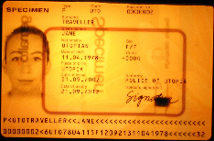
Terminal Authentication II
Country A
Country B
Country C
CV CA
CV CA
CV CA
DV
DV
DV
DV
IS
...
IS
IS
...
IS
IS
...
IS
IS
...
IS
Root public key of issuing country: CV CA

Slide 94
Terminal Authentication III
Supported algorithms
  RSA PKCS#1 v1.5 with SHA-1 or SHA-256
  RSA PSS with SHA-1 or SHA-256
  ECDSA with SHA-1, SHA-224 or SHA-256
  Key lengths
    For ECDSA allowed 160, 192, 224, 256 bits
    For RSA allowed 1024, 1280, 1536, 2048 and 3072 bits
    In practice ECDSA is more common, key lengths 192 and 224 bit most popular, existing implementations also support 256 and 384 bits.
    For RSA the PKCS#1 v1.5 padding is much more popular than PSS, key lengths are between 512 (test only) and 2048 bits.

Slide 95
Active Authentication (AA) protocol
Motivation: Prevent cloning of passport
  Is chip inside passport authentic?
Passport-specific asymmetric key stored on chip
Public key freely readable (DG15 file, hash signed)
Authentication against terminal
  Terminal generates 8 random bytes
  Chip adds additional 8 random bytes, hash and sign
  Terminal verifies signature
Privacy attack: terminal’s challenge is date → signed
PACE protocol replaces Active Authentication

Slide 96
EAC Chip authentication
Verifies the authenticity of the chip
  Replaces Active Authentication
  Improves the security of Secure Messaging
    Keys with higher entropy than for Basic Access Control (BAC)
Diffie-Hellman key pair (passport’s chip)
  Public key and domain parameters stored in DG14
  Private key never leaves the chip
Diffie-Hellman key pair (inspection system – IS)
  Key pair generated according to passport’s domain parameters
  Private key kept secret, public key sent to chip
Both the parties (passport, IS) now share a secret
  The secret is used to derive the SM keys, the ability to communicate proves the authenticity of the chip

Slide 97
Chip authentication II
Algorithms supported by the EAC specification
  Diffie-Hellman (PKCS#3)
  Elliptic Curve Diffie-Hellman (ISO 15946, BSI TR-03111 )
  Both DH and ECDH popular with chip manufacturers
    DH with 1024 or 1536 bit prime
    ECDH with mostly 224 bit curves, some implementations use 256 or 384 bits
No challenge semantics
Coexistence of CA and AA

Slide 98
Passive Authentication
CSCA
Goal: are data in chip unchanged?
The list of the hashes (SHA-1/2)
of all present data groups is digitally
signed by the issuing organisation
(Document Signer)
  State printing house, Embassy, Etc.
The X.509 certificate of the Document Signer issued by the CA of the issuing country (Country Signing CA – e.g. the ministry of interior) is included.
The CSCA certificates must be exchanged bilaterally
ICAO PKD for DS certificates, CSCA CRL and cross certificates
Passive authentication is a mandatory security feature of all ePassports
DS1
DS2
ePassport 1
ePassport 2
ePassport 3

Slide 99
Passive Authentication – the details
The file EF.SOD contains a CMS (PKCS#7) SignedData structure (file is read and validated by inspection system)
  The signed data is the list of hashes of the present data groups
  The DS certificate is included (ICAO optional, EU mandatory)
  Data is signed by the DS
Signature schemes
  RSA with PKCS#1 v1.5 padding (min. 3072 bits for CSCA, 2048 bits for DS)
    E.g. Hungary, France, Spain, Portugal, Italy: RSA 4096 bit key with SHA-1
    E.g. Austria, Netherlands: RSA 3072 bit key with SHA-256
  RSA with PSS padding (min 3072 bits for CSCA, 2048 for DS)
    E.g. Czech Republic, Norway, Denmark, Japan and Australia – all with SHA-256
  DSA (not standardized for key lengths > 1024)
  ECDSA (domain parameters must be specified, min. 256 bits for CSCA, 224 bits for DS)
    E.g. Switzerland, Germany, Russia – all with SHA-1
Message Digest algorithms (for signature schemes and hashes of Data Groups)
  SHA-1 and all SHA-2 algorithms

Slide 100
Secure channel Protocol (for smartcards)
How to authenticate and communicate securely?

Slide 101
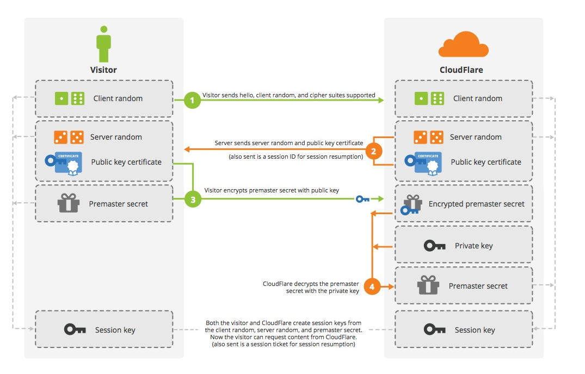
TLS handshake
Credit: Cloudflare

Slide 102
Why not to use TLS all the time?
Requires asymmetric cryptography
  Unsuitable for slower devices
Requires long keys
  Unsuitable for devices with small memory
Requires significant data overhead (~6.5KB)
  http://netsekure.org/2010/03/tls-overhead/
More lightweight protocols exist
  RFID / smartcards / IoT…
Note: TLS can be fully implemented on smartcards (but slow)
  https://github.com/gilb/smart_card_TLS

Slide 103
Secure channels – questions to ask
What attacker model is assumed?
Integrity protection? Encryption? Authentication?
One-side or mutual authentication?
What kind of cryptography is used?
What keys are required/pre-distributed?
Additional trust hierarchy required?
Is necessary to generate random numbers/keys?
What if keys are compromised? Forward secrecy?

Slide 104
What attacker model is assumed?
Integrity protection? Encryption? Authentication?
One-side or mutual authentication?
What kind of cryptography is used?
What keys are required/pre-distributed?
Additional trust hierarchy required?
Is necessary to generate random numbers/keys?
What if keys are compromised? Forward secrecy?

Slide 105
Common lightweight SCPs
OpenPlatform SCP’01,’02 (3DES-based)
OpenPlatform SCP‘10 (RSA-based)
OpenPlatform SCP’03 (AES-based)
ISO/IEC 7816-4 Secure Messaging
ePassports Basic Access Control (3DES-based)
ePassports Extended Access Control (3DES,RSA,DH,SHA1/2-based)

Slide 106
Example: GlobalPlatform SCP’03
Mutual authentication (based on symmetric crypto)
Session key derivation (based on long-term keys)
  NIST SP 800-108
Message (APDU) confidentiality and integrity MAC
INITIALIZE UPDATE
  Random challenge, card’s computations
EXTERNAL AUTHENTICATE
  Terminal response
Secure messaging
What are problems with
usage of symmetric crypto?

Slide 107
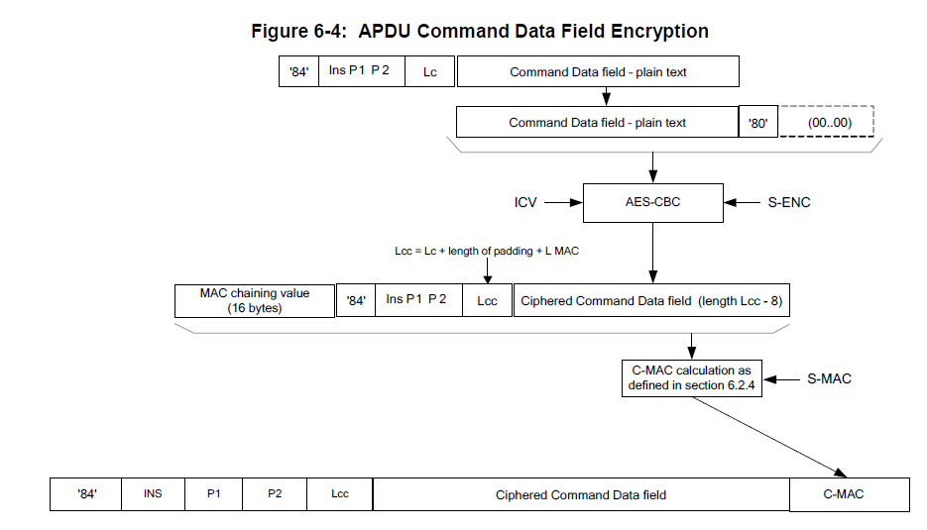
Secure Channel Protocol '03‘, Card Specification v2.2 – Amendment D, GPC_SPE_014

Slide 108
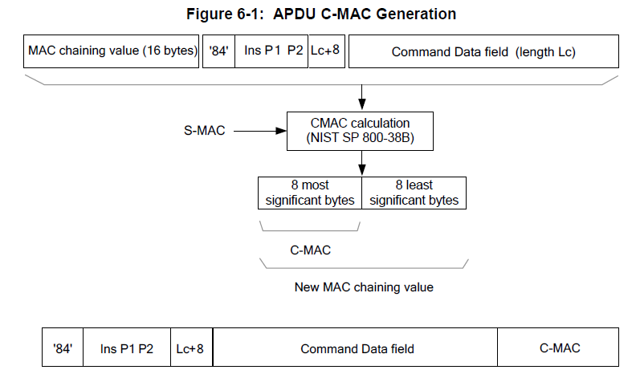
Secure Channel Protocol '03‘, Card Specification v2.2 – Amendment D, GPC_SPE_014

Slide 109
ePassport protocols (ICAO 9303)
Significantly more complex trust model
  Passport, Inspection terminal, Trusting countries, Distrusting countries
  Multiple sensitivity levels (basic info / fingerprint / iris)
  Combination of symmetric and asymmetric cryptography
Basic Access Control (BAC) protocol
  SCP-like protocol, static key is content from MRZ
Extended Access Control (EAC) protocol
  Terminal authentication (RSA/ECDSA, SHA-1/2)
  Chip authentication (DH/ECDSA key)
  PACE protocol to establish session keys
Active Authentication (AA) protocol

