Slide 1

Lasaris – Lab Software Architectures and Information Systems
Tomáš Pitner, Bára Bühnová
Heads of Lab

Slide 2
Lasaris Origin and History
History
Established in 2009
Own premises since 2010
Located at Botanicka 68a, Brno
Teaching
Programming (basic, enterprise, mobile – Java, C#, C, Ruby, XML)
Development methods (OO, quality, architectures, agile, process management)
Soft skills (team work, communication)
Critical infrastructures, cyberphysical systems

Slide 3
Lasaris Mission
Lab of Software Architecture and Information Systems
theoretical and practical problems related to the development of large secure and reliable software systems;
R&D projects in the field of critical infrastructures, such as smart grids, smart transportation and smart cities;
visualisations for education and training.

Slide 4
Lasaris Research Approach
Complex Problems from Reality
Combining Methods from Computer Science and other Disciplines (law, sociology, management, services)
Usually have a „Customer“ who can validate what we do
Collaboration is the Key

Slide 5
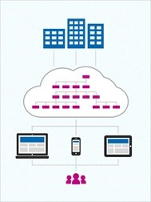
Lasaris Major Research Projects
C4e
Smart Grids
  TAČR SecureFlex
  TAČR National Center of Competence NC3
KYPO Cyber Range Platform
  SABU finished
  KYPO II, III
PostDoc@MU
EU Horizon projects
  Concordia finishing
  RES-Q+ starting

Slide 6
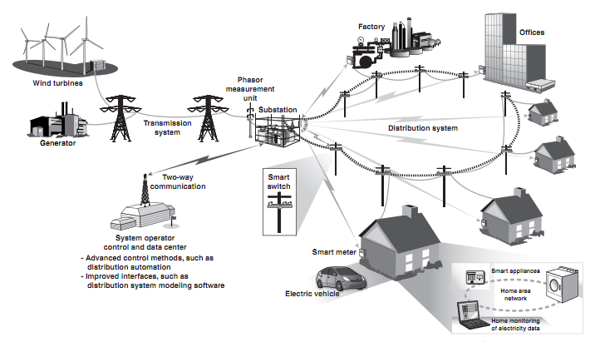
Lasaris Smart and Critical Infrastructures
Domains
  Smart grids
  Smart buildings
  Smart cities
  Internet of Things
Research
  Monitoring and control
  Architecture design
  Modeling and simulation
  Visualization
  Big data
  Cloud computing
  Cyberphysical systems
© GAO, U.S. Congress

Slide 7
Lasaris Values
Scientific performance combination of publication/citation/IF-based metrics & applied project impact (large applied projects for/with industry)
International visibility long-term broad contacts through Czech Cybercrime, Cybersecurity Center of Excellence (C4e): Uni Vienna
Open culture international colleagues since 2012 (AT, IT, RS, DE, ZA, UA and many more), space for young scientists, gender diversity
Societal outreach Czechitas, Central European and International Olympiads in Informatics, student seminars, Summer Schools
Popular science Researchers‘ Night, Open Days

Slide 8
Lasaris Seminar – Talks
Tutorial-like: quick insight into an area
Preparation: quick feedback from lab community
Guest: broader context of our research and collaboration (incl. industry)

