Slide 1
Laboratory of Data Intensive Systems and Applications
DISA
Faculty of Informatics, Masaryk University, Brno
Pavel Zezula - presenter

Slide 2
Content of the talk
Similarity in our lives and digital data processing
The metric space model of similarity
Content based similarity search and feature extraction
DISA contribution – research, results, awards
Applied multidisciplinary research
SWOT a future research directions

Slide 3
DISA members
Staff:
  Michal Batko
  Petra Budikova
  Vlastislav Dohnal
  Vladimir Mic
  Jan Sedmidubsky
  Pavel Zezula
Former members: Petr Elias, Filip Nálepa, David Novak, Jakub Valcik
Current PhD students:
  Miriama Janosova
  Iris Kico
  Jakub Peschel
  Terezia Slaninakova
Plus, about 10 bachelor and master students

Slide 4
Similarity in our Lives quotations from the social psychology literature
Any event in the history of organism is, in a sense, unique.
Recognition, learning, and judgment presuppose an ability to categorize stimuli and classify situations by similarity.
Similarity (proximity, resemblance, communality, representativeness, psychological distance, ...) is fundamental to theories of perception, learning, judgment, etc.
Similarity is subjective and context-dependent

Slide 5
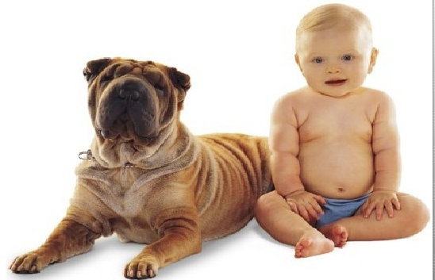
Real-life Similarity
Are they similar?

Slide 6
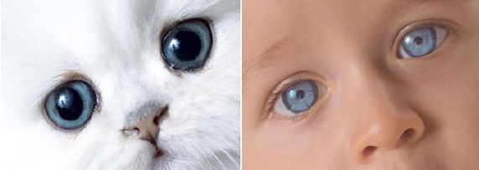
Real-life Similarity
Are they similar?

Slide 7
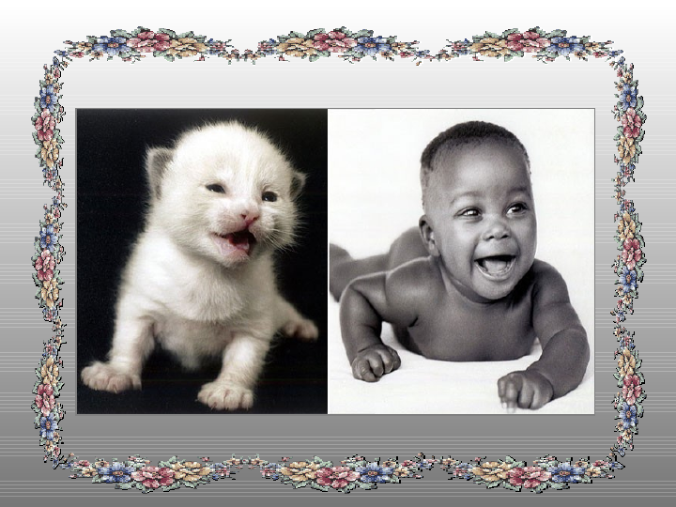
Real-life Similarity
Are they similar?

Slide 8
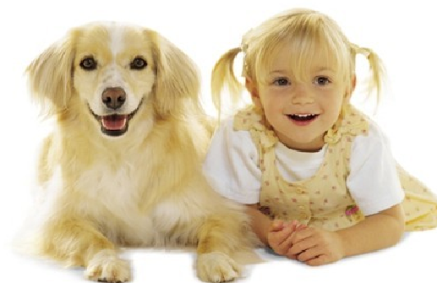
Real-life Similarity
Are they similar?

Slide 9
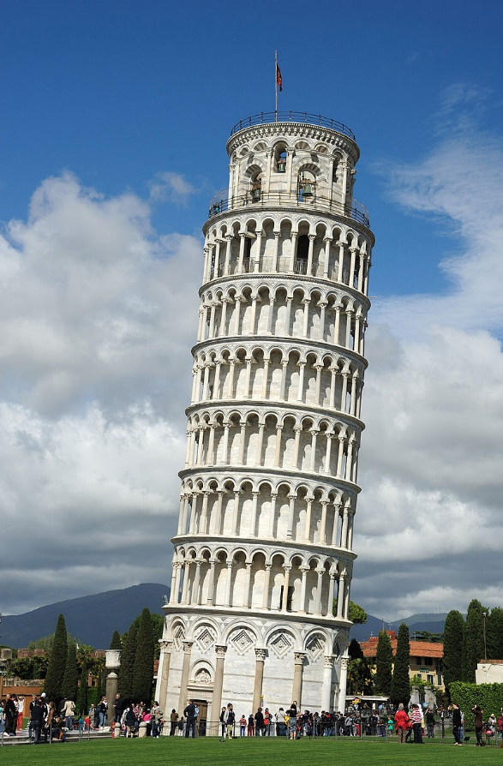
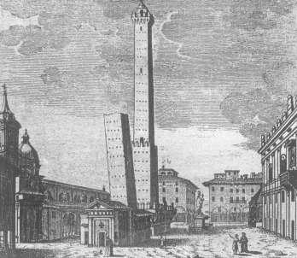
Prototypicality or Centrality not symmetric

Slide 10
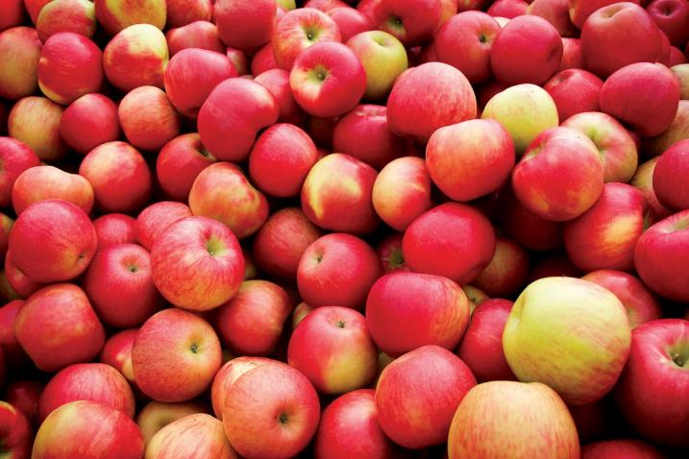
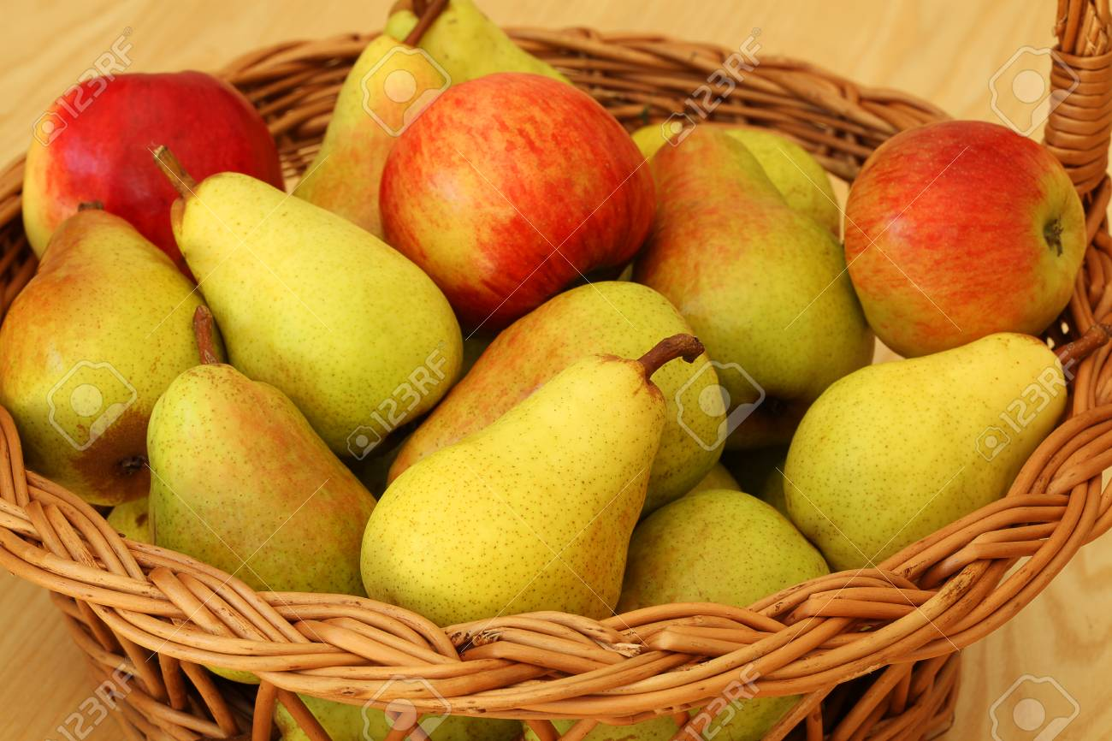
Context/Data/Environment Dependent circumstances alter similarities

Slide 11
Contemporary Networked Media
The digital data view
Almost everything that we see, read, hear, write, measure, or observe can be digital.
Users autonomously contribute to production of global media and the growth is exponential.
Sites like Flickr, YouTube, Facebook host user contributed content for a variety of events.
The elements of networked media are related by numerous multi-facet links of similarity.
Majority of current data is unstructured
possibly only structured on display

Slide 12
Challenge
Networked media database is getting close to the human “fact-bases”
  the gap between physical and digital world has blurred
Similarity data management is needed to connect, search, filter, merge, relate, rank, cluster, classify, identify, or categorize objects across various collections.
WHY?
It is the similarity which is in the world revealing.

Slide 13
We learned from School
GEOMETRY:
Two polygons are similar to each other, if:
  Their corresponding angles are congruent
    ∠A = ∠E; ∠B = ∠F; ∠C = ∠G; ∠D = ∠H, and
  The lengths of their corresponding sides are proportional
    AB/EF = BC/FG = CD/GH = DA/HE
D
C
H
G
A
B
E
F

Slide 14
Similarity & Geometry
If one polygon is similar to a second polygon, and the second polygon is similar to the third polygon, the first polygon is also similar to the third polygon.
In any case:
Two geometric figures are either similar or they are not similar at all

Slide 15
Metric Space:
A Geometric Model of Similarity
Metric space: M = (D,d)
  D – domain
  distance function d(x,y)
    ∀x,y,z ∈ D
    d(x,y) > 0 - non-negativity
    d(x,y) = 0 ⇔ x = y - identity
    d(x,y) = d(y,x) - symmetry
    d(x,y) ≤ d(x,z) + d(z,y) - triangle inequality

Slide 16
Examples of Distance Functions
L_{p} Minkovski distance (for vectors)
    L₁ – city-block distance
    L₂ – Euclidean distance
    L∞ – infinity
Edit distance (for strings)
    minimal number of insertions, deletions and substitutions
    d(‘application’, ‘applet’) = 6
Jaccard’s coefficient (for sets A,B)

Slide 17

Examples of Distance Functions
Mahalanobis distance
  for vectors with correlated dimensions
Hausdorff distance
  for sets with elements related by another distance
Earth movers distance
  primarily for histograms (sets of weighted features)
and many others

Slide 18
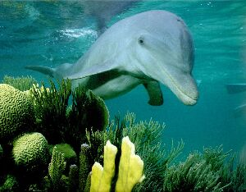
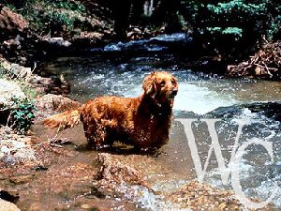
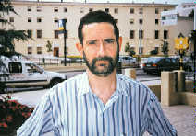
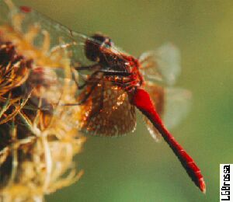
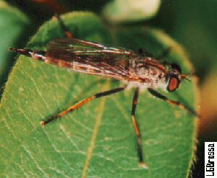
Content-Based Search Objectives
Content-based search in images
Image base
similar?

Slide 19
Content-Based Search Implementation
Extracting features
Image level
B
Feature level
R
G

Slide 20
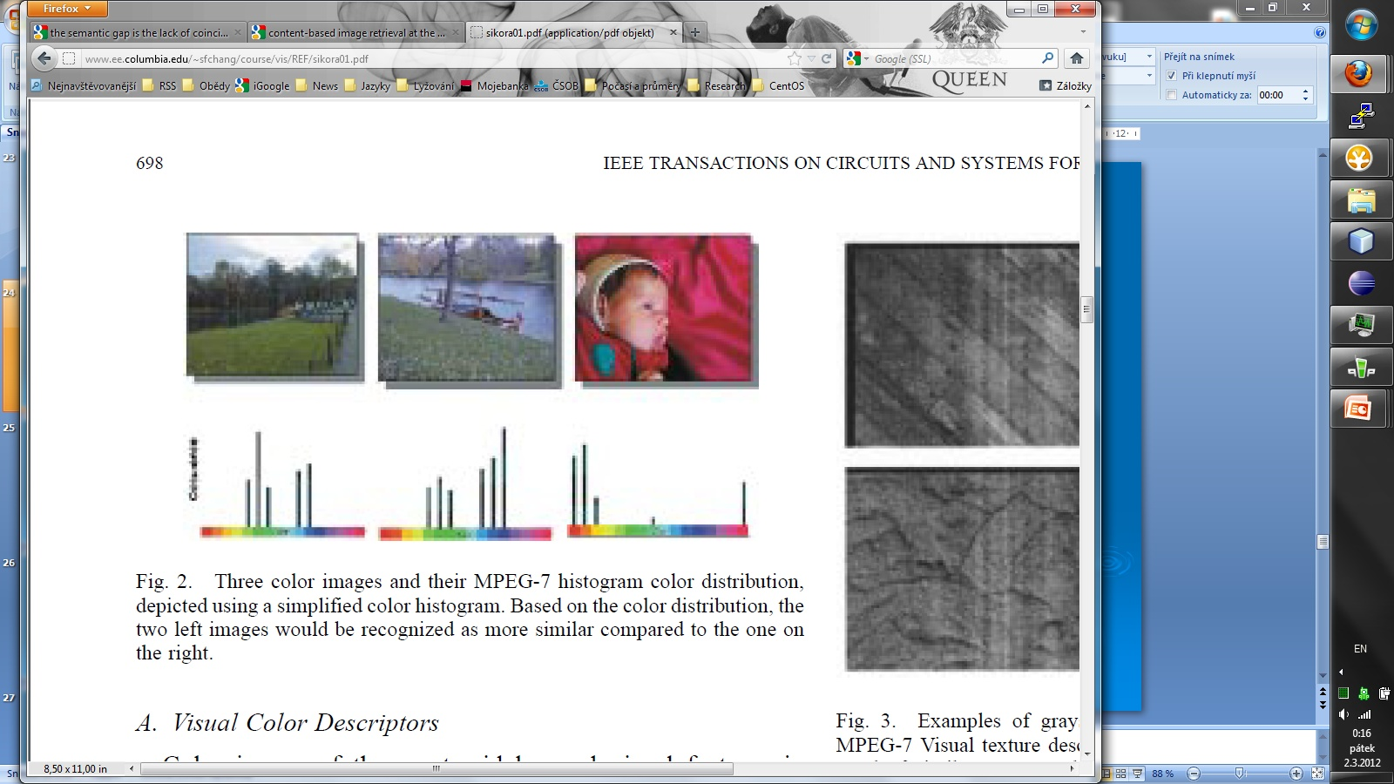
MPEG-7
Multimedia Content Descriptors Standard ~ 2000
Global feature descriptors:
  Color, shape, texture, …
  One high-dimensional vector per image and feature
  Minkovski distance used

Slide 21
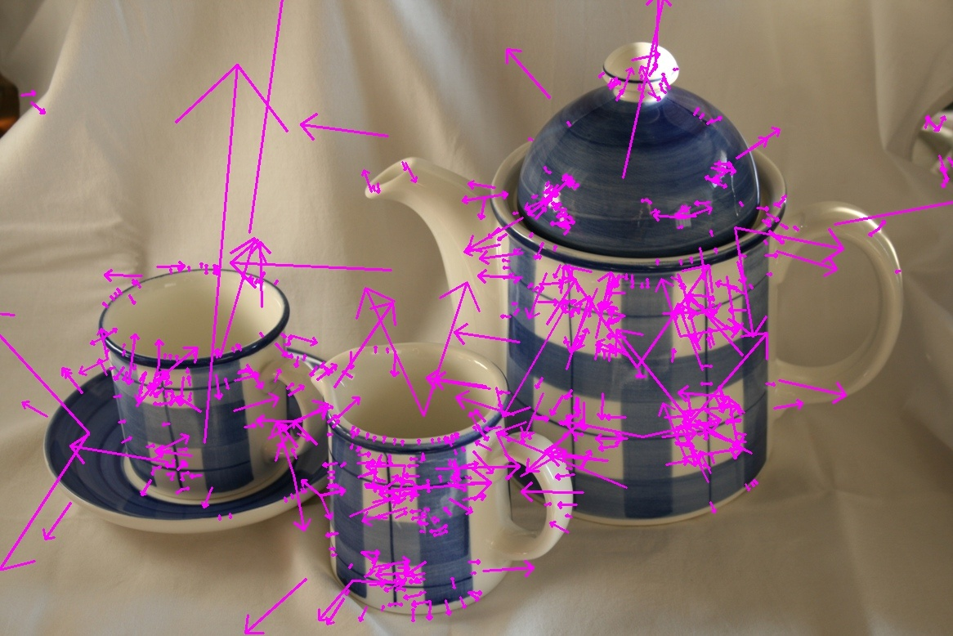
Visual Similarity
Local feature descriptors – SIFT, SURF, etc.
Invariant to image scaling, small viewpoint change, rotation, noise, illumination

Slide 22
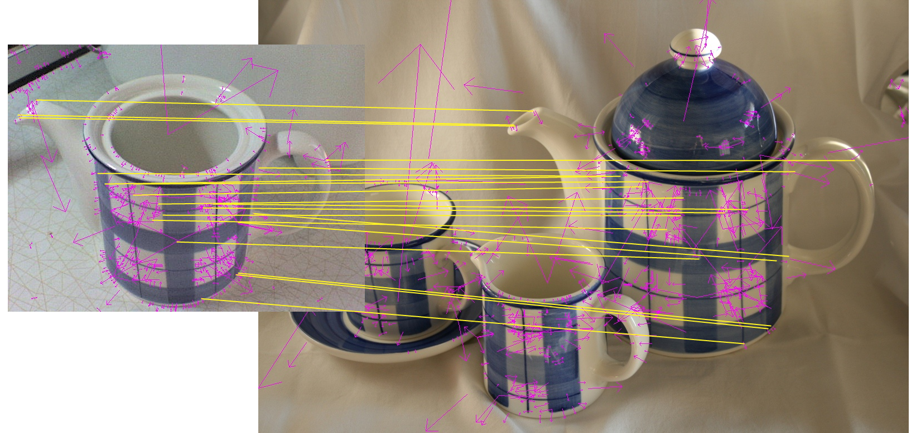
Visual Similarity - finding correspondence

Slide 23
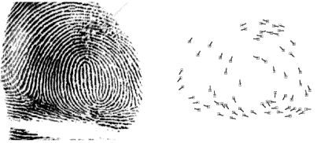
Biometrics: Fingerprint
Minutiae detection:
  Detect ridges (endings and branching)
  Represented as a sequence of minutiae
    P=( (r₁,e₁,θ₁), …, (r_{m},e_{m},θ_{m}) )
    Point in polar coordinates (r,e) and direction θ
Matching of two sequences:
  Align input sequence with database one
  Compute weighted edit distance
    w_{ins,del}=620
    w_{repl}=[0;26] - depending on similarity of two minutiae
Notes:
Points in the sequence are ordered in an increasing order of radial angle (e).

Slide 24
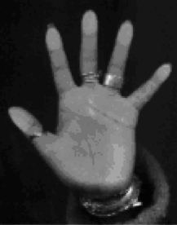
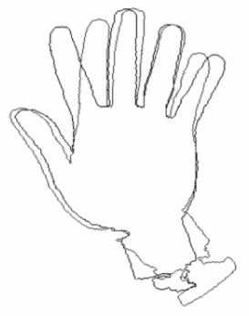
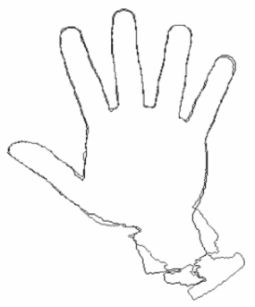
Biometrics: Hand Recognition
Hand image analysis
  Contour extraction, global registration
    Rotation, translation, normalization
  Finger registration
  Contour represented as a set of pixels
  F={f₁,…,f_{NF}}
Matching: modified Hausdorff distance
Notes:
|| f-g || = Euclidean distance between pixel positions of f and g

Slide 25
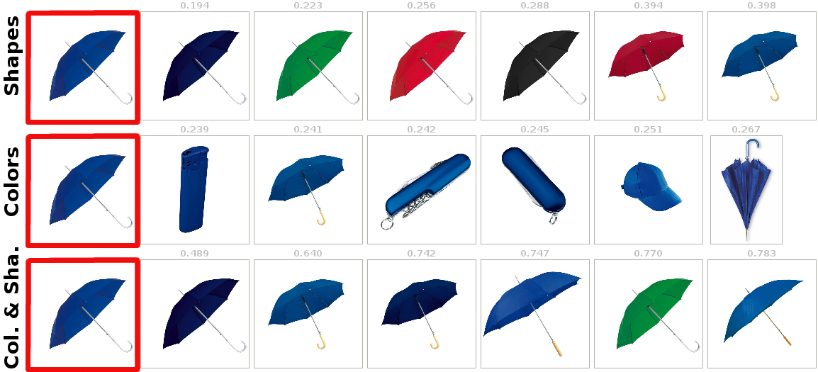
Multiple Visual Aspects

Slide 26
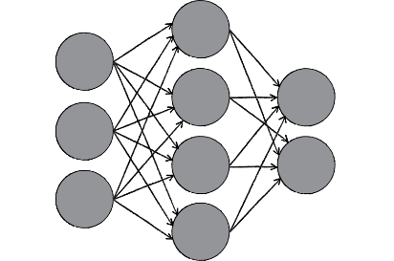
Contemporary Approaches to
Feature Extraction – Metric Learning
Neural networks technology
  Convolutional Neural Networks (CNN)
  Recurrent Neural Networks (RNN)
Training data
Training (Fine-tuning)
Neural network model
Classified
dataset
Data split
Validation data
Validation

Slide 27
Similarity Search Problem
For X ⊆D in metric space M,
pre-process X so that the similarity queries
are executed efficiently.
Implementation problems:
  How to partition the data to reduce search space
  How to ask questions - definition of queries
  - How to execute queries – to achieve required performance
The challenge:
  In metric space, no total ordering exists!

Slide 28



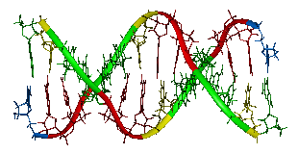
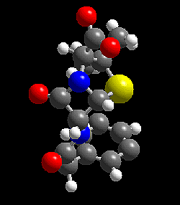
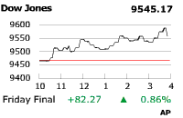
MESSIF - Metric Similarity Search Implementation Framework
Infrastructure independent
Performance statistics
Distributed index structures
Centralized index structures
Metric space (D,d)
Operations
Storage
Communication
Net
Vectors
  L_{p} and quadratic form
Strings
  (weighted) edit and
  protein sequence
Insert, delete,
range query,
k-NN query,
Incremental k-NN
Volatile memory
Persistent memory

Slide 29
DISA Contribution – grants and partners
Large spectrum of contributing grants:
    Academic vs. Industrial
    National vs. European
    Focused research vs. Network of Excellence
Significant cooperating partners:
  academic (including Max Plant Institute, ETH Zurich, CNR Italy, NII Tokyo, University of St. Andrews, University of Bologna, plus tens of other universities in Europe within networks of excellence)
  industrial (including IBM Research, Telenor, Telecom Spain, Bull, Athena Security Israel, XEROX SAS Grenoble, Konica-Minolta)

Slide 30
Scientific Achievements
Most cited works:
  M-tree 2550; Metric book 1250
Advanced publication platforms:
  VLDB, ACM SIGMOD-PODS, ACM SIGIR, ACM TODS, ACM TOIS, VLDB Journal
Tutorials:
  ACM SAC, ACM Multimedia, ICMR, ESMAC
Invited talk and key-notes:
  ACM SIGIR, ADBIS, MMM, IEEE ISM, SOFSEM, SEDB
Best paper awards:
  DEXA, IEEE ISM, SISAP

Slide 31


Textbooks on
Metric Searching technology
Hanan Samet
Foundation of Multidimensional and
Metric Data Structures
Morgan Kaufmann, 2006
P. Zezula, G. Amato, V. Dohnal, and M. Batko
Similarity Search: The Metric Space Approach
Springer, 2005
Teaching material: http://www.nmis.isti.cnr.it/amato/similarity-search-book/

Slide 32
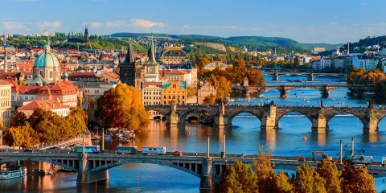
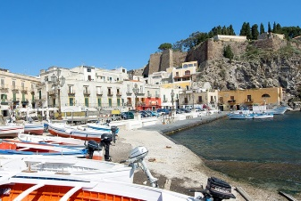
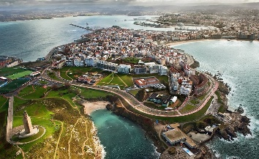

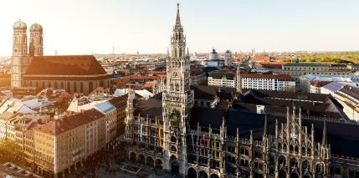
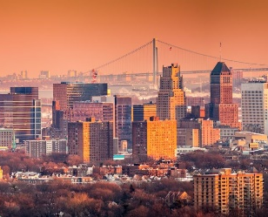

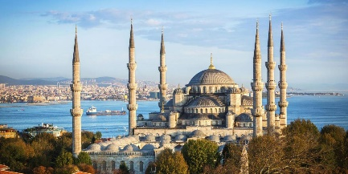
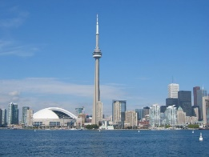
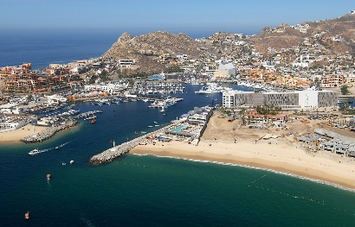
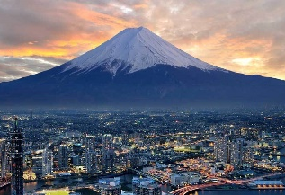
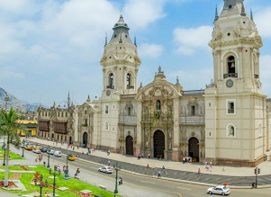
SISAP International Conferences
SISAP (Similarity Search and Applications)
International conference series (http://sisap.org/)
2009
Prague
Czechia
2011
Lipari
Italy
2013
A Coruña
Spain
2015
Glasgow
UK
2017
Munich
Germany
2019
Newark NJ
USA
2008
Cancun
Mexico
2010
Istanbul
Turkey
2012
Toronto
Canada
2014
Los Cabos
Mexico
2016
Tokyo
Japan
2018
Lima
Peru

Slide 33

XIMILAR – Image Recognition and Visual Search https://www.ximilar.com/

Slide 34
Appreciation - Awards
IBM SUR (Shared University Research) Award for
“Web-scale Similarity Search in Multimedia Data”
Top 27 IT Personalities in Czech Republic – Computerworld Magazine
MU Brno Rector’s price 2X

Slide 35
Application Research
Face Retrieval
Image annotation
Motion data management
Improving Treatments in Cerebral-Palsy
Protein Similarity Search
Dyslexia detection

Slide 36
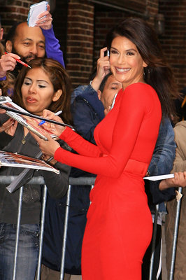




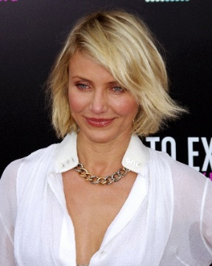






Similarity Search in Collections of Faces
<13.9, 9.5, -6.0, 712.1, …>
<17.9, 12.1, -9.1, 692.0, …>
<8.8, 7.7, -3.5, 570.8, …>
<14.4, 8.2, -8.4, 704.0, …>
<10.1, 5.8, 40.6, 99.6, …>
Merge of detected faces
<5.4, 1.2, -60.4, 88.0, …>
<45.1, 64.8, 90.6, 78.6, …>
Face detection with several technologies
Face description with several technologies
Features indexing by one technique
Fused features saving
Preprocessing
Face Detection
Features Extraction
Retrieval
Index
Fused features DB
Candidate
faces
Candidates
filtering
<13.9, 9.5, -6.0, 712.1, …>
<10.6, 78.9, -45.6, 101.3, …>
0.12
0.17
0.18
0.23
Query image

Slide 37
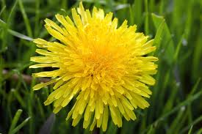
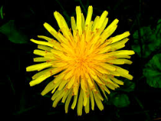


Search-based annotation principles
Annotated image collection
Similar annotated images
d = 0.2
d = 0.5
d = 0.6
?
Content-based
image retrieval
Yellow, bloom, pretty
Meadow, outdoors, dandelion
Mary’s garden, summer
Final candidate keywords
with probabilities
Semantic resources
Candidate
keyword
processing
Plant 0.3
Flower 0.3
Garden 0.15
Sun 0.05
Human 0.1
Park 0.1

Slide 38
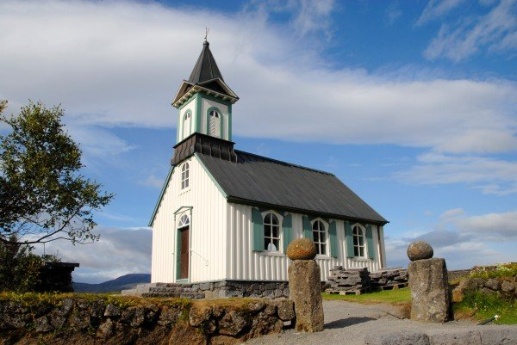
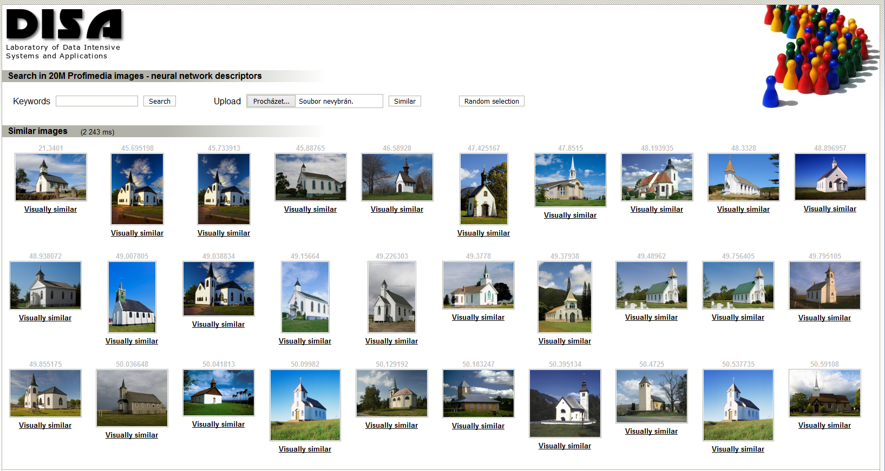
Example
Retrieve 100 similar images from Profiset
Merge their keywords, compute frequencies
Build the semantic network using WordNet
Compute the ConceptRank
Apply post-processing & return 20 most probable keywords
Candidate keywords after CBIR
church, architecture, travel, europe, building, religion, germany, buildings, north, churches, christianity, america, religious, exterior, st, historic, world, tourism, united, usa, …
Semantic network
4 relationships: hypernym (dog → animal), hyponym (animal → dog), meronym (leaf → tree), holonym (tree → leaf)
270 network nodes, 471 edges
ConceptRank scores
building (2.53), structure (2.41), LANDSCAPE (2.10), BUILDINGS (1.87), OBJECT (1.84), NATURE (1.78), place_of_worship (1.75), church (1.74), Europe (1.68), religion (1.64), continent (1.51), …
Final keywords
building, structure, church, religion, continent, group, travel, island, sky, architecture, tower, person, belief, locations, chapel, christianity, tourism, regions, country, district

Slide 39
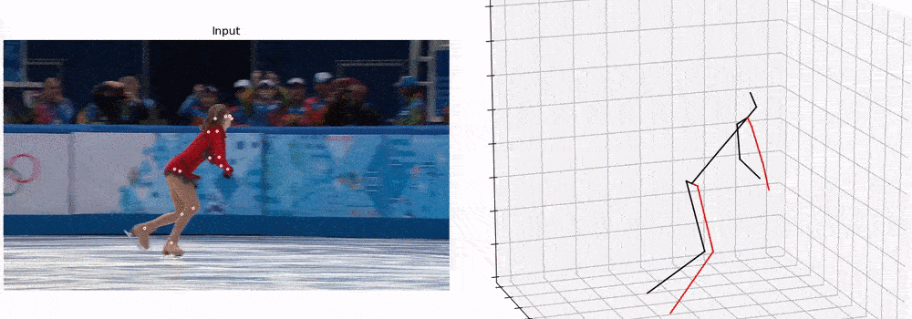
Digitization of Human Motion
Skeleton-data representation
Simplified spatio-temporal representation of human motion
  Sequence of 3D skeletons ~ a set of 3D trajectories of body joints
Better structured and easier to store than video-based representation
Video-based representation Skeleton-based representation
Source: https://blog.usejournal.com/3d-human-pose-estimation-ce1259979306

Slide 40
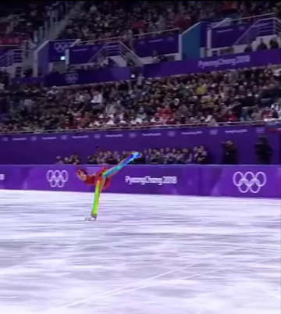
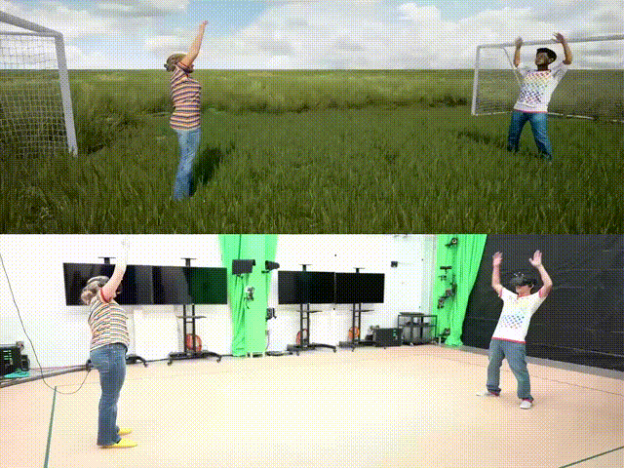
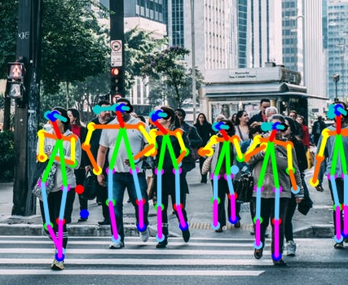
Great Application Potential
A wide variety of possible applications
Sports – digital referees assessing the quality of performance
Virtual reality – recognizing player movements in real time
Smart-cities – detecting falls of persons crossing a street
Healthcare – evaluating the rehabilitation progress remotely
Source: https://www.youtube.com/watch?v=5cI-JibDEMA
Source: https://blog.usejournal.com/3d-human-pose-estimation-ce1259979306
Notes:
The skeleton data have a great potential to be utilized in a wide variety of application domains. For example, in:
Sports – to automatically assess the quality of a figure-skating performance;
Virtual reality – to recognize movement actions of players to enable real-time interactions, e.g., like playing a football with a virtual ball;
Smart cities – to detect falls of elderly people, or to detect suspicious events like kicking or punching somebody else;
Telemedicine – to evaluate how well a given patient performs in rehabilitation after some surgery.
Such great application potential together with the fact that the skeleton representation can now be extracted from ordinary videos indicates that very large volumes of skeleton data can be generated in the near future.

Slide 41


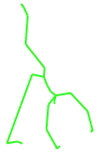
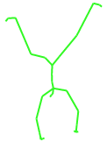
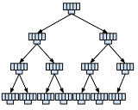


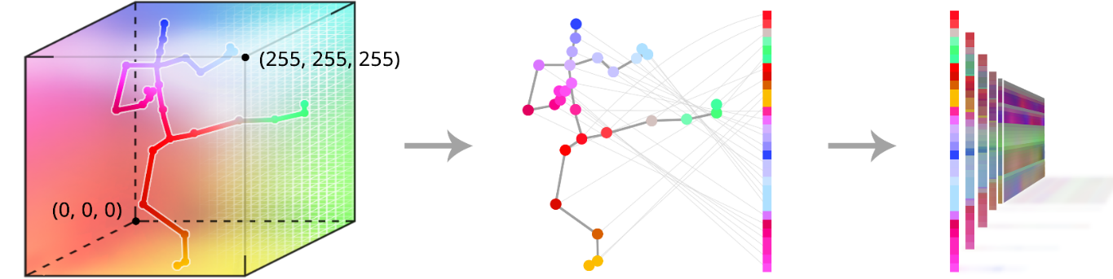

Content-based Processing
Query-by-example searching
Transforming complex motions to fixed-size vectors and indexing them by metric-space search methods
Deep feature extraction
<…, 0.5, 1.1, 9.6, …>
<…, 0.1, 3.4, 6.8, …>
<…, 0.6, 2.9, 7.7, …>
Indexing database features
Fixed-size features
left leg
Joints
right leg
torso
left hand
right hand
Time
[Sedmidubsky, J., Elias, P., Zezula, P.: Effective and Efficient Similarity Searching in Motion Capture Data. Mult. Tools and Apps. 2018]

Slide 42





Motion Words – idea
Cut motion into short, overlapping segments
Quantize the segment space
Represent original sequence by identifiers
of quantized segments
…
…
…
…
… A, A, B, O, M, M, P, D, …
A
C
D
F
G
B
E

Slide 43
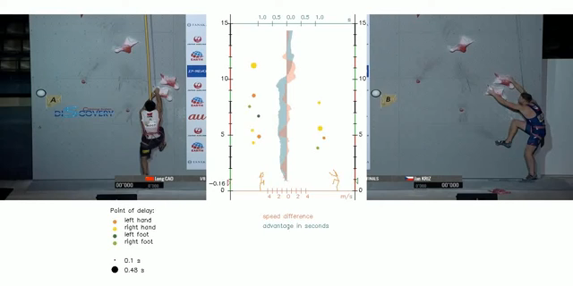
Content-based Analysis
Comparison of speed-climbing performances
Source: https://www.youtube.com/watch?v=tdxMo11KJGk&t=258s

Slide 44
Similarity Search in Protein Chains
Each protein consists of 1 or more subparts – protein chains
Approx. 500,000 chains are known – Protein Data Bank (PDB)
3D models of protein chains are used
to define their pairwise similarity
  Similarity evaluation time strongly depends
  on the size of compared chains
  Distance evaluation time ranges from ms to min.
  Model of a protein chain: balls ≈ atoms, sticks ≈ bonds between atoms. Green ribbon ≈ simplification of the main atoms

Slide 45


Recent Applied Research Project #1
Project scope:
  Improving Treatments in Cerebral-Palsy Children using Artificial Intelligence (2020–2022)
  Cooperation with Children Hospital Brno
  Main objective – estimate whether a given treatment is suitable for a new child patient suffering from the cerebral-palsy disease
  Solution – searching for similar gait cycles recorded in the pre-surgery phase and comparing the quality of walking between the pre-surgery and post-surgery phases

Slide 46


Recent Applied Research Project #2
Project scope:
  Diagnosis of Dyslexia using Eye-Tracking and Artificial Intelligence (2021–2023)
  Cooperation with the Faculty of Arts (Masaryk University) and psychological clinics
  Main objective – estimate how prone the individual is to the dyslexia disease
  Solution – classifying spatio-temporal eye-tracking data (and their derived features) of dyslexia/intact patients on text-reading tasks

Slide 47
SWOT Strengths
Similarity plays a central role in processing contemporary digital data.
We have a leading position in this research - most cited papers and the first monograph in the similarity search domain, organize a conference, spin-off
We teach corresponding courses (even abroad) and have many successful PhD graduates (including foreigners),
Received prestigious awards (e.g. IBM SUR, Computerworld magazine, rector’s price),
Participated in many prestigious national and international projects (e.g. European research – Scholnet, Sapir -, European networks of Excellence – DELOS 2X -, GACR Network of Excellence CEMI),
Cooperated with many academic and industrial institutions
Delivered invited and key-note speeches at important conferences (e.g. ACM SIGIR, SMAC, ADBIS, MMM, IEEE ISM, SEBD),
based on our similarity search technology a spinoff XIMILAR was created by the group’s PhD students,
we organize SISAP International conference (recently received the CORE B grade).

Slide 48
SWOT - Weaknesses
The group is rather small with most researchers exclusively supported from external resources.
The researchers are overloaded with teaching and often must leave the actual research to students - this typically results in routine work, not the best quality.
The endless fight for grants consumes too much time and mental capacity of highly qualified researchers.
Not very efficient communication with the faculty management.

Slide 49
SWOT - Opportunities
Many open questions/problems remain in the similarity search domain thus additional fundamental research is needed – e.g., context dependent, subjective, and adaptable similarity search or explainable similarity data models for AI.
The potential application area is huge and opens additional research areas – in medicine, sports, security, game industry, etc.
We can capitalize on our previous results in the motion data processing and similarity management in general.

Slide 50
SWOT - Threats
To bring up qualified researchers takes years, but you can lose a skilled person very fast when you do not get grant support in time. Such a system repeatedly alternates periods of too much money for available staff and not enough money for existing staff - making qualified researchers redundant.
With the increasing quantity and importance of evaluation indicators, the danger is that researchers will concentrate more on complying with required indicators rather than the quality of their research work.
Students are not motivated to study PhD – it is easy to get a high paid job without a PhD degree.

Slide 51
Our Vision - Future Research Challenges
Challenge No.1 (adaptability):
Respecting continuously changing distance metric – searched collection size as well as up to date collection of known samples – continuously adapt the search indexing mechanisms.
Challenge No. 2 (explainability):
Respecting an application domain – e.g. motion capture data – provide explanation tools that might be requested on demand. Similarity cracks the code of explainable AI.

Slide 52
Research Projects
Selected basic-research projects:
  Center of Excellence on Multi-modal Data Interpretation on a Very Large Scale (GBP103/12/G084); Czech Science Foundation (GAČR); 2012–2018
  Searching, Mining, and Annotating Human Motion Streams (GA19-02033S); Czech Science Foundation (GAČR); 2019–2021
Selected applied-research (application-oriented) projects:
  Efficient Searching in Large Biometric Data (VG20122015073); Ministry of the Interior of the Czech Republic; 2012–2015
  Improving Treatments in Cerebral-Palsy Children using Artificial Intelligence (MUNI/G/1585/2019); GAMU (Interdisciplinary projects); 2020–2022
  Diagnosis of Dyslexia using Eye-Tracking and Artificial Intelligence (TL05000177); Technology Agency of the Czech Republic (TAČR); 2021–2023

