Slide 1
Metaphorical keyness in specialized corpora
Written by Gill Philip
Compiled by Michal Petrov, 2011

Slide 2
Contents
Introduction
Metaphor and textual meaning
Metaphors and corpora
Metaphor themes and key metaphor themes
Conclusion

Slide 3
Introduction
… key words tell us what is important, they do not tell us why.
Flection in languages (difference in frequency)
Groupings in low-frequency vocabulary suggest metaphorical activity.
Metaphors express "affect and attitude along with ideational content" → evaluation
Delexical metaphors

Slide 4
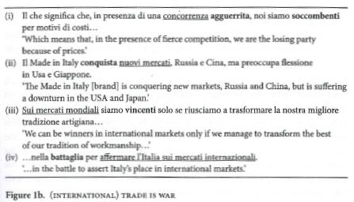
Metaphor and textual meaning
Metaphor theme

Slide 5
Metaphor and textual meaning
Creative and conventional metaphors
Most metaphors are naturalized lexical items, forming part of the conventinal vocabulary. As such they are virtually invisible yet their presence can be perceived subliminaly.
Instances of metaphor themes rise in importance with each subsequent reappearence in the discourse.

Slide 6
Metaphors and corpora
Instances of metaphor themes:
  spread across many texts
  identification is problematic and time-consuming
  even corpora are not successful – machines can look for words but not meaning
Usual solution: partial or total manual searching
Goal: identifying potential metaphorical themes instead of locating all metaphores

Slide 7
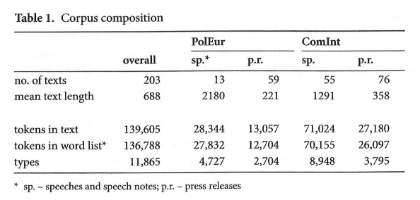
Metaphors and corpora
Emma Bonino, Minister for International Trade and Commerce, Minister for European Policy (June 2006 – May 2007)
140,000 words; Italian

Slide 8
Metaphors and corpora
WordSmith Tools v4
Metaphor requires the presence of an contextually incongruous lexis.
The lexis will not occur near the top of a word-frequency list nor amongst the statistically-generated key words.

Slide 9
Metaphors and corpora
Data:
  Word frequency list for the ComInt corpus
  Key word list according to the entire political corpus (430,000 words)
    elimination of words like "minister" or "government" that are common in political language
Identified groups:
  Markets and sectors, business and industry, the economy, import and export …

Slide 10
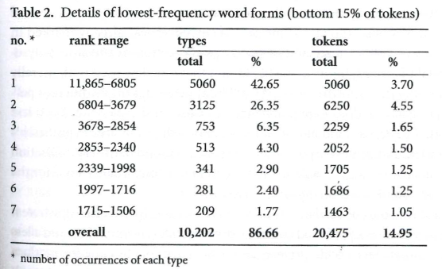
Metaphors and corpora
Low frequency content words (LFCWs) may provide a source of metaphorically-used lexis
  LFCWs make up a large portion of the list
  Not all low-frequency lexis is metaphorical

Slide 11
Metaphors and corpora
Analysis:
  Manual lemmatization of the top of the word frequency list → elimination of low-frequency inflected forms (up to 500 types)
  Sorting of the rest into broadly-defined semantic groups (five or more lemmas, initial cut-off at 3 occurences)
  Lemmas that could not be grouped with others were considered metaphor candidates
  The higher the frequency of a candidate the more consistent was its patterning in the corpus

Slide 12
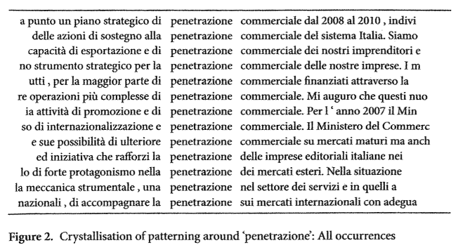
Metaphors and corpora

Slide 13
Metaphor themes and key metaphor themes
Analysis yielded a large set of word forms:
  War and violence
  Hunting, risk, submission and suffering, health, birth, death, emotion
These areas do not become metaphor themes until the target domains have been ascertained
Business is war → International trade is war

Slide 14
Metaphor themes and key metaphor themes
War metaphors are the most frequent in this corpus and a theme common to all political discourse
In the given corpus those metaphors were linked to foreign trade with partuclar reference to China and India
  battaglia (struggle) – Italy
  lotta (fight) – Made in Italy
  penetrazione – Italian expansion
  Invasione – expansion of China and India

Slide 15
Metaphor themes and key metaphor themes
Key metaphors are not key because they are the most frequent but because they interact in significant ways with the key words.
Downward collocation is significant.
"the use and re-use of metaphors leads to conventionalization of attitudinal judgement towards them"

Slide 16
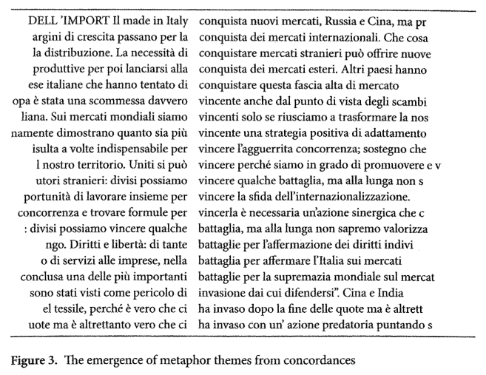
Metaphor themes and key metaphor themes

Slide 17
Conclusion
Keyness represented by statistically-generated key words is overt while keyness represented by metaphors is hidden from view.
Overt keyness tells us what is the key and covert keyness tells us the reasons why.

Slide 18
Conclusion
Key word list indicates that China is important but does not provide reasons for the prominence.
Examining metaphorical activity reveals two aspects:
  Chinese exports and current Chinese economical policy are perceived as a threat
  China is mentioned frequently because of the threat it poses

Slide 19
Conclusion
Metaphors play an important evaluative role
But (!) the source domain lexical items are not interchangeable.

