Slide 1

PV247 – Development I
Introduction to ASP.NET and related technologies

Slide 2
Overview
ASP.NET Basics
  What is ASP.NET?
  What is a request?
  How does ASP.NET deal with stateless http?
  ASP.NET request/page/control life cycle
  REST Services
Kentico CMS Platform Basics
  CMS.IO namespace

Slide 3
What is ASP.NET?
Active Server Pages .NET
Platform for creating dynamic web applications
You can use any .NET language as a code-behind
Development of ASP.NET WebForms applications can be similar to the development of WinForms applicatons. Similar, not same!

Slide 4
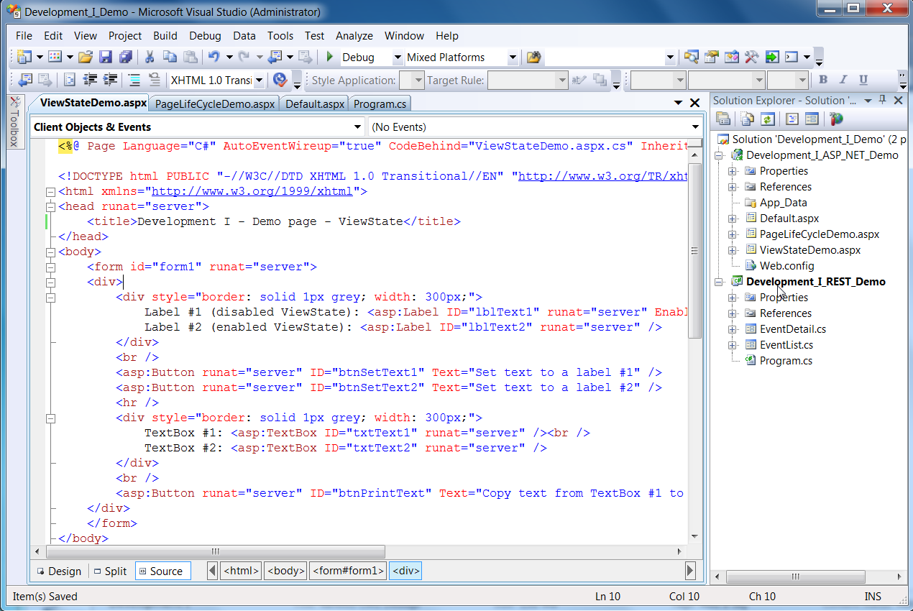
Example of ASP.NET page

Slide 5
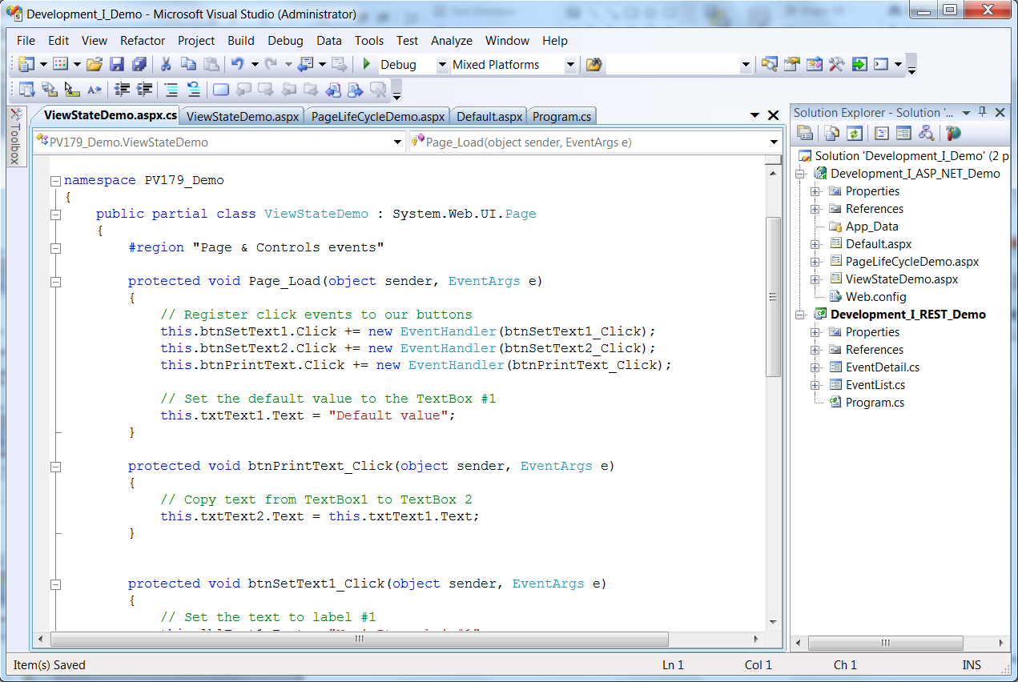
ASP.NET page – code behind

Slide 6
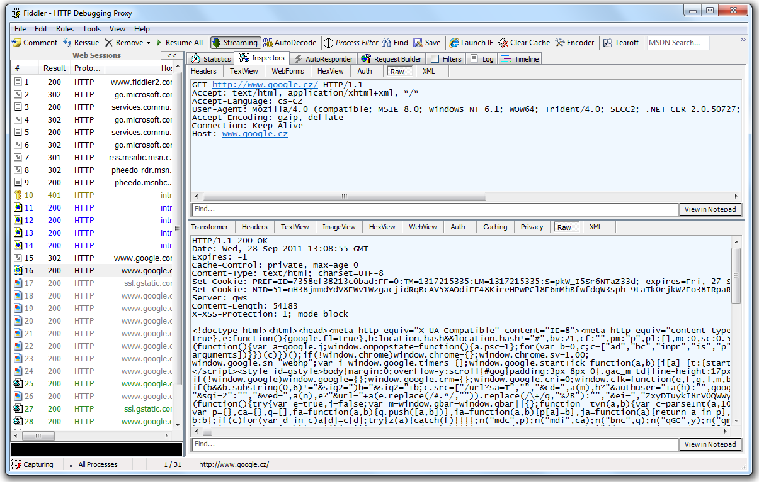
What is a request?

Slide 7
What is a request?
Main thing you need to remember about HTTP protocol:
HTTP is stateless protocol!
But we need state in dynamic web applications!

Slide 8
How does ASP.NET deal with stateless http?
The answer is ... ViewState!
It is a technique used by an ASP.NET Web page to persist changes to the state of a Web Form across postbacks (HTTP POST to the same page that the form is on).
Use ViewState carefuly and only when it‘s really needed! It‘s helpful technique, but it might become too greedy and can cause the application to be less effective.

Slide 9
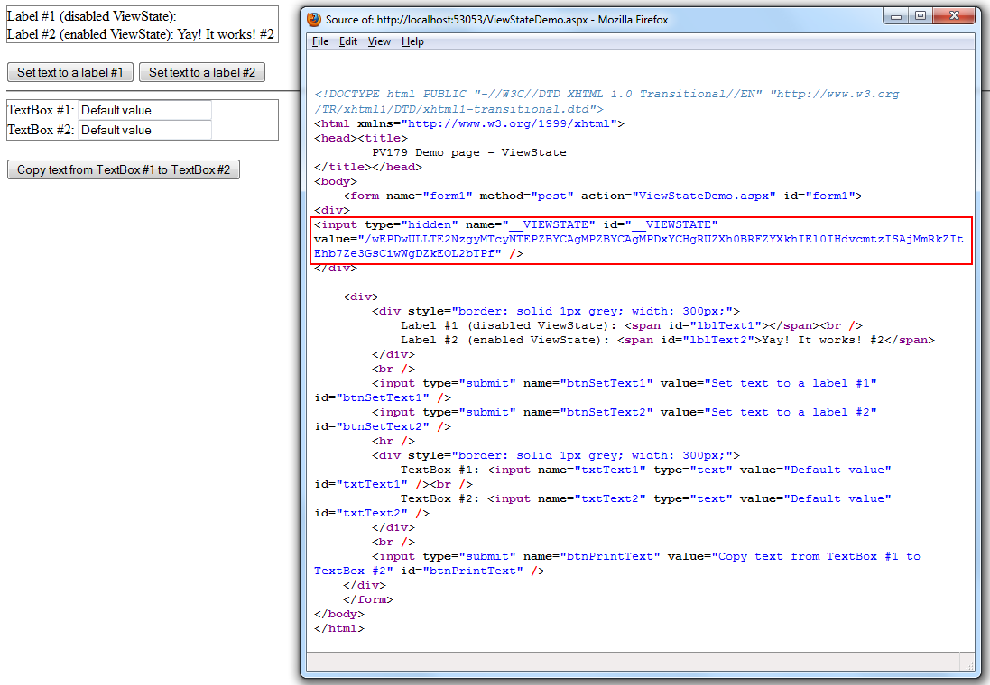
ViewState – How is it send within requests?

Slide 10
ASP.NET page/control life cycle
To be able to work with ASP.NET pages and controls properly you need to understand the life cycle of these elements.
Most importat phases of page/control life cycle are:
  PreInit
  Init
  Load
  PreRender
  Render

Slide 11
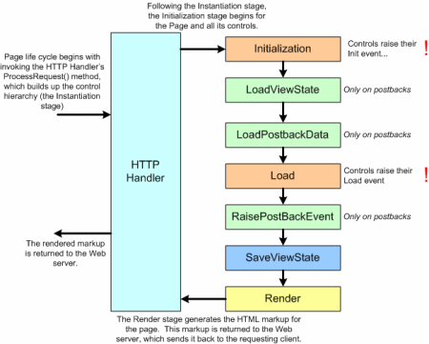
ASP.NET page/control life cycle
Source: http://i.msdn.microsoft.com/dynimg/IC152667.gif

Slide 12
Where to get more information?
Where to start:
http://msdn.microsoft.com/en-us/library/ywdtth2f%28v=vs.71%29.aspx
More about page life cycle:
http://msdn.microsoft.com/en-us/library/ms178472.aspx
More details about how the ViewState works:
http://msdn.microsoft.com/en-us/library/ms972976.aspx

Slide 13
Let‘s have a REST!
Representational state transfer (REST) is a style of a service architecture
Instead of complex technologies (RPC, SOAP, etc.) you use simple HTTP requests which are supported by all the clients!
Commonly used formates of REST responses are XML, JSON, AtomPub

Slide 14
Let‘s have a REST!
Conforming to the REST constraints is referred to as being "RESTful„ service
  Access the objects within the system defining clear structure of URLs
  The structure of URLs should be self-explaining and self-navigating
Kentico CMS supports RESTful service

Slide 15
How to request a REST Service
Create request
Wait for response
That‘s all!
DEMO

Slide 16
CMS.IO
Layer between Kentico CMS and System.IO
System.IO
Kentico CMS
business
layer
Azure blob API
CMS.IO
...

Slide 17
CMS.IO
Allows the system to use various IO providers (local file system, Azure Blob, Amazon S3, …)
To implement a provider you inherit from the base class and override the IO methods
  Directory
  File
  FileStream
  etc.

