Slide 1

ASP.NET Security
Dominik Pinter, dominikp@kentico.com, @DominikPinter

Slide 2
About me
6 years experience with ASP.NET development
MCPD for .NET 4.0
Certified Ethical Hacker
Working at Kentico software
Development -> Product management
Likes: beer, scotch whiskey, cloud, security
@DominikPinter

Slide 3
Agenda
Introduction
Development
  Authentication
  Writing secure code
Deployment

Slide 4
Resistance is futile
A.K.A
No website is 100% Secure

Slide 5
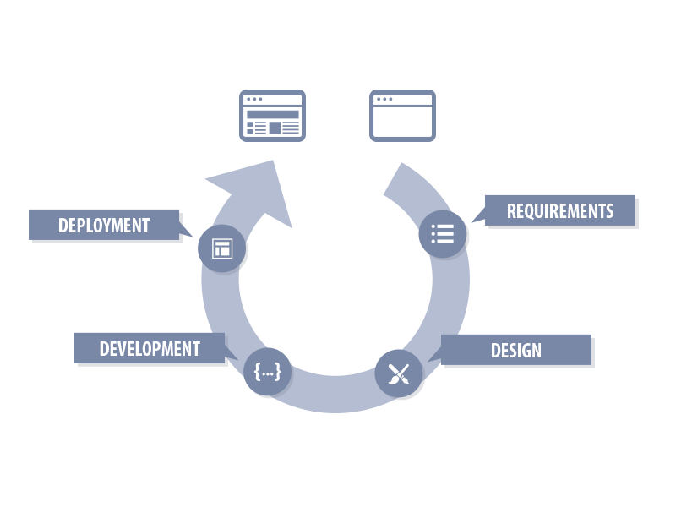
Development process

Slide 6
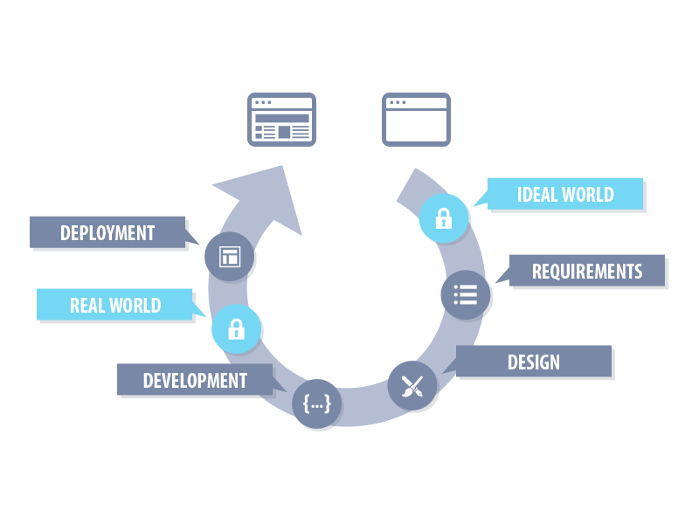
Security process

Slide 7
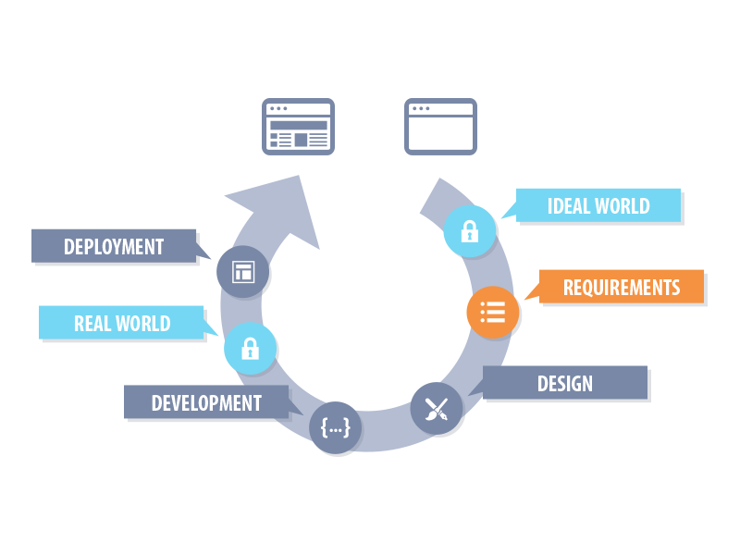
Requirements

Slide 8
Security related certifications
PCI (Payment Card Industry) = Credit cards
  PA = Vendor cerfitication
Safe Harbor = Trasferring data between EU and US
HIPAA = Private medical information

Slide 9
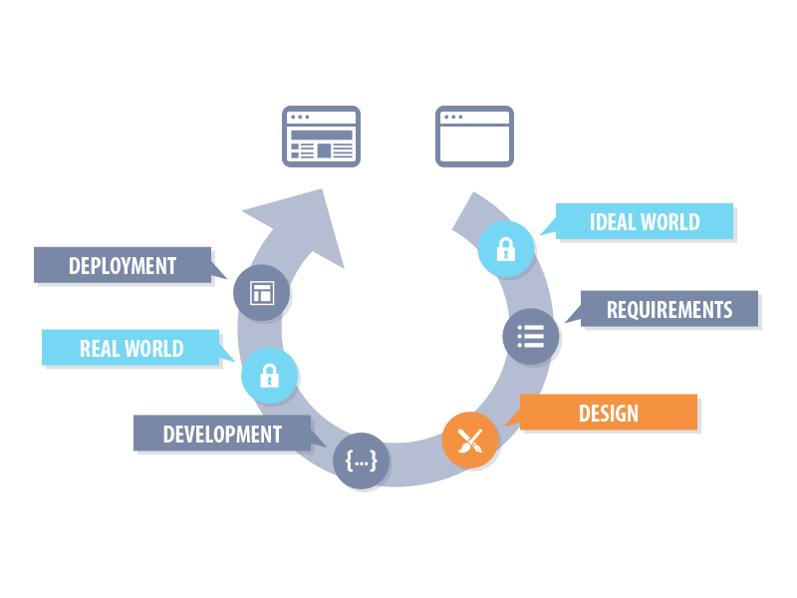
Design

Slide 10
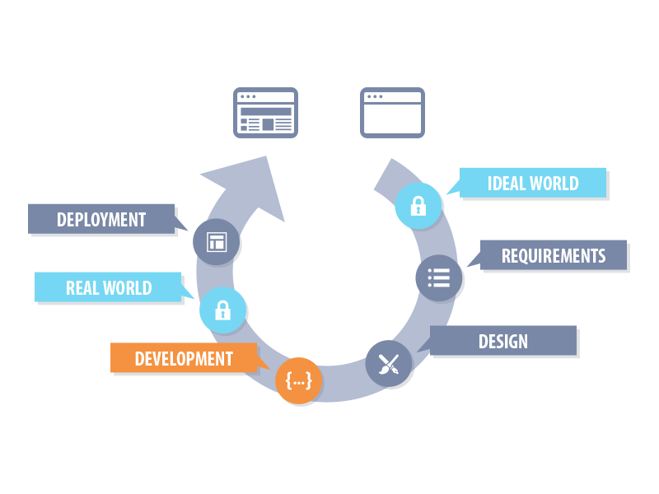
Development

Slide 11
Authentication

Slide 12
HTTP Basic Authentication
GET http://localhost/page HTTP/1.1
Host: localhost
User-Agent: Mozilla/5.0 …
Accept: text/html,application/xhtml+xml,…
Accept-Language: en-us,en;q=0.5
Accept-Encoding: gzip,deflate
Connection: keep-alive
Authorization: Basic dXNlcjpwYXNzd29yZA==
Notes:
Support in HTTP protocol
HTTP response 401
User name and password encoded in Base64
Not safe without SSL (HTTPS)

Slide 13
ASP.NET Forms Authentication
Built in ASP.NET
Uses forms and HTTP POST
Cookie based
Prepared components
Web.config settings
Integrated with ASP.NET membership providers

Slide 14
ASP.NET Membership Providers
.NET way how to work with Users, Roles, …
SQL Tables + Standard classes
Providers model
Notes:
Demo zakladni template s ASP.NET providerem

Slide 15
DEMO
DEMO
ASP.NET Forms + Membership providers

Slide 16
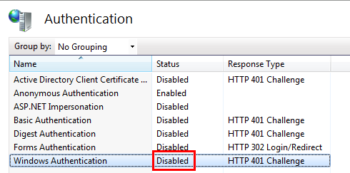
ASP.NET Windows Authentication
Web.config:
<authentication mode="Windows">
</authentication>
IIS
Notes:
Prepnuti na Windows mode

Slide 17
DEMO
DEMO
ASP.NET Windows auhentication

Slide 18

OAuth Basics
An authentication mechanism for web applications/web services
OAuth 1.0 - RFC 5849 http://tools.ietf.org/html/rfc5849
OAuth 2.0 – draft http://tools.ietf.org/html/draft-ietf-oauth-v2-31
Notes:
Problem: 3rd applications built upon existing web services, for example social networks need access to your an user account. The user doesn‘t want to give them an user name and a password.
Solution: The original web service can give them a temporary token for accessing the user account.

Slide 19
OAuth – How It Works
3d party application
5
1
2
User
(Browser)
3
Original webservice
4
User sends request to 3rd party application
3rd party application requests access token
User is redirected to original web service
User authenticates by user name and password to original web service
3rd party application gets the access token
Notes:
Demo OAuth

Slide 20
DEMO
DEMO
OAuth

Slide 21
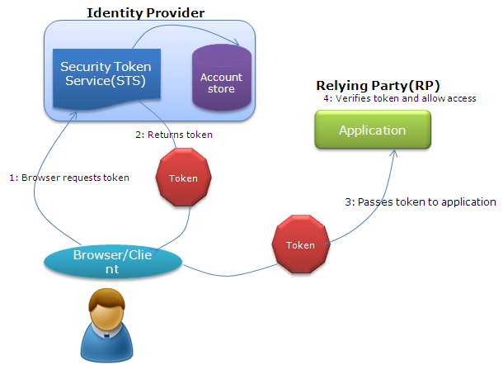
Claim Based Authentication
Notes:
Demo s WIF

Slide 22
DEMO
DEMO
Claim based authentication

Slide 23
Writing Secure Code
SQLi => LinqToSQL, ASP.NET Entity Framework
XSS => Request validation, AntiXSS library, Output encoding
CSRF => ViewState validation (WebForms)
Clickjacking => X-Frame-Option:SAMEORIGIN
Session attacks => Session ID regeneration
OWASP project
Notes:
Demo na utoky + ukazky obran

Slide 24
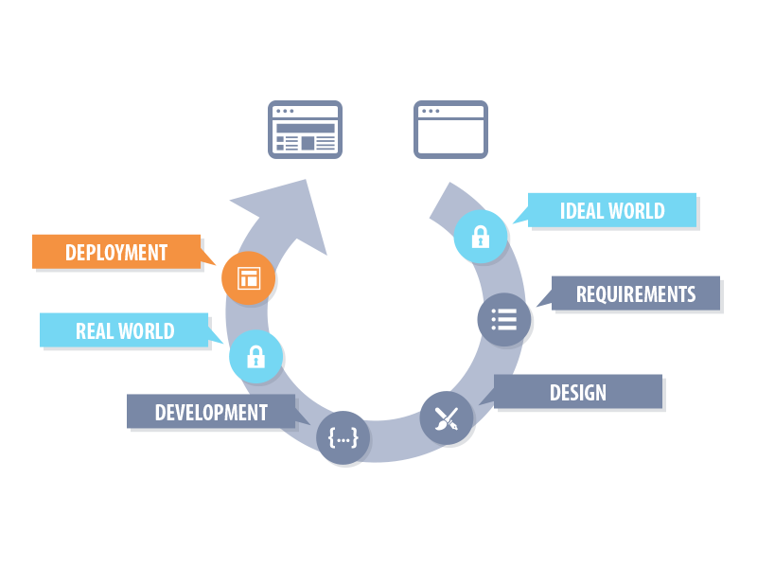

Slide 25
Deployment
Create Checklist and use it!
Delete all the testing data!
Turn off all debugging features!
Deploy to well secured environment!
Configure SSL!
Limit access to private data!
Consider external security audit
Notes:
Ukazka sekci ve web.configu

Slide 26
Q&A
?

Slide 27

Thank you
dominikp@kentico.com
@DominikPinter

