Slide 1
Adobe Edge
Marián Rusnák
LaSArIS
24. 10. 2013

Slide 2
Overview
Adobe Flash
HTML5
Flash vs. HTML5
Adobe Edge
Edge Animate DEMO

Slide 3


Adobe Flash
Software platform
  Adobe Flash Player
  Adobe AIR
Used to
  Video on websites
  RIA

Slide 4
Adobe Flash
More than 500 million devices
More than 20 000 apps in mobile markets
24 of the top 25 Facebook games
http://www.adobe.com/cz/products/flashruntimes/statistics.html

Slide 5
Adobe Flash
Consistency across devices
Animations
Multimedia

Slide 6
But...
Proprietary
Security
Performance?
Mobile browsers!!!

Slide 7

HTML5
Multimedia
  <video> - 82.32% support
    MP4 - 60.85%
    WebM - 55.2%
    Ogg - 48.71%
  <audio> - 82.32% support
    MP3
    WAW
    Ogg

Slide 8

HTML5
Graphics and animations
  <canvas> - 80.73%
  SVG
  CSS3

Slide 9
Flash vs. HTML5
Consistency
Multimedia
Animations
Proprietary
Security
Mobile browsers
Inconsistent across browsers (getting better)
Browser support
Performance of animations
Open standard

Slide 10
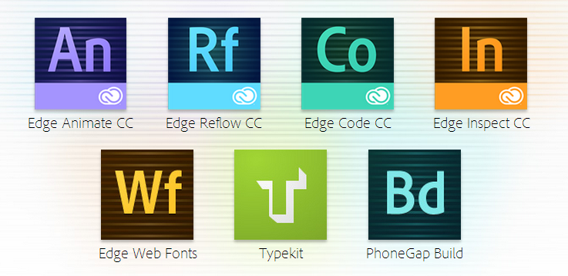
Adobe Edge
Suite of web development tools

Slide 11

Adobe Edge Animate
Flash-like web development
Timeline
Animated HTML

Slide 12



Adobe Edge
Edge Reflow – CSS design
Edge Code – code editor
Edge Inspect – preview in browsers
on various devices

Slide 13



Adobe Edge
Edge Web Fonts – fonts library
Typekit – commercial fonts
PhoneGap Build – mobile apps packaging

Slide 14
Edge Animate DEMO

