Slide 1
Marketing Information Systems: course syllabus
Course code: PV250
Dalia Kriksciuniene, PhD
Faculty of Informatics, Lasaris lab., ERCIM research program
Autumn, 2013

Slide 2

About myself
Diploma of engineer mathematician (Kaunas University of Technology, Applied mathematics study program)
Phd degree: Doctor of social sciences. University of Management and Economics (ISM). Dissertation theme: „Substantiation of multidimensional marketing information system: concept and model“
Pedagogical Certificate of Associated professor of informatics (docent) (Vilnius University)
Assoc.prof. of Vilnius University, Lithuania
Business career: director of bookstore, marketing and IS manager at travel agency, engineer programmer

Slide 3

Every drop in the ocean counts [Yoko Ono]

Slide 4
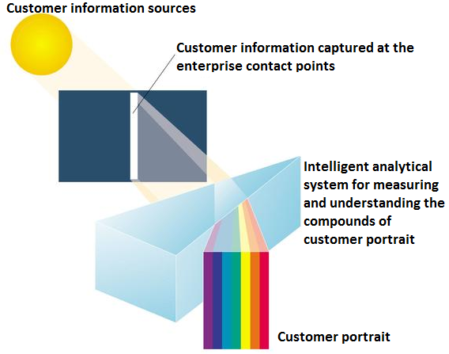
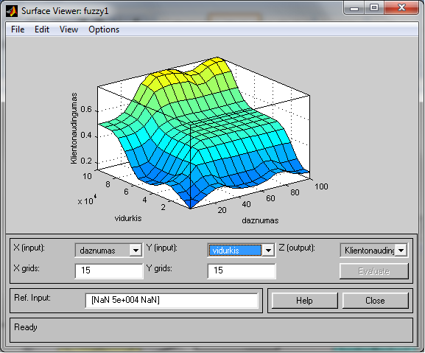
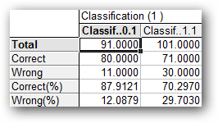
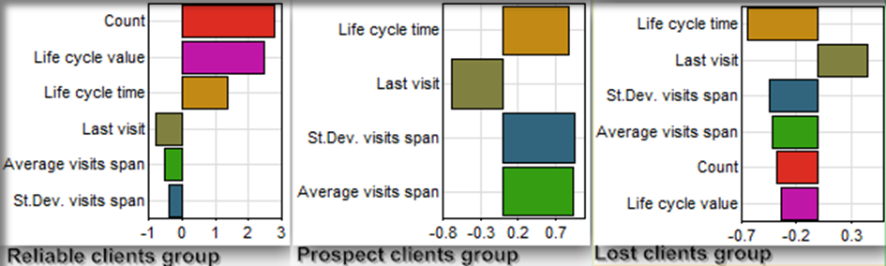
Research themes
The research is oriented to application of artificial intelligence, computational methods for business data analysis in domains of financial markets, marketing and surveillance systems

Slide 5
Timetable
Part 1: Oct.7 Mon 16:00–19:50 B204
Part 2: Oct.8 Tue 14:00--17:50 G331
Part 3: Oct.29 Tue 14:00–17:50 G331
Part 4: Oct.30 Wed 10:00–13:50 G331
Part 5: Nov.26 Tue 14:00–17:50 G331
Part 6: Nov.27 Wed 10:00–13:50 G331
Assessment session: 1-2nd week of January
5

Slide 6
Course objectives
The module is aimed to:
provide advanced interdisciplinary knowledge
augment skills for creating enterprise information systems,
analyse needs for support of marketing management processes
integrate business analytics to marketing
enhance the performance of marketing management specialists by managing information

Slide 7
Course objectives
The teaching module:
introduces creation principles and variety of concepts used for building marketing information systems (MkIS),
provides knowledge of the functional components and structure of MkIS,
develops ability to distinguish and apply specific analytical computational methods
trains skills of computerization in marketing management, including marketing planning, modelling, control and customer relationship management domains.

Slide 8
Course objectives
  The students will:
  get acquainted and acquire practical skills of marketing processes by using
    applied software for marketing operations
    applied software for marketing decision-making, planning and control
    market simulation games,
  acquire knowledge and skills of marketing information management by using
    intelligent computational tools
    cloud-based applications
    functional modules of the integrated systems,
  apply methods of virtual team learning

Slide 9
Lecture 1
Definitions, functions, requirements for the marketing information systems (MKIS).
The careers and users of marketing information,
The user’ requirements for the information content, inputs, retrieval and presentation.
marketing decision making environment, complexity of rules and variables involved
  Tools &software (demo): CESIM simulation solutions for multi-stage market modelling games
  Lab work training: assignment for CESIM team simulation sessions

Slide 10
Lecture 2
  Types and functions of marketing information systems
  Management processes of the marketing manager.
  Operational, analytical, OLAP, expert, executive, decision-support systems.
  Applying ERP, business intelligence, integrated software for marketing tasks
  Big Data issues in marketing
  Tools &software: Sugar CRM
  Lab work training: assignment for cloud-based marketing application

Slide 11
Lecture 3
  Customer relationship systems in marketing: concepts and tasks. CRM operational and analytical methods. Social network analytics
  Information supply for their performance analytics:
    analytical and control applications:
    pivot tools,
    dashboards
  Tools &software: MS Excel pivot module,
  Lab work training: variables., functions and models for analytics: CRM performance analysis by applying pivoting

Slide 12
Lecture 4
Computational intelligence methods neural networks, fuzzy rules, Kohonen self organizing networks
Application and performance of computational analytics for marketing
Tools &software: Statistica advanced models, Viscovery SoMine trial
  Lab work training: CRM performance analysis by applying computational intelligence methods: neural networks, fuzzy rules, Kohonen self organizing networks

Slide 13
Lecture 5
Marketing planning system: MkIS structure
Marketing process modelling by using MKIS.
Marketing system models at the enterprise.
Investigation of the theoretical and experimental research in MkIS area in the scientific literature.
  Tools &software: Marketing plan Pro
  Lab work training: Marketing planning procedures and their linking to the design of MkIS

Slide 14
Lecture 6
  Creating MIS in the enterprise
  Interrelationships with other computerized systems inside and outside the enterprise.
  Variety of concepts for structure and processes of the MIS models.
  ERP application for marketing.
Tools &software (demo): The marketing – oriented tools of MS Dynamic Axapta, IBM solutions for marketing

Slide 15
Total Mark
  Lab training 1 :
  CESIM team simulation sessions (results+report) (Nov.1)
Lab training 2 :
Sugar CRM assignment for cloud-based marketing application (task done)
Lab training 3 :
MS Excel pivot module (CRM data set prepared)
  Lab training 4 :
  CRM by applying computational intelligence methods: (Statistica softw) for analysis of the prepared data set)
Lab training 5:
Marketing plan + MkIS structure
Colloquium

Slide 16
Literature
Berry, M.,J.A., Linoff, G.S. (2011), "Data Mining Techniques: For Marketing, Sales, and Customer Relationship Management", (3rd ed.), Indianapolis: Wiley Publishing, Inc.
Wood, M., B. (2005). The marketing plan handbook (2nd edition). Upper Saddle River, New Jersey: Pearson Education Inc. (Marketing Plan Pro 6.0 software embedded)
Ball, D., A., McCulloch, W., H., Frantz, P., L., Geringer, J., M., Minor, M., S. (2006) International business. The challenge of global competition. 10th edition. McGraw-Hill/ Irwin
CESIM business modelling games (www.cesim.com)
Sugar CRM Implementation http://www.optimuscrm.com/index.php?lang=en
Statsoft: the creators of Statistica http://www.statsoft.com
Viscovery Somine http://www.viscovery.net/
MS Axapta Dyn. http://www.microsoft.com/en-us/dynamics/erp-ax-overview.aspx
Online scientific databases accessed via library.muni.cz
Kotler, Ph. Marketing management (any edition)

