Slide 1
Annotation Framework – Recent state of the application
Honza Botorek, Petra Budíková, Michal Batko

Slide 2
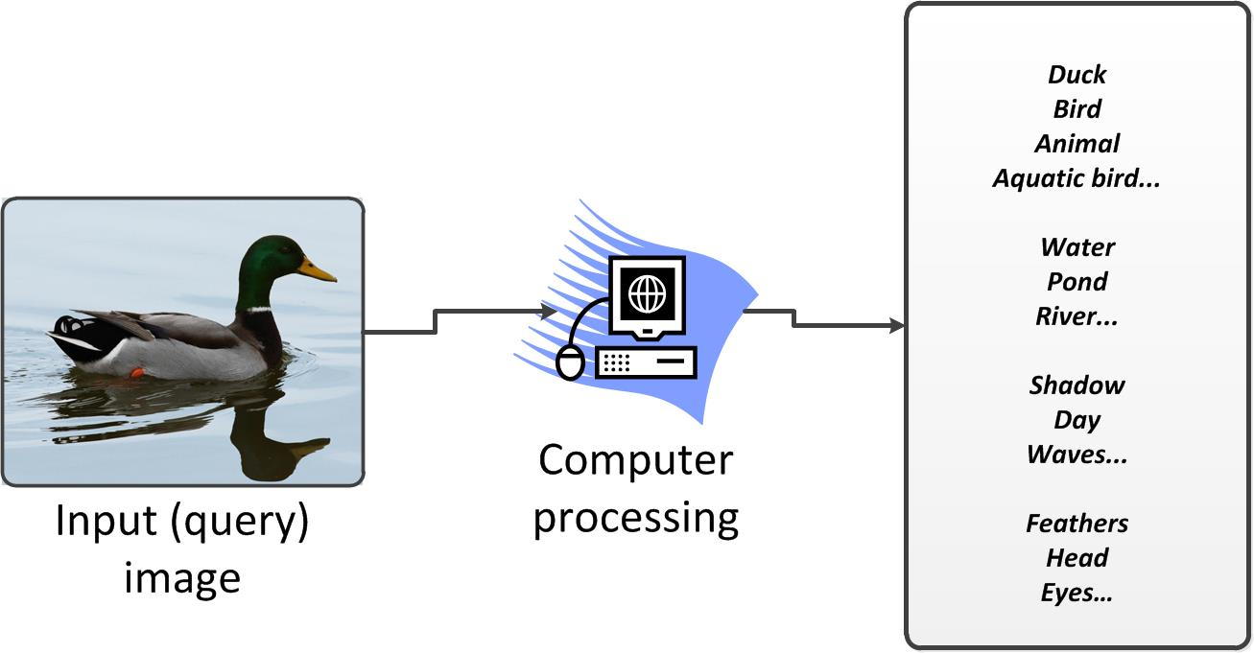
Automatic image annotation – What is it?
Main goal = annotate unknown images with relevant descriptive words

Slide 3
Annotation Framework: Current Approach I.
Given image – CBIR performed (MUFIN) – textual data are retrieved (descriptions)
  iteratively processed by expansion/transformation/reduction members => output
  User may accept, or let perform search again with enriched input data

Slide 4
Annotation Framework: Current Approach II.
Annotation Forming
Fundamental technology: Wordnet
Words are interrelated by meanings – basic relation = synonymy
  synonymous set of words - synset (car, auto, automobile, machine = 1 object)
Important relations utilized to group words together:
  Hypernymy
    Dog IS-A Animal
  Hyponymy
    Animal HAS-DESCENDANT dog
  Meronymy
    Dog HAS-PART tail, head, ears…
  „Gloss relation“
    „… (dog) has been domesticated by man since prehistoric times … „
      => domesticated, man, prehistoric, times
  When relation between 2 words is found, group is formed = 2 words are related

Slide 5
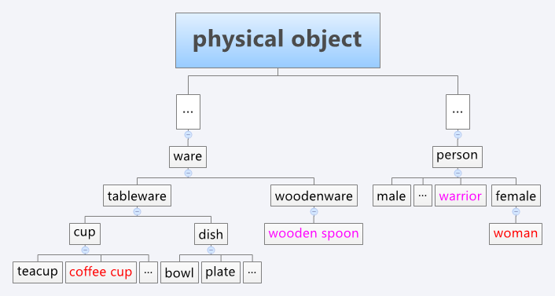

WordNet hypernymy tree – example
… coffee cup, wooden spoon, warrior, woman …

Slide 6
Limitations of current solution
Grouping forms large set of words – mutually unrelated
Not structured output from the framework
  Currently : (dog, puppy, boy, son, child, house)
  Idea: (animals:{dog, puppy}, persons:{boy, child, son}, buildings{house}
Accuracy of annotation is not very high
Annotation Forming tools – space for improvement
Coffee Cup
Woman
bedroom
Objects (clock, brush, plate, screwdriwer)
Persons
(man, human, child, family …)
Housing
(castle, tower, kitchen, bathroom)

Slide 7
Proposed solution I.
Define a hierarchy of categories that enables to refine annotation results
  2 phases: select proper categories; use categories to enrich original query
  Easier and more accurate annotation process
    Structured output
  Ground truth for testing
User-driven relevance feedback
  Idea: Iterative process of image annotation
  Solid hierarchy background is needed

Slide 8
Proposed solution II.
Add other sources of information (relations among words/objects)
  Wikipedie: project DBPedia
    Final thesis topic
Extend classifiers utilization
  Indoor x outdoor; buildings detection…
  OpenCV: Good support for classifiers developing
    Final thesis topic?

Slide 9
Category tree challenges
How to create/select ontology categories?
How to use such categories in the annotation process?
Which relations encode into ontology?

Slide 10
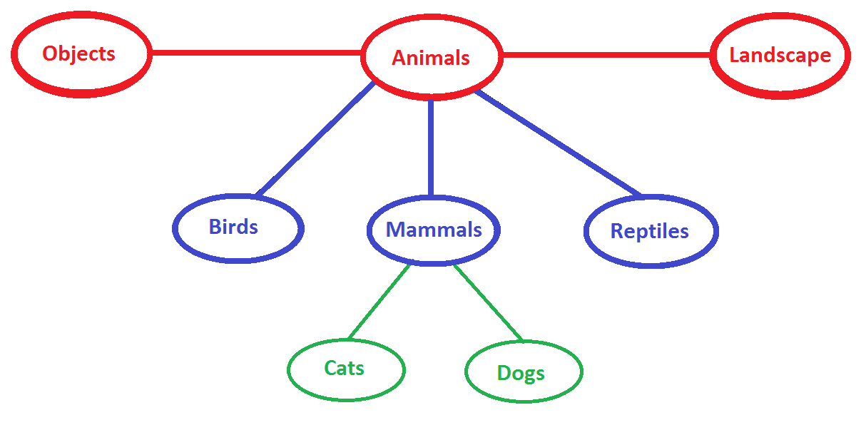
Categorization – Ontology Motivation
“Map words into categories to improve a quality of image annotation”

Slide 11
What is an ontology
„An ontology is a set of concepts – things, events and relations. These concepts form a vocabulary for exchanging information.“
Relations encoding:
  <fruit> <subclass_of> <food>
  <Movie XY> <hasStar> <John Newman>
    < hasStar > <domain> <movie>
    < hasStar > <range> <actor>
No general ontology exists
  ImageCLEF, LSCOM, DBpedia ontology
Some examples of specialized ones
  Food, family, wines, financial institutions…

Slide 12
How to create an ontology?
Category Tree I
Map categories to vital synsets in WordNet structure
Fundamental/root categories
  13 selected (animals, objects, landscape…)
  sub-categories for each „root category“
    Animals – birds, mammals, reptiles
      Mammals – cats, dogs…
  How categories were selected?
    Wordnet – parsing of noun synsets with a high number of hyponyms
    Large ontologies checking (LSCOM, ImageCLEF)

Slide 13
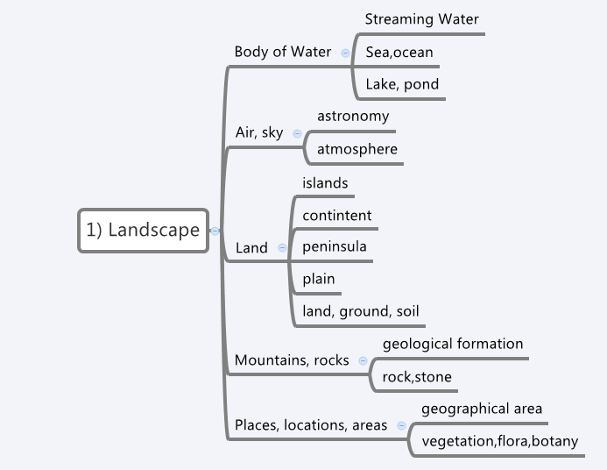
Category Tree II – part of the tree

Slide 14
What relations incorporate into ontology?
Category tree III
IS-A relation: Fundamental requirement to hold relations of the type:
  Fiats ARE cars; Cars ARE Vehicles; Vehicles ARE Objects …
  From more exact categories to more general ones
Incorporation of foreign ontologies
  More specialized hiearchies to some narrow field (eg. food, cars)
Relations encoding into the tree
  opposites (black vs white)
  „person EAT food“ etc.

Slide 15
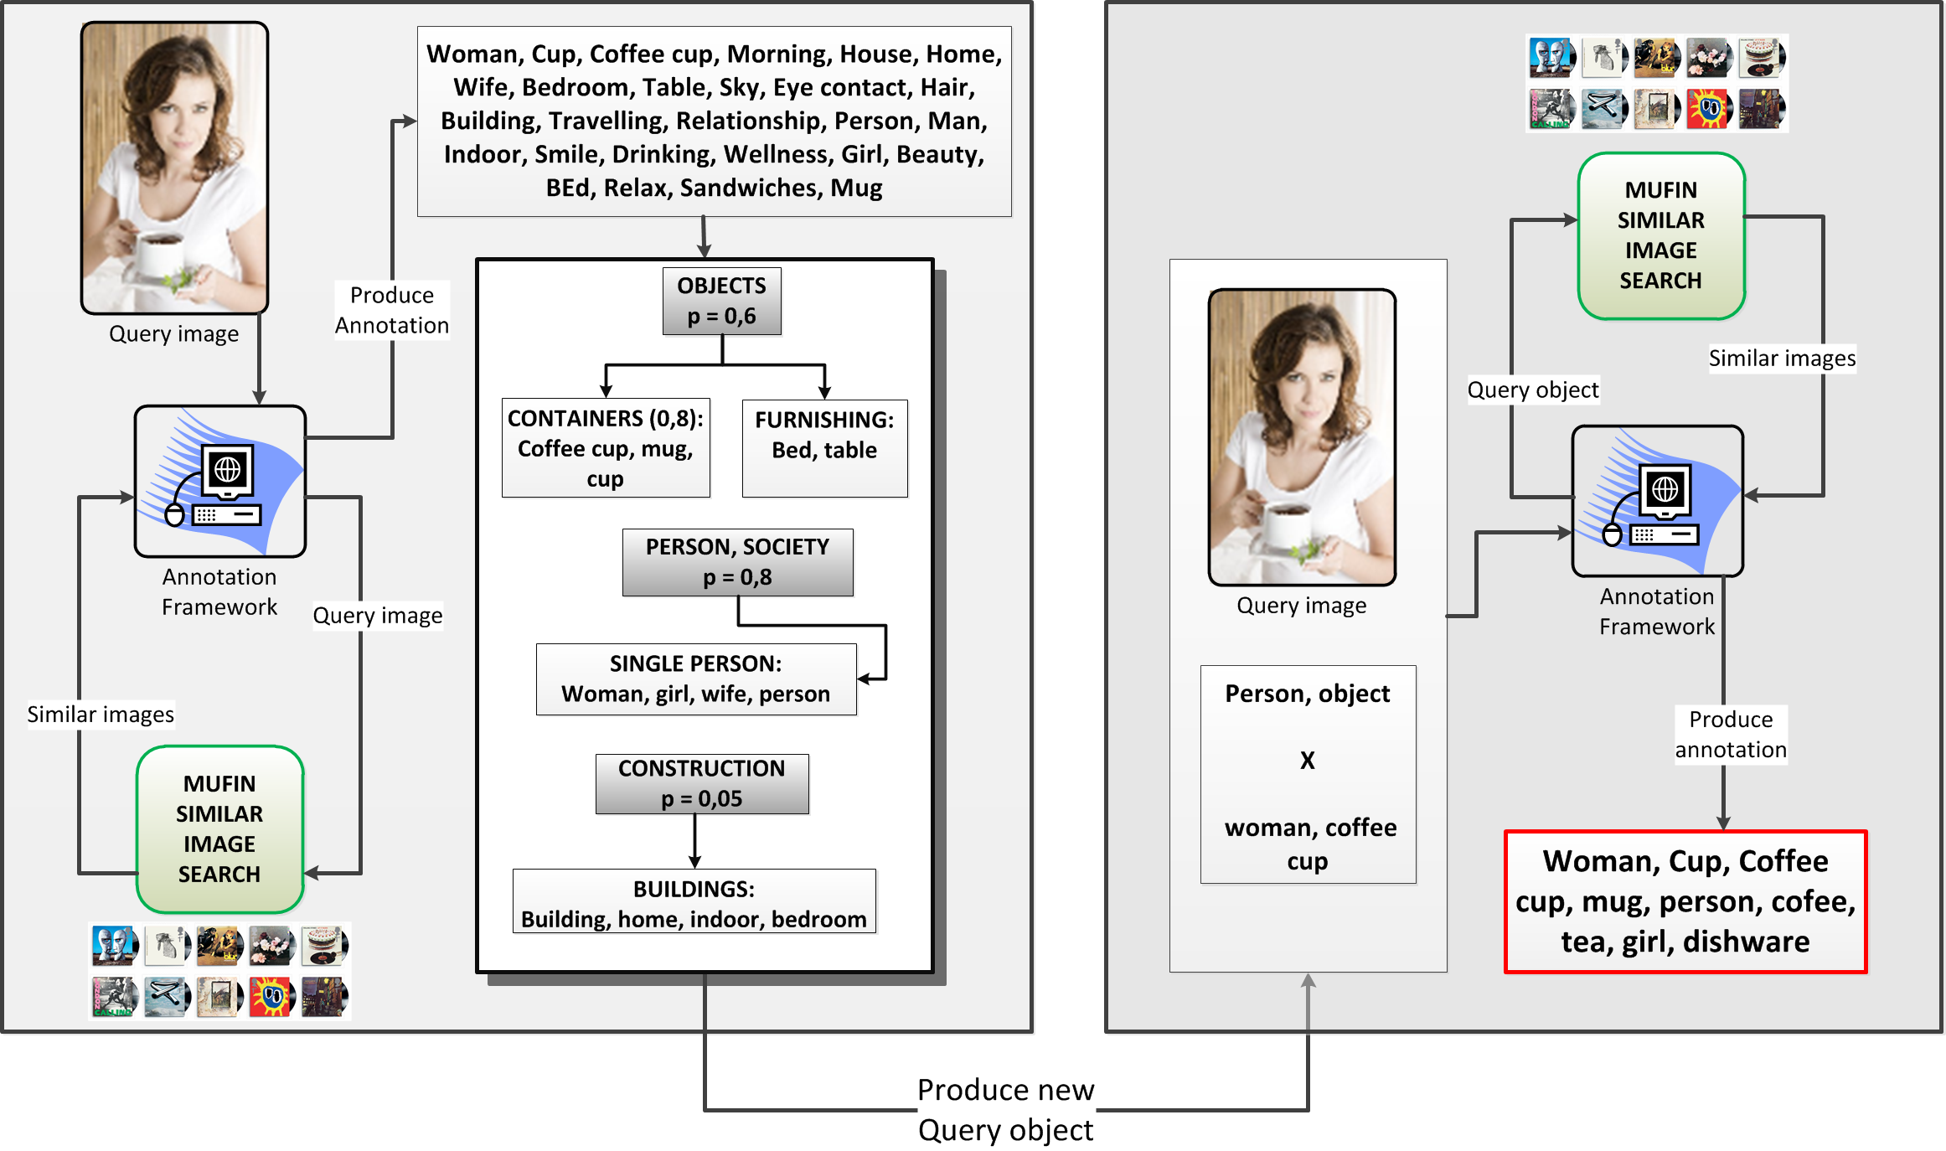
How to use the ontology?
Category Tree IV

Slide 16
Summary
Ontology constructed on WordNet structure is designed
The ontology helps us to improve annotation results
  It can produce more general or more specific annotation
  Different kinds of relations can be encoded
The ontology is extensible and customizable
Near future work
  Implement the ontology into the annotation process
  Incorporate another ontologies
Future work
  Employ the ontology for user relevance feedback

