Slide 1
Content-Based Annotation and Classiﬁcation
Framework: A General Multi-Purpose Approach
Michal Batko, Jan Botorek, Petra Budikova, Pavel Zezula
Laboratory of Data Intensive Systems and Applications
Faculty of Informatics, Masaryk University, Brno
IDEAS 2013

Slide 2
Outline
Motivation
  Why annotations?
  State-of-the-art in multimedia annotation
General annotation model
  Global architecture
  Application to selected tasks
  Speciﬁcation of components
Web image annotation
  Current implementation
  Experimental evaluation
Conclusions and future research directions

Slide 3
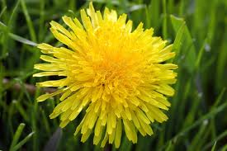
Motivation
nature
Yellow flower
dandelion
Taraxacum officinale
Flower, yellow, dandelion, detail, close-up, nature, plant, beautiful
The first dandelion that bloomed this year in front of the White House.
„Image is worth a thousand words.“

Slide 4
Why do we need the thousand words?
Keyword-based image retrieval
  Popular and intuitive
  Needs pictures with text metadata, we do not want to create them manually
Information seeking: “What is in the photo I just took?”
  Tourist information / Plant identification / …
Impaired users
Classification tasks
  Scientific data (medicine, astronomy, chemistry, …)
  Improper content identification
  Personal image gallery
Data summarization: “What images are on this computer?”
Not only images!
  Sound, video, ….

Slide 5
Several dimensions of the annotation problem
Input
  Image / Image and seed keyword / Image and text / Text
Type of information needed
  Identification / Detection / Categorization
Vocabulary
  Unlimited vocabulary / Controlled vocabulary
Form of annotation required
  Sentence / Set of keywords / All relevant categories / A single category / Localization in a taxonomy
Interactivity
  Online / offline annotation
Easy tasks: identify a single relevant category from a short list
Difficult tasks: wide (unlimited) vocabulary, “all relevant needed”, online processing, very little or no input text

Slide 6
State-of-the-art text-extraction techniques
Pure text-based
  Analyze the text on a surrounding web page
Content-based / Content- and text-based
  Mainly exploit visual properties (+ text when available)
Content-based annotation scenario:
  Basic annotation
    Model-based: train a model for each concept in vocabulary
    Search-based: kNN search in annotated collection
  Annotation refinement
    Statistical
    Ontology-based
    Secondary kNN search
    …

Slide 7
Existing approaches – summary
Model-based techniques:
  Specialized classifiers can achieve high precision
  Fast processing
  Training feasible only for a limited number of concepts feasible, high-quality training data needed
Search-based techniques:
  Can exploit vast amounts of annotated data available online
  No training needed, no limitation of vocabulary
  Costly processing when large datasets need to be searched
  Content-based similarity measures often not precise enough
Summary of state-of-the-art:
  Mostly specialized solutions for a specific type of application
  Reasonable results only for simple tasks
+
+
-
+
+
-
-

Slide 8
Our approach
Facts
  Experiments show that state-of-the-art solutions are not very successful for complex problems
  Psychologic research suggests hierarchical annotation
Our vision:
  Broad-domain annotation is a complex process, needs to be modeled as such
    Multiple processing phases
    Modular design
    Hierarchic annotation
    Combine multiple knowledge sources
    User in the loop
  The same infrastructure can be used for different applications (annotation, classification, …)
    The principal components are the same
    Easy evaluation, comparisons

Slide 9





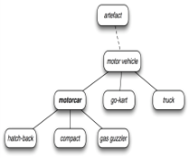
General annotation model
Output
(intermediate or final result)
New query/relevance feedback
Flower, nature, ...
flower
Annotation forming
Input information + inferred information
Resources
expansion
transformation
reduction
flower, ...

Slide 10
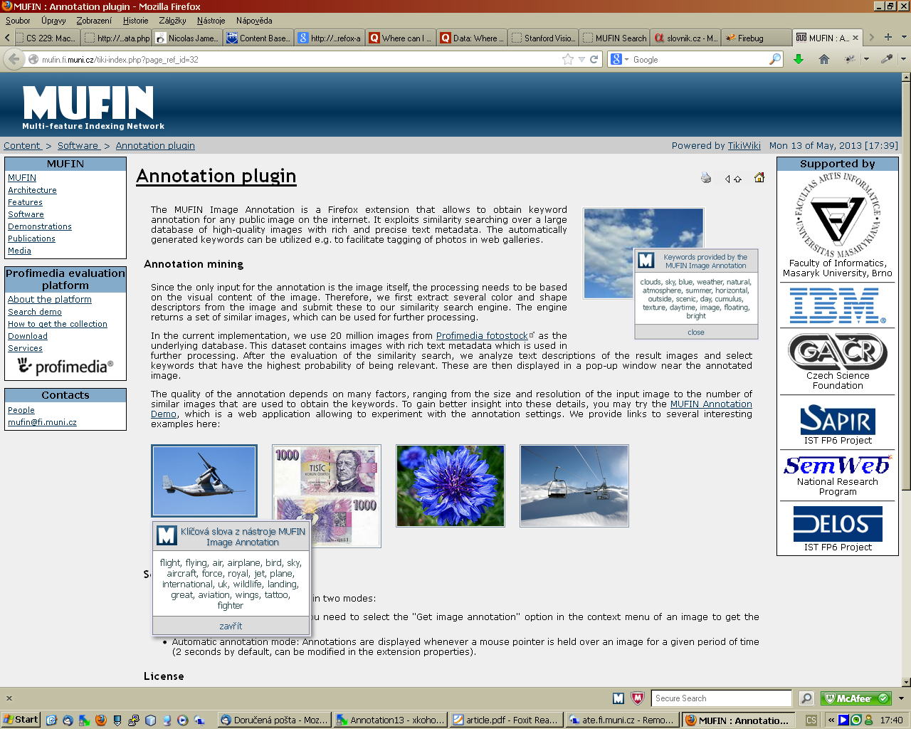
General annotation model (cont.)
Framework components
  Query
    Image / image + text / (text)
  Knowledge sources
    Annotated image collection, WordNet, ontologies, internet, …, user
  Annotation-record
    Query + candidate keywords, weights, any other knowledge
  Processor modules
    Expander, transformer, reducer
  Evaluation scenarios
Properties
  Clear structure, modularity
  Can be adapted to various annotation/classification tasks
  Supports extensive experiments, comparison of techniques
Knowledge source
Annotation-record
word
word
word
word
NULL
NULL
weight
weight
Expander
Transformer
Reducer

Slide 11
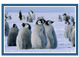
Simple examples
Basic search-based annotation
    Simple model-based annotation
Annotated image collection
Query
Content-based search
Selection of most
frequent words
Annotation-record
Simple annotation
word
word
word
word
NULL
NULL
NULL
NULL
Annotated image collection, WordNet
Query
Concept classifiers
Expansion by similar
and co-occurring words
Annotation-record
Simple annotation
word
word
word
word
NULL
NULL
NULL
NULL

Slide 12

Advanced example: Hierarchic image annotation
Image collections, dictionaries, Wikipedia, …
WordNet,
specialized ontologies
Content-based search
(+ syntactic cleaner,
basic weight transformer)
animals, outdoor
Query
Global
classifiers
Semantic
weight
transformer
Basic concept
reducer
Basic level category
WordNet,
specialized ontologies
Image collections, web, dictionaries, Wikipedia, …
animals, nature, outdoor, snow, pinguins, group, standing
animals, outdoor, pinguins, whales, snow
Multi-modal search
(+ syntactic cleaner,
basic weight transformer)
Keyword /category
selection
Result or next level category
Semantic
weight
transformer
Specialized
classifiers
Relevance
feedback
Relevance
feedback
animals, outdoor, pinguins, whales, snow

Slide 13
Processing modules
“The brain of the annotation process”
    Expanders
      Provide candidate keywords
      Visual-based nearest-neighbor search
        Similarity measured by MPEG-7 global descriptors
        Metric search provided by efficient M-index structure
        Knowledge source: annotated image collection
      Face detection software
        Luxand FaceSDK
        commercial library for detection and recognition of faces
      Depending on number of faces detected, people-related concepts are added to annotation-record
Expander
Reducer
Transformer

Slide 14
Processing modules (cont.)
    Transformers
      Adjust weights of candidate keywords
      Basic weight transformer
        Frequency of a keyword in the descriptions of similar images
        Similarity score of each image with the particular keyword
        Knowledge source: descriptions of similar images
      Semantic transformer
        Uses WordNet hierarchies to cluster related words
        Keyword weight increased proportionately to the size of containing cluster
        Knowledge source: WordNet
    Reducers
      Remove unsuitable candidates
      Syntactic cleaner
        Stopword removal, translation, spell-correction
        Knowledge sources: WordNet, dictionaries, Wikipedia

Slide 15
Web image annotation problem
Task specification
  “Given an image, provide the K most relevant keywords that describe the content of this image.”
Use case
  A professional photographer uploading images to a photo-selling site needs to provide accompanying keywords to enable text search
Basic solution
    Budikova, Batko, Zezula: Online image annotation. SISAP 2011.
Annotated image collection
Query
Content-based
search
Annotation-record
Weight
transformer
(word frequency)
Annotation-record
Final keyword
selection
word
word
word
word
word
word
word
word
NULL
NULL
NULL
NULL
NULL
NULL
weight
weight

Slide 16
Web image annotation problem (cont.)
A more complex solution
Annotated image collection
Dictionary, Wikipedia, WordNet
Query
Content-based
search
Annotation-record
Syntactic
cleaner
Annotation-record
Weight
transformer
(word frequency)
word
word
word
word
word
word
NULL
NULL
NULL
NULL
NULL
NULL
Annotation-record
WordNet
word
word
weight
weight
Flight, fly, airplane, sky, aircraft, plane, aviation
Final keyword
selection
Annotation-record
Weight
transformer
(WordNet
relationships)
Annotation-record
Face
detection
word
word
word
word
word
word
word
word
NULL
NULL
NULL
NULL
weight
weight
weight
weight

Slide 17
Web image annotation – evaluation
Methods under comparison
  Original search-based annotation
  Cleaned keywords
  Boosting by distance
  Clustering by WordNet meaning
  Face detector boosting
  Face detector enrichment
Evaluation methodology
  160 test queries
    Categories easy/medium/difficult
    20 best keywords requested
  Result relevance evaluation:
    User-provided (result relevance assessments)
    Automatic (comparison to image description provided by author)

Slide 18



Web image annotation – evaluation (cont.)
Easy query
entertainment, art, sparkling, event, enjoyment, show, display, air, celebration, festival, flash, level, fireworks, cracker, explosion, fire, excitement, firecracker, light, bang
Medium query
blossom, location, plant, bird, food, trees, natural, citrus, flowers, generic, antique, destinations, nature, recreation, tree, foliage, botany, fruit, determination, flower
Difficult query
form, station, antique, interior, frame, bookcase, indoors, group, animal, antiques, snack, person, construction, food, chinese, study, wood, architecture, dynasty, building

Slide 19
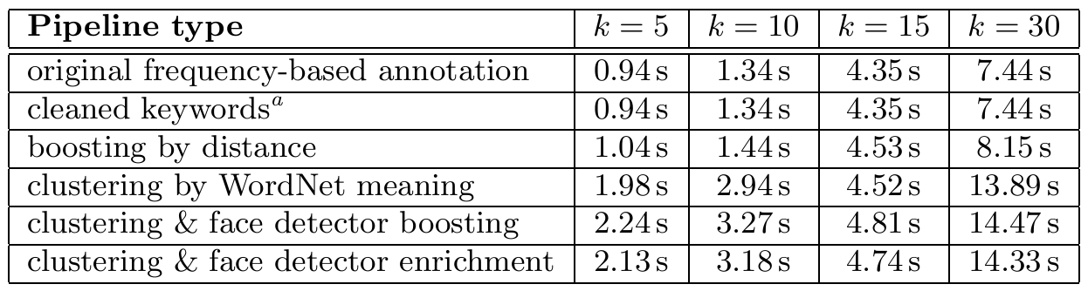
Web image annotation – evaluation (cont.)
Precision – user evaluation
highly relevant keywords (dark) + relevant keywords (light)
query type
Processing costs

Slide 20
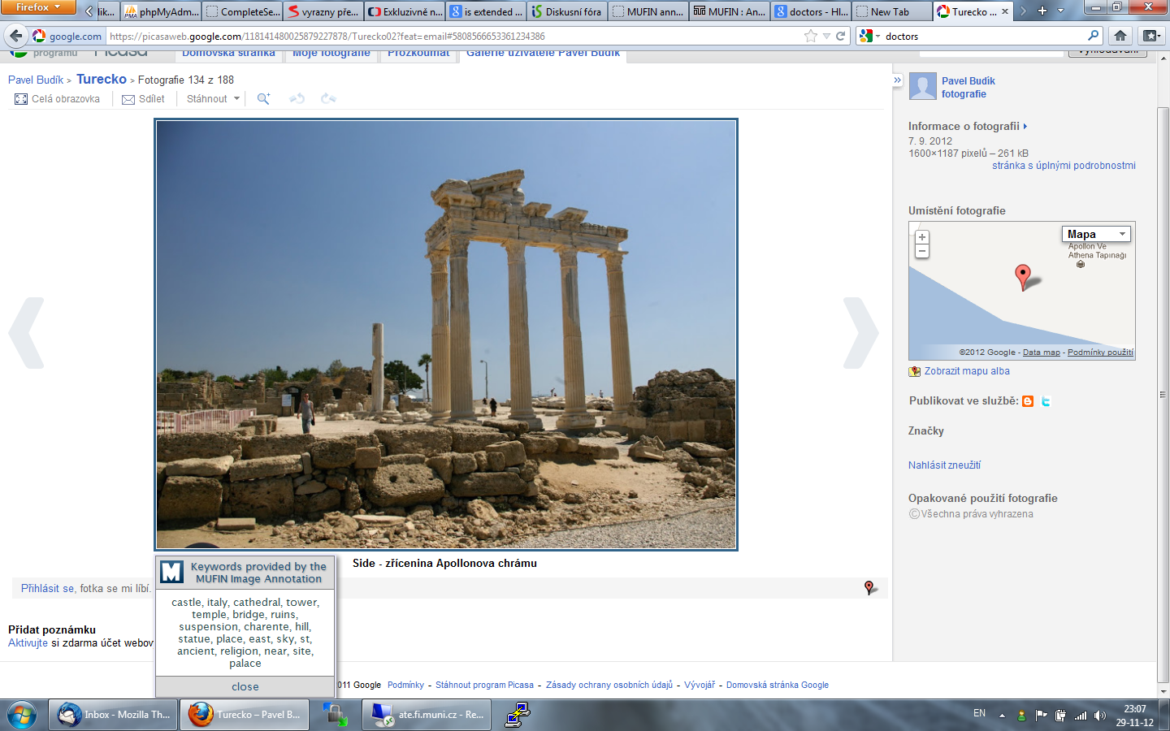
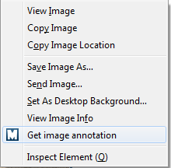

Conclusions
Image annotation remains a challenging task
  Broad domains, interactive applications, lack of training data, …
Our contributions
  General annotation model & implementation framework
  Implementation & evaluation of several processing components
  Improved annotation tool
    http://disa.fi.muni.cz/prototype-applications/image-annotation/
Future work
  Refinement of semantical analysis
  Development of new components, hierarchic annotation processing
  Relevance feedback strategies for image annotation

Slide 21
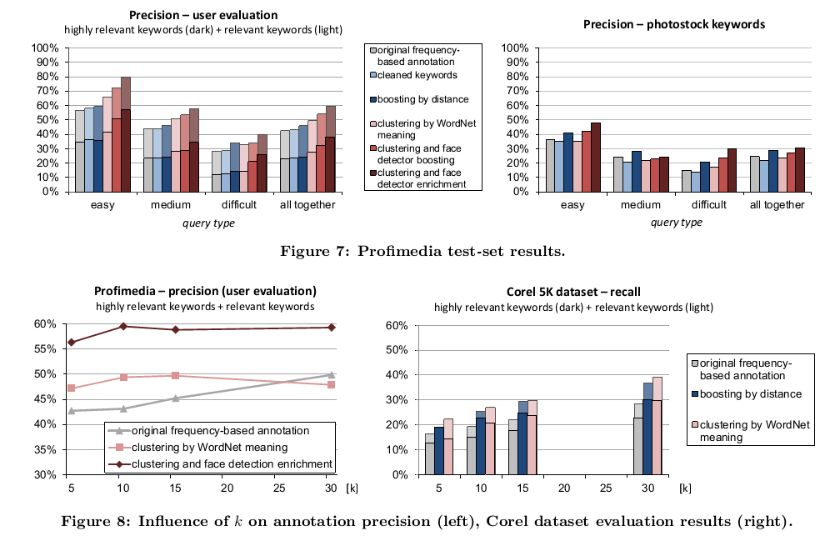
More experimental results

Slide 22
Message
Broad domain image annotation is a highly actual, challenging task
Existing methods provide useful tools, but are not able to solve the problem in its complexity
We propose to approach the problem in a novel way, relying on iterative annotation tuning
We presented a modular annotation framework that supports a variety of annotation and classification tasks
We already have a working annotation software and we evaluated the usefulness of several processing modules experimentaly.

