Slide 1
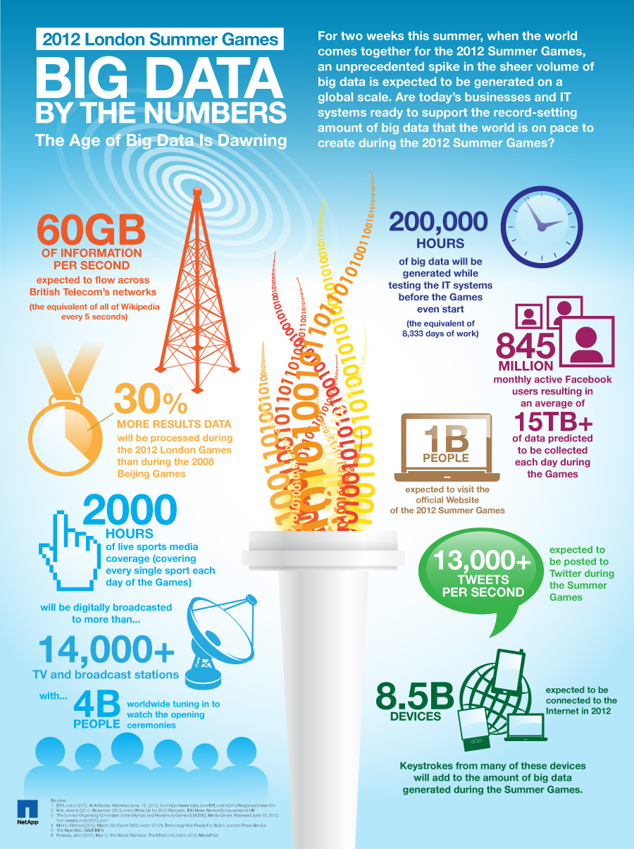

Slide 2

Large scale processing using
Hadoop
Ján Vaňo

Slide 3
What is Hadoop?
Software platform that lets one easily write and run applications that process vast amounts of data
Includes:
MapReduce – offline computing engine
HDFS – Hadoop distributed file system
...

Slide 4

Brief history
Created by Doug Cutting
Named after his son‘s toy - elephant

Slide 5
Brief history
2002 - Project Nutch started (open source web search engine)
2003 - GFS (Google File System) paper published
2004 - Implementation of GFS started
2004 - Google published MapReduce paper
2005 - Working implementations of MapReduce and GFS (NDFS)
2006 - System applicable beyond realm of search
2006 - Nutch moved to Hadoop project, Doug Cutting joins Yahoo!
2008 - Yahoo!s production index generated by 10,000 core Hadoop cluster
2008 - Hadoop moved under Apache Foundation
April 2008 - Hadoop broke world record - fastest sorting of 1 TB of data (209 seconds, previously 297)
November 2008 - Google's implementation sorted 1 TB in 68 seconds
May 2009 - Yahoo! team sort 1 TB in 62 seconds

Slide 6
Why Hadoop?
Scalable: It can reliably store and process petabytes
Economical: It distributes the data and processing across clusters of commonly available computers (in thousands)
Efficient: By distributing the data, it can process it in parallel on the nodes where the data is located
Reliable: It automatically maintains multiple copies of data and automatically redeploys computing tasks based on failures

Slide 7













Who uses Hadoop?

Slide 8
Hadoop modules
Hadoop Common - contains libraries and utilities needed by other Hadoop modules
Hadoop MapReduce - a programming model for large scale data processing
Hadoop Distributed File System (HDFS) - a distributed file-system that stores data on the commodity machines, providing very high aggregate bandwidth across the cluster
Hadoop YARN - a resource-management platform responsible for managing compute resources in clusters and using them for scheduling of users' applications

Slide 9
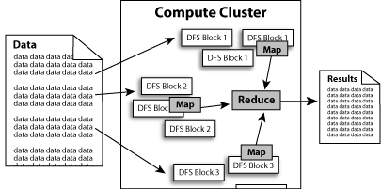
What does it do?
Hadoop implements Google’s MapReduce, using HDFS
MapReduce divides applications into many small blocks of work
HDFS creates multiple replicas of data blocks for reliability, placing them on compute nodes around the cluster
MapReduce can then process the data where it is located
Hadoop ‘s target is to run on clusters of the order of 10,000-nodes

Slide 10
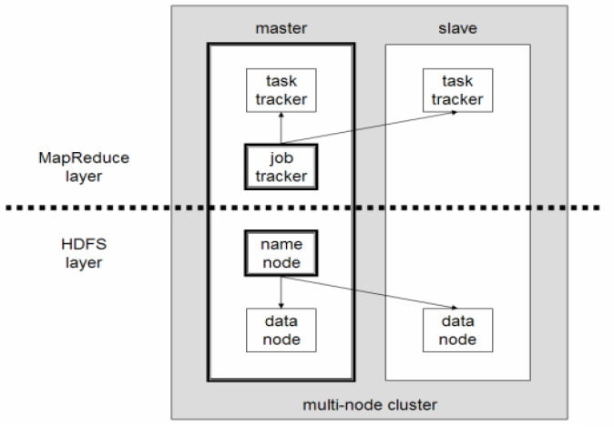
Hadoop architecture

Slide 11
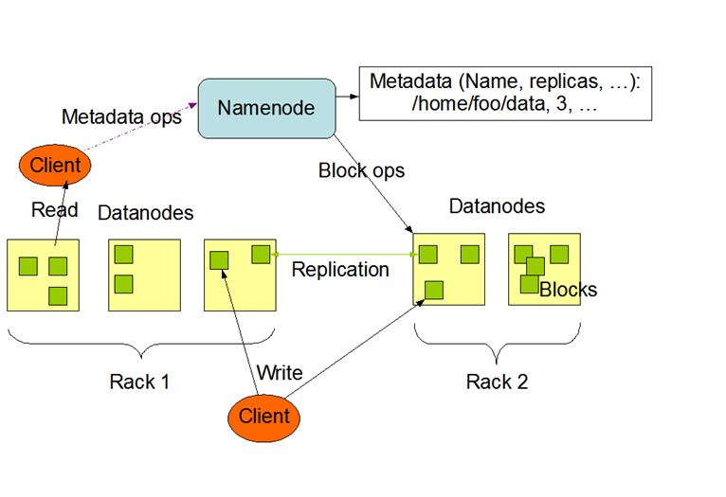
HDFS Architecture

Slide 12
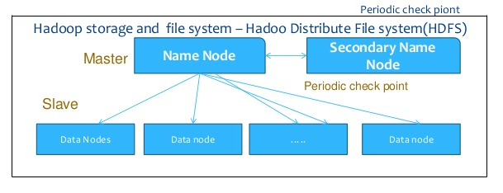
HDFS Architecture

Slide 13
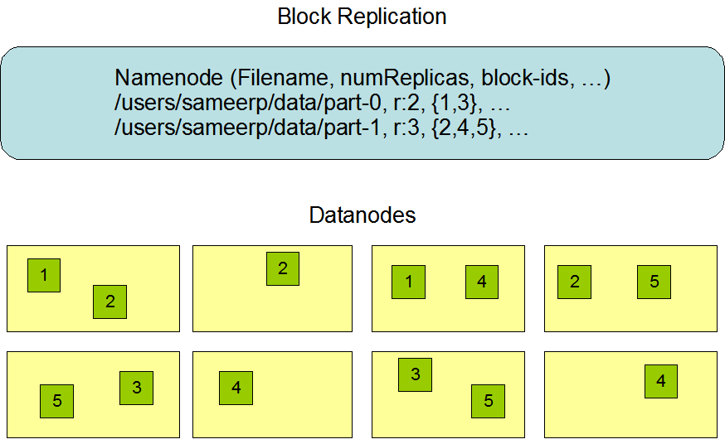
Data replication in HDFS

Slide 14
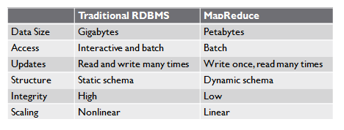
MapReduce vs. RDBMS

Slide 15
Data Structure
Structured Data – data organized into entities that have a defined format.
  Realm of RDBMS
Semi-Structured Data – there may be a schema, but often ignored; schema is used as a guide to the structure of the data.
Unstructured Data – doesn’t have any particular internal structure.
MapReduce works well with semi-structured and unstructured data.

Slide 16
Assumptions
Hardware will fail
Processing will be run in batches. Thus there is an emphasis on high throughput as opposed to low latency
Applications that run on HDFS have large data sets. A typical file in HDFS is gigabytes to terabytes in size
It should provide high aggregate data bandwidth and scale to hundreds of nodes in a single cluster. It should support tens of millions of files in a single instance
Applications need a write-once-read-many access model
Moving Computation is Cheaper than Moving Data
Portability is important

Slide 17
How to use Hadoop?
Implement 2 basic functions:
  Map
  Reduce

Slide 18
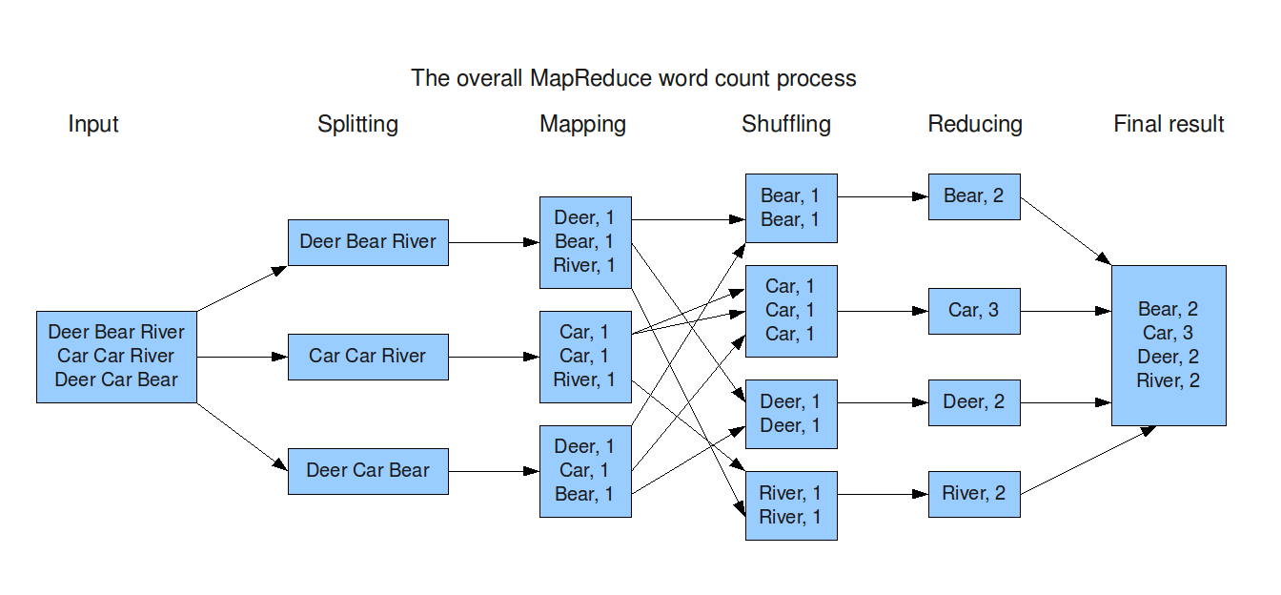
MapReduce

Slide 19
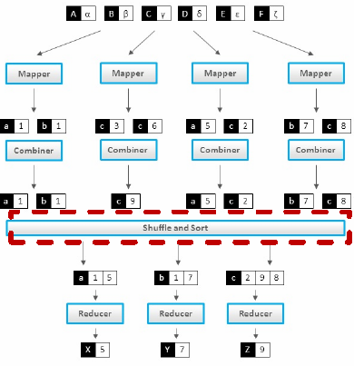
MapReduce structure

Slide 20
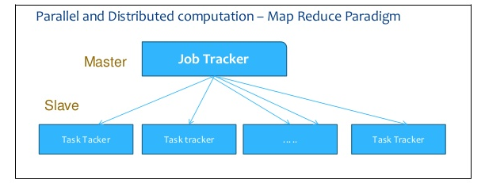
Job submission

Slide 21
Job submission
Client applications submit jobs to the Job tracker
The JobTracker talks to the NameNode to determine the location of the data
The JobTracker locates TaskTracker nodes with available slots at or near the data
The JobTracker submits the work to the chosen TaskTracker nodes
The TaskTracker nodes are monitored. If they do not submit heartbeat signals often enough, they are deemed to have failed and the work is scheduled on a different TaskTracker

Slide 22
Job submission
A TaskTracker will notify the JobTracker when a task fails. The JobTracker decides what to do then: it may resubmit the job elsewhere, it may mark that specific record as something to avoid, and it may may even blacklist the TaskTracker as unreliable
When the work is completed, the JobTracker updates its status
Client applications can poll the JobTracker for information

Slide 23
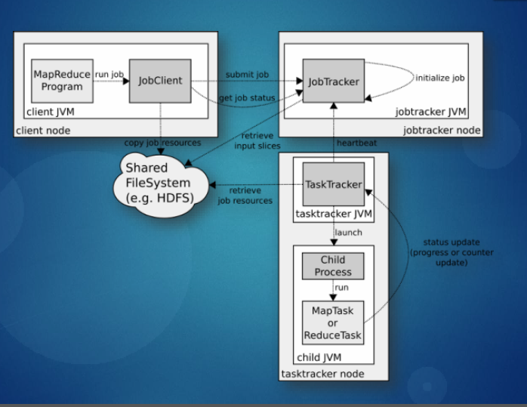
Job flow

Slide 24
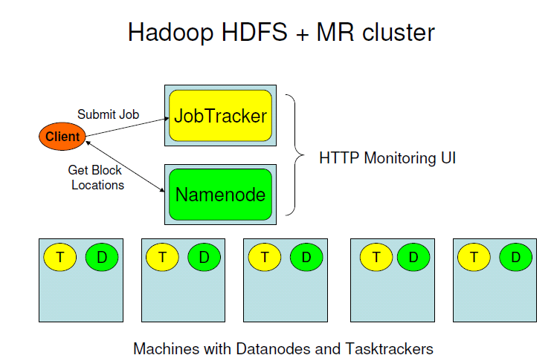

Slide 25
What is Hadoop not
A replacement for existing data warehouse systems
A database

Slide 26
Hadoop-related projects
Apache Pig [high-level platform for querying]
Apache Hive [data warehouse infrastructure]
Apache Hbase [database for real-time access]
Apache Sqoop [CLI for SQL to/from Hadoop]
...

Slide 27
Examples of production use
Yahoo! : More than 100,000 CPUs in ~20,000 computers running Hadoop; biggest cluster: 2000 nodes (2*4cpu boxes with 4TB disk each); used to support research for Ad Systems and Web Search
Facebook: To store copies of internal log and dimension data sources and use it as a source for reporting/analytics and machine learning; 320 machine cluster with 2,560 cores and about 1.3 PB raw storage

Slide 28
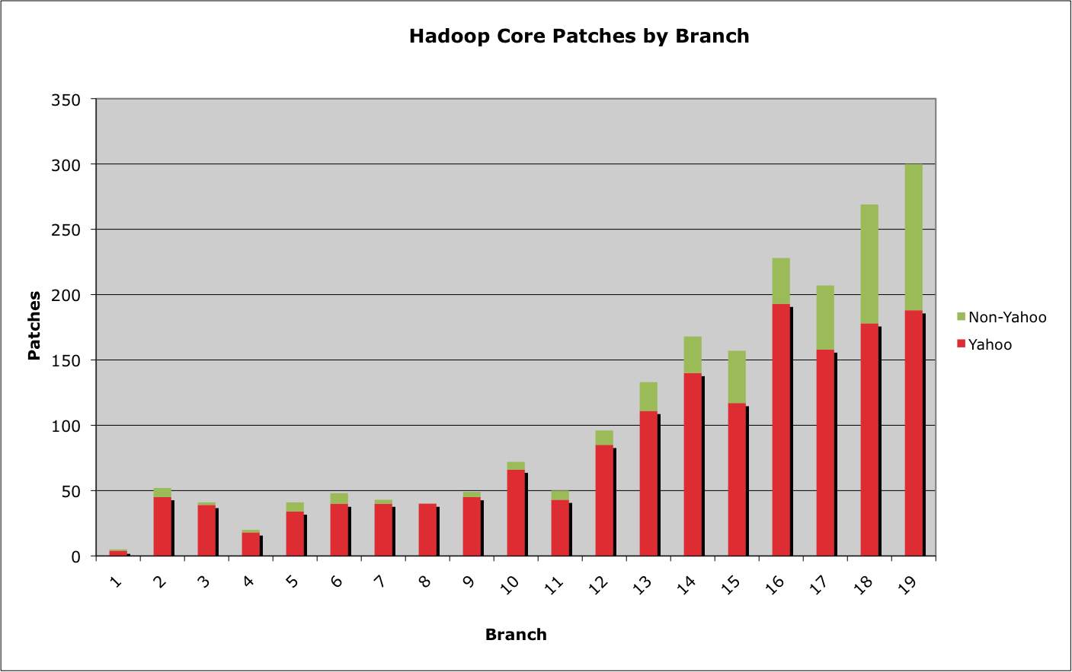
Size of releases

Slide 29
Hadoop
+ Framework for applications on large clusters
+ Built for commodity hardware
+ Provides reliability and data motion
+ Implements a computational paradigm named Map/Reduce
+ Very own distributed file system (HDFS) (very high aggregate bandwidth across the cluster)
+ Failures handles automatically

Slide 30
Hadoop
- Time consuming development
- Documentation sufficient, but not the most helpful
- HDFS is complicated and has plenty issues of its own
- Debugging a failure is a "nightmare"
- Large clusters require a dedicated team to keep it running properly
- Writing a Hadoop job becomes a software engineering task rather than a data analysis task

Slide 31
Alternatives
BashReduce - MapReduce for std. Unix commands (no task coordination, lack of fault tolerance)
Disco Project - MapReduce by Nokia Research for Python written in Erlang (no own file system, no persistent fault tolerance)
Spark - UC Berkeley implementation in Scala with in-memory querying even distributed across machines (depends on cluster manager Mesos)

