Slide 1
NoSQL
Marián Rusnák
Seminar of DISA Laboratory
9.12.2013

Slide 2
Outline
Motivation
What is NoSQL
Key-Value stores
Wide-Column stores
Document stores
Summary

Slide 3
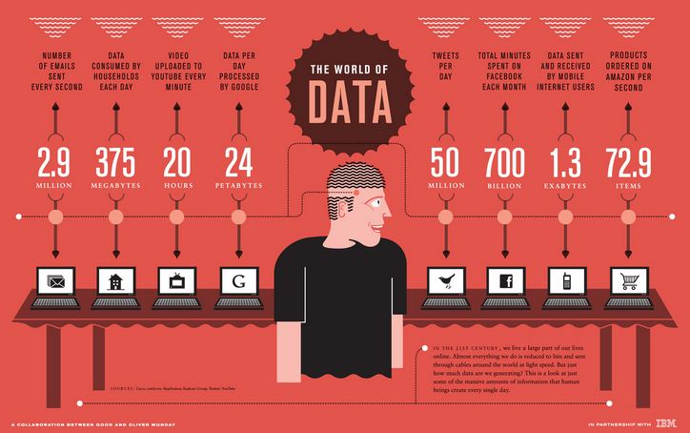

Slide 4

Motivation
Massive data volumes
Extreme query workload
Schema evolution

Slide 5



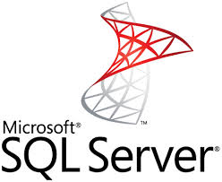

Traditional RDBMS
Transactions – ACID
Integrity
Complex queries

Slide 6

But…
Modern web apps may have different needs
  Low latency
  Scalability & elasticity
  High availability
  Flexible schemas / semi-structured data
  Distributed

Slide 7

What is NoSQL
Term NoSQL
  Not Only SQL
  Non-relational database
Databases different from traditional RDBMS

Slide 8
What is NoSQL
Meet modern web apps requirement
Scalable
  huge volumes of data
Distributed
  multiple nodes
  multiple datacenters
Flexible
  no strict schema

Slide 9
What is NoSQL
Umbrella term for different types of datastores
  Key-Value stores
  Wide column stores / column families
  Document stores
  Graph databases
  Other…

Slide 10

What is NoSQL
http://nosql-database.org/
  150 NoSQL databases
Almost every big company has own solution

Slide 11
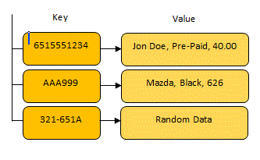
Key-Value Stores
Simplest
Largest group
Something like distributed hash tables
Examples
  Amazon Dynamo
  Amazon DynamoDB
  Voldemort
  Redis
  Oracle NoSQL Database
  SimpleDB

Slide 12

Dynamo
Key-Value distributed storage system
Pioneer in the area
Many features incorporated by others
Peer-to-Peer
Simple data model – unique keys, no schema

Slide 13
Dynamo
Consistent hashing
  “Ring” of nodes
  Virtual nodes – node has several positions in the ring
Replication
  Successors in the ring

Slide 14
Dynamo
Quorum
  Coordinator
  R+W > N
Gossip
  Failure detection
Object versioning

Slide 15


Voldemort
LinkedIn, now open-source
Based on Dynamo
Written in Java

Slide 16
Wide-Column Stores
Key is associated with multiple attributes
Inspired by Google BigTable
Examples
  Google BigTable
  HBase
  Cassandra

Slide 17

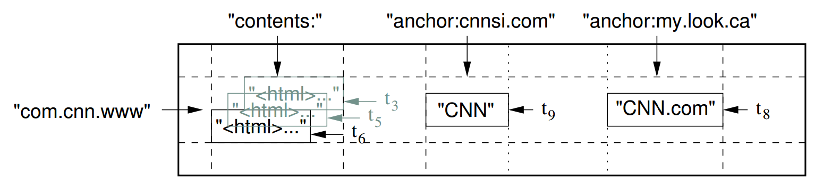
BigTable
Proprietary
  Only short info paper released
Sparse, distributed multi-dimensional sorted map
<row_key,column_key,timestamp> → <value>

Slide 18
BigTable
Rows
  Data sorted by row key
Tablets
  Sequence of rows
  Distributed
Columns, Column families
  Unlimited numbers of columns

Slide 19
BigTable
Versioning
  Timestamps
  Garbage collection
Stores data on Google File System

Slide 20


HBase
Inspired by BigTable
Open-source – Apache
Uses Hadoop Distributed File System

Slide 21


Cassandra
Facebook
  Fast inbox search
Now open-source Apache project
Data model of BigTable
Infrastructure of Dynamo

Slide 22

Document Stores
Value is more than a string
  JSON
  BSON
Inspired by IBM Lotus Notes
Very flexible schema
Examples
  MongoDB
  CouchDB

Slide 23

CouchDB
Open-source Apache project
Schema free
JSON format
B-Tree storage
MVCC, no locking
No joins, no primary or foreign keys
Written in Erlang
REST API

Slide 24

MongoDB
Open-source
BSON format – similar to JSON
Queries can be objects
Multiple types of indexing
Master/slave replication
Written in C++
Drivers in many languages
Most popular
  23 000 questions on stackoverflow

Slide 25
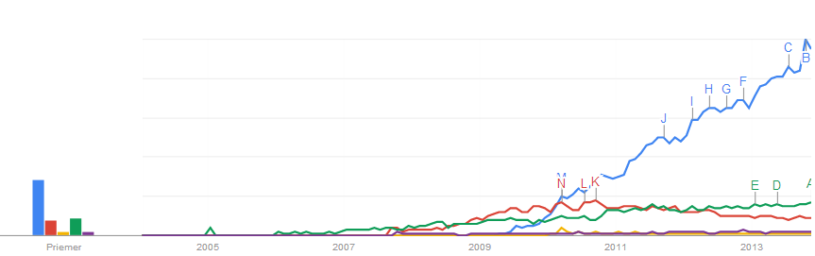
Trends

Slide 26
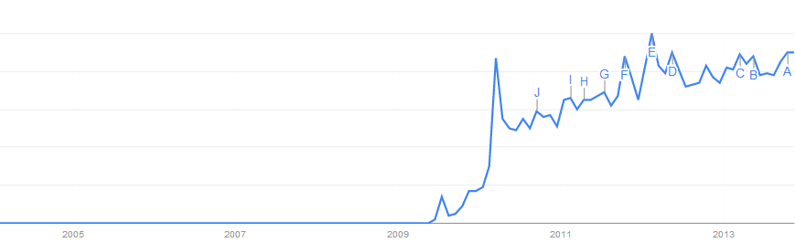

Trends
Gaining in popularity…

Slide 27
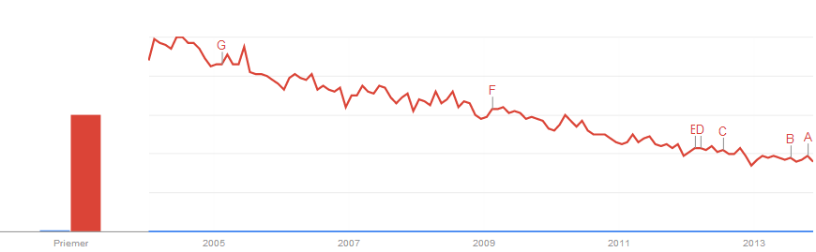

Trends
…but still got a long way to go

Slide 28
Summary
NoSQL is suitable for modern web apps
  Scalable
  Distributed
  Flexible
4 main types
  Key-Value stores
    Key to value mapping
  Wide column stores / column families
    More attributes associated with key
  Document stores
    Key to document mapping, not only to string
  Graph databases
    Connection between objects

Slide 29
References
SlideShare
  http://www.slideshare.net/marin_dimitrov/nosql-databases-3584443
  http://www.slideshare.net/dstainer/introduction-to-nosql-databases
  http://www.slideshare.net/quipo/nosql-databases-why-what-and-when
Google BigTable paper
  http://static.googleusercontent.com/media/research.google.com/sk//archive/bigtable-osdi06.pdf
Stanford course
  http://infolab.stanford.edu/~widom/cs145/NoSQL_activity.pdf
http://www.mongodb.com/learn/nosql

