Slide 1
A Key-Pose Similarity Algorithm for Motion Data Retrieval
Jan Sedmidubsky, Jakub Valcik, Pavel Zezula
ACIVS 2013
OCT 28, 2013
Notes:
Good afternoon, my name is Jakub Valcik and I am going to present here our key-pose similiarity algorithm for motion data retrieval

Slide 2
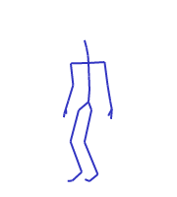
Outline
Motion Capture Data
Motivation
Similarity Motion Retrieval
Results
Summary
Notes:
This presentation is structured as follows. Firstly I’ll introduce you to motion capture data and show you where these data can be used. The main part of this presentation is devoted to similarity motion retrieval and description of our algorithm. If time allows us I would like to show you our demo.

Slide 3
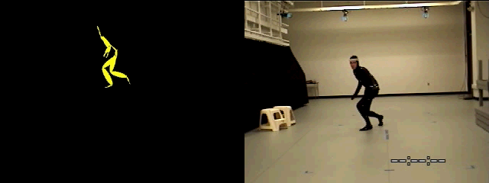
Motion Capture Data
Motion Capture Data ~ Human Motion Data
  Sequence of poses of 3D joint coordinates
Notes:
At the beginning is a moving human which is recorded by an ordinary video camera. This can be seen at the ride side of this slide. Also this man has attached reflective markers on his body and the system of synchronized cameras together with specialized software are able to reconstruct 3D coordinates of these markers thus the movement performed by the man on the right can be represented as a moving articulated stick figure at the left side.

Slide 4
Motivation
Analysis of recorded human motion
  Health care – success of rehabilitative treatments
  Sports – performance aspect comparison
  Security – person identification, event detection
  Computer animation – realistic motion synthesis
Human motion retrieval
  Content-based retrieval
  Machine learning
Notes:
Digitalized human motion is used in various areas. For example orthopedists use analysis of patient movement for measuring success of rehabilitative treatment. Trainers can compare performance aspects of athletes. In security, the motion analysis can be used for person identification or event detection. Also digitalized human motion is used for realistic motion synthesis in computer animation area.
However, to effectively work with motion databases human motion retrieval is needed. There are used two main approaches where the first one is a content based retrieval and the second approach is a machine learning. From now on we focus on the content based retrieval only.

Slide 5
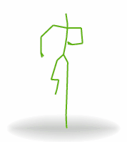
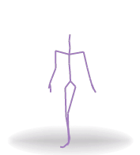
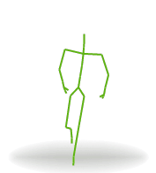
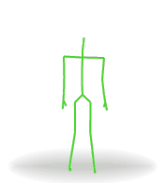
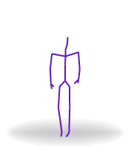
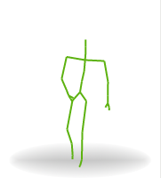
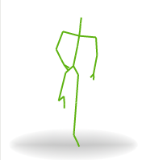
Human Motion Retrieval
Content-based retrieval:
  Search for motions in a database that are similar to a query motion example
  Approaches:
    Sequence-based approach – searches for entire motions
    Subsequence-based approach – searches for all possible sub-motions within recorded database motions
Notes:
Content based human motion retrieval searches for motions in a database that are similar to a query motion example. Two main approaches are used. Sequence-based approach searches for entire motion thus motion sequence is assessed as a whole when similarity is computed. This concept is used for searching in database of motion snippets as you can see at the bottom of slide. There are four different well defined movements. First is bending, second is jumping and so on. And probably the second and the forth snippets are most similar.
The second approach does not consider a motion sequence as atomic but tries to find sub-motions in it similar to the query motion. As you can see on the slide there is rather complex movement containing walking, jumping, turning and so on. So if we are looking for jumping sub-motion it would be probably this. Tohle bylo obecny a nyni vam ukazeme nas pristup inspired by the subsequence-based approach.

Slide 6
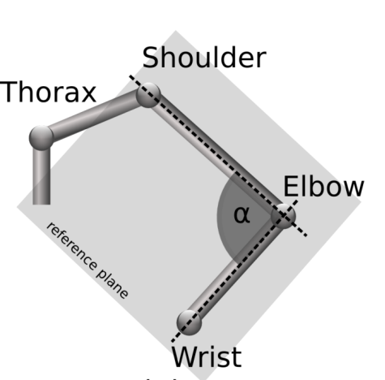
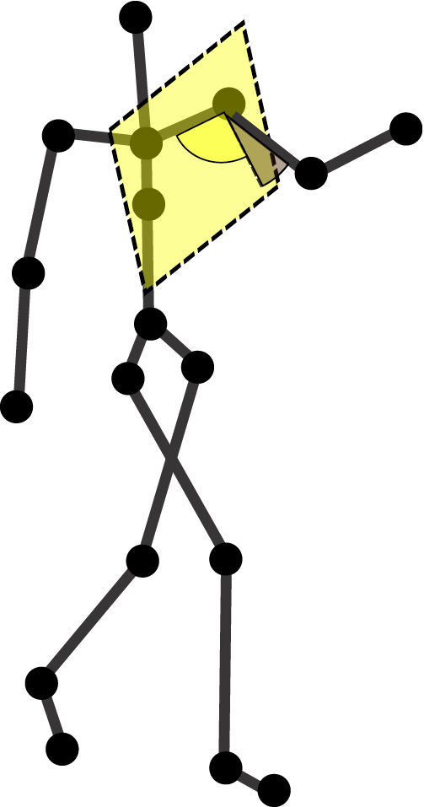
Motion Content-based Retrieval
Similarity model
  Pose features
    Each pose = 28-D vector of angles of joints
    Angles are independent of the observer view plane
  Pose similarity function
    Pose distance based on the L₁ metric
Notes:
In our solution we use following similarity model. Here, by the pose we mean joint coordinates extracted from one frame, such pose is represented by static stick figure. From each pose we extract pose features which is 28 dimensional vector of angles of joints. L1 metric is utilized as a similarity measure between two poses.

Slide 7
Indexing
Offline preprocessing
Indexing all poses (28-D vectors) by the L₁ metric
  Any metric-based structure
  (e.g., M-Index [Novak, 2011])
Use of range queries to retrieve the most similar poses to query poses
Notes:
To make our algorithm more efficient we index all poses in database by the L1 metric. Any metric-based structure can be utilized. In our approach we used metric index by Novak et al. This index is transparently used when algorithm wants to evaluate range queries.

Slide 8
Searching – Overview
A specialized key-pose retrieval algorithm
  Solves the problem of spatial and temporal variances
  Detection of query key poses
  Location of relevant parts by retrieving the most similar database poses to any query key pose
  Identification of candidate sub-motion for each relevant part retrieved in previous step
  Filtering of overlapping candidate sub-motions
Notes:
Now we know the background of our key-pose retrieval algorithm and we can go through its 4 steps. First of all, this algorithm solves the problem of spatial and temporal variances of motion. The temporal variance means that the same motion can be performed more quickly or more slowly. The spatial variance means that the same type of motion can be done in several ways.
The overview of four steps of our algorithm is presented here. First step detects query key-poses, Second steps locates relevant parts by retrieving the most similar database posed to any query key pose – here enters metric index on the scene. Third step identifies candidate sub-motion for each relevant part retrieved in previous step and forth step filters overlapping candidate sub-motions. This was brief overview of main steps of our algorithm. Let’s look at them in more detail.

Slide 9
Query Evaluation Steps – 1
Detection of query key poses
  Distance (in frames) of consecutive key poses is fixed to some constant
Selected poses
(28-D vectors)
Joint angle
170°
130°
35°
Only single (of 28) time series of joint angle rotation is shown
Query motion
Frames
Notes:
Only single out of 28 time series of joint angles is depicted in this figure of query motion. On the x axis is discrete time in frames and on the y axis is a joint angle. First step detects query key poses so that first frame is first query key pose and than every n-th pose is considered as a query key pose. Here the n is 10 thus every tenth frame is considered as a query key pose and all poses in-between are ignored. Remember that this pose does not consist of one number but it is 28 dimensional vector.

Slide 10
Query Evaluation Steps – 2
    Location of relevant parts – poses similar to query key poses
M-Index range query
Selected poses
(28-D vectors)
360°
Joint angle
170°
170°
130°
130°
35°
40°
Query motion
Frames
Database motion
Frames
Notes:
The graph on the right side represents an arbitrary database movement. The second step of algorithm locates relevant parts around which candidate sub-motion will be looked for. This is done by evaluating a range query for each query key pose. Here we have result only for this query key pose. As we can see our metric index returns three poses which are similar enough. Here I have to say that the range is a parameter which can tune algorithm for better precision or better recall. More on this topic in evaluation section.

Slide 11
Query Evaluation Steps – 3
Identification of candidate sub-motions
  Locates key poses to be as much similar as the query key poses in corresponding order
  Copes with temporal and spatial variances
Selected poses
(28-D vectors)
360°
Retrieved sub-motion
Joint angle
170°
170°
130°
130°
35°
40°
Query motion
Frames
Database motion
Frames
Notes:
Third step identifies candidate sub-motions for every located pose in previous step. We start with the one in middle and we will call this pose as root pose. Firstly the algorithm scans feature interval before this root pose. Scanned interval has its constraints set from half of distance between query key-poses to its double, thus if the distance between query key-poses was 10 then the scanned interval is from five to twenty frames before the root pose. Within this interval we want to find pose which is most similar to its corresponding query key pose. This process linearly continues to the first query key pose. And then the analogous process finds poses after the root pose. And we obtain candidate sub-motion.
Musime najit tolik kandidatnich poses kolik je query key poses.

Slide 12
Query Evaluation Steps – 4
Retains the most ranked and non-overlapping sub-motions
  Ranking: average L₁ between query and candidate key poses
M-Index range query
Selected poses
(28-D vectors)
360°
Retrieved sub-motion
Joint angle
170°
170°
130°
130°
35°
40°
Query motion
Frames
Database motion
Frames
Notes:
Last step filters overlapping candidate sub-motions. We have our candidate sub-motion but in second step other root poses were located and that means that other candidate sub-motions were found. This step retains the most ranked and non-overlapping ones. Candidate sub-motion ranking function is average of L1 distances between query and candidate key poses.
Pridat ranking

Slide 13
Experiments
HDM05 motion database [Muller, 2005]:
  102 motions of 491,847 frames (poses) ~ 68 minutes
  User-defined ground truth of 15 motion classes (1476 annotated sub-motions in 102 motions)
Measures:
  Objective – to evaluate search effectiveness and efficiency
  Effectiveness – annotation of 102 motions by 15 predefined motion classes (recall and precision)
  Efficiency – the average number of similarity comparisons between 28-D vectors needed to evaluate a single query
Notes:
To test our algorithm we used annotated subset of HDM05 motion database consisted of 68 minutes of motion clips with defined ground truth.
Objective of our tests was to evaluate search effectiveness and efficiency. Effectiveness was evaluated over 15 predefined motion classes and efficiency yields the average number of similarity comparisons needed to evaluate a single query.

Slide 14
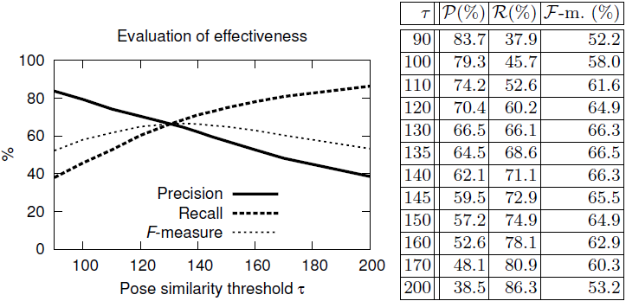
Effectiveness
Competitive to the annotation technique [Muller, 2009]
  49% Precision, 80% Recall
Notes:
Results of effectiveness evaluation are in the table on the right. Also they are depicted in the graph where on the x axis is changing pose similarity threshold we were talking about few slides ago.
Our algorithm achieved similar results to annotation technique by Muller at al. on the same data. However, the annotation technique is classification task and thus can categorize sub-motion only into predefined classes. Pokud by meli najit nejaky pohyb even from predefined classses it would take in order of magnitude more distance computaitons than our algorithm.
On the contrary, the motion retrieval task is able to search for an arbitrary sub-motion.

Slide 15
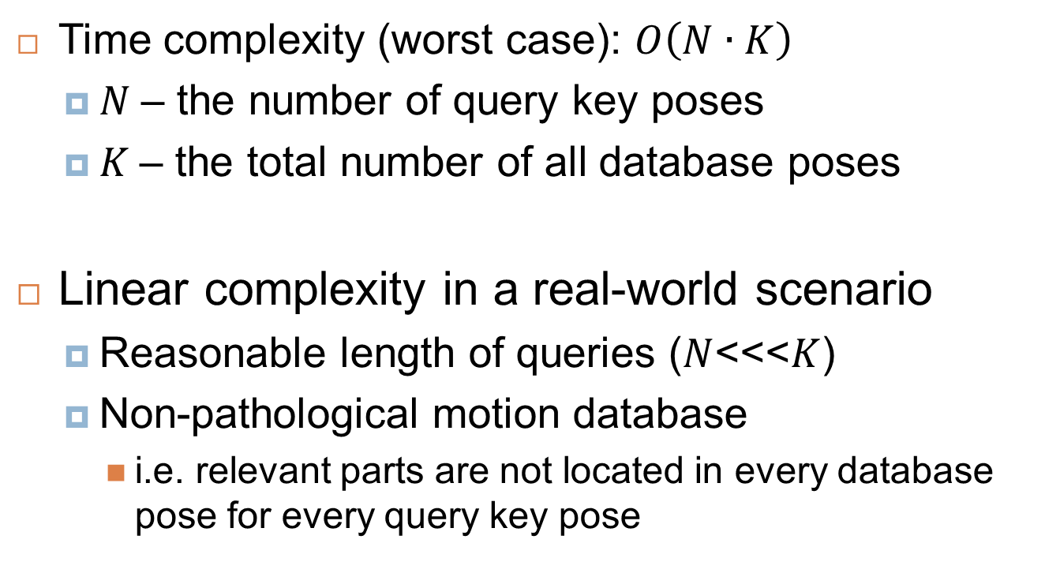
Efficiency
  Time complexity (worst case): $O\left(N∙K\right)$
  $N$– the number of query key poses
  $K$– the total number of all database poses
Linear complexity in a real-world scenario
  Reasonable length of queries ($N$<<<$K$)
  Non-pathological motion database
    i.e. relevant parts are not located in every database pose for every query key pose
Notes:
Theoretical worst case of efficiency is the number of query key poses multiplied by the total number of all database poses – this would happen only in pathological state.
In a real world scenario complexity was linear to the number of all database poses. The assumptions for this are reasonable length of queries and motion database which does not contain only sequence of one pose, for example still standing person.

Slide 16
Demonstration
Demo
  http://disa.fi.muni.cz/motion-retrieval

Slide 17
Summary
Key-pose similarity algorithm for motion data retrieval
  Linear complexity in real world scenario
  64.5% precision and 68.6% recall
  Can be generalized for multidimensional time series retrieval
Future work
  Exploring new similarity models
  Improvement of key-pose detection
Notes:
To sum up, our key-pose similarity algorithm for motion data retrieval has linear complexity in real world scenario and achieves 65% precision an 69% recall. Also this algorithm can be generalized form multidimensional time series retrieval. As a future work we would like to explore new similarity models and we would like to improve key-pose detection phase.

Slide 18
Motion Data Retrieving
Try our demo:
  http://disa.fi.muni.cz/motion-retrieval
  Thank you for your attention
A Key-Pose Similarity Algorithm for Motion Data Retrieval
Jan Sedmidubsky, Jakub Valcik, Pavel Zezula
Notes:
Thank you

Slide 19
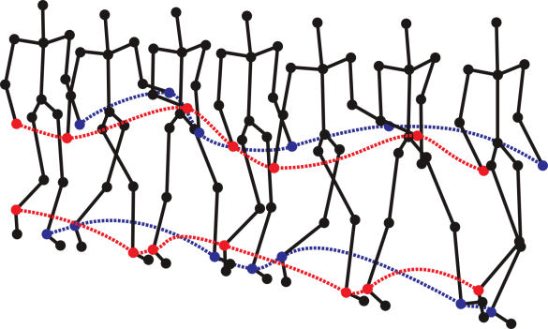
Motion Capture Data
Motion Capture Data ~ Human Motion Data
  Sequence of poses of 3D joint coordinates
Capturing devices:
  Tracking markers attached to a human body (e.g., Vicon)
  Systems of synchronized cameras (e.g., Microsoft Kinect)
  Estimating body parts coordinates from ordinary videos

Slide 20
Searching – Algorithm
Notation: data sequence ,
query
Query evaluation steps:
    Detection of query key poses
      Distance (in frames) of consecutive key poses is fixed to
    Retrieval of root poses – poses similar to query key poses
      Spatial deformations:
    Identification of relevant motions
      Location of data key poses similar to
      Temporal deformations:
    Filtering of relevant overlapping motions

Slide 21
Similarity Model cont.
Pose similarity function
  Pose distance based on the L₁ metric
    (28-D vector)
Motion similarity function
  Key-pose searching algorithm produces candidate sub-motions of the same key-pose count
    Length can vary [L/2, L*2], where L is a query length
  Average distance between corresponding query and candidate key poses

Slide 22
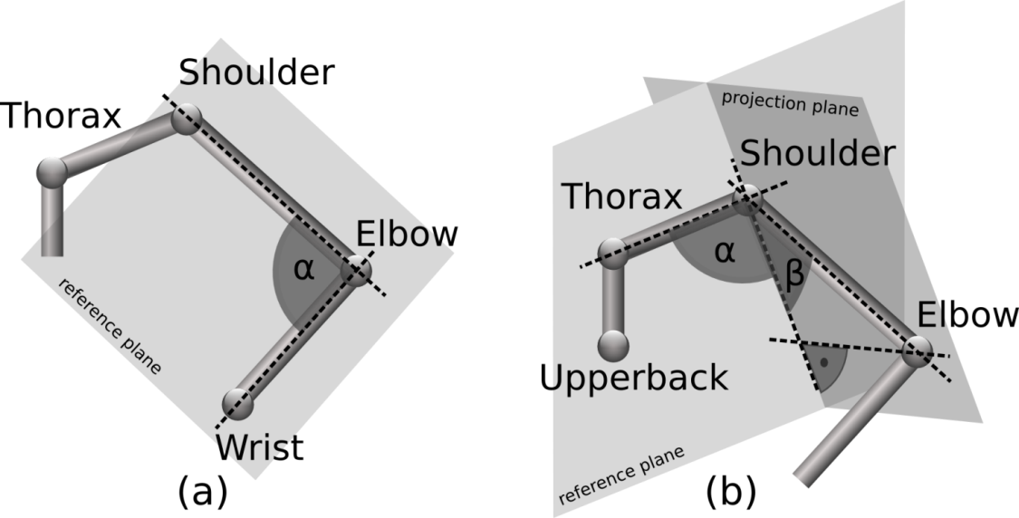
  Pose features
    Each pose = 28-D vector of angles of joints
    Eight 1-DOF joints (a) and ten 2-DOF joints (b)
    Angles are independent to the observer view plane

Slide 23
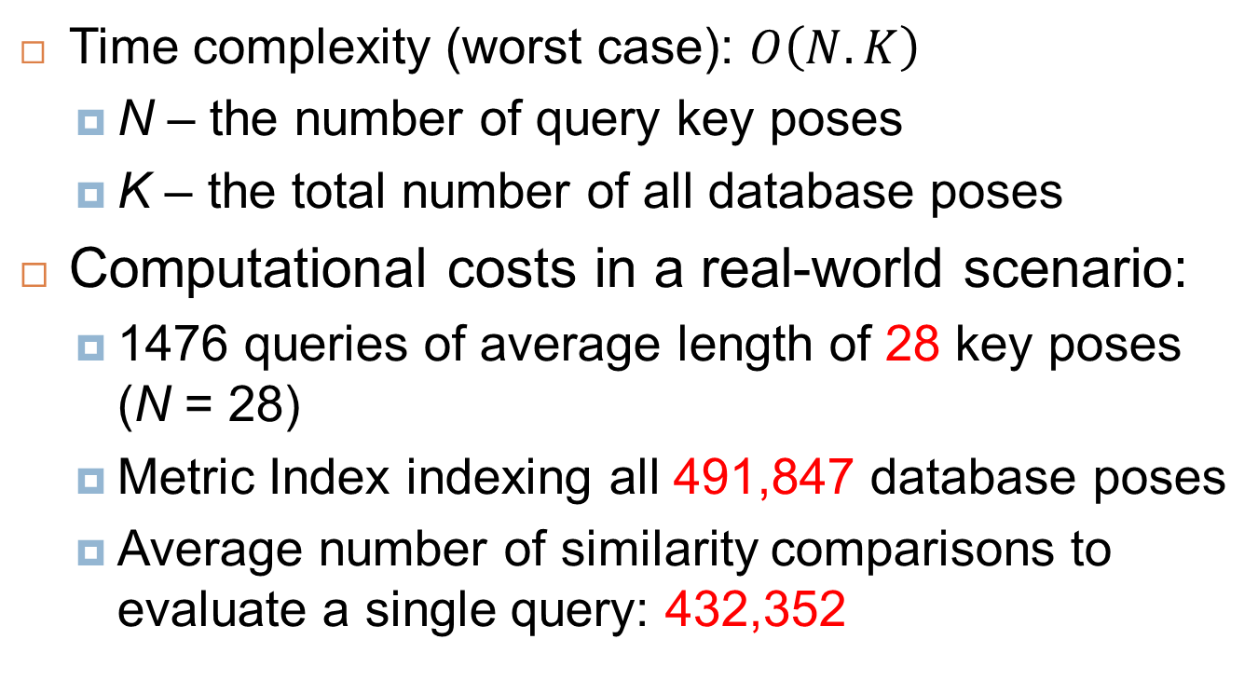
Efficiency
  Time complexity (worst case): $O\left(N.K\right)$
  N – the number of query key poses
  K – the total number of all database poses
Computational costs in a real-world scenario:
  1476 queries of average length of 28 key poses (N = 28)
  Metric Index indexing all 491,847 database poses
  Average number of similarity comparisons to evaluate a single query: 432,352
Notes:
Dosahuje linearni complexity

Slide 24
Competitive

