Slide 1
Towards Effective Human Motion Descriptors
Jakub Valcik
Supervisor: Pavel Zezula
Consultant: Jan Sedmidubsky
NOV 18, 2013

Slide 2
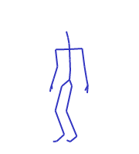
Outline
Motion Capture Data
Motivation
Evaluation Methodology
Results
Summary

Slide 3
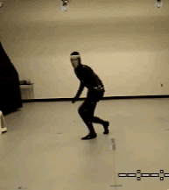
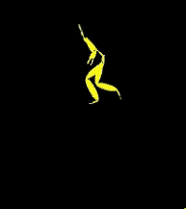
Motion Capture Data
Digitalized human motion
  joint coordinates,
  euler angles
Features
  Derived descriptors
Movement
MoCap Data
Features

Slide 4
Optical Systems
  Triangulations of the 3D position from image sensors data
  Multiple high-speed video cameras 2~48 (even 300)
  Markers or surface features
  Passive markers
    Retro-reflective material reflects light generated near the camera lens
    +Wireless -Marker swapping
  Active markers
    LED emitting own light
    Marker identified by modulation of amplitude, pulse width, time window

Slide 5
Optical Systems, cont.
Passive imperceptible markers
  Up side down approach
  Photosensitive markers
    Depth Map
Markerless
  Analysis of video
    Identify human forms and brake down into constituent parts for tracking
  Stanford, UMD, MIT, MPI
  MS Kinect, Asus Xtion, PrimeSense Carmine, Organic Motion, Xsens

Slide 6
Non-optical systems
Inertial systems
  Miniature inertial sensors
  Wireless comunication
  Position error accumulates over time
  Wii controller
Mechanical systems
  Exo-skeleton system tracks angles directly
Magnetic systems
  Relative intensity of the voltage or current of coils

Slide 7
Applications
Health care – success of rehabilitative treatments
  Range of joint angle rotation
Sports – performance aspect comparison
  Variability of same motion – pole-jump, figure skating
Security – person identification, event detection
  Gait recognition, stealing, fighting
  Home for the elderly
Computer animation – realistic motion synthesis
  Motion retrieval

Slide 8
Premise
Ultimate descriptor solving problems of all applications does not exist

Slide 9
Purpose
Application => Purpose
Action oriented
  What?
  Action, style of action, event detection
  Logically similar movements
Subject oriented
  Who?
  Subject recognition, age, gender, drunkenness, pregnancy, skeletal disease

Slide 10
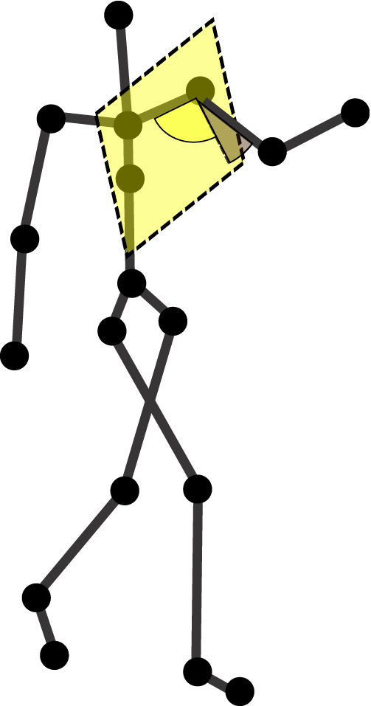
Similarity Model
Pose – skeleton configuration in one frame
Pose features – extracted from one pose
  Distances between joints/planes, joint angles, velocities, accelerations, powers, torques, directions
  Optional quantization
    relational features, fuzzy features
Distance between:
  Poses – L_{P}, Hamming, Mahalonobis
  Sequences – DTW, UTW, Uniform scaling

Slide 11
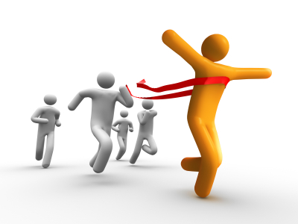
Evaluation Methodology
Choose optimal descriptor for given purpose
Test Dataset
How to interpret purpose?
Purpose
Similarity Models
Joint Angles
L1
UTW
Muller Features
Hamming distance
DTW
How to chose optimal model
Torso Declination
L1
UTW

Slide 12
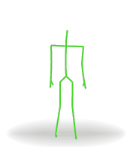
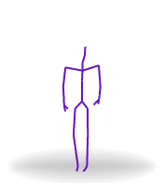
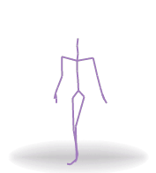
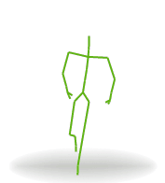
Ground Truth as a Purpose
Purpose represented by ground truth to the given test dataset
  Subject_1: Seq1, Seq4, Subject_2: Seq2, Subject_3: Seq3
  Bending: Seq1, Jumping: Seq2, Seq4, Throwing: Seq3

Slide 13
Measures
Retrieval Oriented
  Mean Average Precision (MAP)
  Mean Reciprocal Rank (MRR)
  Discounted Cumulative Gain (DCG)
  K-Nearest Neighbors
Space Oriented
  Dunn index
  Davis-Bouldin index
  Distance Distribution
Time consumption

Slide 14
Results
Dataset : HDM, CMU

Slide 15
Summary
Purpose oriented descriptor evaluation
Purpose represented as a ground truth
Provided measures
Future work
  Distance distribution
  Statistical testing

Slide 16
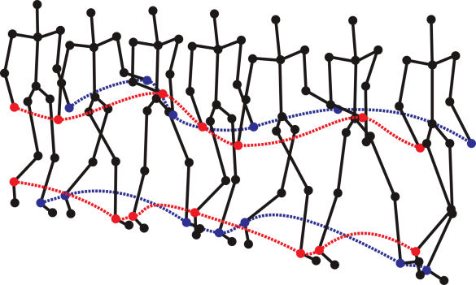
Towards effective human motion descriptors
Q & A
Thank you for your attention

