Slide 1
PA165: Introduction to Java EE
Petr Adámek
Tomáš Pitner
Lecture 1, D2, 12:00
Tue Sep 16, 2014

Slide 2
Content
Course profile
Learning style
Assessment
Outline
Java EE applications
Java EE application architectures
Technology around Java EE
Basic concepts

Slide 3
Organization of the Course

Slide 4
Course composition
Lectures
Recommended (slides in English, given in Czech)
Lab Sessions
Compulsory
Examples to the matter from lectures
Consulting the projects
Team Project
4-member teams
Checkpoints
Work throughout the semester
Fall 2014 - PA165 – Lecture 1

Slide 5
Assessment
Project: 70 points
Checkpoints: 4x10 points
Defense: 30 points
Final exam (written on paper): 30 points
Completion:
Credit: min. 60 points
Exam: min. 70 points
Fall 2014 - PA165 – Lecture 1

Slide 6
Course outline
Intro to Java EE (architecture, technology, concepts)
Data Persistence (ORM, JPA, Spring JDBC, iBatis, Testing)
Application logic (IoC, AOP, Transactions, Security, Testing)
Presentation layer (web frameworks, Stripes, Spring MVC, Wicket, JSF, Safety)
Integration technologies (Web services SOAP, REST, JMS, RMI, IIOP, ESB)
Testing (unit, integration, functional, acceptance, user-friendliness, efficiency, safety)
Fall 2014 - PA165 – Lecture 1

Slide 7
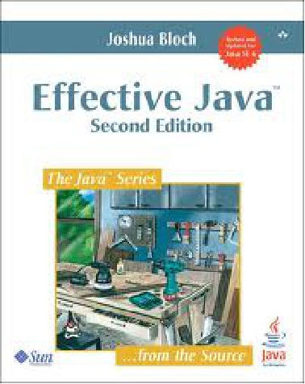
Recommended reading
Viz osnova předmětu
Effective Java (2nd Edition)
Joshua Bloch
http://amazon.com/dp/0321356683/
For more info see the course outline in IS
Fall 2014 - PA165 – Lecture 1

Slide 8
Java EE Platform
Fall 2014 - PA165 – Lecture 1

Slide 9
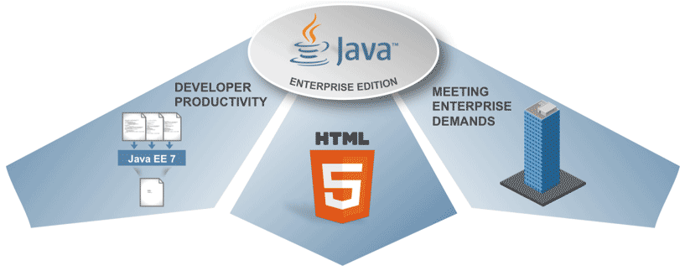
What is Java EE Platform?
Platform for modern IS development
Provides the infrastructure
Industry standard (JCP)
Current version: Java EE 7 (since June 2013, still the current version)
Support for
Web applications
Web services
Multitier-applications
Fall 2014 - PA165 – Lecture 1

Slide 10
Modern Information Systems
Complex and large systems
Require integration with other systems
Adaptability to different customer requirements
Deployment on different platforms
Support for a large number of clients (especially for Web applications)
Security
Quality and reliability
Fall 2014 - PA165 – Lecture 1

Slide 11
IS Developer Needs
Rapid development
Easy maintenance
Easy extensibility and customization
Easy integration with other systems
Support for agile
Support for the team and multi-team development
Portability
Various software and hardware platforms, different tools and application servers
Scalability
Security
Easy to test
Fall 2014 - PA165 – Lecture 1

Slide 12
Fundamental concepts

Slide 13
Fundamental concepts
Infrastructure
Modularity
Independence and low invasiveness
Declarative access
Convention over Configuration
Adherence to the guidelines for the development of maintainable code
Fall 2014 - PA165 – Lecture 1

Slide 14
Infrastructure
The developer should focus on your problem domain and should not be forced to deal with general issues that must be addressed in any application.
Application architecture, security, transaction management, data persistence, communications and integration, remote access, infrastructure presentation layer, localization, etc.
Java EE platform and the built application framework (frameworks) therefore provide the necessary infrastructure.
Never implement your own framework!
Fall 2014 - PA165 – Lecture 1

Slide 15
Modularity
The application is developed as a set of cooperating components
Components should
Be loosely connected (loosely coupled), which between them should be as little dependent
Being reusable (whether only in the project, or even beyond)
Having a well designed and a separate interface (among other things, reduce the level of dependence, especially those in transition)
Being well-tested
If we have a set of well-designed components, it is easy to modify and adapt application behavior
Replacement of components
By changing the configuration of components
By changing the connections between components
Fall 2014 - PA165 – Lecture 1
Notes:
Lépe zdůvodnit výhody oddělení rozhraní od implementace, vysvětlit kdy ano a kdy ne, přidat příklad, zmínit testování

Slide 16
Independent and less invasive
Components should be independent not only among themselves but also to specific technologies and application frameworks
At least at the level API
This simplifies maintenance and increases reusability
The concept of POJO (Plain Old Java Object) component
A common class that does not implement any specific interfaces or extend any particular class
It is therefore independent of any part or class library
Simple, clear understanding of the business does not require any special knowledge
You can easily create an instance, you can easily test
Fall 2014 - PA165 – Lecture 1
Notes:
Lépe vysvětlit výhody, příklad na test, příklady komponent, porovnání pojo komponenty a heavyweight komponenty

Slide 17
Declarative Approach
Certain aspects of program behavior are not defined by traditional imperative code (sequence of commands), but the specifications of the intent (what to do).
This leads to simplification and streamlining code.
Recommended for transaction management, security management and access rights, automated conversion, various automatic mapping, etc.
Self declaration desired behavior can be placed
In the deployment descriptor (deployment descriptor)
Directly in code via annotations (modern and preferred approach)
Fall 2014 - PA165 – Lecture 1

Slide 18
Imperative transaction control
public void someMethod() {
UserTransaction transaction = context.getUserTransaction();
try {
transaction.begin();
doSomething();
transaction.commit();
} catch (Exception ex){
try {
transaction.rollback();
} catch (SystemException syex){
throw new EJBException
("Rollback failed: " + syex.getMessage());
}
throw new EJBException
("Transaction failed: " + ex.getMessage());
}
}
Fall 2014 - PA165 – Lecture 1

Slide 19
Declarative transaction control
@TransactionAttribute(TransactionAttributeType.RequiresNew)
public void someMethod() {
doSomething();
}
Fall 2014 - PA165 – Lecture 1

Slide 20
Convention over Configuration
Concept … Ruby on Rails
Fall 2014 - PA165 – Lecture 1

Slide 21
In previous versions
The first version of the Java EE platform focused mainly on infrastructure and technology
Ease of development was underestimated
Complex technology is a complex application
Steep learning curve
The need to use complex tools
This led to the frustration developers and the emergence of alternative approaches and technologies (Hibernate, Spring)
The change came with Java EE 5
Strong inspiration tool Spring, Hibernate, etc.
Annotations
POJO components
Fall 2014 - PA165 – Lecture 1

Slide 22
Architecture & technology
Fall 2014 - PA165 – Lecture 1

Slide 23
Prezentační vrstva (Presentation layer)
Klientská vrstva (Client Tier)
Client computer
Desktop application
Mobile
application
Web Browser
Webová vrstva (Web tier)
Application server
JSF
Servlety JSP
Aplikační logika (Application logic)
Aplikační vrstva (Business Tier)
EJB
Spring
Perzistence dat (Data persistency)
JDBC
ORM
Integrační vrstva (EIS Tear)
DB/IS server
Databáze
Jiný IS
Fall 2014 - PA165 – Lecture 1

Slide 24
Presentation Layer
Desktop applications
Swing
AWT
SWT
Java Web Start
Mobile applications
Java ME
Android/iOS/BlackBerry OS/Windows Phone
Web applications
Servlets, JSP, JSTL
MVC frameworks
Request based (Struts, Stripes, Spring MVC)
Component based (JSF, Tapestery, Wicket)
Portlets
Applets
Fall 2014 - PA165 – Lecture 1

Slide 25
Application Logic
Plain class library
Not suitable for larger applications
EJB
Requires an application server supporting EJB or EJB lite
Spring framework
3rd party (community) products, not part of Java EE
Very popular
Non-invasive
Fall 2014 - PA165 – Lecture 1

Slide 26
Data Persistence
JDBC
Universal API for DB access
Cumbersome (too low-level) when used directly, so we use:
Template Method
Spring JDBC
Commons DB
RowSet
ORM
Standard JPA (currently JPA 2.0)
Hibernate, TopLink, Eclipse Link
Obsolete
EJB 2.x
JDO
Fall 2014 - PA165 – Lecture 1

Slide 27
Application servers
Open Source - full
JBoss
Glassfish
Open Source - only servlet container
Tomcat
Jetty
Commercial
WebSphere (IBM)
WebLogic (Oracle, formerly BEA)
Fall 2014 - PA165 – Lecture 1

Slide 28
Questions
?
Fall 2014 - PA165 – Lecture 1

