Slide 1
DIAMOND-PATH FRAMEWORK
Introduction to Service Science
Jan Rosecký

Slide 2
Outline
Introduction
  Presentation aims
  Motivation
Service Systems Reference Model
  Organization
  Predictive behaviour
Universal modelling
  Meta-modelling
  Context-specific classification
See – Recognize – Organize – Do
Reflexion
  Usability
  Follow-up Efforts

Slide 3
Presentation Aims
Introduce Diamond-Path Framework as is
Initiate a discourse on usefulness
Show current follow-up efforts, state-of-the-art

Slide 4
Diamond-Path Framework
What is it?
Paradigm aimed to help understand and act in a service-system environment
Theoretical concept
4 diamond-shaped models
See
Recognize
Organize
Do
Attention
Focussing
Cognitive
Elements
Agent-Team
Organization
Predictive
Behaviour

Slide 5
Diamond of Agent-Team Organization
Goal
follower
establisher
Agent
author
learner
superior
collaborator
Activity

Slide 6
Goal
follower
establisher
Action
Agent
Flow
organizer
organizer
member
member
author
learner
superior
collaborator
Activity

Slide 7
Goal
reaching
reaching
fulfilling
fulfilling
follower
establisher
Action
Agent
Flow
organizer
organizer
member
member
author
learner
covering
superior
collaborator
focusing
Activity

Slide 8
GBS
Goal
reaching
reaching
fulfilling
fulfilling
follower
establisher
composite
Action
Agent
Flow
organizer
organizer
member
member
author
learner
covering
superior
collaborator
focusing
Activity
detail

Slide 9
GBS
R22
Goal
reaching
reaching
fulfilling
fulfilling
follower
establisher
composite
R11
Action
Agent
Flow
organizer
organizer
member
member
author
learner
covering
superior
collaborator
focusing
Activity
detail
R33

Slide 10
GBS
R22
Goal
reaching
reaching
fulfilling
fulfilling
follower
establisher
composite
R11
Action
Agent
Flow
organizer
organizer
member
member
author
learner
covering
superior
collaborator
focusing
R01
R02
Activity
detail
R33

Slide 11
Diamond of Organization
Summary
Matrix-based organization: Action vs. Flow
Activity vs. Action / Flow
R-edges
GBS
R22
Goal
reaching
reaching
fulfilling
follower
fulfilling
establisher
composite
R11
Action
Agent
Flow
organizer
organizer
member
member
author
learner
covering
superior
collaborator
focusing
R01
Activity
R02
detail
R33

Slide 12
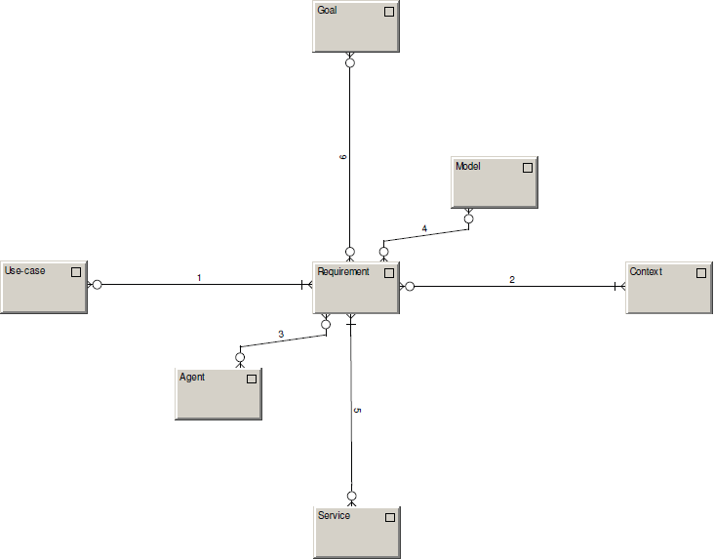
fulfilling
recorded in
forming / formed by
occuring within
addressing
solved by

Slide 13
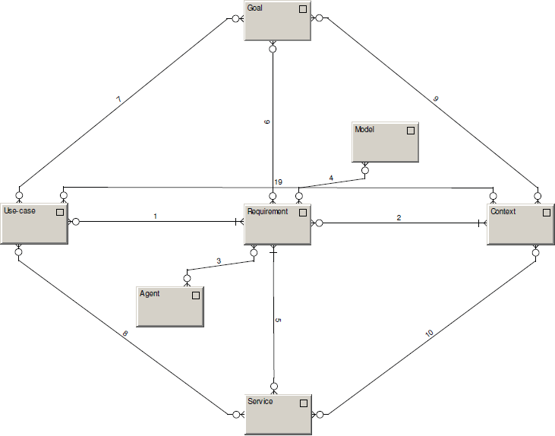
achievable within
achievable by
Identified within
creatable by
creatable within

Slide 14
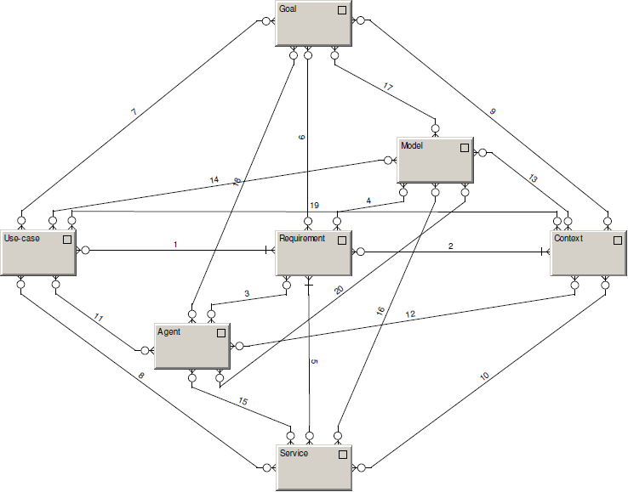
Model records.
Agent wishes, defines, does.

Slide 15
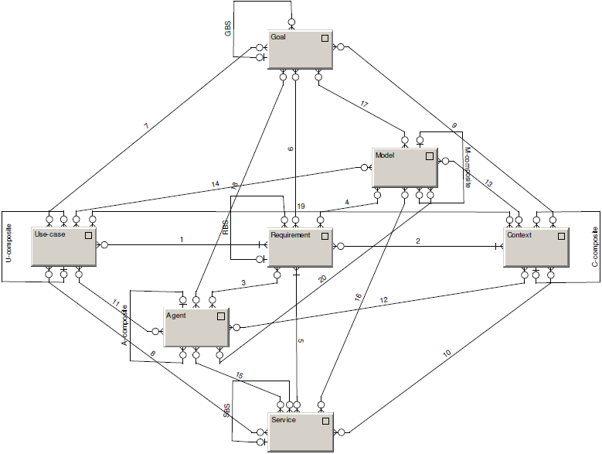
Composites

Slide 16
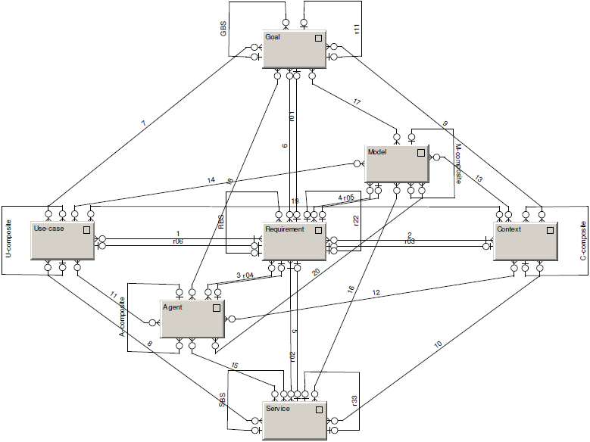
R-edges

Slide 17

Diamond of Predictive Behaviour
Depicts the motivation of agents to DO
Everything can be seen as a requirement
Forming and being formed by behavioral patterns
Models as a system memory

Slide 18
Universal modelling
CMM
metrics for process and products quality measurement
Accidental
Repeatable
Optimized
Defined
Managed
descriptions exists
experience from
the past
capability of
continual
process
improvement
base for process monitoring
comparing of projects
ad hoc,
non-formal
How long does it take for regular ISs to adjust
in order to support newly optimized processes?

Slide 19
Current Modelling Tools
Current CASE tools, BPMT, PMT, … allow to record only such objects and relationships, which had their creators in minds in the time when they were developing the tool.
Objects and relationships, we focus on when modeling various aspects of business, are continually changing.
Problem of effective communication within any IT project lies nearly always on boundaries of capability of a given modeling tool (… thus the model doesn’t represent the reality appropriately)
Except of some isolated cases, there are only few ways to extend used MT by constructs which are needed for current specific requirements.
A problem arises in integration of some partial views into one common view.

Slide 20
Meta-modelling
Generic MT
Domain-specific MT
Domain model
Ability to develop and adjust domain-specific modelling tools
Helps to construct the domain in terms comprehensible to domain experts
Hierarchy of modelling tools

Slide 21
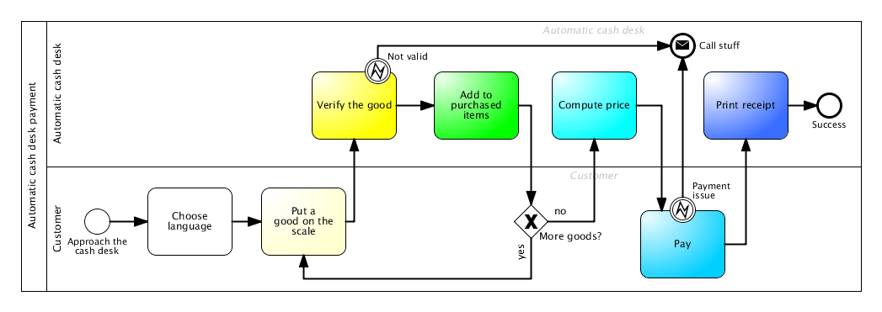
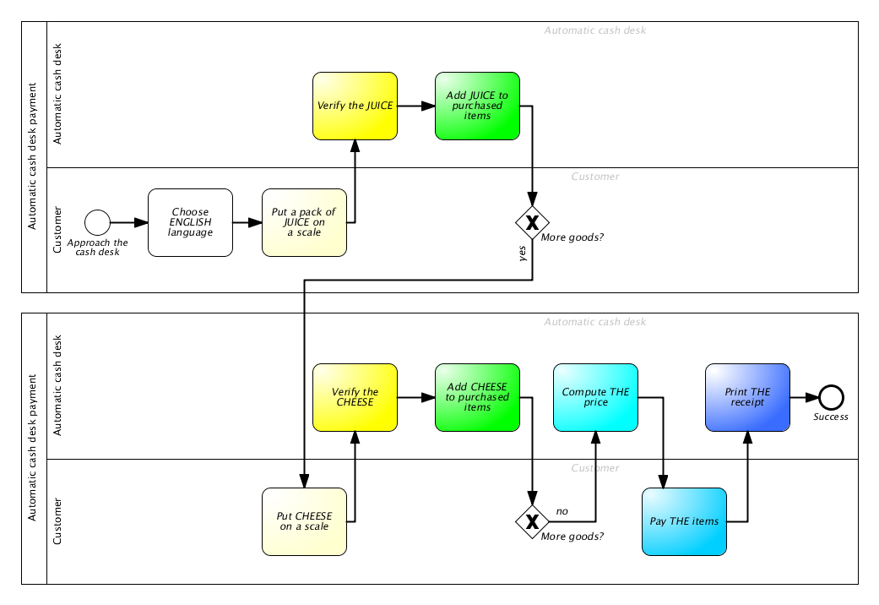

Slide 22
How do we model reality in our heads?
We identify...
Object
-s
...we find interesting

Slide 23
Then, we find...
Relationship
-s
...between our...
Object
-s

Slide 24
Each relationship can connect multiple objects...
Relationship
Relationship
Relationship
Object
Object
Object
...and each object can be present in multiple connections.

Slide 25
Each relationship can connect multiple objects...
Relationship
projection
Object
...and each object can be present in multiple connections.

Slide 26
Which objects do we find interesting for modelling?
Relationship
Category
Rule
Operation

Slide 27
MENTION – USE duality
Relationship
R
P
Category
R
Object
R
Rule
R
Operation

Slide 28
Diamond of Attention Focussing
Relationship
characteristic
characteristic
R
P
Category
R
Object
R
Rule
R
characteristic
characteristic
Operation

Slide 29
Diamond of Attention Focussing
Objects and relationships between them
Mention-use duality
  Modelling a modelling tool
  Referring to itself
Relationship
characteristic
characteristic
R
P
Category
R
Object
R
Rule
characteristic
R
characteristic
Operation

Slide 30
Classification example
killing
killing
Juliet
In love with
Romeo
In love with
killing
Paris

Slide 31
We can see that some connections are somehow similar – they belong to the same category:
killing
killing
Juliet
In love with
Romeo
In love with
killing
Paris

Slide 32
It‘s possible to classify everything we see in the diagram. But how to classify our objects?
killing
killing
Juliet
In love with
Romeo
In love with
killing
Paris

Slide 33
We could certainly divide the objects to men and women:
killing
killing
Juliet
In love with
Romeo
In love with
killing
Paris

Slide 34
But won‘t it be more useful to show, which chatacter belongs to the house of Montague and which one to the house of Capulet?
killing
killing
Juliet
In love with
Romeo
In love with
killing
Paris

Slide 35
It probably depends on a context – a mental model we want to build. Sometimes, both categorizations may be useful:
killing
killing
Juliet
In love with
Romeo
In love with
killing
Paris

Slide 36

Classifications are blurred
Good or bad?

Slide 37
Certainty
Items (= objects as such, not their constructs) belongs to a category with a given certainty
Category
CI-connection
Item

Slide 38
Attention
The fact is manifested with a certain attention in a given context
Category
CI-connection
Item
Context
Manifestation

Slide 39
R-edges
In some cases, it might be also useful to mention non-trivial concepts – contexts, categories, classifications or manifestations
Romeo killing Romeo
Resulting in
Juliet killing Juliet
Romeo belonging to Monteques
Romeo in love with Juliet
Juliet belonging to Capulets
Fact1
Fact2
Fact3
<fact1> and <fact2> and <fact3>
Story plot
Belonging to

Slide 40
R-edges
Category
R
CI-connection
Item
R
Context
R
R
Manifestation

Slide 41
Context base
Context serves as a model. The base edge defines the set of categories to classify its items to
Category
base
R
CI-connection
Item
R
Context
R
R
Manifestation

Slide 42
Example modelling tool: ERD
Attribute
Cardinality
Name
Entity attributes
Entity
Participants
Relationship
Associative entity

Slide 43
Attribute
Cardinality
Name
Entity attributes
Entity
Participants
Relationship
Associative entity
Forms category base for:
Phone no.
Date of birth
Name
Person

Slide 44
Attribute
Cardinality
Name
Entity attributes
Entity
Participants
Relationship
Associative entity
Here is a little more complex example of a model created in modelling tool above.
Phone no.
Name
Id
Date of birth
Working in
Name
Person
*
*
Company

Slide 45
Interconnected models
The same object classified to different categories, manifested in different context
Class diagram 1
ERD 1
Customer
Class diagram 1: Context
ERD 1: Context
Customer
-name: string
-address: string
-invoices: Invoice[]
1
Inv. As Class in CD1: Manifestation
Inv. As Entity in ERD 1: Manifestation
0..*
Invoice
Invoice as Class: CI-connection
Invoice as Entity: CI-connection
-cust: Customer
-good: string
-amount: int
-singlePrice: float
Invoice
-getTotal (): float
-print(): void
Class: Category
Invoice: Item
Entity: Category

Slide 46
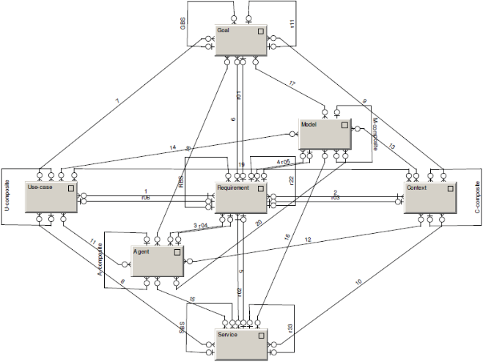
Diamond-Path Framework
Overview
See
Recognize
Organize
Do
Attention
Focussing
Cognitive
Elements
Agent-Team
Organization
Predictive
Behaviour
Category
base
R
CI-connection
R
Item
R
Context
GBS
R22
Relationship
Goal
characteristic
characteristic
R
reaching
reaching
fulfilling
follower
fulfilling
R
P
Manifestation
establisher
composite
R11
Category
R
Object
R
Rule
Action
organizer
Agent
organizer
Flow
member
member
author
learner
collaborator
characteristic
R
characteristic
covering
superior
focusing
Operation
R01
Activity
R02
detail
R33

Slide 47
Reflection
Do you find it interesting?
And useful?
Why has it remained a pure theoretical concept?
Is it too complex?

Slide 48
Follow-up Efforts
Several academical works, none has made it to the business practice
...with one exception

Slide 49
GridMind
Simulation environment designed to benchmark technological solutions of future-energy grids
Combines objects on various levels of abstraction
object
energy-grid element
secondary substation
BR_1234
Comprises a number of mental contexts: distribution network, communication network, information scope, devices, technical processes, ...
Very complex, difficult environment – worth systematical thinking

