Slide 1
Service Dominant Logic and asymetrics information

Slide 2
In previous lessons
Asymmetric information
Information gap
Filling the information gap
Role of IT in filling the gap
Role of government on information market

Slide 3
Knowledge we need more
Service System
Elements of service system
  Client
  Provider
  Target
Consequences and relations

Slide 4

Service system
Provider
  Individual
  Organization
  Any of previous combined with the technology and/or piece of environment
  Technology that provider is responsible for
Client
  Individual
  Organization
  Any of previous combined with the technology and/or piece of environment
  Portion of reality owned by Client
Target
  The reality to be transformed or operated on by Provider for sake of Client
  People, dimensions of business
  Dimensions of products, technology artefacts & environment
  Information, codified knowledge

Slide 5
Client – Provider Relationship
Information Sharing
Knowledge Sharing
Negotiations
Balancing and establishing Value Proposition
Repetitive reviewing of previous items
In Mention Mode

Slide 6
Client – Target connection
Client owns the Target
Client owns rights to use and/or manipulate the Target
Client has (owns) problem
  Client recognizes a problem on the Target
  Client is willing to invest to the problem solution
The solution involves an operating and/or transformation of the Target
Relation is in Use mode

Slide 7
Provider – Target Connection
Kind of competence
Provider knows and is able to operate on the Target
Provider knows how and is able to transform the Target
Provider understands the Target and is able to plan operation on transformation of it
Provider improves in a way the Target for its better utilization by the Client (benefit for the Client)

Slide 8
Mentioning and Using
Mentioning
  To think about future actions
  What / how / who / where / when / why / for how much
  Negotiation between client and provider
Using
  Use our capabilities to do some action to bring a value
Duality between mentioning and using
Project management

Slide 9
Mention - Use
Forms of relationship
value co-creation
value proposition
information sharing
Provider
Client
Mention
Forms of ownership
C is owner of T or
C needs an added
value on T
Forms of responsibility
P is responsible for
the actions with T
Mention/Use
Use
Target

Slide 10
Problem of moral hazard
a tendency to take undue risks because the costs are not borne by the party taking the risk
The customer is able to affect an event he is insured against, but the seller has no power to monitor or affect this event.
  ERP supplier has limited information about customers IT security
  Provider has limited information about the basement of the real client´s problem
Double moral hazard
  Client does not know if the provider is able to operate on the particular target

Slide 11
Double moral hazard
Illusion of value proposition
Provider is not able to see the basis of target
Client is not able to see the benefits of the cooperation
Both are motivated to share information and knowledge
Value proposition can not be set up

Slide 12
Example
The company needs information system to support its core business
The company has serious problems with
  communication with customers
But also hidden problems
  publishing information
  time spent on one particular business case is too long – mostly caused by bad communication inside the company

Slide 13
IT company
Offers a big customised ERP system together with CMS system
  CMS system has connection to Social Networks
The problem to solve is the communication
But it is not a part of the problem
IT company needs to find its paths through particular targets – to analyse the situation if the client

Slide 14
Value
Value proposition is hidden
  is hidden by the hill
Hierarchy of barriers hiding the target
  have to be overcame step by step
  leads to process of value estimation
Value can not be proposed
It can be only estimated
  is used to find value proposition
  there is not a target, only target area
    target area is the space of all sub-targets, corresponding with particular value estimation

Slide 15
Value estimation
modified by the value co-creation process
motivated by the decreasing of the level of information asymmetry of both parties
the process is about particularize of value estimations
till the moment of founding the value proposition

Slide 16
Value proposition
can be found in the moment client and provider can see the target
  share the same point of view
  both can see the utility level
  and share as well
both partners agree with concrete mutual criteria of success
  variables to test
    no of customers
    profitability
  target values
    number of customers rise of 30%
    profitability rises more than 10%

Slide 17
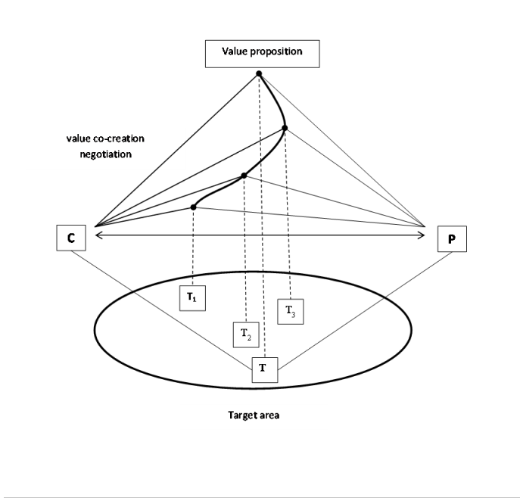
Value proposition

Slide 18
Costs of value estimation
must be shared and paid
  problem is complex
  must be understood and explored
provider must be paid for using his sources to do it
Client is paying for the analysis of the target area

Slide 19
Conclusion
Information asymmetry and its role in service system
Value estimation
Target area
Negotiation and information sharing
  Leeds to target finding

